Slide 1
News from Saclay
P. Colas, D. Attié, S. Herlant, W. Wang

Slide 2
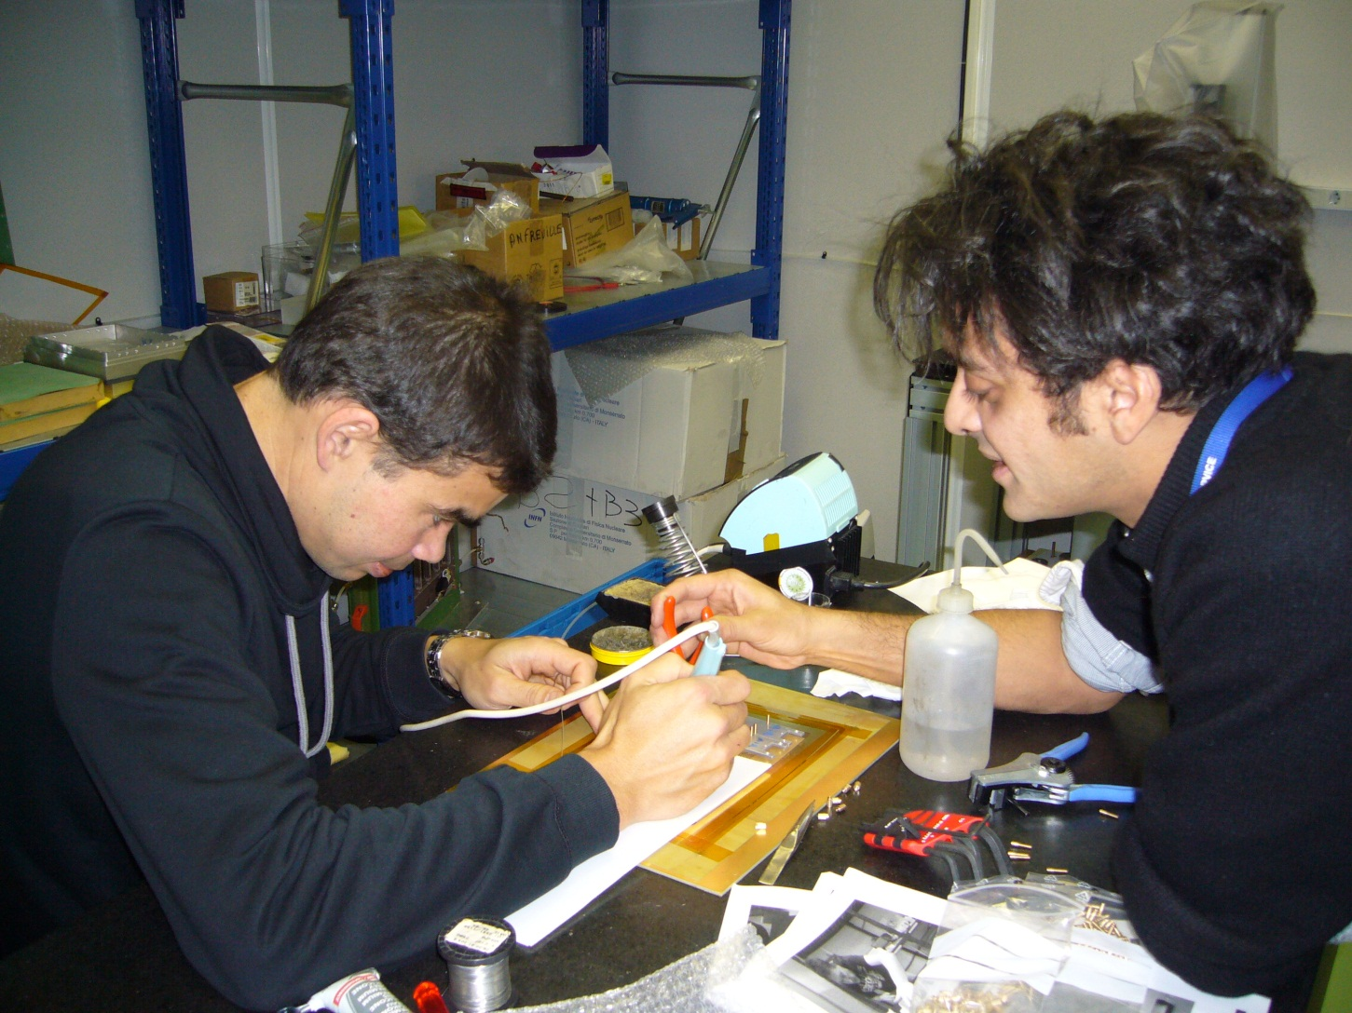
Mounting 4 new detectors at CERN

Slide 3
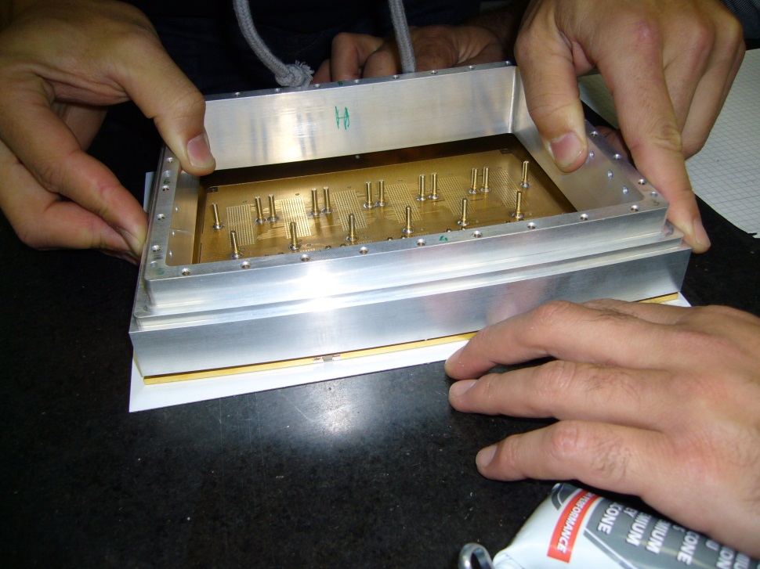
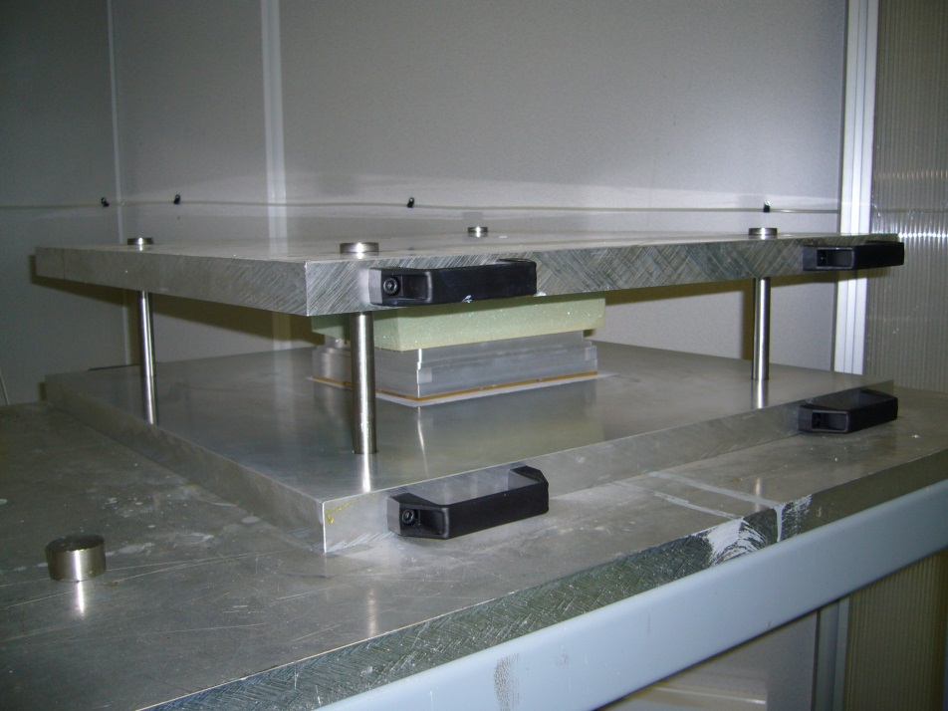
6 modules have been tested at DESY in July 2012, one from 2011 with known design flaws and 1 from pre-serie. Some were assembled at the last minute at DESY
This time, we aim at having 7 new modules and 2 spares, better tested and calibrated.
Also final installation work of the cosmic trigger configuration and monitoring is needed (dec. 10 and 11?)

Slide 4
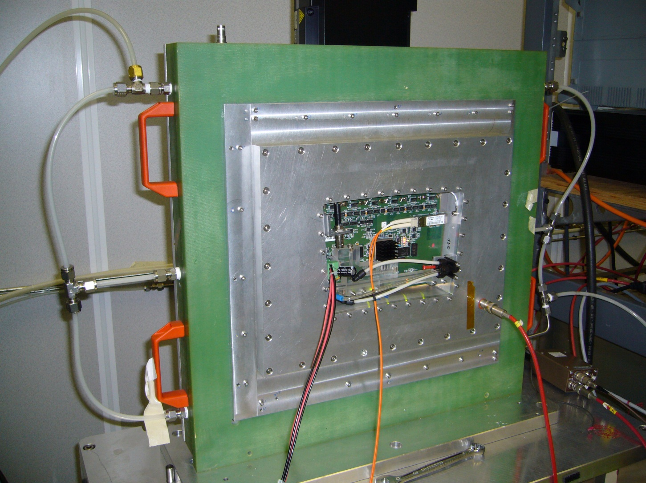
And testing them on the bench

Slide 5
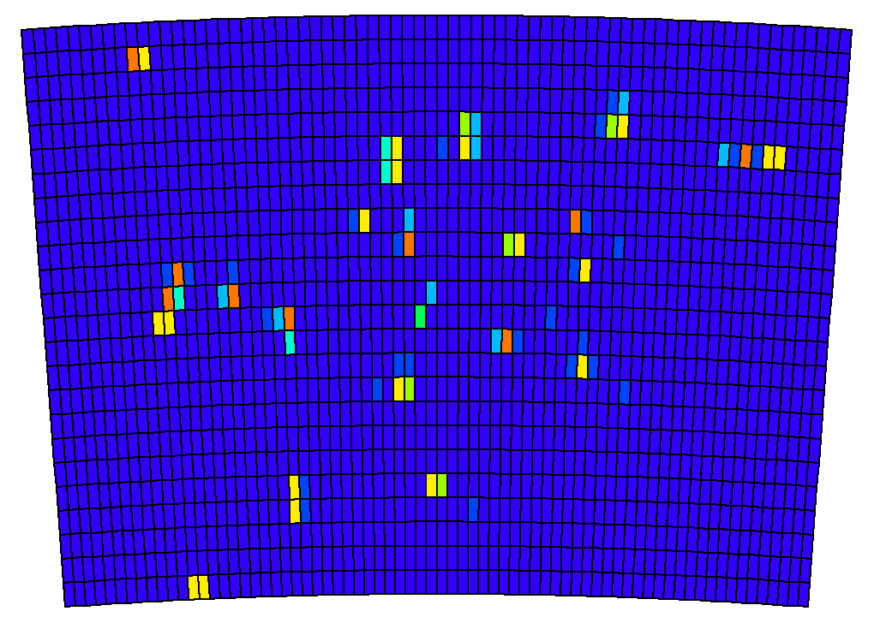
Evt with uncollimated source
(each cluster is an X-ray photon)

Slide 6
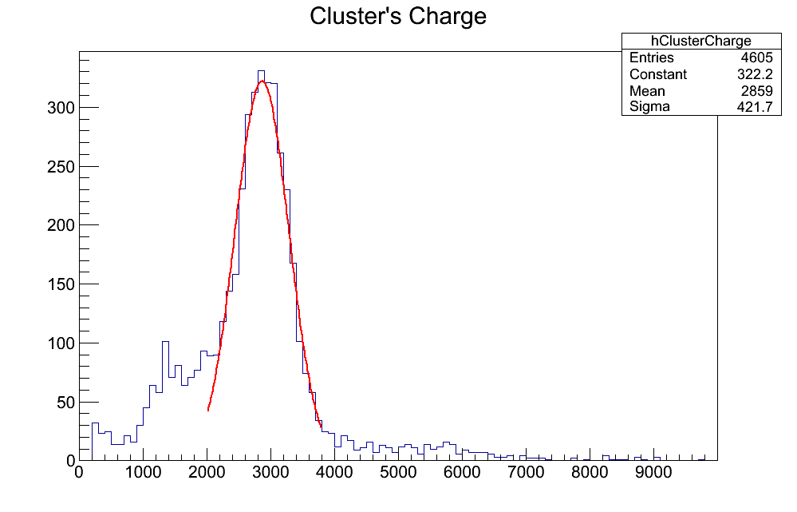
Calibration with 55Fe source
Raw data with sum of signal in a cluster
(using collimated source)
Energy Resolution (preliminary) :
15% rms
Gain ~2800

Slide 7
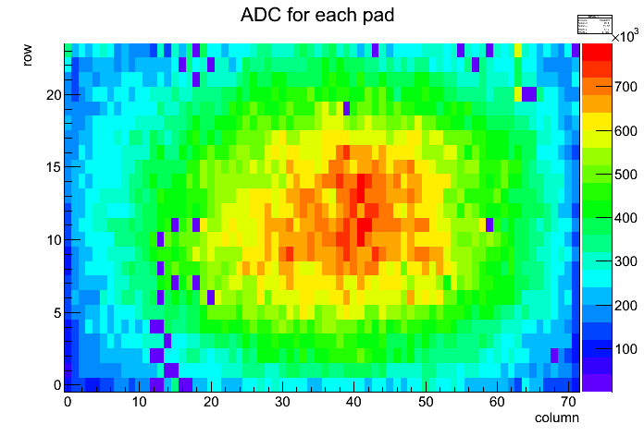
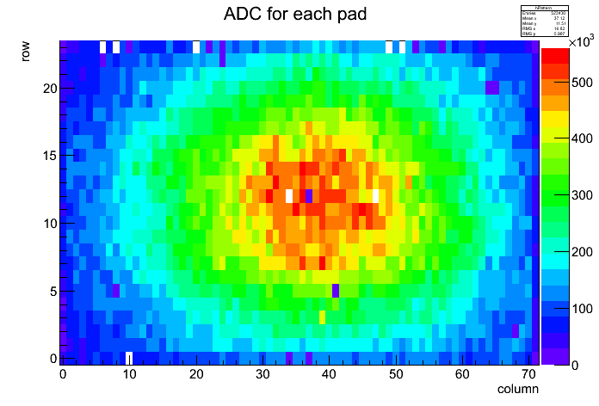
Map of the disconnected or dead channels
Module S1D - ~30 disconnected pads
Module S7H - ~5 disconnected pads + some at the boarder

Slide 8
Schedule
Reserve January 28 to February 8 to take good data at DESY (before VCI, and last chance for Wenxin’s thesis)
Analysis of July data in progress. Analysis meeting on December 10 or 11?
In the meantime (and after), there is a lot of work to study the modules one by one, understand calibration, etc…

