Slide 1


Further Analysis of ATF Data
Mikey Davis
1/12

Slide 2
Introduction
I have looked at some of the things that were suggested in the meeting last Thursday
Several things in particular are interesting
I still can’t make the calibration results fit the IP waist scans
Mikey Davis
16 November 2012
2/12

Slide 3
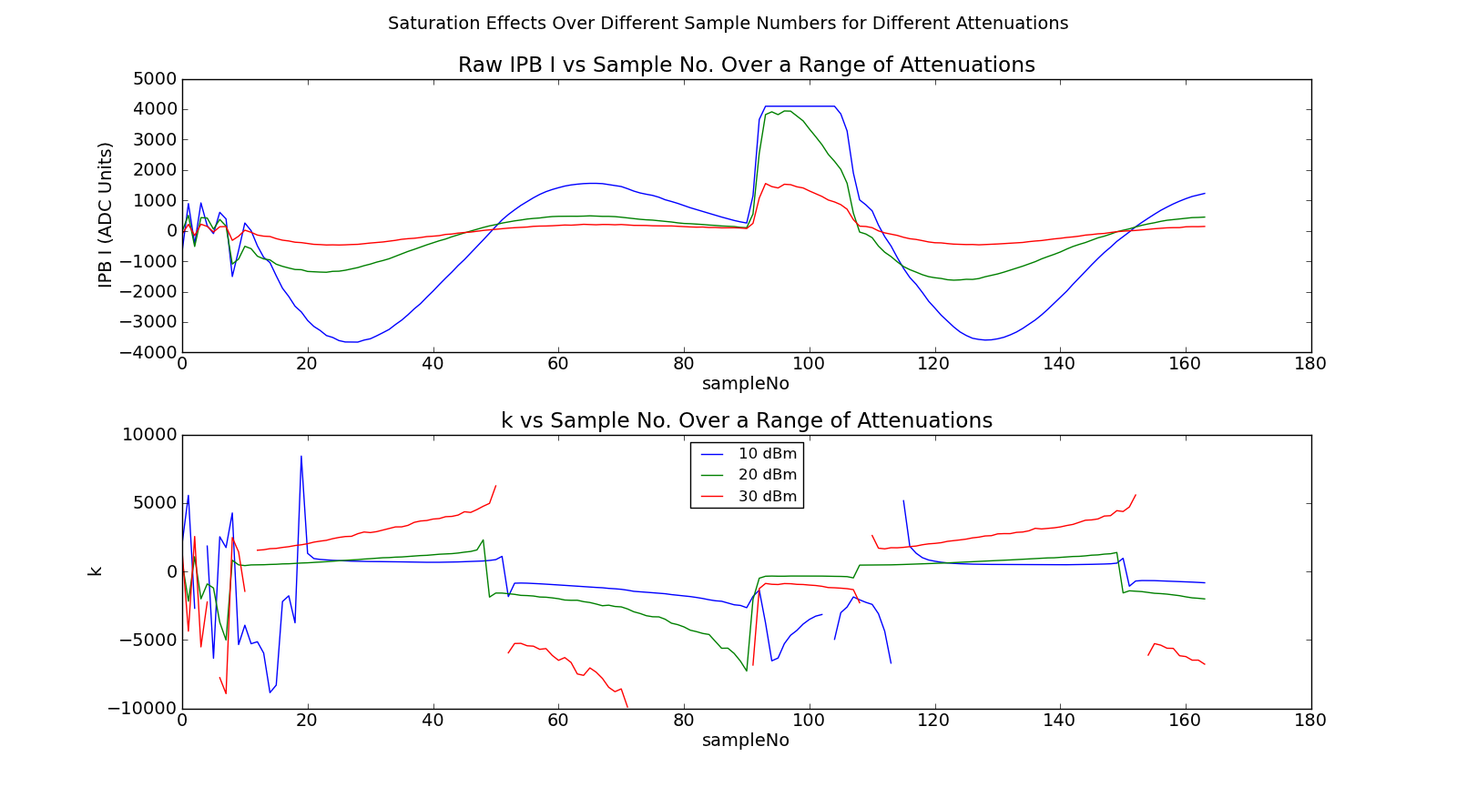
Saturation During Calibrations
Mikey Davis
16 November 2012
3/12

Slide 4
IP Waist Scans
I’ve given up trying to use the calibrations to get results that make sense with the IP waist scan – they just don’t make any sense
However the IP Waist scan waveforms look ok
I have moved on to a more systematic approach
  What we actually have with an IP waist scan is a calibration
  Do the individual files make sense when compared with epics?
If I can make this make sense I’ll go back to the calibrations
Mikey Davis
16 November 2012
4/12

Slide 5
Saturation During Calibrations
This introduces some new problems
  Firstly the EPICs data doesn’t match with the FONT data
  Secondly the data files are of a different format so my other code doesn’t work
Mikey Davis
16 November 2012
5/12

Slide 6
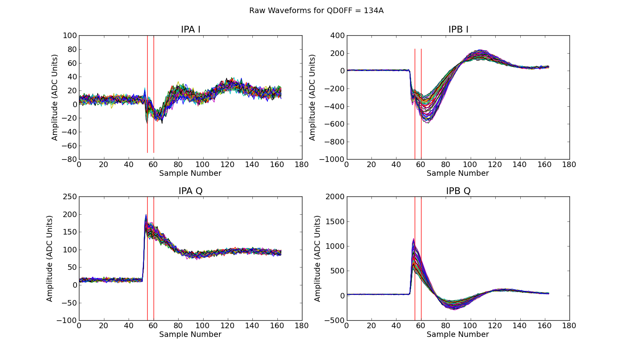
Raw Waveforms
Mikey Davis
16 November 2012
6/12

Slide 7
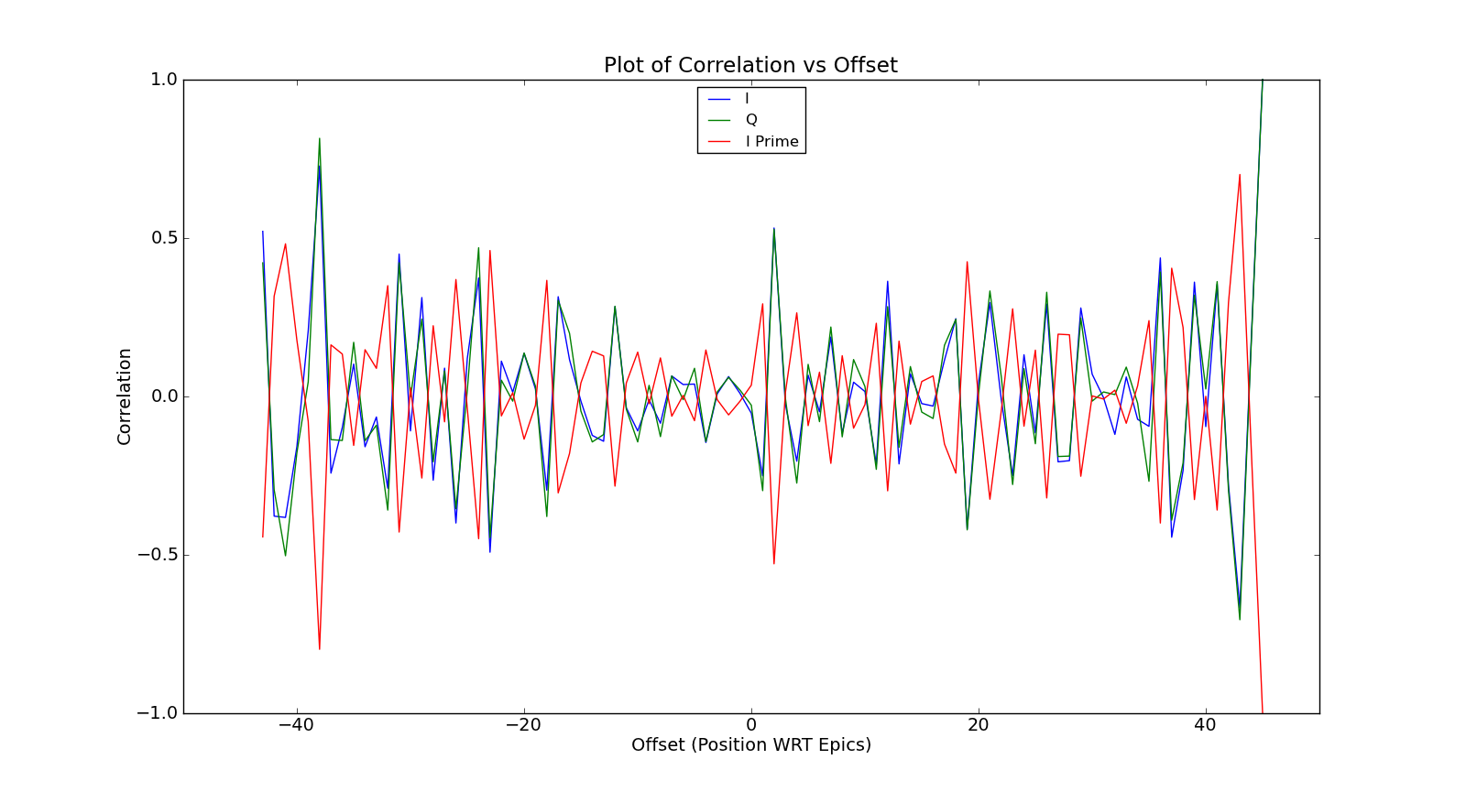
Epics Offset (QD0FF = 134A)
Mikey Davis
16 November 2012
7/12

Slide 8
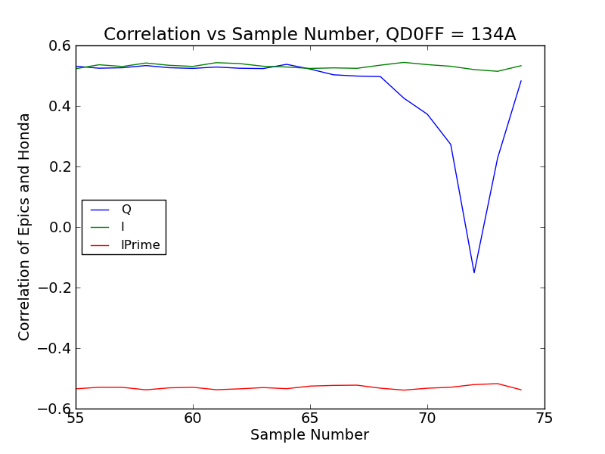
Epics Correlation with Honda
Mikey Davis
16 November 2012
8/12

Slide 9
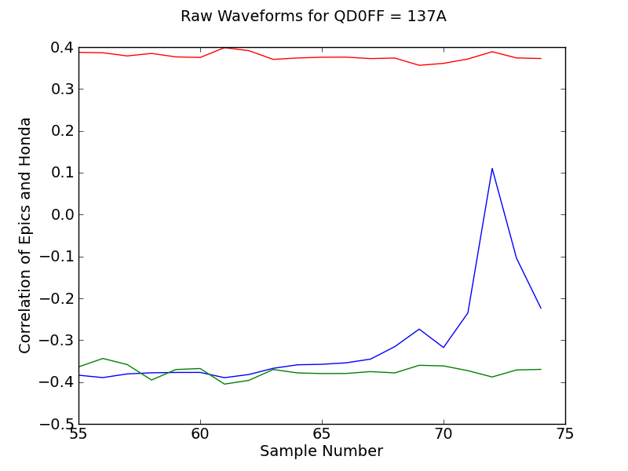
Epics Correlation with Honda
Mikey Davis
16 November 2012
9/12

Slide 10
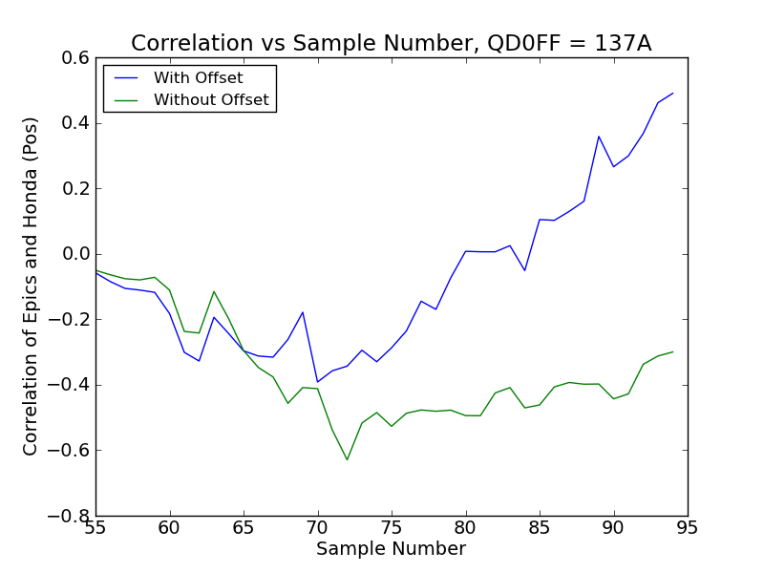
Epics Correlation with Honda
Mikey Davis
16 November 2012
10/12

Slide 11
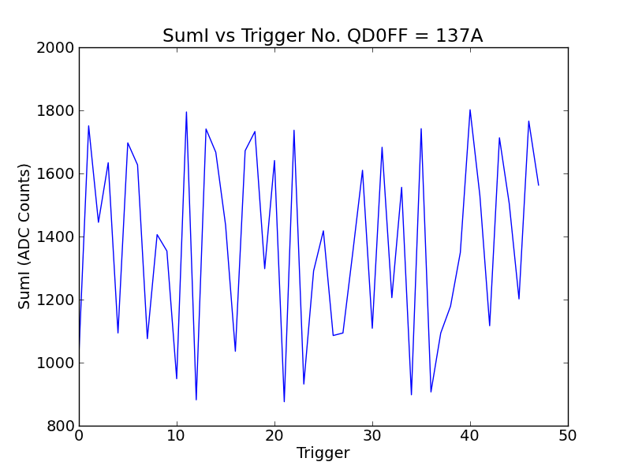
Epics Correlation with Honda
Mikey Davis
16 November 2012
11/12

Slide 12
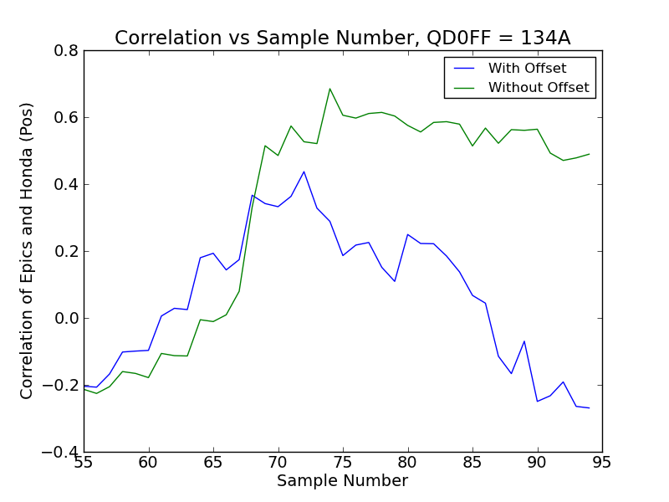
Epics Correlation with Honda
Mikey Davis
16 November 2012
12/12

