Slide 1
ML-SCRF: Monthly WebEx Meeting
Nov., 21, 2012
Reports from PMs
  GDE activity and meeting plan
  GDE-LCWS
Reports from TA Group Leaders
  Cavity, Cavity Integration, Cryomodule, Cryogenics, HLRF, ML
Discussions on TDR Status and PAC
  TDR Status J. Carwardine
  TDR1 and 2, SCRF A. Yamamoto
  TDR Cost Review G. Dugan/A. Yamamoto
  PAC M. Ross

Slide 2
KEK-LC： FY2012~13 Plan
月 | LC定例 | GDE / International
10 | 1, 8, 15, 22, 29 | 8-12: ASC-12 @ Portland 22-26: LCWS @ Arlington 28-29: IEEE-NSS @ Anaheim
11 | 5, 12, 19, 26 | 5-8: TTC (JLab) 13-14: GDE Cost Review (Fnal) 14-16: Higgs factory WS (Fnal)
12 | 3, 10, 17, 24 | 13-14: ILC-PAC (KEK) 15: LC Symposium (Tokyo)
1 | 7, 14, 21, 28 | 1E: Ext. Cost-Review (LAL-Orsay)
2 | 4, 11, 18, 25 | 21-22: ICFA/ILCSC (Vancouver) : Transition to the next organization
5 |  | 13~17: IPAC (Shanghai) 27-31: ECFA-LC 2013 (DESY)
6 |  | 12 ILC Event (KEK, CERN, Fnal) at 5:00 pm
9 |  | 22-27: SRF2013 (Paris)
11 |  | 11-15: LCWS-2013 (Tokyo)

Slide 3
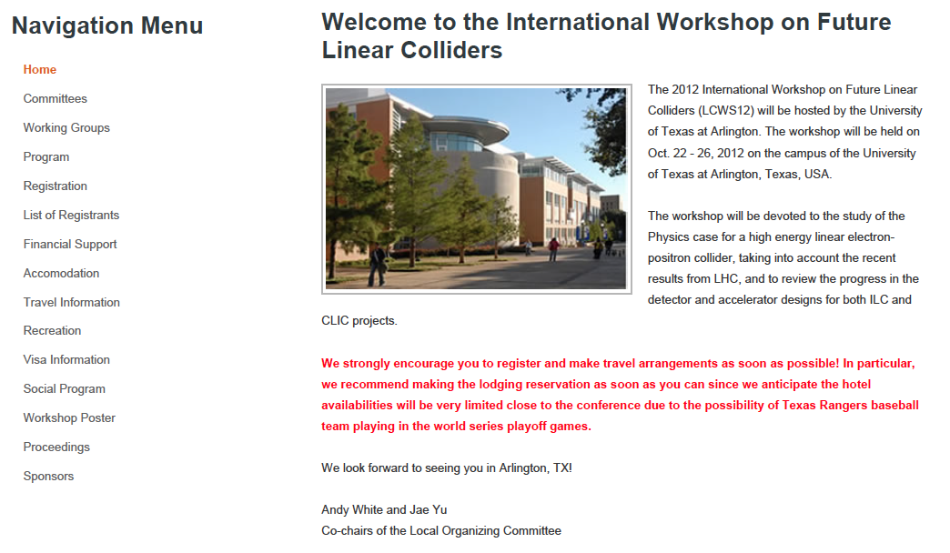
LCWS 2012
LCWS12: International Workshop on Future Linear Colliders 2012
Dates: Oct. 22 ~ 26
Held at: Arlington, Texas
    http://www.uta.edu/physics/lcws12/
  Accommodation
    http://www.uta.edu/physics/lcws12/pages/accomodation.html
Program
  22(Mon): Joint plenary, Accelerator plenary
  23(Tue): ILC-CLIC Common issues
    am： Emittance preservation, Power consumption
    Pm1： System tests, and cost & schedule
    Pm2： Higgs Factory session (Joint session of accelerator and physics)
  24(Wed): Accelerator: CLIC & ILC separate programs
    Finalizing TDR
  25(Thu): Working Groups: Parallel Sessions
    SCRF/NCRF >> Convener H. Hayano
  26(Fri): Accelerator plenary, Joint plenary (~ 13:00）

Slide 4
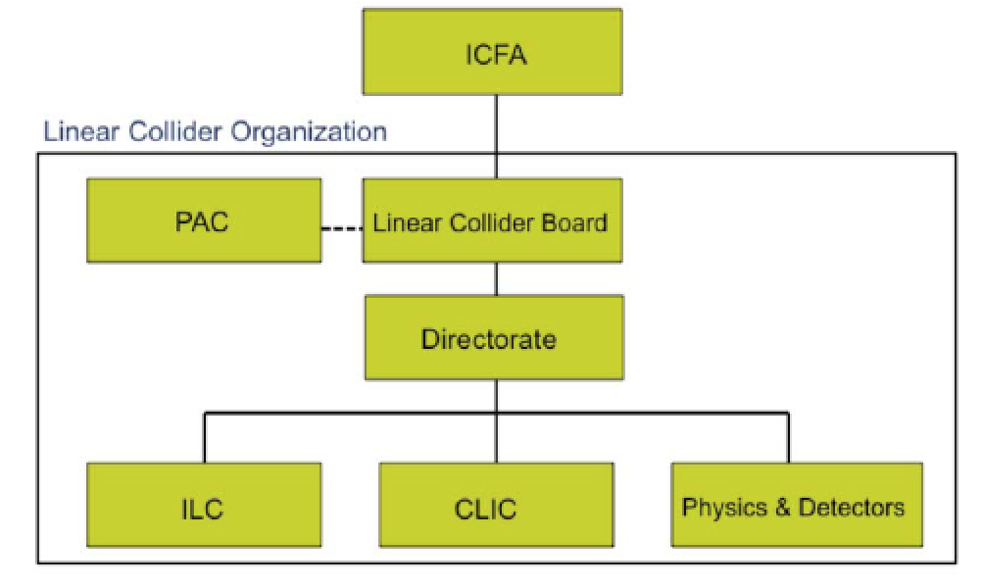
New LC Organization
L. Evans
L. Evans
Deputy (Physics)
H. Murayama
M. Harrison
S. Stepnes
Recent discussions of the European Members of the LCB (5+5+5+1) and soon also advisory group – discussions lead by ECFA chair Manfred Krammer
Lyn Evans appointed director for the LC efforts (starting in 2013) – ICFA announced in June

Slide 5
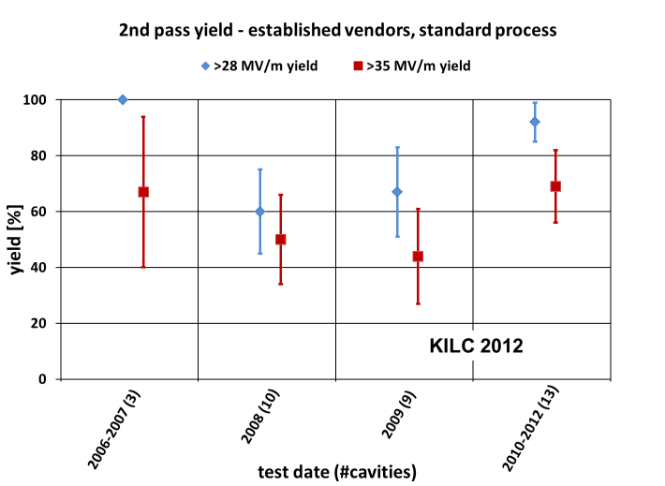
Yearly Progress in Cavity Gradient Yield
94 % +/-6 % achieved
at ≥ 35 MV/m

Slide 6
Future objectives
L. Evans
Strongly support the Japanese initiative to construct a linear collider as a staged project in Japan.
Prepare CLIC machine and detectors as an option for a future high-energy linear collider at CERN.
Further improve collaboration between CLIC and ILC machine experts
Move towards a “more normal” structure of collaboration in the detector community to prepare for the construction of two high-performance detectors.

Slide 7
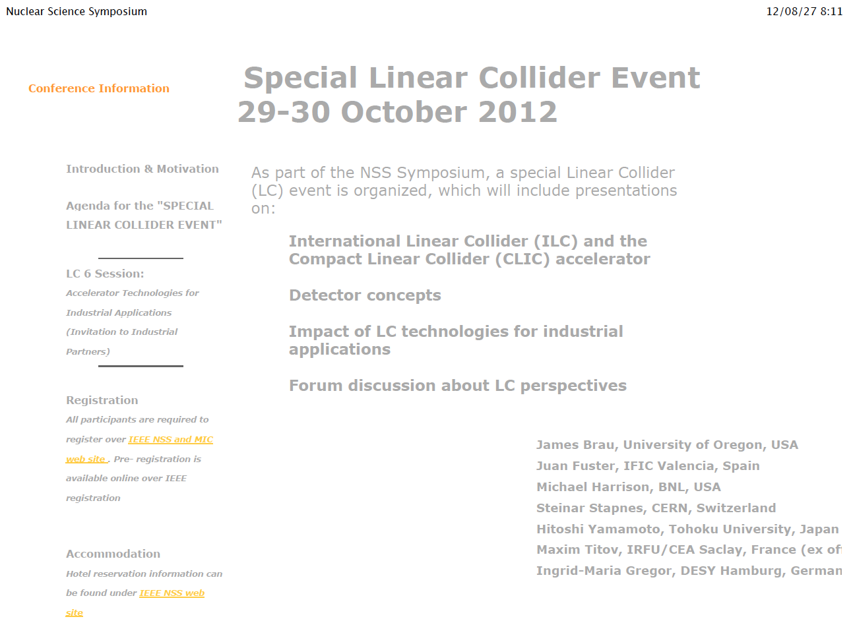
IEEE -NSS Symposium:
Institute of Electrical and Electronics Engineers
2012 IEEE NSS/MIC/RTSD Anaheim, California
27 October - 3 November 2012

Slide 8
LC Special Event: Agenda
Session 1: Introduction
  Welcome: R. Heier (CERN)
  ILC: B. Barish (Caltech
  CLIC : S. Steinar (CERN)
  Physic of LC: H. Murayama (IPMU-Tokyo, LBNL)
Session 2: ILC/CLIC accelerator and Detector Concept
  SCRF acceleration and ILC: N. Walker (DESY)
  X-band, two-beam acceleration and CLIC D. Schulte (CERN)
  Vertec Detector LC: M. Winter (IPHC, CNRS/IN2P3)
  Silicon Tracking for LC T. Nelson (SLAC)
Session 3: ILC/CLIC Detector Concept and Summary of Detector Spin-offs
  Gaseous tracking for LC T. Matsuda
  EM Calorimetry for LC J-C Brient (Ecole Polytechniques, CNRS/IN2P3)
  Hadron Alorimetery for LC J. Repond (ANL)
  Forward calorimetry and … S. Kulis (AGH Univ. ST Cracow)
  Spin-off Document “ILC Detector R&D” M. Demarteau (ANL)
Session 4: ILC/CLIC detector spin-off and ILC/CLIC Accelerator Instrumentation
  From ILC imaging calorimeter to a PET E. Grautti (U. Hamburg)
  LC Spin-offs outside Medial Imaging C. de la Taille (IN2P3/CNRS)
  LC instrumentation T. Lefevre (CERN)
  Linear Collider module control and stabil. A Jeremie (LAPP, CNRS/IN2P3)
Session 5: ILC/CLIC Accelerator Technologiew for Industrial Applications I
  Opportunties for applications of LC technology M. Ross (SLAC)
  Overview of industrial, medical, energy, and … N. Holtkamp (SLAC)
  Application of SCRF LC J. Rathke (AES)
  Application of NCRF LC W. Wuensch (CERN)
  Aplication of LC supporting RF Technology S. Lenci (Communications & Power Industries, LLC)
Session 6: ILC/CLIC Accelerator Technologies for Industrial Applications II
  Application of LC supporting instrumentation M. Ross (SLAC)
  The Status of AAA M. Matsuoka (AAA, Japan)
Session 7: Forum Discussion about LC perspetives
  R. Heuer (CERN), J. Mnch(DESY)i, and A. Suzuki (Suzuki), P. Oddone (FNAL), and ..

Slide 9
Reports from TA Group Leaders
Cavity Gradient R&D : R. Geng
Cavity integration: H. Hanano
Cryomodule: P. Pierini
Cryogenics: T. Peterson
HLRF S. Fukuda/C. Nantista
ML Integration C. Adolphsen

Slide 10
ML-SCRF: Monthly WebEx Meeting
Nov., 21, 2012
Reports from PMs
  GDE activity and meeting plan
  GDE-LCWS
Reports from TA Group Leaders
  Cavity, Cavity Integration, Cryomodule, Cryogenics, HLRF, ML
Discussions on TDR Status and PAC
  TDR Status J. Carwardine
  TDR1 and 2, SCRF A. Yamamoto
  TDR Cost Review G. Dugan/A. Yamamoto
  PAC M. Ross

Slide 11

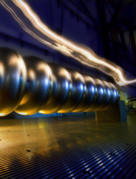
TDR Technical Volumes
2007
2011
2013*
TDR Part I:
R&D
~250 pages
Deliverable 2
ILC Technical Progress Report
(“interim report”)
AD&I
TDR Part II:
Baseline
Reference
Report
~300 pages
Deliverables 1,3 and 4
Technical Design Report
Reference Design Report
* end of 2012 – formal publication early 2013

Slide 12
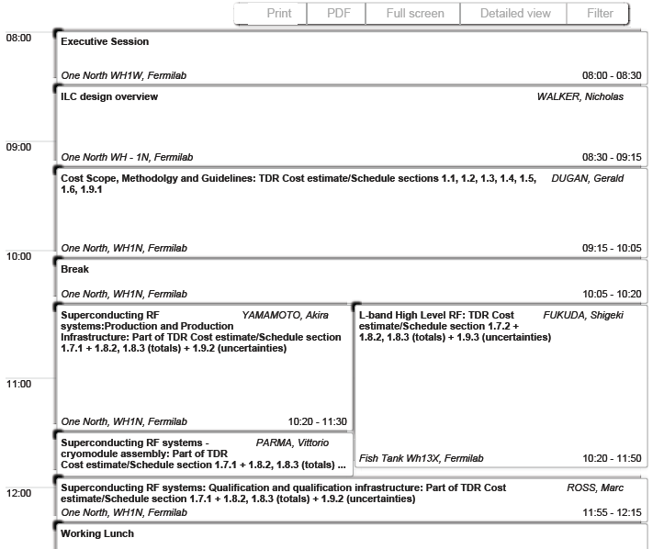
GDE Internal Cost Review
Agenda: Nov. 13, am

Slide 13
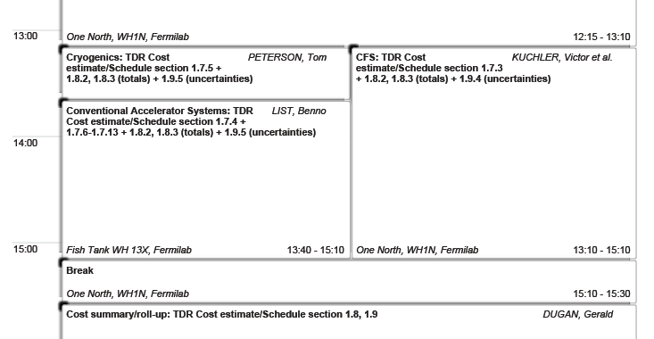
Agenda: Nov. 13 pm

Slide 14
GDE-PAC held at KEK, Dec., 13-14, 2012
Last PAC during TD Phase
TD Report (Part II) submitted to the PAC
Reviewers
  Jonathan Bagger
  Jia-er Chen
  Stefan Choroba
  Michel Davier
  Lyn Evans (Chair)
  Enrique Fernandez
  Paul Grannis
  Stuart Henderson
  Masao Kuriki
  Tomio Kobayashi
  Lutz Lilje
  John Mammosser
  Wolf-Dietrich Moeller
  Katsunobu Oide
  Robert Orr
  Ray Pillay
  John Seeman
  Hans Weise
Agenda
09:00 – 09:45 Executive Session
09:45 – 10:30 Accelerator Overview B. Barish
10:30 – 10:45 Break
10:45 – 11:45 Machine Design N. Walker
11:45 – 12:30 ML Layout & HLRF S. Fukuda, M. Ross
12:30 – 13:00 Executive Session
13:00 – 14:15 Lunch
14:15 – 15:45 SCRF A. Yamamoto
15:45 – 16:00 Break
16:00 – 16:30 Positron Source W. Gai
16:30 -- 17:00 Damping Rings G. Dugan
17:00 – 18:00 Conventional Facilities Kuchler/Enomoto
18:00 – 19:00 Executive Session

Slide 15
GDE-PAC held at KEK, Dec., 13-14, 2012
Agenda
09:00 – 09:45 Executive Session
09:45 – 10:30 Accelerator Overview B. Barish
10:30 – 10:45 Break
10:45 – 11:45 Machine Design N. Walker
11:45 – 12:30 ML Layout & HLRF S. Fukuda, M. Ross
12:30 – 13:00 Executive Session
13:00 – 14:15 Lunch
14:15 – 15:45 SCRF A. Yamamoto
15:45 – 16:00 Break
16:00 – 16:30 Positron Source W. Gai
16:30 -- 17:00 Damping Rings G. Dugan
17:00 – 18:00 Conventional Facilities Kuchler/Enomoto
18:00 – 19:00 Executive Session

Slide 16
Preparation
Presentation Draft due: November 30,
Review the preparation files, through webex
  Main Linac Layout and HLRF, and SCRF: Dec. 3, Mon
  CFS: Dec., 4,
  Others: Dec., 5
PAC: Dec. 13, 14

