Slide 1
Kicker amplifier tests
N. Blaskovic

Slide 2
Introduction
The kicker tests involved reproducing the ATF set-up from FONT5 board to kicker.
The lab BPM was used as the kicker.
Hardware swaps were performed and its effect on the signal sent to the kicker was assessed.
Acknowledgements to: Colin and Glenn.
N. Blaskovic

Slide 3
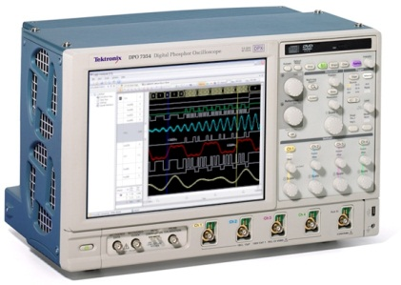
Set-up
FONT5 board
ZPUL
TMD amplifier
Generator
Fast clock
DAC 1
In
Out
Analogue in
FONT4
Dig in 1
Aux out A
Trigger in
FONT4
Dig in 2
Out (+)
Out (–)
BPM
(used as kicker)
Colin’s box
In (+)
In (–)
Monitor (+)
Monitor (–)
In (‘top’)
Out (+)
In (‘bottom’)
Out (–)
N. Blaskovic

Slide 4
Set-up
CHANGE
CHANGE
FONT5 board
ZPUL
TMD amplifier
Generator
Fast clock
DAC 1
In
Out
Analogue in
FONT4
Dig in 1
Aux out A
Trigger in
FONT4
Dig in 2
Out (+)
Out (–)
CHANGE
BPM
(used as kicker)
Colin’s box
In (+)
In (–)
Monitor (+)
Monitor (–)
In (‘top’)
Out (+)
In (‘bottom’)
Out (–)
N. Blaskovic

Slide 5
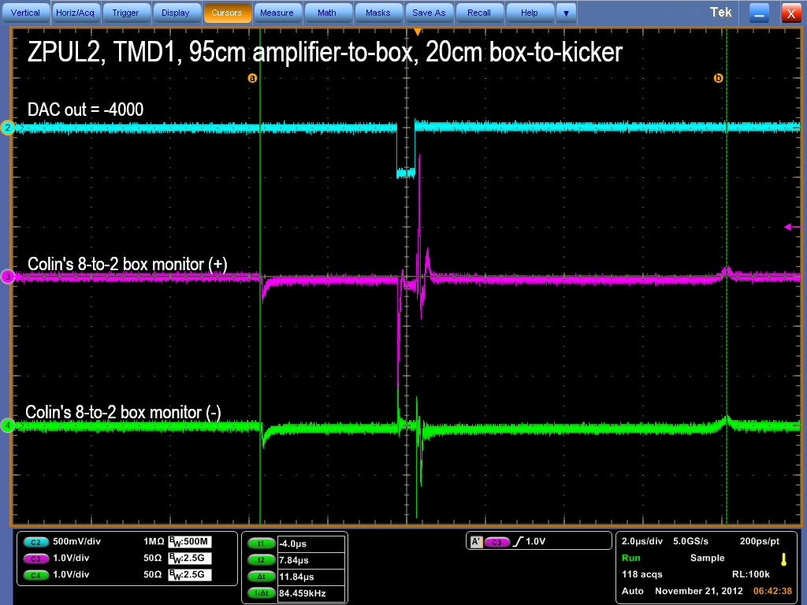
Typical waveform
N. Blaskovic

Slide 6
~12 us
Kicker is ready for ~12 us.
Constant DAC out is on for ~450 ns.
~450 ns
N. Blaskovic

Slide 7
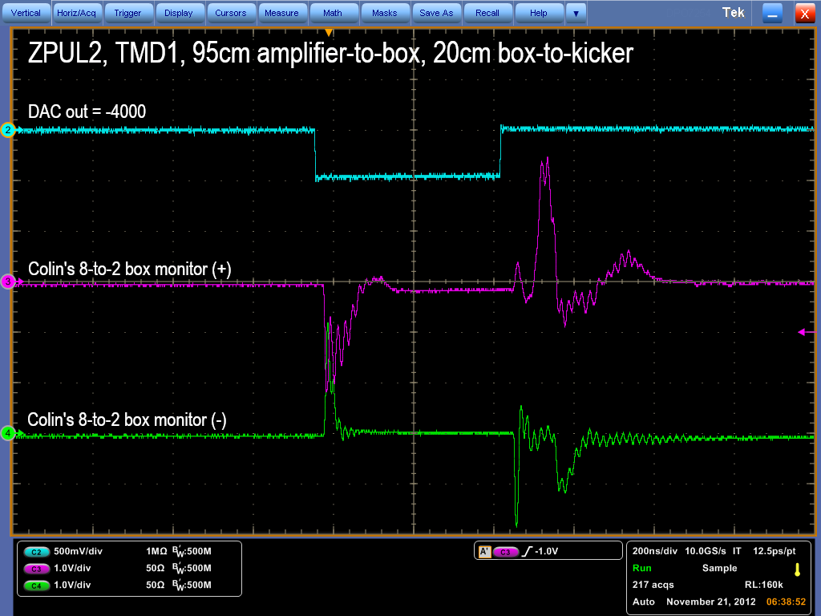
N. Blaskovic

Slide 8
Dodgy cable in test set-up
The cable carrying the input to the ZPUL in the test set-up was found to be dodgy.
Shaking or twisting the dodgy cable augmented the ~55 MHz oscillations.
On replacing the dodgy cable, the oscillatory behaviour was reduced, and any remaining oscillations were insensitive to cable manipulations.
N. Blaskovic

Slide 9
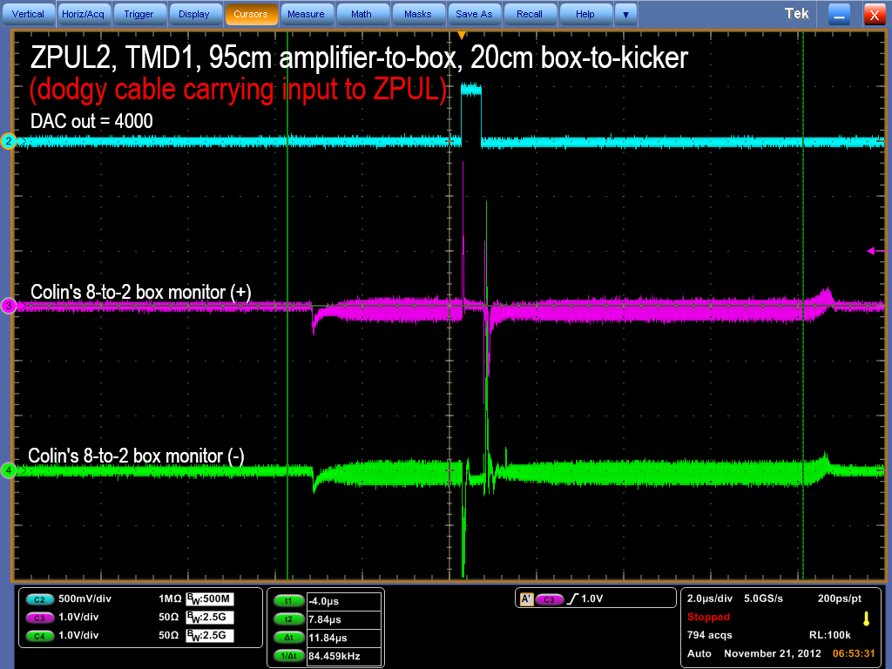
N. Blaskovic

Slide 10
(dodgy cable carrying input to ZPUL)
~55 MHz oscillations
~55 MHz oscillations
N. Blaskovic

Slide 11

(good cable carrying input to ZPUL)
N. Blaskovic

Slide 12
A little history
Regarding the amplification of K2 and IPK signals, the initial set-up in October was:
After removing ZPUL3, reported broken:
FONT5
DAC out
ZPUL2
TMD3
K2
Splitter
ZPUL3
TMD1
IPK
FONT5
DAC out
TMD3
K2
ZPUL2
Splitter
TMD1
IPK
N. Blaskovic

Slide 13
Waveforms for multiple set-ups
In the following:
Each slide corresponds to a different DAC out
Each slide contains four oscilloscope screens, for four hardware set-ups
N. Blaskovic

Slide 14
Using ‘broken’ ZPUL
ZPUL3 (reported broken in Oct)
TMD1 (at IP in Oct)
50cm amplifier-to-box (at K2 in Oct)
20cm box-to-kicker (at IP in Oct)
Set-up at end of October
ZPUL2 (for K2 in Oct)
TMD1 (at IP in Oct)
95cm amplifier-to-box (at IP in Oct)
20cm box-to-kicker (at IP in Oct)
Take set-up at end of October and swap TMD amplifier & cable length
ZPUL2 (for K2 in Oct)
TMD3 (for K2 in Oct)
50cm amplifier-to-box (at K2 in Oct)
20cm box-to-kicker (at IP in Oct)
Take set-up at end of October and swap cable length only
ZPUL2 (for K2 in Oct)
TMD1 (at IP in Oct)
50cm amplifier-to-box (at K2 in Oct)
20cm box-to-kicker (at IP in Oct)
N. Blaskovic

Slide 15
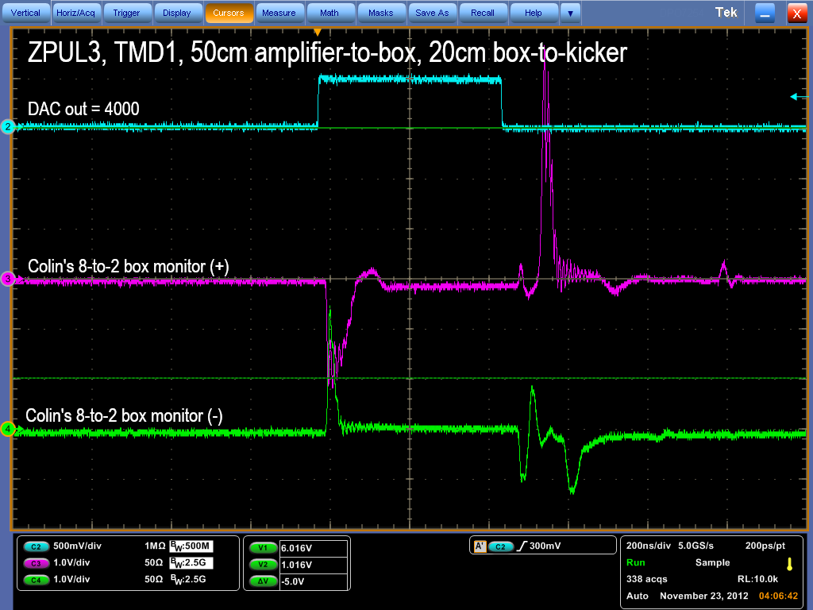
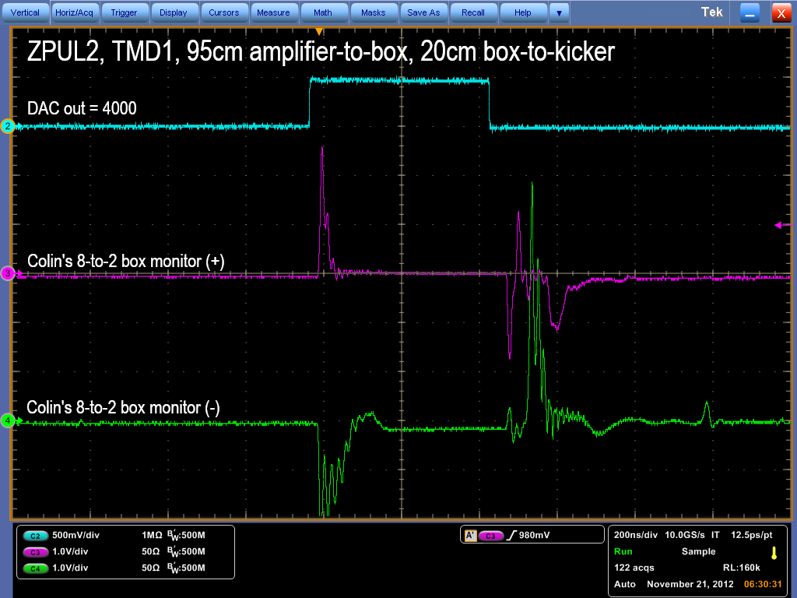
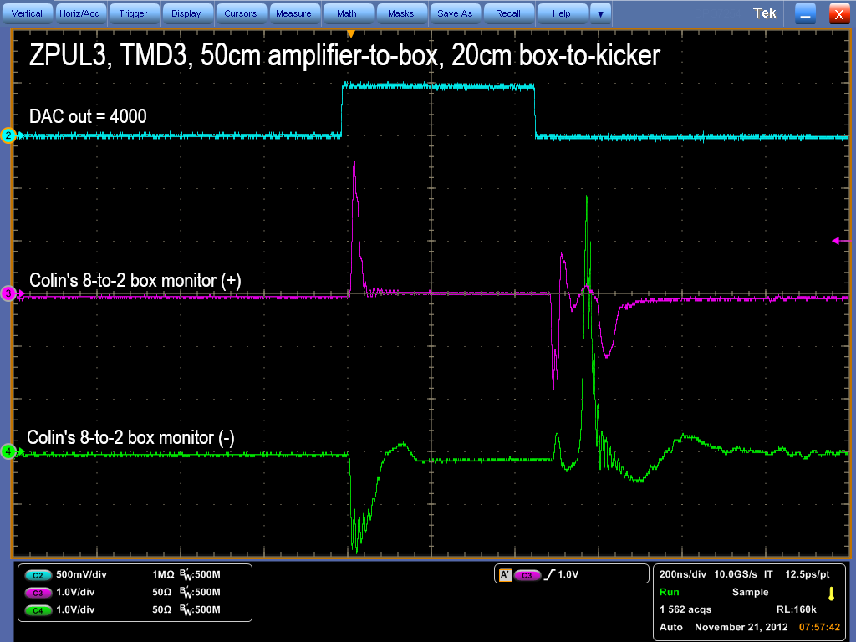
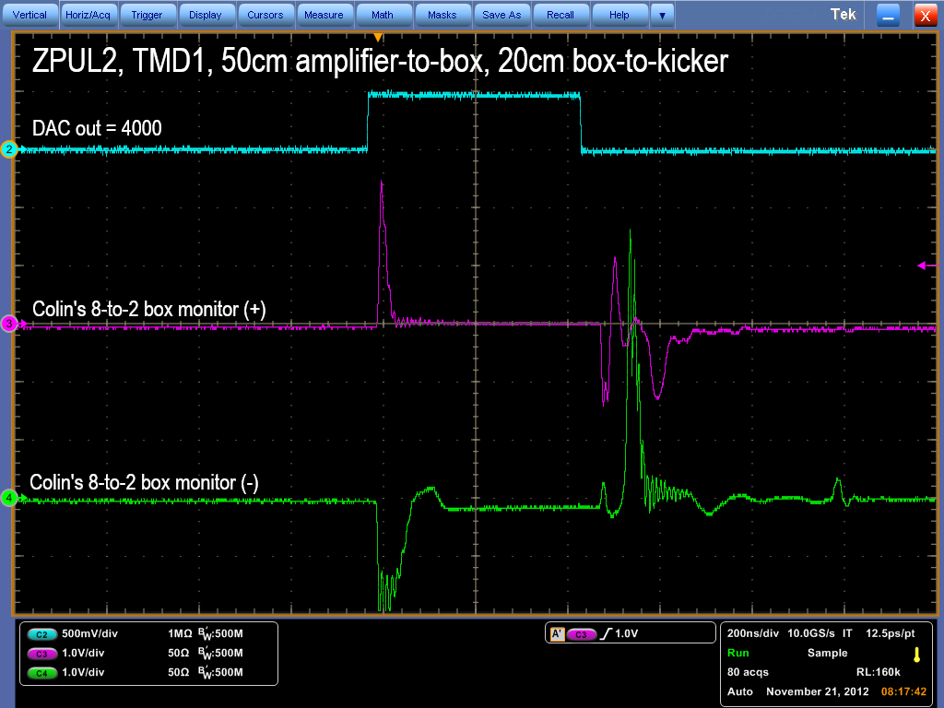
2
N. Blaskovic

Slide 16
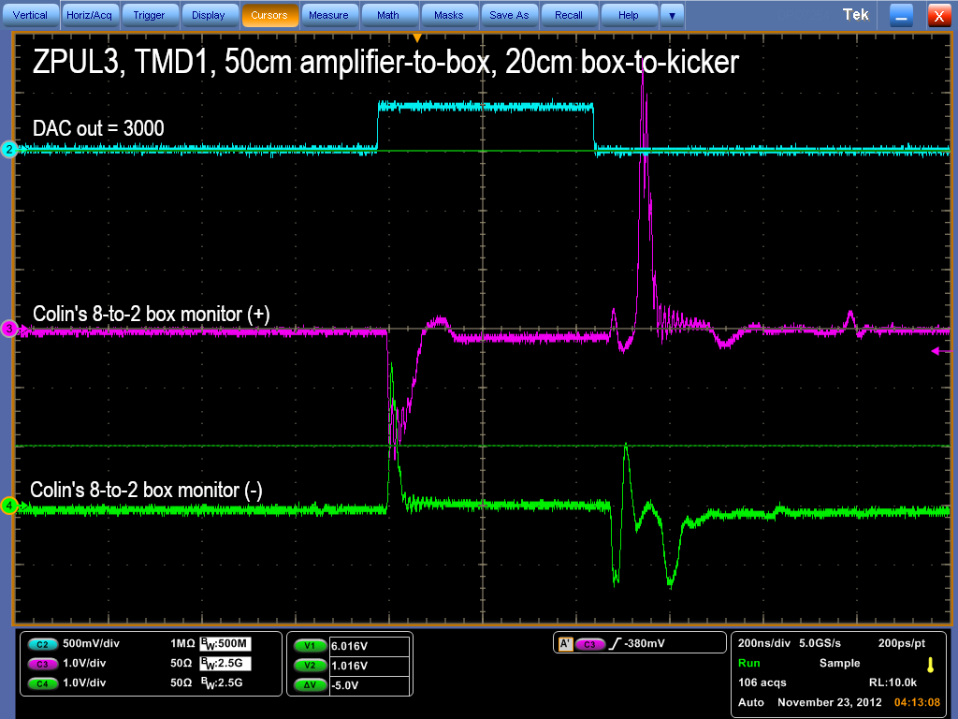
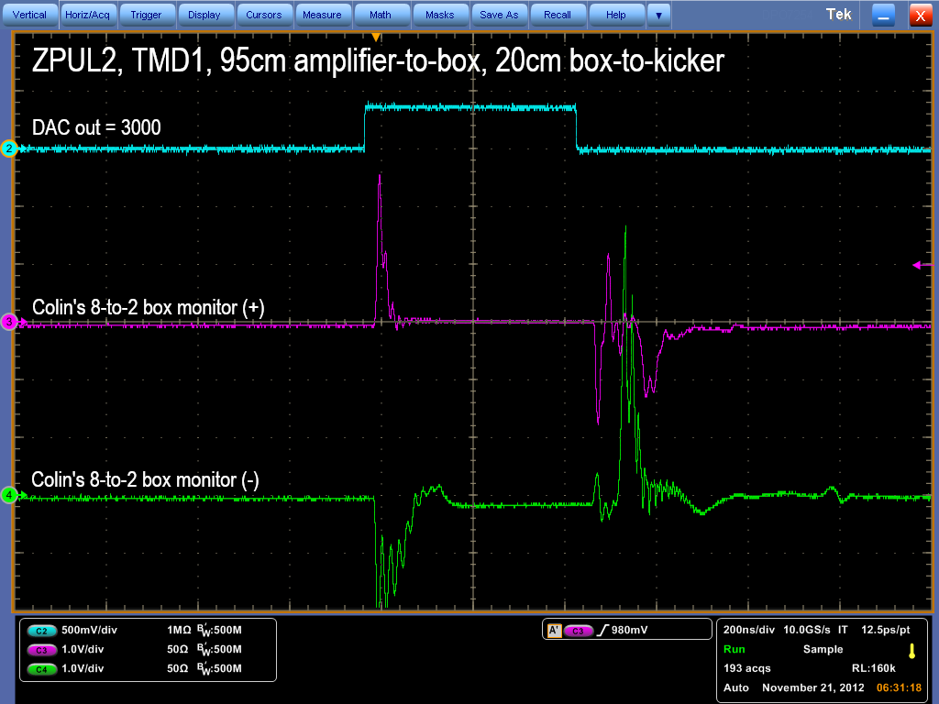

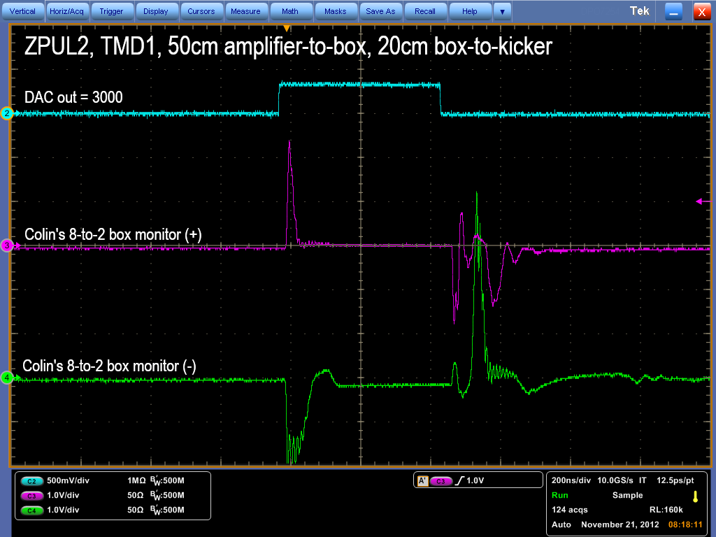
2
N. Blaskovic

Slide 17
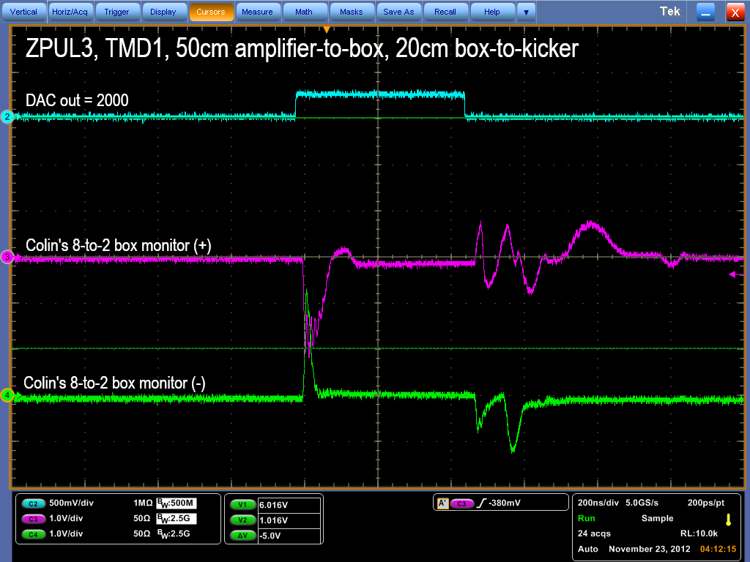
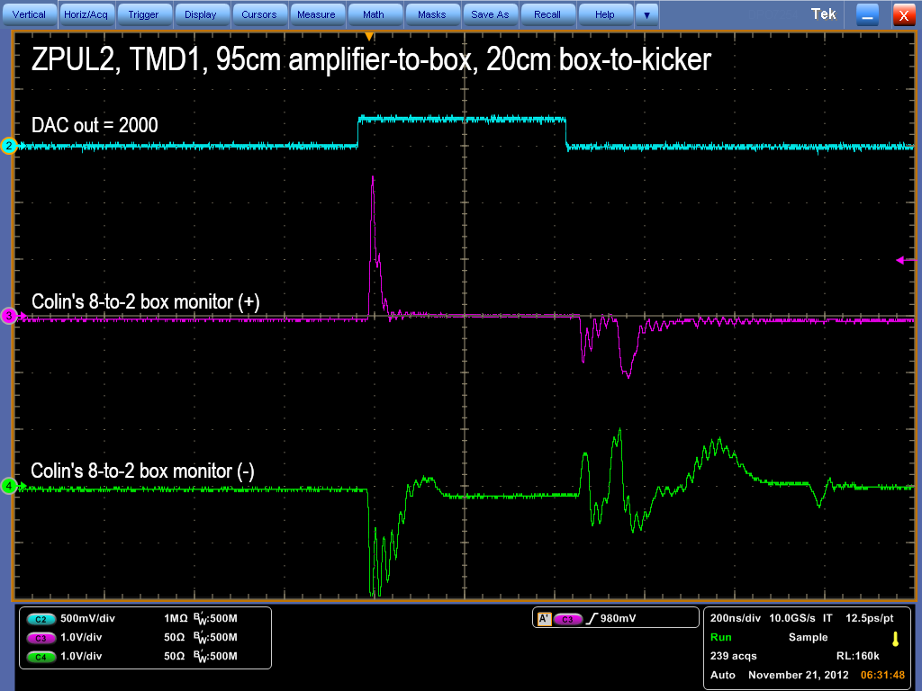
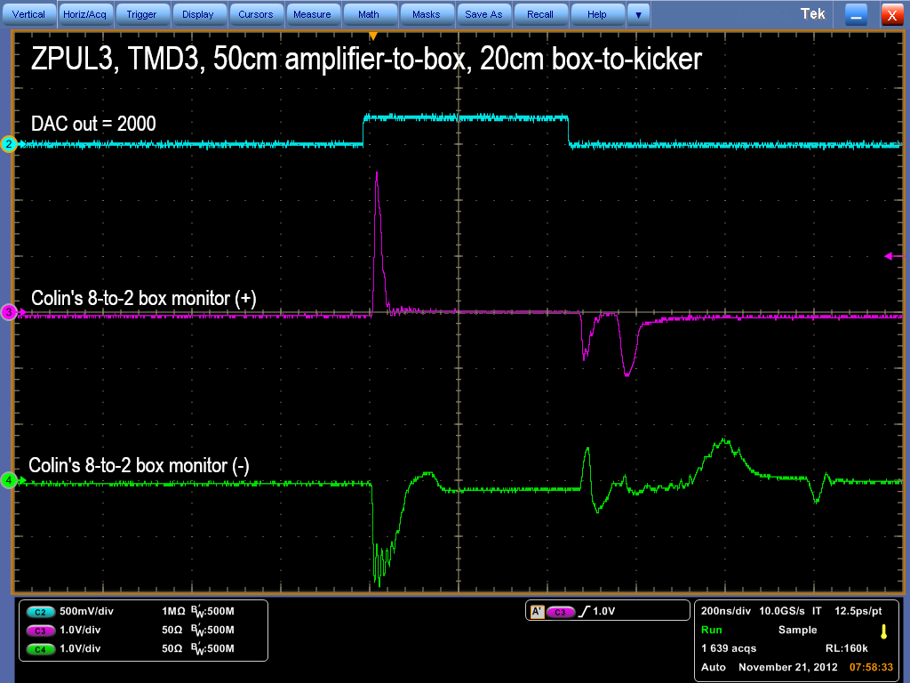
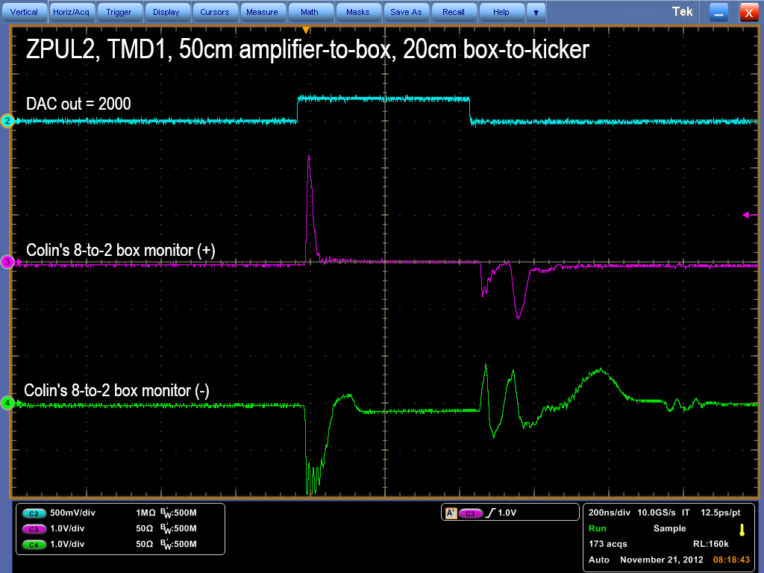
2
N. Blaskovic

Slide 18
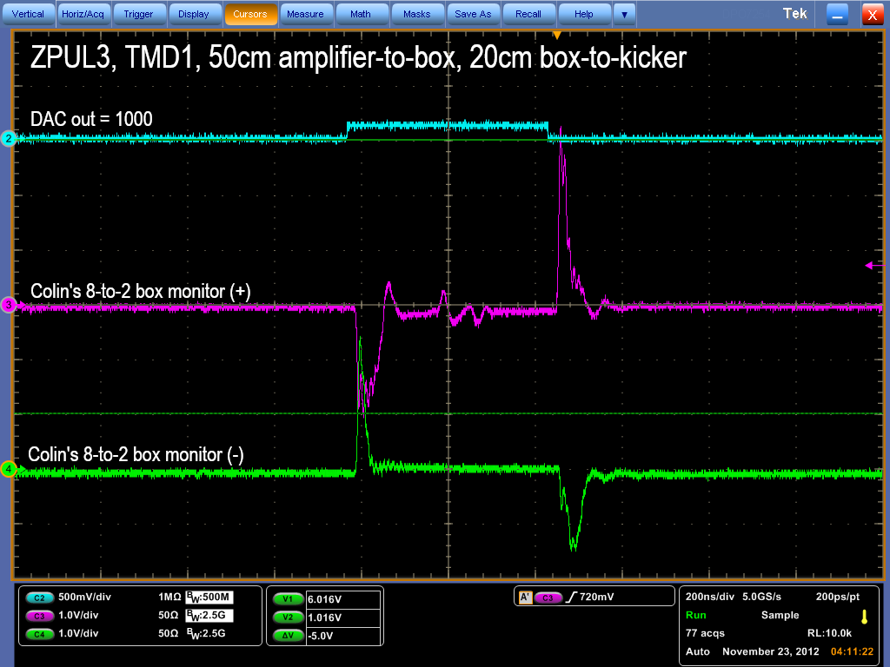
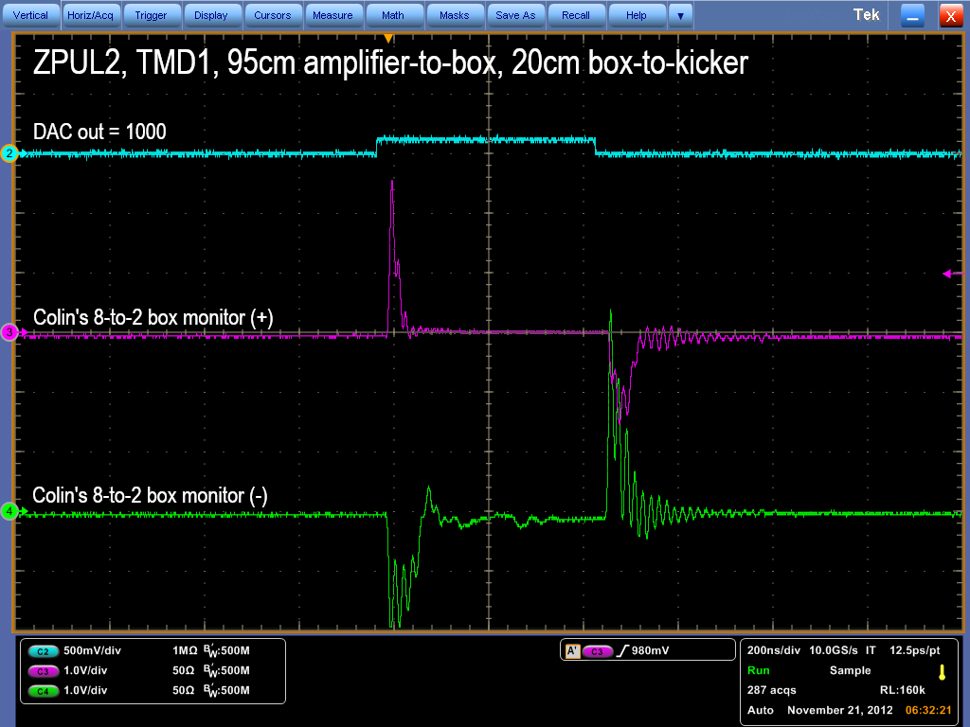
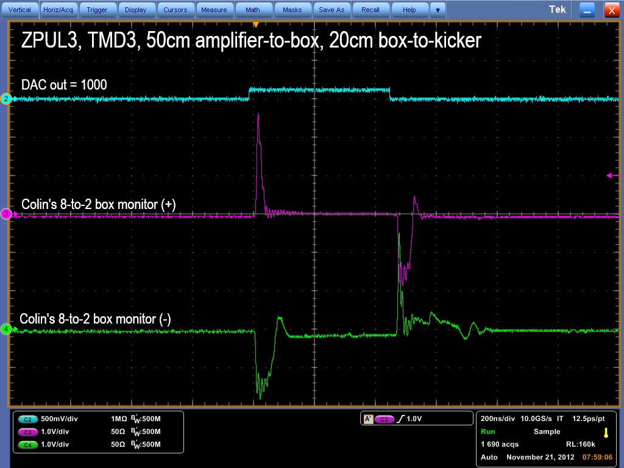
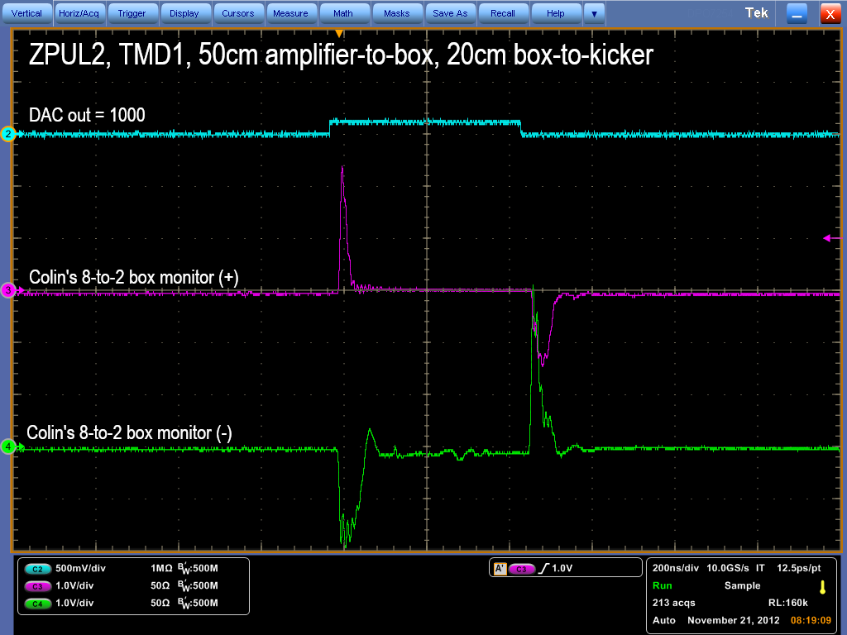
2
N. Blaskovic

Slide 19
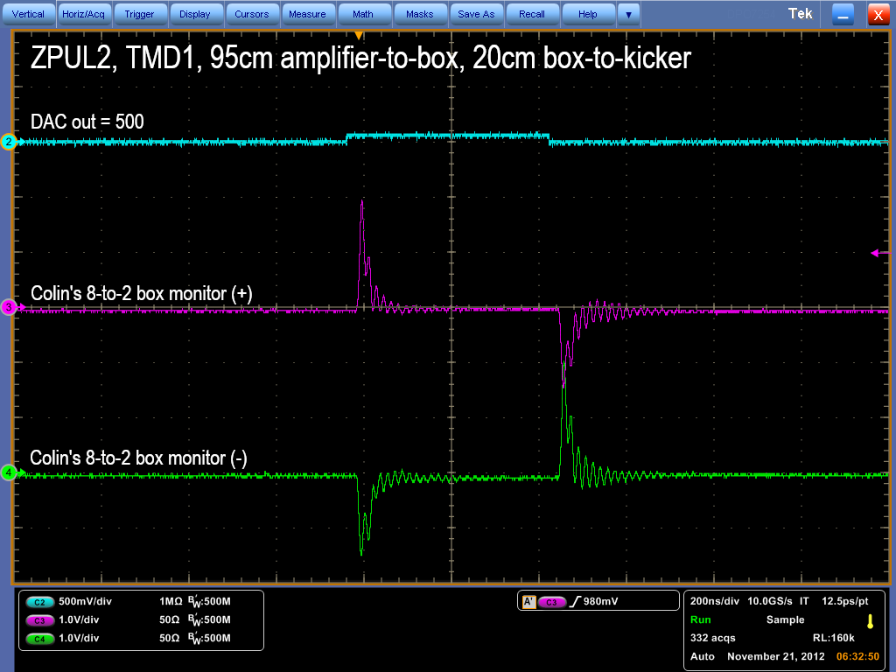
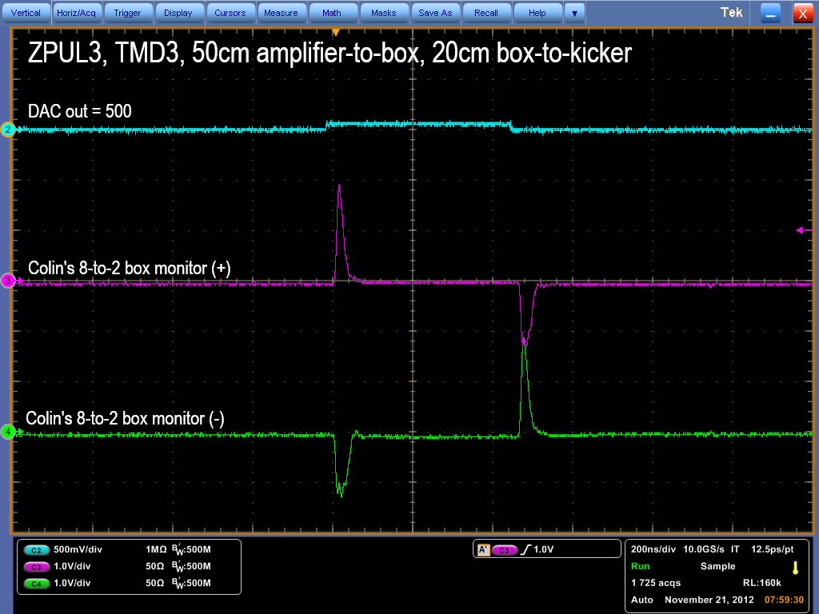

Sorry, no traces saved!
~55 MHz oscillations
2
N. Blaskovic

Slide 20
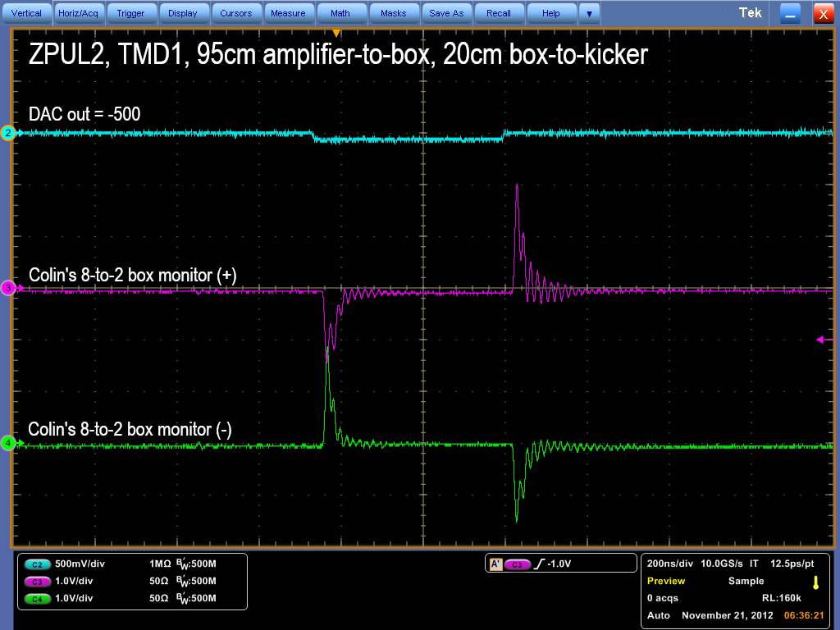
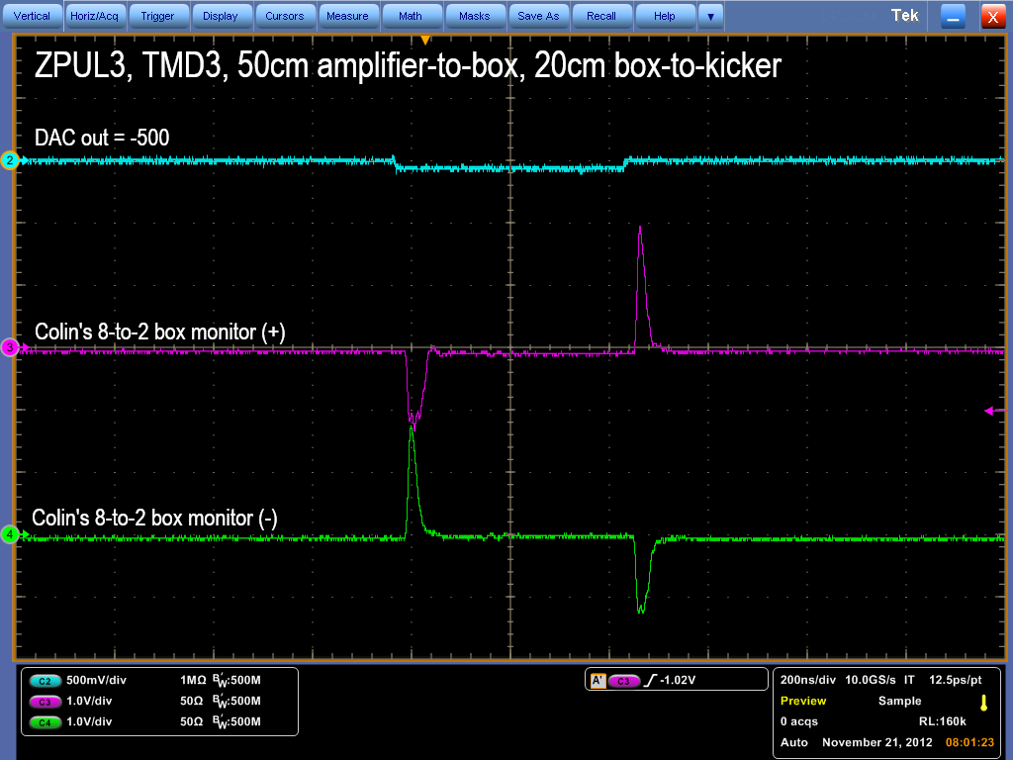
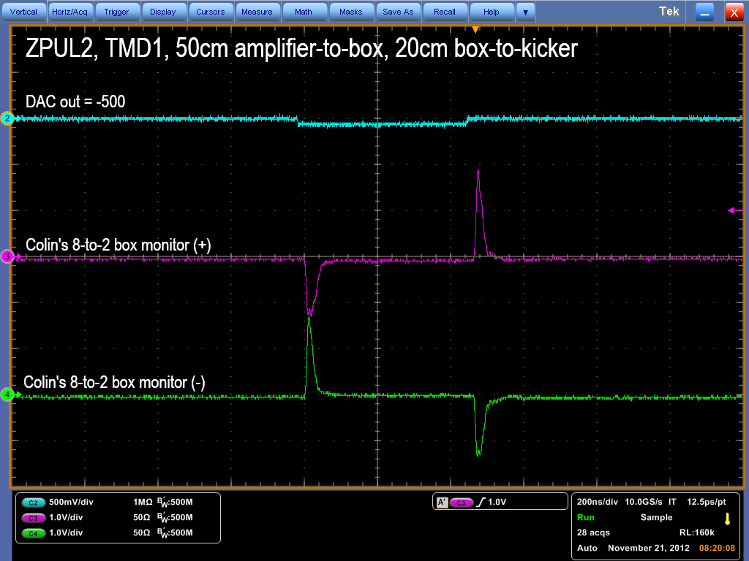
Sorry, no traces saved!
~55 MHz oscillations
2
N. Blaskovic

Slide 21
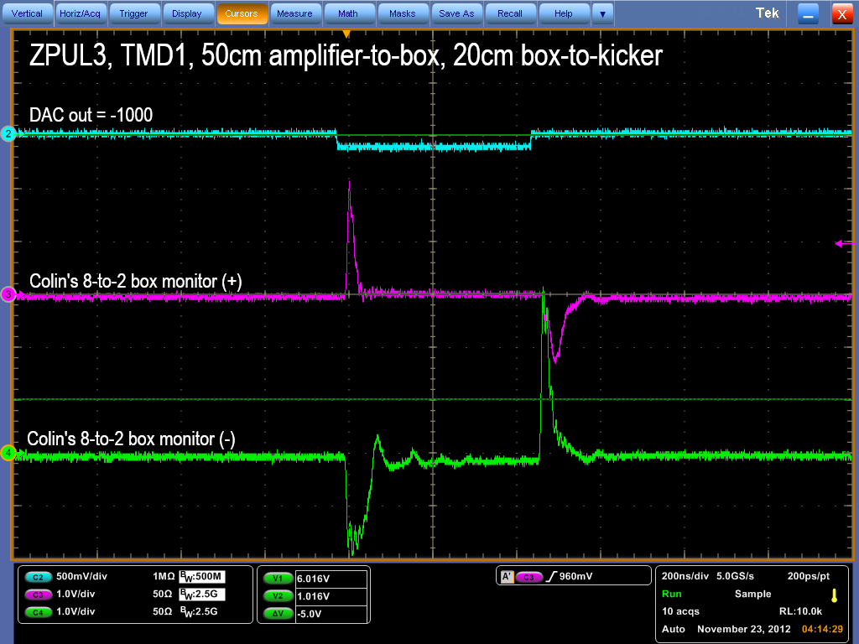
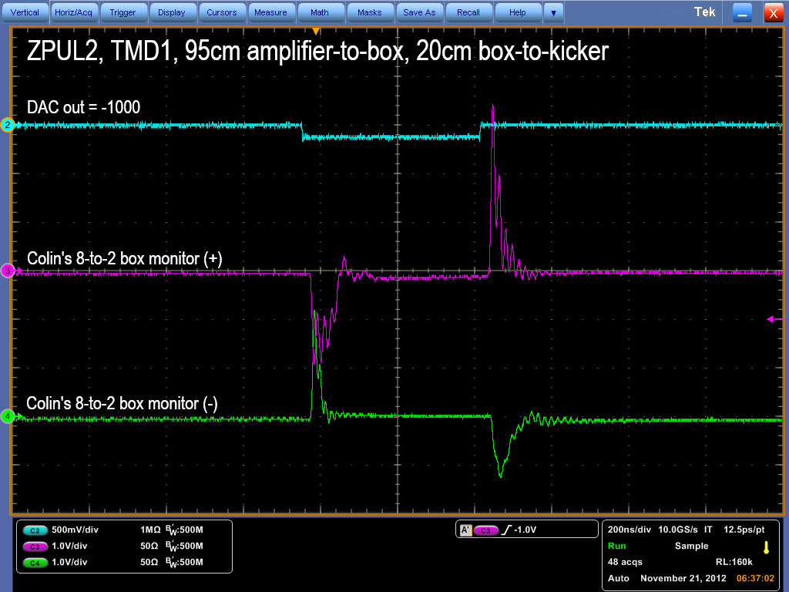
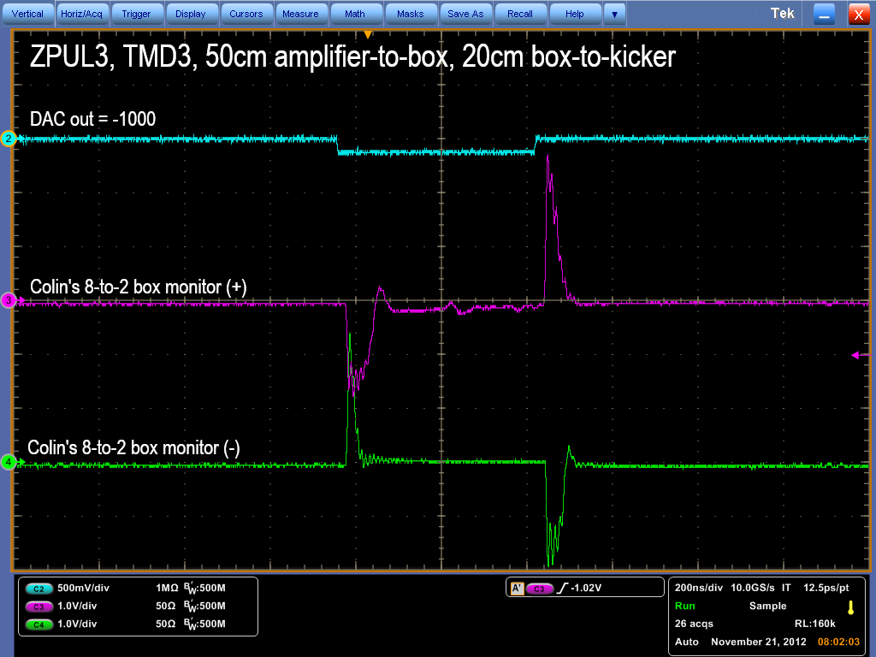
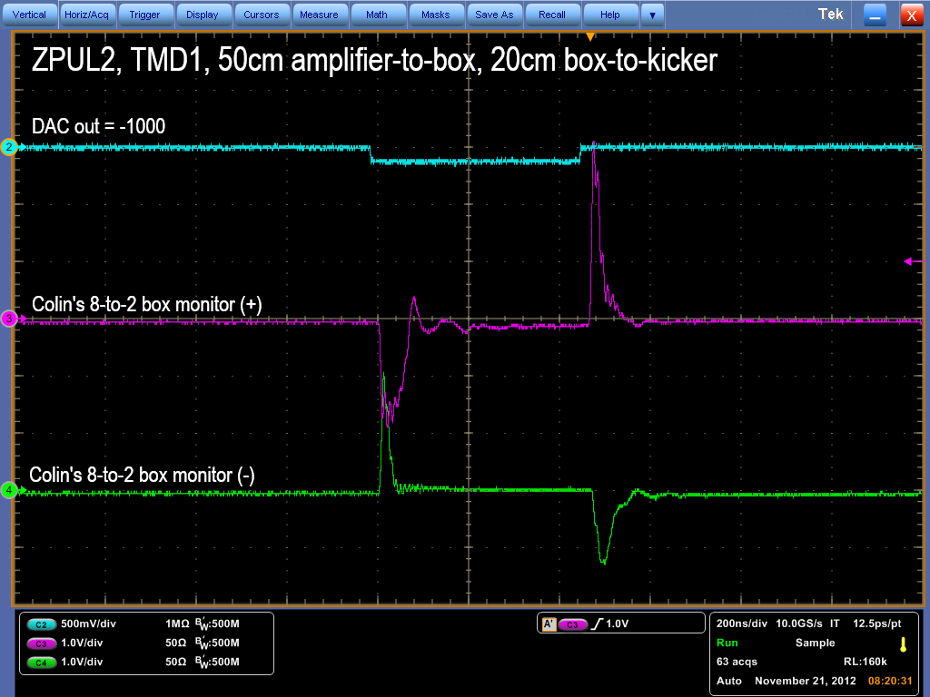
2
N. Blaskovic

Slide 22
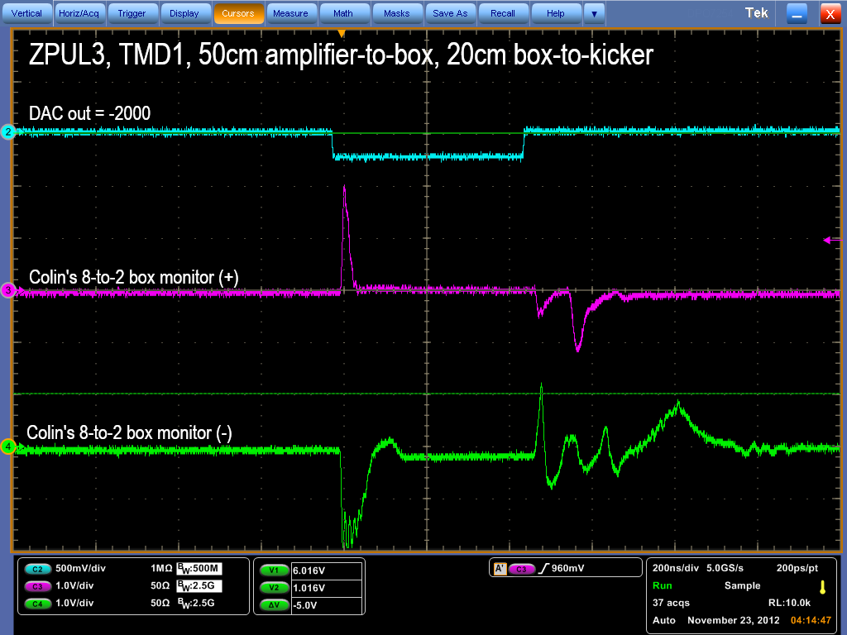


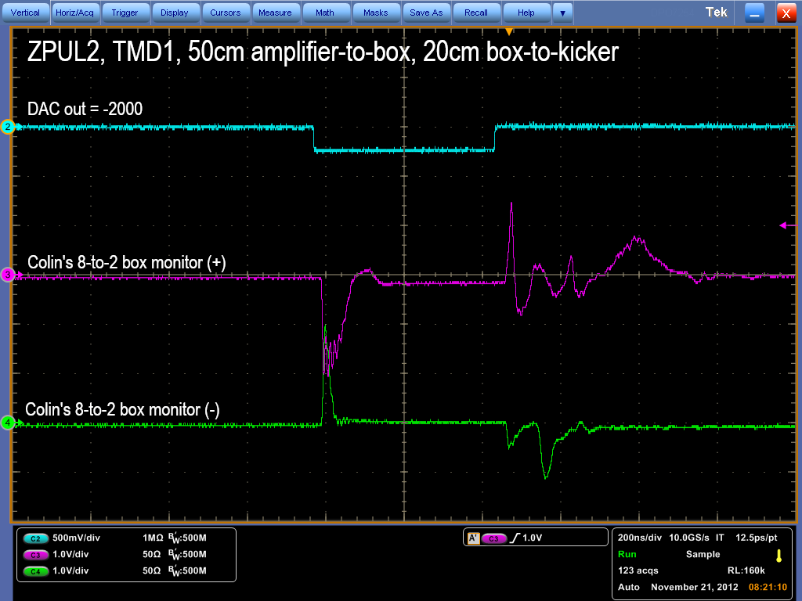
2
N. Blaskovic

Slide 23
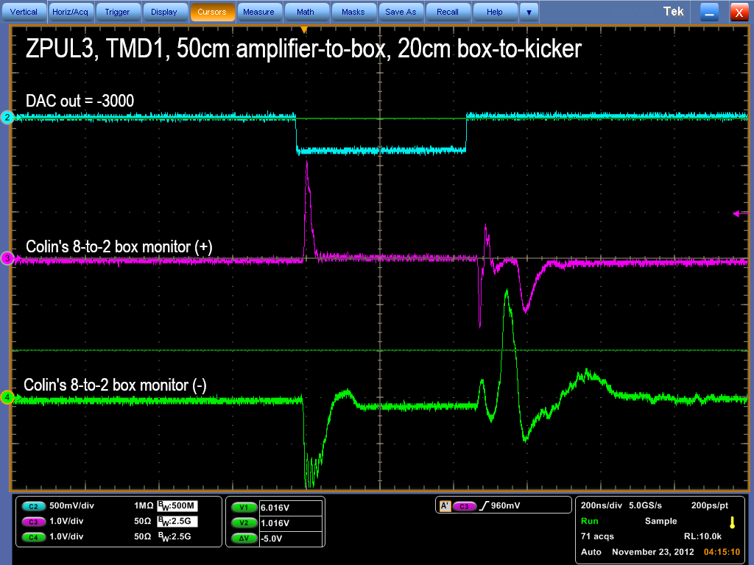

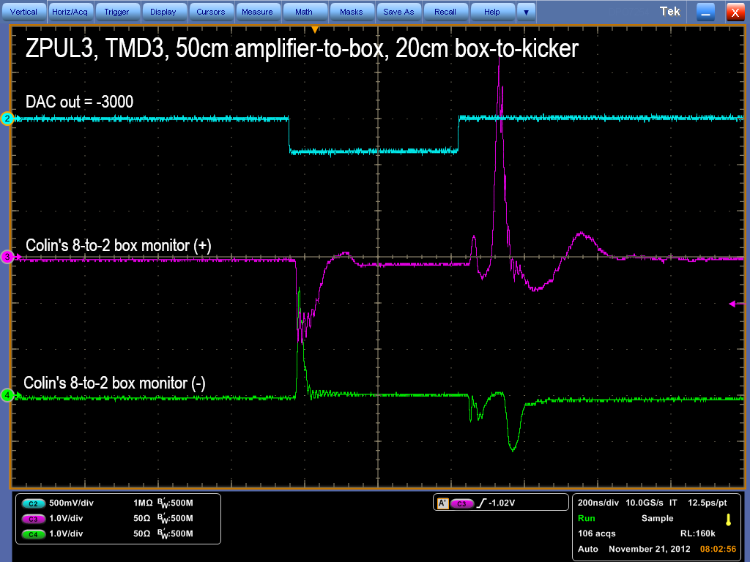
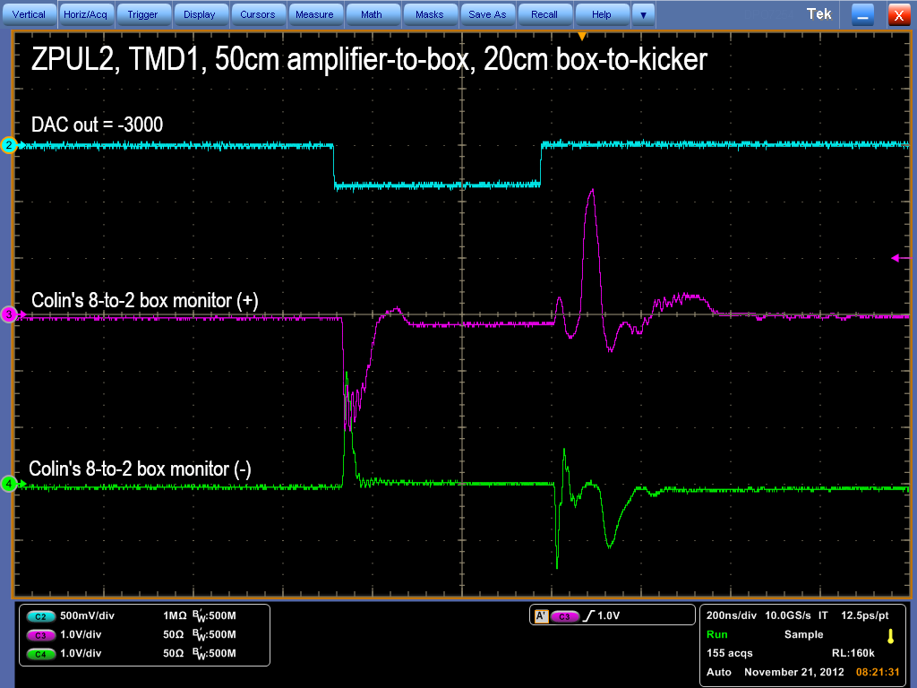
2
N. Blaskovic

Slide 24
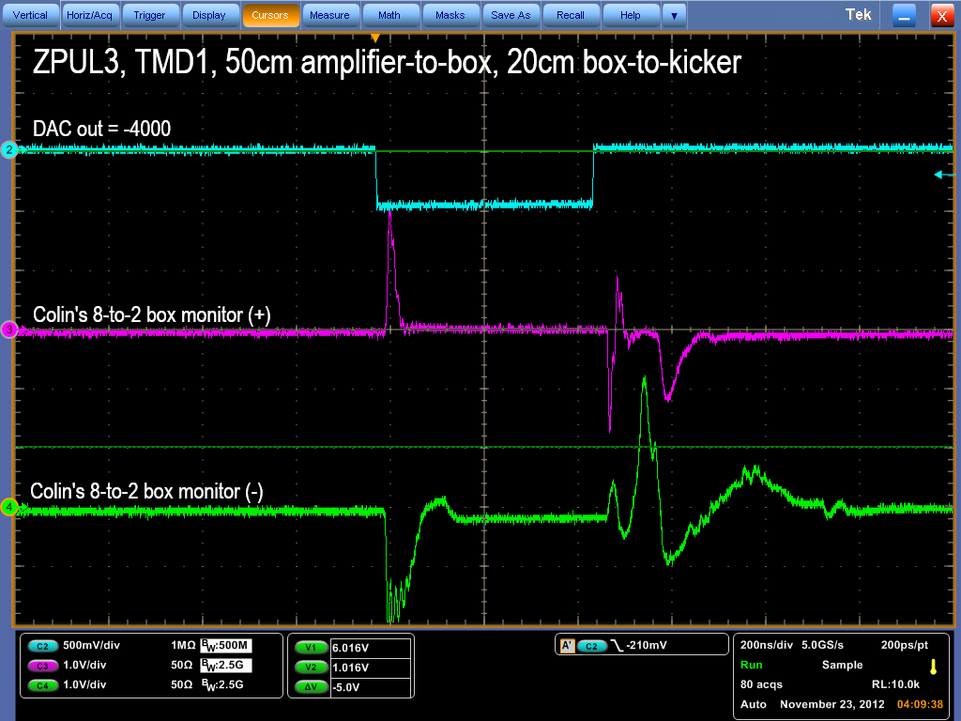
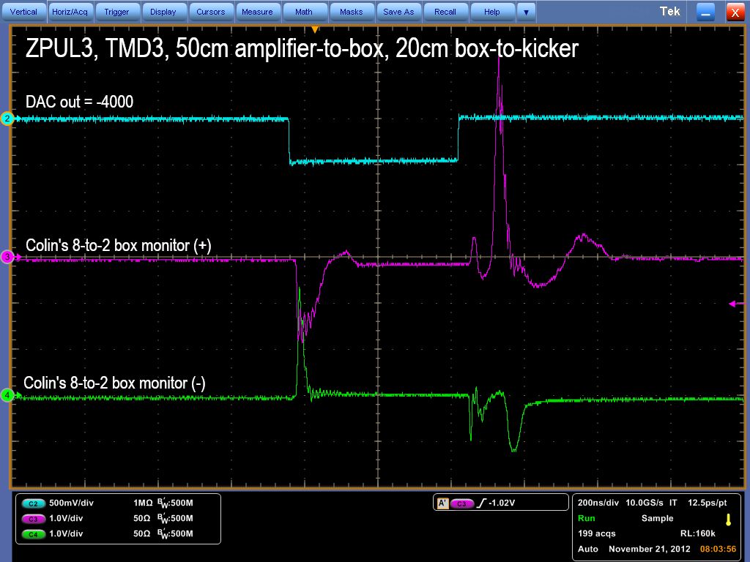
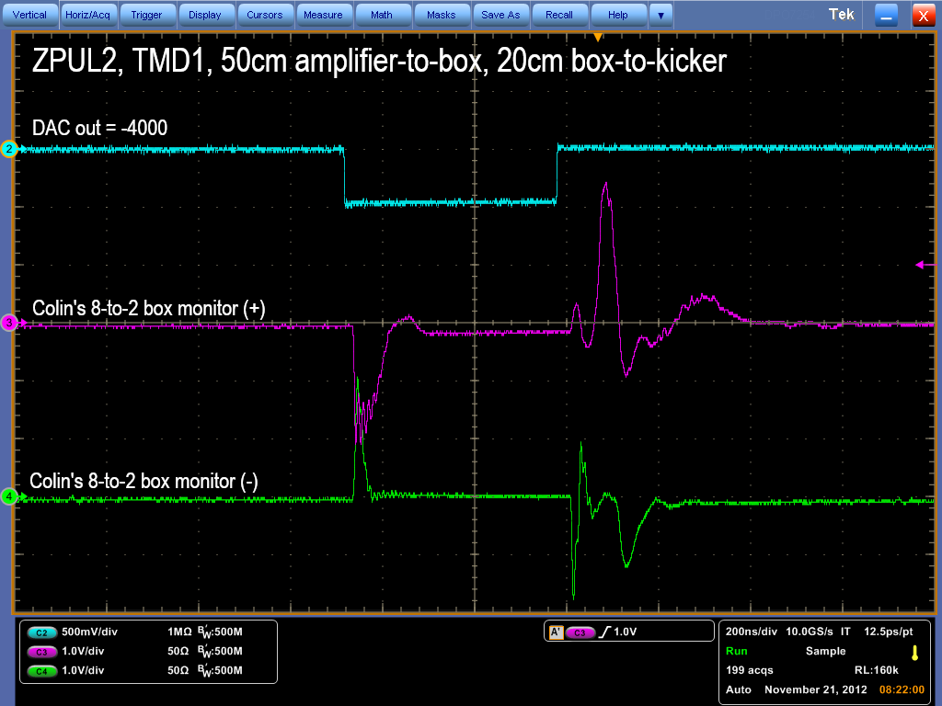
2
N. Blaskovic

Slide 25
Observations
ZPUL3 is not completely broken, but its performance may be inferior to ZPUL2.
~55 MHz oscillations appear to be reduced on changing the amplifier-to-box cable length from 95 cm to 50 cm.
N. Blaskovic

Slide 26
Possible further work
Investigate using other cable lengths.
Glenn suggests looking at the effect of coiling cables around ferrite.
N. Blaskovic

