Slide 1


BPM Processor Tests
Mikey Davis
30 November 2012
1/17

Slide 2
Introduction
I have rebuilt my setup to test the BPM processors
I have :
  Re measured the cable mismatch for processor 7
  Begun analysing all the LO Phase Tests from this year
  Tested the effectiveness of the new Phase shifter
Mikey Davis
30 November 2012
2/17

Slide 3
Reminder of the Test Setup
Colin and I constructed a test setup to mimic the BPMs at ATF
A Kentech pulse generator is used to generate an imitation stripline pulse
The 714 phase stable trigger for the Kentech is generated using a box Colin built
This gives a stripline pulse that is relatively phase stable to a 714 used as the LO for the processor
Mikey Davis
30 November 2012
3/17

Slide 4
Reminder of the Test Setup
The LO is sent through a phase shifter so the processor can be phased
The stripline signal is split and input into the processor
The processor is then phased on the sum
If the processor was perfectly setup, the difference signal would be zero, if there is a cable length mismatch then this won’t be the case
Mikey Davis
30 November 2012
4/17

Slide 5
Previous Tactics
Last time this was done the tactic was to manually offset one of the cable lengths with respect to the other by a known length
We then did the LO Phase Test
You should then try and minimise the residual between the max and min lo phase settings by adjusting the external cable length offset
Mikey Davis
30 November 2012
5/17

Slide 6
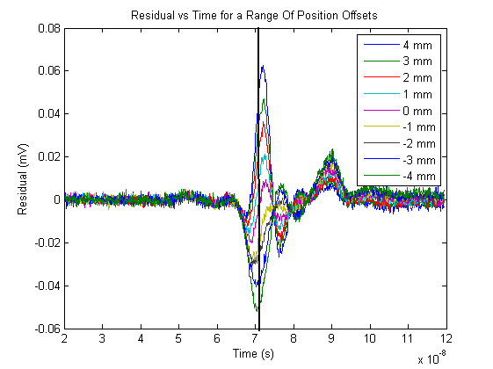
Residual Plots
Mikey Davis
30 November 2012
6/17

Slide 7
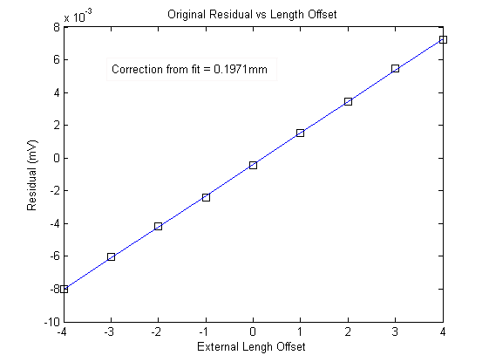
Previous Result
Mikey Davis
30 November 2012
7/17

Slide 8
Recap of Targets
When I did this before I considered a correction of
  0.5 mm acceptable
  0.2 – 0.3 mm exceptional (I felt this was also luck)
  1 mm unacceptable (needed to be adjusted)
We used processors 7 and 10 as they have corrections of < 0.3mm
Mikey Davis
30 November 2012
8/17

Slide 9
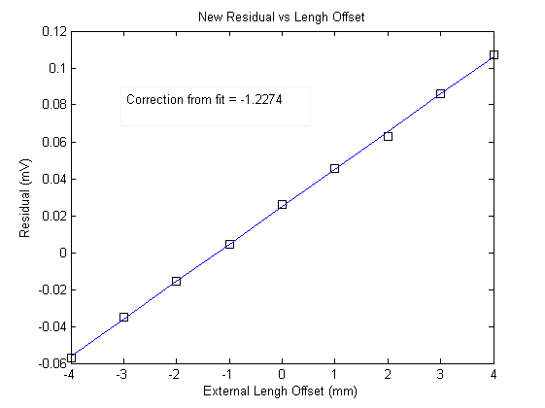
New Result
Mikey Davis
30 November 2012
9/17

Slide 10
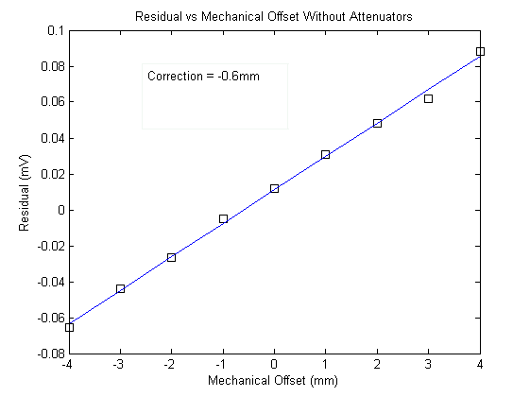
New Result
Mikey Davis
30 November 2012
10/17

Slide 11
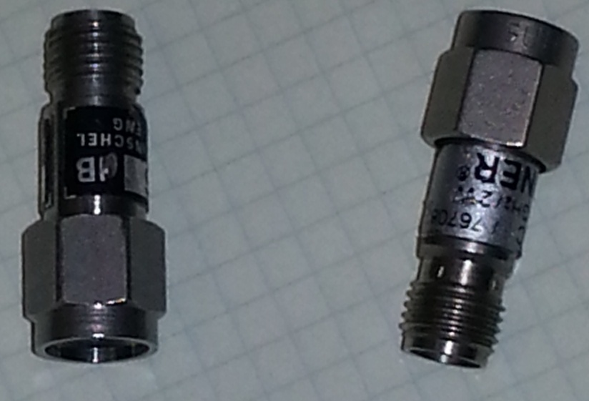
Attenuators
We had assumed that the attenuators were the same length
Measured them on the network analyser
  Path length difference ≈ 1mm
Mikey Davis
30 November 2012
11/17

Slide 12
Manual Correction
If a processor was this bad in the past I would have then made a manual correction using slightly different length cables
As the cables change length when you bend them this never worked very well
Now I can use the phase shifter to change the length without touching the setup
Mikey Davis
30 November 2012
12/17

Slide 13
New Test Procedure
Repeat test with a constant mechanical offset of zero but for different phase shifter settings
Use the phase shifter to then correct for the offset
Re measure the offset using the mechanical phase shifters
Mikey Davis
30 November 2012
13/17

Slide 14
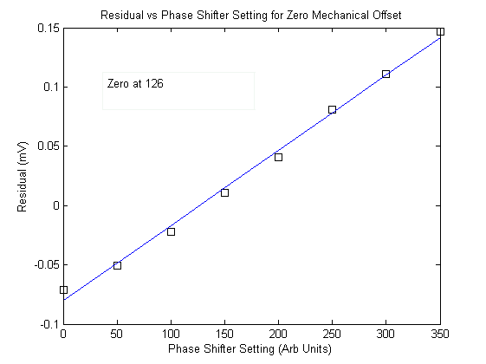
Phase Shifter Plot
Mikey Davis
30 November 2012
14/17

Slide 15
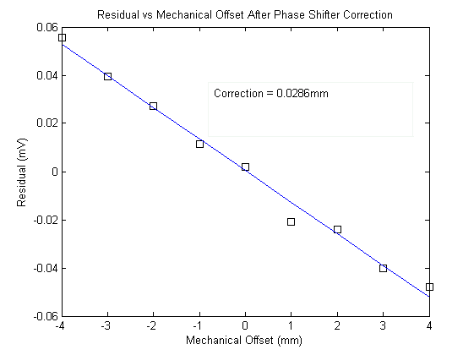
Mechanical Test Plot (At 6)
Mikey Davis
30 November 2012
15/17

Slide 16
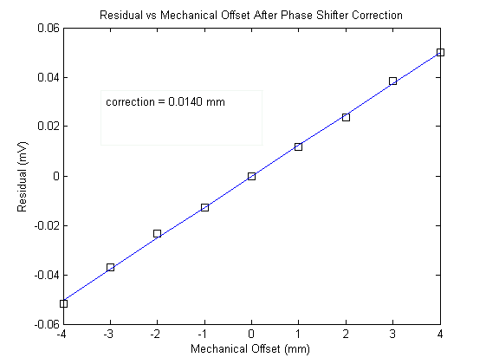
Mechanical Test Plot (At 7)
Mikey Davis
30 November 2012
16/17

Slide 17
Conclusions
The new test setup certainly seems to work better in the lab
I will continue to look at this years data
Will re measure all the cables on the network analyser today
Mikey Davis
30 November 2012
17/17

