Slide 1
Kicker amplifier tests
N. Blaskovic

Slide 2
Introduction
Further amplifier tests were performed following input from the last meeting.
This presentation contains waveforms for:
  ZPUL input and output
  ZPUL and TMD amplifier swaps
  Cable length swaps over full DAC out range
N. Blaskovic

Slide 3
ZPUL3 power supply
It was found that the wires carrying the 24 V supply to ZPUL3 made an intermittent connection to the ZPUL.
Re-soldering the wires to the ZPUL led to a stable connection.
N. Blaskovic

Slide 4
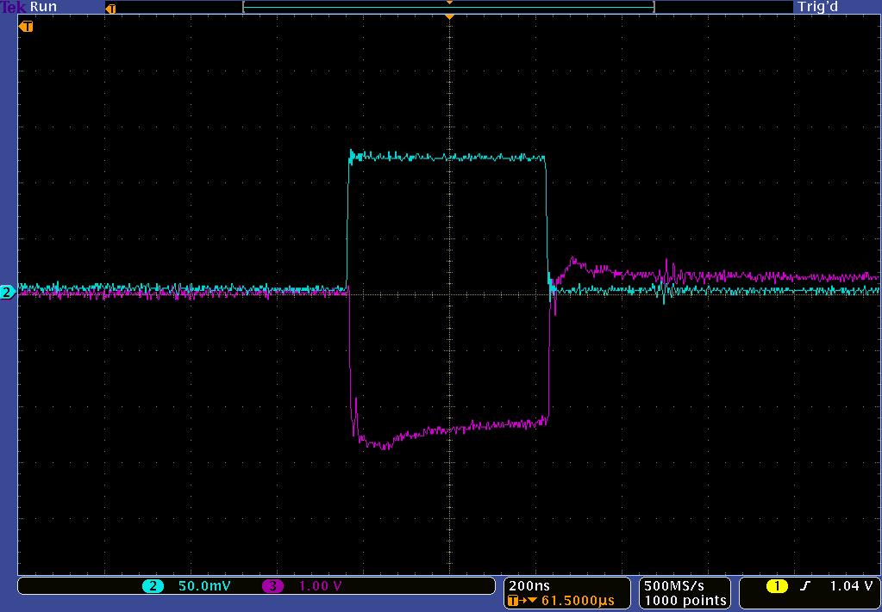
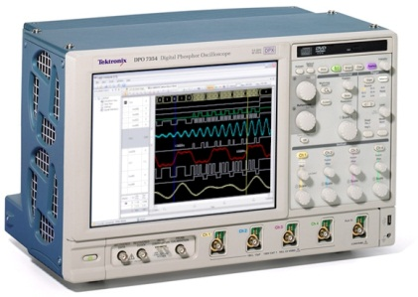
ZPUL tests
ZPUL1
ZPUL
ZPUL in
0.12 V
-2.3 V
-2.6 V
ZPUL out
N. Blaskovic

Slide 5
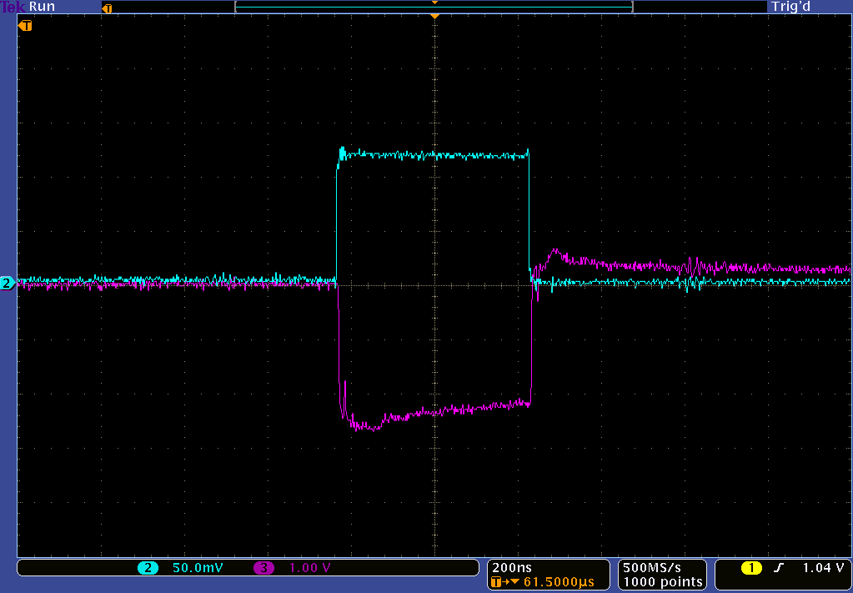
ZPUL tests
ZPUL2
ZPUL
ZPUL in
0.12 V
-2.2 V
-2.6 V
ZPUL out
N. Blaskovic

Slide 6
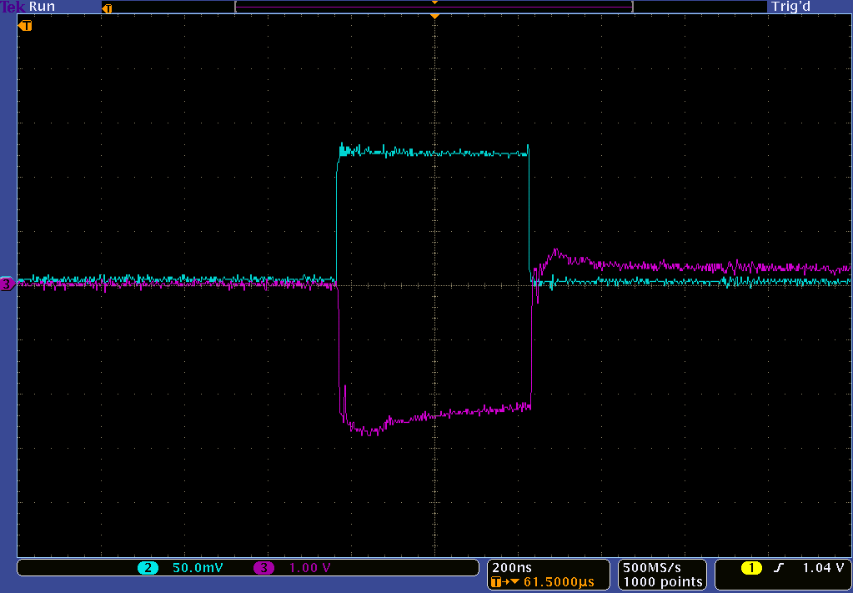
ZPUL tests
ZPUL3
ZPUL
ZPUL in
0.12 V
-2.3 V
-2.7 V
ZPUL out
N. Blaskovic

Slide 7
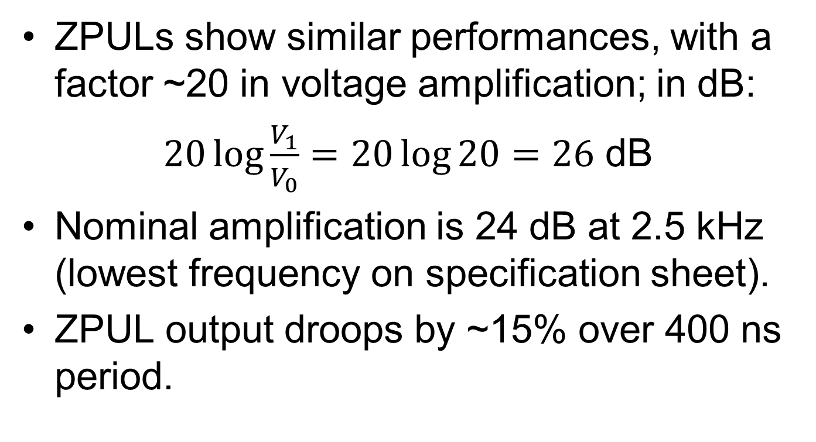
ZPUL tests
ZPULs show similar performances, with a factor ~20 in voltage amplification; in dB:
$20\log{\frac{V_{1}}{V_{0}}}=20\log{20}=26$ dB
Nominal amplification is 24 dB at 2.5 kHz (lowest frequency on specification sheet).
ZPUL output droops by ~15% over 400 ns period.
N. Blaskovic

Slide 8
Set-up
FONT5 board
ZPUL
Atten
TMD amplifier
Generator
Fast clock
DAC 1
6dB
Analogue in
FONT4
Dig in 1
Trigger in
FONT4
Dig in 2
Aux out A
Out (+)
Out (–)
BPM
(used as kicker)
Colin’s box
In (+)
In (–)
Monitor (+)
Monitor (–)
In (‘top’)
Out (+)
In (‘bottom’)
Out (–)
N. Blaskovic

Slide 9
Set-up
NEW
FONT5 board
ZPUL
Atten
TMD amplifier
Generator
Fast clock
DAC 1
6dB
Analogue in
FONT4
Dig in 1
Trigger in
FONT4
Dig in 2
Aux out A
Out (+)
Out (–)
BPM
(used as kicker)
Colin’s box
In (+)
In (–)
Monitor (+)
Monitor (–)
In (‘top’)
Out (+)
In (‘bottom’)
Out (–)
N. Blaskovic

Slide 10
Amplifier combinations
ZPUL and TMD amplifier combinations were interchanged, whilst operating with the same DAC out throughout.
Colin’s box monitors (and their integrals over time) are shown over the ~450 ns period that the DAC is on.
Consistent waveforms are observed for all combinations.
N. Blaskovic

Slide 11
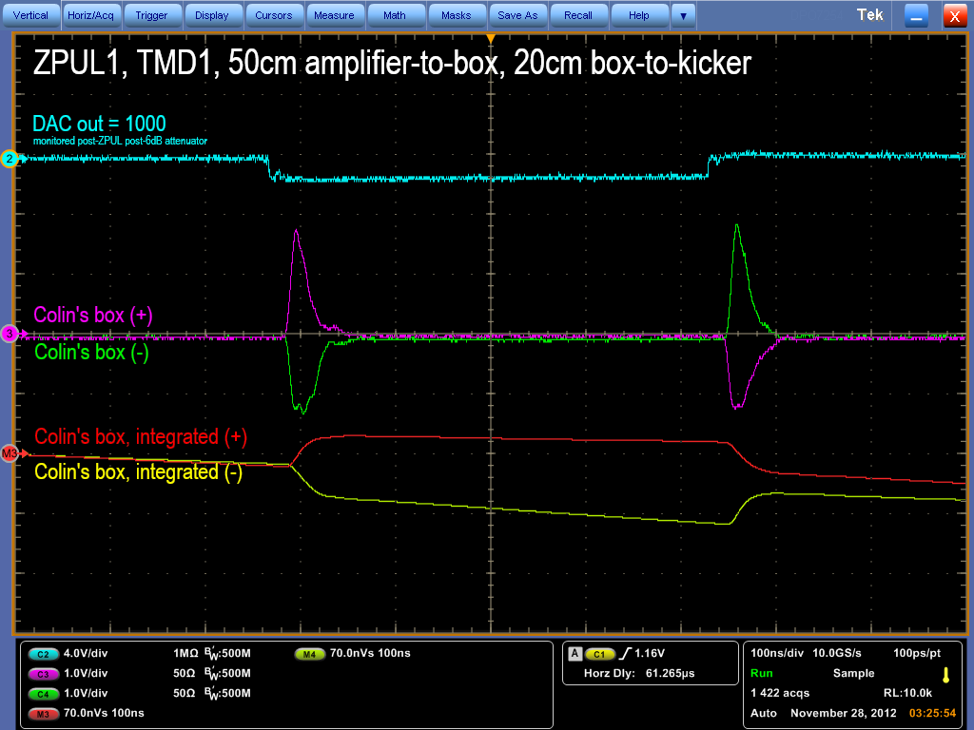
ZPUL3 power supply
N. Blaskovic

Slide 12
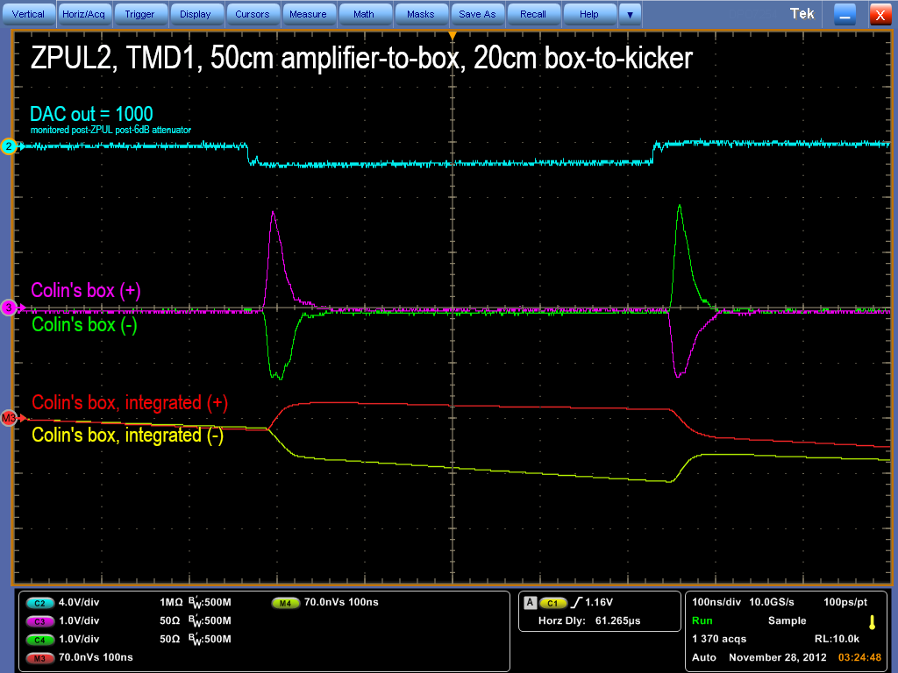
ZPUL3 power supply
It was found that the wires carrying the 24 V supply to ZPUL3 made an intermittent connection to the ZPUL.
Re-soldering the wires to the ZPUL led to a stable connection.
N. Blaskovic

Slide 13
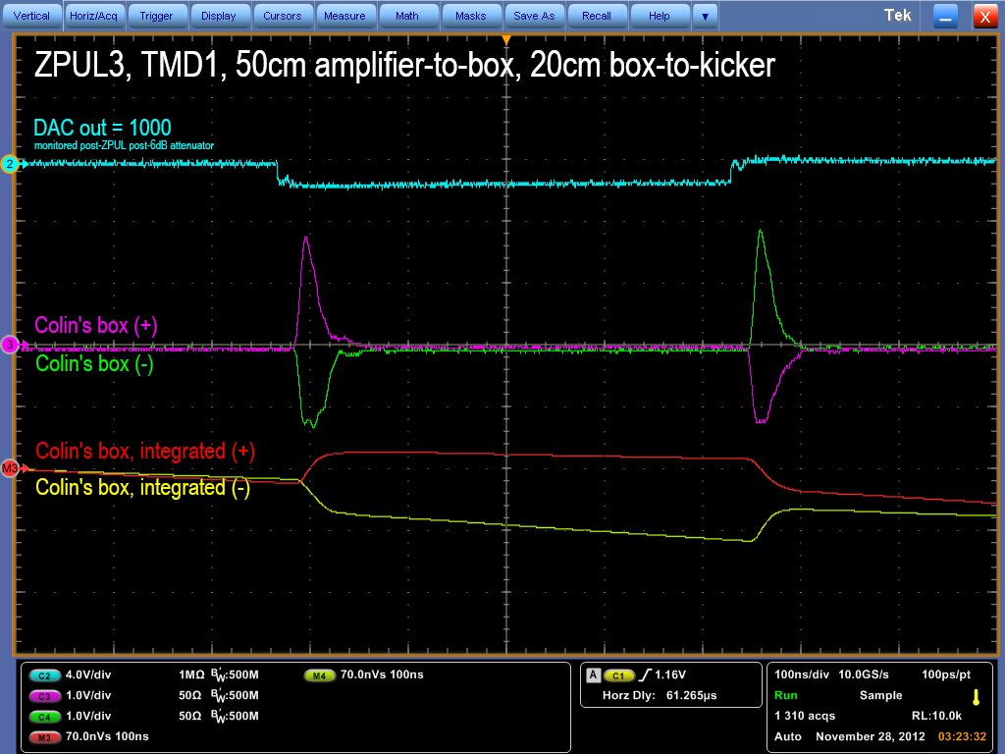
ZPUL3 power supply
It was found that the wires carrying the 24 V supply to ZPUL3 made an intermittent connection to the ZPUL.
Re-soldering the wires to the ZPUL led to a stable connection.
N. Blaskovic

Slide 14
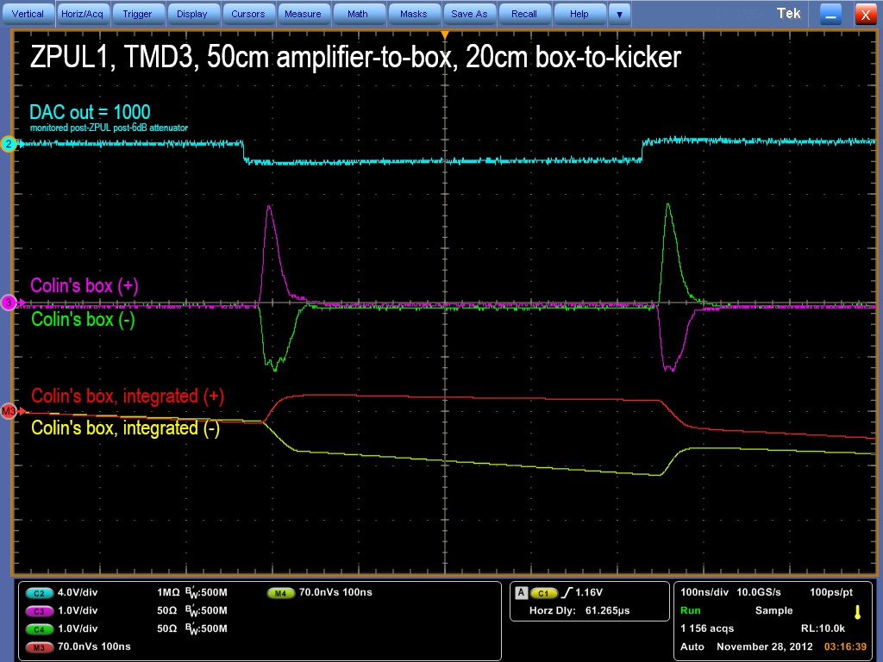
ZPUL3 power supply
It was found that the wires carrying the 24 V supply to ZPUL3 made an intermittent connection to the ZPUL.
Re-soldering the wires to the ZPUL led to a stable connection.
N. Blaskovic

Slide 15
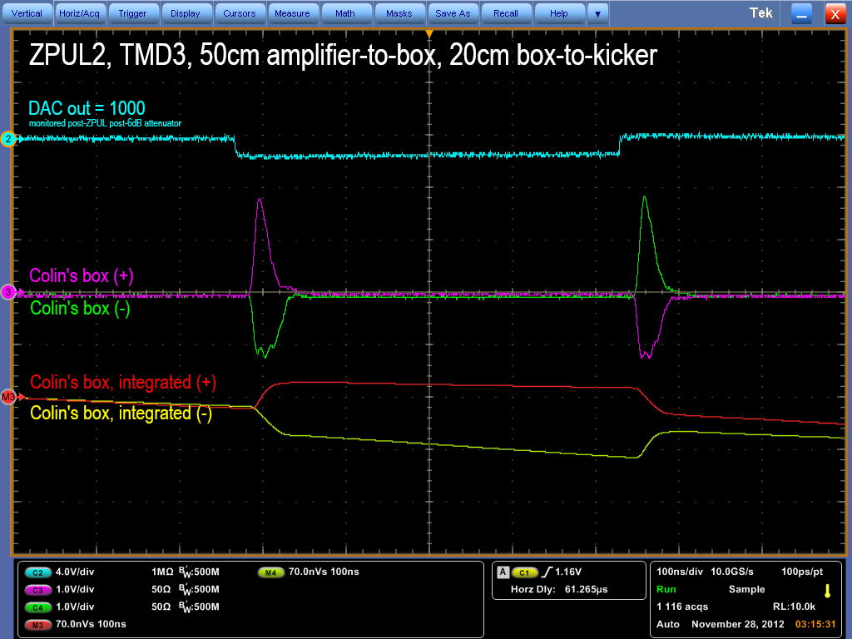
ZPUL3 power supply
It was found that the wires carrying the 24 V supply to ZPUL3 made an intermittent connection to the ZPUL.
Re-soldering the wires to the ZPUL led to a stable connection.
N. Blaskovic

Slide 16
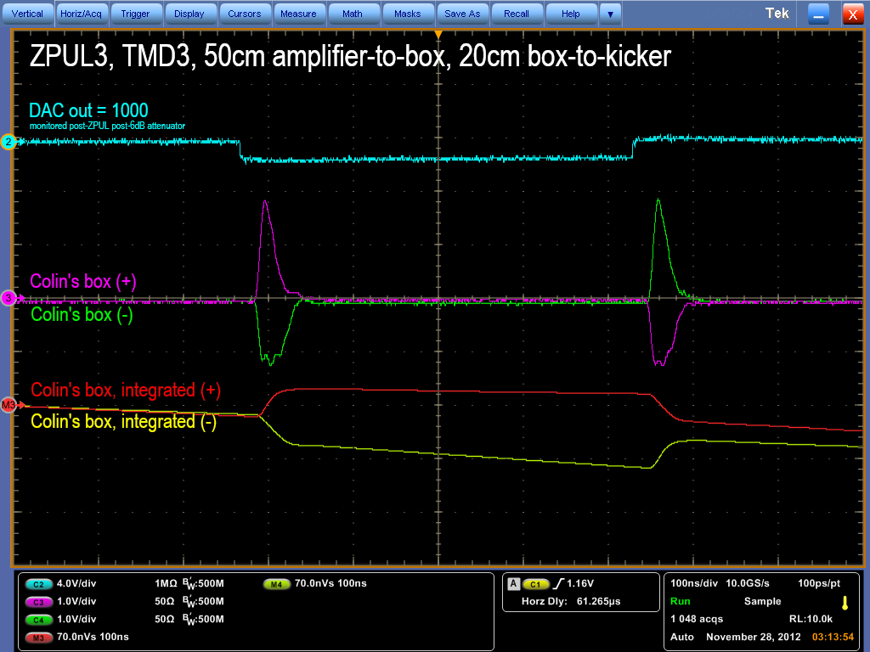
ZPUL3 power supply
It was found that the wires carrying the 24 V supply to ZPUL3 made an intermittent connection to the ZPUL.
Re-soldering the wires to the ZPUL led to a stable connection.
N. Blaskovic

Slide 17
Varying DAC out
Use ZPUL1, TMD1 & 20cm box-to-kicker.
Each slide has a different DAC out.
Each slide contains four scope screens:
95 cm
amplifier-to-box
positive DAC
50 cm
amplifier-to-box
positive DAC
95 cm
amplifier-to-box
negative DAC
50 cm
amplifier-to-box
negative DAC
N. Blaskovic

Slide 18
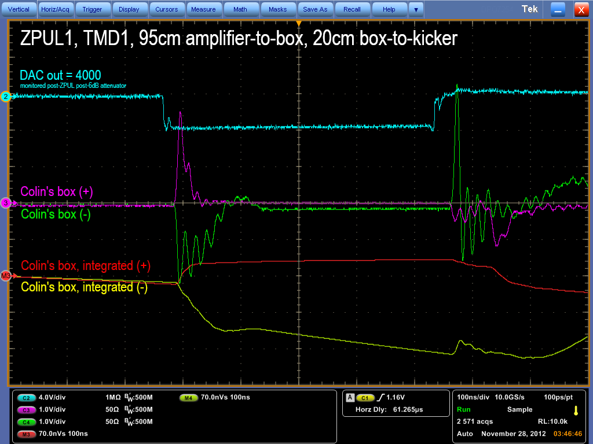
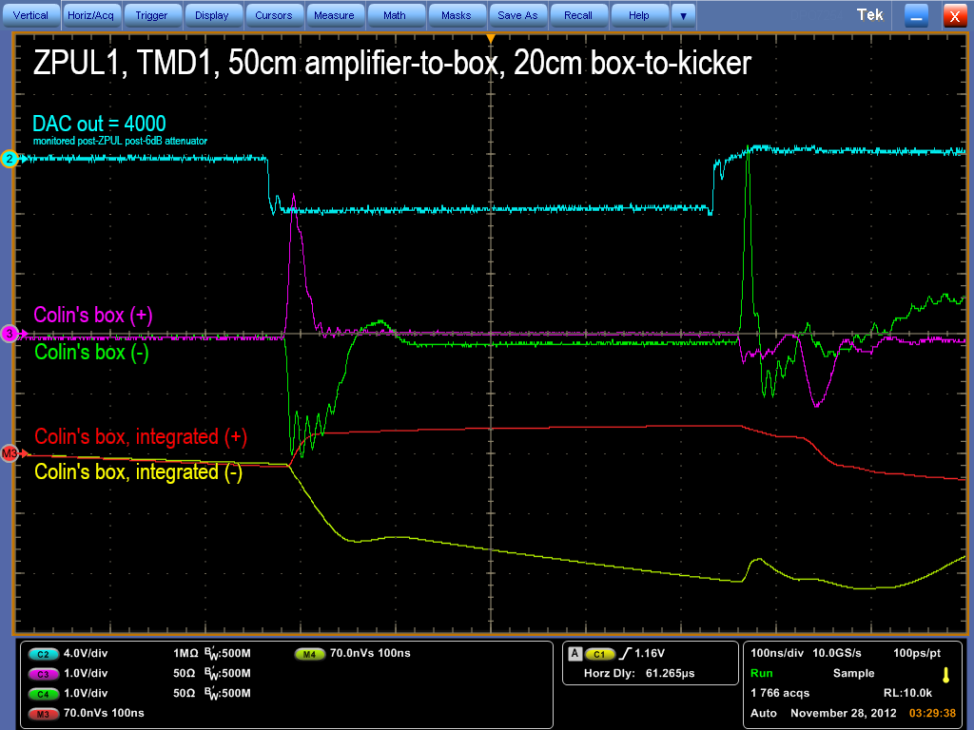
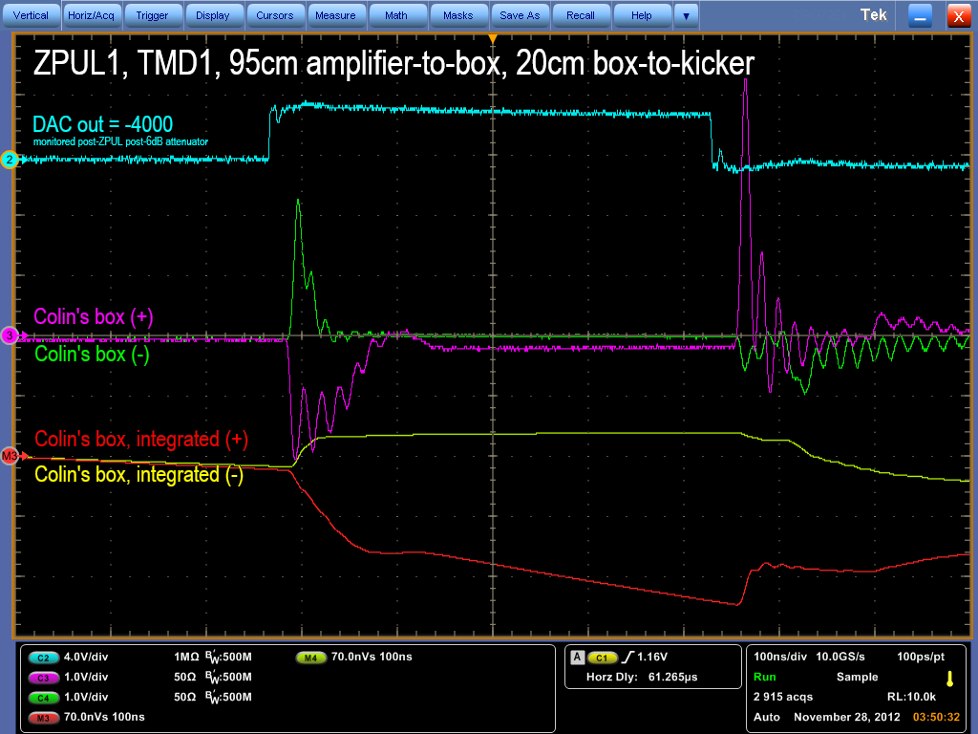
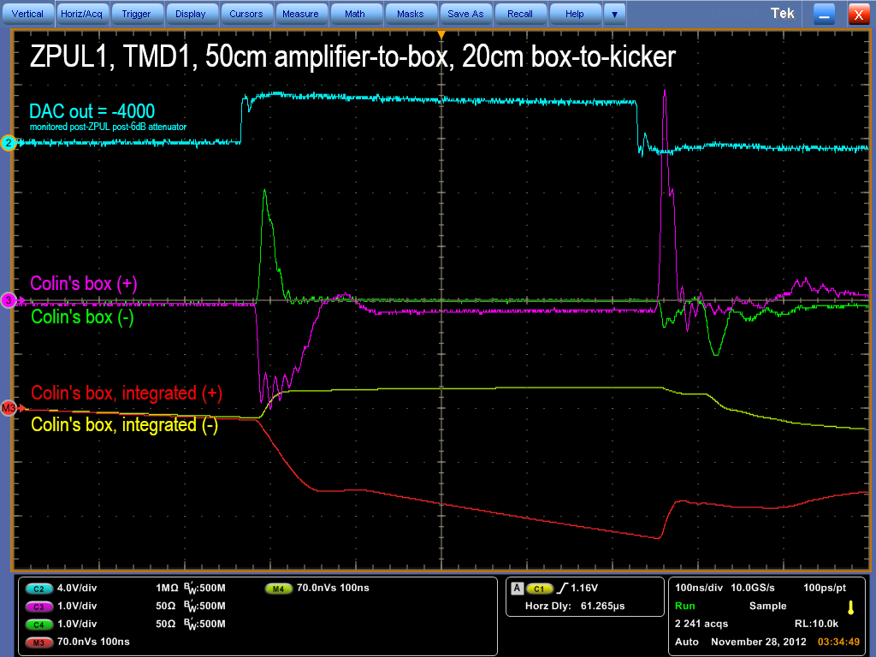
N. Blaskovic

Slide 19
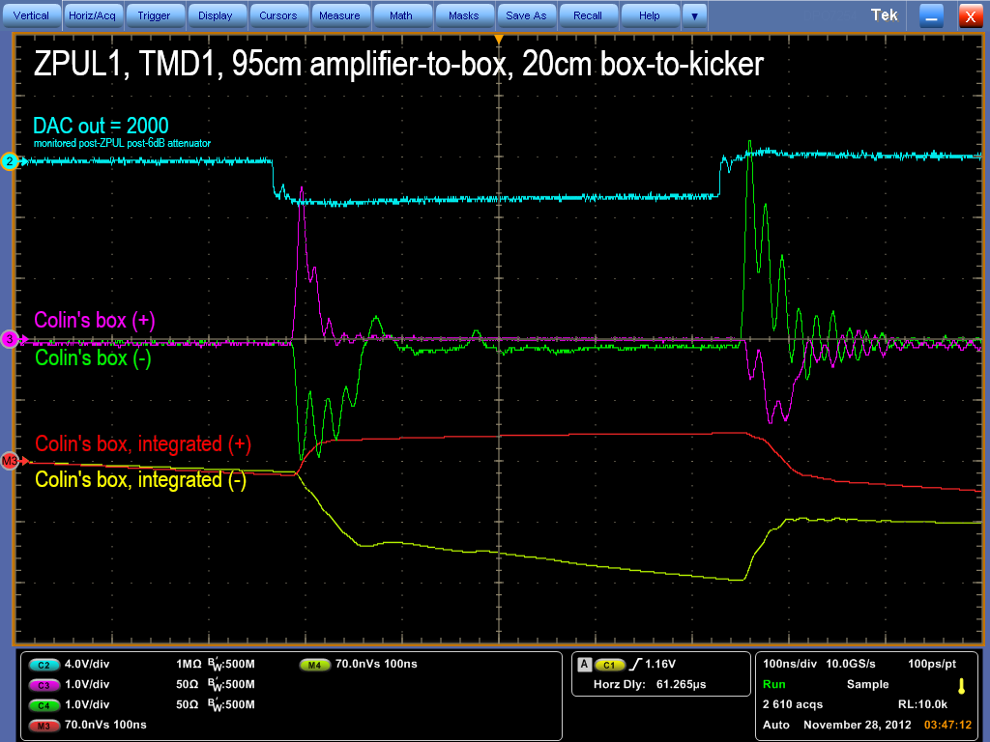
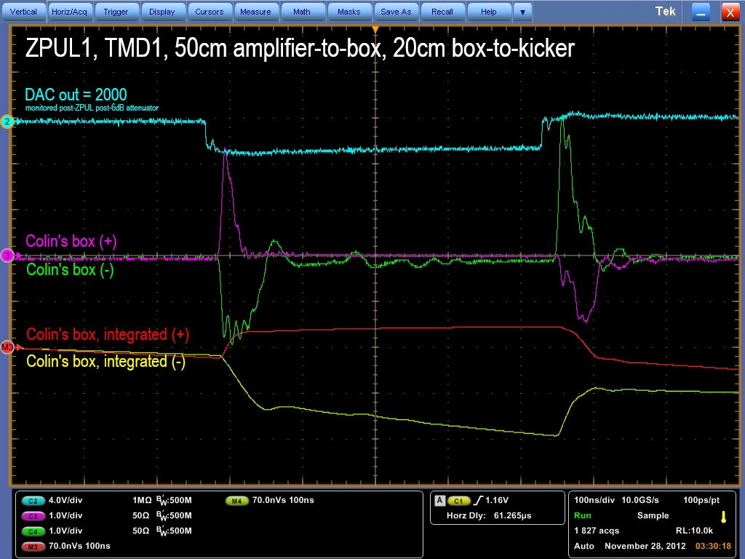
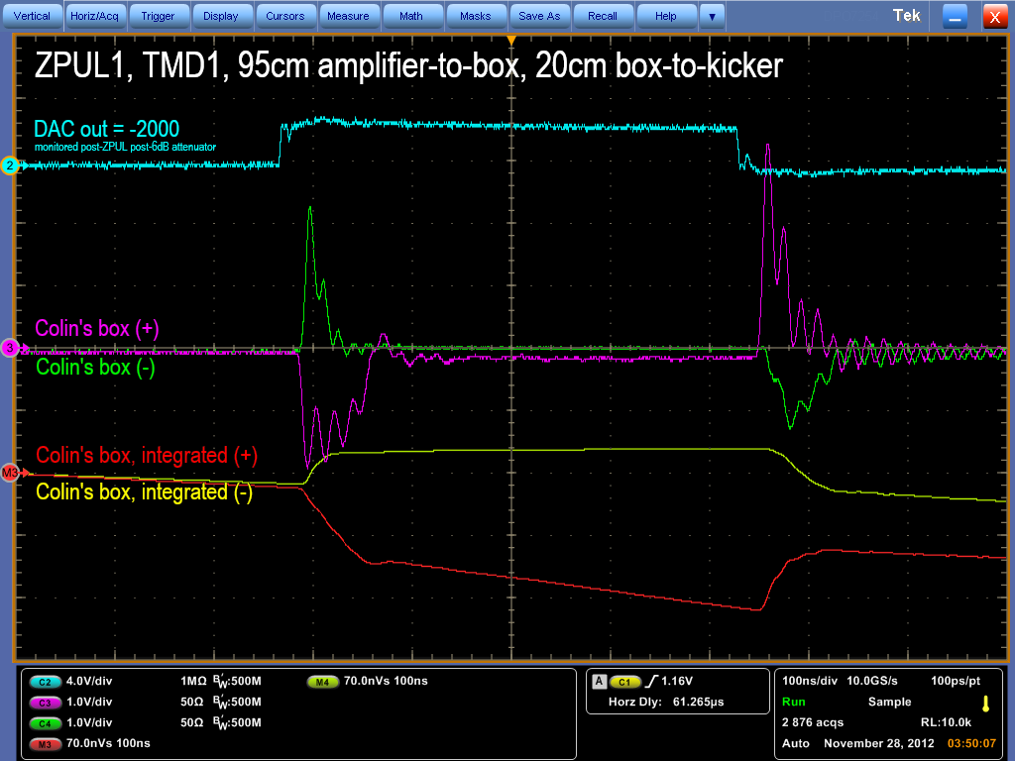
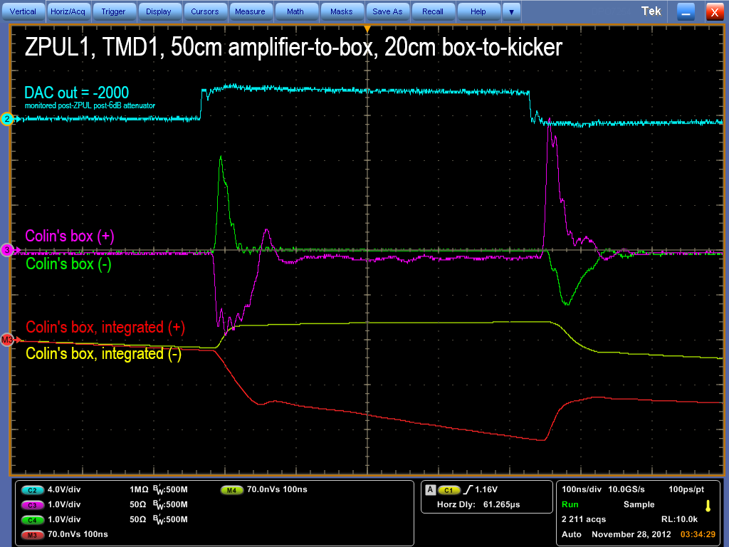
N. Blaskovic

Slide 20
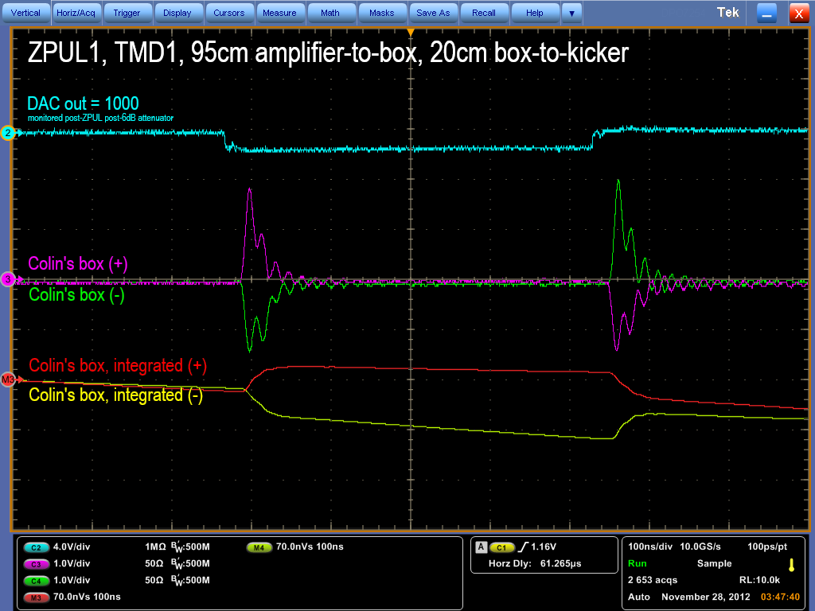

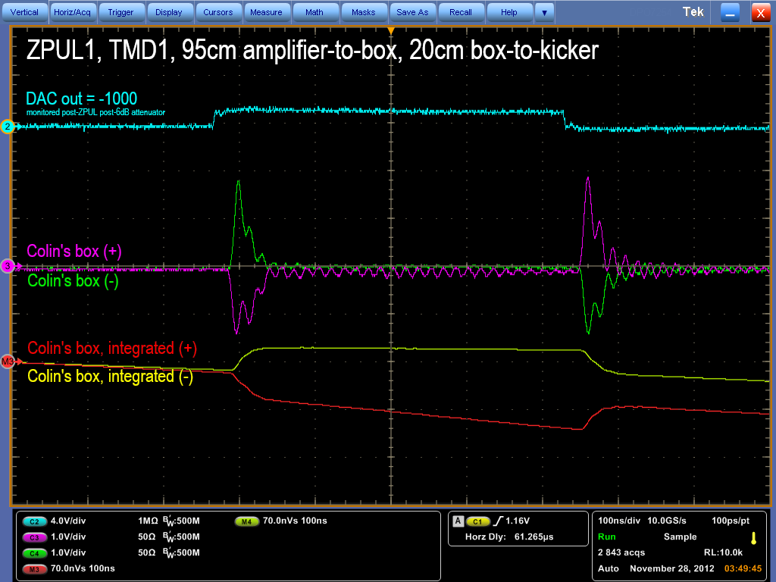
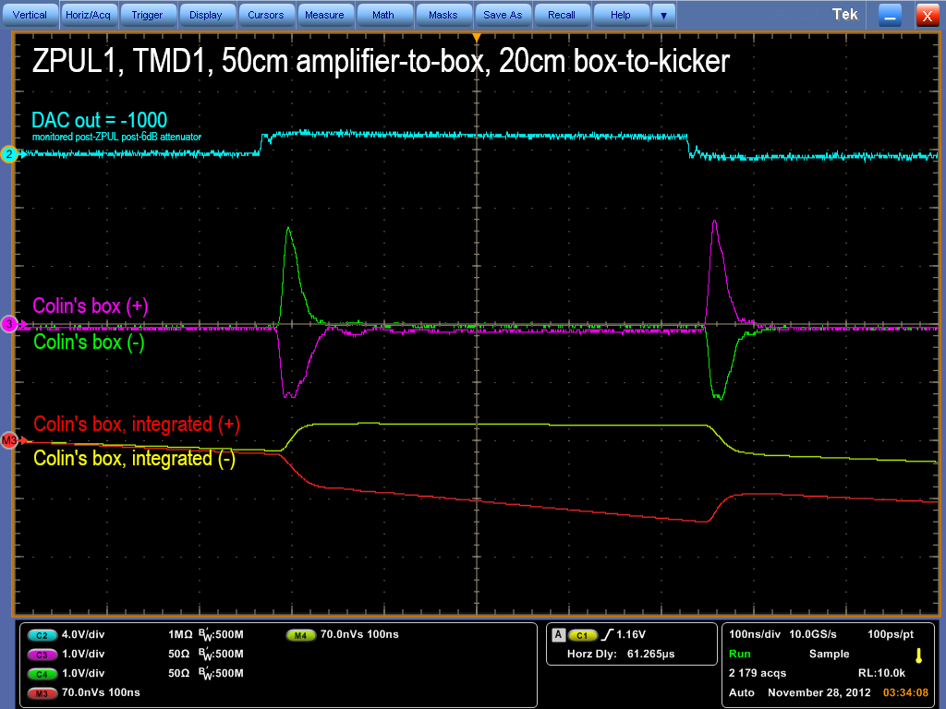
N. Blaskovic

Slide 21
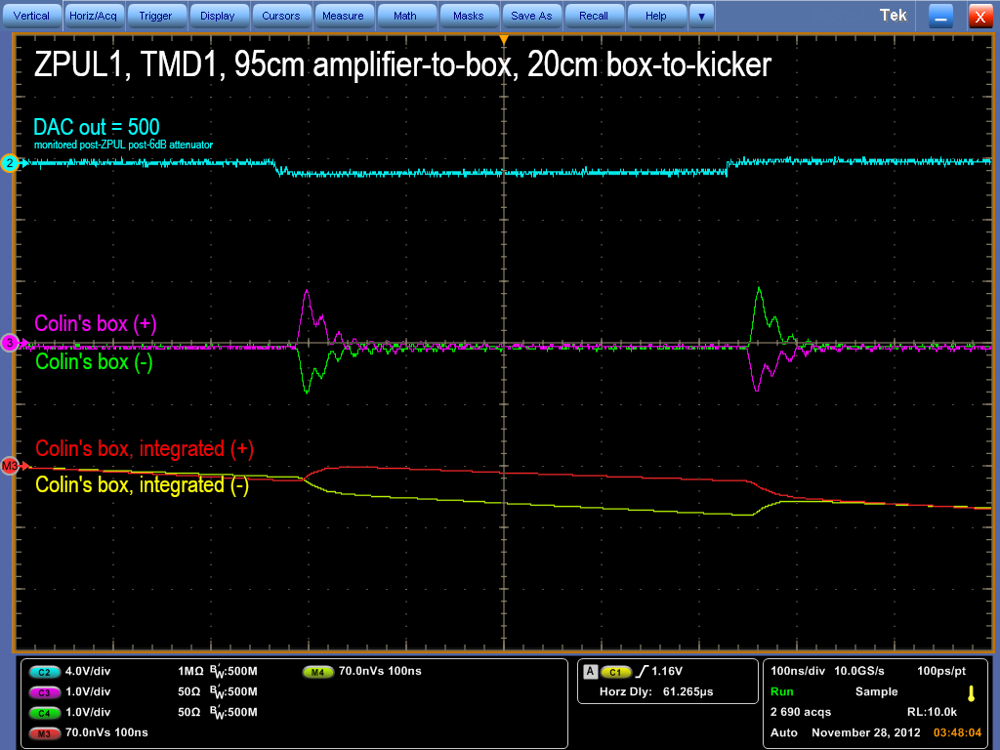
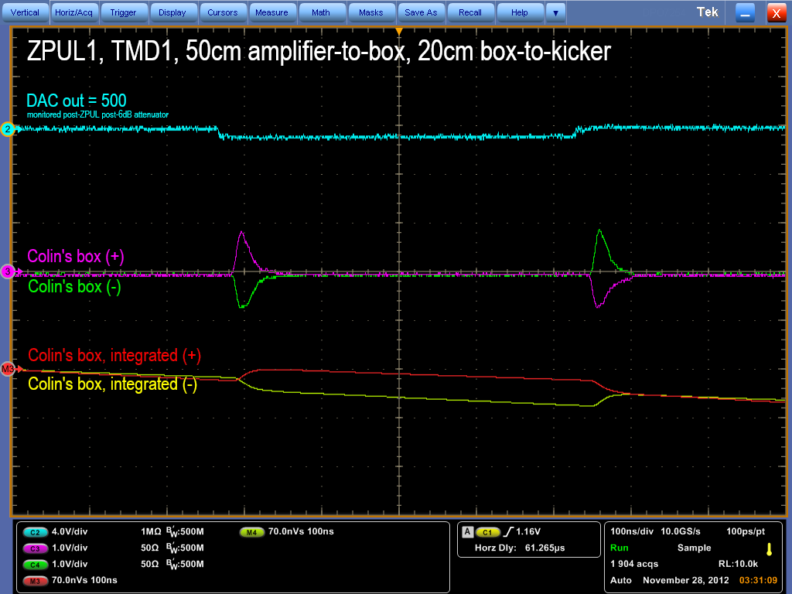

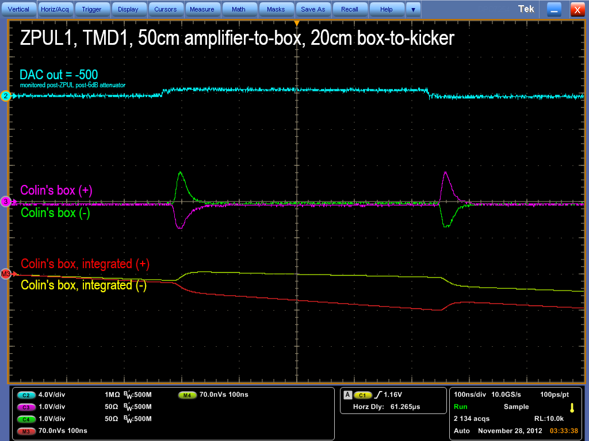
N. Blaskovic

Slide 22
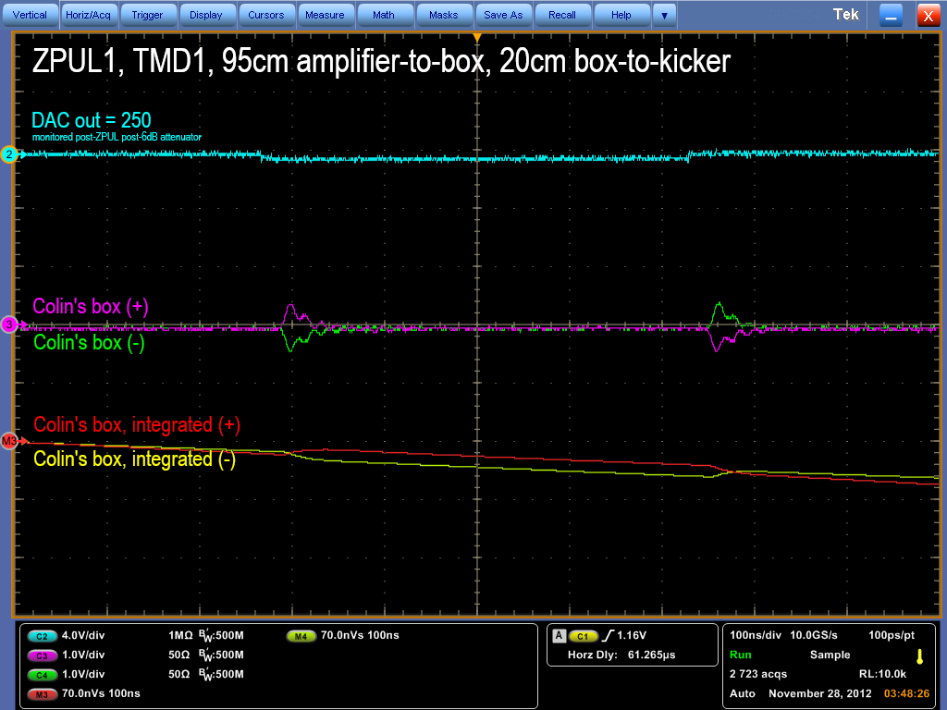
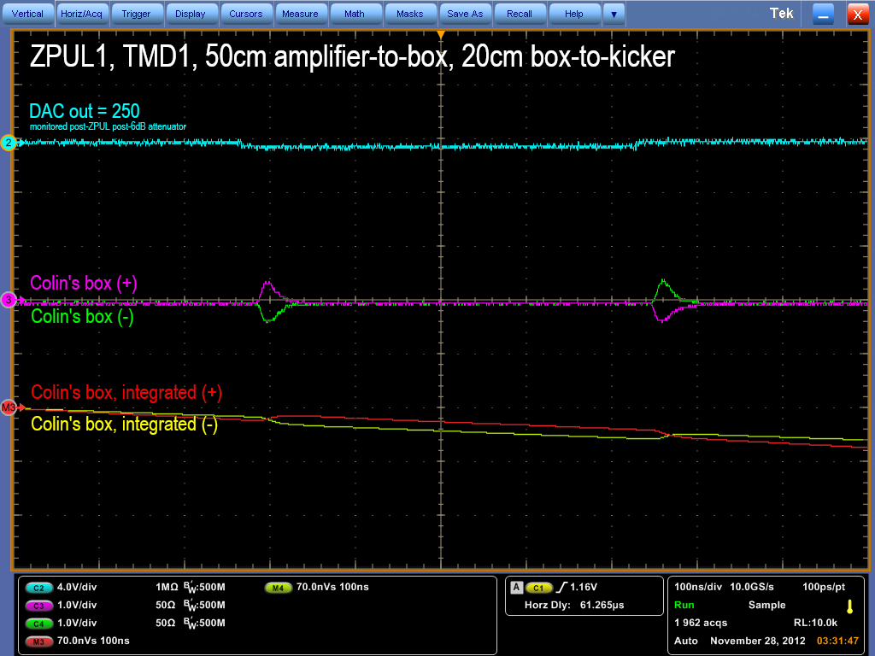
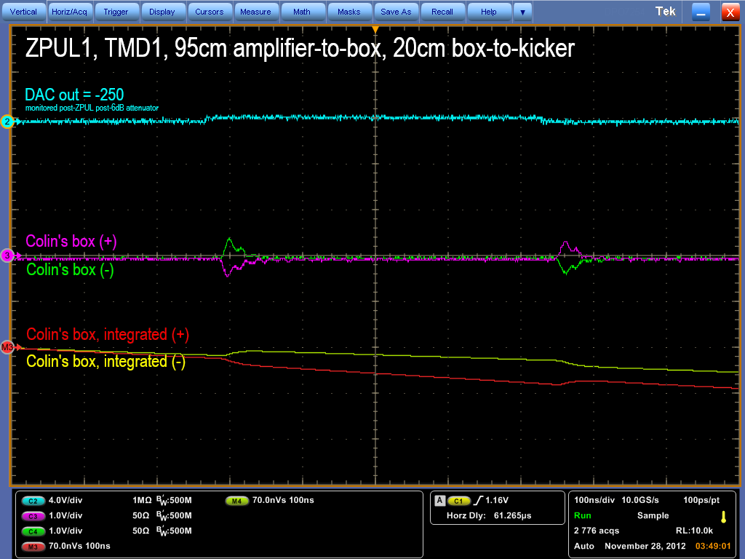
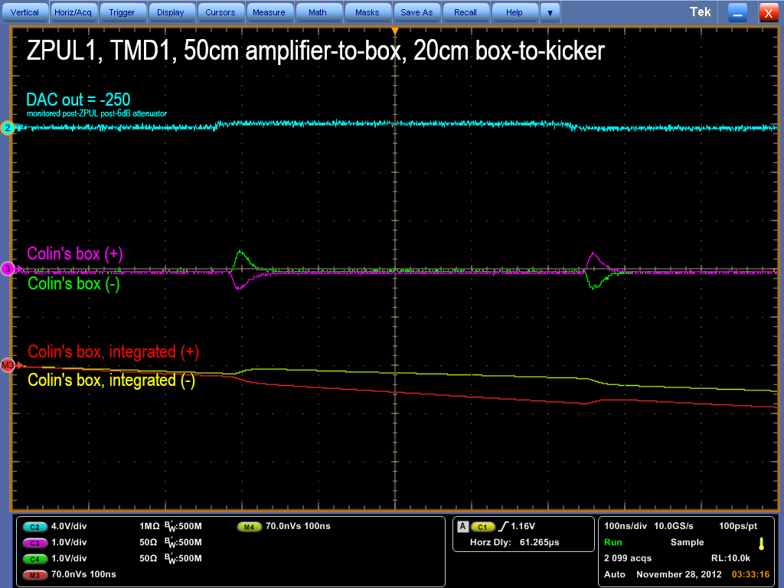
N. Blaskovic

Slide 23
Observations
~60 MHz oscillations are reduced on changing the amplifier-to-box cable length from 95 cm to 50 cm.
4000 DAC counts corresponds to ~4 V at TMD amplifier input. If input is to be kept below ~1.5 V to avoid saturation, the DAC out must be kept below ~1500 counts.
N. Blaskovic

Slide 24
Conclusions
Intermittent performance of ZPUL3 solved by re-soldering 24 V power supply wires.
ZPULs 1, 2 & 3 and TMD amplifiers 1 & 3 seem to perform to the same standard*.
Size of ~60 MHz oscillations depends on TMD amplifier-to-kicker cable length.
TMD2 (used for K1) has not been tested.
N. Blaskovic

Slide 25
Spare
ATF upstream kicker scan plots
from October 2012
N. Blaskovic

Slide 26
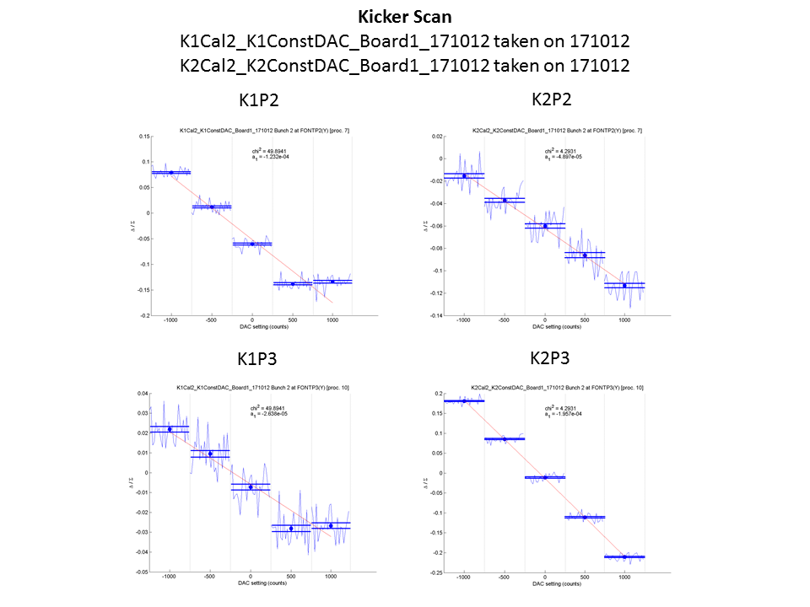
ZPUL3 power supply
N. Blaskovic

