Slide 1
R56 measurements at CTF3 Content
Measurement with all three R56 values
Pulse profile
Pulse average
Standard deviations
Klystron data
correlation of the klystron data with the beam phase after the chicane

Slide 2
Measurement of CTF3 phase
Two data sets – from 16/11 and from 20/11
R56 values of 0.0, 0.2 and 0.45
16/11
Each R56 value measured twice for about 10 min.
0.0 -> 0.2 -> 0.45 -> 0.2 -> 0.0 -> 0.45
Total measurement time span of several hours
20/11
Each R56 measured once for about 10 minutes
0.2 -> 0.0 -> 0.45
Total measurement time span about four hours

Slide 3


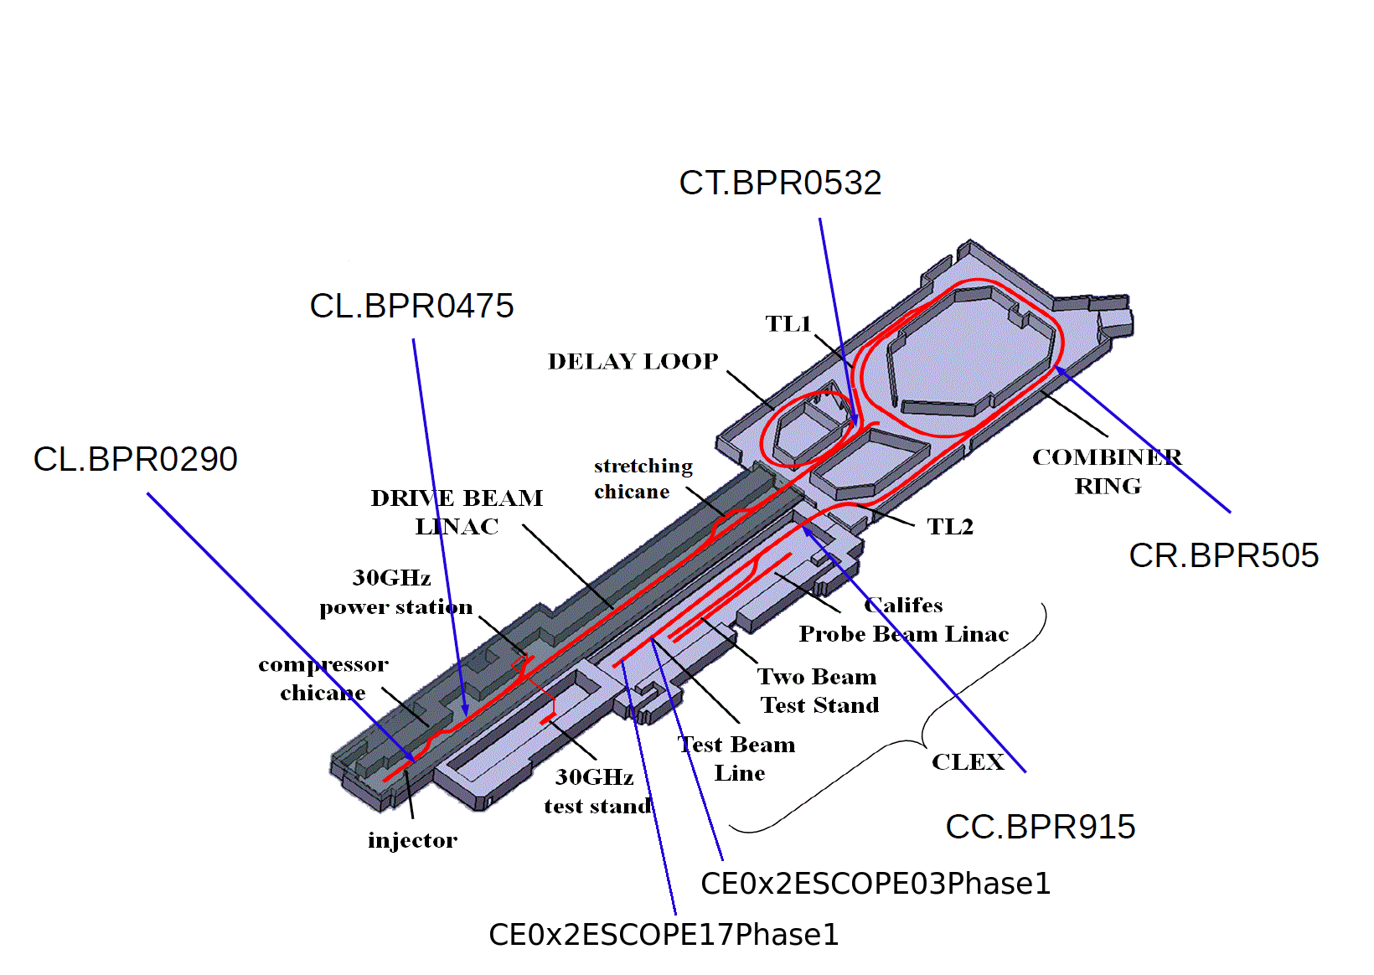
Active phase monitors
02/02/12
3

Slide 4
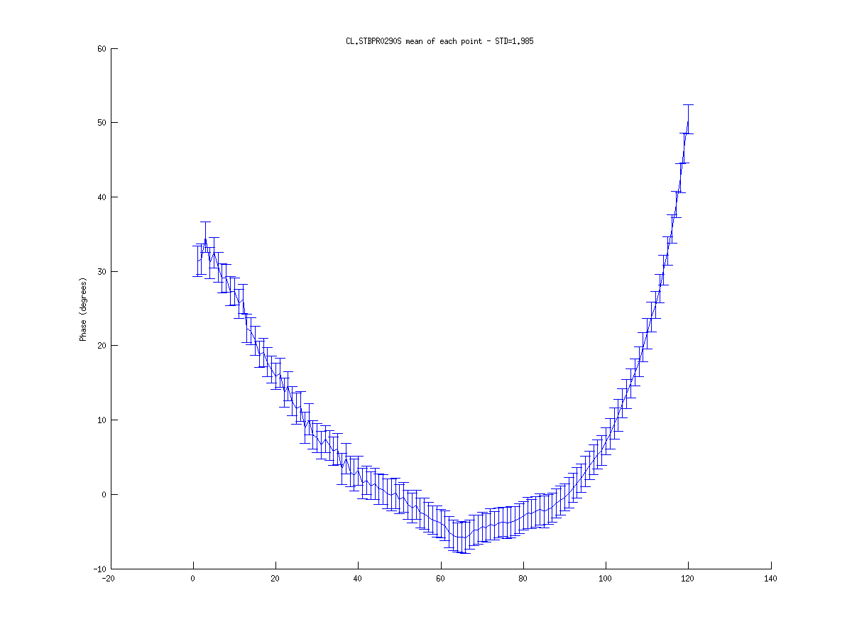

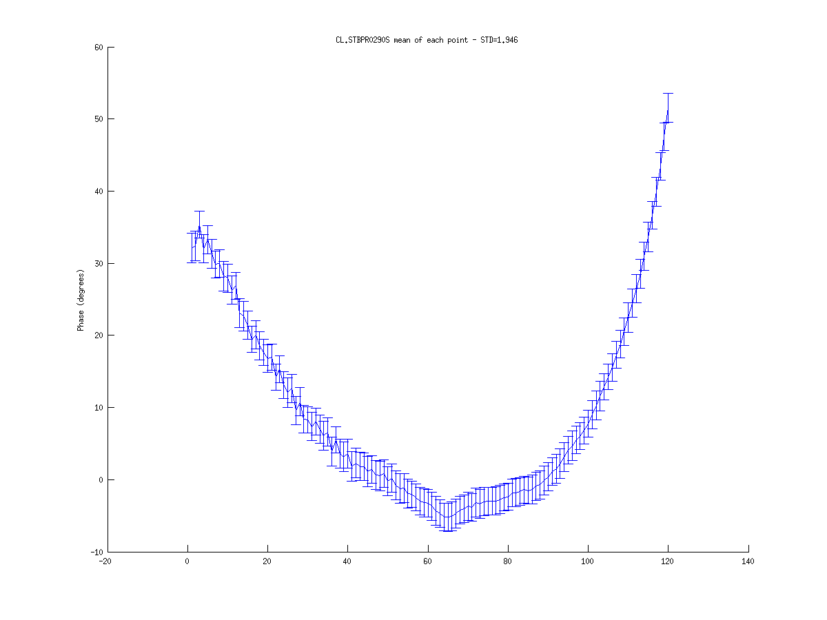
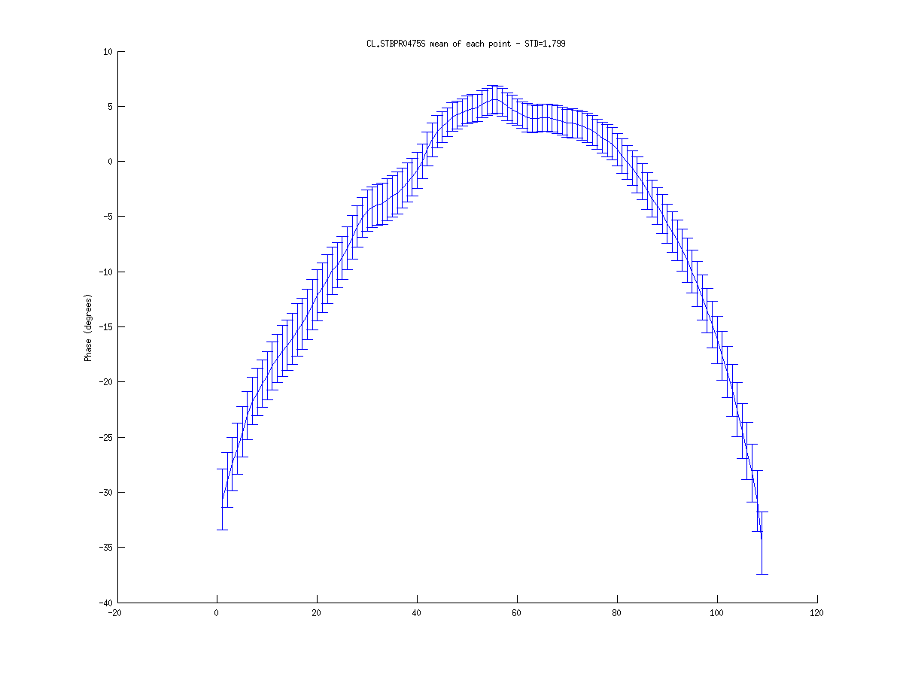
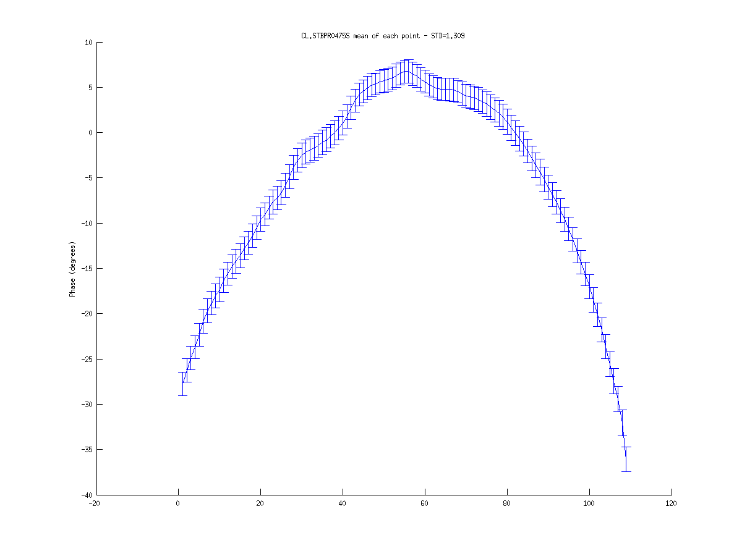
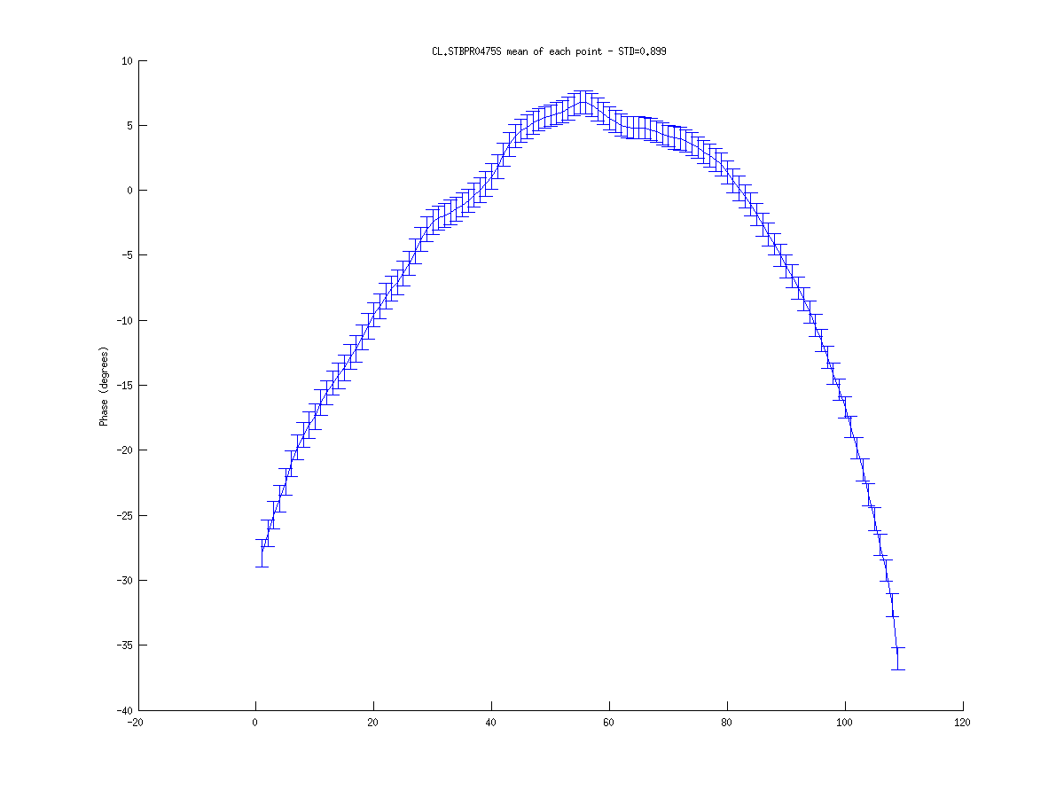
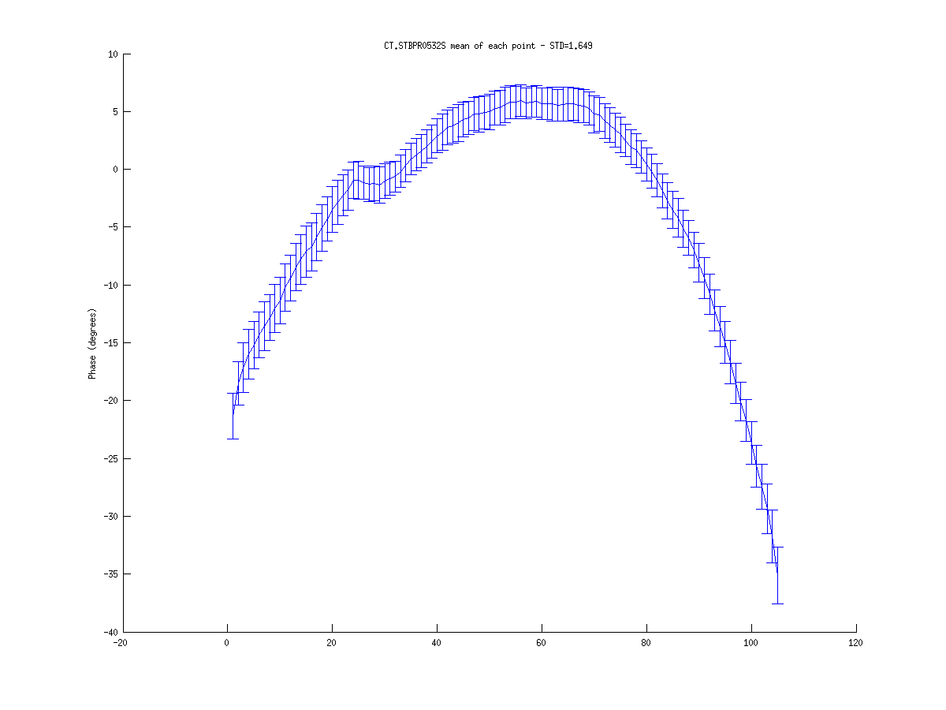
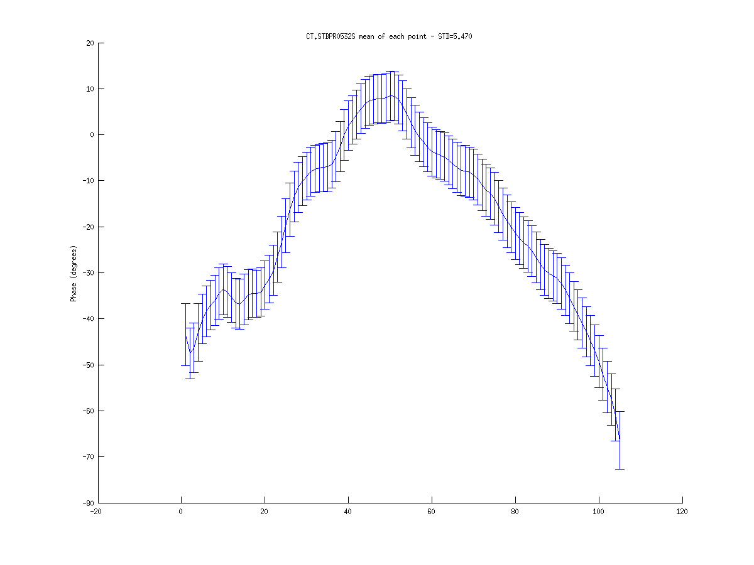
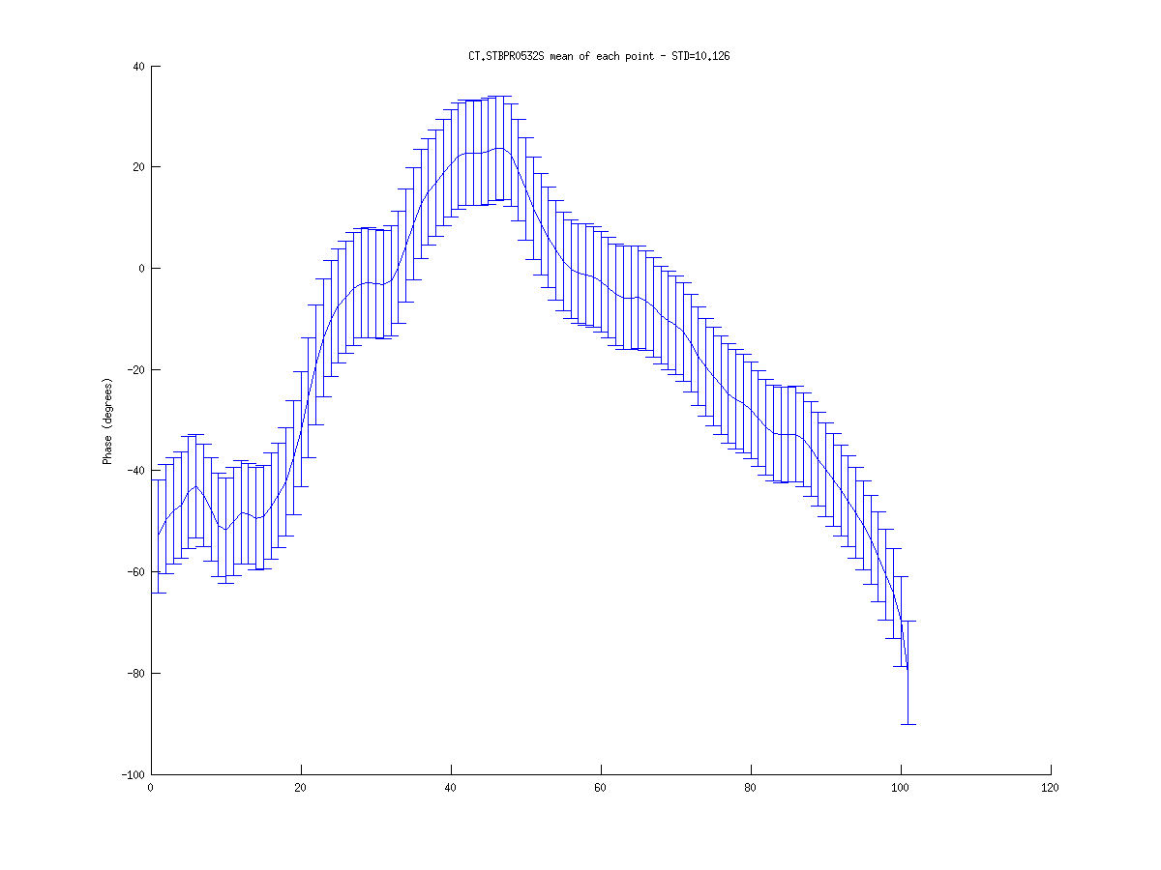
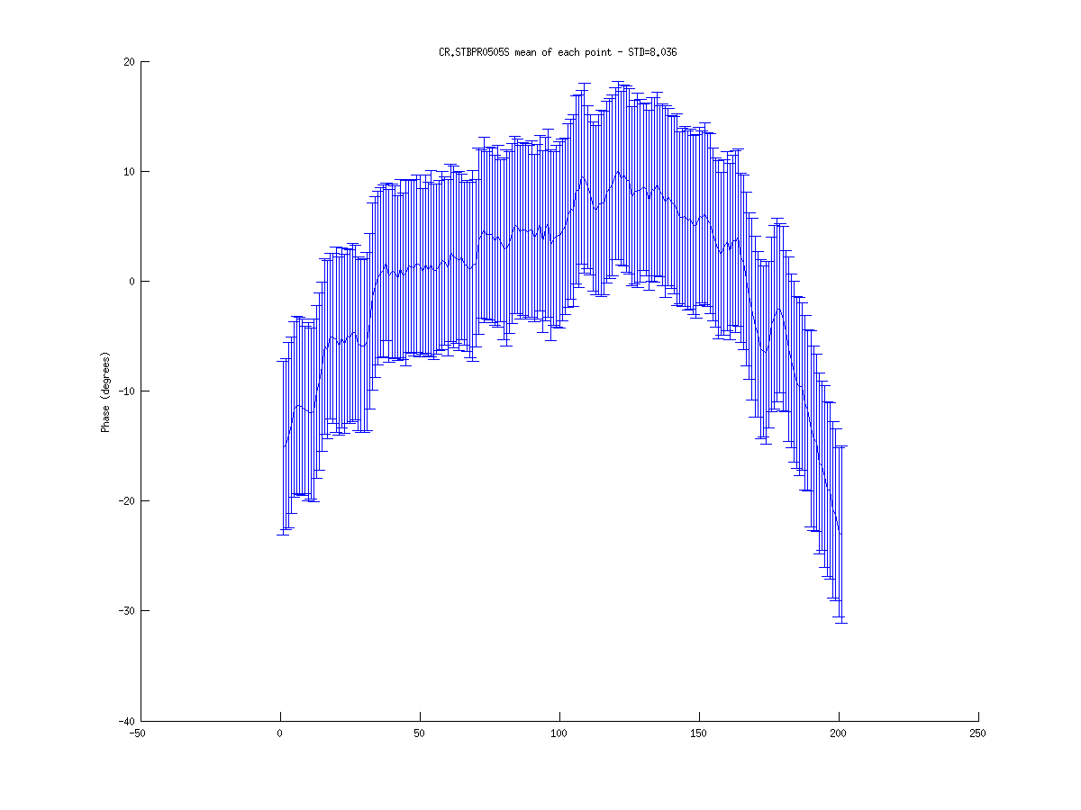
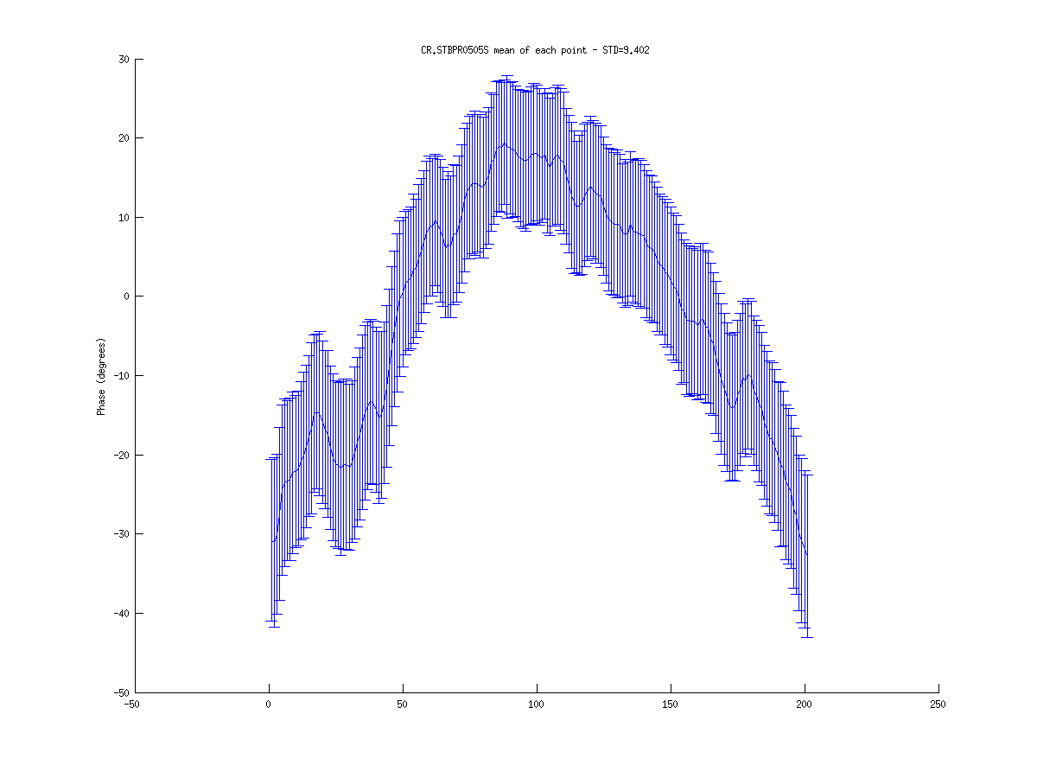
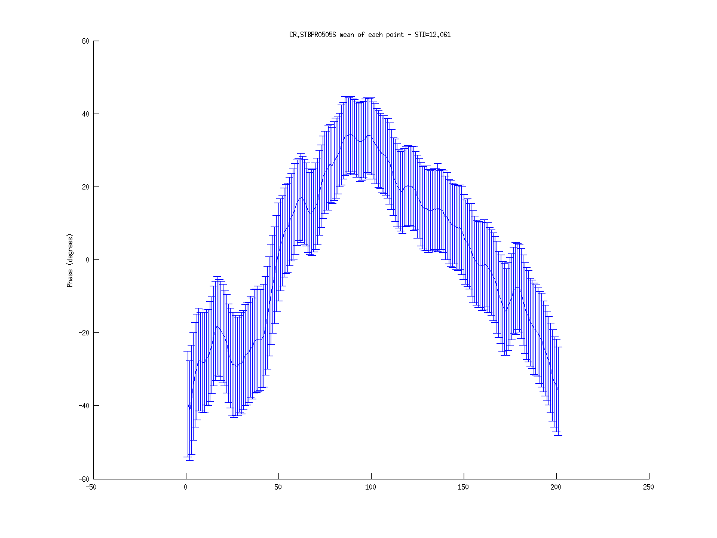
16/11 train profile
R56 = 0.0
R56 = 0.2
R56 = 0.45
Monitor
CL 290
STD = 1.99
STD = 2.01
STD = 1.95
Monitor
CL 475
STD = 1.80
STD = 1.31
STD = 0.90
Monitor
CT 532
STD = 1.65
STD = 5.47
STD = 10.13
Monitor
CR 505
STD = 8.04
STD = 9.40
STD = 12.06

Slide 5
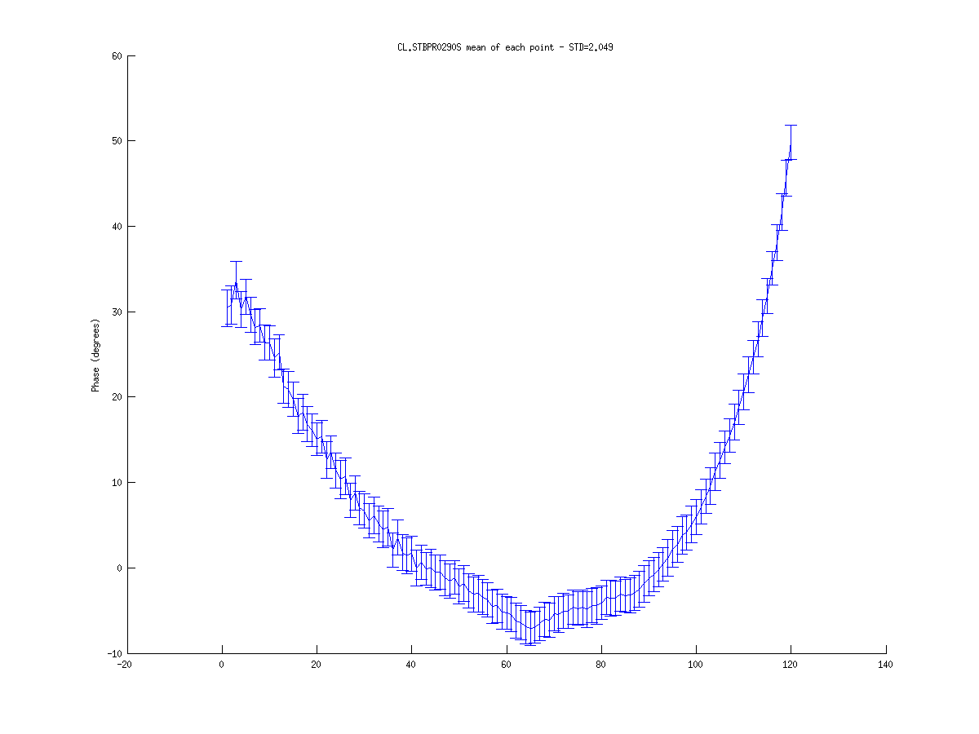


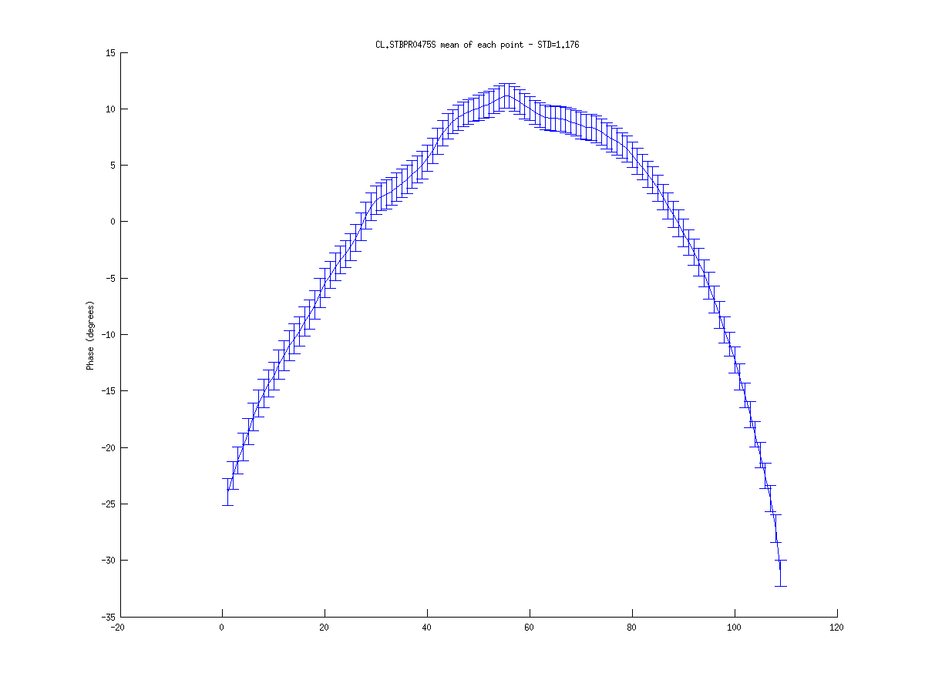
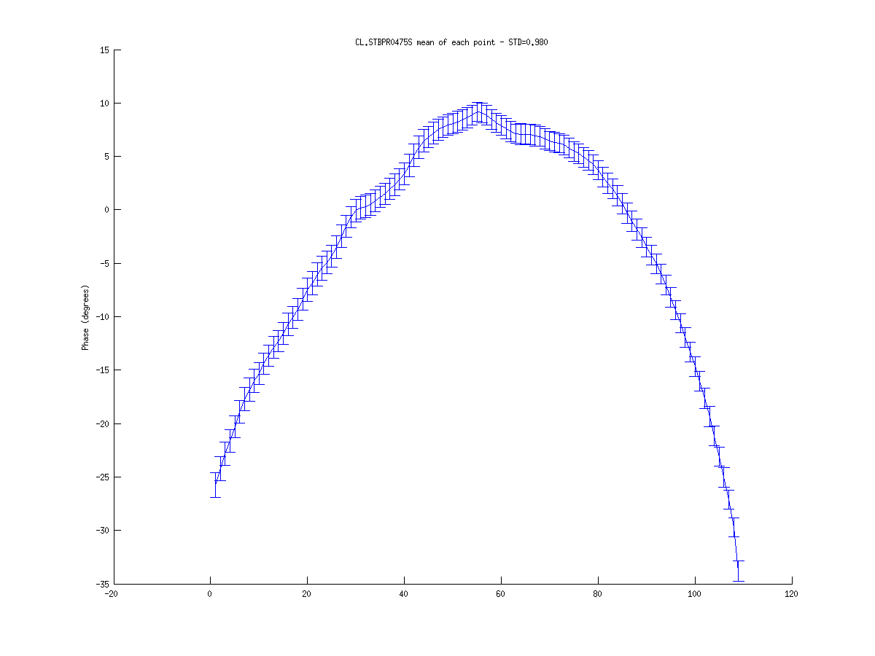
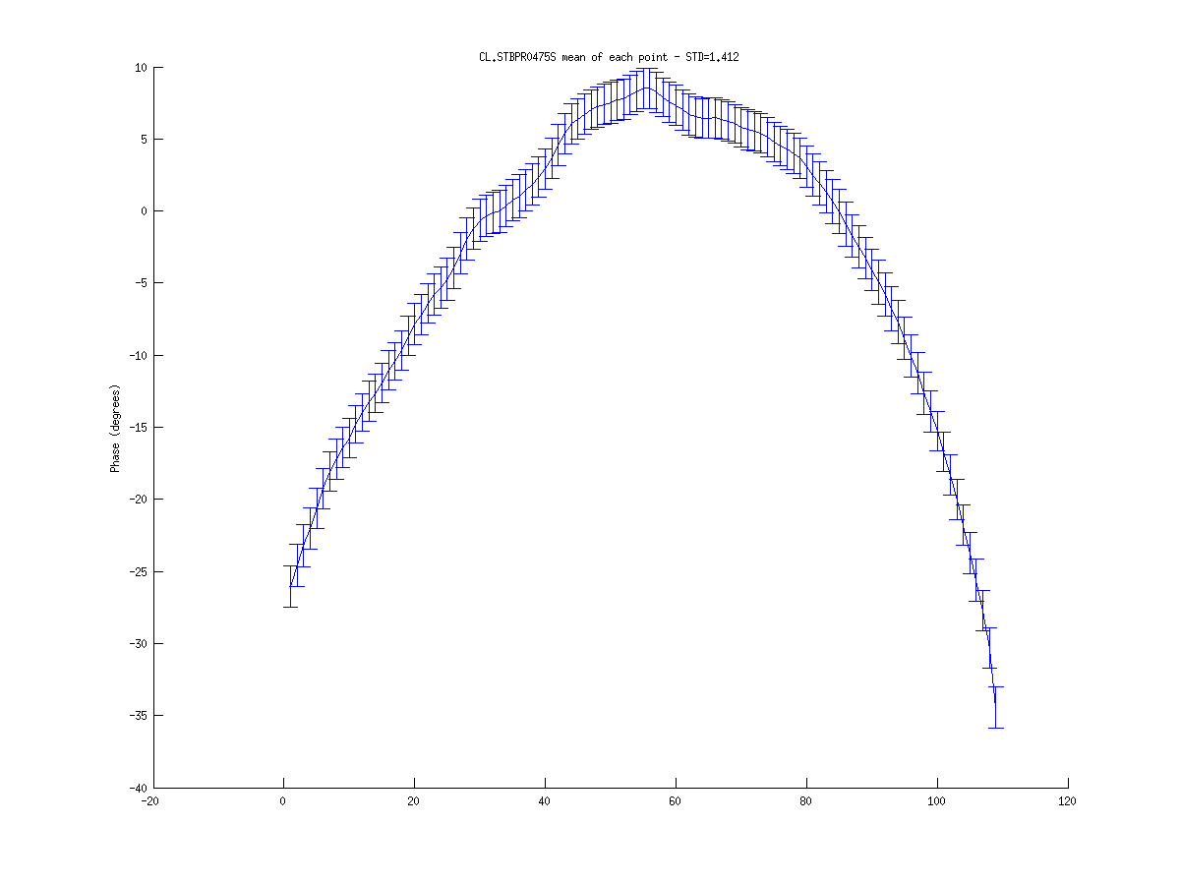
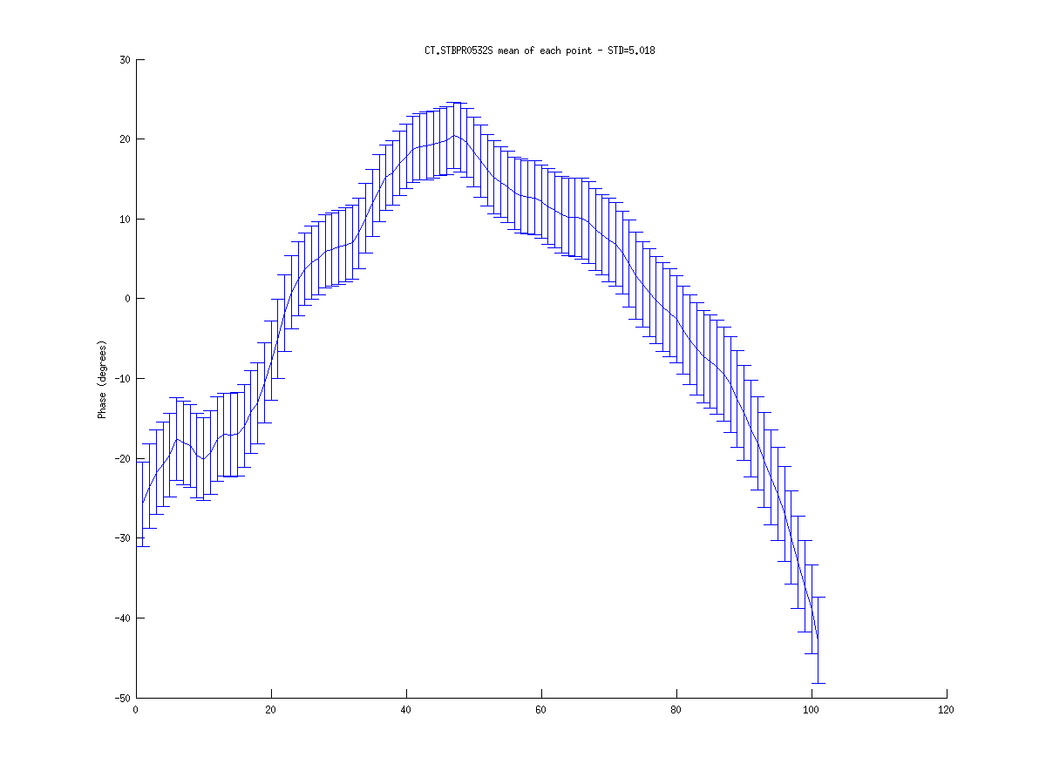
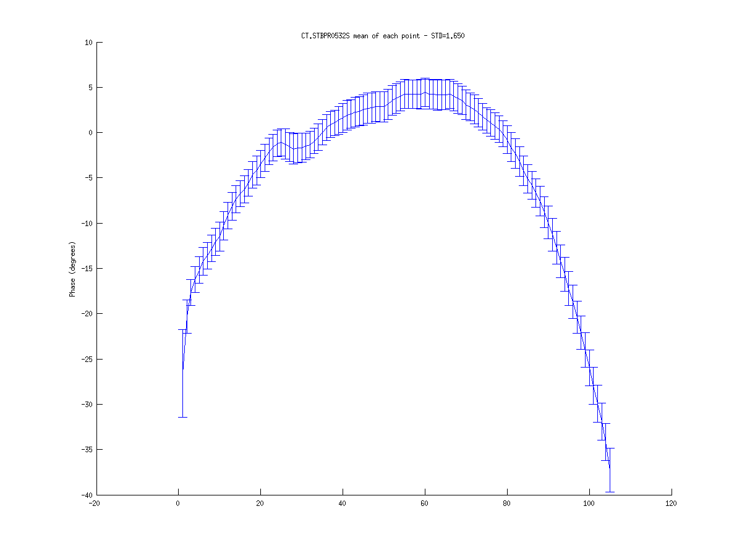
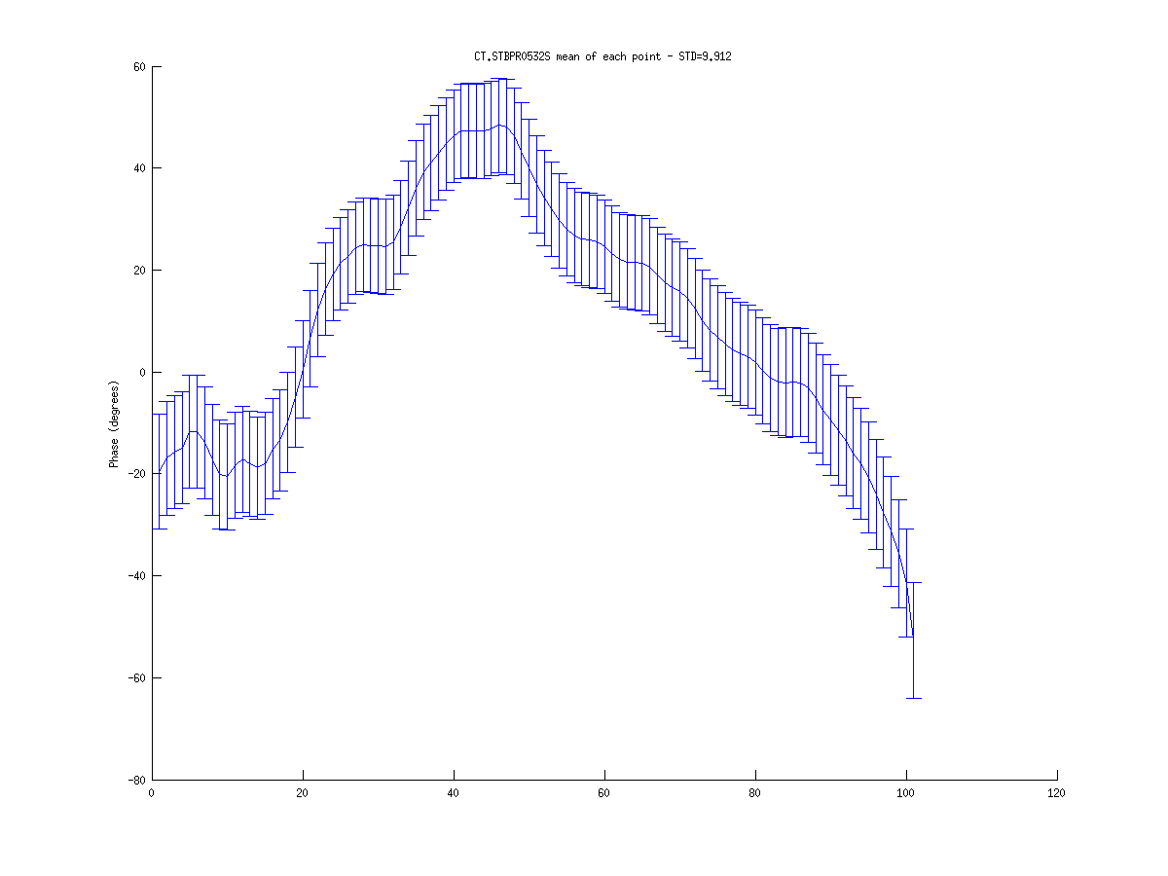
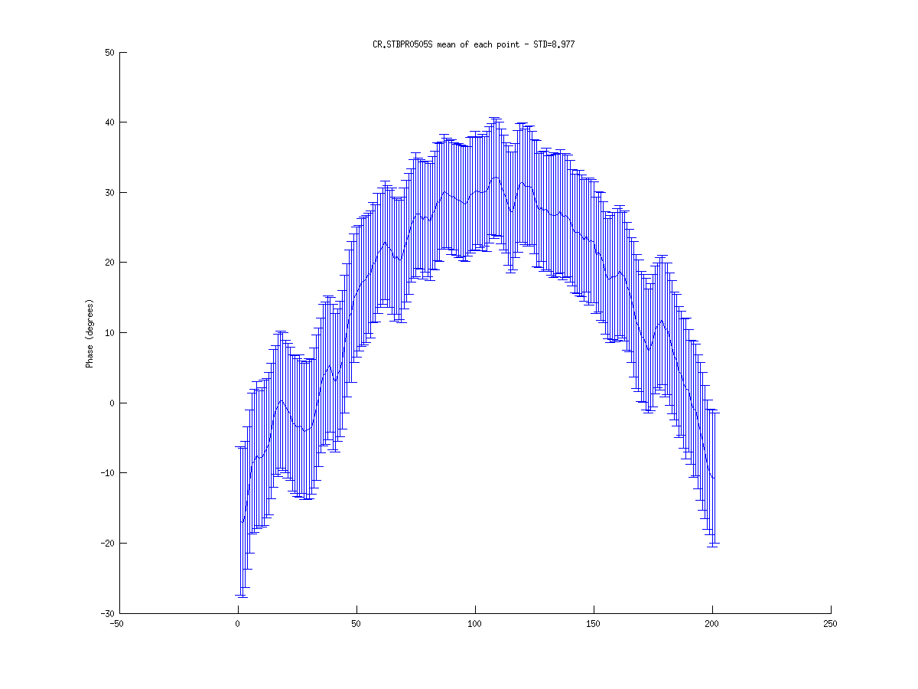
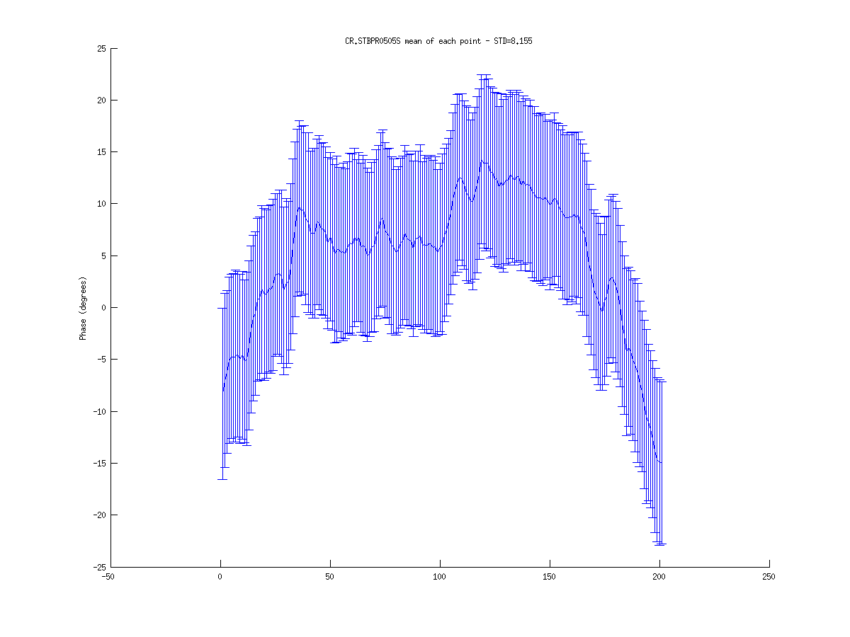
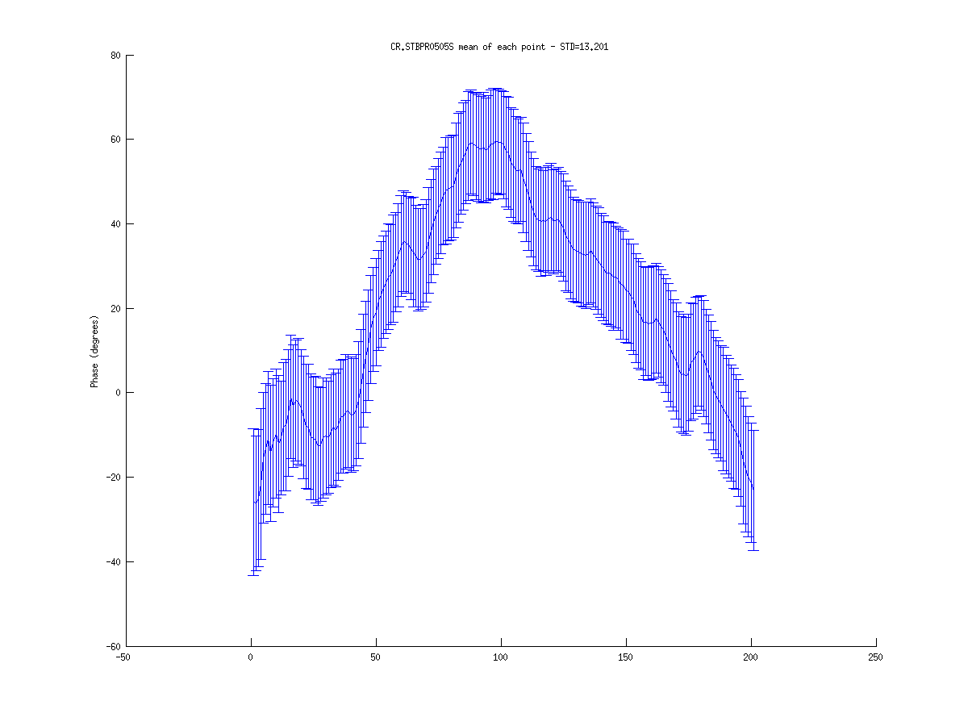
16/11 train profile
R56 = 0.2
R56 = 0.0
R56 = 0.45
Monitor
CL 290
STD = 2.05
STD = 1.97
STD = 1.96
Monitor
CL 475
STD = 1.18
STD = 0.98
STD = 1.41
Monitor
CT 532
STD = 5.02
STD = 1.65
STD = 9.91
Monitor
CR 505
STD = 8.98
STD = 8.16
STD = 13.2

Slide 6
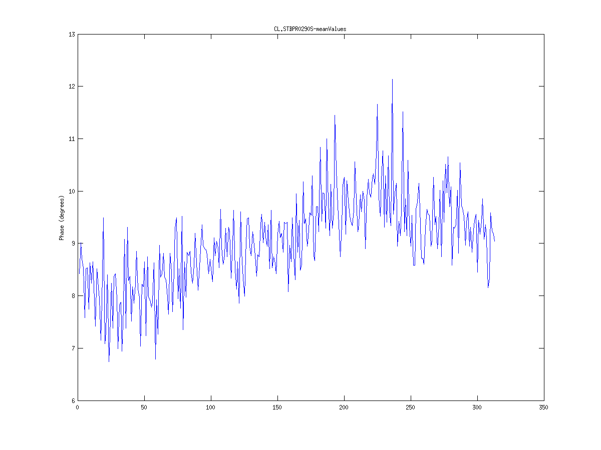
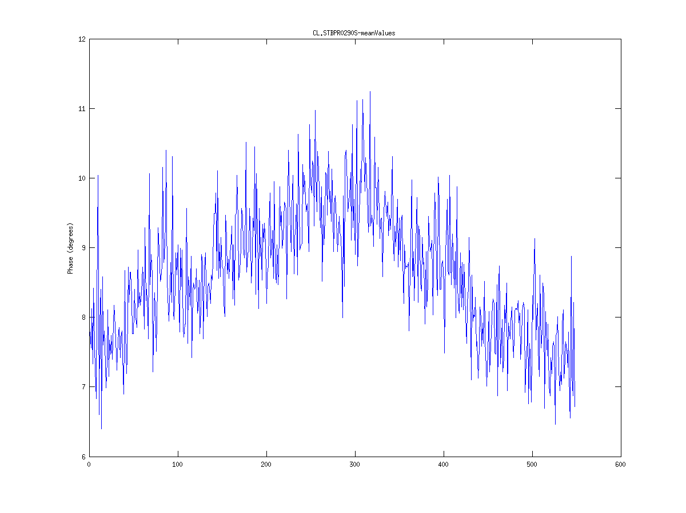
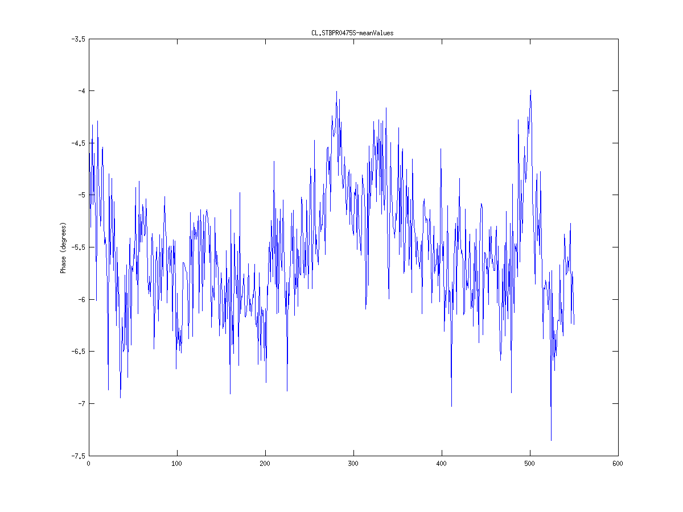
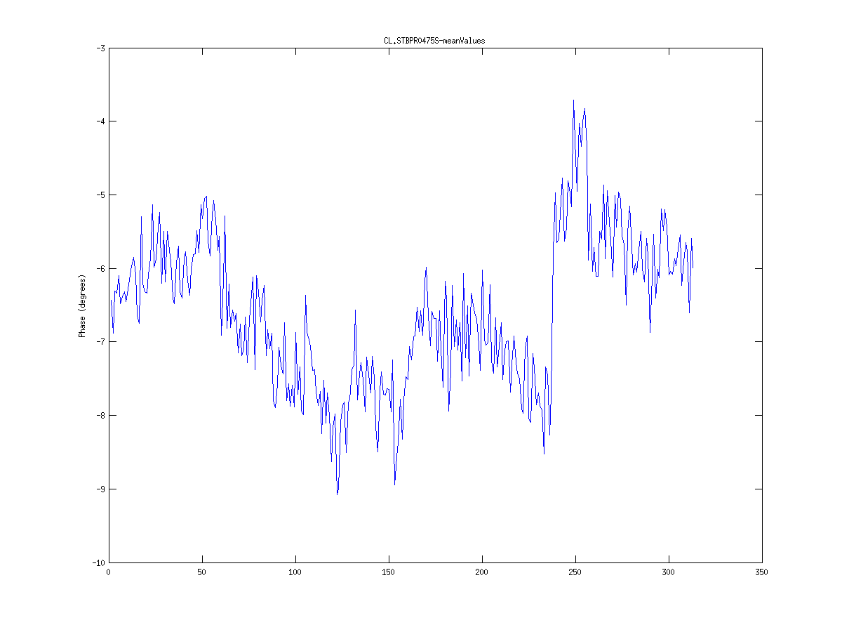
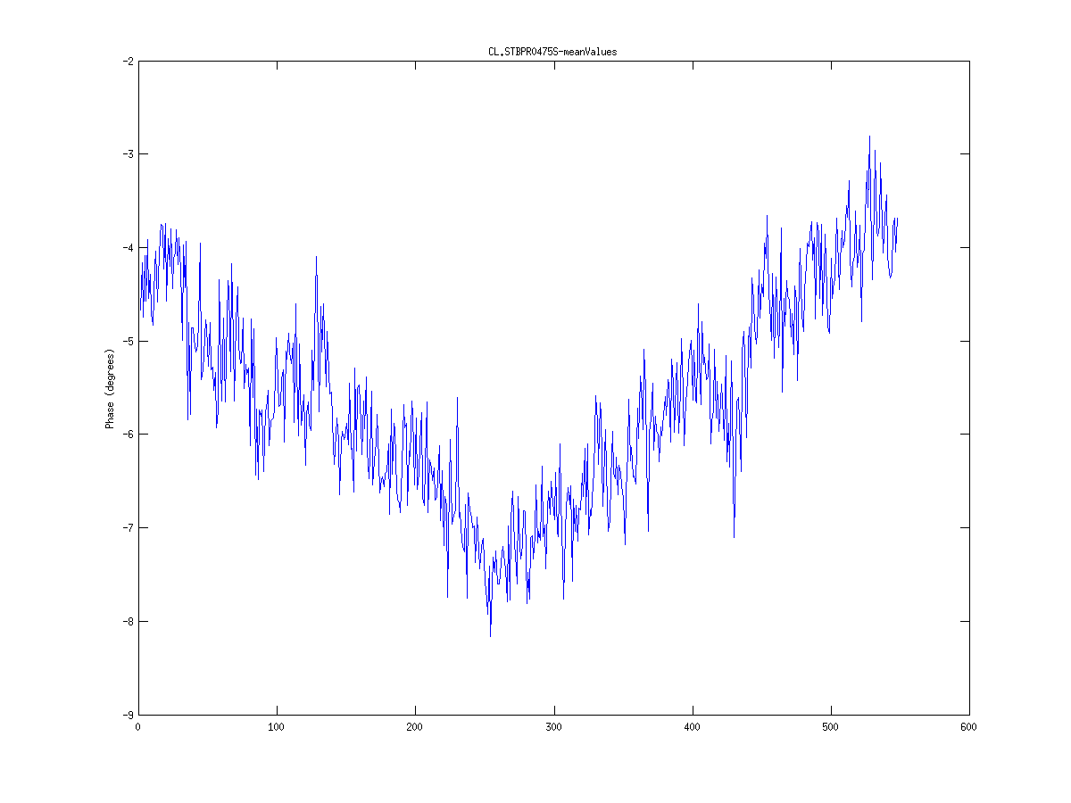
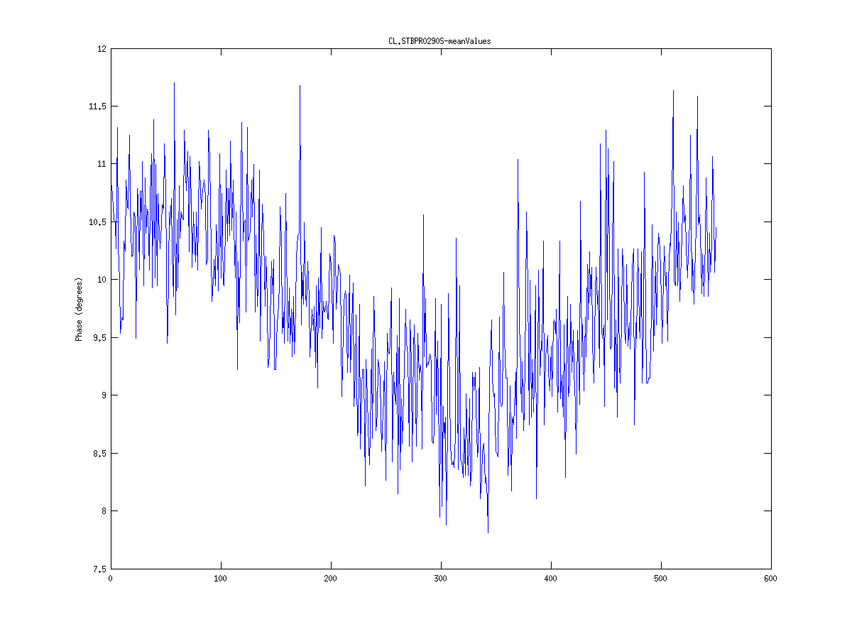
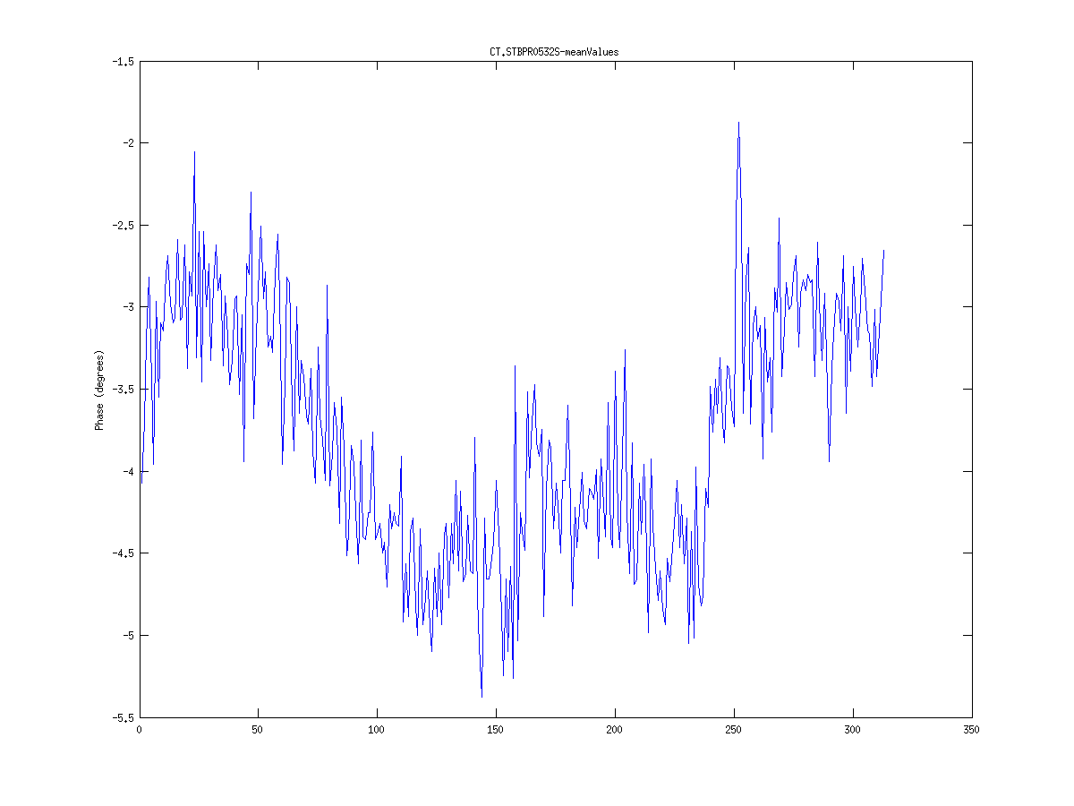
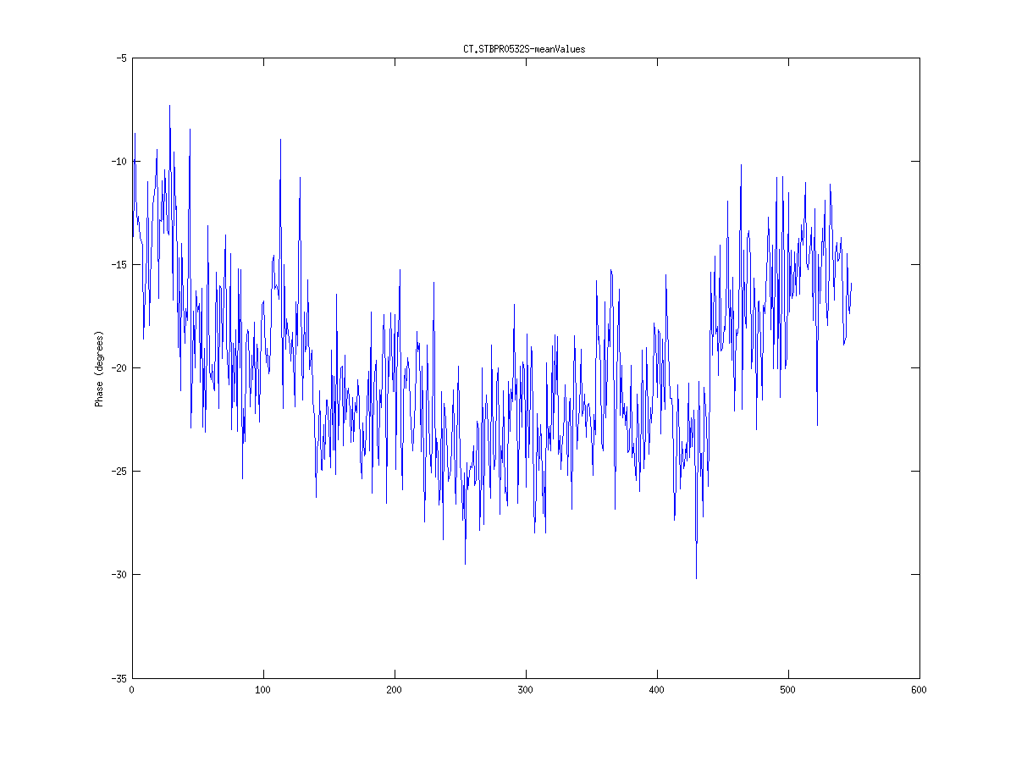
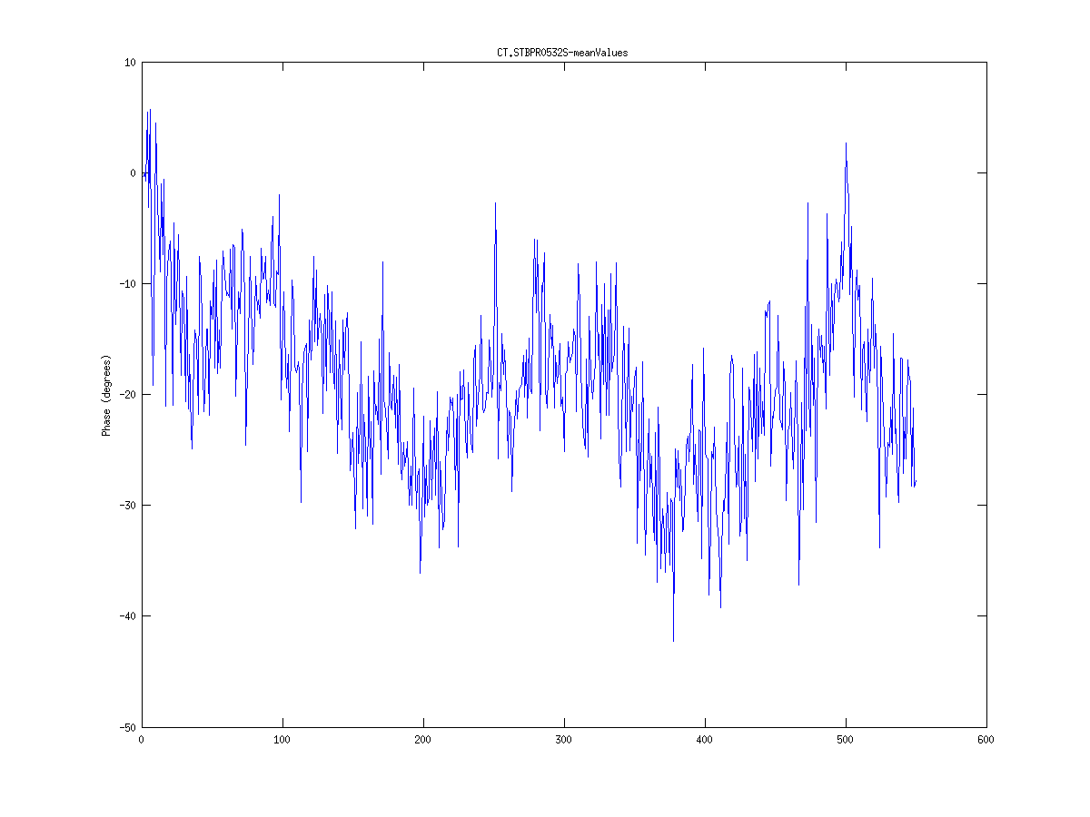
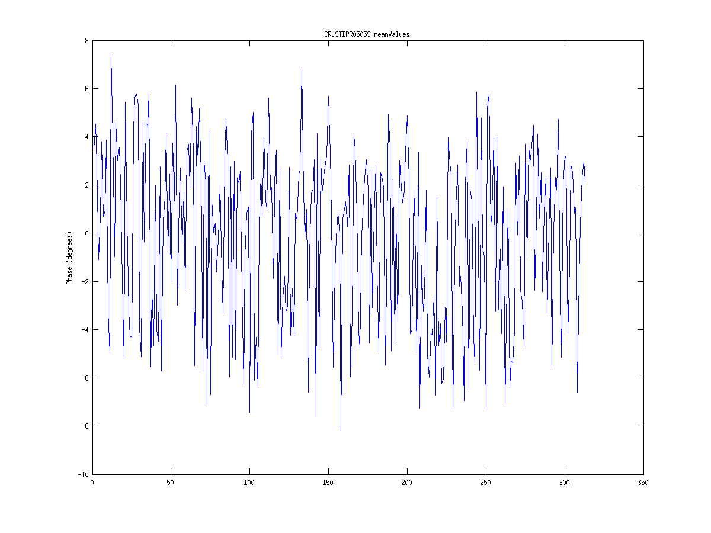
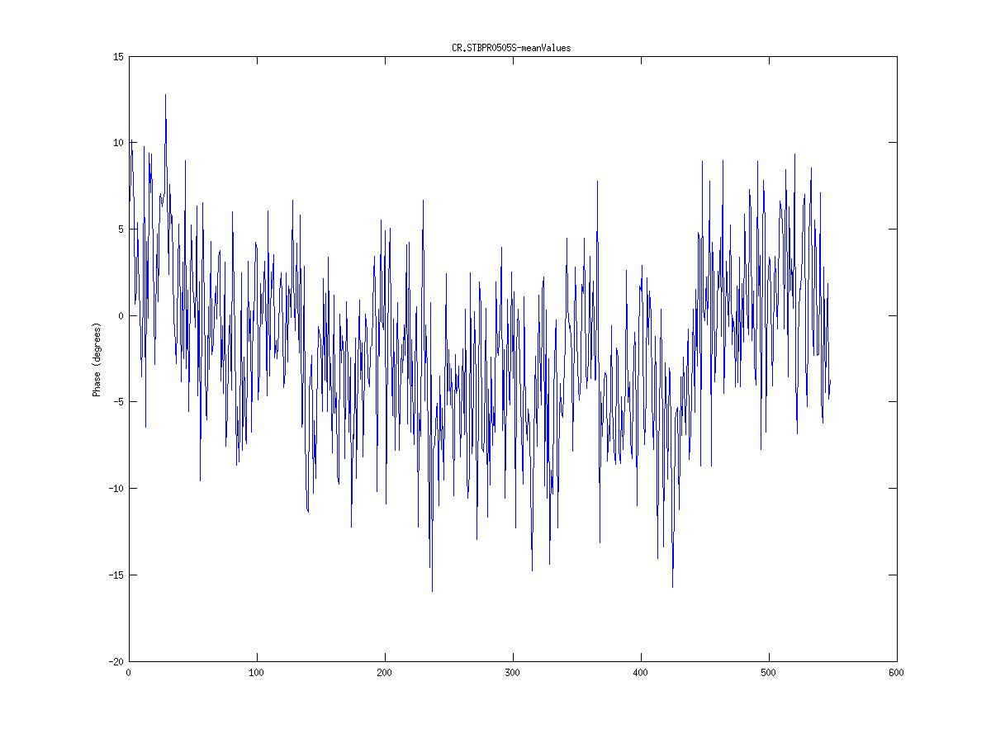
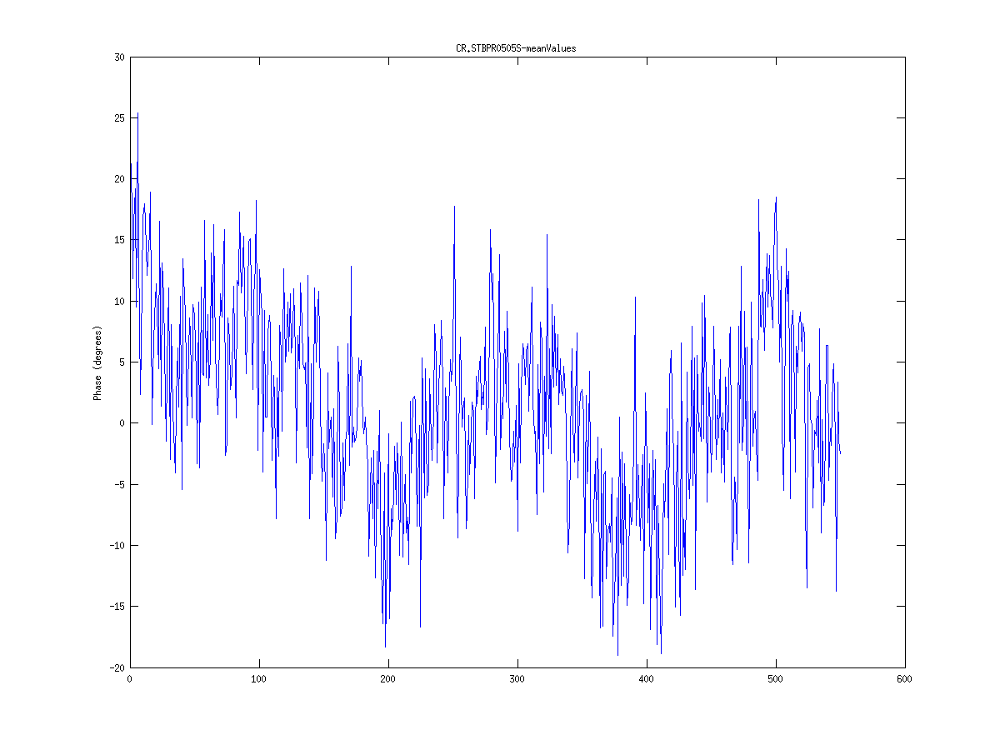
16/11 train average
R56 = 0.0
R56 = 0.2
R56 = 0.45
Monitor
CL 290
STD = 1.99
STD = 2.01
STD = 1.95
Monitor
CL 475
STD = 1.80
STD = 1.31
STD = 0.90
Monitor
CT 532
STD = 1.65
STD = 5.47
STD = 10.13
Monitor
CR 505
STD = 8.04
STD = 9.40
STD = 12.06

Slide 7
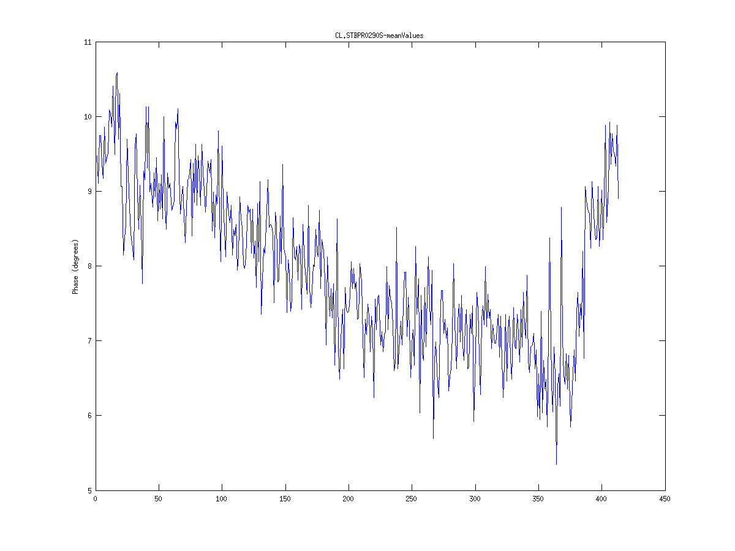
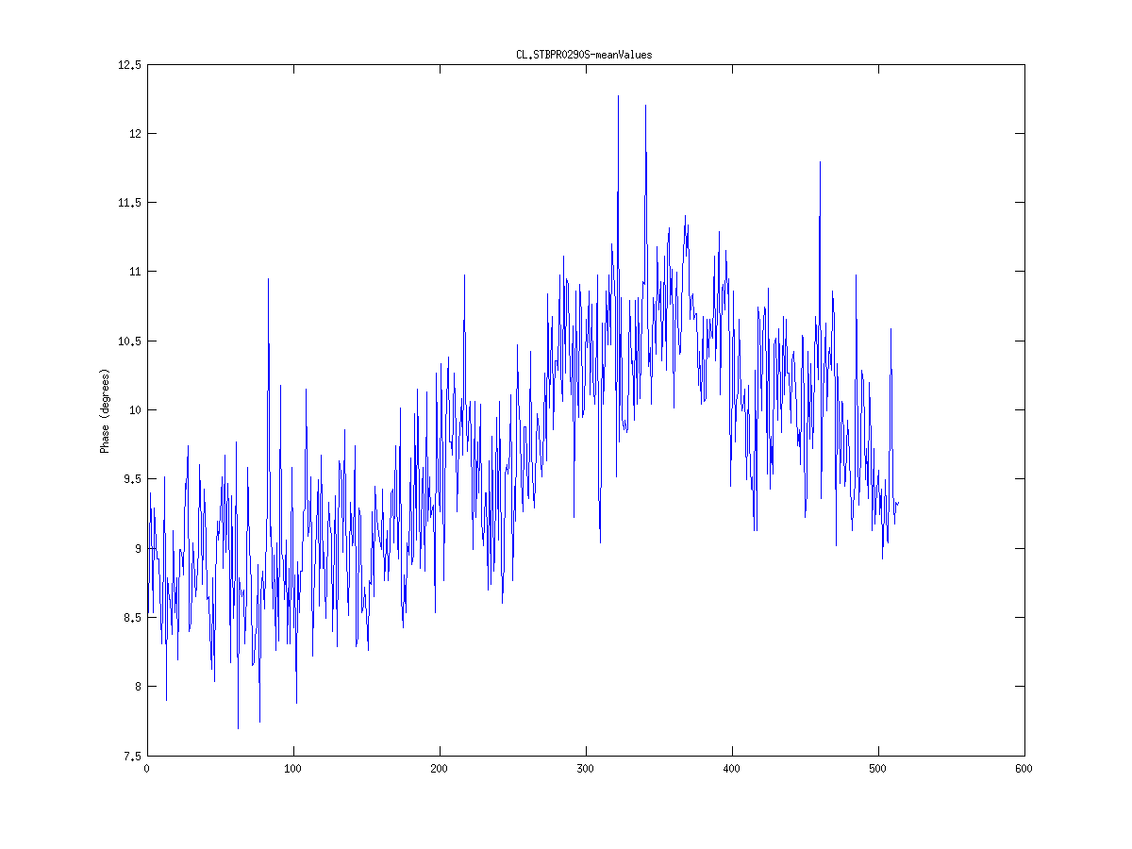
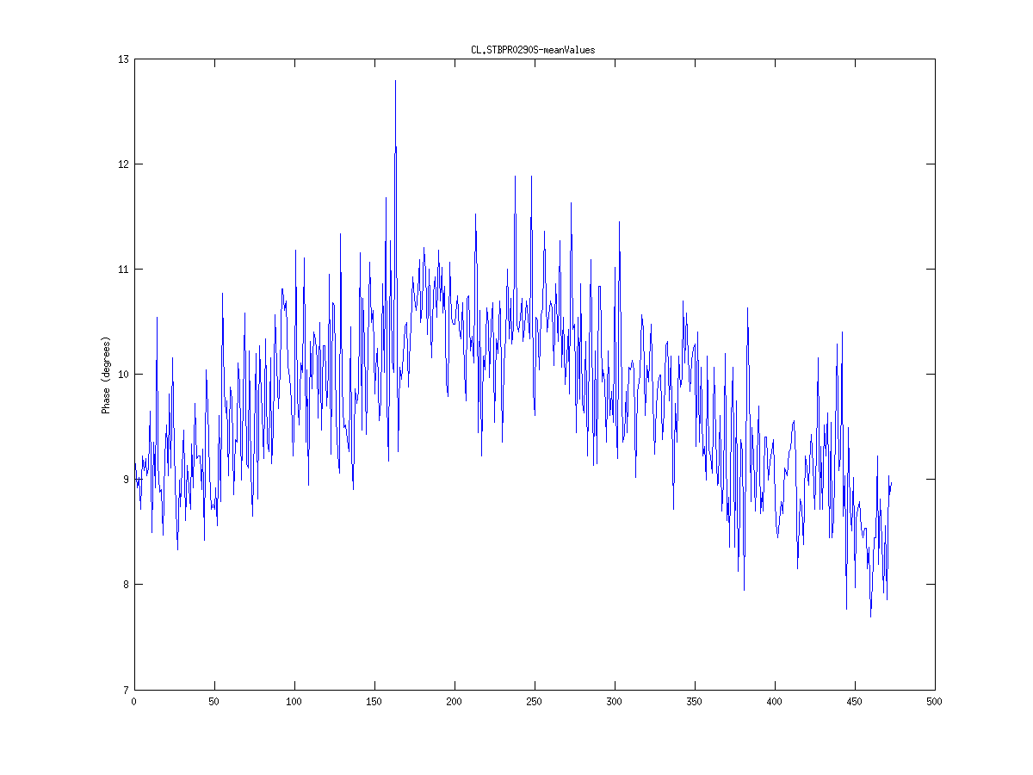
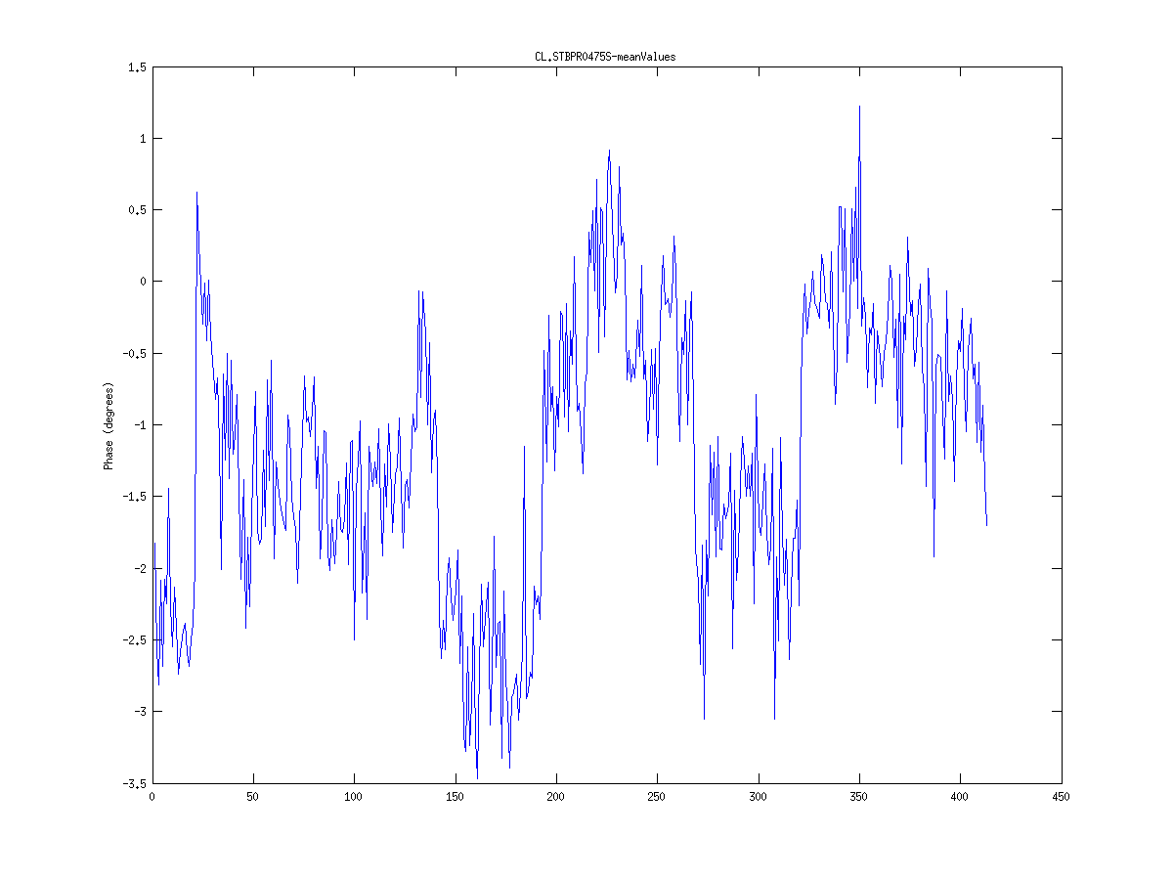
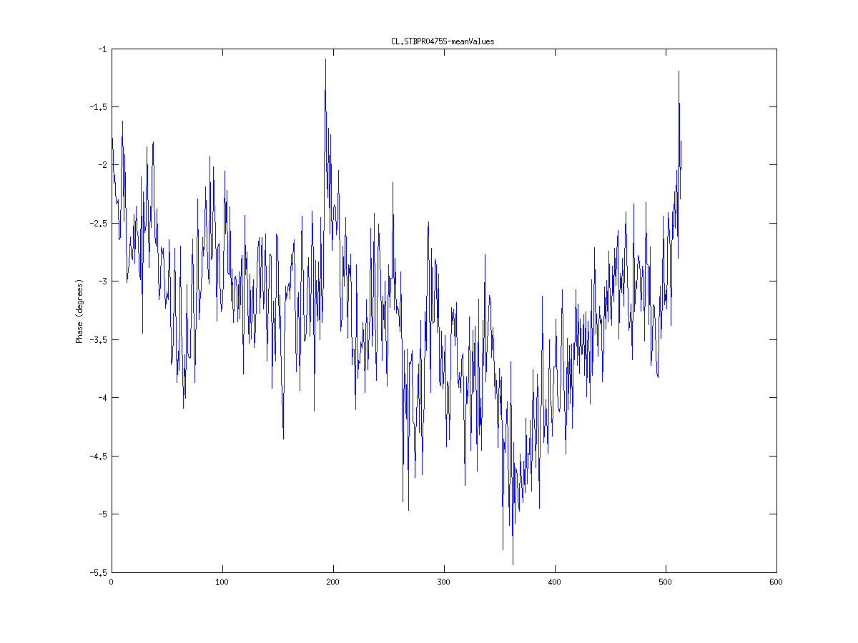
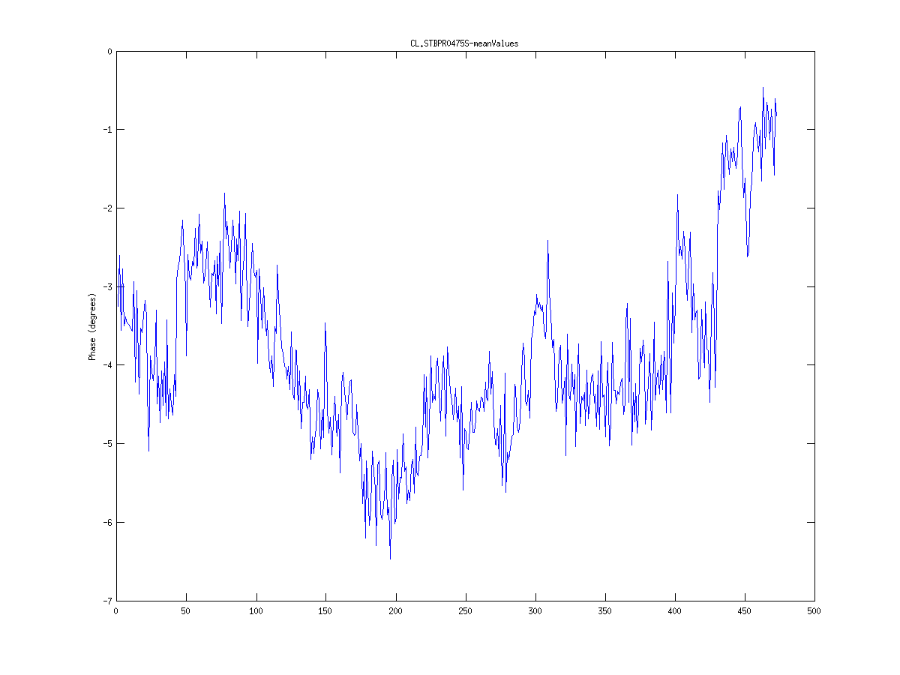
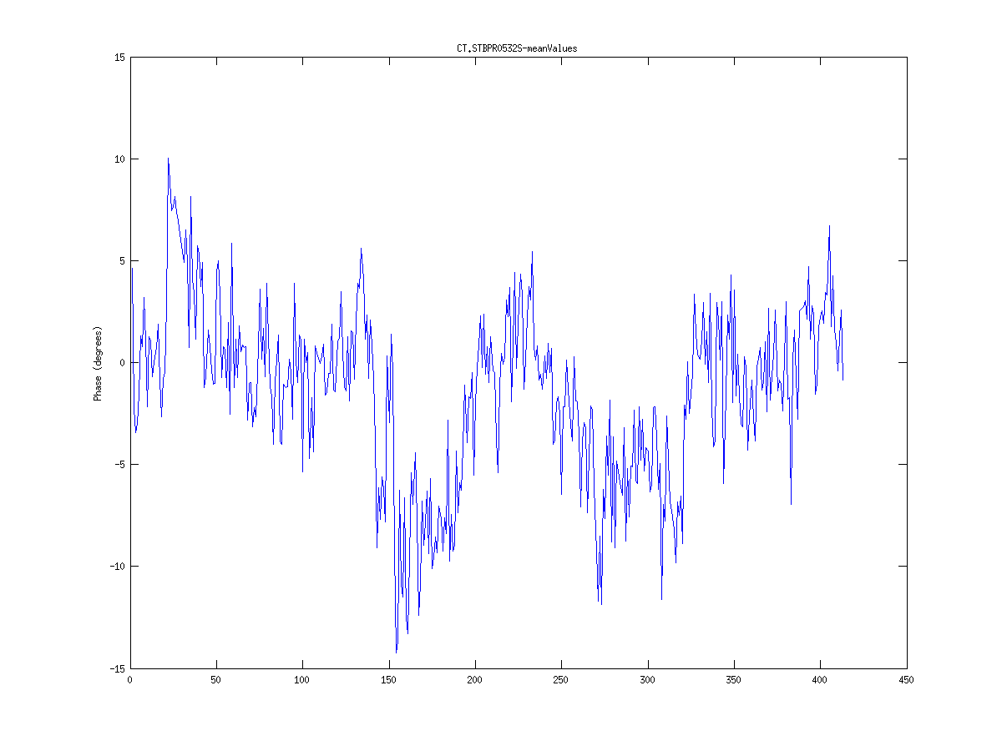
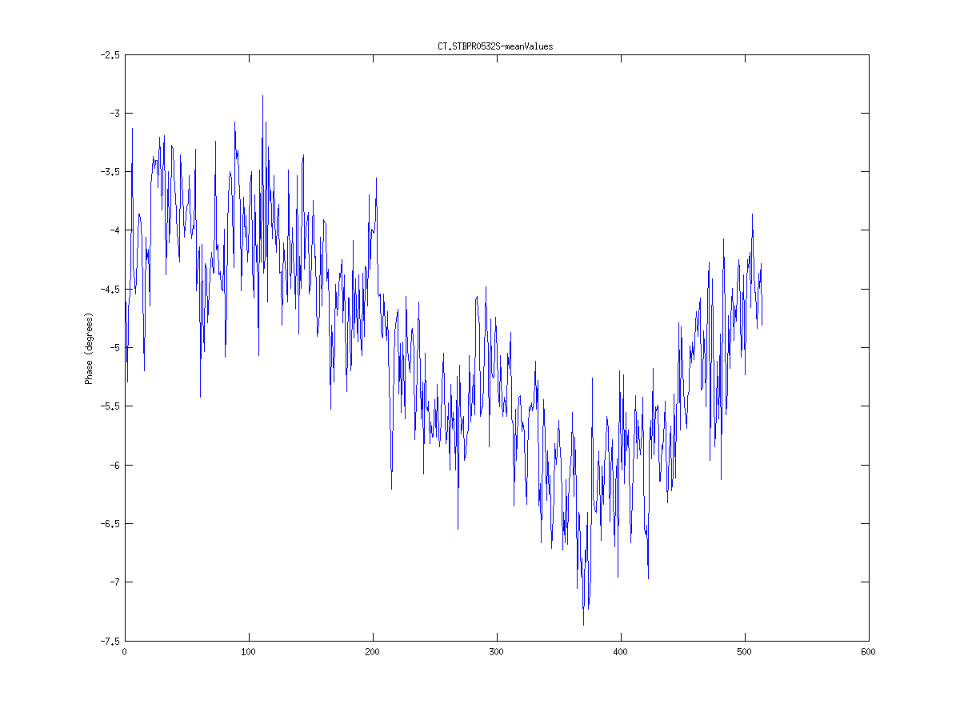
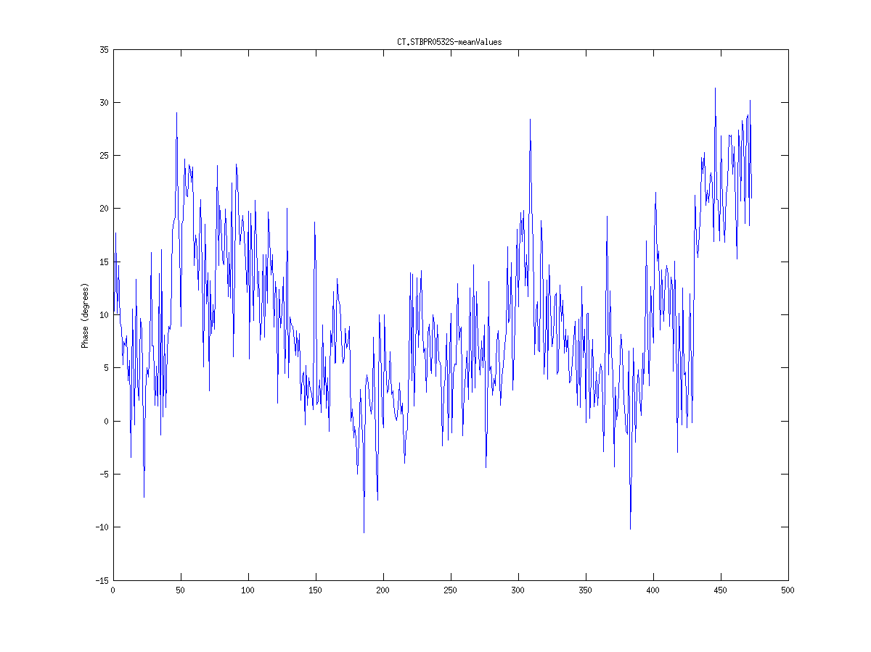
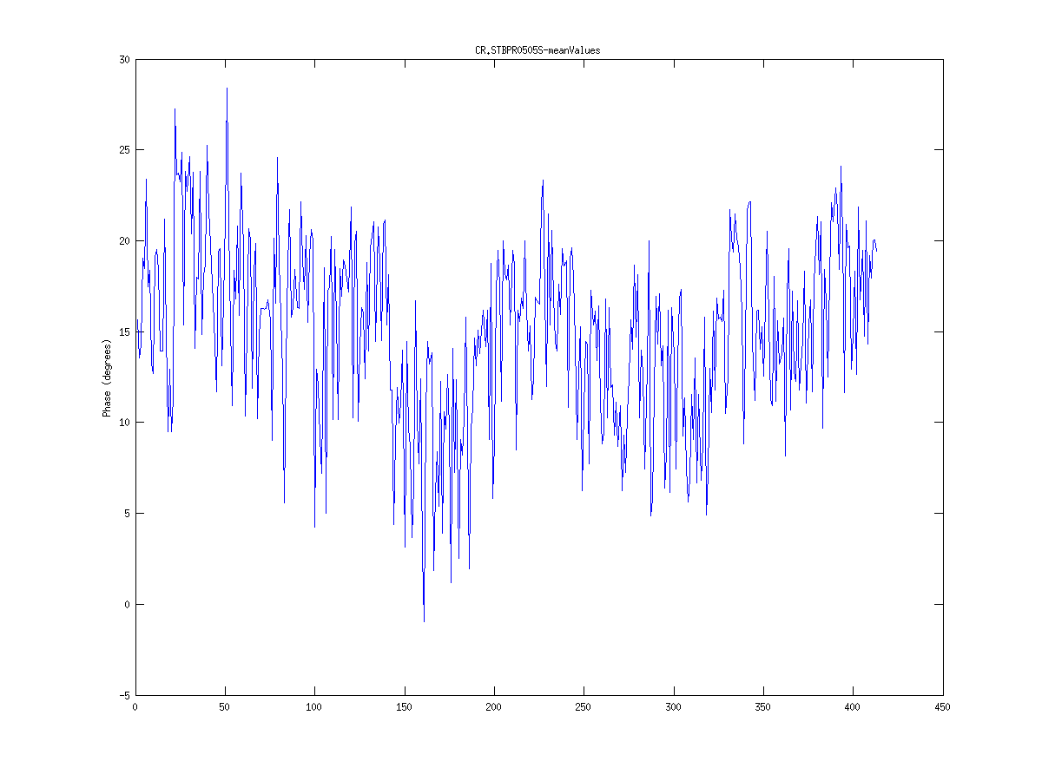
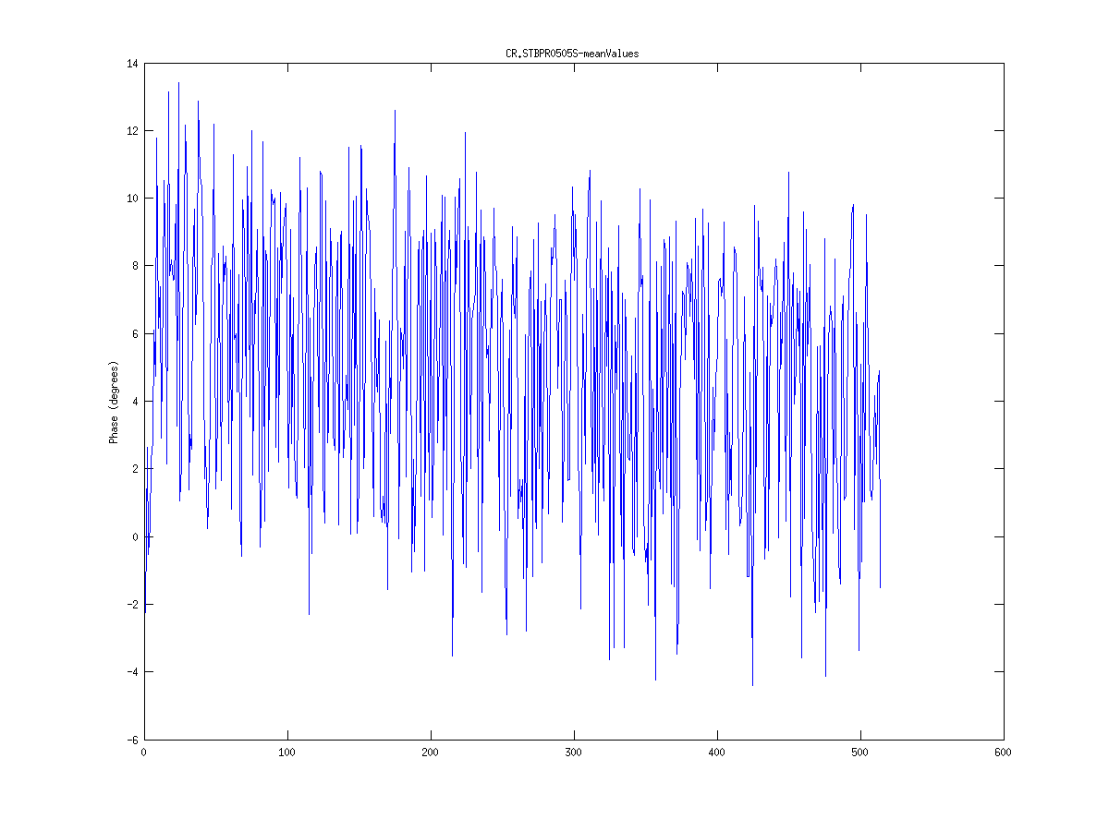
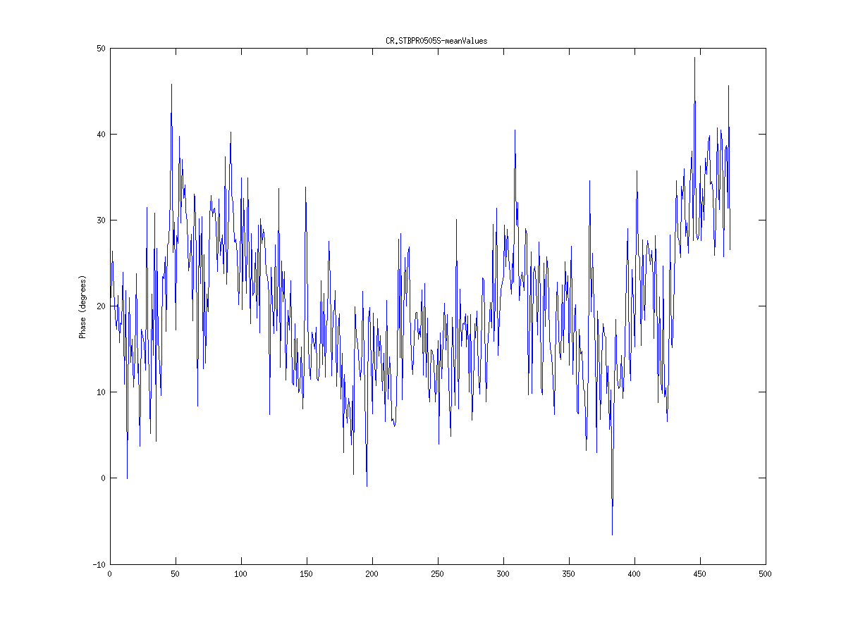
16/11 train average
R56 = 0.2
R56 = 0.0
R56 = 0.45
Monitor
CL 290
STD = 2.05
STD = 1.97
STD = 1.96
Monitor
CL 475
STD = 1.18
STD = 0.98
STD = 1.41
Monitor
CT 532
STD = 5.02
STD = 1.65
STD = 9.91
Monitor
CR 505
STD = 8.98
STD = 8.16
STD = 13.2

Slide 8
16/11 standard deviations
Phase in deg@12 GHz

Slide 9
16/11 standard deviations
Conclusions:
Most of the phase error after the chicane in previous measurements (R56 =0.45) was caused by the energy spread
With R56 = 0.0 the phase error doesn’t grow in the chicane
Large error in the combiner ring
Monitor resolution?
R56 of TL1 dog leg or of the Combiner Ring is non-zero?

Slide 10
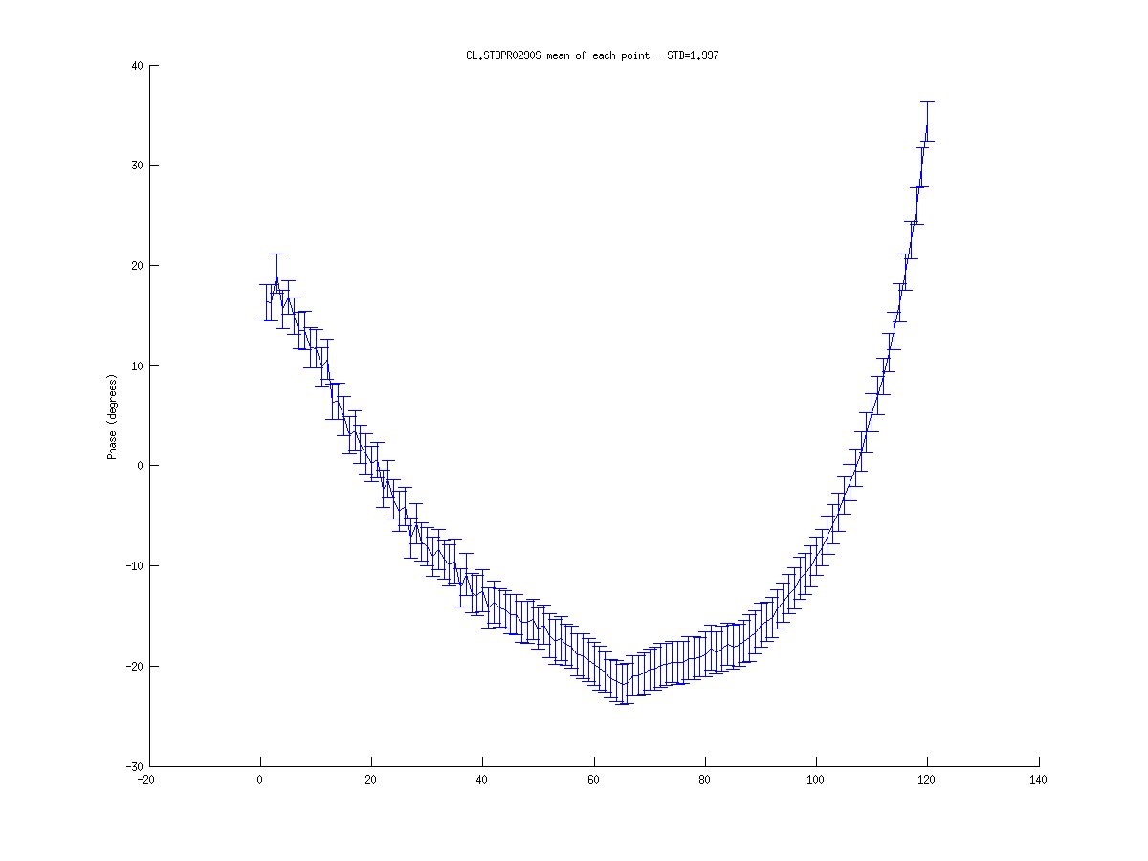
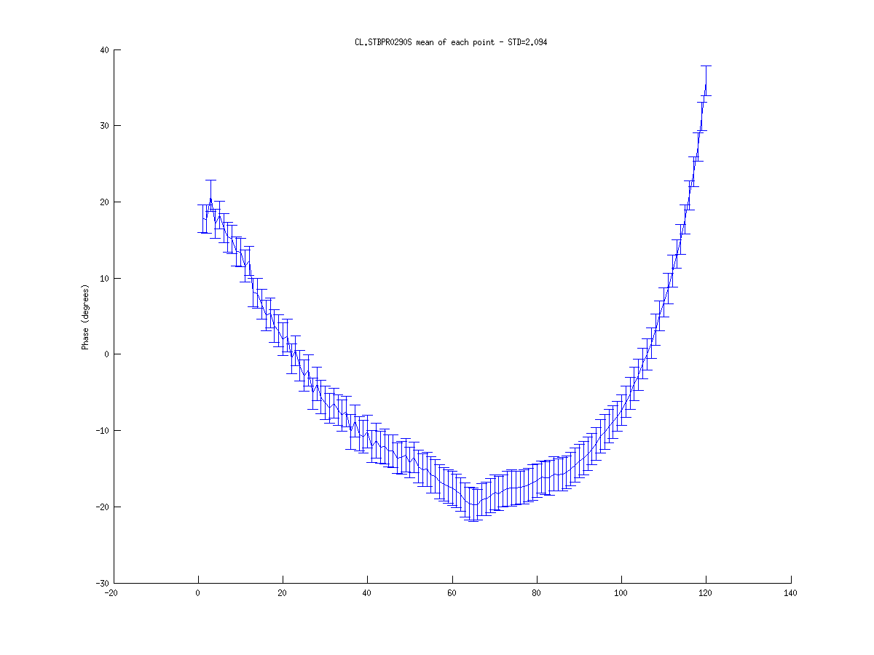
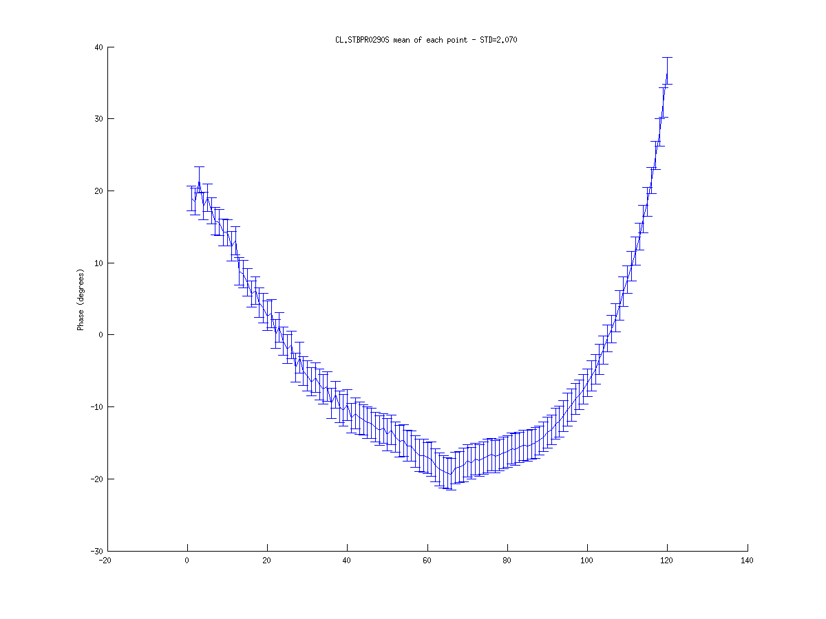

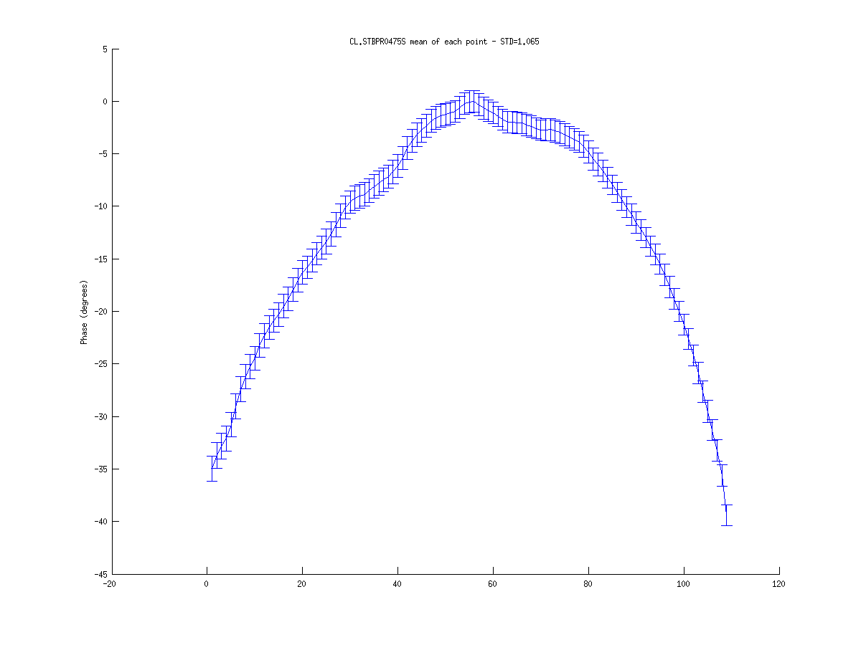







20/11 train profile
R56 = 0.2
R56 = 0.0
R56 = 0.45
Monitor
CL 290
STD = 2.00
STD = 2.09
STD = 2.01
Monitor
CL 475
STD = 1.10
STD = 1.07
STD = 1.12
Monitor
CT 532
STD = 5.92
STD = 9.75
STD = 1.367
Monitor
CR 505
STD = 8.59
STD = 8.28
STD = 8.478

Slide 11












20/11 train average
R56 = 0.2
R56 = 0.0
R56 = 0.45
Monitor
CL 290
STD = 2.00
STD = 2.09
STD = 2.01
Monitor
CL 475
STD = 1.10
STD = 1.07
STD = 1.12
Monitor
CT 532
STD = 5.92
STD = 9.75
STD = 1.367
Monitor
CR 505
STD = 8.59
STD = 8.28
STD = 8.478

Slide 12
20/11 standard deviations
Phase in deg@12 GHz

Slide 13
20/11 standard deviations
Conclusions:
The datasets were interchanged?
Some other data acquisition problems?
To be investigated…
For the rest of the presentation we will focus on the datasets from 16/11

Slide 14
16/11 standard deviations
Phase in deg@12 GHz
Is there a correlation between the klystron data and the phase directly after the chicane (CT 532)?

Slide 15


16/11 klystron data
Data from 10 klystrons:
CK.STPKI02P
CK.STPKI03P
CK.STPKI05P
CK.STPKI06P
CK.STPKI07P
CK.STPKI11P
CK.STPKI12P
CK.STPKI13P
CK.STPKI14P
CK.STPKI15P
Data of train average phase:
Most of the time STD of 0.1-0.3 deg at 3 GHz
Often large peaks (10s of deg @ 3 GHz)

Slide 16









16/11 klystron data First R56 = 0.2 measurement
PKI02
PKI03
PKI05
PKI06
PKI07
PKI11
PKI12
PKI13
PKI14
PKI15

Slide 17










16/11 klystron data First R56 = 0.45 measurement
PKI02
PKI03
PKI05
PKI06
PKI07
PKI11
PKI12
PKI13
PKI14
PKI15

Slide 18










16/11 klystron data Second R56 = 0.2 measurement
PKI02
PKI03
PKI05
PKI06
PKI07
PKI11
PKI12
PKI13
PKI14
PKI15

Slide 19









16/11 klystron data Second R56 = 0.45 measurement
PKI02
PKI03
PKI05
PKI06
PKI07
PKI11
PKI12
PKI13
PKI14
PKI15

Slide 20
16/11 klystron data
Observation:
Peaks are often for the same trains
=> problems with the beam? If yes,
- why are there no phase peaks measured by BPRs?
- why do not all PKIs show peaks for the same pulse?

Slide 21
16/11 klystron data
Correlation with the monitor after the stretching chicane (CT 532)

Slide 22










16/11 klystron data First R56 = 0.2 measurement
‘cc‘is correlation coefficient
PKI02
cc=0.10
PKI03
cc=0.11
PKI05
cc=0.09
PKI06
cc=0.08
PKI07
cc=-0.03
PKI11
cc=0.10
PKI12
cc=0.02
PKI13
cc=-0.08
PKI14
cc=0.09
PKI15
cc=0.08
large peaks push correlation constant nearer to zero

Slide 23


16/11 klystron data First R56 = 0.2 measurement
For comparison: correlation of the beam phase before and after the chicane
CL290 vs CT532
cc = -0.53
CL475 vs CT532
cc =0.83

Slide 24










16/11 klystron data First R56 = 0.45 measurement
PKI02
cc=0.07
PKI03
cc=0.07
PKI05
cc=0.10
PKI06
cc=0.10
PKI07
cc=-0.08
PKI11
cc=-0.05
PKI12
cc=-0.10
PKI13
cc=0.06
PKI14
cc=-0.06
PKI15
cc=-0.03

Slide 25


16/11 klystron data First R56 = 0.45 measurement
For comparison: correlation of the beam phase before and after the chicane
CL290 vs CT532
cc= 0.28
CL475 vs CT532
cc=0.52

Slide 26










16/11 klystron data Second R56 = 0.2 measurement
PKI02
cc=-0.23
PKI03
cc=-0.73
PKI05
cc=-0.46
PKI06
cc=0.06
PKI07
cc=-0.04
PKI11
cc=0.05
PKI12
cc=0.10
PKI13
cc=0.23
PKI14
cc=-0.11
PKI15
cc=-0.29
dataset without peaks => correlation constant is further from zero!

Slide 27


16/11 klystron data Second R56 = 0.2 measurement
For comparison: correlation of the beam phase before and after the chicane
CL290 vs CT532
cc=0.29
CL475 vs CT532
cc= 0.67

Slide 28










16/11 klystron data Second R56 = 0.45 measurement
PKI02
cc=0.09
PKI03
cc=-0.11
PKI05
cc=0.01
PKI06
cc=-0.14
PKI07
cc=-0.11
PKI11
cc=0.03
PKI12
cc=-0.20
PKI13
cc=-0.19
PKI14
cc=0.23
PKI15
cc=-0.16

Slide 29


16/11 klystron data Second R56 = 0.45 measurement
For comparison: correlation of the beam phase before and after the chicane
CL290 vs CT532
cc =-0.28
CL475 vs CT532
cc =0.85

Slide 30
R56 measurements at CTF3
Conclusions:
R56 of the stretching chicane has a large impact on the phase after the chicane (almost factor 10 error difference between 0.45 and 0.0 settings)
Data from the measurement at 20/11 has to be checked (interchanged R56 datasets? Piotr and Reidar are investigating)
The measured phase error in the Combiner Ring is high even with R56=0.0
monitor problem?
non-zero R56 of TL1 dogleg or of the Combiner Ring?
Have to figure out the reason for the peaks in klystron data
exclude them from the correlation analysis?
Correlation studies show that the energy error is caused partially by the phase error of the klystron and partially by the phase error of the incoming beam

