Slide 1
JLab Update
Rongli Geng, Ari Palczewski, Yongming Li
December 11, 2012
43rd ILC Cavity Group Meeting

Slide 2
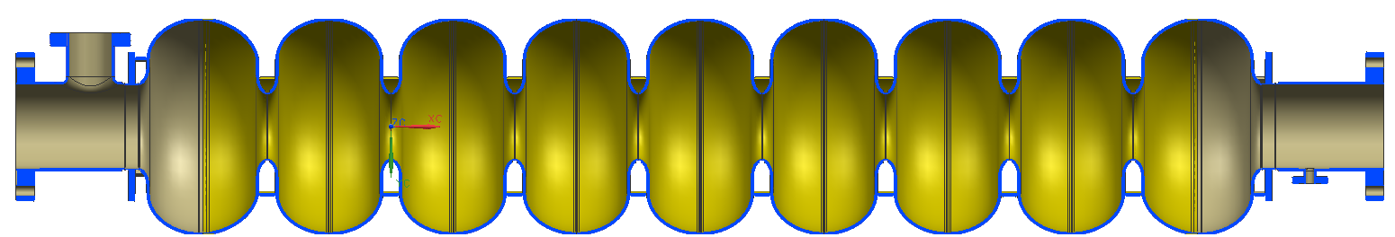
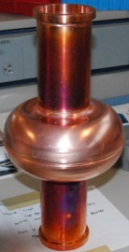
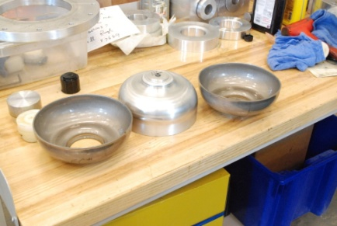
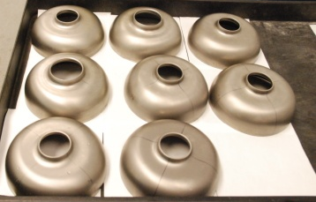
JLab Status: 9-cell Cavities
New 9-cell Low-Surface-Field shape (SLAC design) cavity.
  Design package 100% completed
  First Cu prototype completed
    Used for wall removal assessment by CBP
      Flat region removes at 75% of that at equator
  All niobium cups are in hand
    Deep drawing, Nitric soaking, vacuum furnace stress relief
      CMM inspection of key dimension shows good precision
    Next re-stamping and weld prep machining
Two large-grain ICHIRO shape cavities waiting for processing

Slide 3
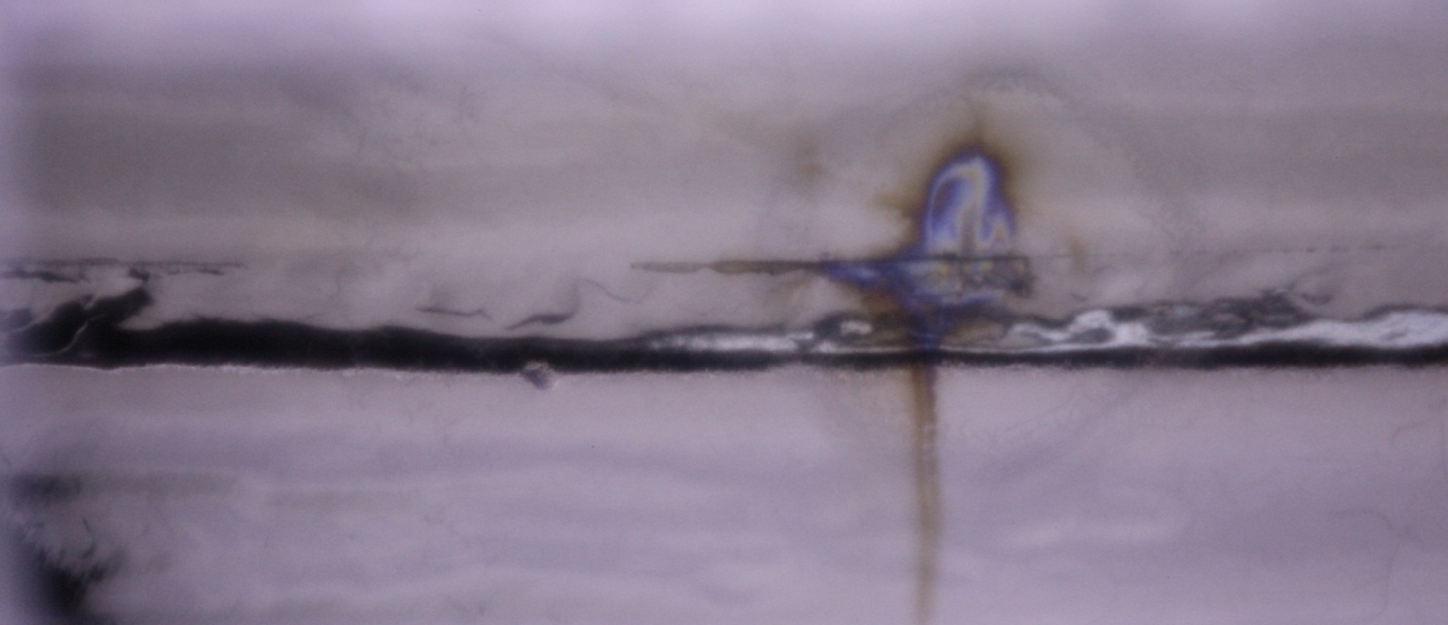
JLab Status: Field Emission/Dark Current R&D
9-cell cavity JLab LG#1 optical inspection following RF test with strong field emission
  Discovery of discoloration at iris
HOM coupler multipacting
  Prediction of a hard MP barrier at > 42 MV/m in ILC cavity HOM coupler
  Results cross-checked with similar HOM couplers at different frequencies
Iris 2
Z=220mm
angle=247.2

Slide 4
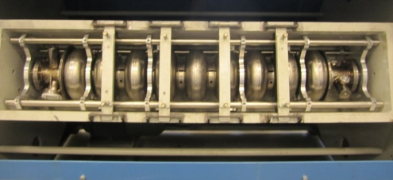
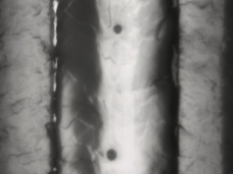

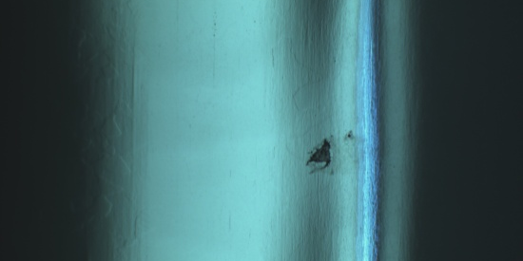
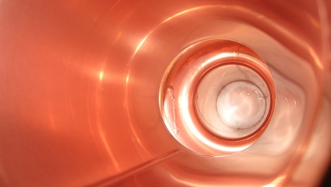
JLab Status: In-House Mechanical Polishing
First 9-cell cavity (NR1) in-house mirror-finish mechanical polishing completed
  Four-step procedure based on C. Cooper’s developed at FNAL
  Operation in the new building at Test Lab Addition
  Intermediate rinse using a medium pressure wand
  Optical inspection
    Clear removal of twin defects in cell#5 which limited cavity at 17 MV/m
    But a new defect was disclosed in cell#6 in fussion zone of equator weld
  Cavity out-gassed in vacuum furnace, waiting for light EP
1-cell cavity mechanical polishing
  Copper 1-cell LSF shape LSF1-1
  Large-grain niobium 1-cell G2
Cell 6 new defect 324 degrees

