Slide 1
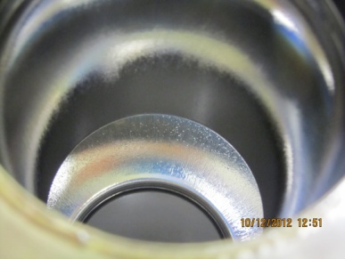
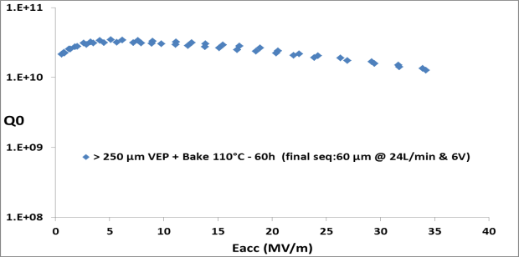
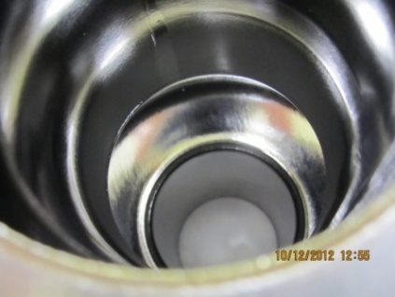
VEP at Saclay : INVESTIGATION OF PARAMETERS:
Low voltage – High acid flow: 6V & >24L/min
1AC3: 250µm VEP with unadapted parameters (bubbles traces + pits)
+ 60µm VEP at 6V & 24L/min
Pits only partially removed
VT (1.6K) Qo=1.26E10 Eacc=34MV
quench limited
1AC1: BCP + ~ 120 µm VEP
Leak at 4K during VT
Re-test in January 2013
1AC3 cavity
1DE1: Horizontal EP + 60 µm VEP
Bright and smooth surface
VT planned for January 2013
1DE1 Cavity
TB9RI025 (9Cell): HEP + 60µm VEP at Saclay
Bright surface
Overcoupling was observed during 1st VT at Saclay
Cavity has been Re-HPR’ed and assembled with new antennas
Test planned for end of december 2012 – January 2013

