Slide 1
TMD2 amplifier test
N. Blaskovic

Slide 2
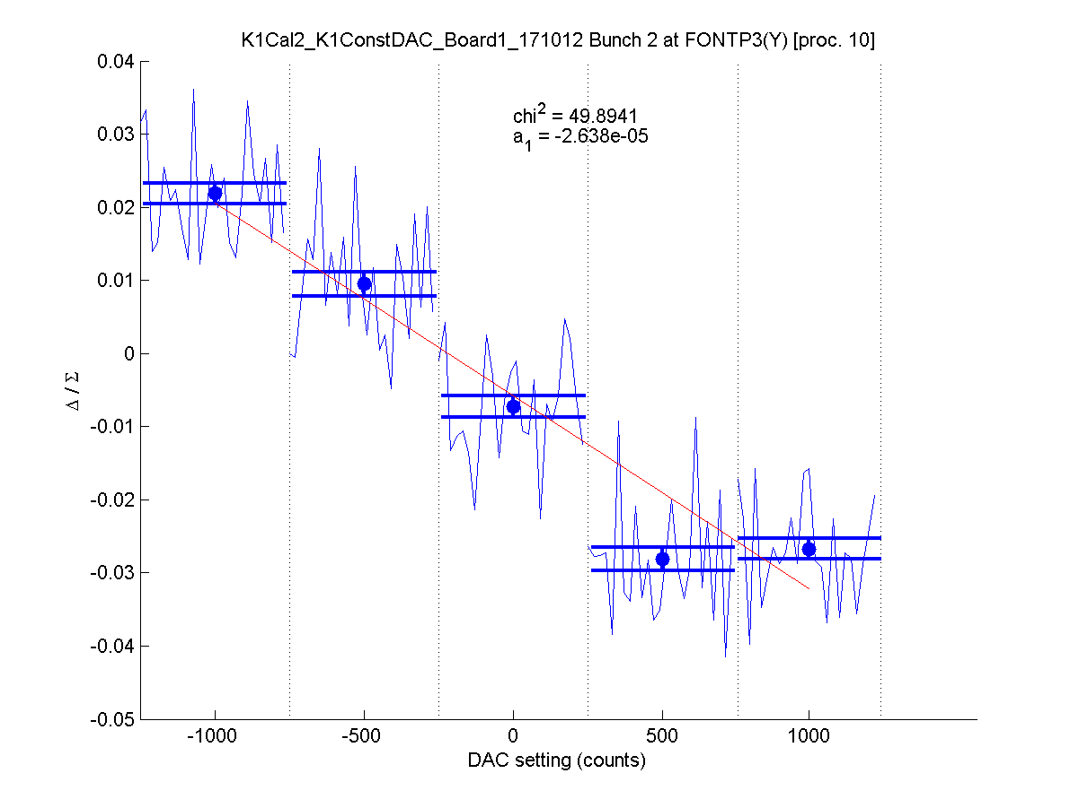
Introduction
Kicker K1 scans in October are anomalous at a K1 DAC setting of 1000 counts:
position at P3 (Δ/Σ units)
K1 DAC setting (counts)
N. Blaskovic

Slide 3
TMD2 amplifier test
The performance of amplifier TMD2 (at K1 in October) was tested in the lab using last week’s set-up.
The waveforms from the monitor of Colin’s 8-to-2 box were recorded for a range of DAC settings.
The waveforms obtained using TMD2 were compared to those using TMD1.
N. Blaskovic

Slide 4
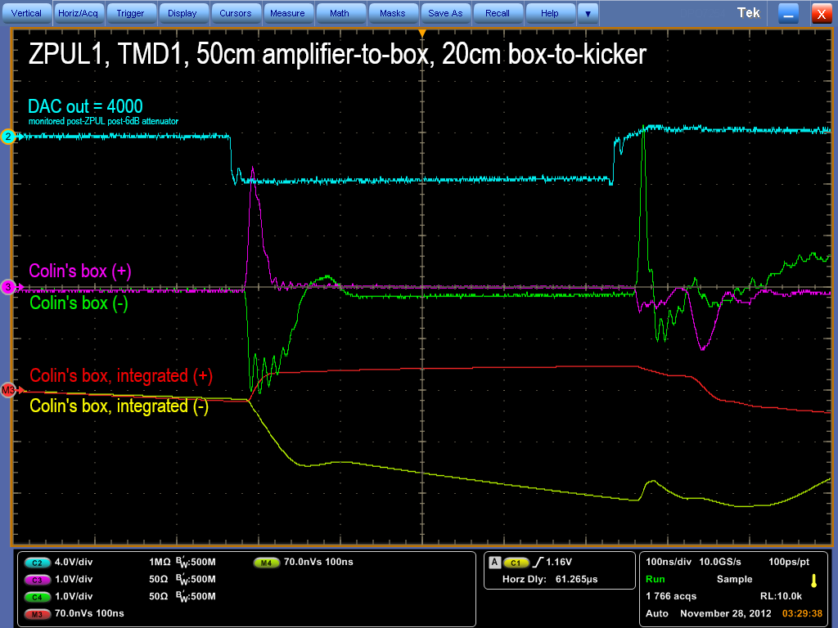
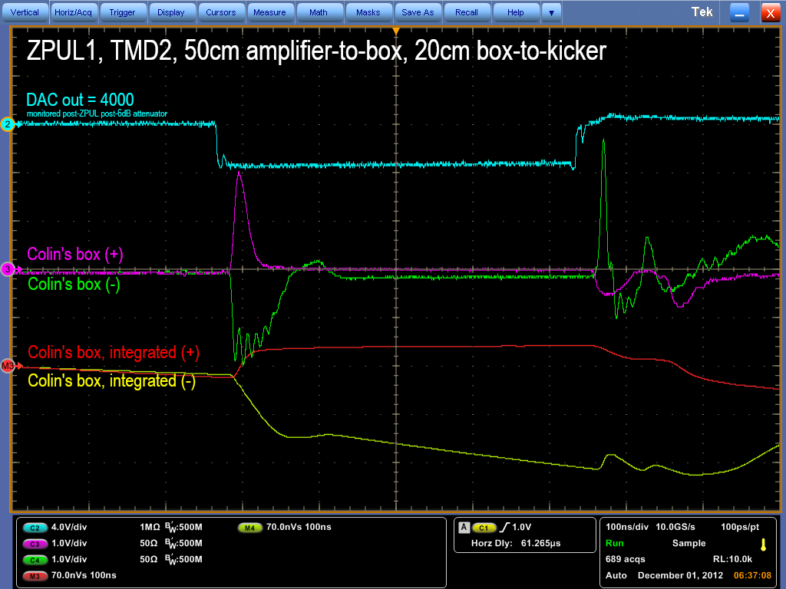
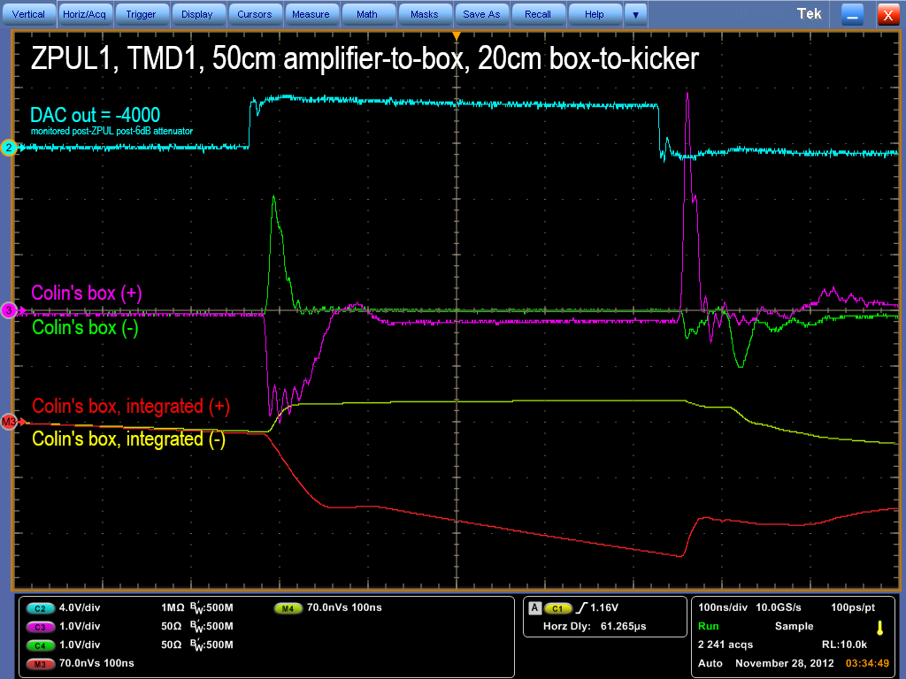
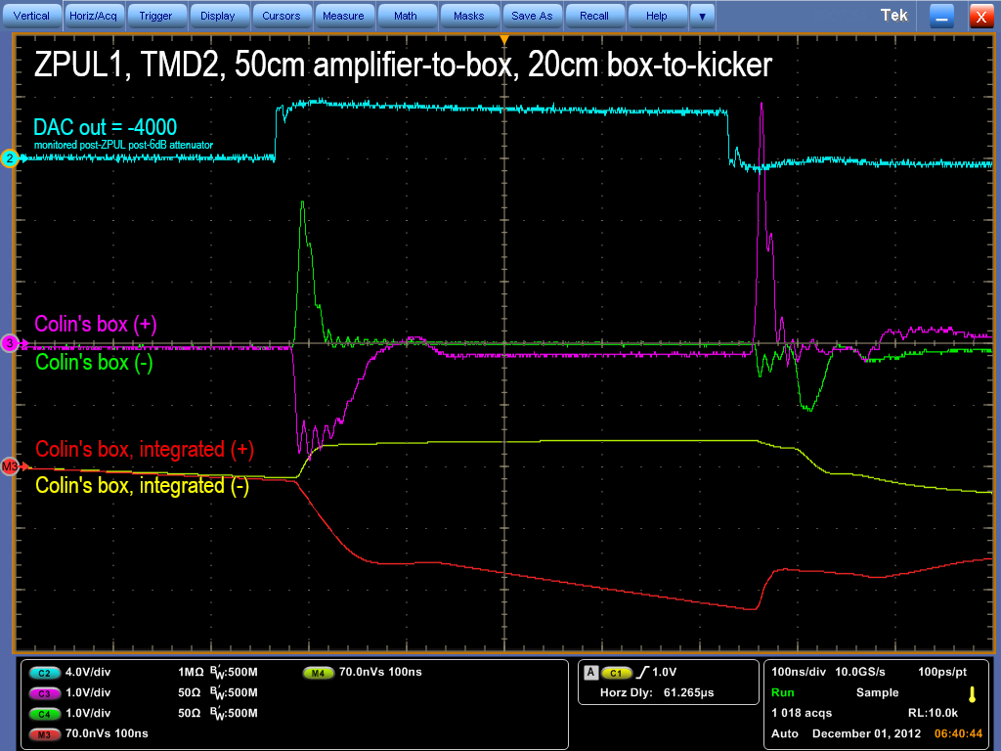
TMD1
TMD2
DAC out = 4000
DAC out = -4000
N. Blaskovic

Slide 5
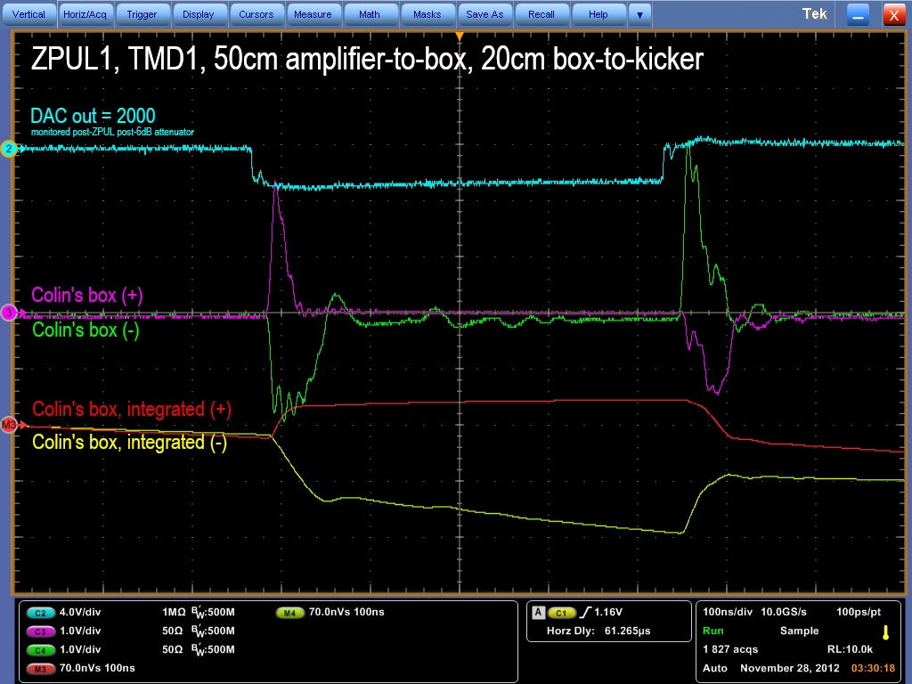
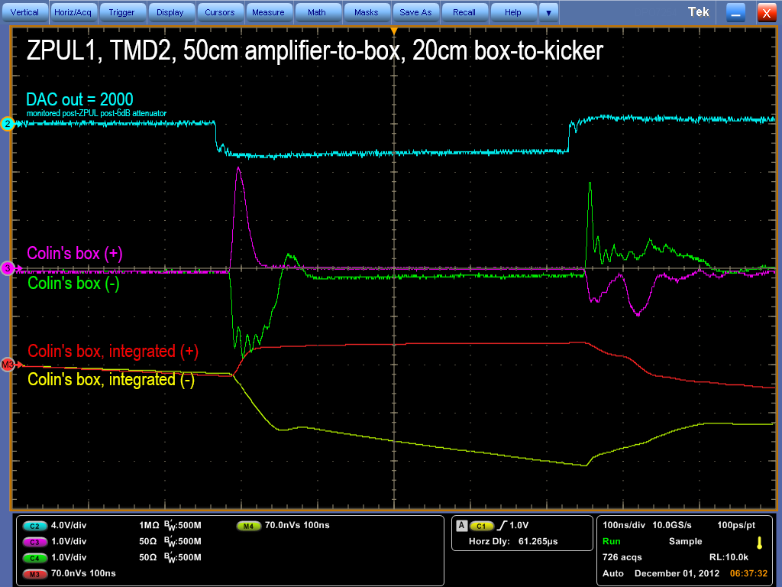
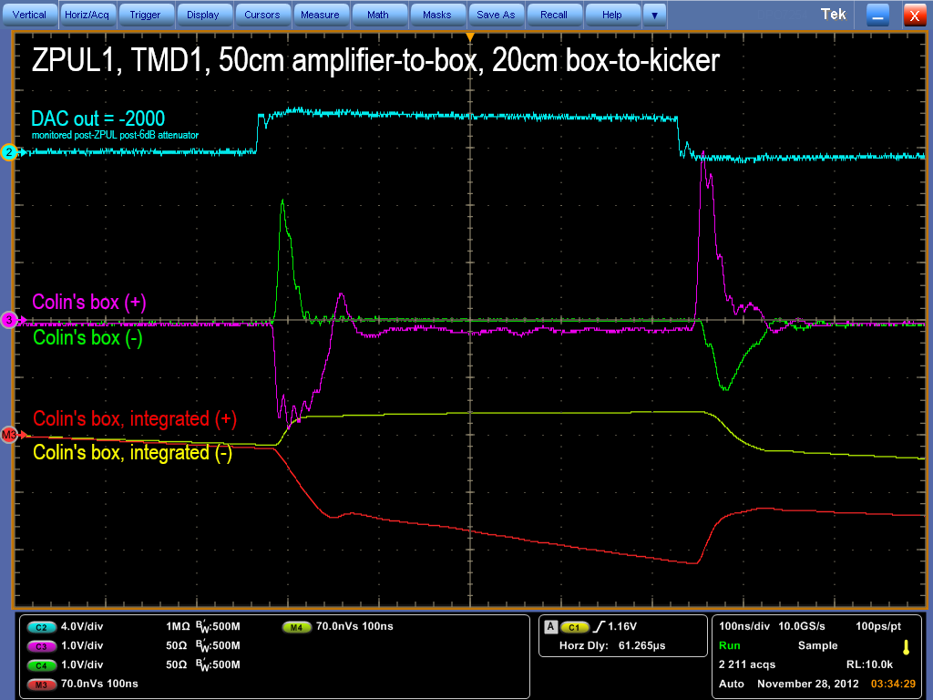

TMD1
TMD2
DAC out = 2000
DAC out = -2000
N. Blaskovic

Slide 6
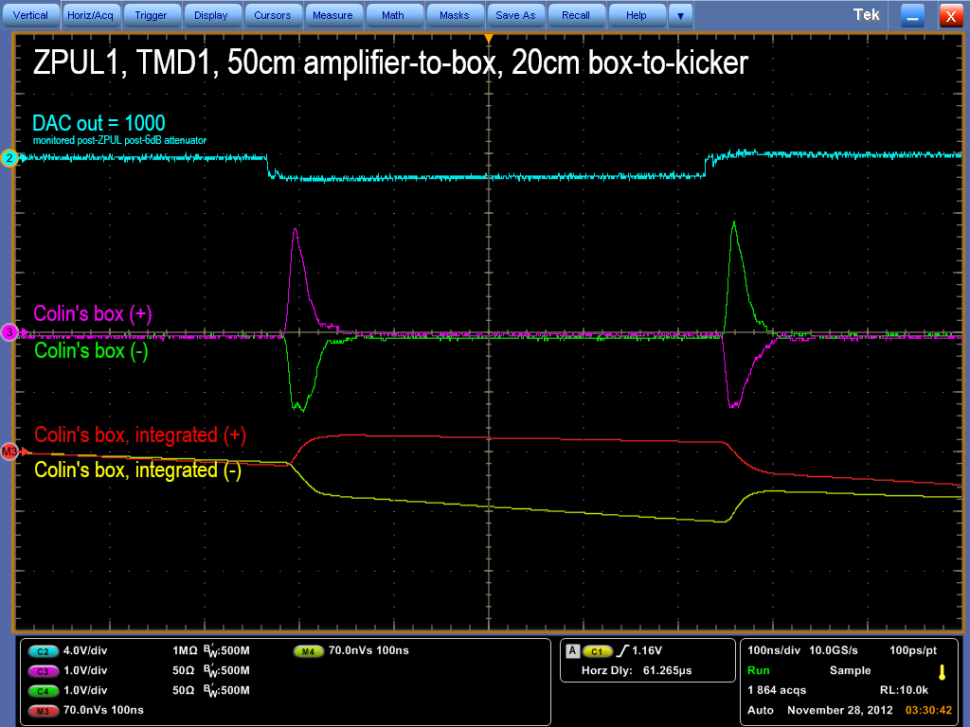
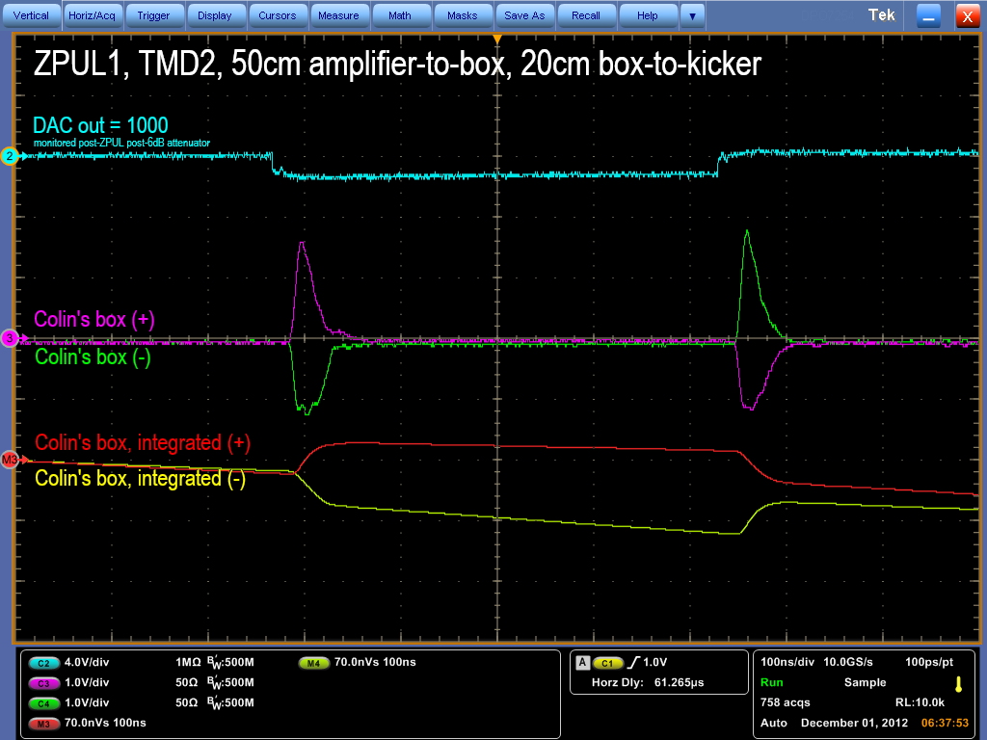
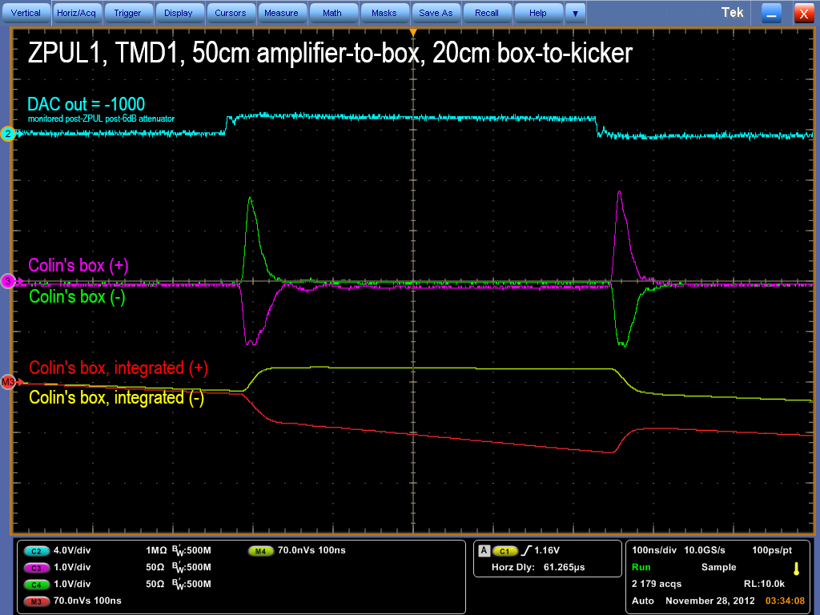

TMD1
TMD2
DAC out = 1000
DAC out = -1000
N. Blaskovic

Slide 7
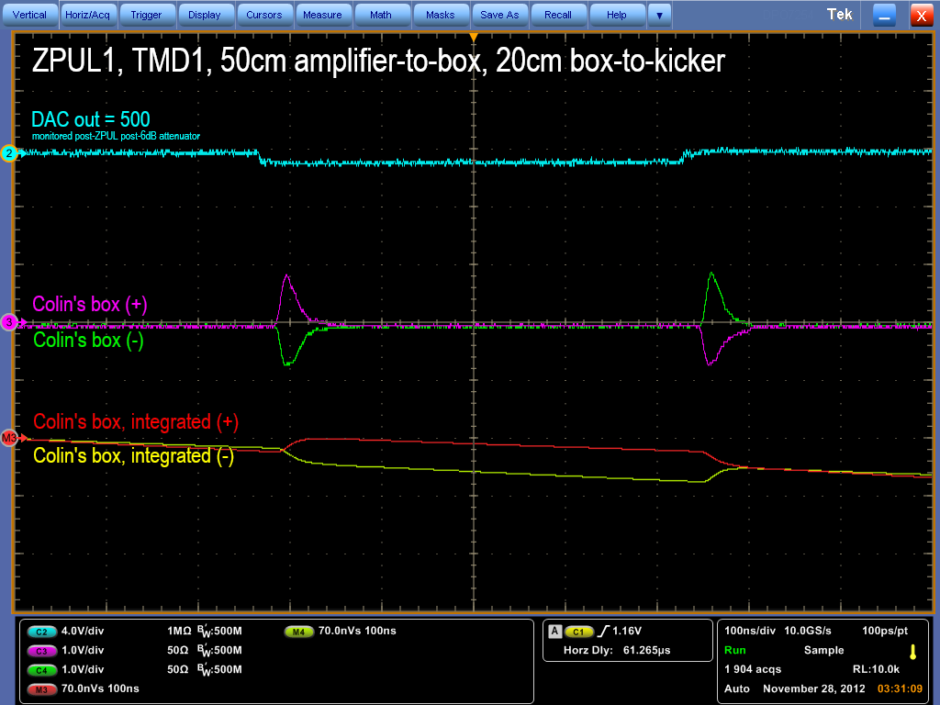
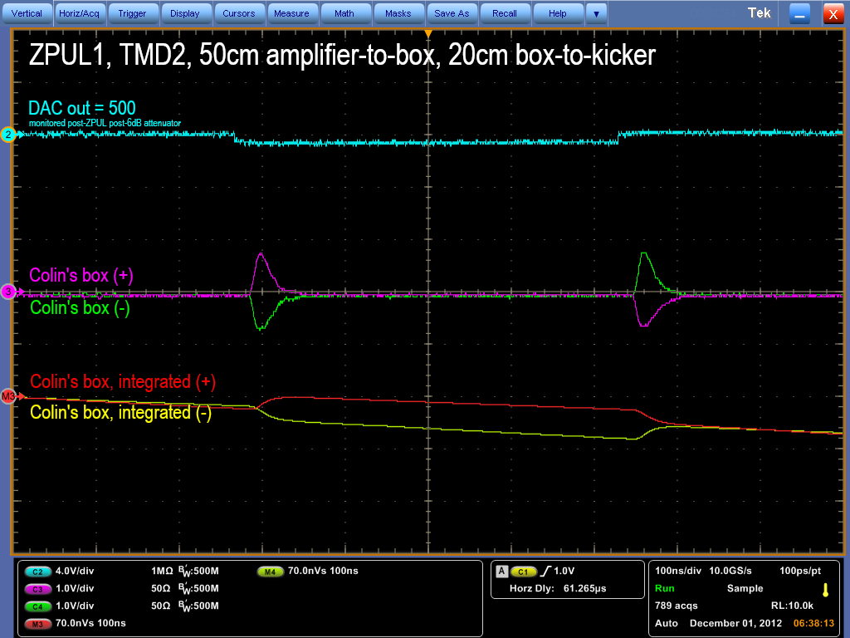
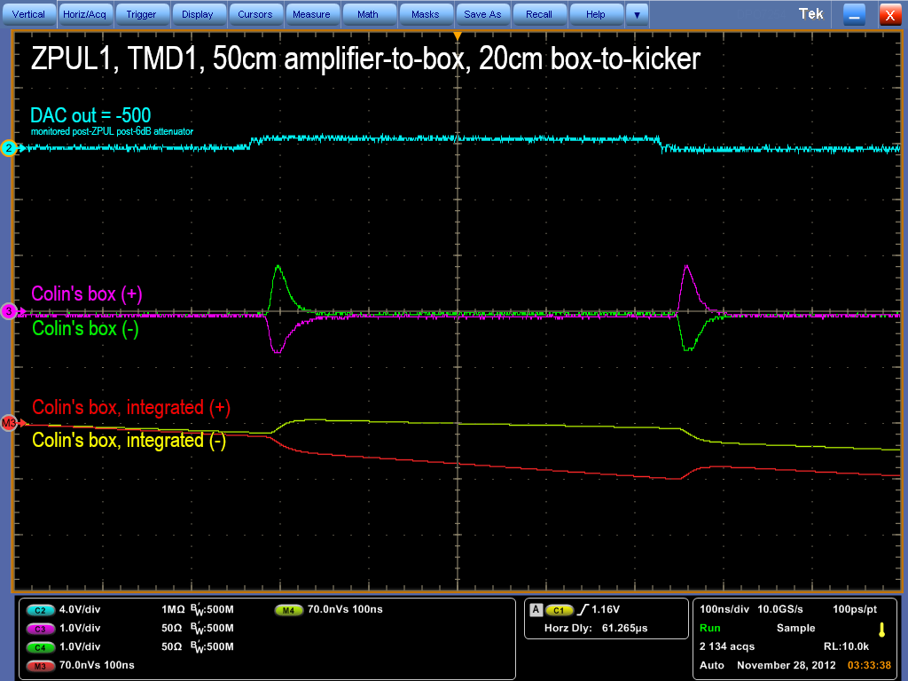

TMD1
TMD2
DAC out = 500
DAC out = -500
N. Blaskovic

Slide 8
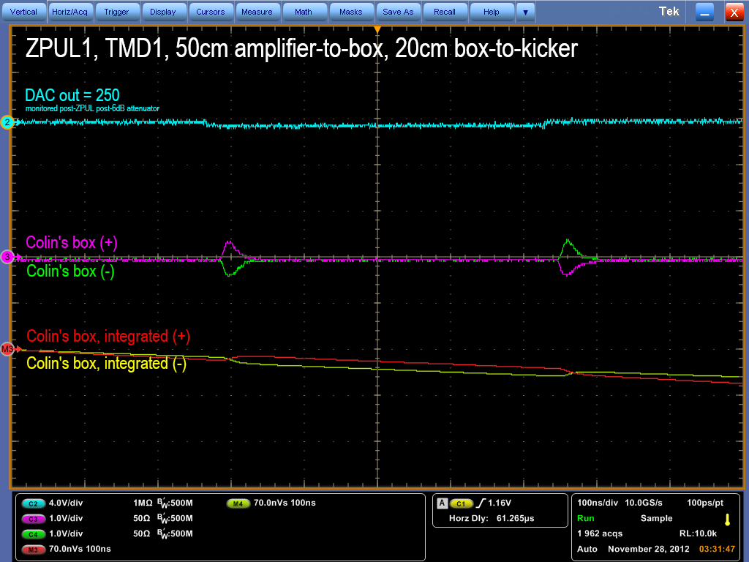
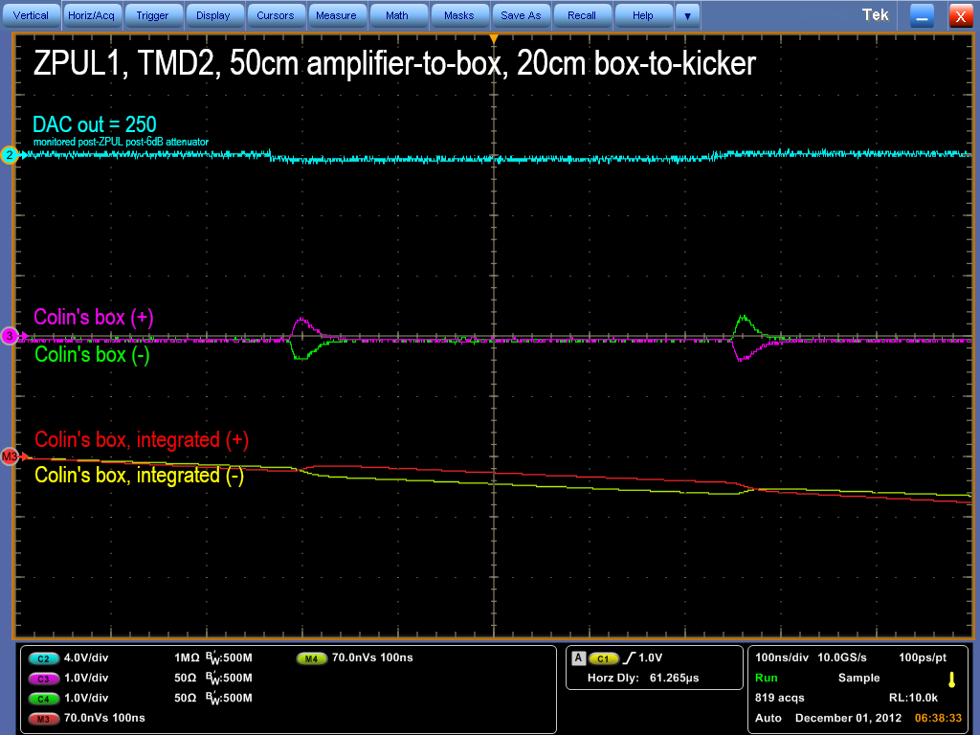

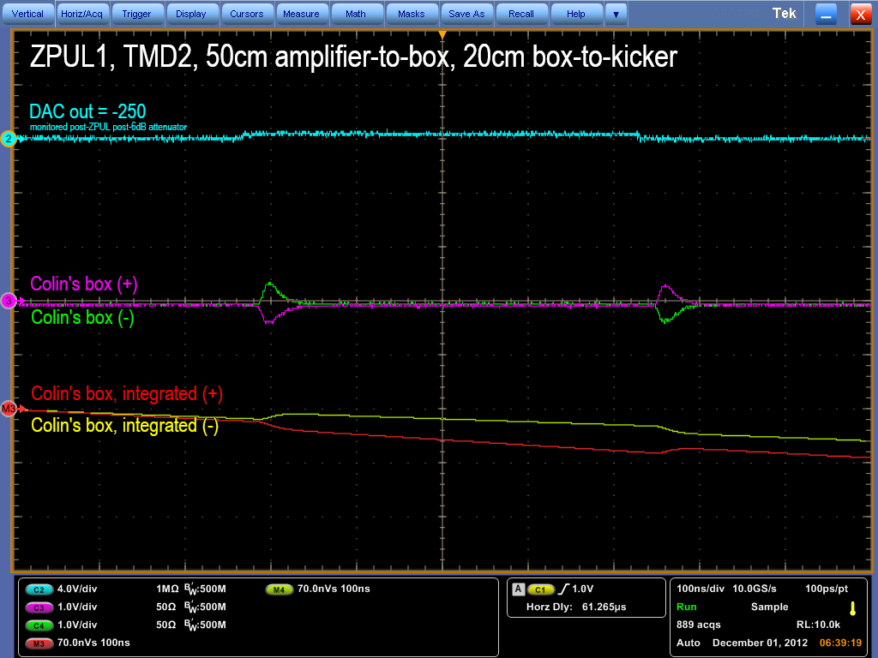
TMD1
TMD2
DAC out = 250
DAC out = -250
N. Blaskovic

Slide 9
Observations
Waveforms are virtually identical for both TMD1 and TMD2.
The amplifiers seem to saturate at DAC settings ≥ 2000, but not at settings ≤ 1000.
The anomalous behaviour observed in the K1 kicker scans in October appears not to be caused by TMD2 malfunction nor by amplifier saturation.
N. Blaskovic

