Slide 1

Test Bench
Wenxin Wang
11/12/2012

Slide 2
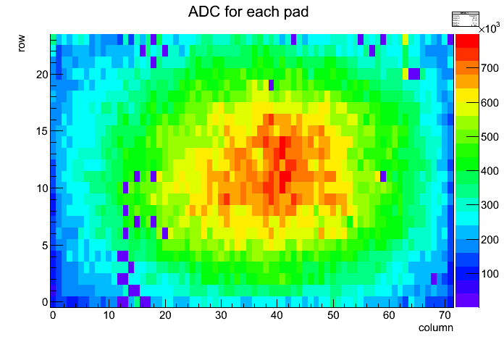
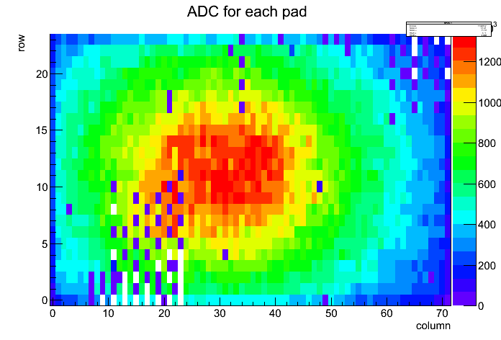
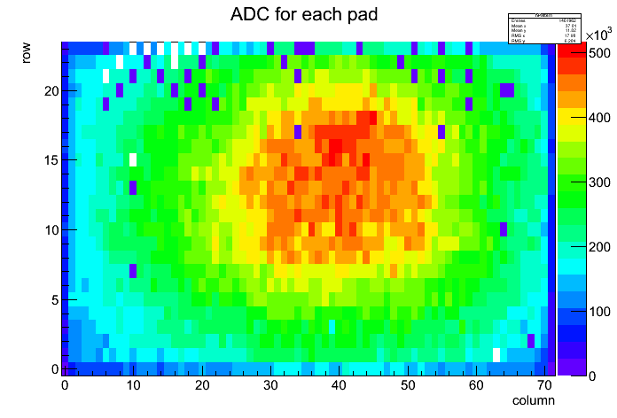
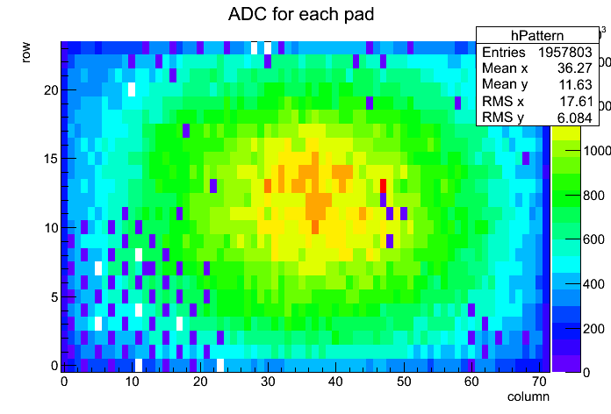
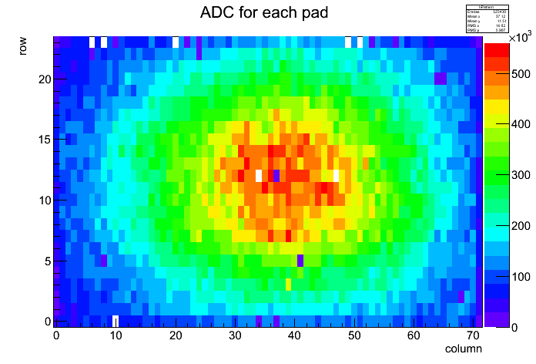
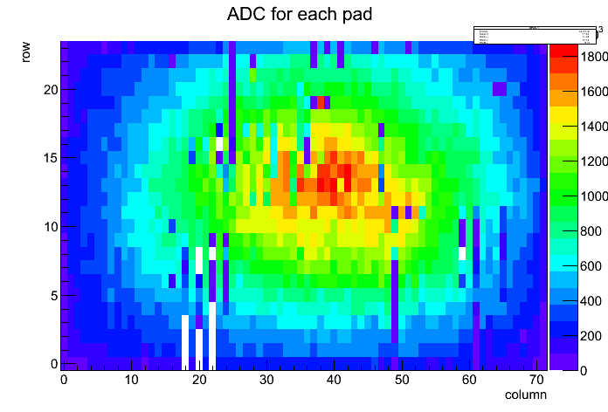
Test Bench
S1F_fem2 S3B-fem7 S8G-fem4
S4E-fem3 S7H-fem1 S9A-fem2

Slide 3
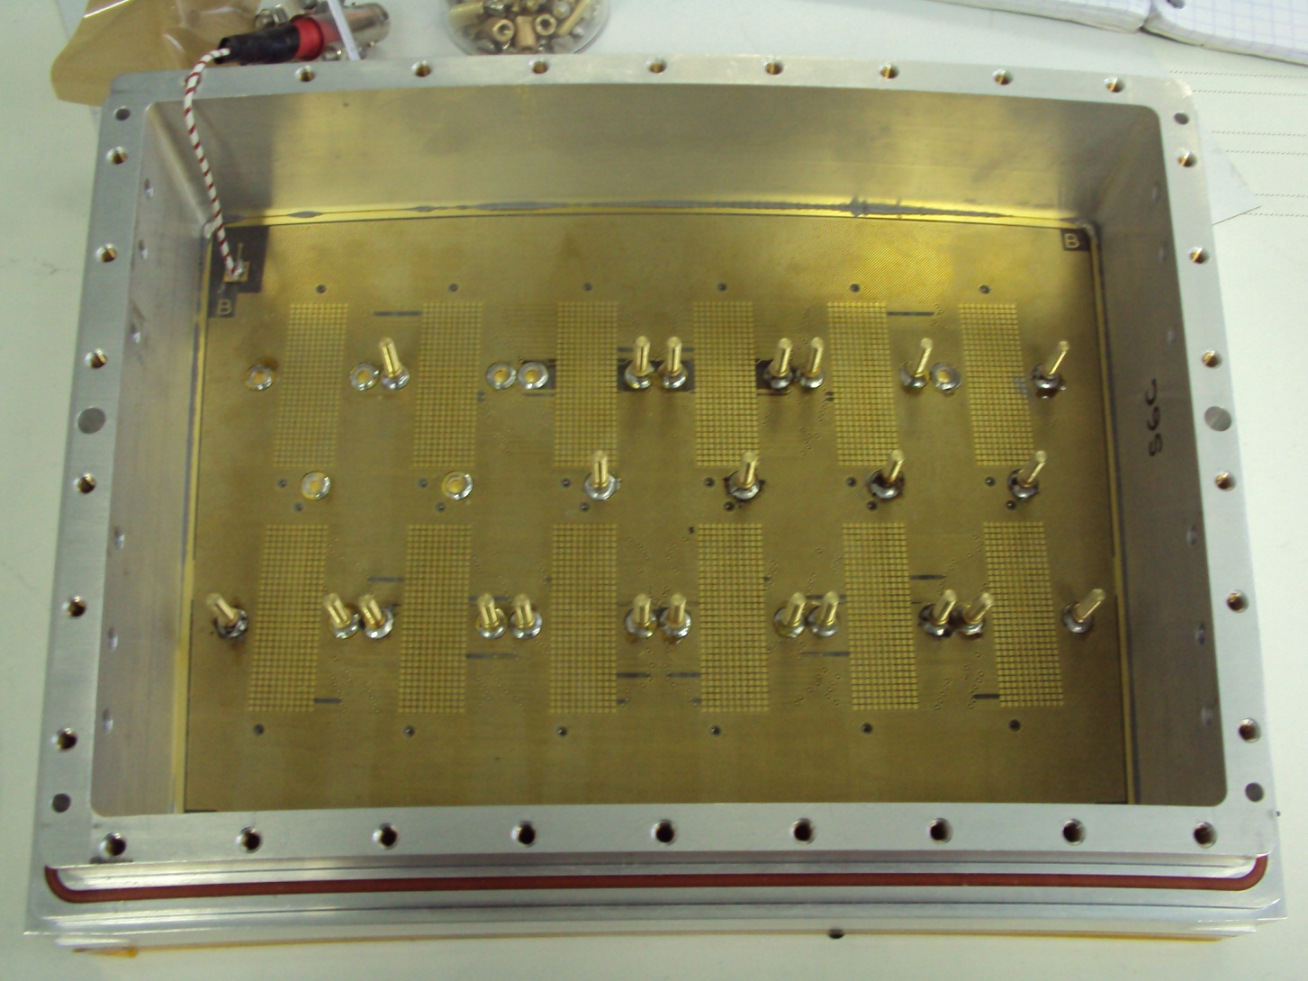

Disconnected Pads

Slide 4
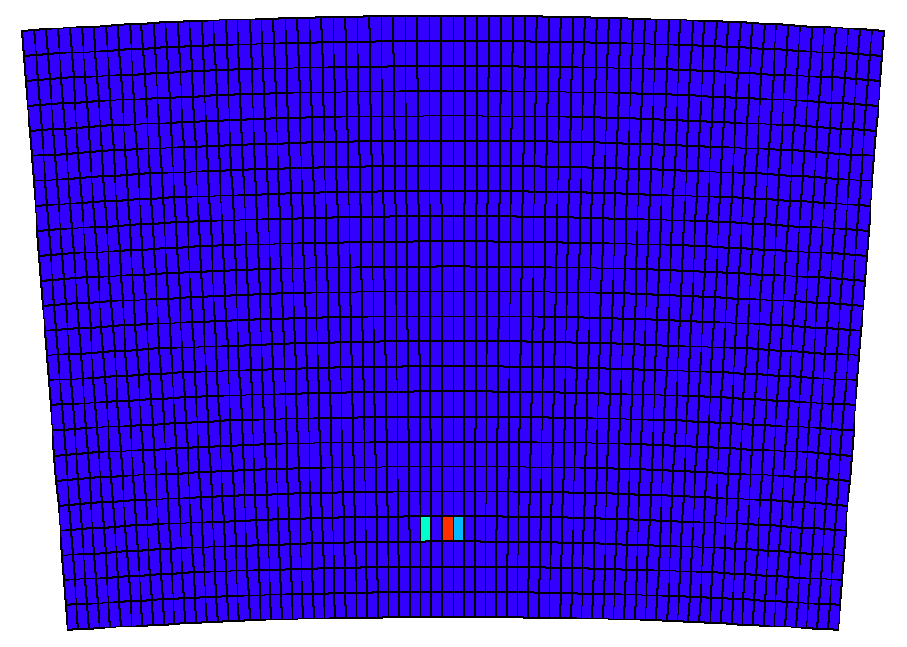
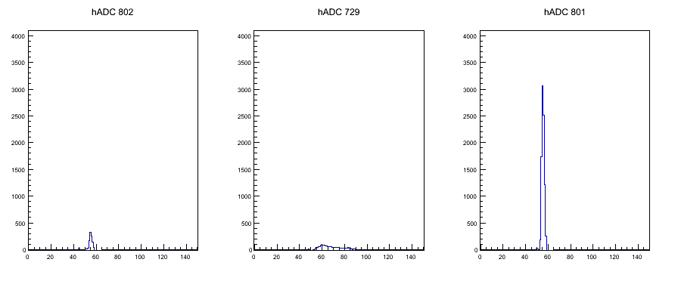
Cross-talk

Slide 5
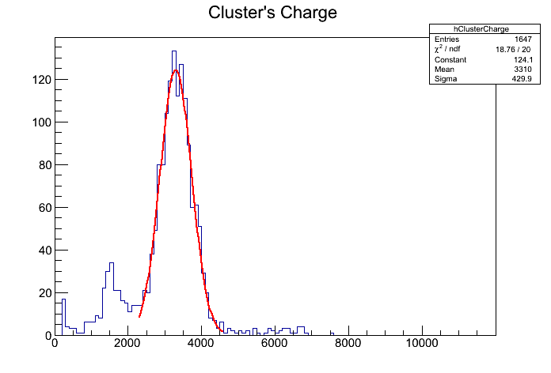
Energy resolution
Energy Resolution (preliminary) :~13% rms
Gain ~2600
(using collimated source)

Slide 6
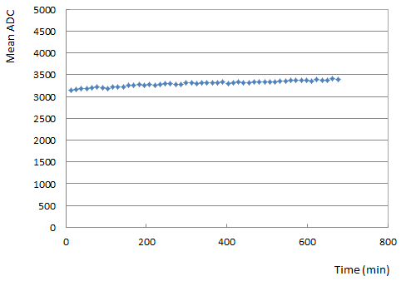
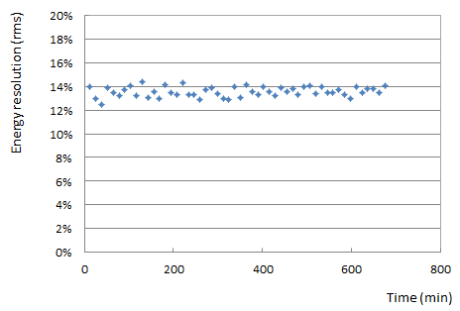
Stability
5h
10h
5h
10h
Energy resolution as a function of time
Mean ADC of cluster as a function of time

Slide 7
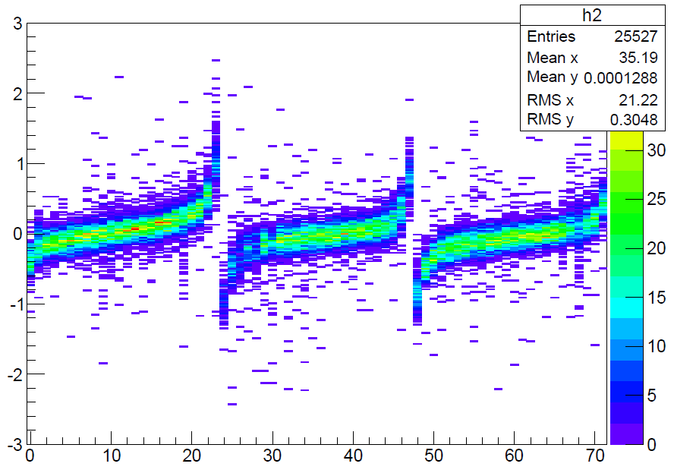
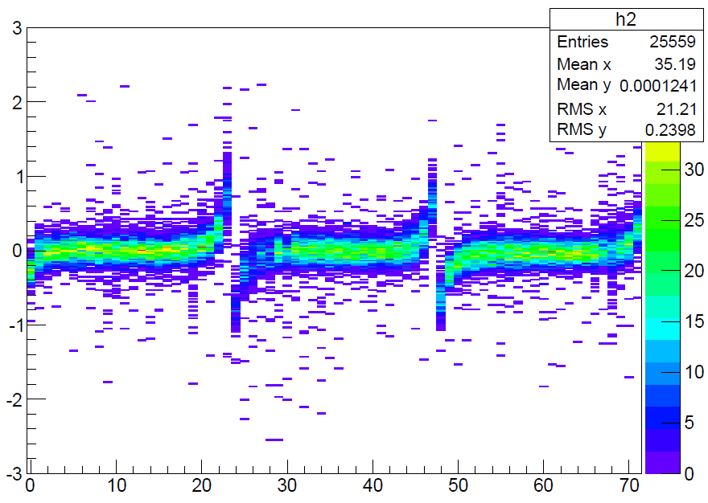
Six modules (B=1T)
Row Number: 3 x 24 = 72 Displacement in mm
One module has 1726 pads (24 rows x72 columns)
(b): After alignment
δφ= 2.9 , 2.1 and 2.2 mrad
δx = 47 µm, -43 µm and -52 µm
(a): Before alignment

