Slide 1
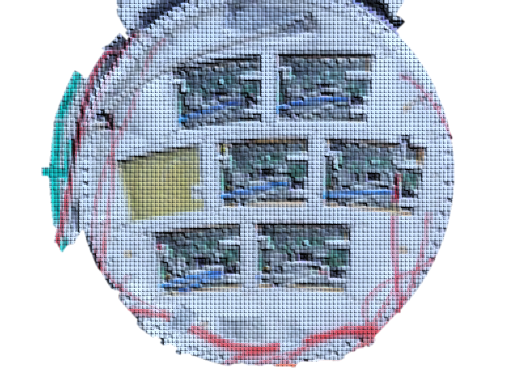

7-Module Crosstalk
D. Attié
Notes:
I’m here to present a TPC review

Slide 2
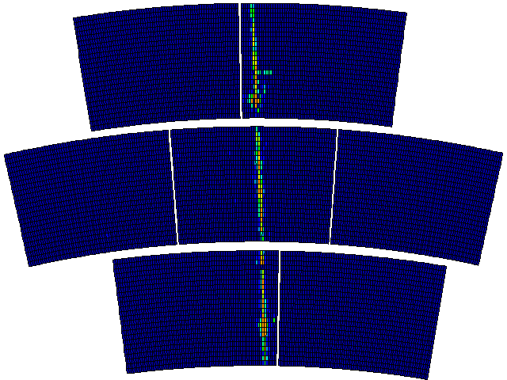
Some events: all have crosstalk

Slide 3
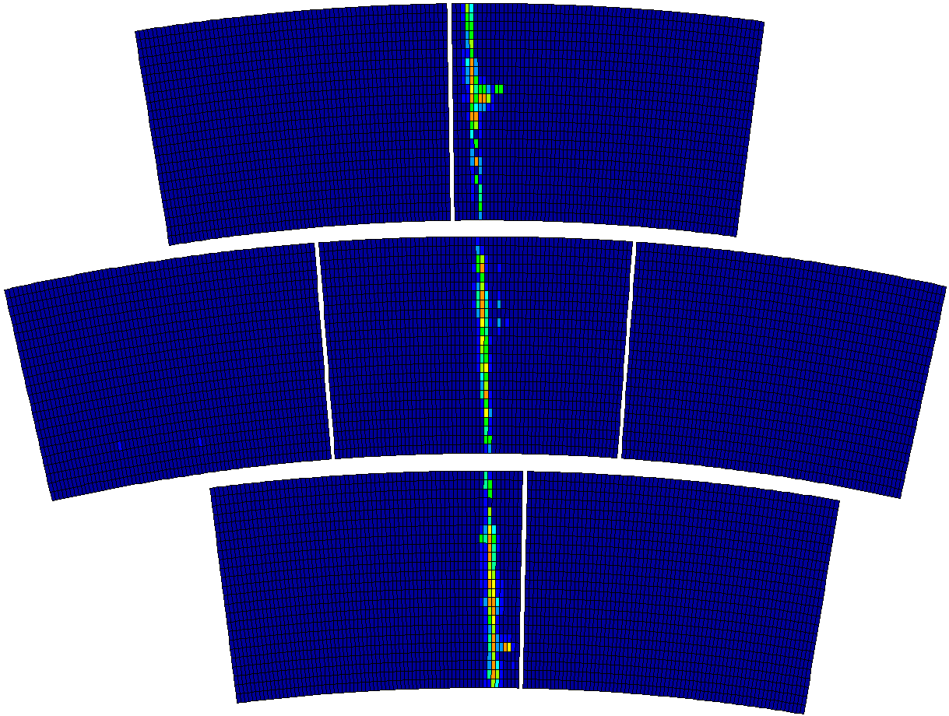
Event selection with overflowed signals

Slide 4
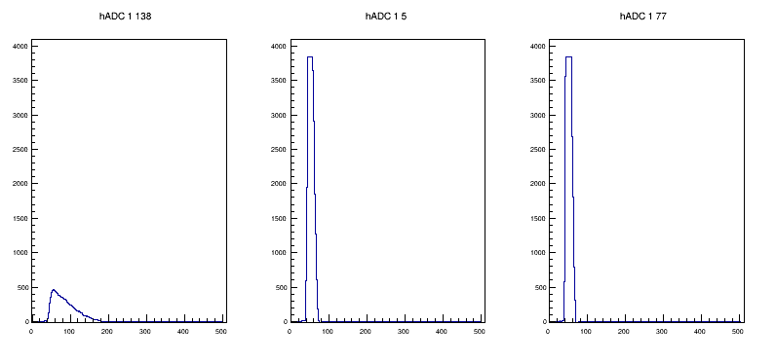
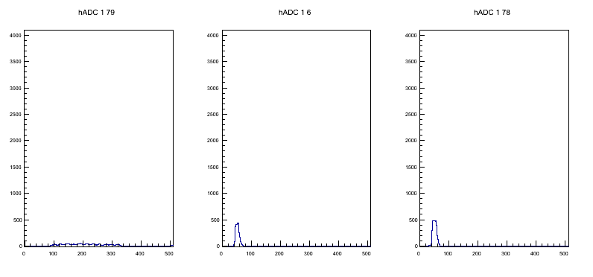
Crosstalk size ~12 %
3845
3845
436
477

Slide 5
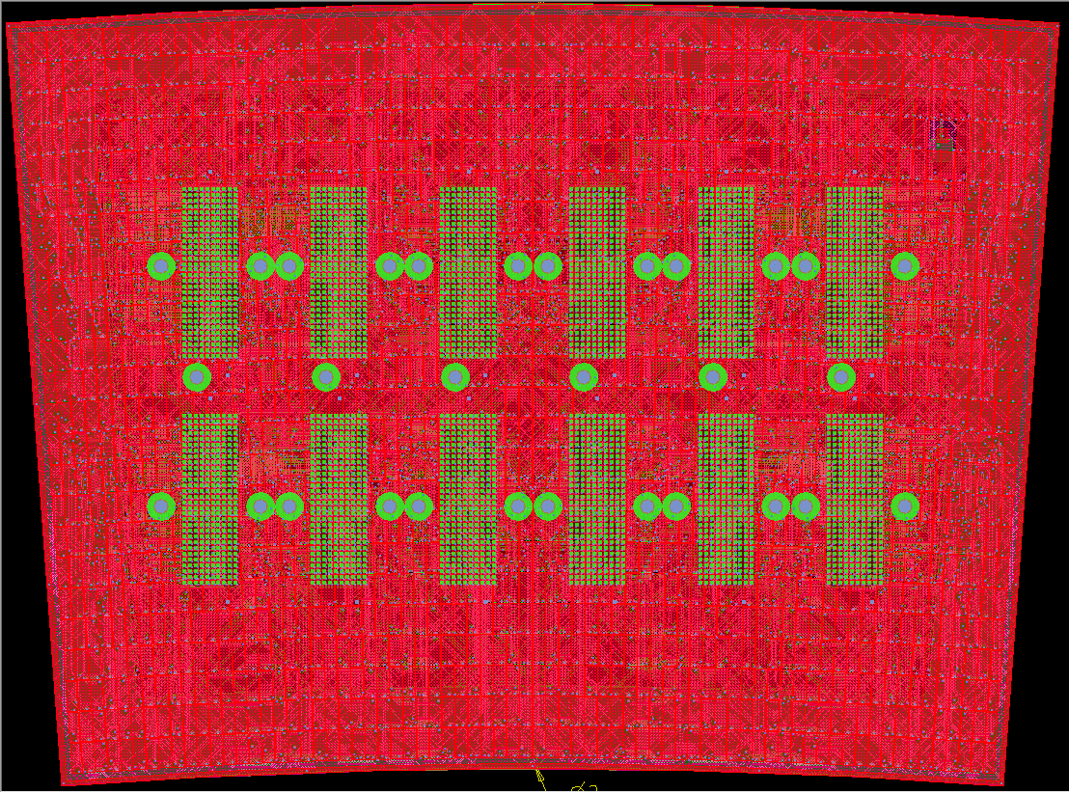

Detector routing

Slide 6
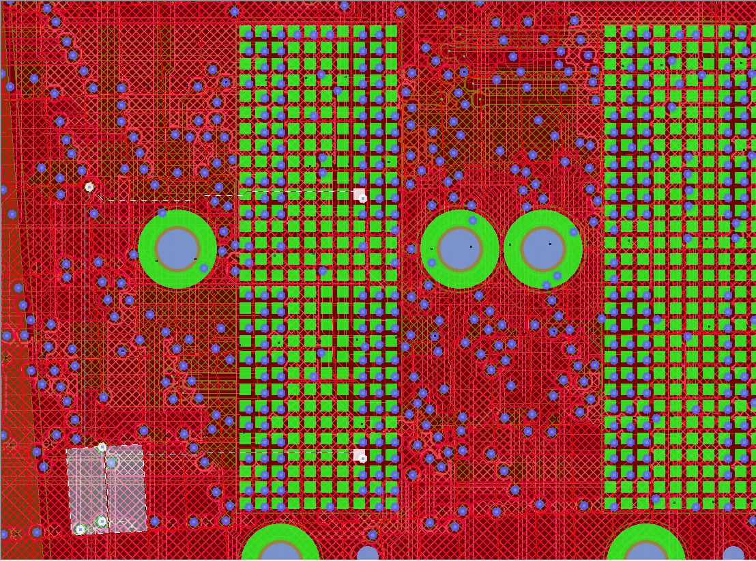
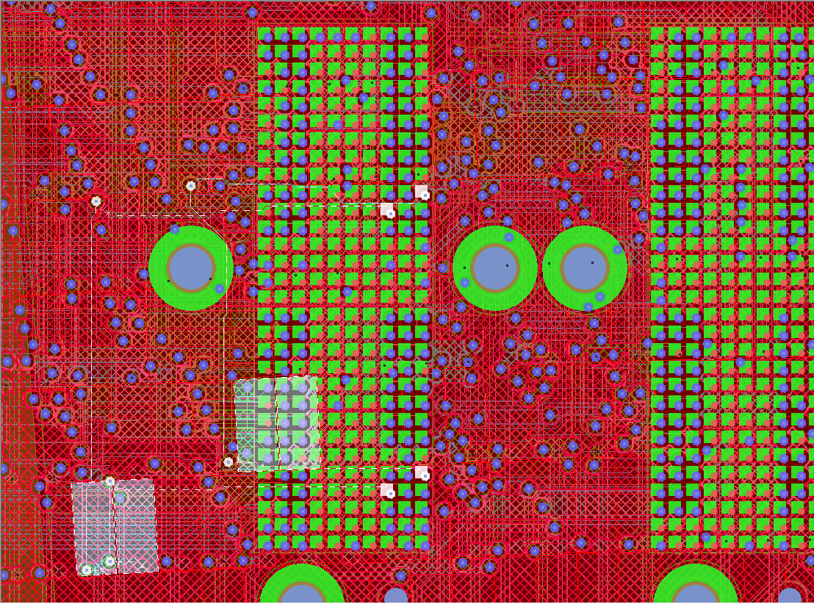
Detector routing

Slide 7
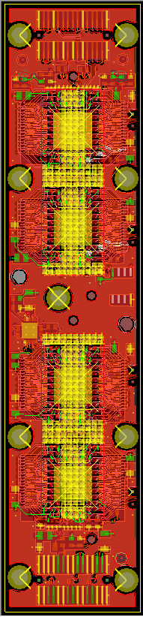
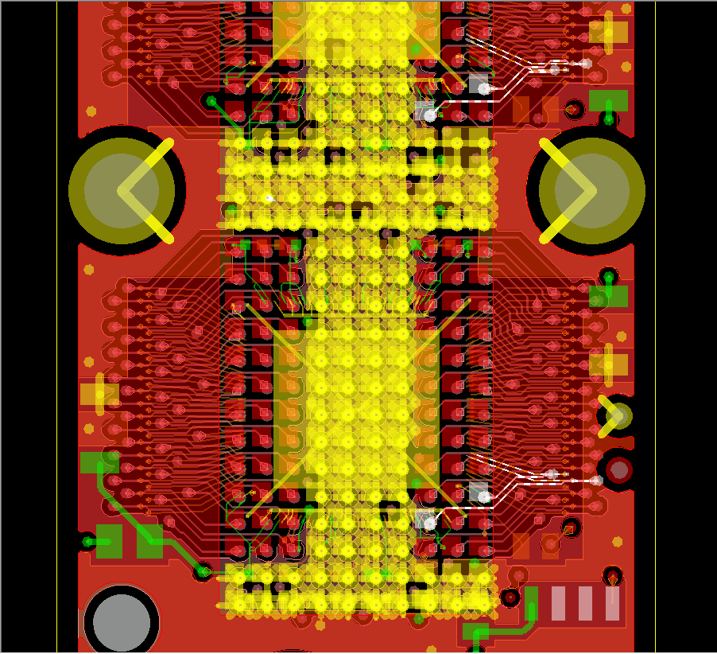
ASIC inputs
33
34
30
31

Slide 8
ASIC inputs
33
34

Slide 9
ASIC inputs
30
31

Slide 10
Conclusion
Crosstalk not coming from detector board routing or FEC board routing
ADC clock misalignment while reading analog output signal from ASICs?

