Slide 1
FONT5 board #2 DAC tests
N. Blaskovic

Slide 2
Introduction
Young-Im and I saw a flickering DAC1 output from FONT5 board #1 on Monday.
Following Doug, Glenn and Colin’s suggestion, the DAC outputs of the available FONT5 board (#2) were tested.
Scope screens presented here were saved on infinite persistence to record any such flickering.
N. Blaskovic

Slide 3
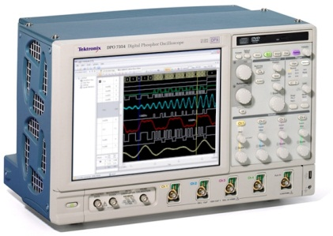
Set-up
S-band hut
C-band hut
Trigger
Fan out
Ring clock
Fan out
50Ω termination
Local Control Room (LCR)
FONT5 board 2
Dig in 1
DAC 1
Dig in 2
DAC 2
Mikey’s clock distribution box
Fast clock
50Ω termination
N. Blaskovic

Slide 4
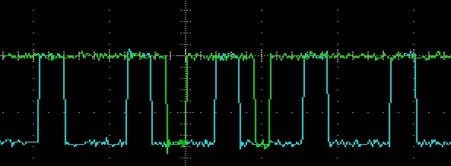
Note on fan outs
It was found that the pairs of fan out outputs must be terminated if not in use.
A scope was used for termination due to inability to find 50 Ω terminators.
If unterminated, spurious edges observed, e.g. ‘double’ trigger.
‘double’ trigger
ring clock
N. Blaskovic

Slide 5
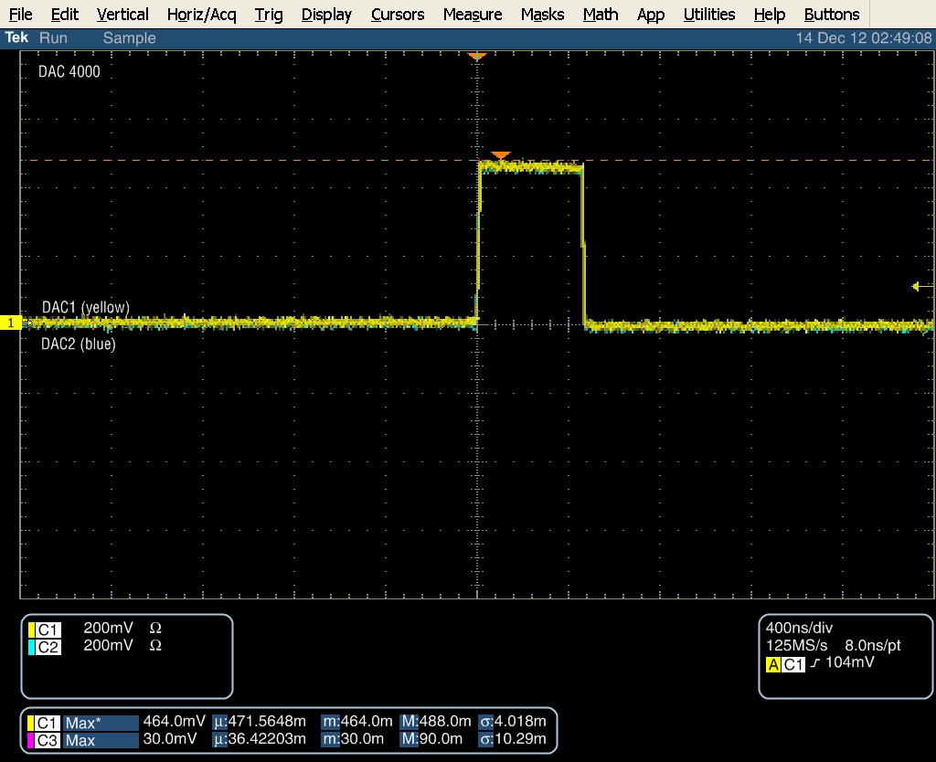
ZPUL3 power supply
DAC 4000, in binary: 0 1111 1010 0000
N. Blaskovic

Slide 6
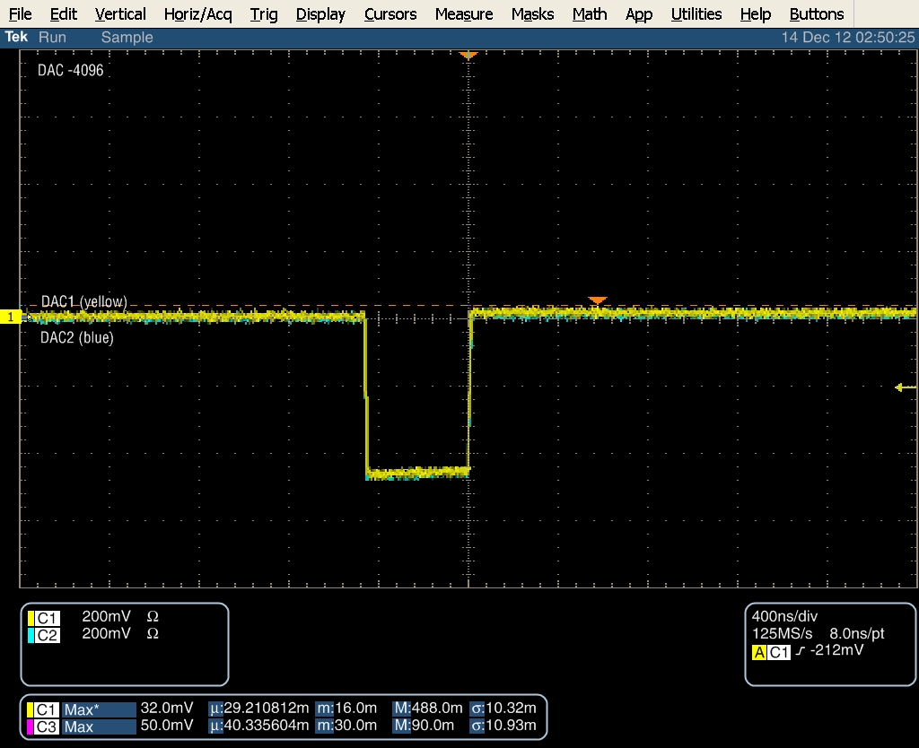
ZPUL3 power supply
DAC -4096, in binary: 1 0000 0000 0000
N. Blaskovic

Slide 7
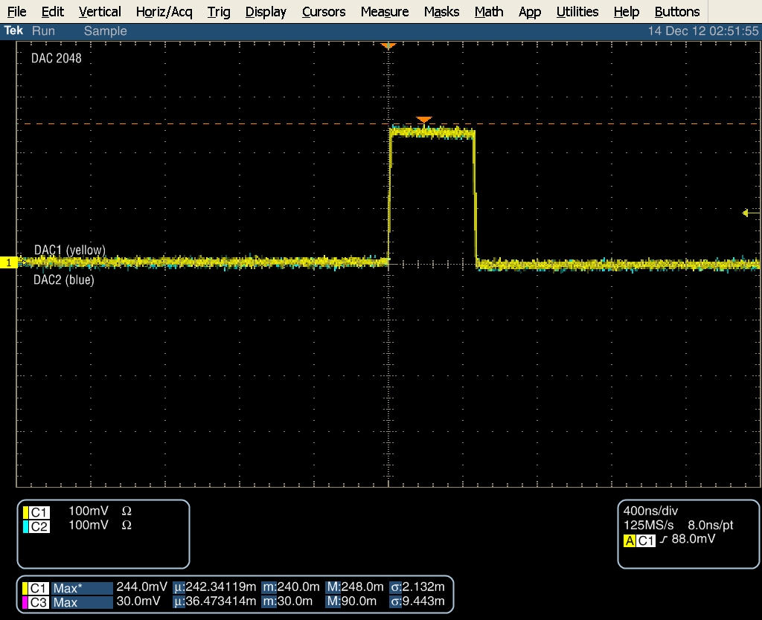
ZPUL3 power supply
DAC 2048, in binary: 0 1000 0000 0000
N. Blaskovic

Slide 8
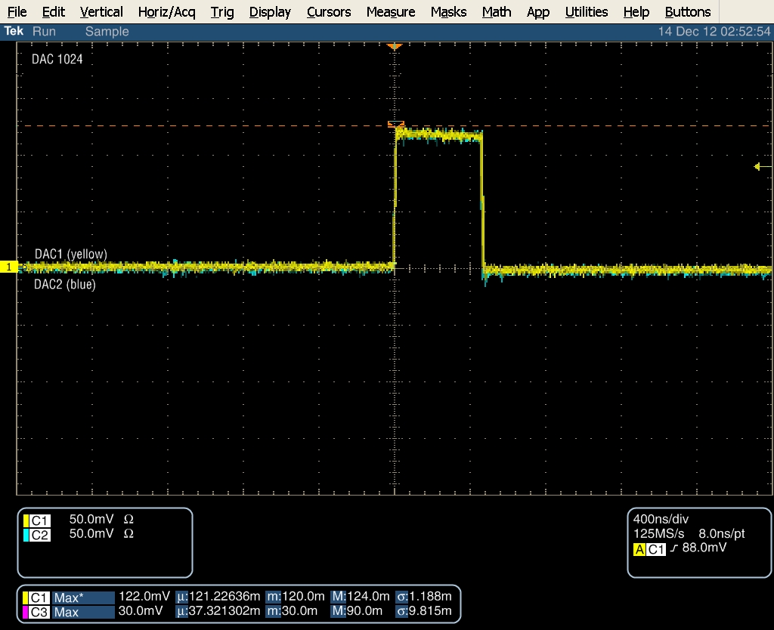
ZPUL3 power supply
DAC 1024, in binary: 0 0100 0000 0000
N. Blaskovic

Slide 9
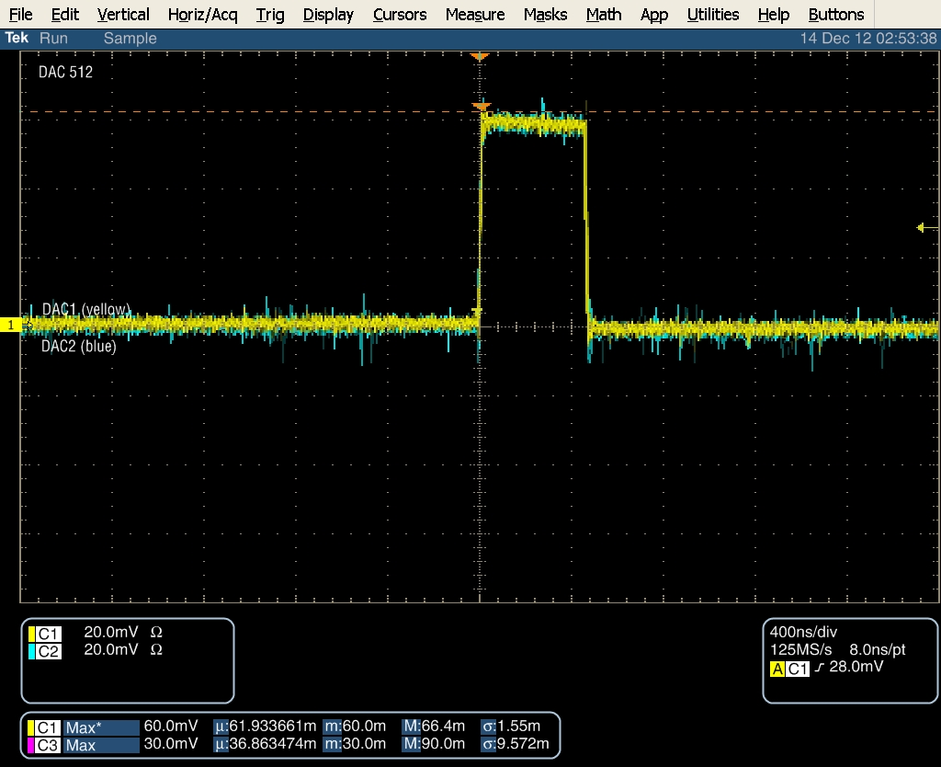
ZPUL3 power supply
DAC 512, in binary: 0 0010 0000 0000
N. Blaskovic

Slide 10
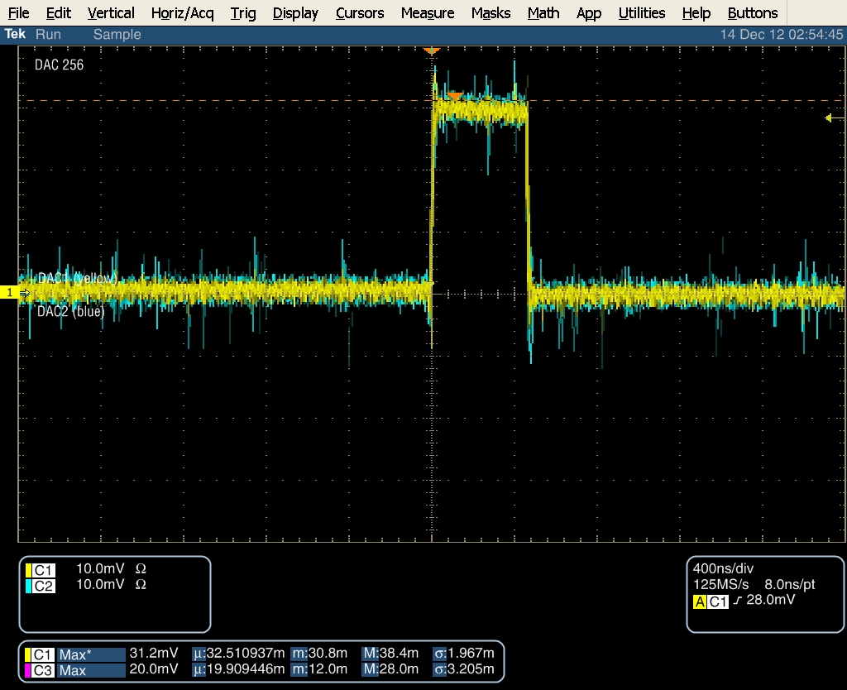
ZPUL3 power supply
DAC 256, in binary: 0 0001 0000 0000
N. Blaskovic

Slide 11
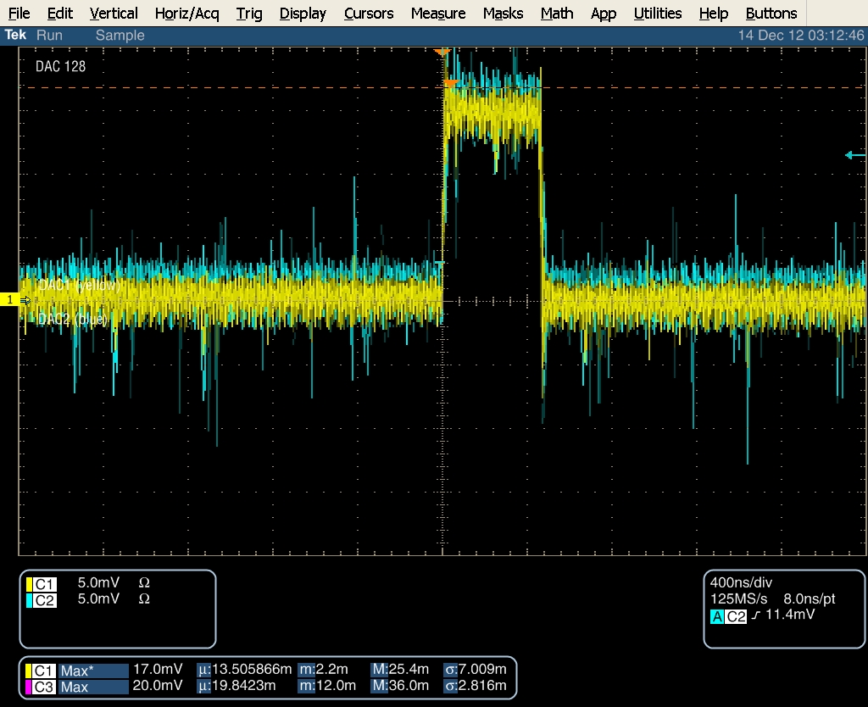
ZPUL3 power supply
DAC 128, in binary: 0 0000 1000 0000
N. Blaskovic

Slide 12
Comment
The series of power-of-2 DAC settings show no anomalous behaviour.
A drawback is that the scope is triggered on the DAC waveform itself; a null output will not trigger!
Triggering on the kicker trigger would have been appropriate.
Final test: exonerate a DAC out of 1000.
N. Blaskovic

Slide 13
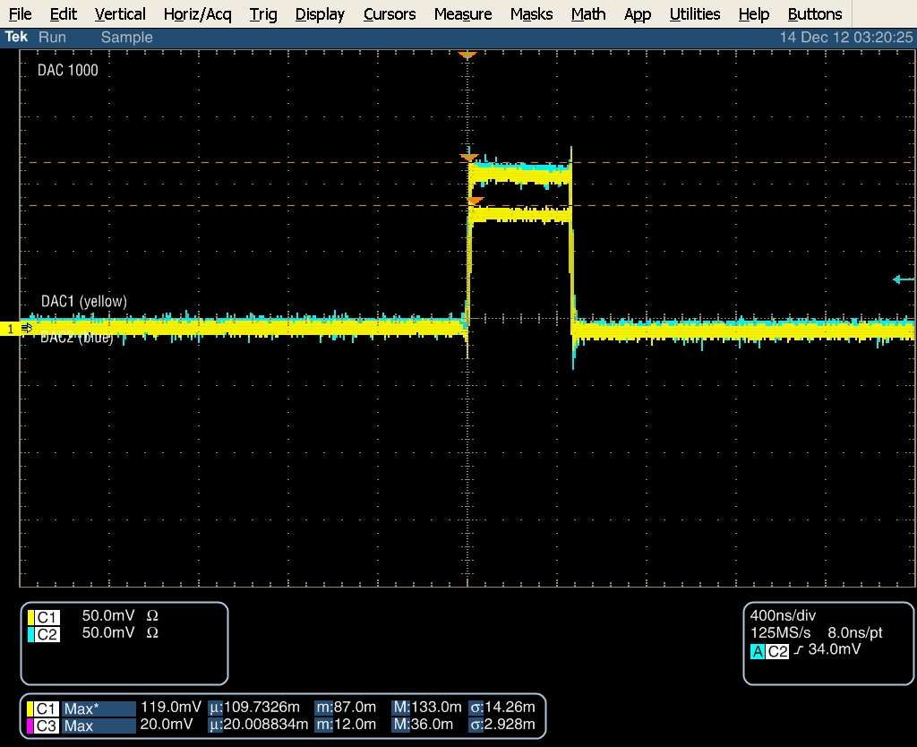
ZPUL3 power supply
DAC 1000, in binary: 0 0011 1110 1000
N. Blaskovic

Slide 14
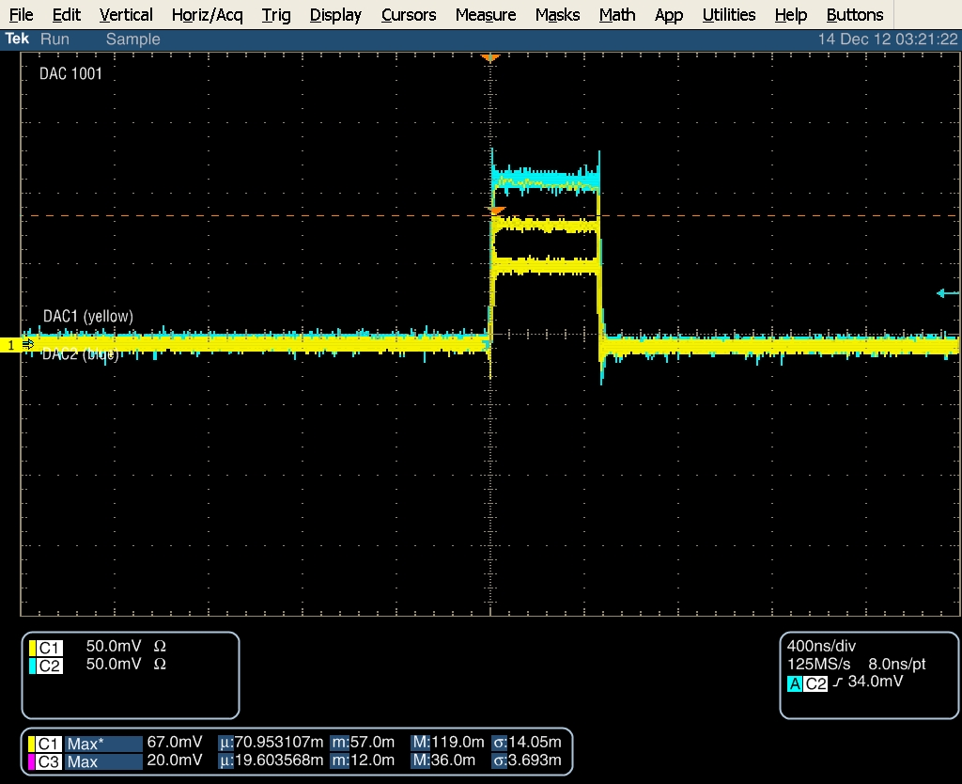
ZPUL3 power supply
DAC 1001, in binary: 0 0011 1110 1001
N. Blaskovic

Slide 15

ZPUL3 power supply
DAC 1002, in binary: 0 0011 1110 1010
N. Blaskovic

Slide 16
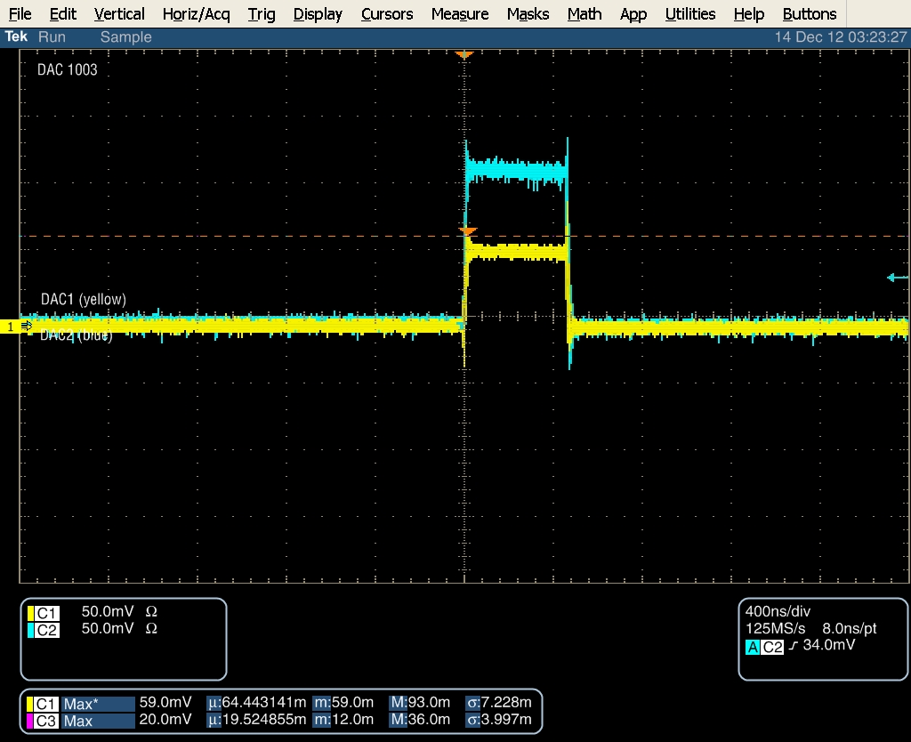
ZPUL3 power supply
DAC 1003, in binary: 0 0011 1110 1011
N. Blaskovic

Slide 17

ZPUL3 power supply
DAC 1004, in binary: 0 0011 1110 1100
N. Blaskovic

Slide 18
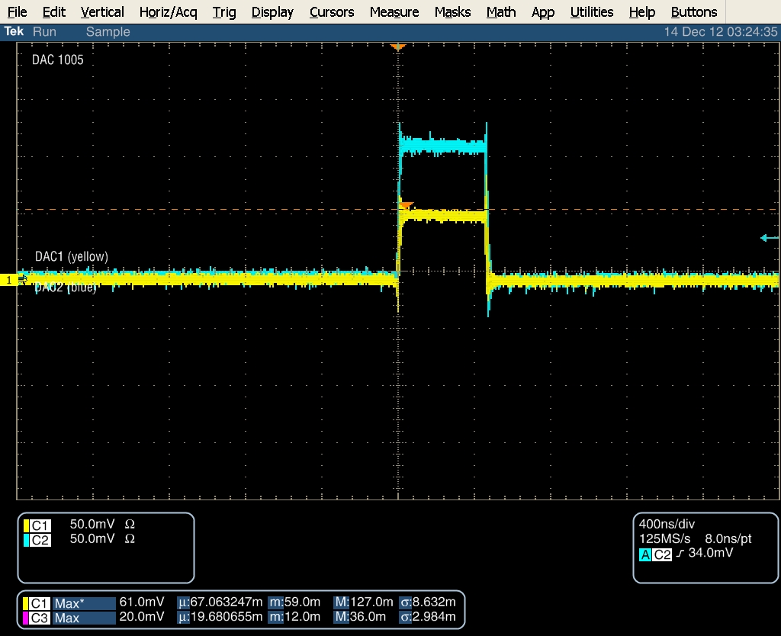
ZPUL3 power supply
DAC 1005, in binary: 0 0011 1110 1101
N. Blaskovic

Slide 19
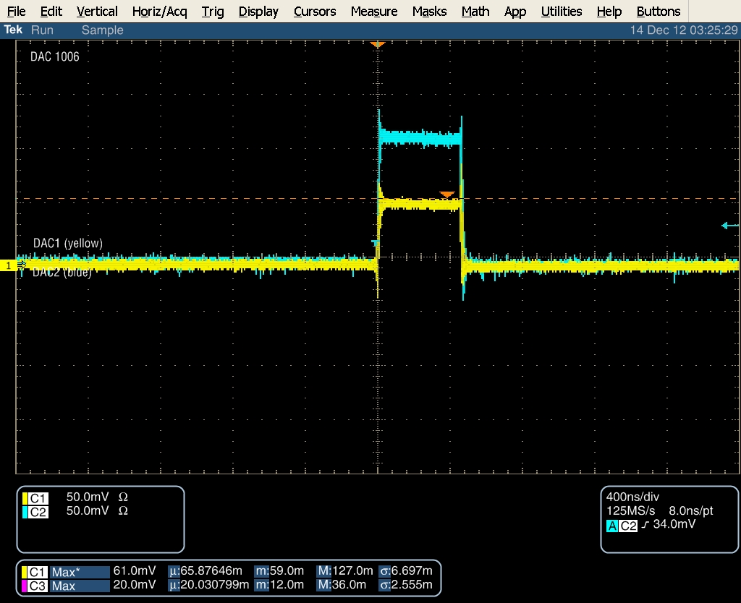
ZPUL3 power supply
DAC 1006, in binary: 0 0011 1110 1110
N. Blaskovic

Slide 20
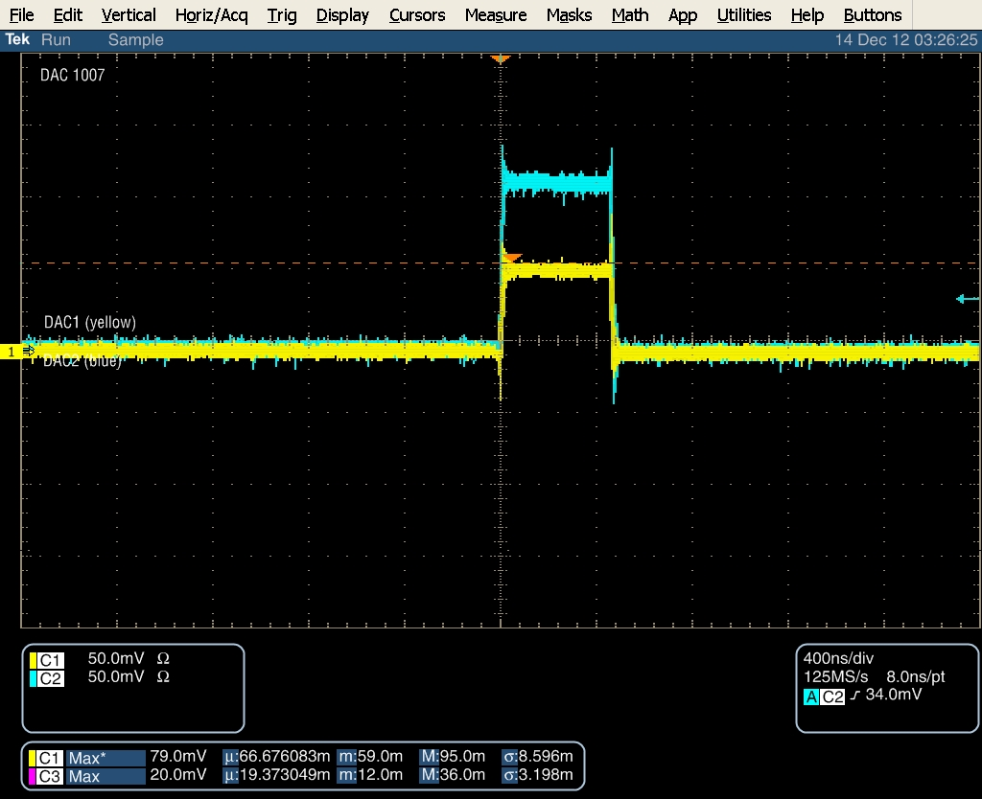
ZPUL3 power supply
DAC 1007, in binary: 0 0011 1110 1111
N. Blaskovic

Slide 21

ZPUL3 power supply
DAC 1008, in binary: 0 0011 1111 0000
N. Blaskovic

Slide 22

ZPUL3 power supply
DAC 1009, in binary: 0 0011 1111 0001
N. Blaskovic

Slide 23

ZPUL3 power supply
DAC 1010, in binary: 0 0011 1111 0010
N. Blaskovic

Slide 24
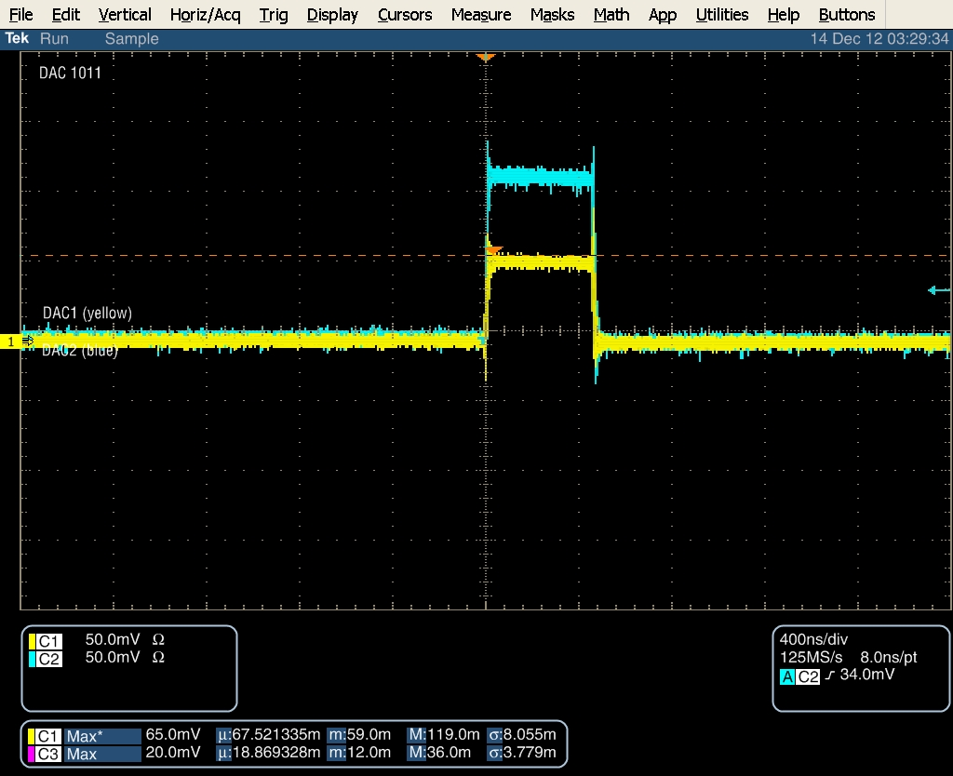
ZPUL3 power supply
DAC 1011, in binary: 0 0011 1111 0011
N. Blaskovic

Slide 25

ZPUL3 power supply
DAC 1012, in binary: 0 0011 1111 0100
N. Blaskovic

Slide 26
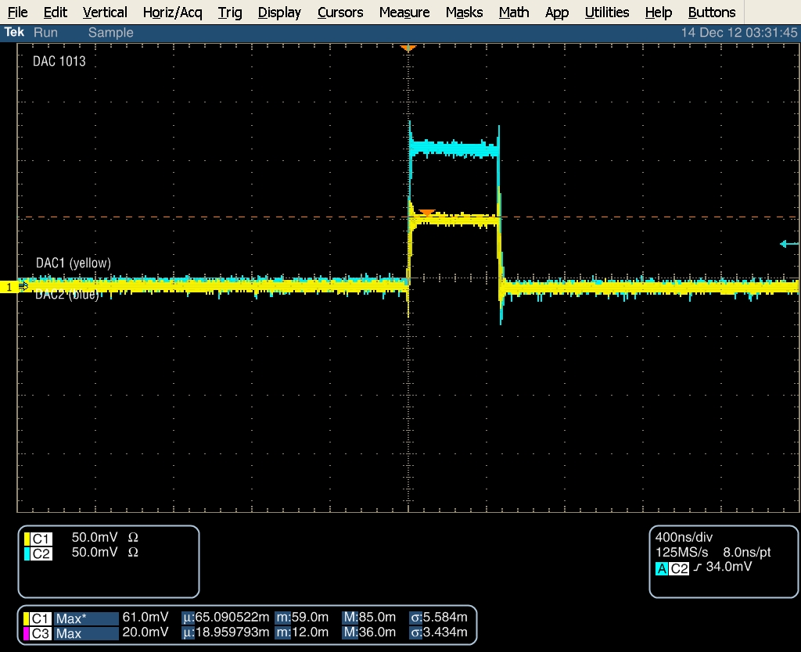
ZPUL3 power supply
DAC 1013, in binary: 0 0011 1111 0101
N. Blaskovic

Slide 27
Observations
The DAC1 flickering output was obtained again, using the other FONT5 board than on Monday.
The DAC2 output does not flicker.
The existence and extent of flickering may depend on the number of ‘1’ digits in the binary form of the DAC value set.
N. Blaskovic

