Slide 1


Remote Control Phase Shifter Initial Tests
Mikey Davis
14 December 2012
1/4

Slide 2
Setup
Phase shifters have been installed in the tunnel
Installed on P1 and P2
Processor no. 8 has been left on P2
The screw head phase shifters are used on the other channels to compensate
Mikey Davis
14 December 2012
2/4

Slide 3
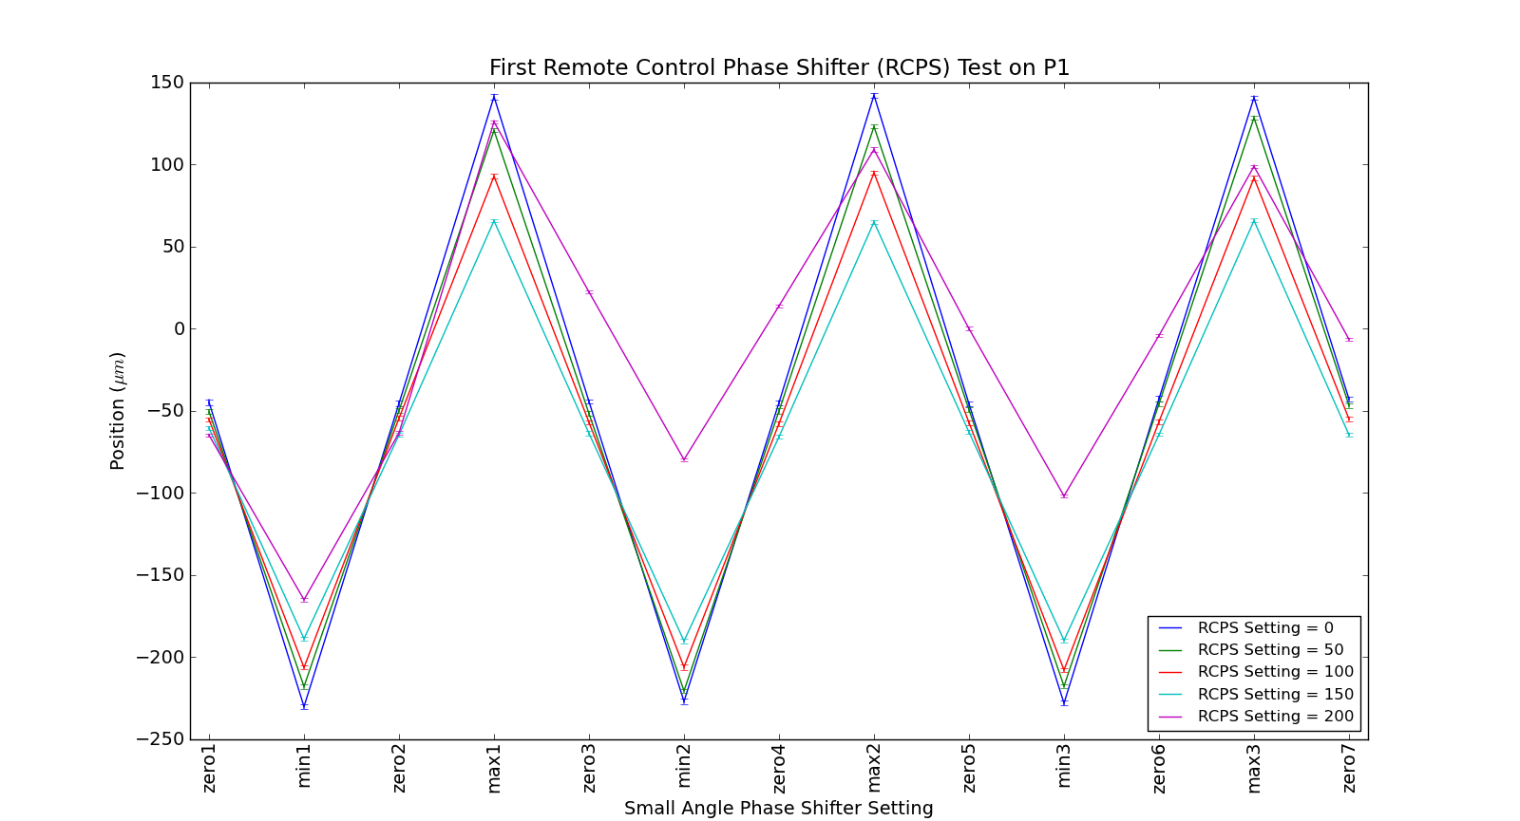
Initial Results
Mikey Davis
14 December 2012
3/4

Slide 4
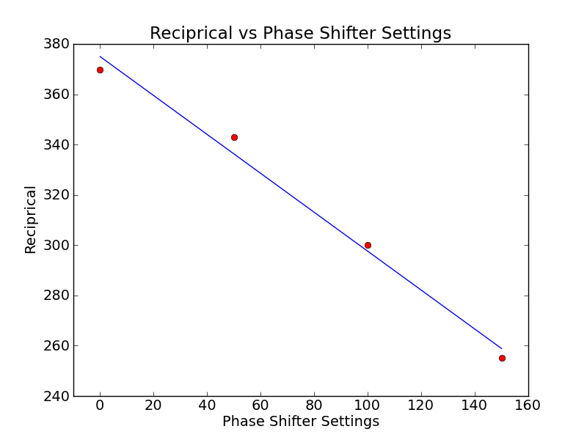
Reciprocal Plot
Mikey Davis
14 December 2012
4/4

