Slide 1
PAC report
Yasuhiro Sugimoto
2012/12/19

Slide 2
PAC meeting
Web page
  http://ilcagenda.linearcollider.org/conferenceDisplay.py?confId=5843
Physics and detector session on Dec. 14th
Tim Barklow presented SiD analysis quite in detail, while I presented ILD results very briefly

Slide 3
My presentation for benchmark analysis

Slide 4
LOI benchmark
ECM (GeV) | Observable | Precision | Comments | Post LOI analysis
250 | σ(e⁺e⁻ → Zh) | 2.5% | Model independent
 | m_{h} | 32 MeV | Model independent
 | m_{h} | 27 MeV | Model dependent
250 | Br(h→bb) | 2.7% | Includes 2.5% of σ(Zh) | 2.7%*
 | Br(h→cc) | 12% |  | 7.3%*
 | Br(h→gg) | 29% |  | 8.9%*
 | Br(h→ττ) |  |  | 4.9%
 | Br(h→WW*) |  |  | 8.6%
500 | σ(e⁺e⁻ →χ₁⁺χ₁⁻) | 0.6%
 | σ(e⁺e⁻ →χ₂⁰χ₂⁰) | 2.1%
 | m(χ₁⁺) | 2.4 GeV | From kinematical edges Two masses (LSP and χ₁⁺/χ₂⁰) are fitted simultaneously
 | m(χ₂⁰) | 0.9 GeV
 | m(χ₁⁰) | 0.8 GeV
* http://arxiv.org/abs/arXiv:1207.0300
H.Ono, Akiya Miaymoto

Slide 5
LOI benchmark
ECM (GeV) | Observable | Precision | Comments
500 | σ(e⁺e⁻→ττ) | 0.29% | θττ>178degree
 | A^{τ}_{FB} | 0.0025 | θττ>178degree
 | Pτ | 0.007 | Excluding a₁ν
500 | σ(e⁺e⁻ → tt) | 0.4% | (bqq)(bqq) only
 | m_{t} | 40 MeV | Fully hadronic only
 | m_{t} | 30 MeV | + semi-hadronic
 | Γ_{t} | 27 MeV | Fully hadronic only
 | Γ_{t} | 22 MeV | + semi-hadronic
 | A_{FB} | 0.0079 | Fully hadronic only
500 | σ(e⁺e⁻→μ_{L}⁺μ_{L}⁻) | 2.5% | SPS1a’ (smuon)
 | m(μ_{L}) | 0.5 GeV
500 | m(τ₁) | 0.1GeV⊕1.3σ_{LSP} | SPS1a’ (stau)
1000 | α₄ | -1.4< α₄ <1.1 | Strong EWSB in WW scattering
 | α₅ | -0.9< α₅ < 0.8

Slide 6
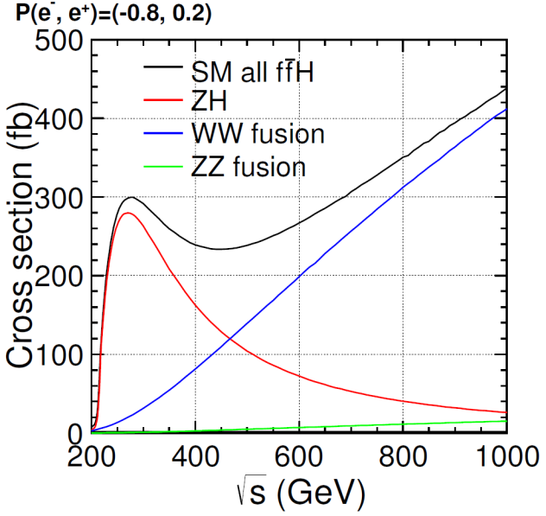
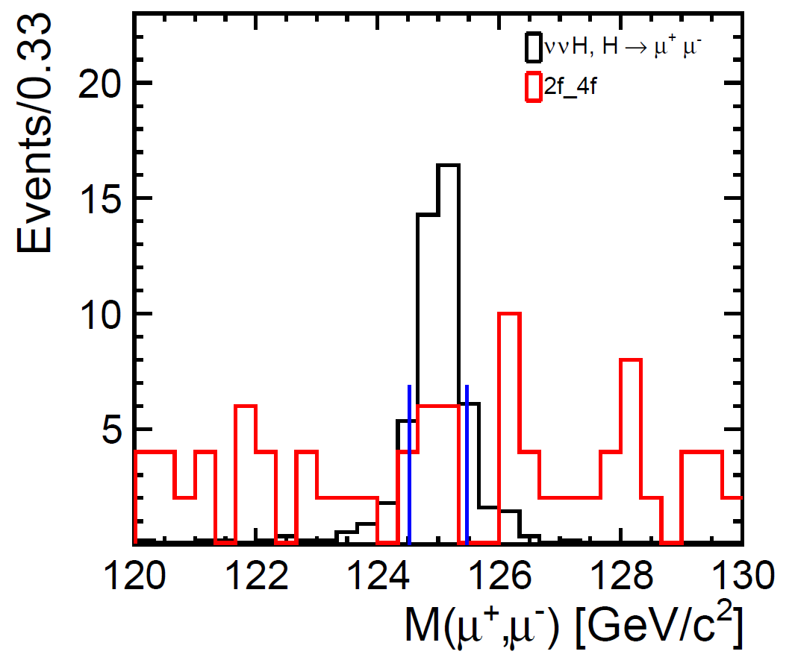
1TeV benchmark
e⁺e⁻ → ννh
  Higgs production cross section is larger than 250 GeV
  Luminosity is larger than 250 GeV
  Higgs → μμ channel can be measured
Decay mode | σBr accuracy (500fb⁻¹, -0.8,+0.2) | Comments
bb | 0.4%
cc | 5%
gg | 4%
WW* | 3% | Fully hadronic mode only
μμ | ??
Preliminary

Slide 7
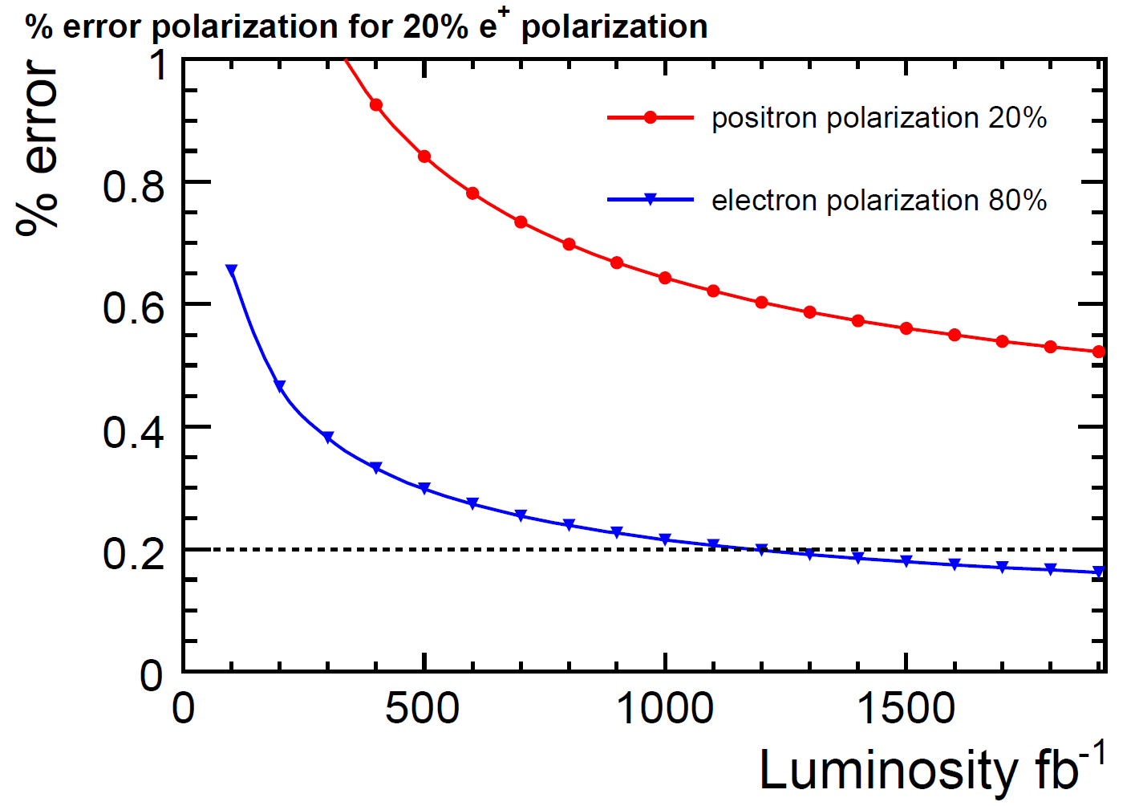
1TeV benchmark
e⁺ e⁻ → W⁺ W⁻
  Precise measurement of beam polarization
  Two methods
    Modified Blondel scheme: (+,+),(+,-),(-,+),(-.-) data required
    Angular distribution of W → Analysis not finished yet
Blondel method

Slide 8
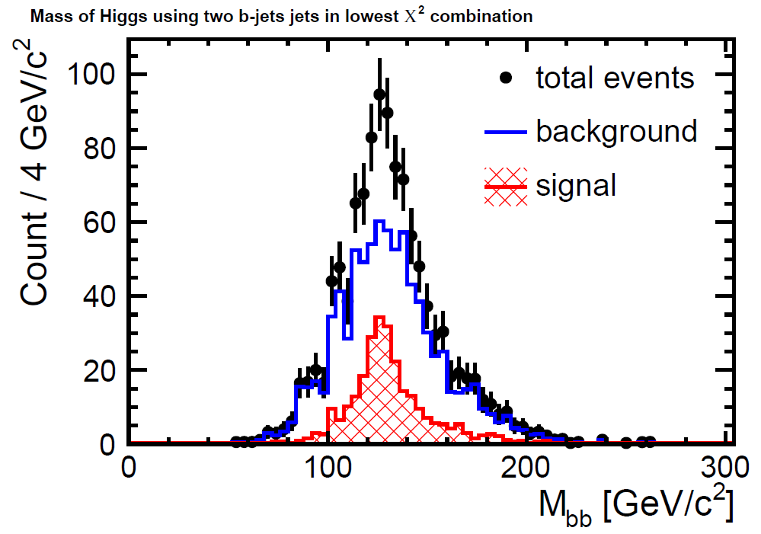
1TeV benchmark
e⁺ e⁻ → t t h
  Fully hadronic mode (8 jets, no isolated lepton) and semi-leptonic mode (6 jets + 1 isolated lepton) were used
  Main background: ttbb, ttZ, and tt
  Multivariable analysis technique is effective to reduce the background
  Preliminary result on accuracy of top Yukawa coupling with 500fb⁻¹ (+0.8,-0.2) and 500fb⁻¹ (-0.8,+0.2)
    7.0% for semi-leptonic mode
    6.5% for hadronic mode
    4.8% for combined data

Slide 9
LOI-DBD common benchmark
We used e⁺e⁻ → t t channel for the comparison between LOI and DBD analysis @500 GeV
Forward-backward asymmetry is determined by hadronic decay mode
Vertex charge determination is needed → good benchmark for vertex detector/finding
Results with 500fb⁻¹, P(e⁻, e⁺)=(-0.8, +0.3) :
  A^{t}_{FB} = (DBD)
  A^{t}_{FB} = 0.334±0.0079 (LOI)
Coming soon

Slide 10
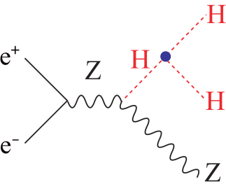
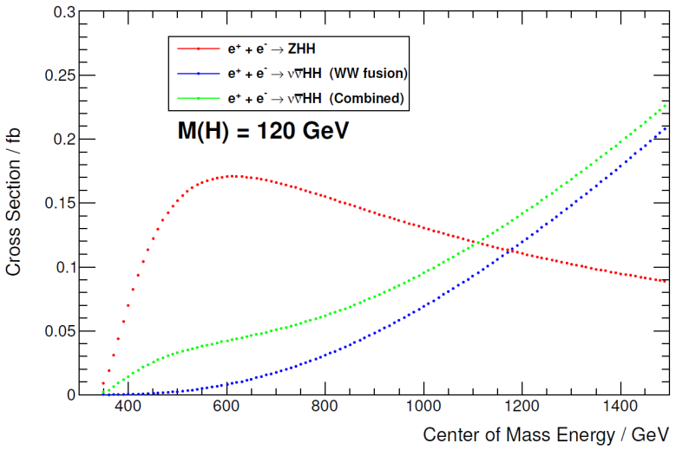
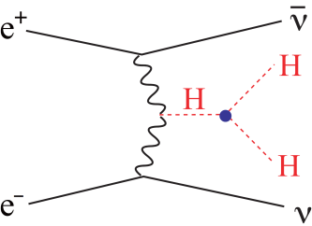
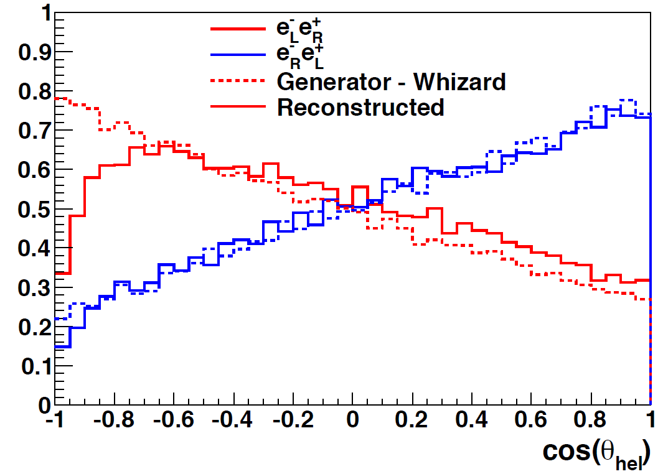
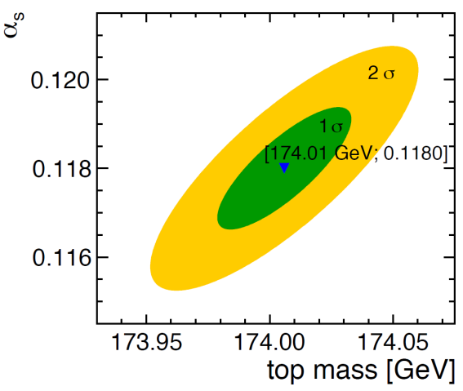
Other physics processes
Higgs self coupling
  Zhh final state at 500 GeV
    27% accuracy in Zhh cross section = 44% accuracy in λ with 2ab⁻¹
  ννhh final state at 1TeV
    17% accuracy in λ with 2ab⁻¹ (Fast simulation)
    Full simulation study on going
Further t t study
  A^{t}_{FB} by semi-leptonic decay mode
    1% measurement can be done
  A^{t}_{hel} (helicity asymmetry) measurement
  t t at threshold: measurement of m_{t} and α_{s}

Slide 11
Discussion at PAC

Slide 12
SUSY mass
There is large difference of the accuracy of SUSY masses between SiD and ILD in LOIs
We discussed this issue and we understand the reason
We still have to discuss how to present it in DBD → Tim will contact Jenny to discuss it

Slide 13
Higgs branching ratio at 1TeV
SiD knows the unbelievable accuracy in Higgs branching ratio at 1TeV is wrong
They will re-evaluate the accuracy

Slide 14
Beam polarization
SiD and ILD should use same luminosity for each polarization combination
If possible, we should give the results of both cases (1ab⁻¹ with preferable polarization and 500fb⁻¹ each) → Gives a guideline for running plan at 1TeV
 | L (-80%,+20%) | L (+80%,-20%) | SiD | ILD
tth | 1000 fb⁻¹ | 0 | 4.1% | NA
 | 500 fb⁻¹ | 500 fb⁻¹ | 4.6% | 4.8%
WW | 500 fb⁻¹ | 500 fb⁻¹ | 0.17% (e-) | In progress
ννh | 1000 fb⁻¹ |  | In progress | ?
 | 500 fb⁻¹ | (500 fb⁻¹) |  | Results shown

Slide 15
BR summary table
IDAG suggested to make one table which summarizes precision of branching ratios of all accessible decay channels by ILC
The table would be placed either in the Physics volume or in the introduction chapter of DBD
Michael Peskin and Keisuke Fujii will discuss how to make it

Slide 16
All summary table
In PEB meeting yesterday, Sakue-san mentioned that the directorate is considering to make a table summarizing all of the physics analysis results, and put it in the summary chapter

Slide 17
Summary
We still have a lot of things to do
  Finalize 1 TeV benchmark study and fix the results through internal review by middle of January (before SiD WS 16-18 Jan. 2013?)
  Revise the description on LOI benchmark analysis to include post-LOI analysis
  Discuss and coordinate with SiD to make the whole DBD self-consistent
  Collaborate with RD and physics common task group to make summary tables

