Slide 1
Summary of DAC stability tests
Glenn, Neven, Jack, Doug
20/12/2012

Slide 2
Set-up
Loop DAC 1 and 2 back into ADC 1 and 2.
Log DAC output over full DAC range (-4096 to 4095), with 65 triggers per DAC setting
Look at FBFW_v5 firmware first (used in Oct).
FONT5 board
Generator
Fast clock
DAC 1
FONT4
Dig in 1
DAC 2
FONT4
Dig in 2
ADC 1
ADC 2

Slide 3
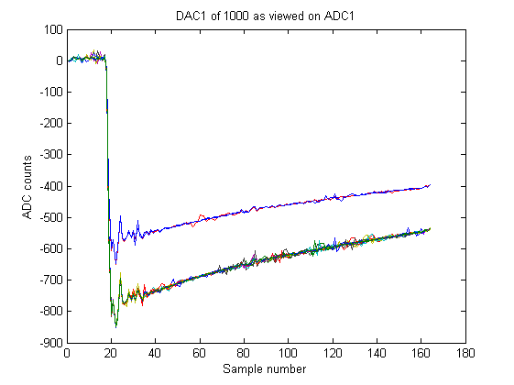
Use sample number 100
Different coloured traces correspond to different triggers

Slide 4
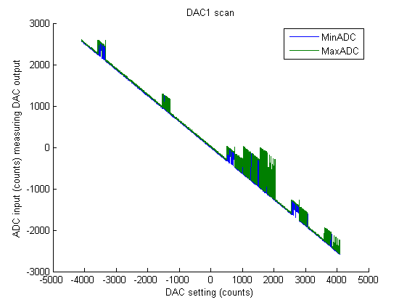
Minimum and maximum ADCs over all triggers at the given DAC setting

Slide 5
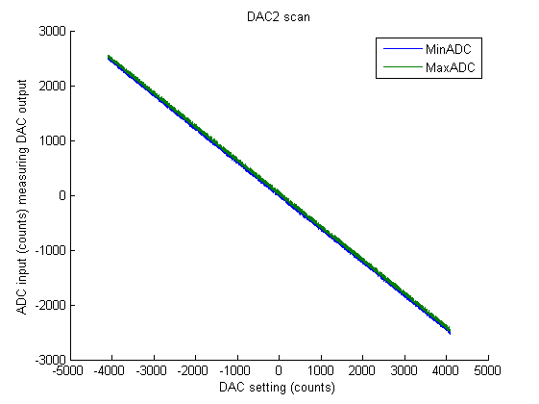
Minimum and maximum ADCs over all triggers at the given DAC setting
Gradient =
-0.61 ADC counts/DAC count

Slide 6
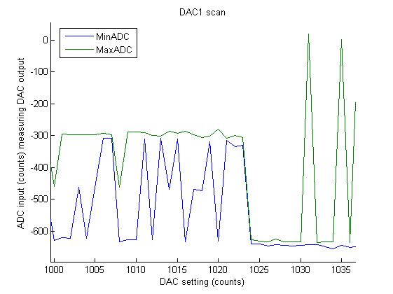
Zoom into DAC1 scan
Minimum and maximum ADCs over all triggers at the given DAC setting

Slide 7
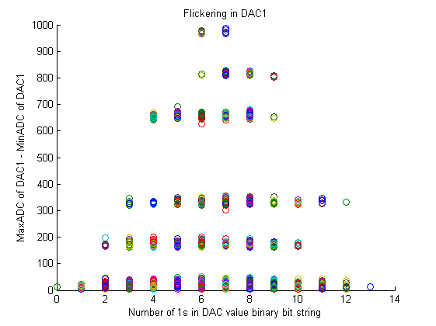
1 point per DAC setting
(different colours represent different DAC settings)

Slide 8
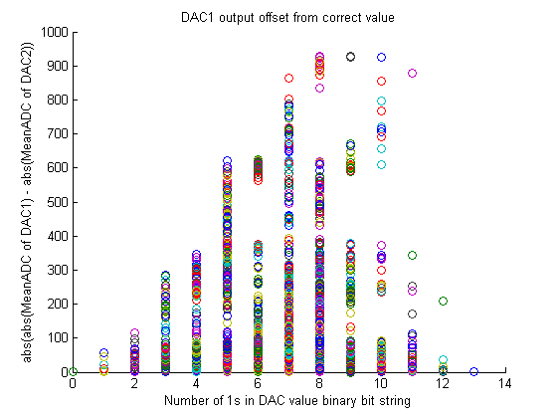

Slide 9
Comparison with different firmware
For versions of FW other than FBFW_v5 (currently burnt on PROM) only very limited tests were made at DAC codes around 1000-1024 and 2047.
May be useful to do more extensive tests of certain versions to verify working correctly or understand previous behaviour, eg with phase compensating FBFW.

Slide 10
Bitstream name | Firmware base version | Remarks/modifications | Observations
FBFW_v5.bit | FBFW_v5 | Version on PROM (vanilla version) | Glitching/incorrect values observed
DACtests_reference_181212.bit | FBFW_v5 | Reference bitstream before changes (vanilla version) | Glitching etc as above
DACtests_DefaultDAC1clk_NOIOBregs.bit | FBFW_v5 | DAC1 clock output changed to 12mA drive, slow slew rate | OK, no glitching observed
FBFW_v4_DACtest.bit | FBFW_v4 | Final registers in paths for DAC clock and data packed into IOBs (both DACs) | OK, no glitching observed
font5_9chan_FBFW_v4.bit | FBFW_v4 | Vanilla | OK, no glitching observed
font5_phasecompfb_bigtrigout.bit | Doug’s PCFBFW |  | Glitching/incorrect values observed (1000-1023 OK, >1024 bad!)
font5_couple_duptrig_2-798.bit | Ben’s FBFW | As used April 2010 and beyond | OK, no glitching observed

