Slide 1


Analysis of the Remote Control Phase Shifters (RCPS)
Mikey Davis
20 December 2012
1/23

Slide 2
Recap
The RCPS have been installed in the tunnel on P1 and P2
Last week P2 was untested, P1 was not setup correctly
There was an access in the week which gave me a chance to go in an tweak the P1 setup
Mikey Davis
20 December 2012
2/23

Slide 3
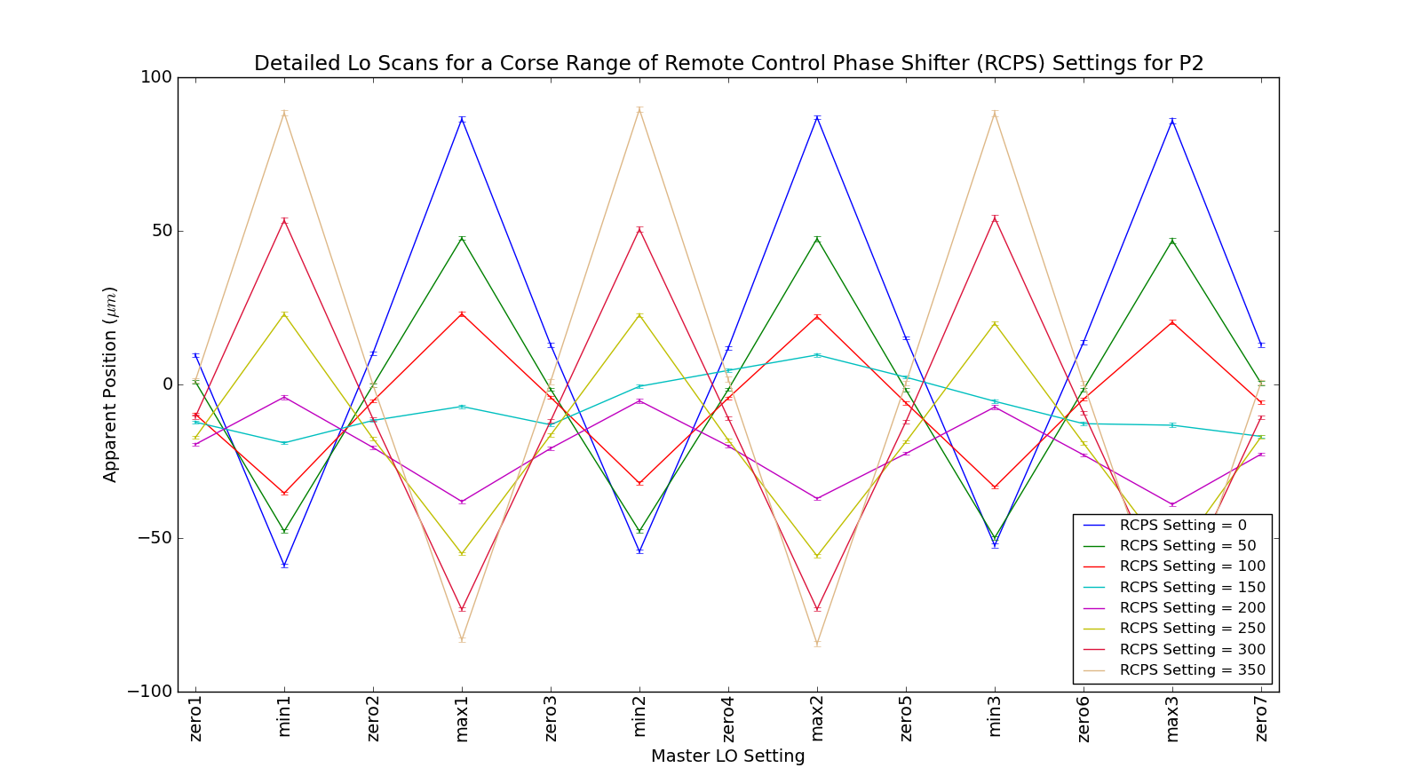
P2 Corse Scan
Mikey Davis
20 December 2012
3/23

Slide 4
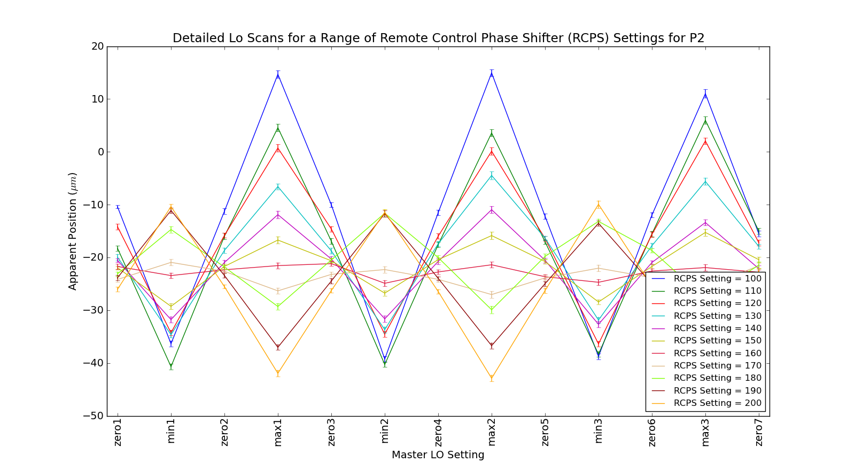
P2 Fine Scan
Mikey Davis
20 December 2012
4/23

Slide 5
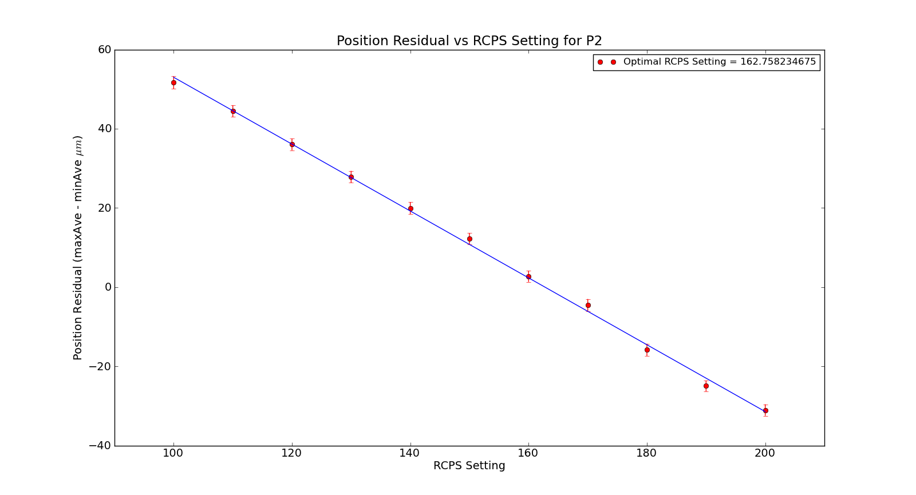
Residual Plot – Linear as we Expected
Mikey Davis
20 December 2012
5/23

Slide 6
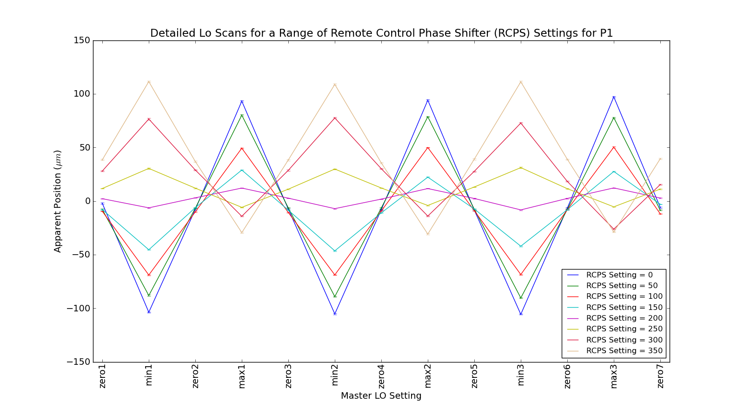
P1 Corse Scan
Mikey Davis
20 December 2012
6/23

Slide 7
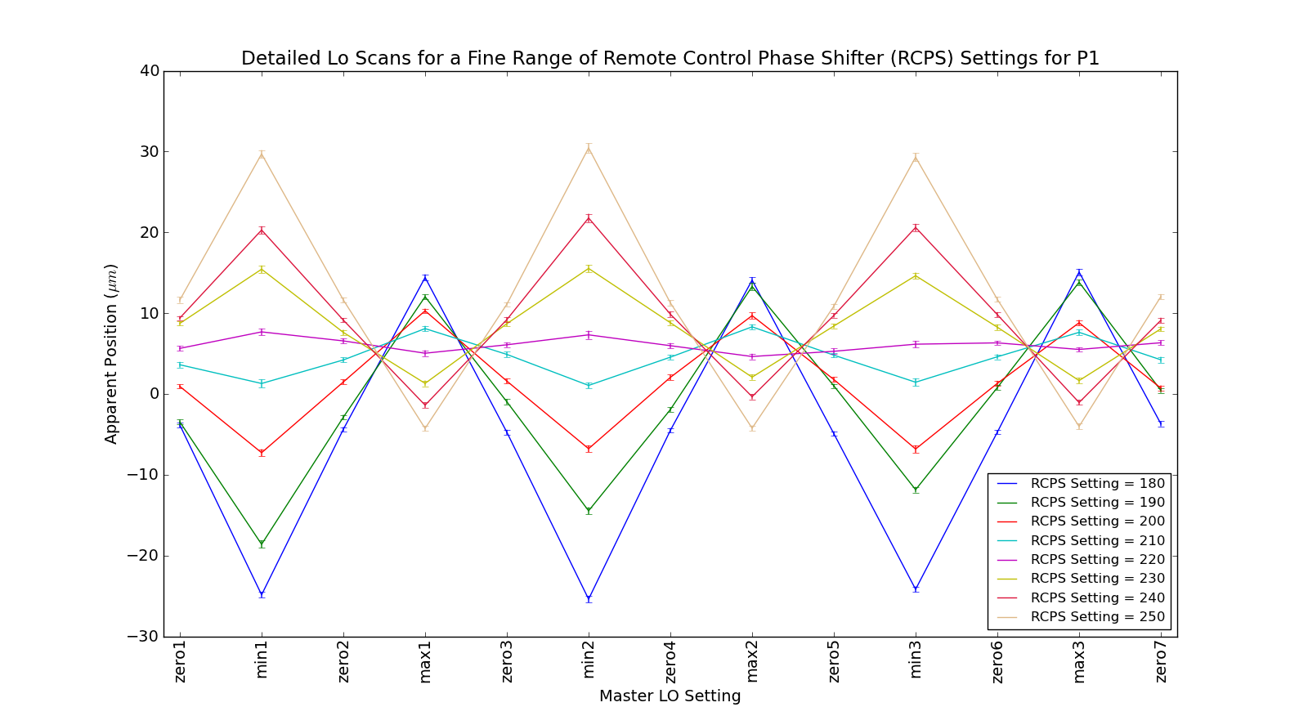
P1 Fine Scan
Mikey Davis
20 December 2012
7/23

Slide 8
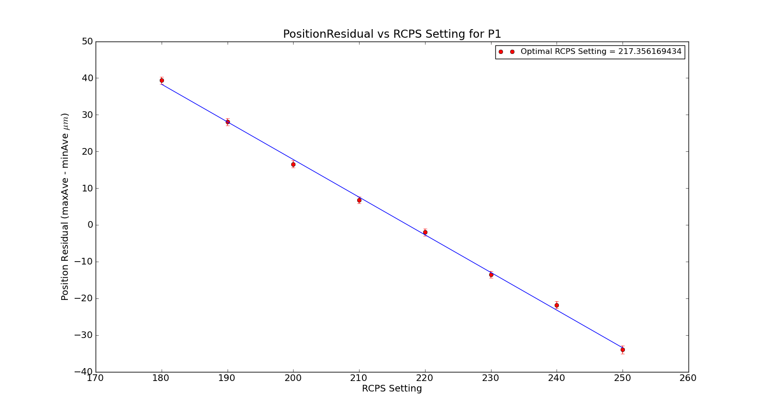
Residual Plot – Linear as we Expected
Mikey Davis
20 December 2012
8/23

Slide 9
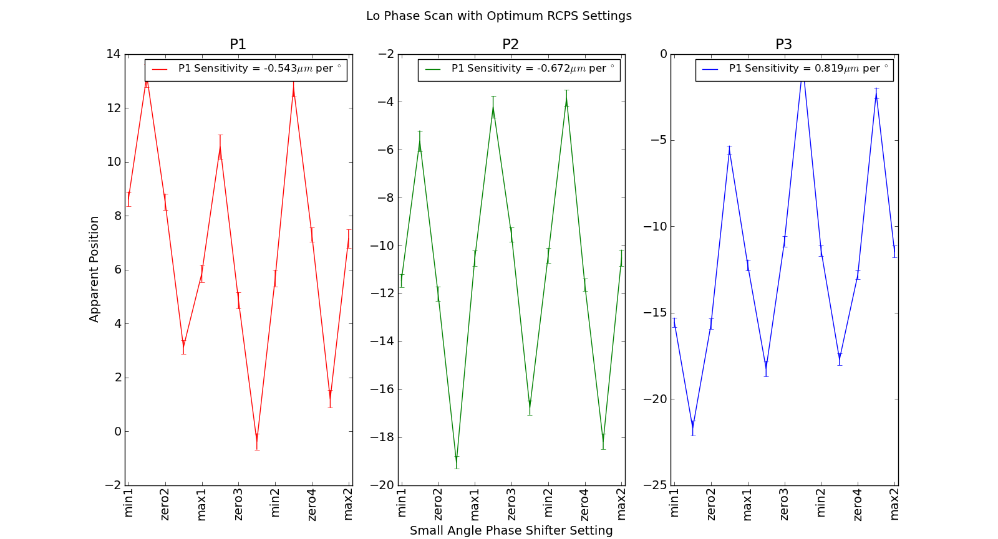
Phase Sensitivity with Optimum Settings
Mikey Davis
20 December 2012
9/23

Slide 10
Results
Typically, the effect of the phase compensation is to increase the resolution
Now the resolution with and without offline compensation is largely the same
They have been running with low charge all week and so resolution numbers are nothing to write home about
Mikey Davis
20 December 2012
10/23

Slide 11
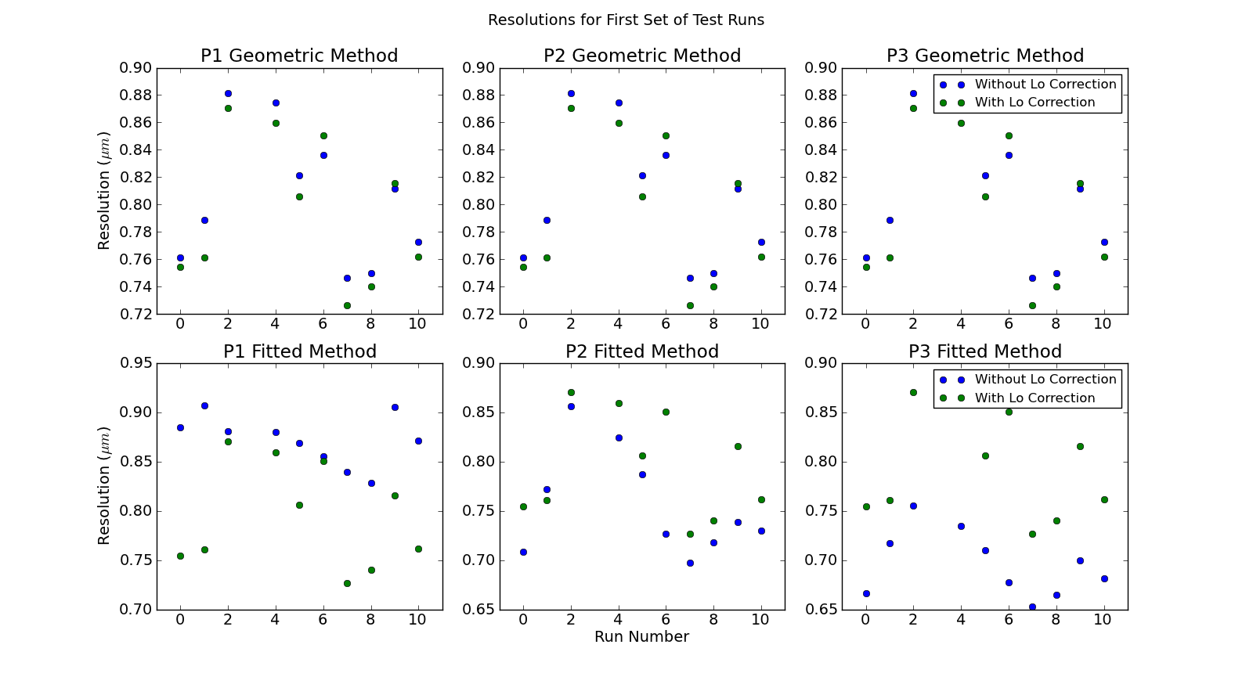
Results – First Runs
Mikey Davis
20 December 2012
11/23

Slide 12
Long Runs
I have taken some very long data runs (>200,000 triggers)
Runs called long run 1, long run 2, long run 3
They are split into 1000 trigger files
I’ve done this to test the stability of the system
Found some interesting things
Mikey Davis
20 December 2012
12/23

Slide 13
Long Runs
First run fine up until there is some sort of glitch
This happens during file 119
There is no beam for a period preceding this
Mikey Davis
20 December 2012
13/23

Slide 14
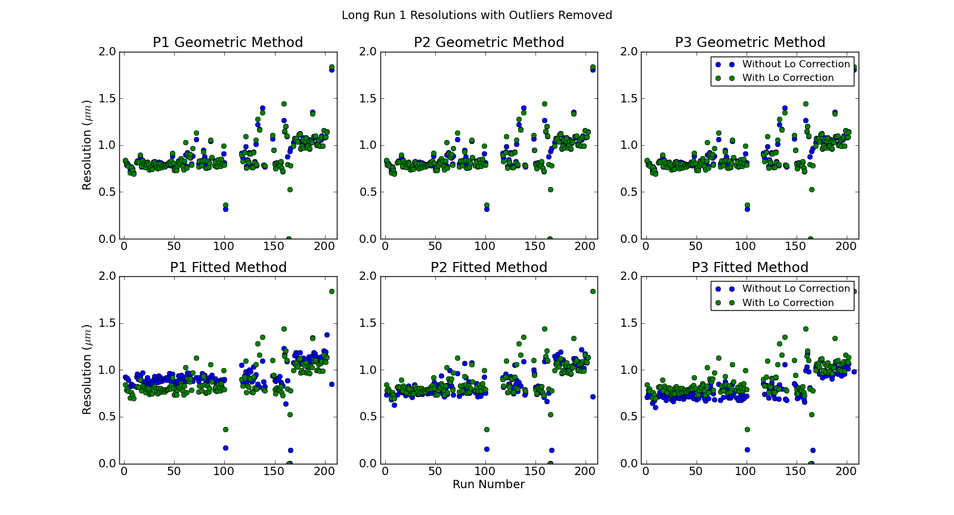
Results – Long Run 1
Mikey Davis
20 December 2012
14/23

Slide 15
Results – Long Run 1
1 2 3
Mikey Davis
20 December 2012
15/23

Slide 16
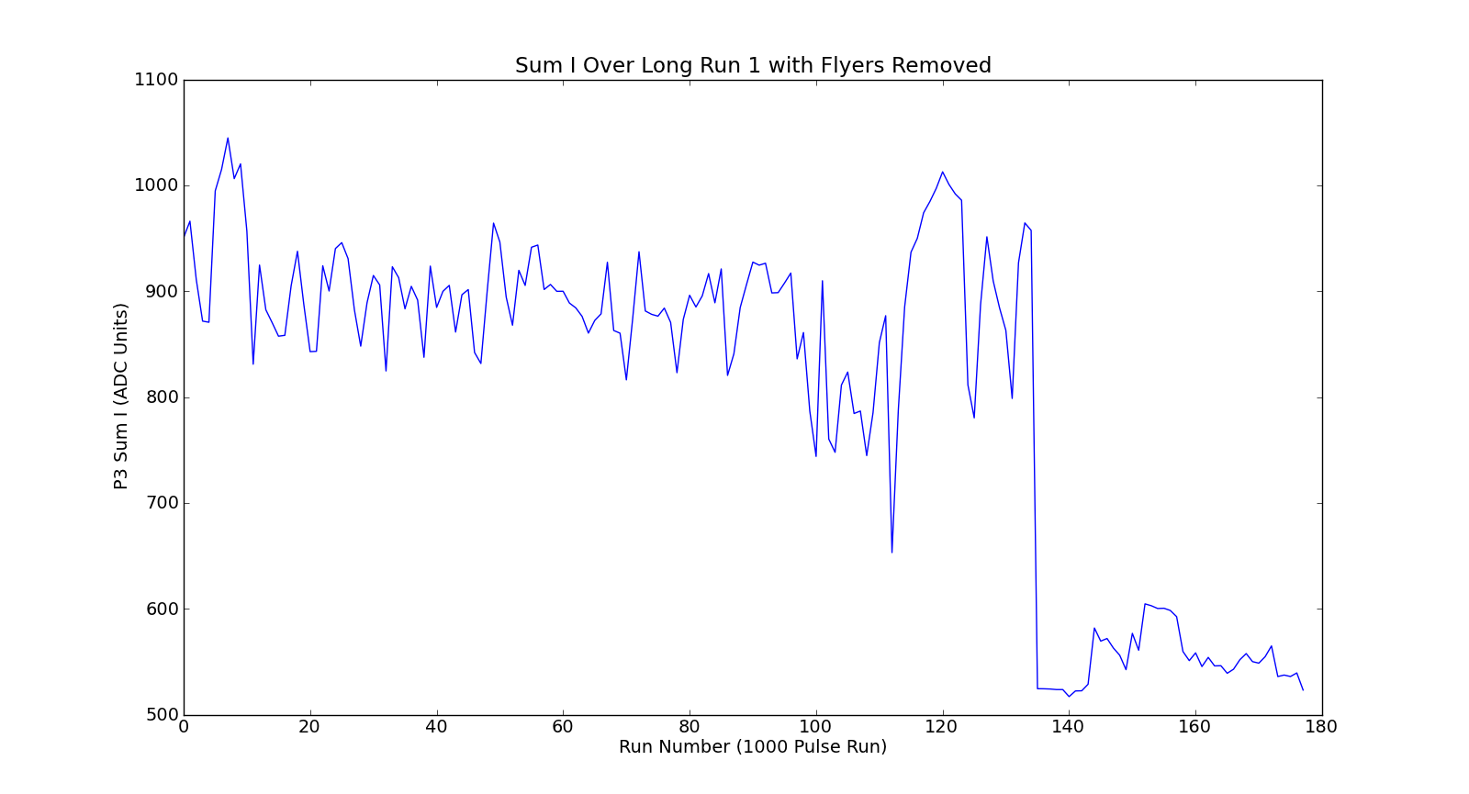
Results – Long Run 1
Mikey Davis
20 December 2012
16/23

Slide 17
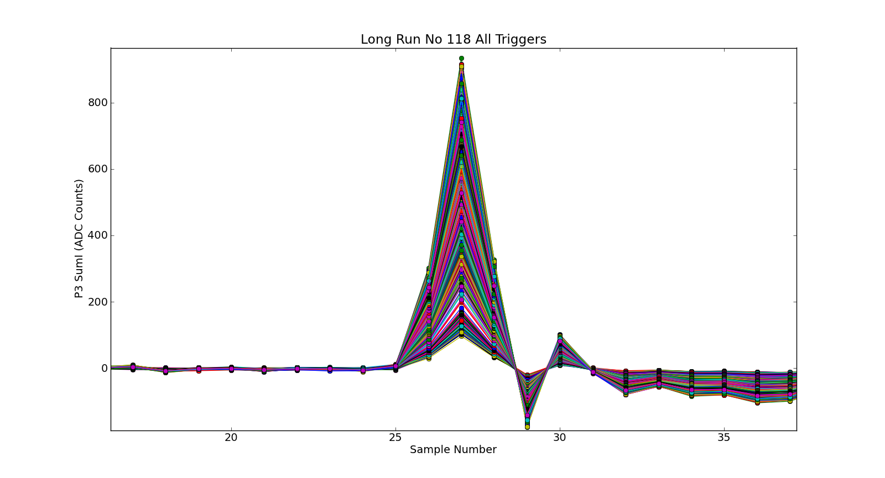
Long Run 1 – Before Glitch
Mikey Davis
20 December 2012
17/23

Slide 18
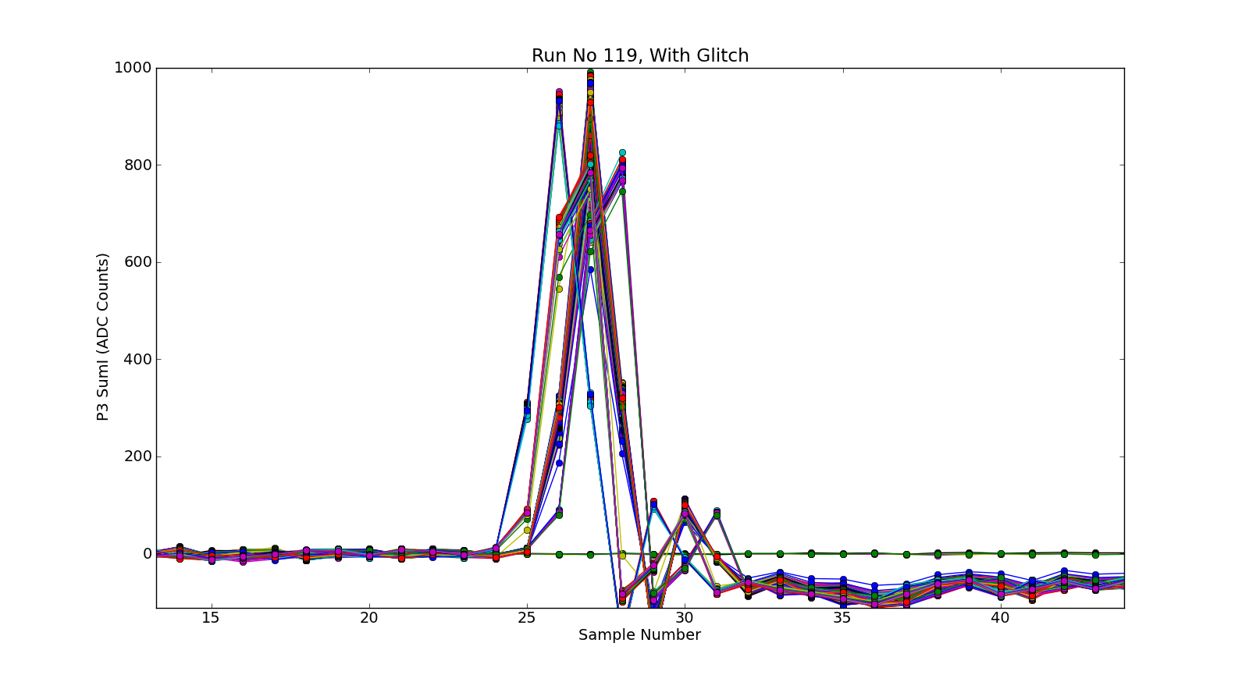
Long Run 1 – After Glitch
Mikey Davis
20 December 2012
18/23

Slide 19
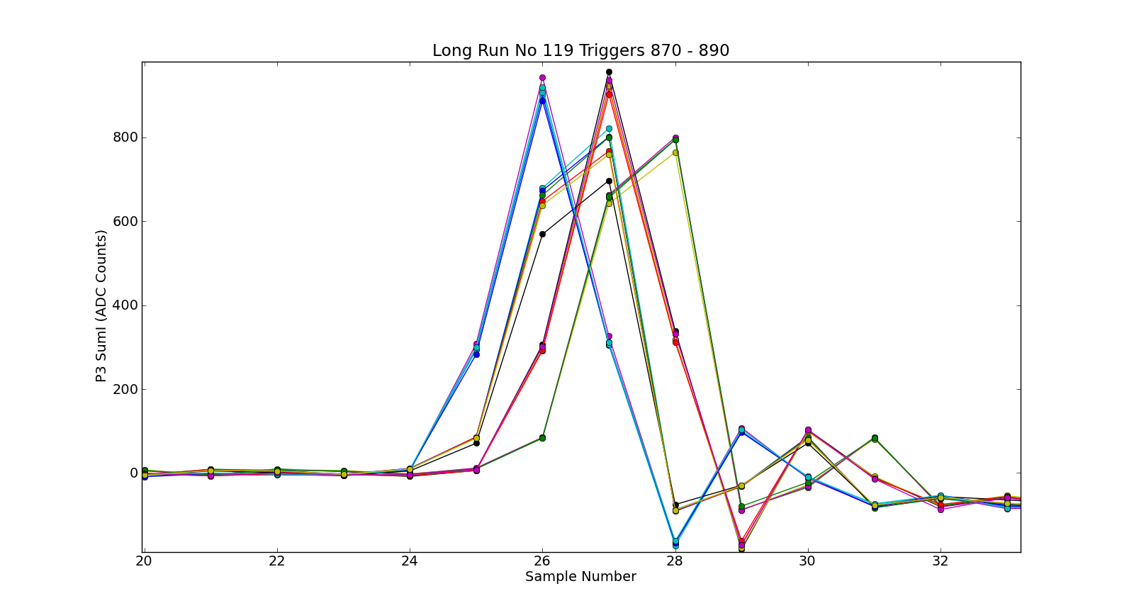
Long Run 1 – Glitch
Mikey Davis
20 December 2012
19/23

Slide 20
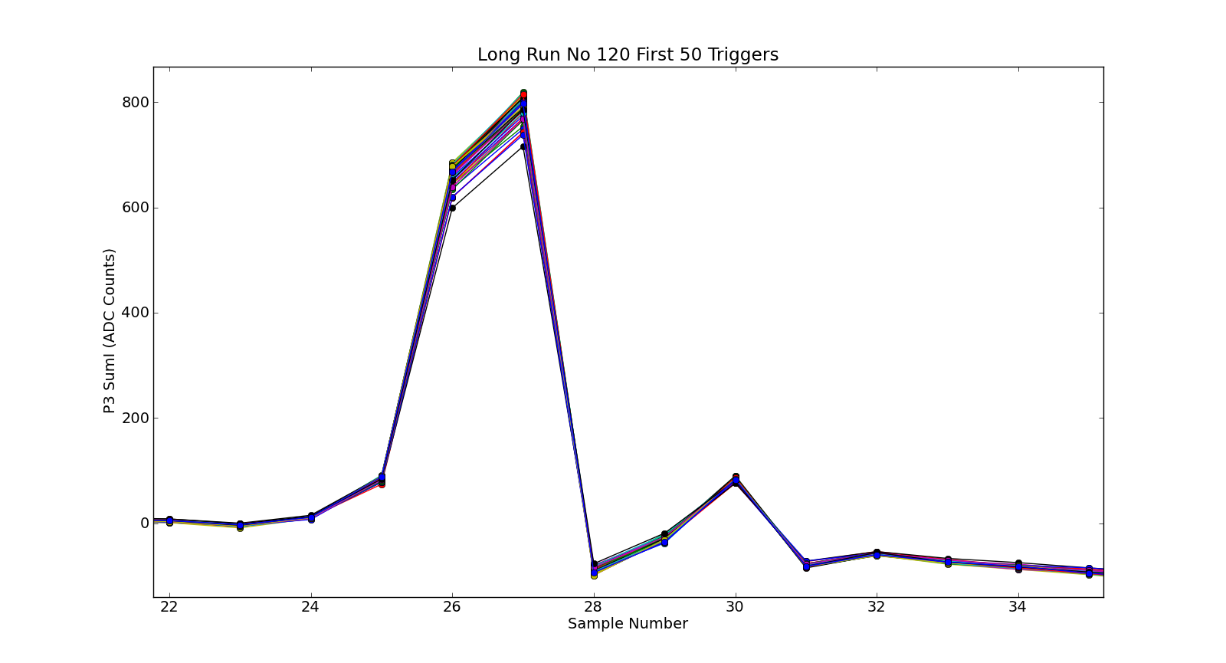
Long Run 1 – After Glitch
Mikey Davis
20 December 2012
20/23

Slide 21
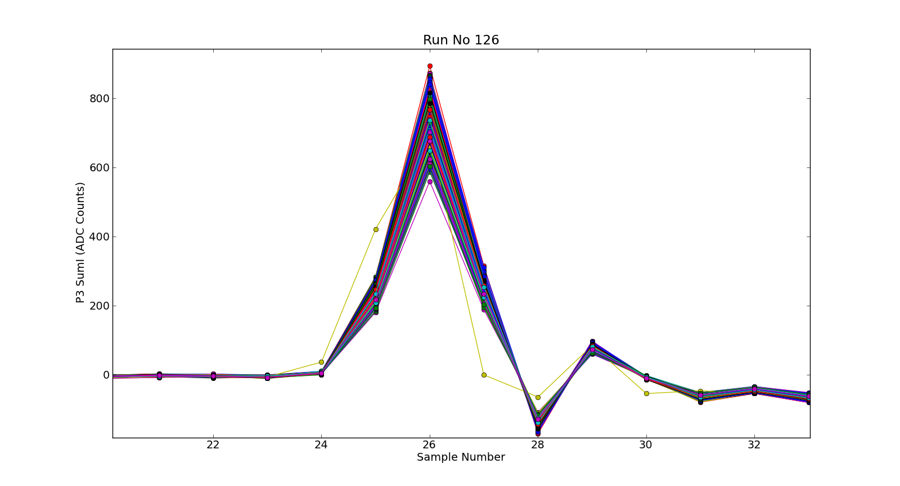
Long Run 1 – After Glitch
Mikey Davis
20 December 2012
21/23

Slide 22
Conclusion s
Phase shifters appear to work well and increase the resolution
The system is stable over long periods
Will glitch, investigating further
Mikey Davis
20 December 2012
22/23

