Slide 1
Frascati Phase Monitors at CTF3
FONT Meeting 20/12/12
Jack Roberts

Slide 2
Overview
Two (out of three) Frascati phase monitors installed and working at CTF3.
Analysis of data collected on 10/12/12 (120 pulses):
Signals and removal of bad pulses
Correlation between the two monitors
Resolution estimate
Time alignment
Comparison with BPR532

Slide 3
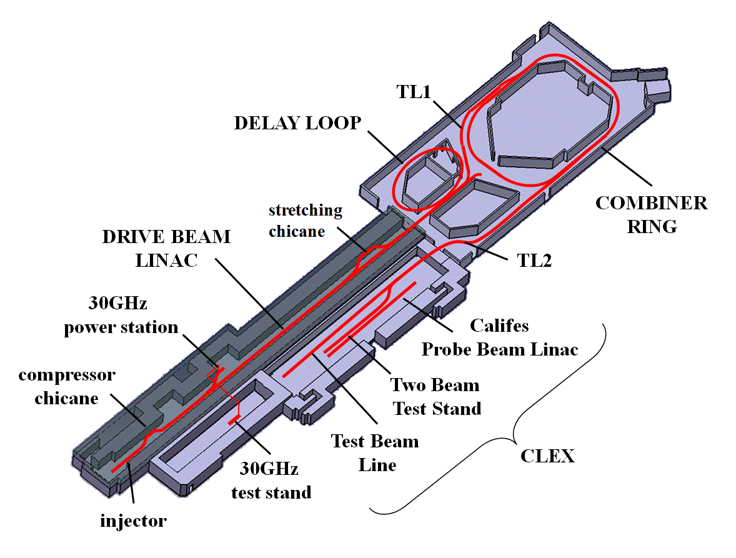
Location
Frascati Monitors
(M1 and M3)
BPR532

Slide 4
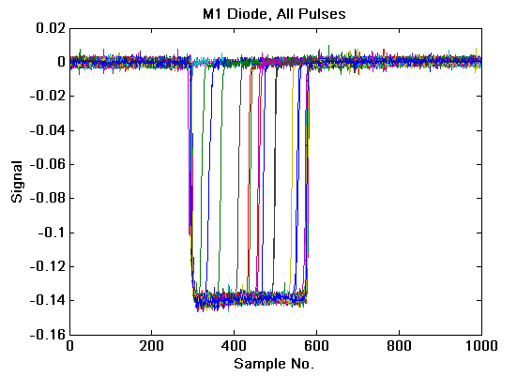
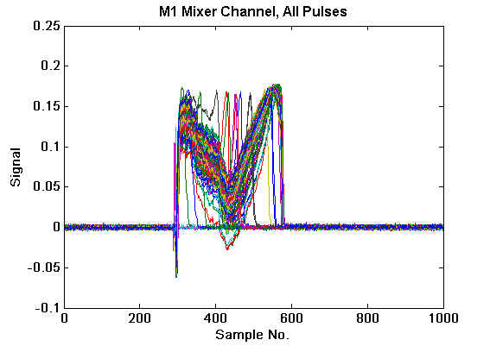
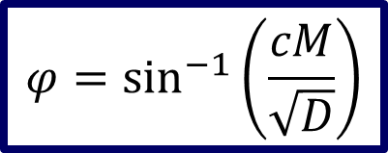


Signals
Diode Channel
Mixer Channel
$$D\text{ =} A^{2}$$
$$M=A\sin{φ}$$
$$φ=\sin^{−1}\left(\frac{cM}{\sqrt{D}}\right)$$
M1: c = -1.9398, M3: c = -1.2066

Slide 5
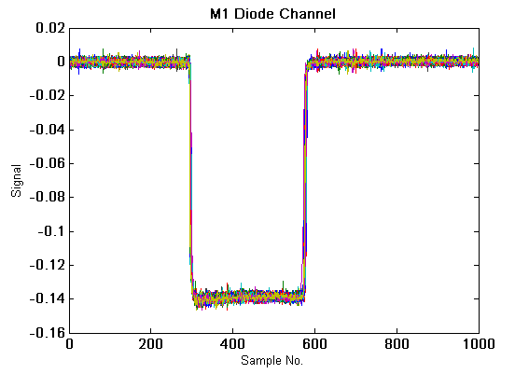
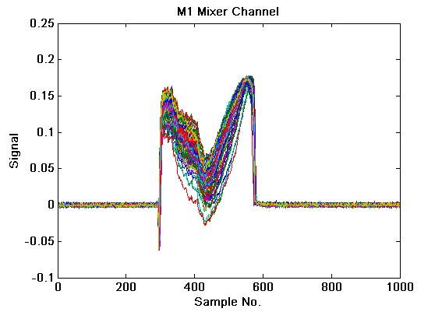

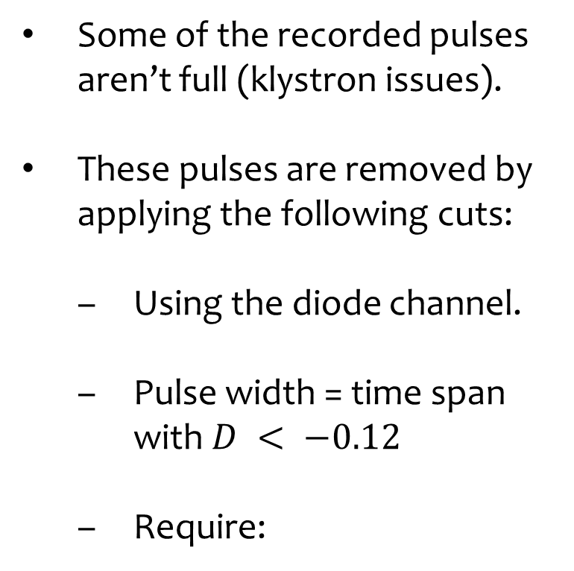
Removal of “Bad” Pulses
Some of the recorded pulses aren’t full (klystron issues).
These pulses are removed by applying the following cuts:
Using the diode channel.
Pulse width = time span with $D < −0.12$
Require:
$$\text{Width} >0.95 ×\text{Max} \text{Width}$$

Slide 6
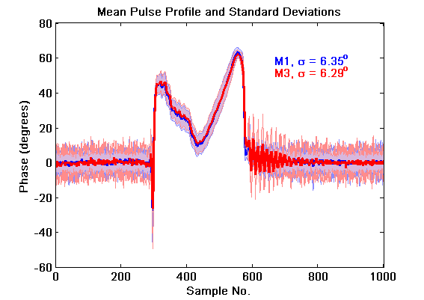
Mean Pulse Profile – Whole Range

Slide 7
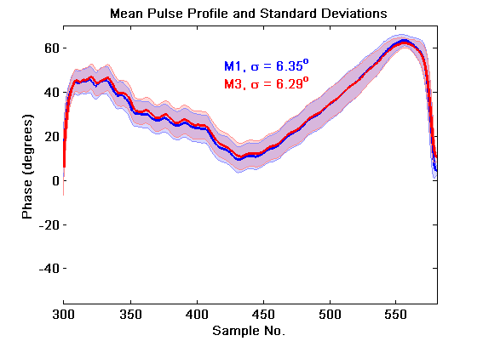
Mean Pulse Profile – Pulse Range

Slide 8
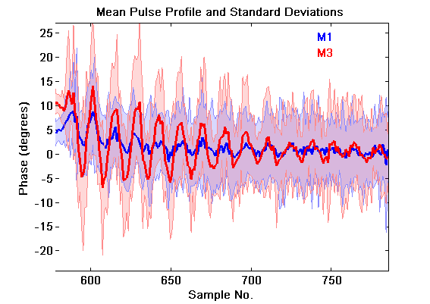
Mean Pulse Profile – Pulse Tail

Slide 9
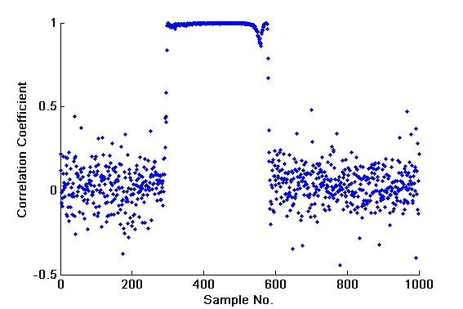
Correlation

Slide 10
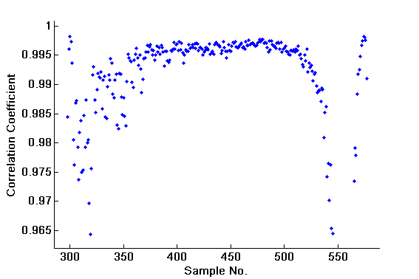
Correlation – Pulse Range
Correlation ~0.995 for sample numbers 375-510.
This range used for estimates of resolution etc.

Slide 11
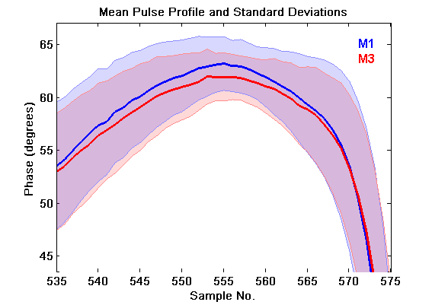
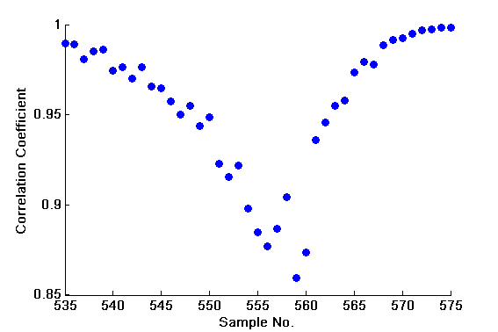
Correlation – Near End of Pulse
Seems like a fairly minor deviation.
Not related to oscillating behaviour seen after the pulse in M3.

Slide 12
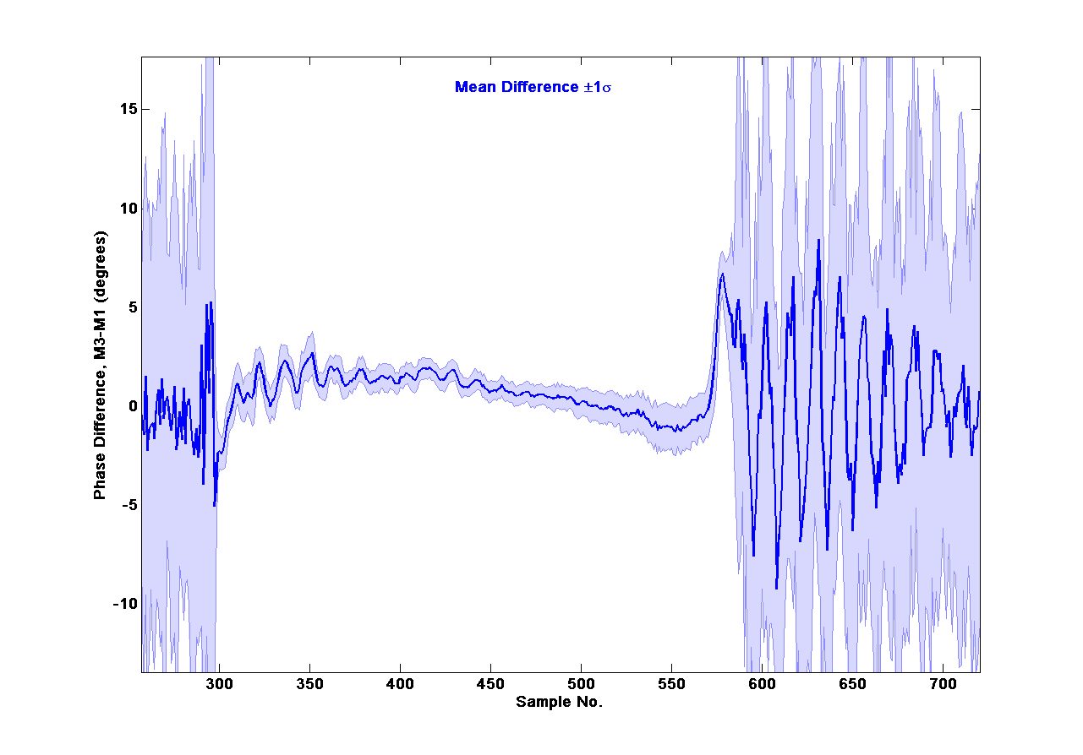
Difference Between M1 and M3
Used to estimate the resolution…

Slide 13
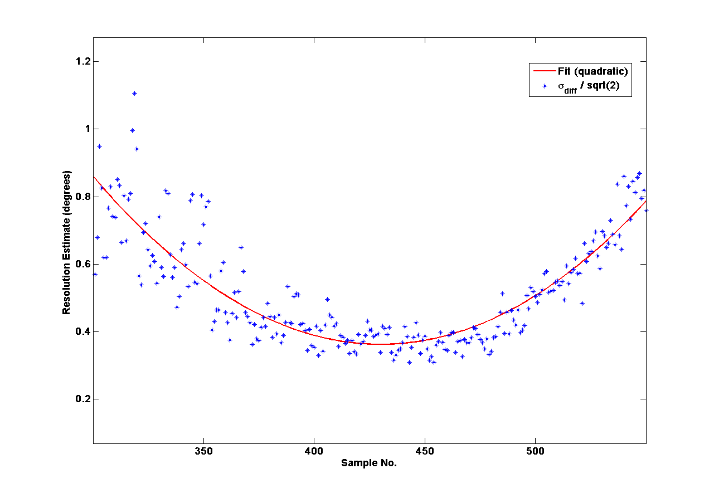

Resolution Estimate
Resolution Estimate:
Mean ~0.6º
Minimum ~0.4º at sample 429.
$$\frac{σ_{diff} }{\sqrt{2}}$$

Slide 14
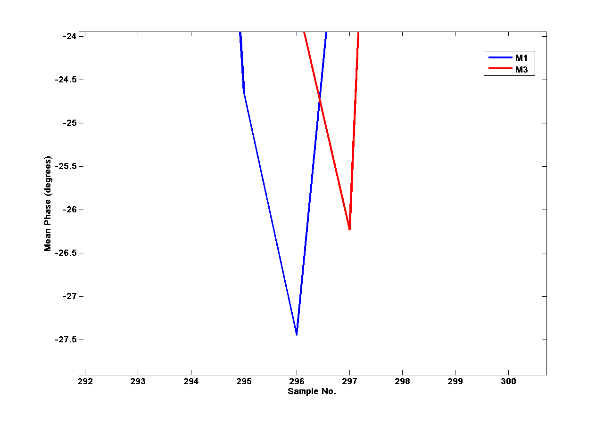
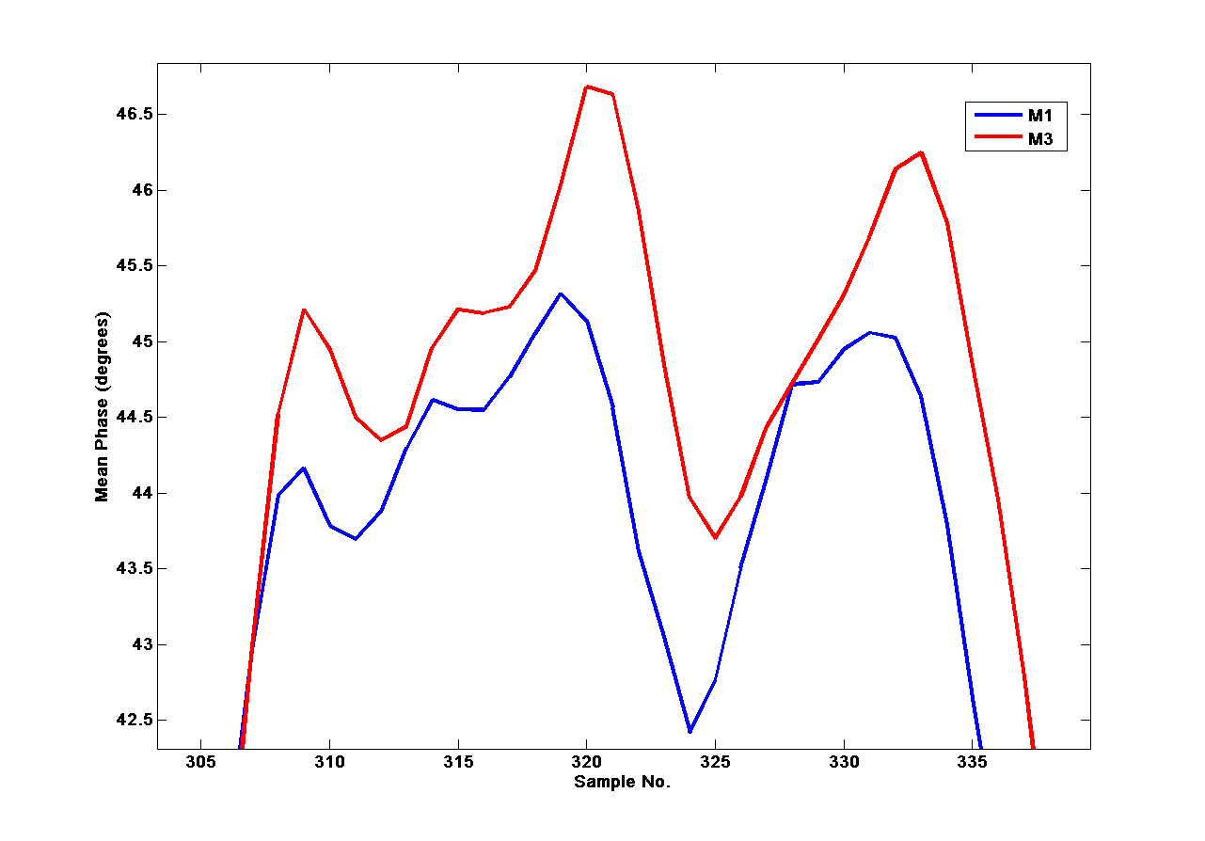
Time Misalignment?
Some evidence to suggest that M3 is offset by ~one sample with respect to M1

Slide 15
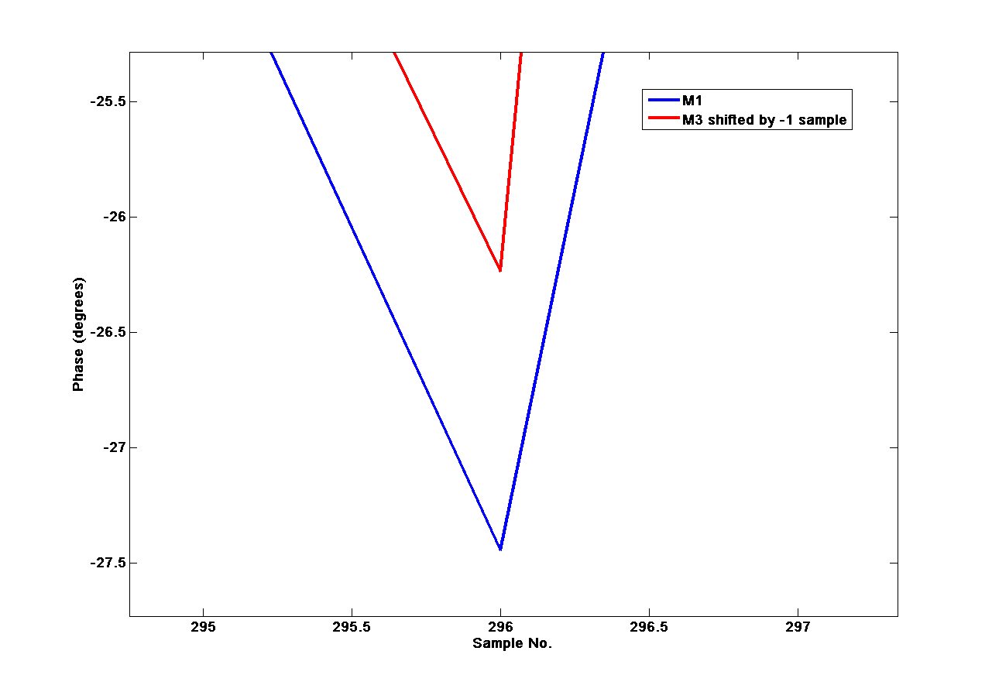
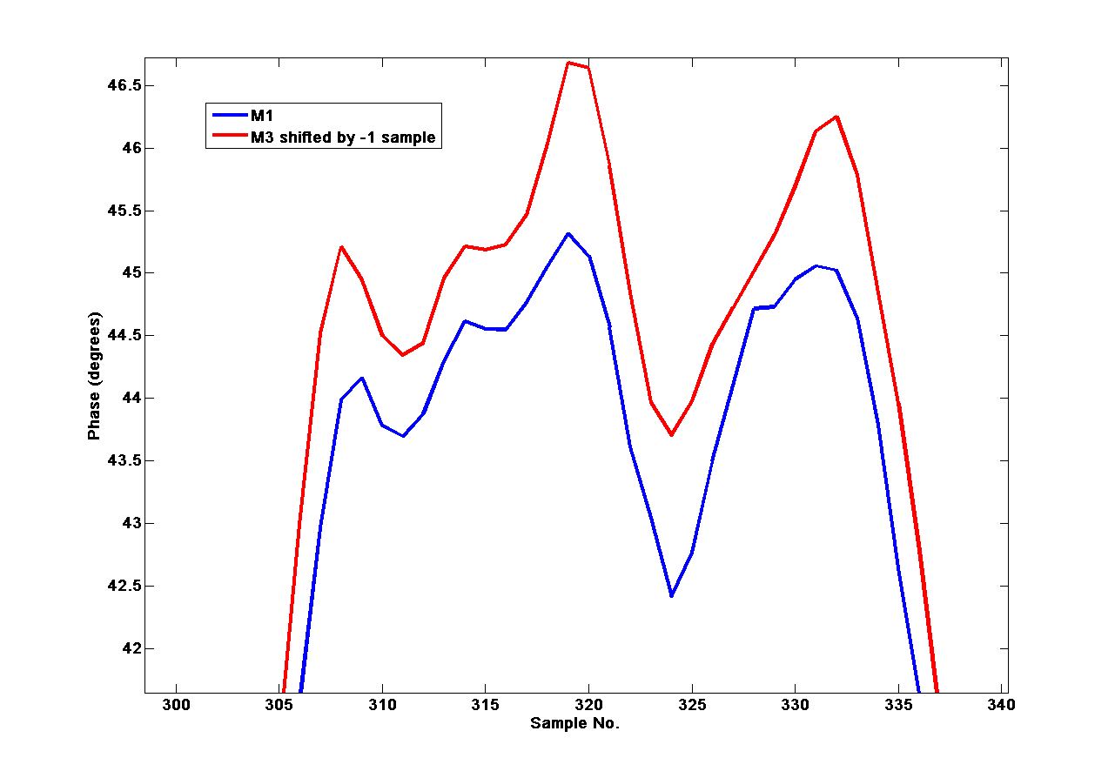
M3 Shifted By One Sample
M3 and M1 appear to be in better alignment.
In some areas (not shown) a shift of one sample may bring M3 before M1.
Measured correlation and resolution after shift does not improve.
Not pursued further.

Slide 16
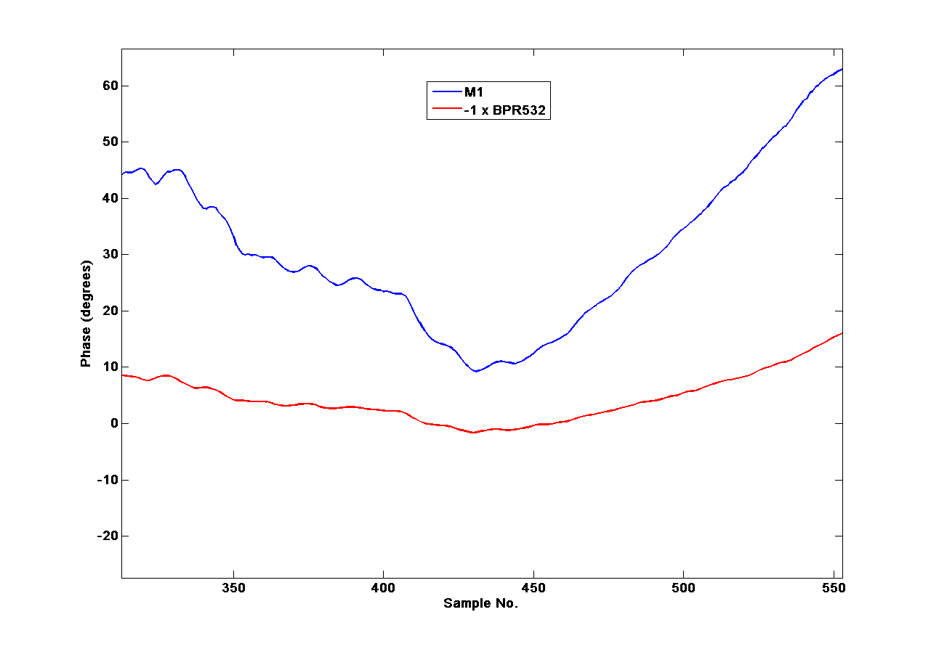
Comparison with BPR532
BPR532 phase varies between ~-25º and +5º
Frascati monitor phases vary between ~5º and 65º.
BPR532 phases have opposite sign to Frascati monitors.
Calibration constants different for this dataset?

Slide 17
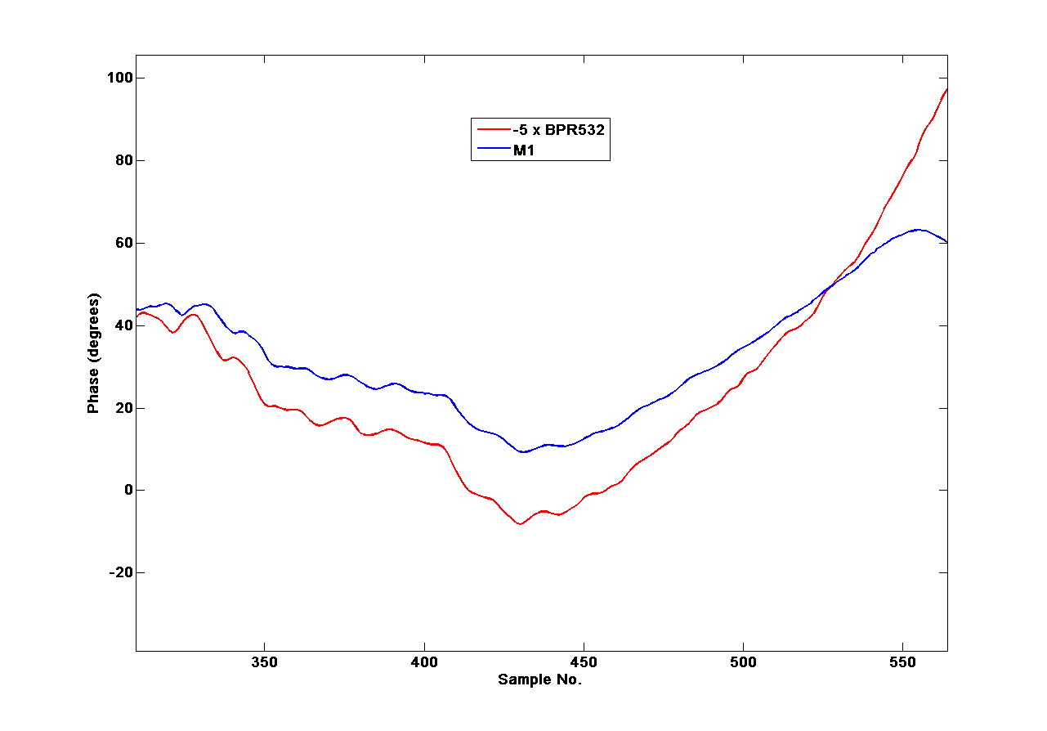
Comparison with BPR532
Small features in BPR seem to match Frascati monitors.

Slide 18
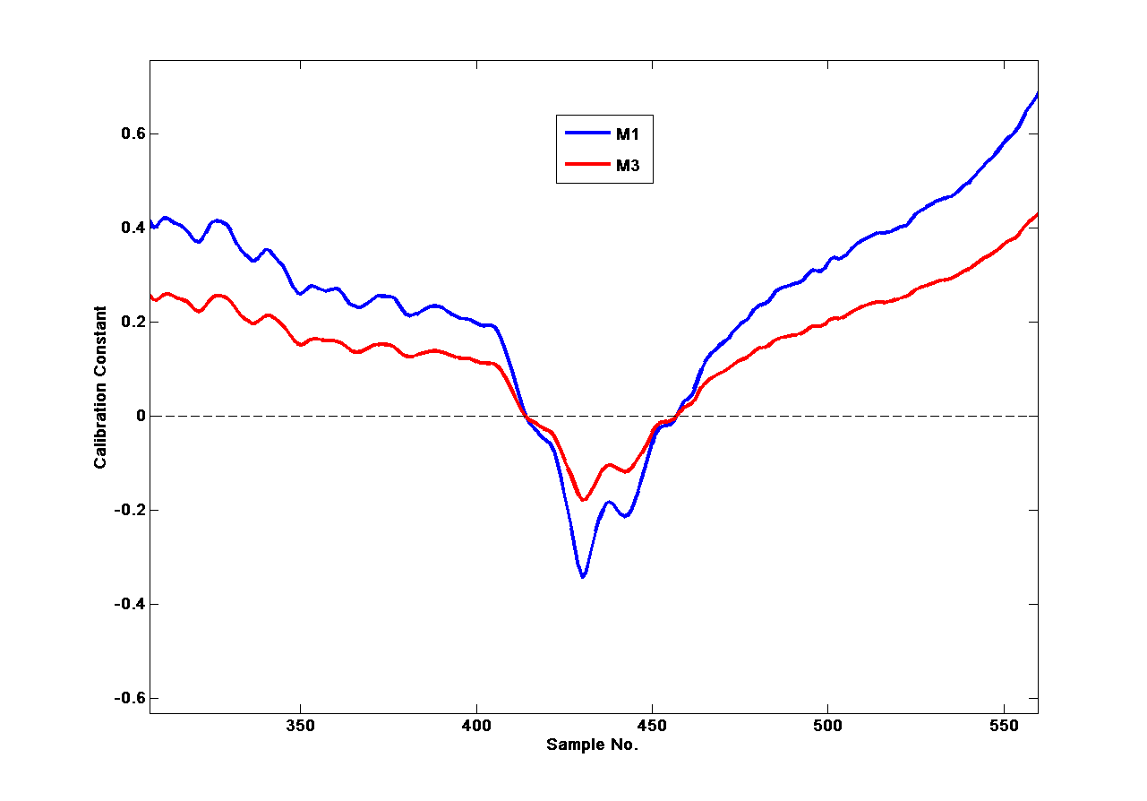
Recalculating Calibration Constants
BPR532 phase measurement goes through zero
If c is a calibration constant to match the Frascati monitors to the BPRs, the correct values for this data are:
M1: c ~ 0.4 M2: c ~ 0.2

Slide 19
Summary
The correlation between the two Frascati phase monitors is extremely good (coefficient ~ 0.995).
The resolution currently achievable is ~0.6º.
There is inconclusive evidence to suggest that the M3 signals arrive one sample later than M1.
The magnitude of the phases measured by the Frascati monitors and BPR532 appear to be very different.
Unsure where the calibration constants come from.

