Slide 1


Emittance Reconstruction from measured Beam Sizes
Faus-Golfe and Jesus Navarro Faus
IFIC Valencia

Slide 2
Emittance Reconstruction
Introduction and Objectives
New design of the OTR for ATF-ATF2
The emittances could be reconstructed from the beam size measurements at different locations along the beamline. The 2D (transverse) and 4D (intrinsic) emittances could be obtained by numerically solving three separated systems of coupled equations. When the number of measurement stations is greater than four, these systems are overdetermined, and the numerical solutions can lead to unphysical results. The incidence of such meaningless results usually increases if the measurements are noisy. Some numerical rules could be used to study the conditioning of these systems.
The main objective of this work is to study analytically the conditions of solvability of these systems of equations and its implication in the emittance reconstruction algorithms used in the accelerators. The aim is to give some hints about the optical constrains and the location of the measurement stations.
Notes:
2

Slide 3





Emittance Reconstruction
The formalism
New design of the OTR for ATF-ATF2
The transverse beam envelope matrix:
The projected emittances (2D) ε_{x} and ε_{y} are:
X submatrix
Y submatrix
Diagonalization of the beam matrix yields the intrinsic emittances ε₁ and ε₂ (4D) :
Notes:
3

Slide 4
Emittance Reconstruction
The formalism
New design of the OTR for ATF-ATF2
Experimentally only the horizontal σ₁ vertical σ₈ are directly measured. The coupling term σ₃ can be deduced by measuring the beam size along a tilted axis at an angle respect to the horizontal beam size.
At least ten measurements are required to reconstruct the beam matrix. The ten values could be obtained by changing the optics in a controlled manner at the location of the measurements or by measuring the beam size at different locations.
Assuming N measurement stations, for each measurement station labelled as i one obtain the following systems of coupled equations:
Notes:
4

Slide 5
Emittance Reconstruction
The formalism
New design of the OTR for ATF-ATF2
Introducing the matrices:
Notes:
5

Slide 6
Emittance Reconstruction
The formalism
New design of the OTR for ATF-ATF2
The equations could be expressed as:
- with 3 stations only the projected emittance (2D) could we reconstructed
- with 4 stations coupled beam matrix could be reconstructed but the first two systems are overdetermined.
- with >4 stations coupled beam matrix could be reconstructed but the three systems are overdetermined.
Notes:
6

Slide 7
Emittance Reconstruction
Analytical conditions: Projected Emittance (2D)
New design of the OTR for ATF-ATF2
In the general case of N measurement stations we have M_{X} and M_{X}*
The system has unique solution (σ₁ σ₂ σ₅) if and only if the rank of both M_{X} and M_{X}* is equal to three. That means that the determinants of all 3x3 minors of M_{X} should not vanish and the determinants of all 4x4 minors of M_{X}* should be zero.
In terms of Twiss parameters the determinants of such minors are:
Notes:
7

Slide 8
Emittance Reconstruction
Analytical conditions: Projected Emittance (2D)
New design of the OTR for ATF-ATF2
This give us two conditions:
Condition1:
This is the only required condition in the case of 3 measurement stations.
For 4 or more stations a second condition is required to get a unique solution.
Condition 2:
Condition 1 tell us that the measurement stations should be located at places where the phase advances correspond to different snapshots of the beam. Condition 2 involve the β and the measurements, one can see that in general the equality cannot be exactly satisfied. One could replace the zero by some previously fixed error value, related with the error of the measurements.
Idem for vertical plane.
Notes:
8

Slide 9
Emittance Reconstruction
Analytical conditions: Coupling Terms
New design of the OTR for ATF-ATF2
In the general case of N measurement stations we have M_{XY} and M_{XY}*
The system has unique solution (σ₃ σ₄ σ₆ σ₇) if and only if the rank of both M_{XY} and M_{XY}* is equal to four. That means that the determinants of all 4x4 minors of M_{XY} should not vanish and the determinants of all 5x5 minors of M_{Xy}* should be zero.
Notes:
9

Slide 10
Emittance Reconstruction
Analytical conditions: Coupling Terms
New design of the OTR for ATF-ATF2
In terms of Twiss parameters the determinants of such minors are:
Notes:
10

Slide 11
Emittance Reconstruction
Analytical conditions: Coupling Terms
New design of the OTR for ATF-ATF2
This give us two more conditions:
Condition 3:
This is the only required condition in the case of 4 measurement stations.
In the particular case where φ_{x}^{(ji)}=φ_{y}^{(ji)} the system has no solution.
For 5 or more stations an additional condition is required to get a unique solution.
Condition 4:
One could replace the zero by some previously fixed error value, related with the error of the measurements.
Notes:
11

Slide 12
Emittance Reconstruction
Some examples: NLC 2D diagnostic section
New design of the OTR for ATF-ATF2
1
2
3
4
β_{x}=20m
β_{y}=50m
Φ_{xy}=π/4
Φ_{xy}=π/4
Φ_{xy}=π/4
coupling factor r=0.1
1% measurement errors
Condition 1: not an integer
1 2 0.2500 0.2500
1 3 0.5000 0.5000
2 3 0.2500 0.2500
1 4 0.7500 0.7500
2 4 0.5000 0.5000
3 4 0.2500 0.2500
Condition 2: ax4 (CL s1,fx3) = 0
1 2 3 4 0.000E+00 0.253E-07
Condition 2: ay4 (CL s8,fy3) = 0
1 2 3 4 0.000E+00 0.200E-07
Condition 3: f4 different from 0
1 2 3 4 0.0000
No problems for solving the 2D systems
Equivalent planes, not valid for 4D
Notes:
12

Slide 13
Emittance Reconstruction
Some examples: NLC 4D diagnostic section
New design of the OTR for ATF-ATF2
1
2
3
4
5
6
β_{x}=20m
β_{y}=50m
Φ_{xy}=π/2
Φ_{x}=π
Φ_{x}=π/2
Φ_{xy}=π/4
Φ_{xy}=π/4
Φ_{xy}=π/4
coupling factor r=0.1
1% measurement errors
Condition 1: not an integer
1 2 0.5000 0.5000
1 3 1.5000 1.0000
2 3 1.0000 0.5000
1 4 1.7500 1.2500
2 4 1.2500 0.7500
3 4 0.2500 0.2500
1 5 2.0000 1.5000
2 5 1.5000 1.0000
3 5 0.5000 0.5000
4 5 0.2500 0.2500
1 6 2.2500 1.7500
2 6 1.7500 1.2500
3 6 0.7500 0.7500
4 6 0.5000 0.5000
5 6 0.2500 0.2500
Some stations are redundant
Notes:
13

Slide 14
Emittance Reconstruction
Some examples: NLC 4D diagnostic section
New design of the OTR for ATF-ATF2
1
2
3
4
5
6
β_{x}=20m
β_{y}=50m
Φ_{xy}=π/2
Φ_{x}=π
Φ_{x}=π/2
Φ_{xy}=π/4
Φ_{xy}=π/4
Φ_{xy}=π/4
coupling factor r=0.1
1% measurement errors
Condition 2: ax4 (CL s1,fx3) = 0
1 2 3 4 0.493E-22 0.179E-07
1 2 3 5 0.470E-37 0.981E-23
1 2 4 5 -0.106E-21 0.179E-07
1 3 4 5 -0.106E-21 0.179E-07
2 3 4 5 -0.776E-22 0.179E-07
1 2 3 6 -0.566E-22 0.179E-07
1 2 4 6 0.000E+00 0.253E-07
1 3 4 6 0.106E-21 0.253E-07
2 3 4 6 -0.106E-21 0.179E-07
1 2 5 6 0.722E-23 0.179E-07
1 3 5 6 0.722E-23 0.179E-07
2 3 5 6 -0.283E-22 0.179E-07
1 4 5 6 -0.261E-21 0.179E-07
2 4 5 6 0.000E+00 0.253E-07
3 4 5 6 0.000E+00 0.253E-07
Condition 2: ay4 (CL s8,fy3) = 0
1 2 3 4 -0.541E-22 0.141E-07
1 2 3 5 0.000E+00 0.489E-23
1 2 4 5 0.000E+00 0.141E-07
1 3 4 5 -0.535E-22 0.141E-07
2 3 4 5 0.000E+00 0.141E-07
1 2 3 6 0.518E-22 0.141E-07
1 2 4 6 0.000E+00 0.200E-07
1 3 4 6 -0.529E-22 0.141E-07
2 3 4 6 0.000E+00 0.200E-07
1 2 5 6 0.541E-22 0.141E-07
1 3 5 6 -0.523E-22 0.141E-07
2 3 5 6 -0.541E-22 0.141E-07
1 4 5 6 -0.529E-22 0.200E-07
2 4 5 6 -0.535E-22 0.141E-07
3 4 5 6 0.000E+00 0.200E-07
Valid for 2D
Notes:
14

Slide 15
Emittance Reconstruction
Some examples: NLC 4D diagnostic section
New design of the OTR for ATF-ATF2
1
2
3
4
5
6
β_{x}=20m
β_{y}=50m
Φ_{xy}=π/2
Φ_{x}=π
Φ_{x}=π/2
Φ_{xy}=π/4
Φ_{xy}=π/4
Φ_{xy}=π/4
coupling factor r=0.1
1% measurement errors
Condition 3: f4 different from 0
1 2 3 4 -2.0000
1 2 3 5 -4.0000
1 2 4 5 -2.0000
1 3 4 5 2.0000
2 3 4 5 2.0000
1 2 3 6 -2.0000
1 2 4 6 -0.0000
1 3 4 6 2.0000
2 3 4 6 2.0000
1 2 5 6 2.0000
1 3 5 6 2.0000
2 3 5 6 2.0000
1 4 5 6 2.0000
2 4 5 6 2.0000
3 4 5 6 0.0000
two planes equivalent
Condition 4: a5 (CL s3, f4) equal to 0
1 2 3 4 5 -0.12E-26 0.19E-12
1 2 3 4 6 -0.16E-26 0.13E-12
1 2 3 5 6 0.89E-26 0.19E-12
1 2 4 5 6 -0.44E-26 0.13E-12
1 3 4 5 6 -0.69E-26 0.13E-12
2 3 4 5 6 0.65E-26 0.13E-12
Valid for 4D
Notes:
15

Slide 16
Emittance Reconstruction
Some examples: ATF2 mOTR system
New design of the OTR for ATF-ATF2
1
β_{x}=36.0m
β_{y}=12.8m
β_{x}=58.7m
β_{y}=8.6m
β_{x}=10.7m
β_{y}=15.0m
β_{x}=2.4m
β_{y}=2.7m
2
3
4
Φ_{y}=0.004
Φ_{y}=0.026
Φ_{y}=0.026
Φ_{y}=0.045
Φ_{y}=0.1
Φ_{y}=0.164
coupling factor r=0.1
1% measurement errors
2π units
Condition 1: not an integer
1 2 0.0080 0.0520
1 3 0.0600 0.1420
2 3 0.0520 0.0900
1 4 0.2600 0.4700
2 4 0.2520 0.4180
3 4 0.2000 0.3280
Condition 2: ax4 (CL s1,fx3) = 0
1 2 3 4 0.117E-07 0.458E-06
Condition 2: ay4 (CL s8,fy3) = 0
1 2 3 4 -0.647E-11 0.947E-09
Condition 3: f4 different from 0
1 2 3 4 -0.0497
No problems for solving the 2D systems
Valid for 4D
Notes:
16

Slide 17
Emittance Reconstruction
Some examples: ATF2 WS system
New design of the OTR for ATF-ATF2
1
β_{x}=18.6m
β_{y}=17.3m
β_{x}=67.0m
β_{y}=7.8m
β_{x}=15.0m
β_{y}=17.0m
β_{x}=4.5m
β_{y}=2.2m
β_{x}=5.4m
β_{y}=9.9m
2
3
4
5
Φ_{y}=0.006
Φ_{y}=0.024
Φ_{y}=0.016
Φ_{y}=0.044
Φ_{y}=0.087
Φ_{y}=0.139
Φ_{y}=0.389
Φ_{y}=0.12
2π units
coupling factor r=0.1
1% measurement errors
Condition 1: not an integer
1 2 0.0120 0.0480
1 3 0.0440 0.1360
2 3 0.0320 0.0880
1 4 0.2180 0.4140
2 4 0.2060 0.3660
3 4 0.1740 0.2780
1 5 0.9960 0.6540
2 5 0.9840 0.6060
3 5 0.9520 0.5180
4 5 0.7780 0.2400
No problems for solving the 2D systems
Notes:
17

Slide 18
Emittance Reconstruction
Some examples: ATF2 WS system
New design of the OTR for ATF-ATF2
1
β_{x}=18.6m
β_{y}=17.3m
β_{x}=67.0m
β_{y}=7.8m
β_{x}=15.0m
β_{y}=17.0m
β_{x}=4.5m
β_{y}=2.2m
β_{x}=5.4m
β_{y}=9.9m
2
3
4
5
Φ_{y}=0.006
Φ_{y}=0.024
Φ_{y}=0.016
Φ_{y}=0.044
Φ_{y}=0.087
Φ_{y}=0.139
Φ_{y}=0.389
Φ_{y}=0.12
2π units
coupling factor r=0.1
1% measurement errors
Condition 2: ax4 (CL s1,fx3) = 0
1 2 3 4 -0.845E-08 0.389E-06
1 2 3 5 -0.207E-09 0.779E-08
1 2 4 5 -0.160E-08 0.615E-07
1 3 4 5 -0.889E-09 0.379E-07
2 3 4 5 0.509E-09 0.125E-06
Condition 2: ay4 (CL s8,fy3) = 0
1 2 3 4 0.234E-10 0.901E-09
1 2 3 5 0.121E-09 0.491E-08
1 2 4 5 0.208E-10 0.116E-08
1 3 4 5 -0.260E-10 0.275E-08
2 3 4 5 -0.303E-10 0.115E-08
No problems for solving the 2D systems
Notes:
18

Slide 19
Emittance Reconstruction
Some examples: ATF2 WS system
New design of the OTR for ATF-ATF2
1
β_{x}=18.6m
β_{y}=17.3m
β_{x}=67.0m
β_{y}=7.8m
β_{x}=15.0m
β_{y}=17.0m
β_{x}=4.5m
β_{y}=2.2m
β_{x}=5.4m
β_{y}=9.9m
2
3
4
5
Φ_{y}=0.006
Φ_{y}=0.024
Φ_{y}=0.016
Φ_{y}=0.044
Φ_{y}=0.087
Φ_{y}=0.139
Φ_{y}=0.389
Φ_{y}=0.12
2π units
coupling factor r=0.1
1% measurement errors
Condition 3: f4 different from 0
1 2 3 4 -0.0086
1 2 3 5 0.0047
1 2 4 5 0.0751
1 3 4 5 0.2328
2 3 4 5 0.1672
Condition 4: a5 (CL s3, f4) equal to 0
1 2 3 4 5 -0.18E-10 0.19E-11
No problems for solving the 4D systems
Notes:
19

Slide 20
Emittance Reconstruction
Conclusions
New design of the OTR for ATF-ATF2
We have studied analytically the conditions of solvability of the systems of equations involved in the process of emittance reconstruction and we have obtained some rules about the locations of the measurements to avoid unphysical results.
Notes:
20

Slide 21
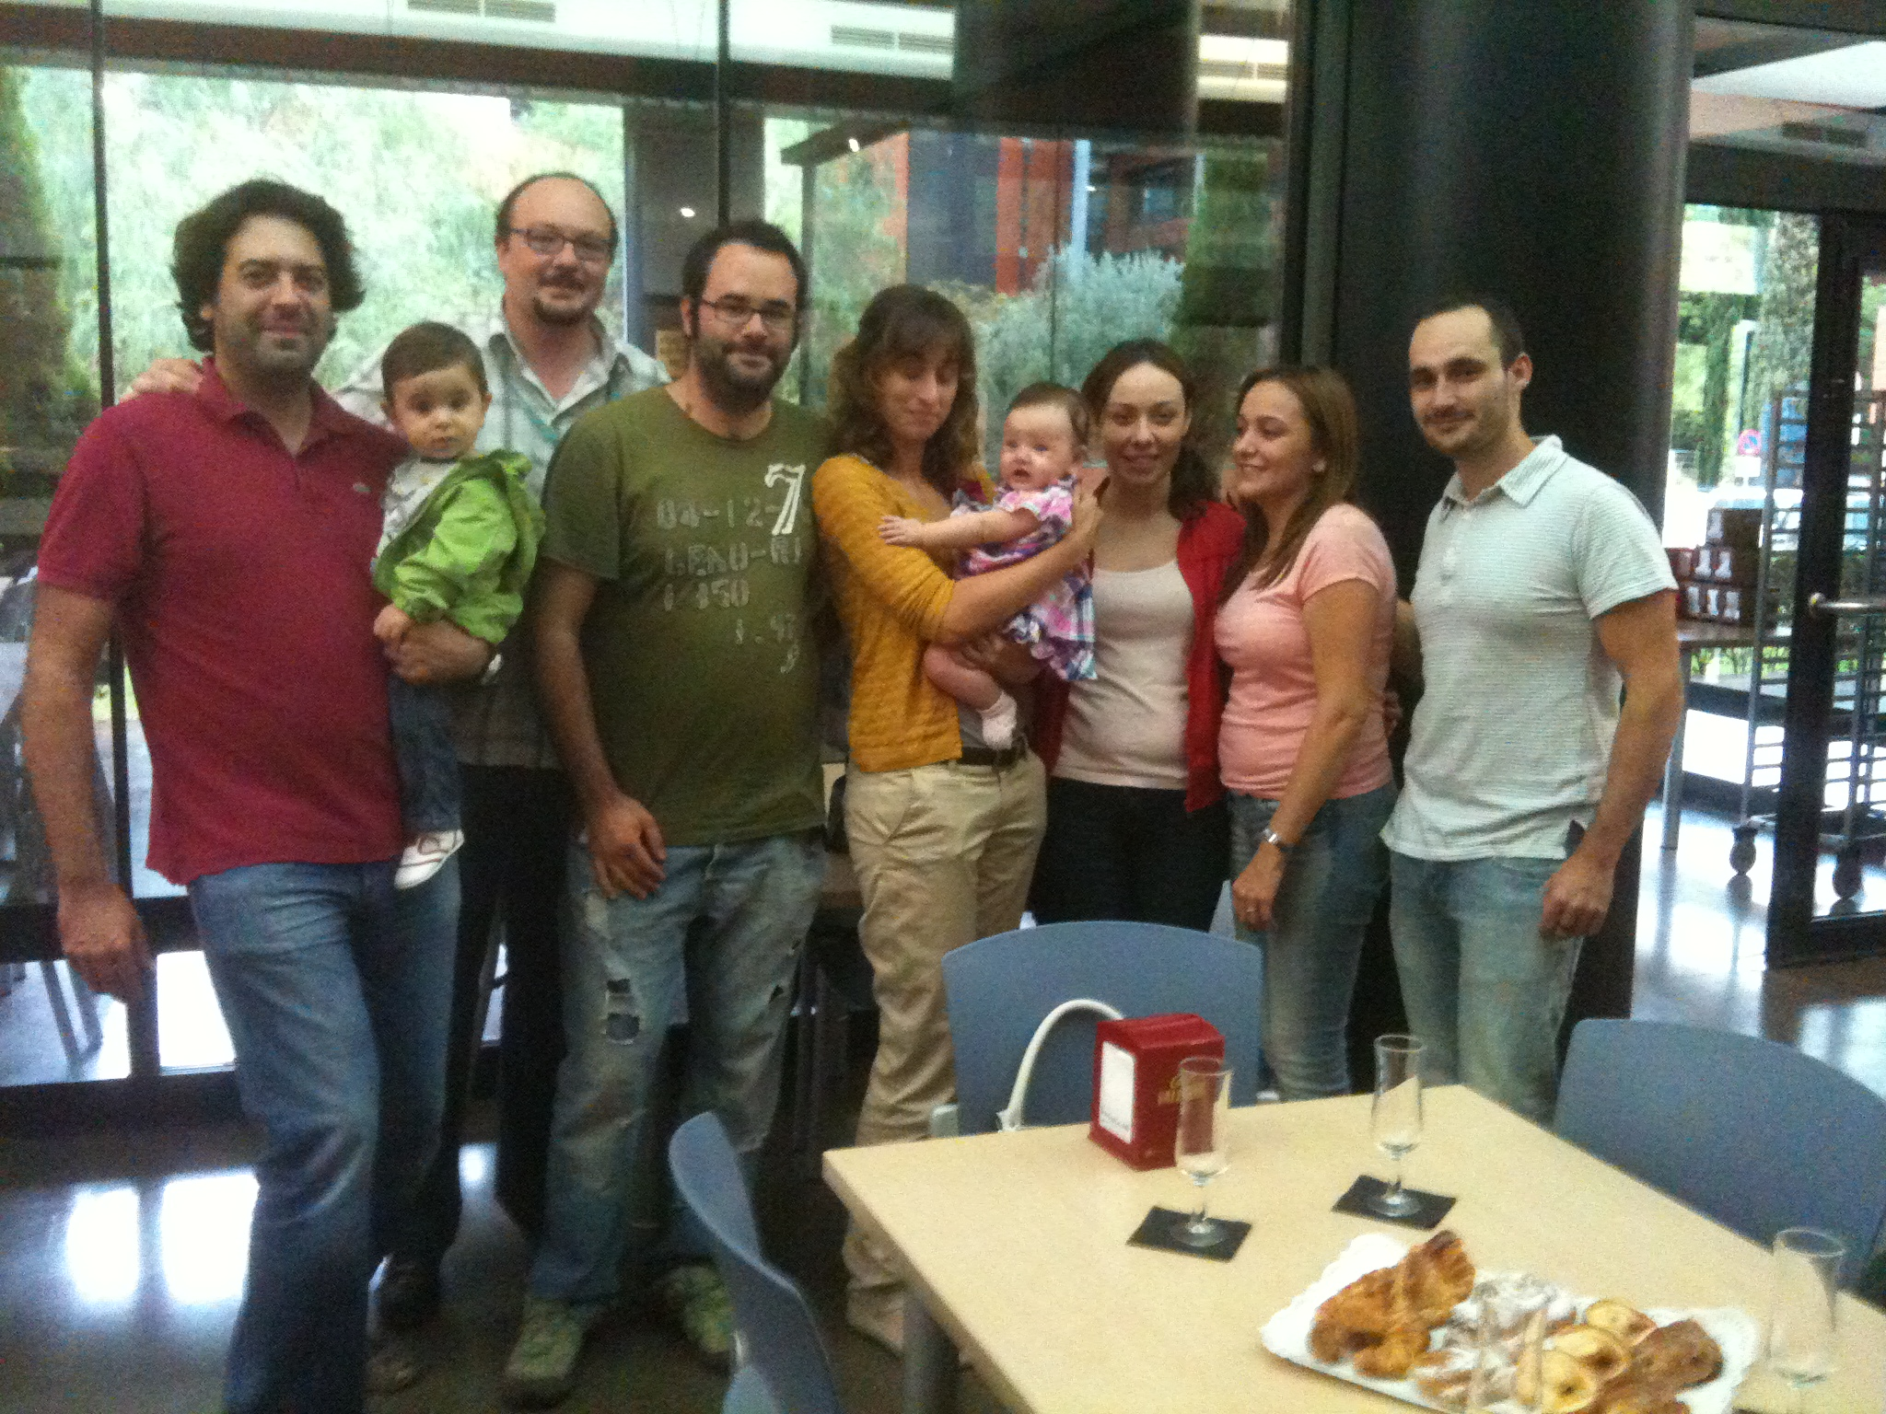
Thanks for your attention

