Slide 1

Extraction Line Laser-wire
24th January 2013
A.Aryshev, G.A.Blair, S.T.Boogert, L.Corner, L. Nevay, P.Karataev, N.Terunuma, J.Urakawa, R.Walczak

Slide 2
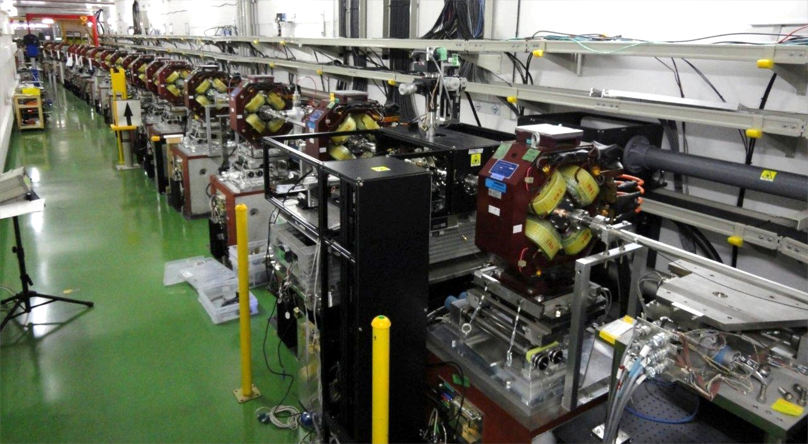
Laser-wire Setup
ATF-II Extraction Line
Detector
New IP
e⁻

Slide 3
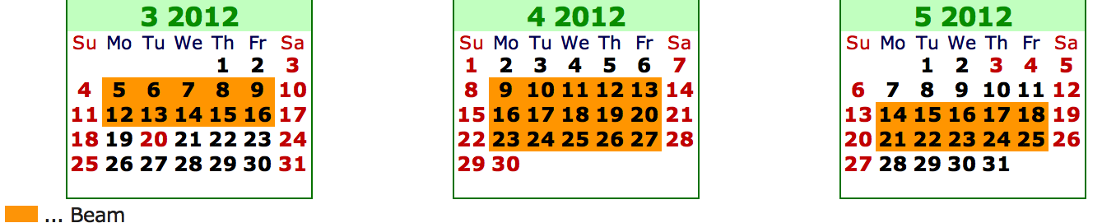
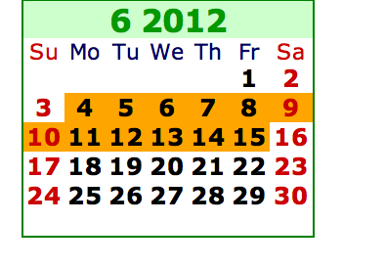
Operations
Operations during March – June
No operations during Autumn
Goal of 1 micron laser-wire scan
Full characterisation of laser-wire

Slide 4
Results
Many scans between 0.9 and 1.5 um
Non-Gaussian shape as expected from laser

Slide 5
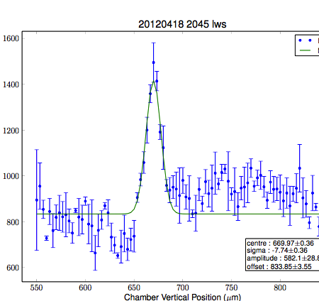
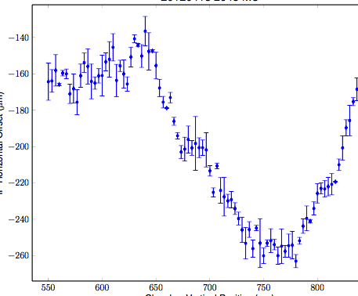
Consistent Picture
Not always so good
Beam drift
  much improved now due to linac feedback
Bpm orbit subtraction in progress
e⁻
LWIP
BPM
BPM
BPM
Mover
Mover

Slide 6
Signal to Noise
Background low under normal ATF2 operation
Required squeeze in βat Laser-wire IP increases
Laser old and can be unstable -> lower energy

Slide 7
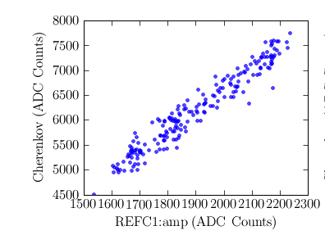
Signal Correlations
Background correlation varies from week to week
Hardware improvements for laser normalisation

Slide 8
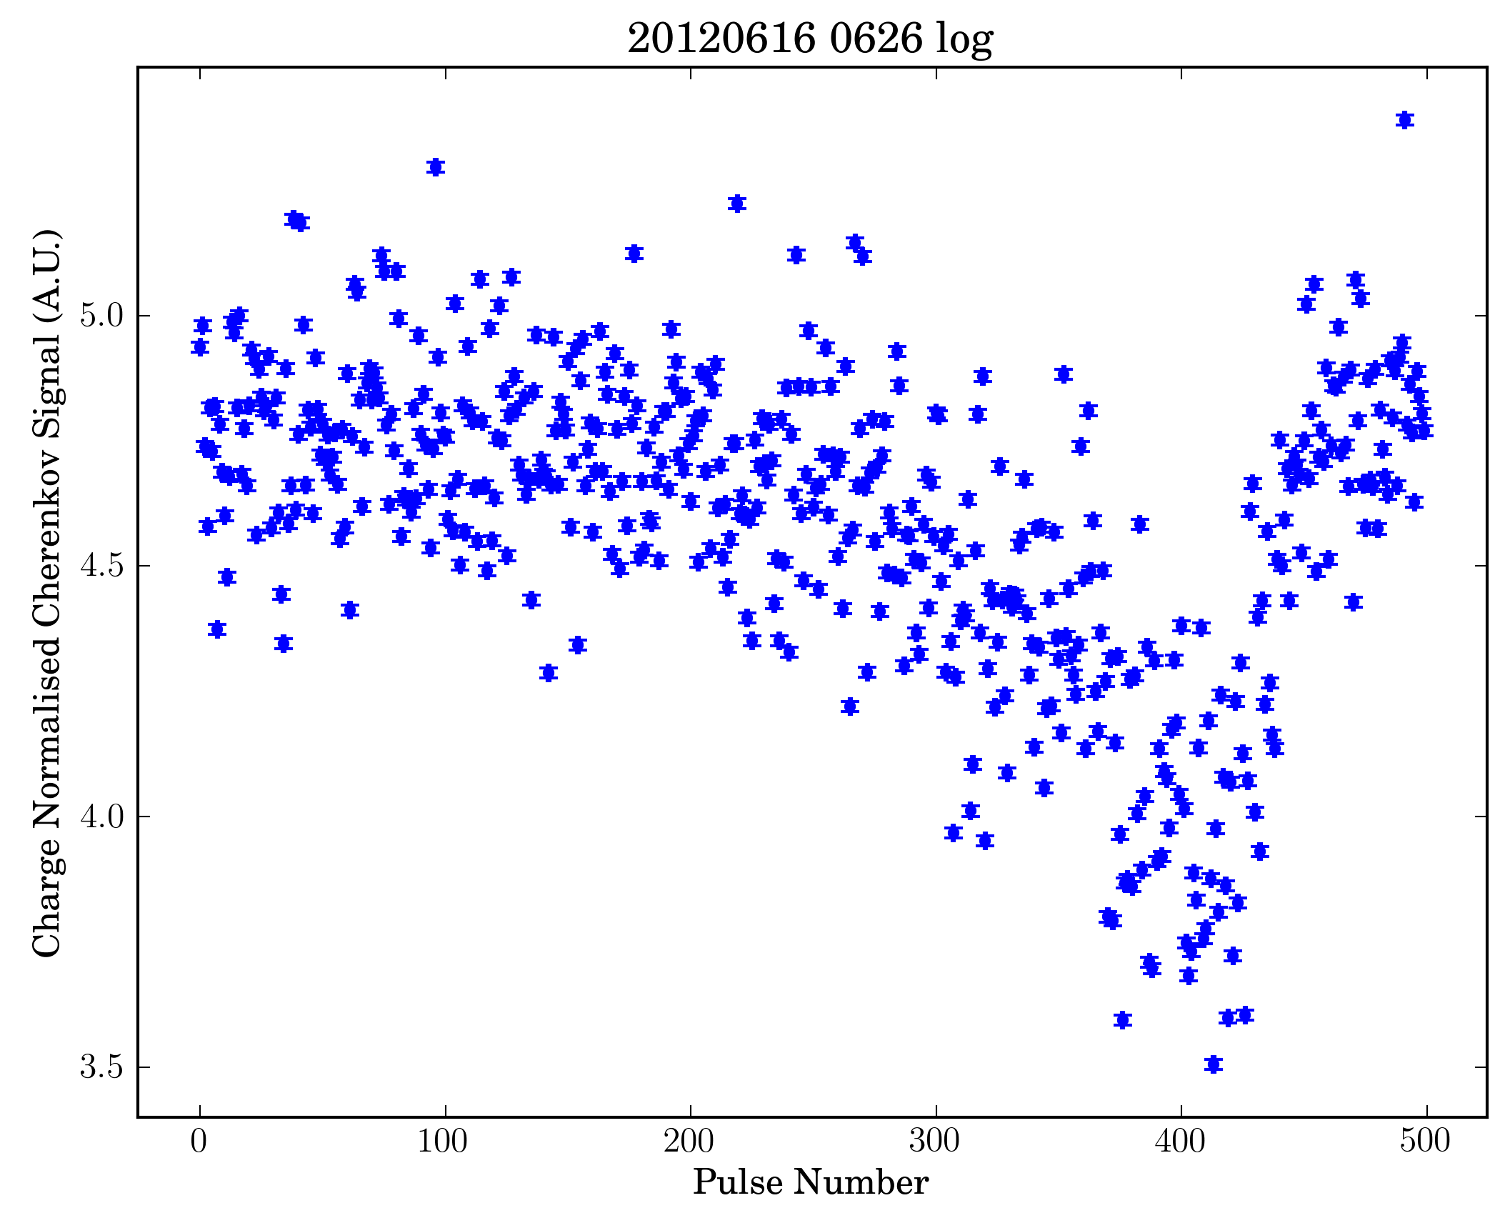
Variation in Background

Slide 9
Laser Characterisation
Characterise using scaled up focus
Scale this measurement to laser-wire IP
Two axis – astigmatic – project vertical sigma

Slide 10
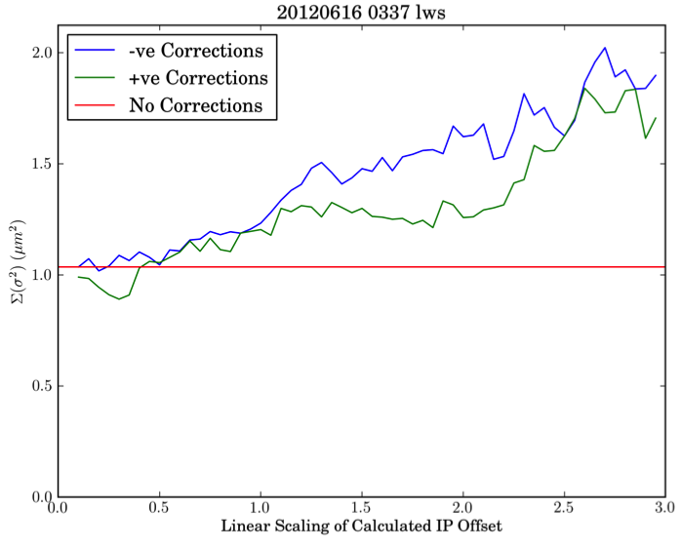
Orbit Jitter Subtraction
Orbit jitter subtraction currently doesn’t improve
Method being revised
Correction is small compared to poor correlations

Slide 11
Current Operations
Recommissioning laser-wire since last year
Investigation of signal correlations
Investigation of orbit correction
Improvements in signal characterisation
Increased precision

Slide 12
Future Operations
Goal of 1 micron laser-wire scans a reality
Consistent data needed for publication
Operations confirmed until March
Possible operations until Summer 2013
Current incarnation will finish this summer
New laser source required for further operations
Resolution aspect of laser-wire study complete
High repetition rate and intra-train scanning underway at DESY

