Slide 1
Electrical wiring for piezo movers piezo power supply strain gauges readout temperature probes

Slide 2
Overview : the way to connect from IP chamber to control room :
- piezo movers (power supply and strain gages readout),
- temperature probes.
Overview by flange : the wiring on the flange :
- inside the IP chamber,
- outside.
Detail for the 2 flanges : an example of a equipped flange :
- vacuum connectors,
- equipped flange with feedthroughs,
- external connectors and cables.
Overview of the existing at LAL : LAL wiring uses to perform tests of piezo movers :
- piezo movers,
- movers command box,
- inputs / outputs electronics,
- laptop with NI Labview software.
Existing ADC / DAC : equipment bought and used by LAL :
- National Instruments (NI) modules,
The LAL need at KEK : necessary equipment to connect LAL electronics to KEK control room :
- an example given by National Instruments (NI) modules.
Conclusion
Summary

Slide 3
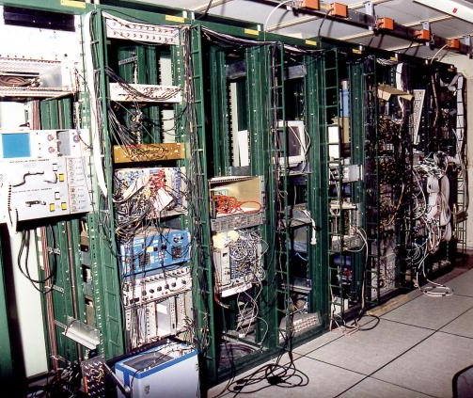
Overview
PI movers
(BPM3)
Connecting cable for mover (25 m)
temp probe* (BPM3)
Linking box
Cedrat movers
(BPM1&2)
4 movers command box
(PI)
Linking box
Analog inputs & outputs
Connecting cable for Temp probe (25 m)
4 movers command box
(Cedrat)
temp probe* (BPM1&2)
Analog inputs & outputs
Link to control room*
T. probe*
DAC
ADC
DAC
ADC
4 wires
16 bits / +-10 v
24 bits / +-10 v
16 bits / +-10 v
24 bits / +-10 v
* To be defined

Slide 4
Inside ip chamber 6E-8 mbar
Overview per flange
Vacuum removable connectors
Outside ip chamber (air pressure)
Outside removable connectors
3 Connecting cables (25 m)
4 movers
1 Connecting cable (25 m)
1 Temp probe
Linking box
Φ252 mm flange*
4 movers command box
4 Electrical feedthroughs*
Temp probe (4 wires)
*Not supplied by LAL
Analog inputs & outputs
Electrical wiring for piezo movers
Notes:
Frédéric BOGARD – LAL/IN2P3/CNS – 13-01-25

Slide 5
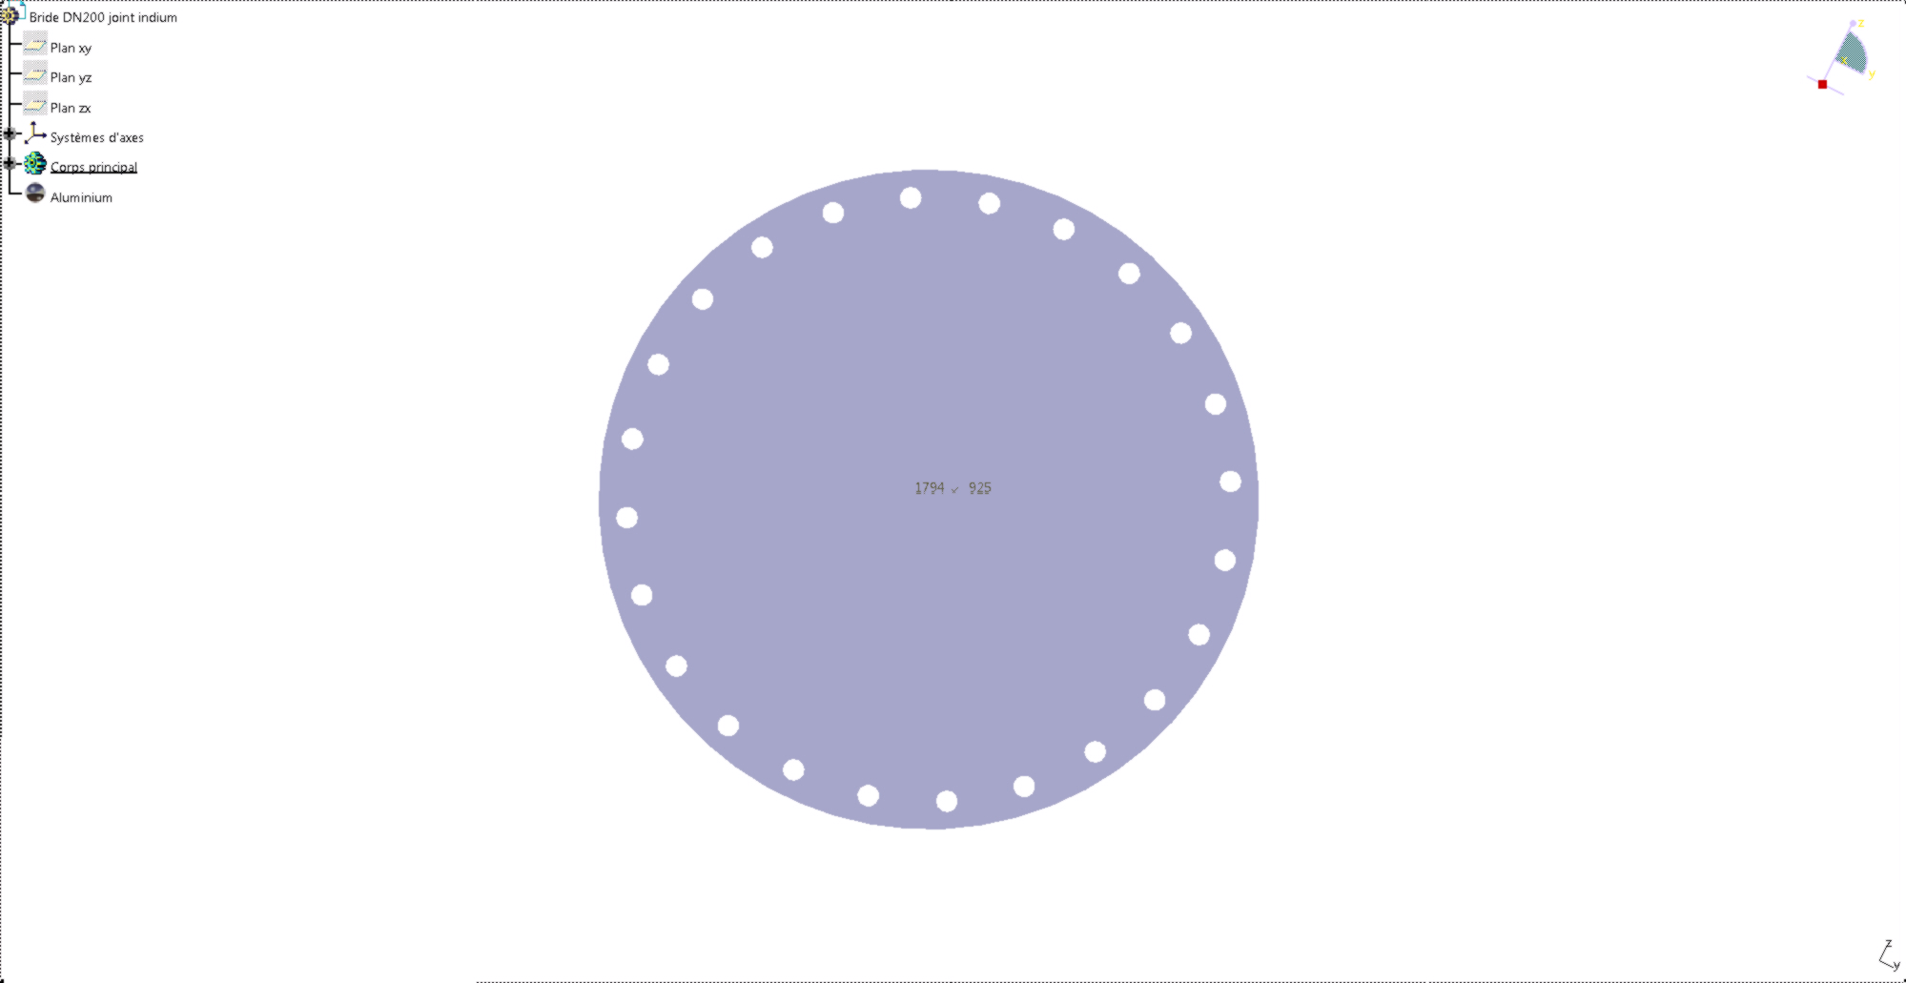
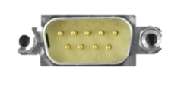
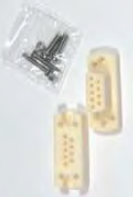
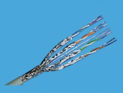
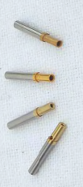
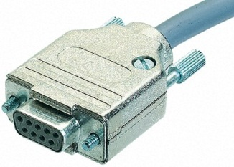

Detail for the 2 flanges
Inside ip chamber 6E-8 mbar
Outside ip chamber (air pressure)
2x4 Connectors subD9 female (Ceramic UHV)
Small crimp pins
KEK supply
2x 4x25m
‘7 S/FTP’ cable
Strain gauges connectors
Temp probe connectors
Piezo power supply connectors
2x4 Connectors subD9 female
2x4 metal covers subD9
2x1 flange with 4 feedthroughs subD9 male for each flange
(feedthoughs position on the flange surface : KEK discretion)
Thanks to
P.Cornebise SERDI-LAL
Electrical wiring for piezo movers
Notes:
Frédéric BOGARD – LAL/IN2P3/CNS – 13-01-25

Slide 6
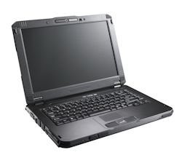
PI movers
(BPM3)
Overview of the existing at LAL
2 wires (piezo power supply)
Welding wire to wire
4 wires (strain gauges readout)
Cedrat movers
(BPM1&2)
4 movers command box
(PI)
Analog inputs & outputs
Welding wire to wire
4 movers command box
(Cedrat)
Analog inputs & outputs
Labview interface
USB link
DAC
ADC
DAC
ADC
16 bits / +-10 v
24 bits / +-10 v
16 bits / +-10 v
24 bits / +-10 v

Slide 7
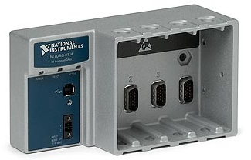
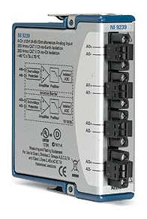
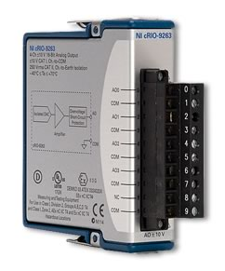
Existing ADC / DAC at LAL
USB link
for Labview interface
Rack for 4 modules
NI cDAQ 9174
2 wires (piezo power supply)
2 wires (piezo power supply)
PI mover (x4)
Cedrat mover (x4)
4 wires (strain gauges readout)
4 wires (strain gauges readout)
ADC module
24 bits / +-10V (input x4)
DAC module
16 bits / +-10V (output x4)
ADC module
24 bits / +-10V (input x4)
DAC module
16 bits / +-10V (output x4)
NI 9239
NI 9263
NI 9239
NI 9263
Electrical wiring for piezo movers
Notes:
Frédéric BOGARD – LAL/IN2P3/CNS – 13-01-25

Slide 8
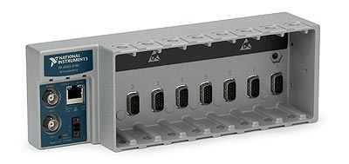
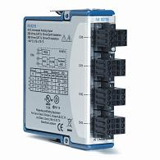
The LAL need at KEK
Ethernet / RS432-485 / … link to connect with KEK control room
For example
Output : DAC
piezo power supply
16 bits / +-10Vc (input x4)
Input : ADC
strain gauges readout
24 bits / +-10V (input x4)
Input : ADC
Temp probe readout
(PT100 / PT1000) (input x4)
x2
x2
x1
These electronic modules must be connected to the control room devices at KEK. No preference for National Instruments (NI), Keyence…
Electrical wiring for piezo movers
Notes:
Frédéric BOGARD – LAL/IN2P3/CNS – 13-01-25

Slide 9
Distance from IP chamber (warm zone) to movers / temp probes electronics (cold zone) :
- 25 m.
Temperature probes :
- need inside IP chamber ? How many (1 for BPM1&2 / 1 for BPM3) ?
- heating wire wound around the chamber to maintain constant the temperature ? KEK ?
Flanges supply :
- flanges with feedthroughs to be supplied by KEK ?
- subD9 male feedthrough as purposed by LAL ?
Electronics to connect to control room devices :
- LAL supply with NI modules and Labview software ?
- or KEK supply with LAL specs ?
- USB / RS 485 / ethernet link ?
Conclusion
Electrical wiring for piezo movers
Notes:
Frédéric BOGARD – LAL/IN2P3/CNS – 13-01-25

