Slide 1

Study of cross-talk with 55Fe evts, and distortions at B=0 and 1T

Slide 2
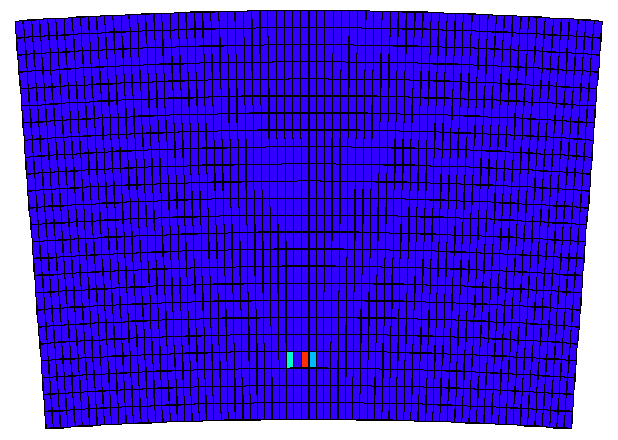
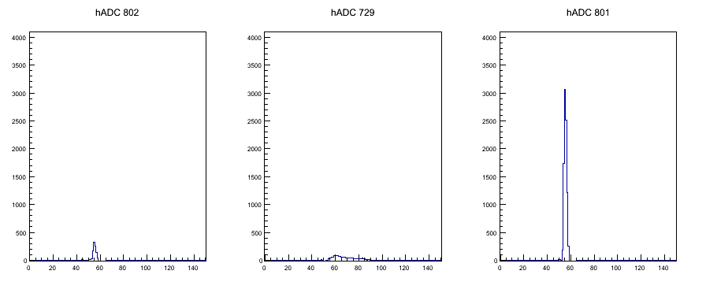
Cross-talk
Pad 1
Pad 2

Slide 3
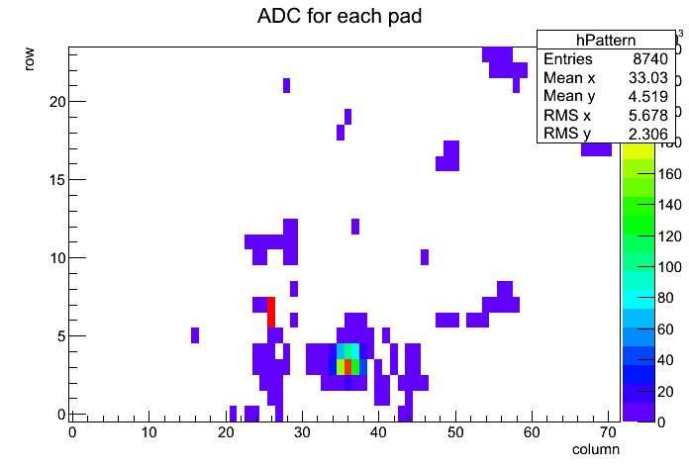
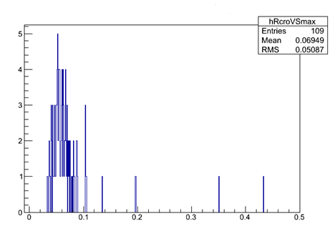
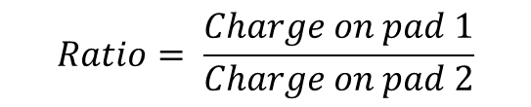
Cross-talk at different positions and detectors
$$Ratio= \frac{Charge on pad 1}{Charge on pad 2}$$
S9A_Femi2 RUN2552

Slide 4
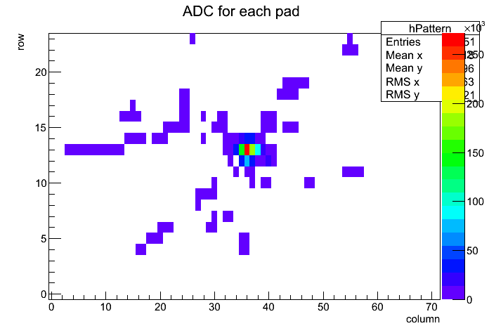
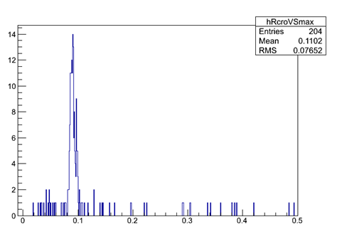
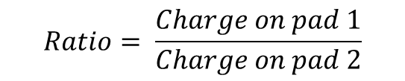
Cross-talk at different positions and detectors
$$Ratio= \frac{Charge on pad 1}{Charge on pad 2}$$
S7H_Femi1 RUN2544

Slide 5
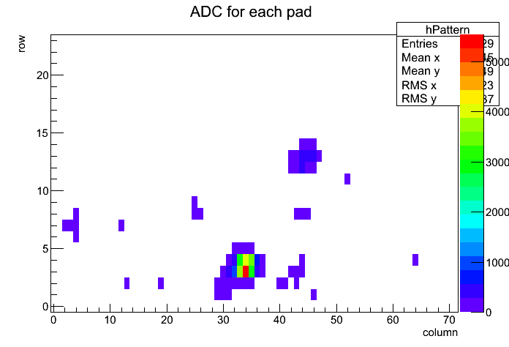
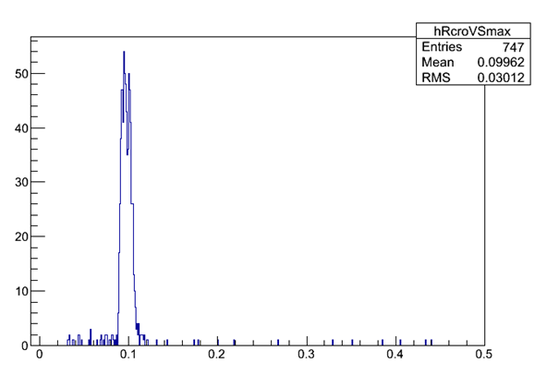
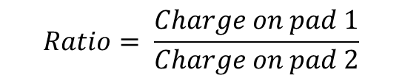
Cross-talk at different positions and detectors
$$Ratio= \frac{Charge on pad 1}{Charge on pad 2}$$
S4G_Femi3 RUN2556

Slide 6
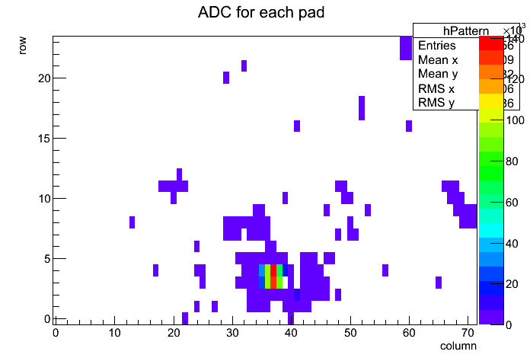
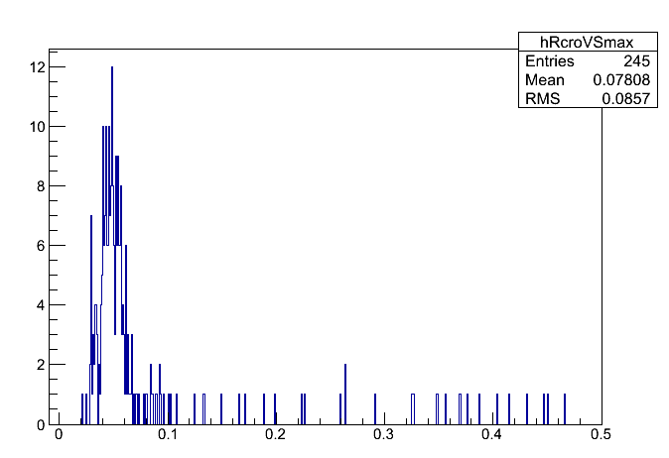
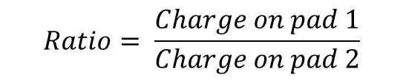
Cross-talk at different positions and detectors
$$Ratio= \frac{Charge on pad 1}{Charge on pad 2}$$
S3B_Femi7 RUN2559

Slide 7
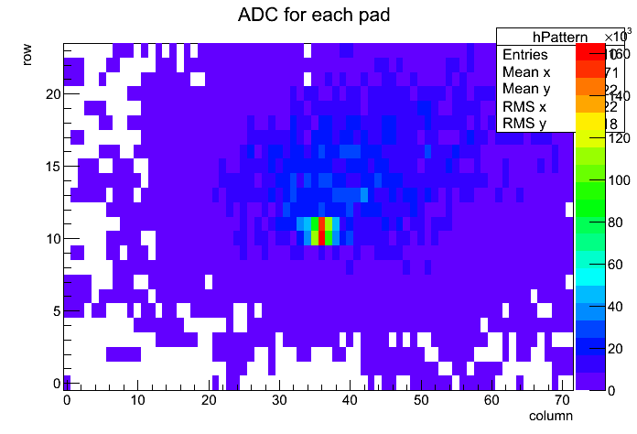
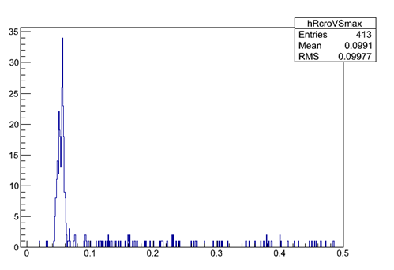
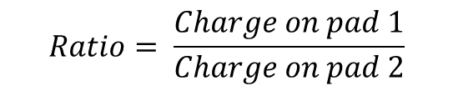
Cross-talk at different positions and detectors
$$Ratio= \frac{Charge on pad 1}{Charge on pad 2}$$
S8G_Femi4 RUN2548

Slide 8
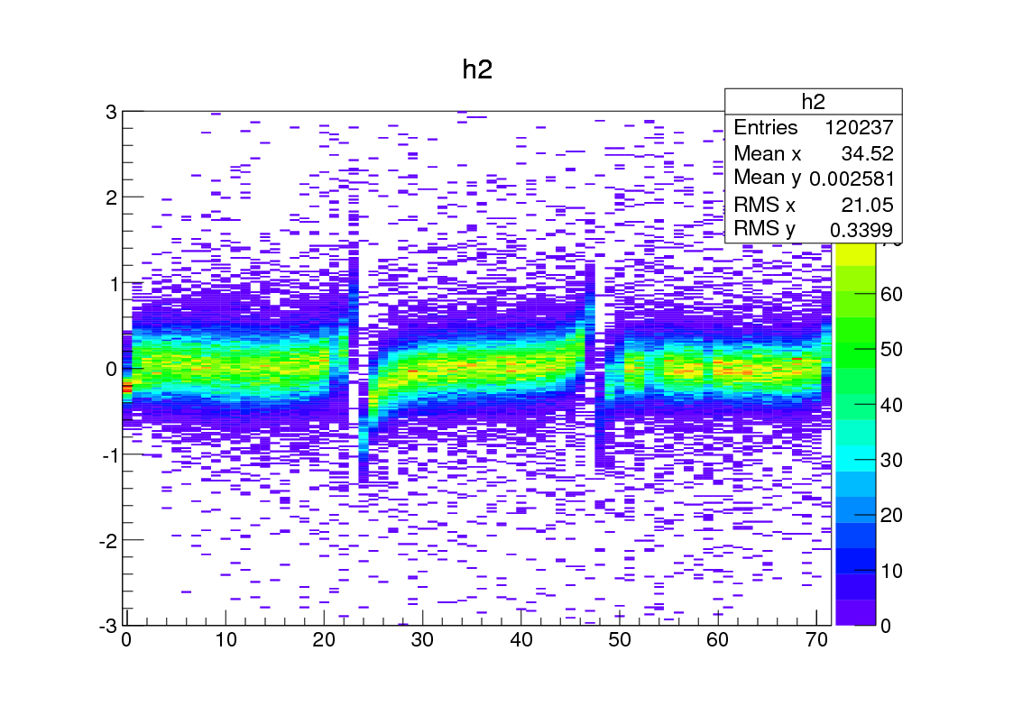
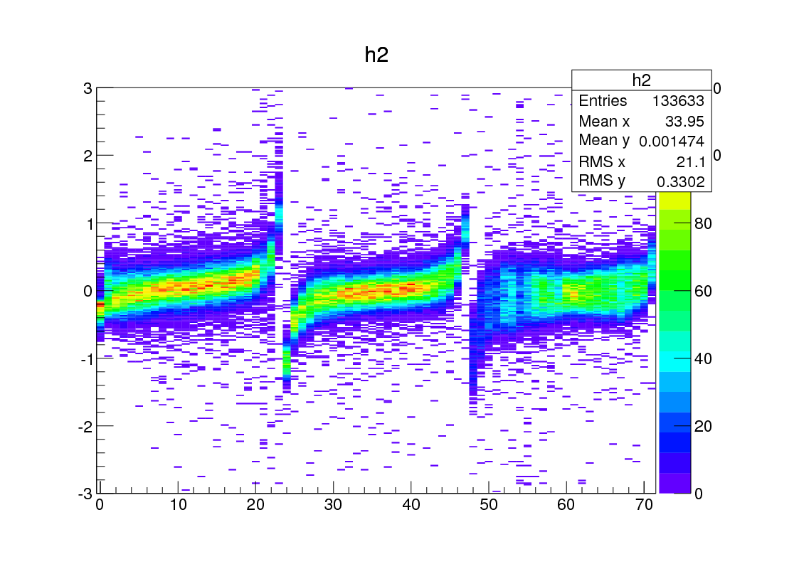
Residual
RUN2161: B=1T, phi ∼ 10º
RUN2158: B=0T, phi∼10º

Slide 9
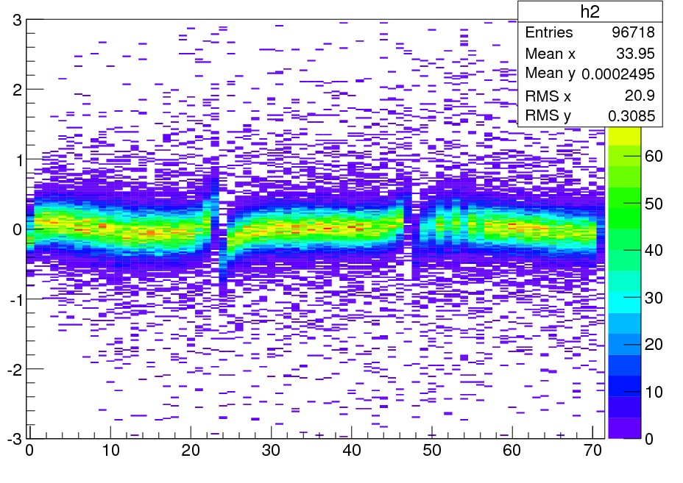
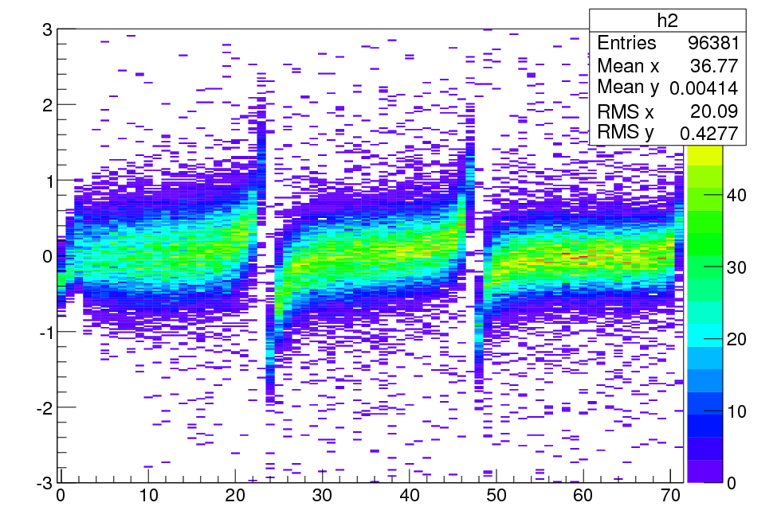
Residual (B=0T)
RUN2157: B=0T, phi ∼ 5º
RUN2158: B=0T, phi ∼ 10º
RUN2159: B=0T, phi ∼ 15º

Slide 10
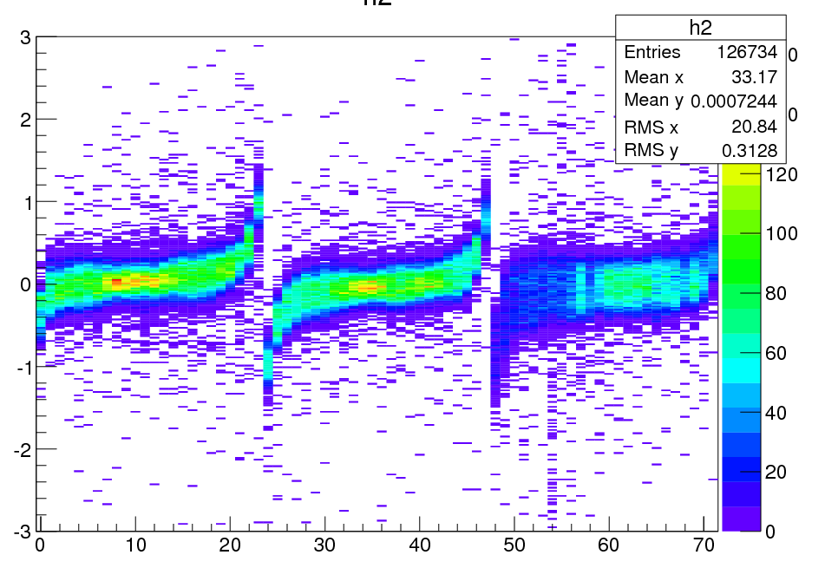
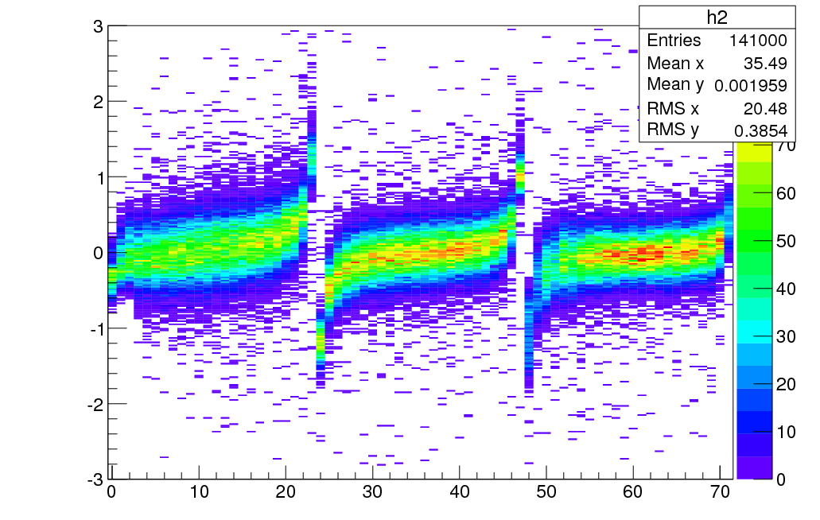
Residual (B=1T)
RUN2162: B=1T, phi ∼ 5º
RUN2161: B=1T, phi ∼ 10º
RUN2160: B=1T, phi ∼ 15º

