Slide 1



Automatic tile/SiPM placement on the HBU boards
21.3.12 - Calice Collaboration Meeting
DESY Hamburg
Phi Chau
Bruno Bauss, Volker Büscher, Reinhold Degele, Karl Heinz Geib, Sascha Krause, Yong Liu, Lucia Masetti, Uli Schäfer, Rouven Spreckels, Stefan Tapprogge, Rainer Wanke, André Welker

Slide 2

Need for an automatic placement
Hadron tests (2014)
  60 HBU boards → 8.500 tiles with SiPM have to be placed on HBU boards
Full prototype (2015)
  160 HBU boards → 23.000 tiles with SiPM have to be placed on HBU boards
AHCAL (final design)
  About 8.000.000 tiles have to be placed on HBU boards
Notes:
Format noch korrigieren

Slide 3
Need for an automatic placement
That means with an effort of 20 seconds for a manual placement per tile you will need for
One HBU board: ~ 1 h
Hadron tests (2014): ~ 1 week
Full prototype (2015): ~ 1 month
AHCAL (final design): ~ 15 years
Notes:
Format noch korrigieren

Slide 4
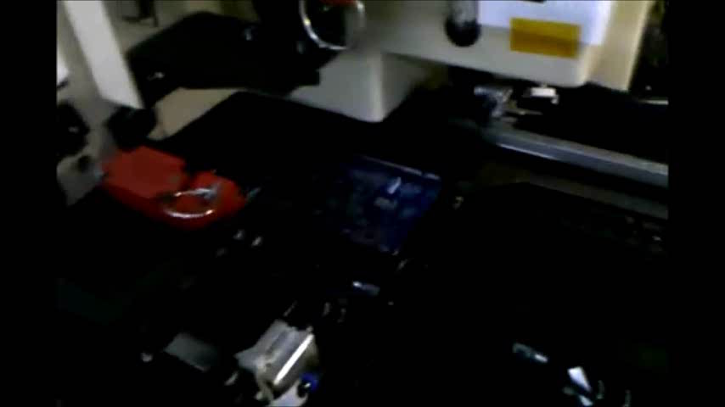
Need for an automatic placement
For this number of tiles an automatic placement is needed
→ pick-and-place machine
Notes:
Video Hinzufügen

Slide 5
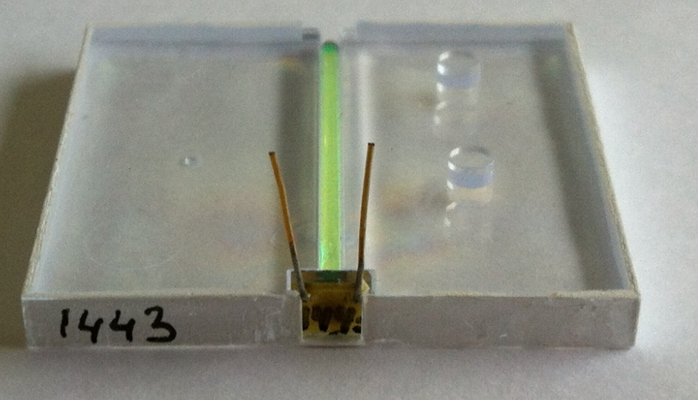
Present design
Possible drawback of automatic placement to design→ Alignment and SiPM pins need to be considered
Alignment pins
SiPM pins

Slide 6
Alignment pins
Automatic pressing of tiles in the alignment pin connectors of HBU board is problematic. Possible problems:
  Force has to be applied to connect alignment pins with the connectors
  Other possible problems:
    The alignment pins may have too much space -> tiles aren‘t fixed
    They may not fit

Slide 7
Alignment pins
Idea
  Fixation of tiles without alignment pins by glueing on reflector foil/HBU board

Slide 8
Alignment pins
Present design:
Possible new design:
Alignment pins
HBU
Pin (SiPM)
Glue points
SiPM
→ Tile without alignment pins
→ Tile fixation with optical glue
Absorption layer
Reflector foil

Slide 9
Alignment pins
Possible influence of glueing to optical properties?
→ Test measurements
with BC-600 (Bicron)

Slide 10
Measurement Set-up
Pin
Acrylic glass
SiPM
tile
Reflector foil
Black box
Idea:
Cosmic ray test

Slide 11
Measurement Set-up
Pin
Acrylic glass
SiPM
Trigger scintillator
Case
Black box

Slide 12
Measurement Set-up
Pin
Scope + signal amplifier
Light guide + PMT
Trigger scintillator
Case
Black box

Slide 13
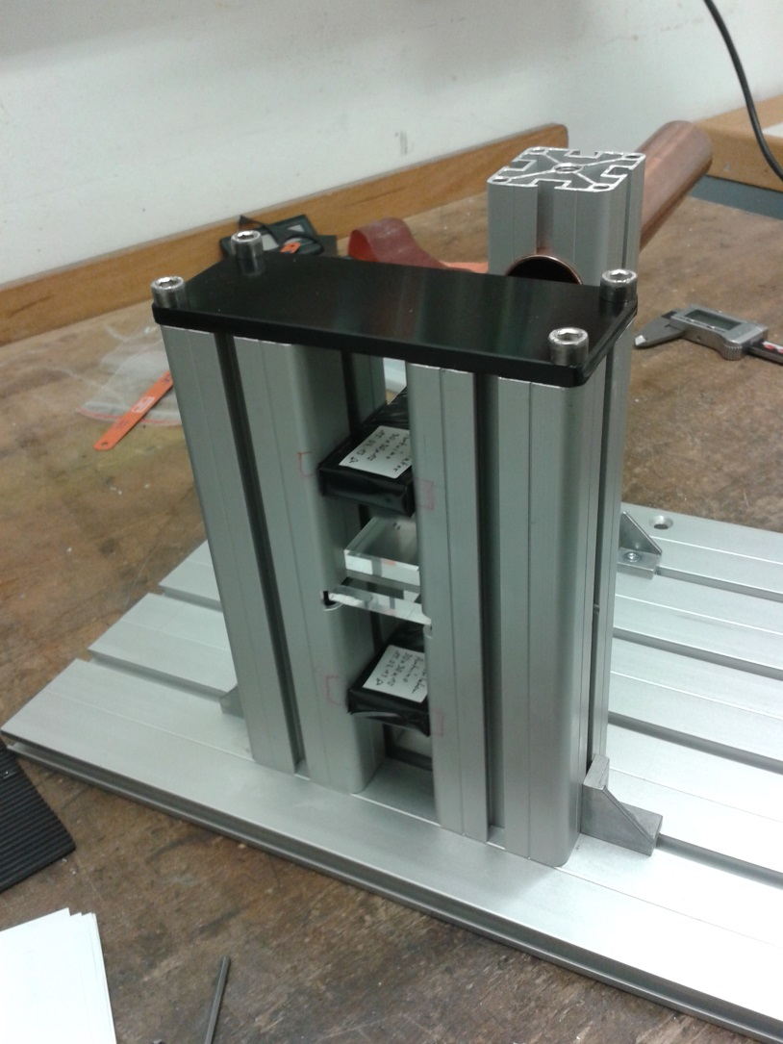
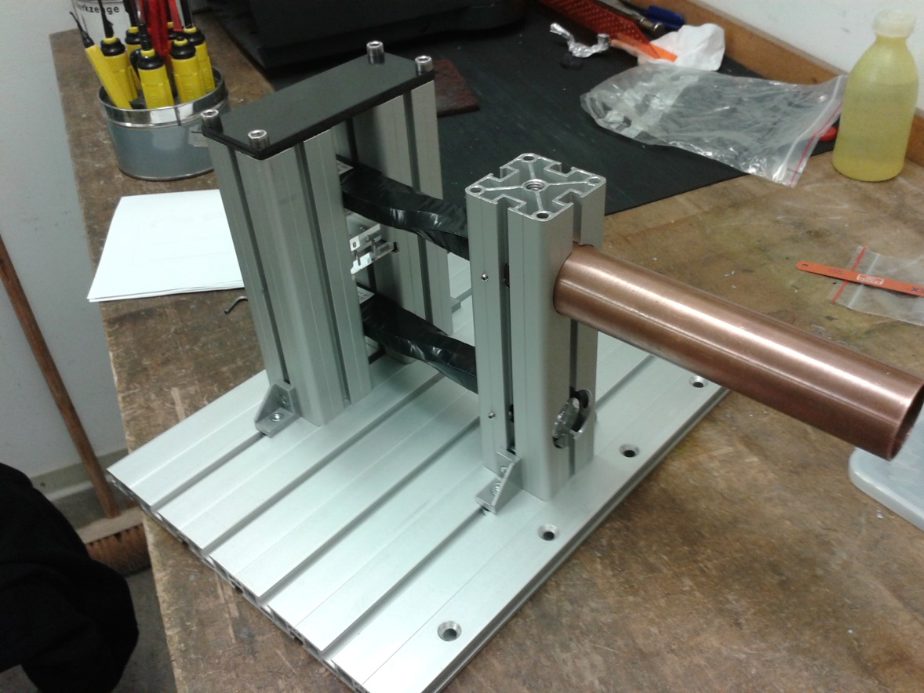
Measurement Set-up

Slide 14
Measurement of optical properties
Four different measurements
  Measurement according to original concept
  Direct contact beween tile and reflector foil without alignment pins (without glue)
  Measurement with one or two glue points on tile (without alignment pins)
  Tests with glue on whole surface of tile (without alignment pins)

Slide 15
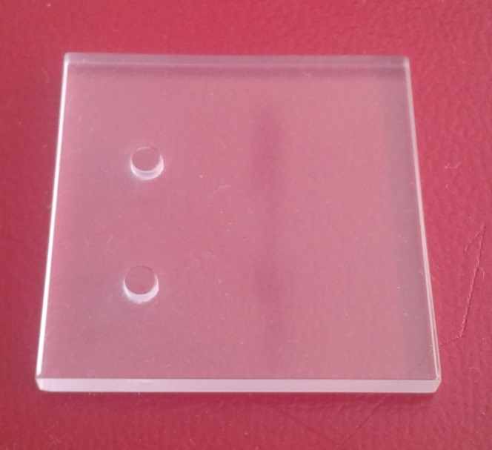
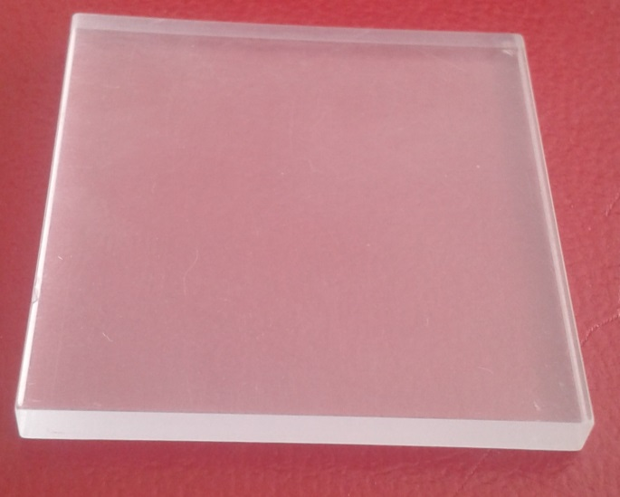
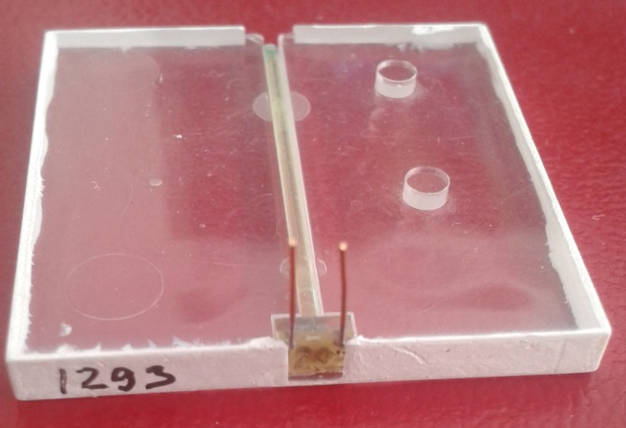
Test configuration
Replica tile with
alignment pins
Replica tile without
alignment pins
Original tile with SiPM
Notes:
Bearbeiten!!

Slide 16
Test configuration
Configuration of test tiles
  Borders of test tiles are painted with white reflecting color
Is the painting comparable?
  Test original ITEP tile and CPTA SiPM
  Then remove etched borders und paint white reflecting color on
Notes:
Bearbeiten!!

Slide 17
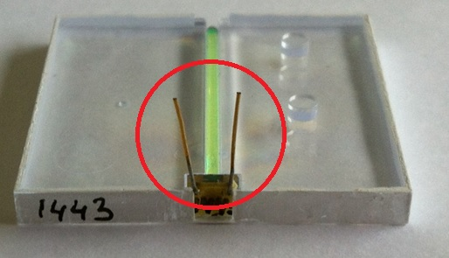
SiPM pins
To guarantee a reliable automatic placement
  Robust and linear pins of the SiPM are needed

Slide 18
SiPM pins
Exact positions in the space of tolerances are absolutely necessary for automatic placement
SiPMs have to fulfill definit specifications
Example: SiPM pins with Hamamatsu MPPC

Slide 19
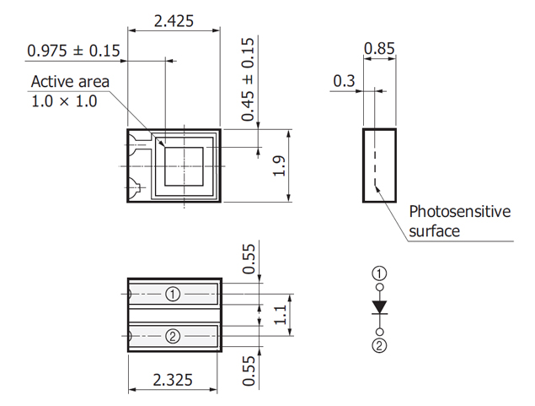
SiPM pins
Exact positions in the space of tolerances are absolutely necessary for automatic placement
Example: Hamamatsu
MPPC S10362-11-xxxP
Pins
Front view
Side view
0.55
Back view
1.1 ± 0.2
0.55
3.0 mm

Slide 20
General schematic of pick-and-place machine
Assembly line transports HBU boards
1. Glue points on reflector foil/HBU board
2. tiles are set on foil/HBU
3. SiPM pins are soldered on HBU
4. Deposit station – glue can dry
5. Test of functionality for tiles and SiPMs with LEDs on HBU
We will obtain a test machine for the automatic placement
→ Price for a used machine: 10.000 – 20.000 €

Slide 21
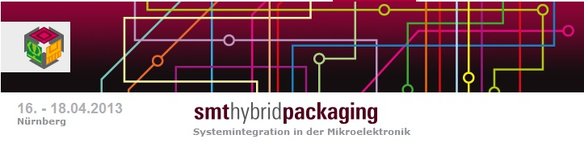
Forecast
April SMT Hybrid packaging fair in Nürnberg
http://www.mesago.de/de/SMT/Fuer_Besucher/Willkommen/index.htm

Slide 22
Thank you for your attention!

