Slide 1
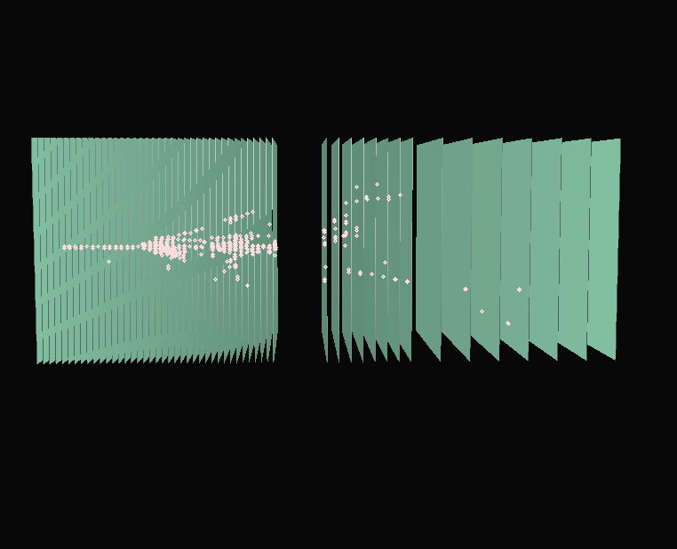
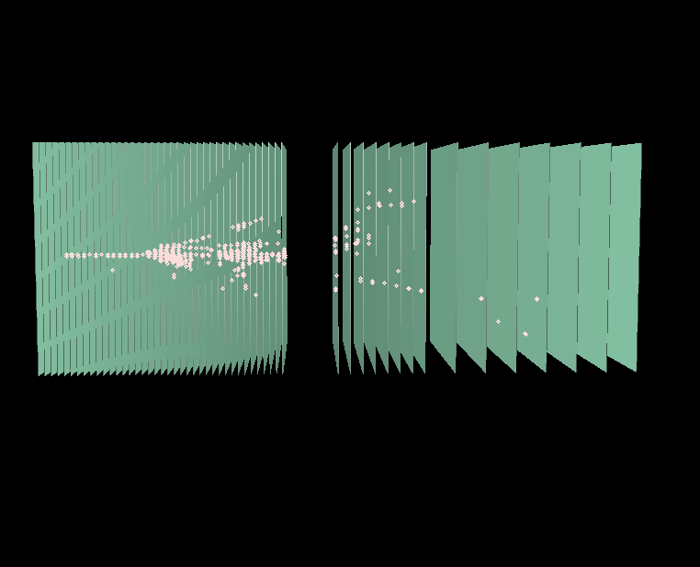
DHCAL Overview
José Repond
Argonne National Laboratory
CALICE Collaboration Meeting
DESY, Hamburg, Germany
March 20 – 22, 2013

Slide 2
Activities of the Next Year
Emphasis on data analysis
R&D with resistive plates (decrease resistivity and increase rate capability)
Build and test RPCs with new Bakelite plates
(new, lower resistivity Bakelite, Bakelite with resistive paint layer inside the plate)
Build and test RPCs with new, semi-conductive glass plates
1-glass RPCs (pad multiplicity ~1, resistive layer not critical, thinner, higher rate capability)
Build more large chambers and continue to test
Set-up of large cosmic ray test stand with DHCAL layers
Development of next generation readout (token ring passing, lower power consumption…)
Currently on hold (no funds)

Slide 3
Plans for Publishing Test Beam Results
Instrumentation paper
On hold due to missing electronics measurements (sensitivity)
Draft exists
Electronics paper
On hold due to missing electronics measurements (sensitivity)
Draft exists
Noise paper
Analysis started
Student left
Studies need to be completed
At the moment no manpower
Muon response paper
CALICE_Note exists
Analysis virtually completed
Fe-DHCAL
Fe-DHCAL

Slide 4
Plans for Publishing Test Beam Results
Pion/positron/calibration paper
Analysis well advanced
CALICE_Note being drafted
Pion shower shapes
Analysis ongoing
Still ways to go
Longitudinal calibration paper
Analysis virtually completed
Thesis exists
CALICE_Note to be drafted
Fe-DHCAL
Fe-DHCAL
Fe-DHCAL

Slide 5
Plans for Publishing Test Beam Results
Combined Si-W ECAL + DHCAL data
No concrete plans to analyze (yet)
Minimal absorber data
No concrete plans to analyze (yet)
W-DHCAL data
CALICE_Note exists with response/resolution
Analysis being taken over by CERN group
Software Compensation with W-DHCAL data
W-DHCAL better suited than Fe-DHCAL
No concrete plans (yet)
Fe-DHCAL
DHCAL
W-DHCAL
W-DHCAL

Slide 6
Plans for Test Beams after Shutdowns
Fe-DHCAL data
Completed
W-DHCAL
Completed
Tests of individual RPCs/GEMs
High rate RPCs (GIF, FNAL)
1-glass RPCs (FNAL)
GEM prototypes w/ or w/out DHCAL (FNAL)

Slide 7
Overall Goals for the DHCAL
No matter what
Complete test beam analysis and publish
Develop and test high-rate RPCs
Built and test more 1-glass RPCs
Seek involvement in other experiments where RPCs might be needed
Assuming no ILC project in near future
Increase involvement in ATLAS upgrade
Look for other possibilities to utilize RPC technology
Assuming ILC project materializes
Activities need to be coordinated with new reality: detector collaborations?
Design and prototype next generation readout
(low power, better time-stamping resolution, higher channel count...)
Build and test gas recycling system (Iowa)
Continue work on HV distribution system (Iowa)
Start work on LV distribution system (DC-DC converters?)
Re-start work on HCAL engineering design

