Slide 1

Optical fiber calibration system
Jiri Kvasnicka
Prague, Institute of Physics
kvas@fzu.cz
QMB1a - the LED driver
Test setup - 6 HBU at DESY
Results - HBU data
Results - notched fibers

Slide 2
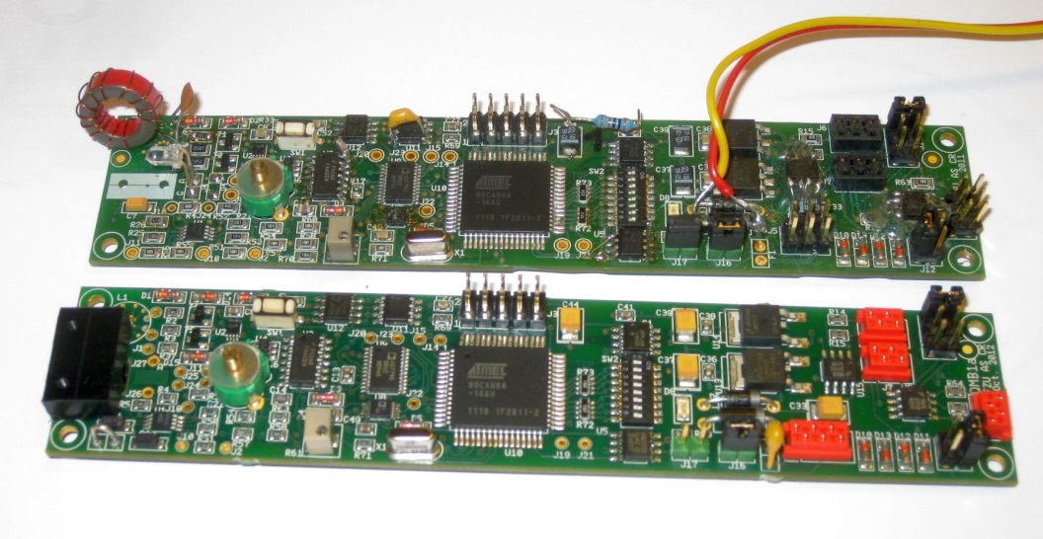
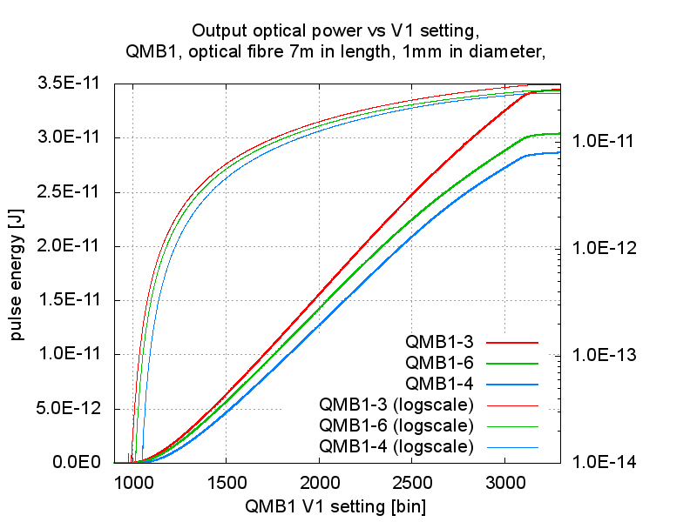
The LED driver – QMB1
QMB1
QMB1a
Quasi-resonant LED driver
Modular system
Dec 2012: QMB1a
  External coil pads (~30 ns pulse)
  New connectors, minor changes
  Boards are working,
  Performance measurements ongoing
Main parameters:
  Smooth pulse shape (half-sinus shape)
  Variable amplitude (~1A peak)
  Repetition rate up to 100 kHz
  Fixed pulse width (2.4–3.5 ns)
  PCB size 30 × 140 mm2
  Output power is not linear to the V1 setting
  UV LEDs has a different threshold

Slide 3
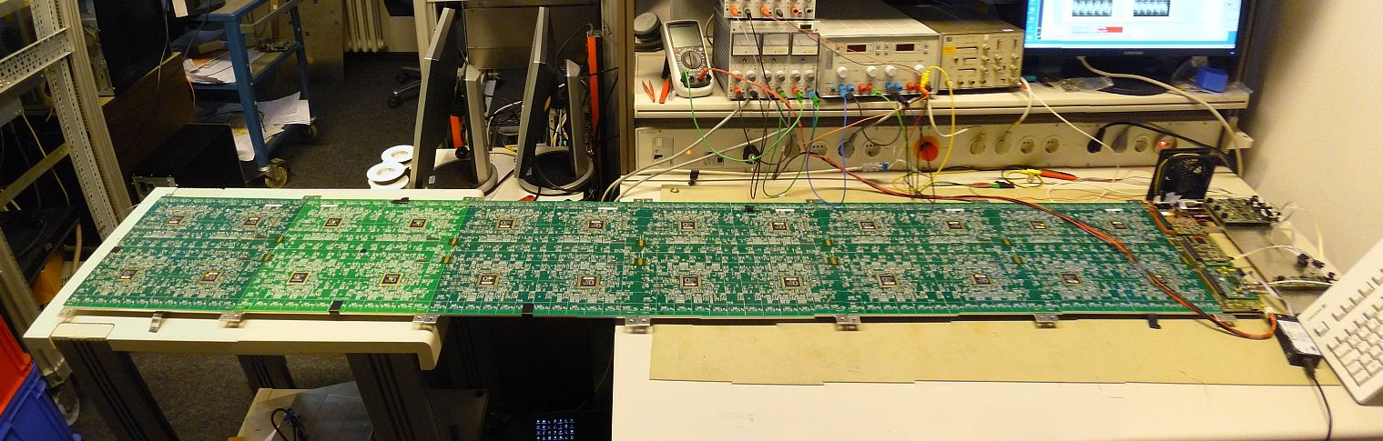
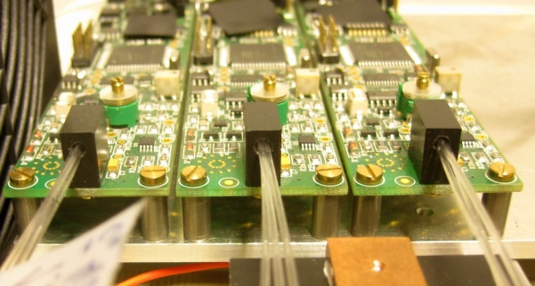
6-HBU setup – DEC 2012
Full setup with 6 HBU (2.2 m of electronics!)
Data readout from all HBUs is stable
  only 5 HBU equipped with tiles
3 row of tiles (3×72 tiles) illuminated by notched fibers and QMB1 LED drivers
1 row of tiles was illuminated by 1 QMB1 and 3 fibers (each fiber has 24 notches) → fiber triplet bundle (see next slide)
One QMB1 LED driver per row of 72 tiles

Slide 4
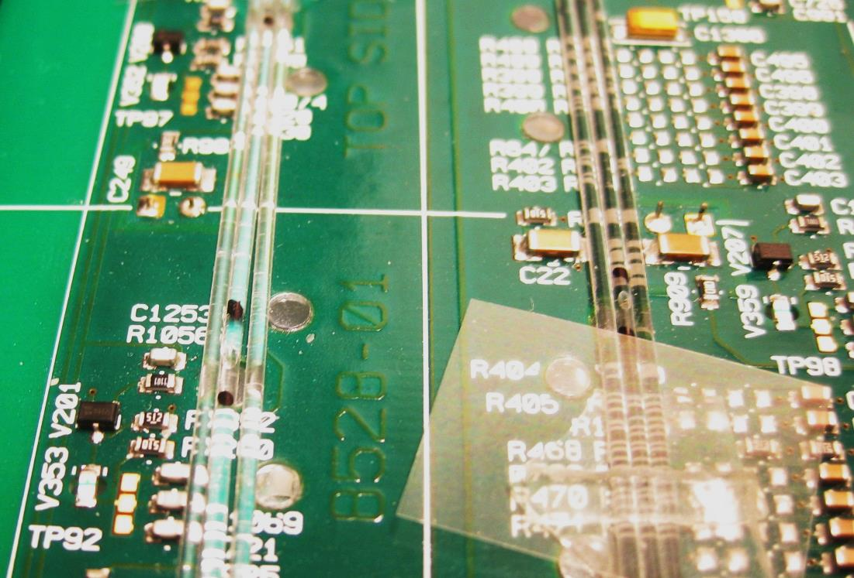
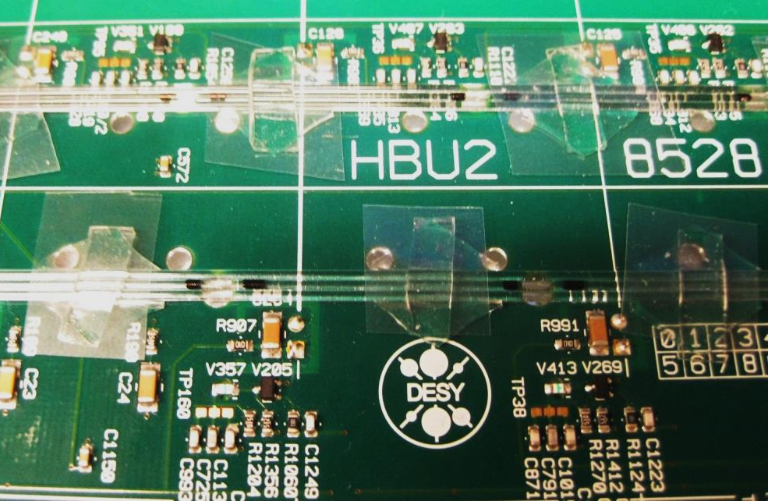
Notched Fiber triplet
“Glued” manually by a TESA stickers
  Good for testing
  Not suitable for the mass production (it took few hours to install and de-install the fibers)
Why 3 fibers with 24 notches instead of 1 fiber with 72 notches?
  24 notches can be produced with better precision
  The manufacturer has a semi-automatic machine for 24-notched fibers
  The light output from the 3mm LED couples well into 3 fibers → 3 times more light in total
    Due to the light profile of the LED
  Reminder: we have a single 72-notched fiber prototype with spread <25% made by hand

Slide 5
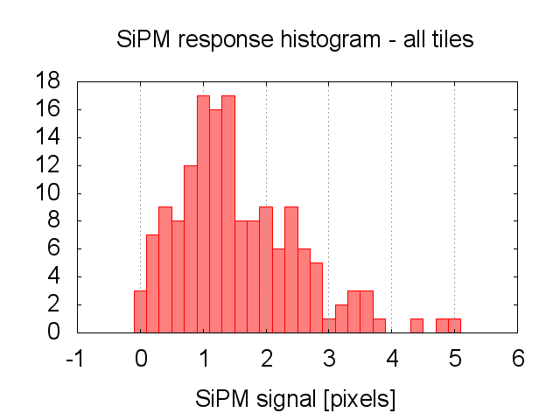
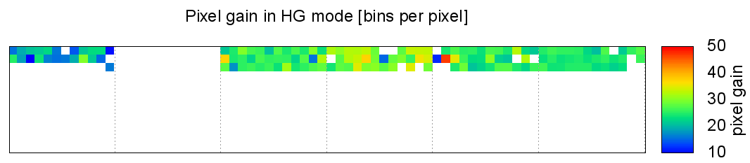
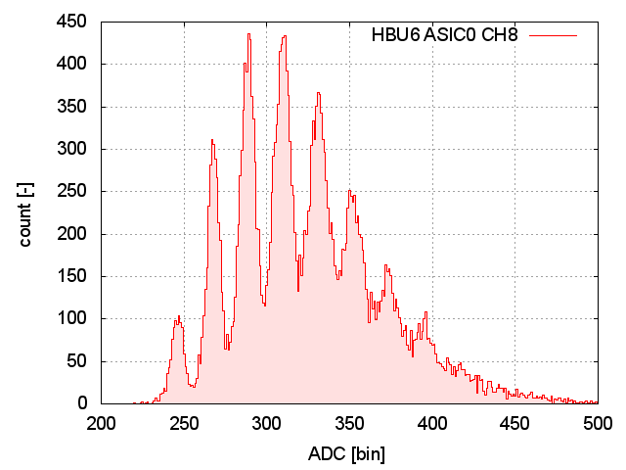
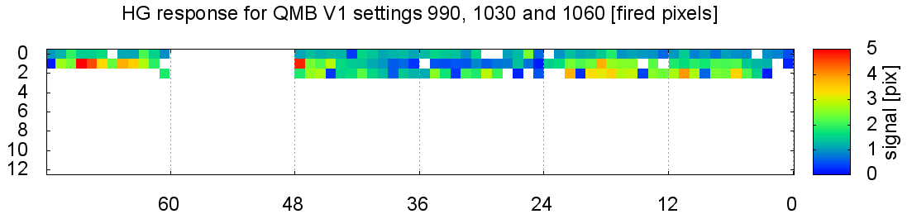
Results
153 “good” tiles (90.5% of assembled tiles)
  “good” means visible SPS (Single Pixel Spectra)
Gain successfully extracted from SPS, good fit with signal within 0.5–5 pixels range (noise-free channels even larger signal)
Gain extraction successful for 92% of the good tiles within a single run
Some channels need more light (especially tiles without holes in the PCB for the fiber)
Good SPS fit range
Pixel gain
Signal
One of the good SPS

Slide 6
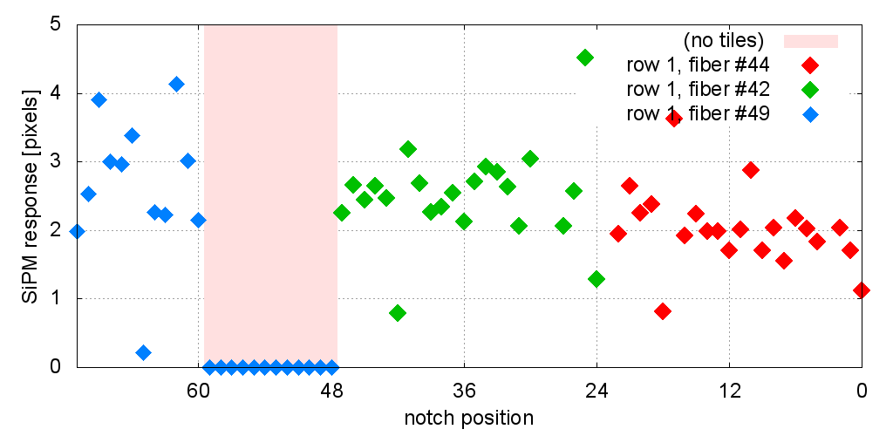
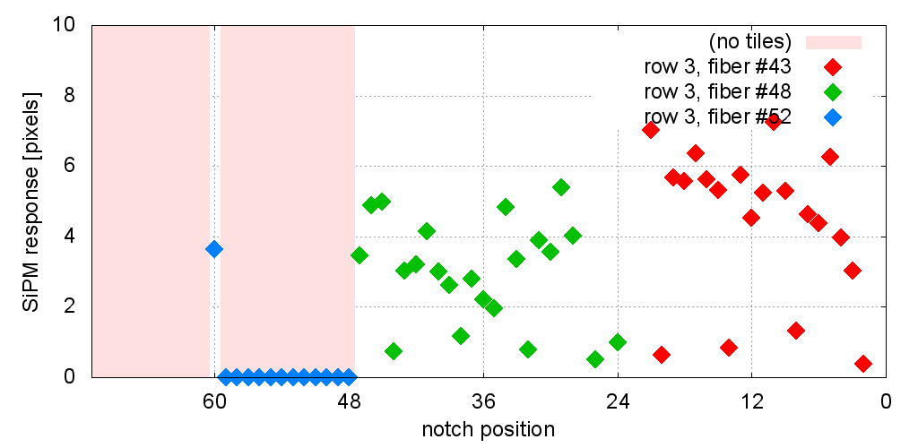
Notched fiber performance
Spread of light registered by the SiPM is shown
Testing fibers used, first fiber triplet prototype in our hands
Fibers have issues with quality (personal changes at the manufacturer)
Missing holes in the PCB (due to ASIC) clearly seen, but still got some light from reflection
Row 1
No tiles
Row 3
No tiles
No tiles
Signal
No holes in PCB

Slide 7
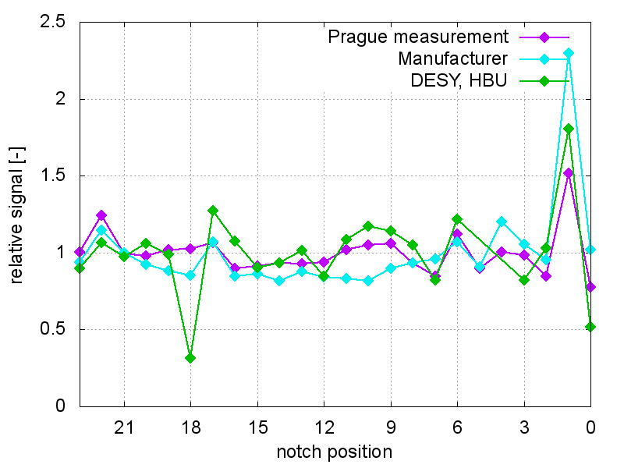
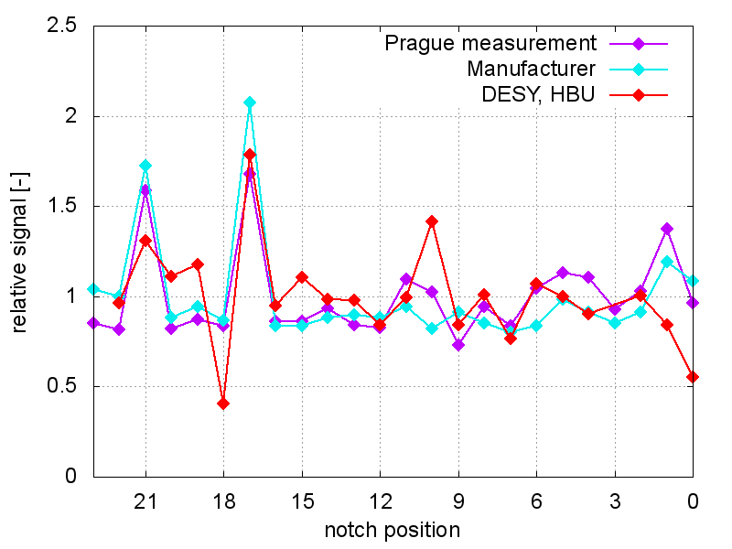
Measurements compared
Fibers were measured:
  During manufacturing
  At the institute in the Lab
  At DESY on HBU
We finally came to measurements agreement
Some trouble at starting points points (systematically lower, because fiber is lifted there due to the connector)
Some points do not match (HBU vs. LAB) for unknown reason
For the fiber production, notches will have 15% spread limit
Fiber #42
No tiles
Fiber #44

Slide 8
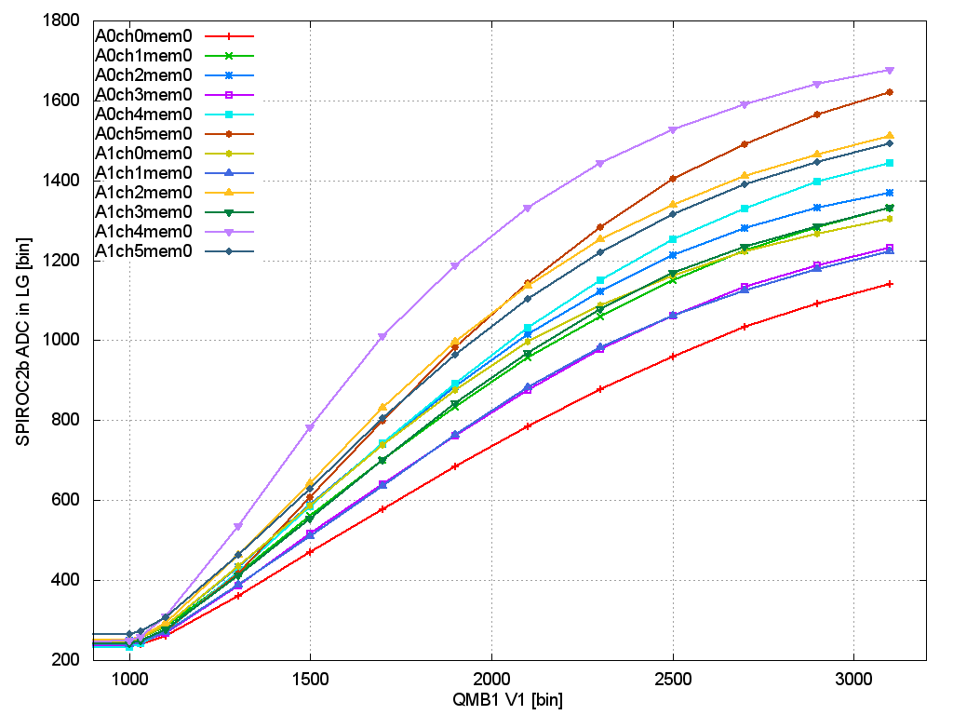
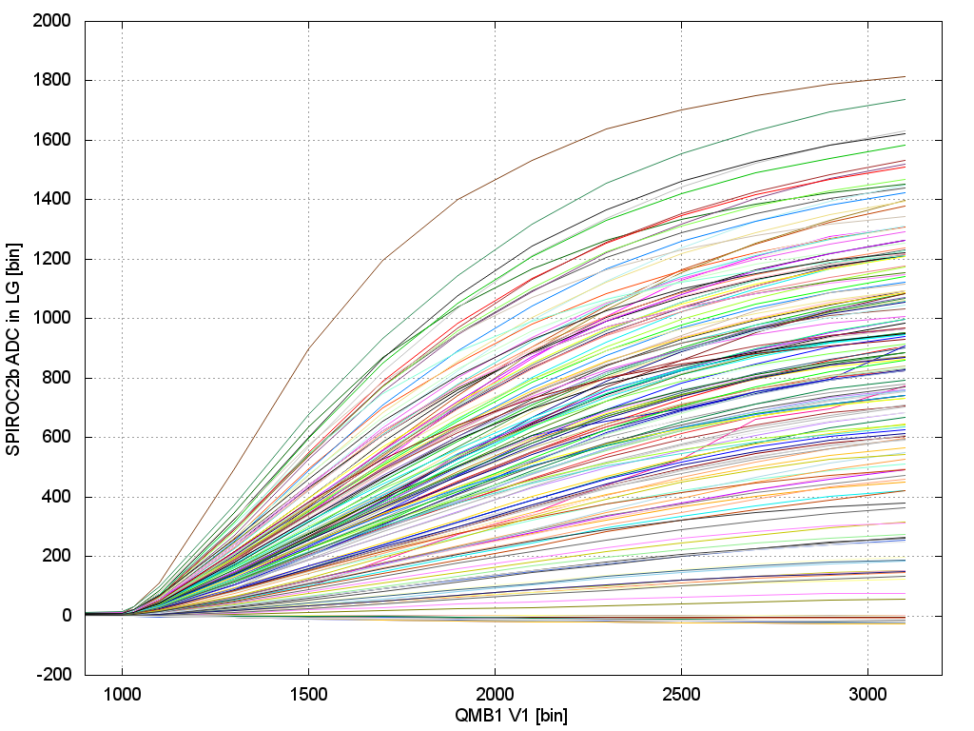
Results: Saturation curves
1st row, 1st HBU (12 channels)
RAW Spiroc ADC data
All 205 channels (including dead and without SPS
RAW Spiroc ADC data
pedestal subtracted

Slide 9
Summary
We have tested 6 HBU setup
  Worked smoothly and stable
First test of full length illumination (72 tiles) by a single LED
Beautiful Single Pixel Spectra taken
  Gain was extracted
  Gain extracted for 92% of tiles in a single run
  Some channels required more light for gain extraction (no holes in PCB, fiber lifted
SiPM saturation seen
Fiber to HBU attaching tuned
  Good for tests
  Not suitable for production – high assemble time
New version of the LED driver produced (QMB1a)
  Working, QA ongoing
Fiber semi-automatic machine is ready
  we expect fibers, that match the production quality (<15% spread) this year

Slide 10
Backup slides

Slide 11
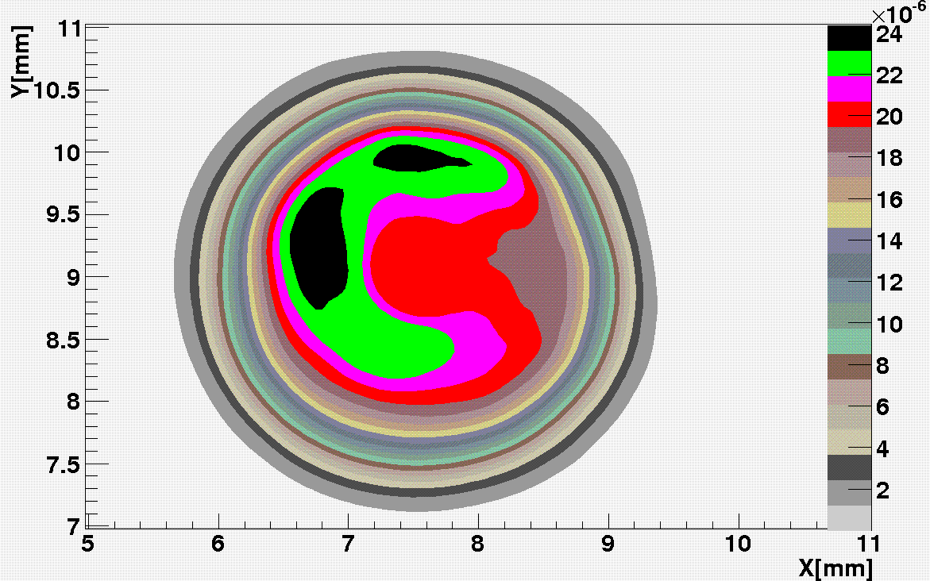
LED light output profile
Fibres

Slide 12
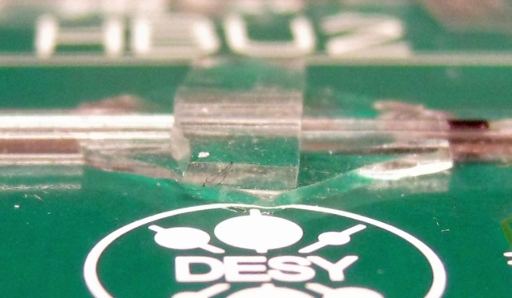
TESA Kleberpads fiber holder
B

Slide 13
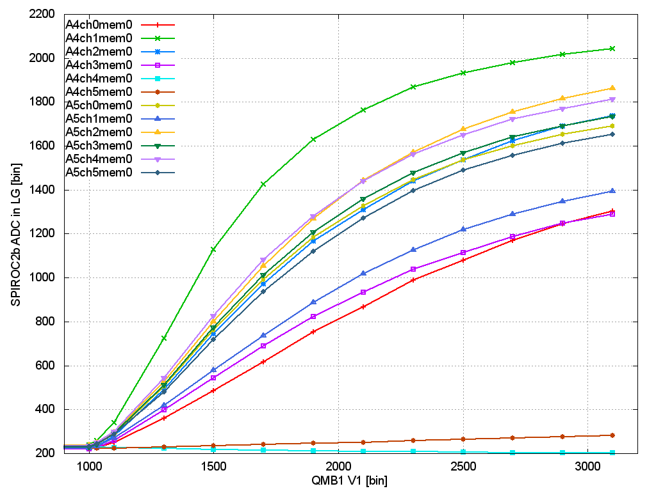
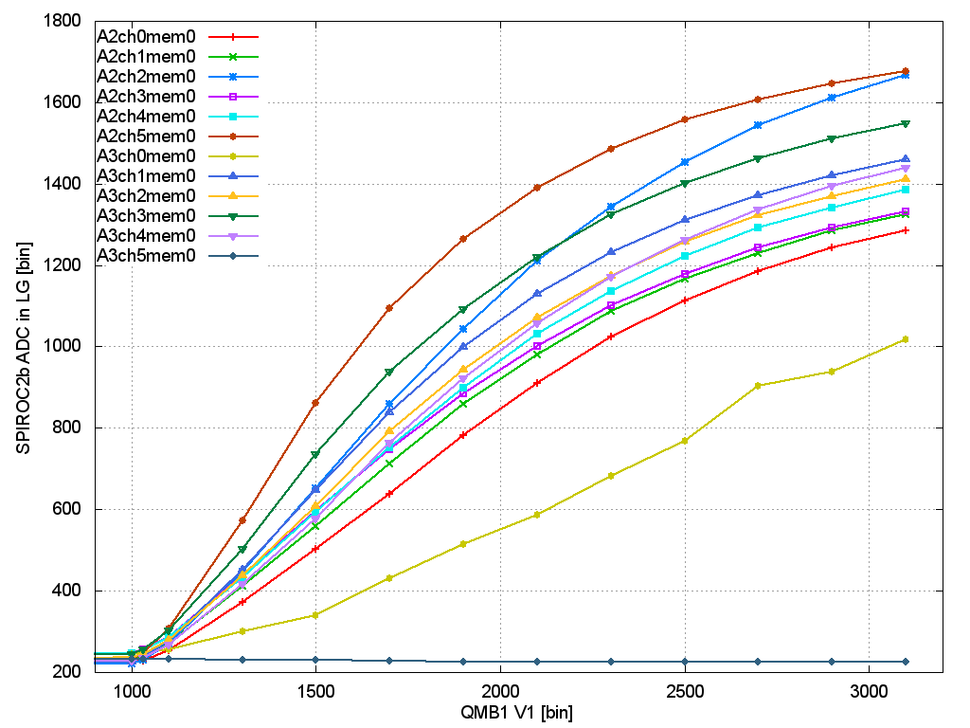
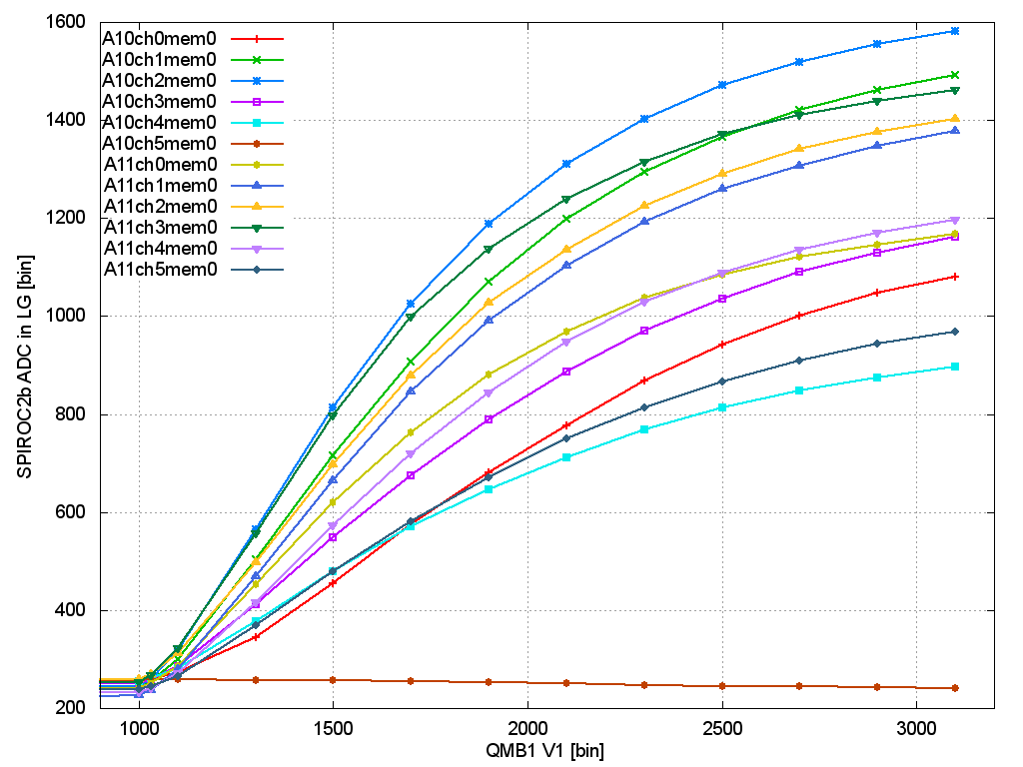
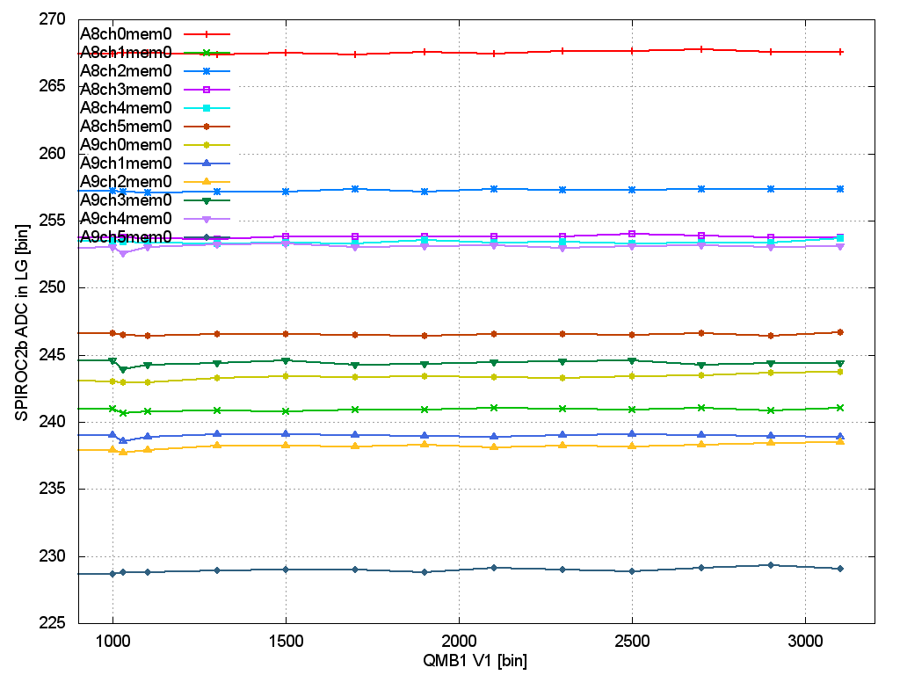
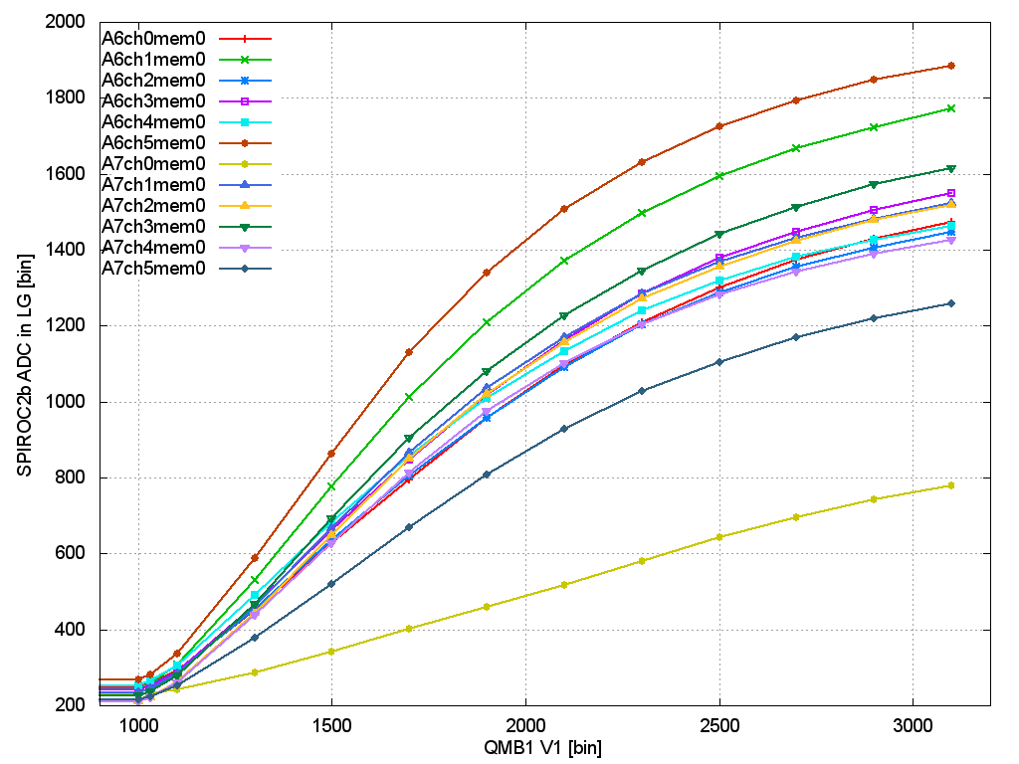
Saturation curves of row1
B
HBU 3
HBU 2
HBU 1
HBU 6
HBU 5
HBU 4

Slide 14
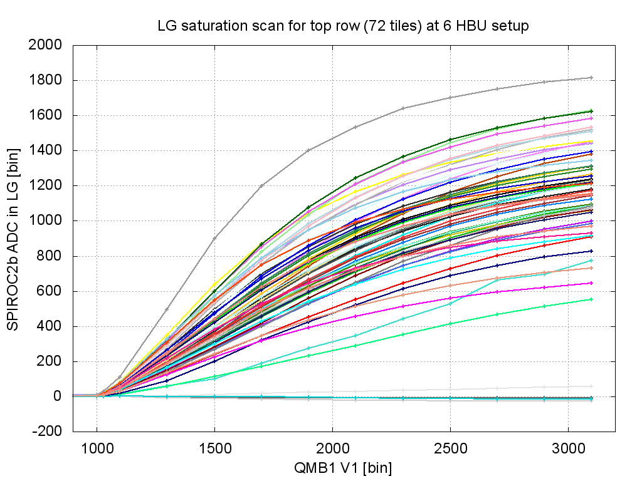
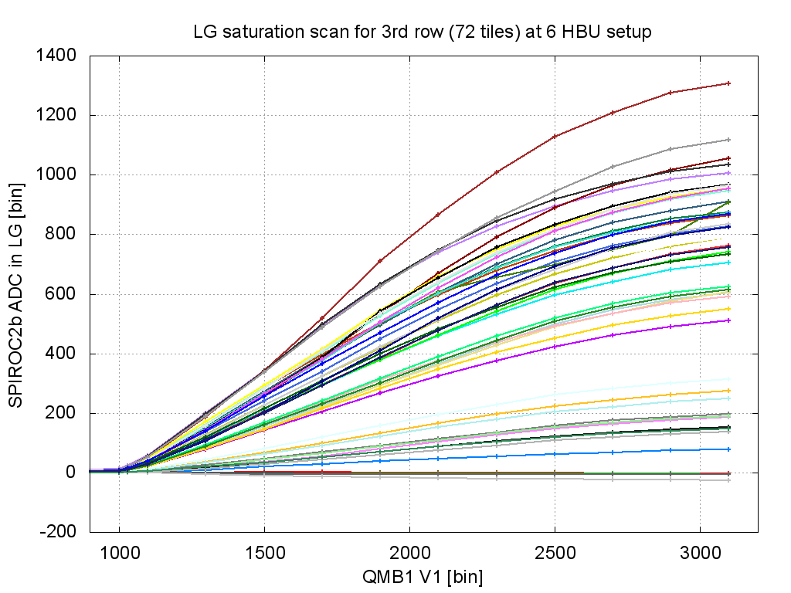
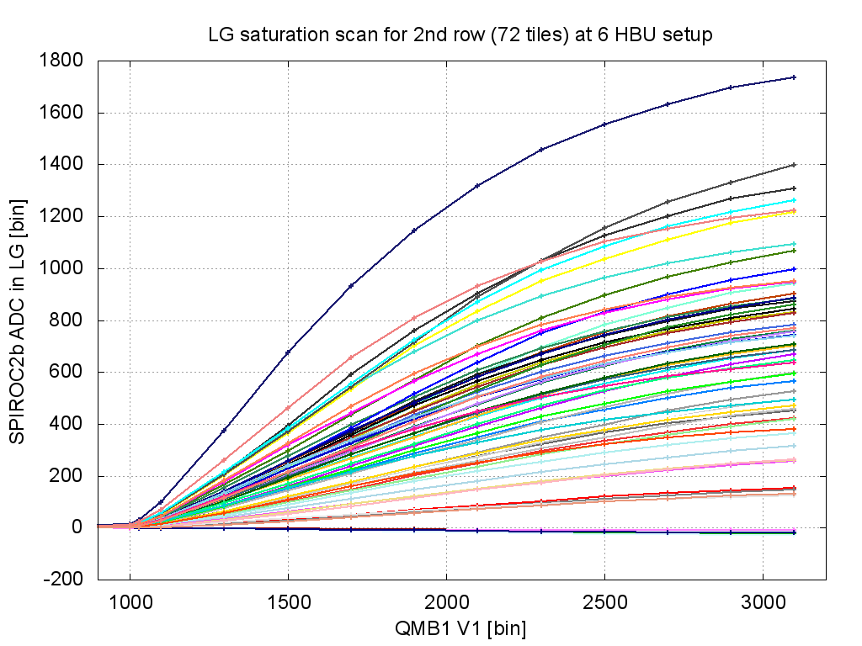
Saturation curves
Row 1
Each row: 3 fibers
Row 3
Row 2

Slide 15
Saturation of all channels

Slide 16
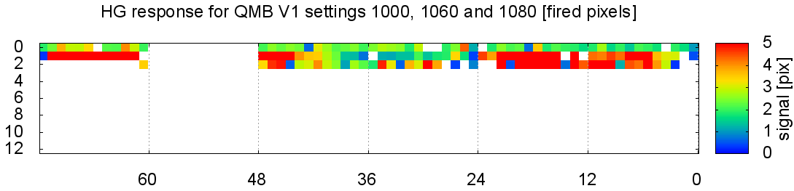

Slide 17
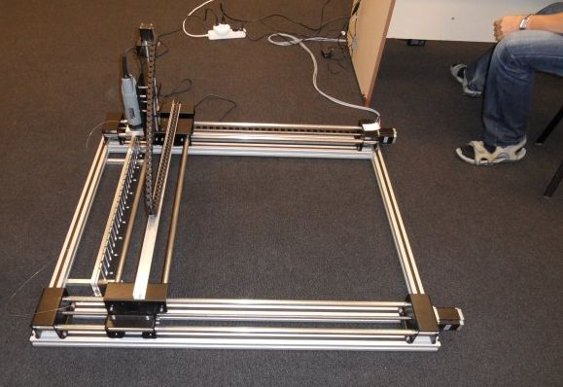
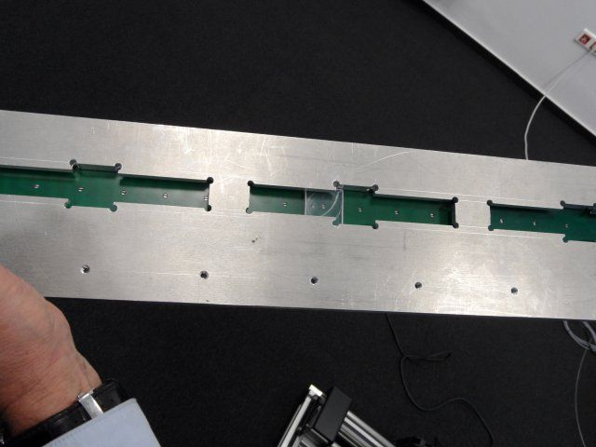
Semi-automatic drilling machine
Frame with x-y stepper motors
Drill machine used as milling cutter to groove the notch
Alu/PCB Template with moving scint tile
PCB with 3mm holes
Scintilator tile w SiPM

Slide 18
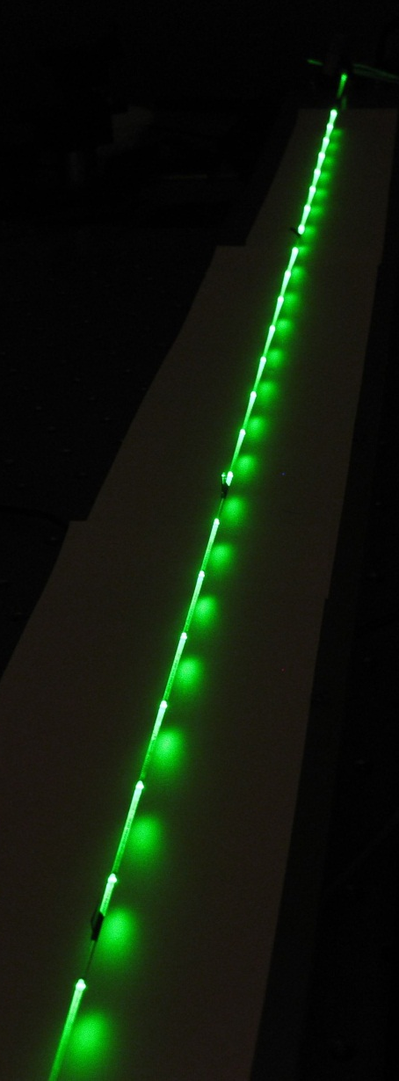
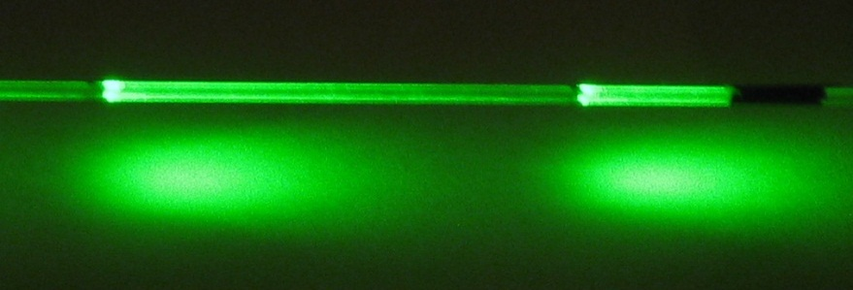
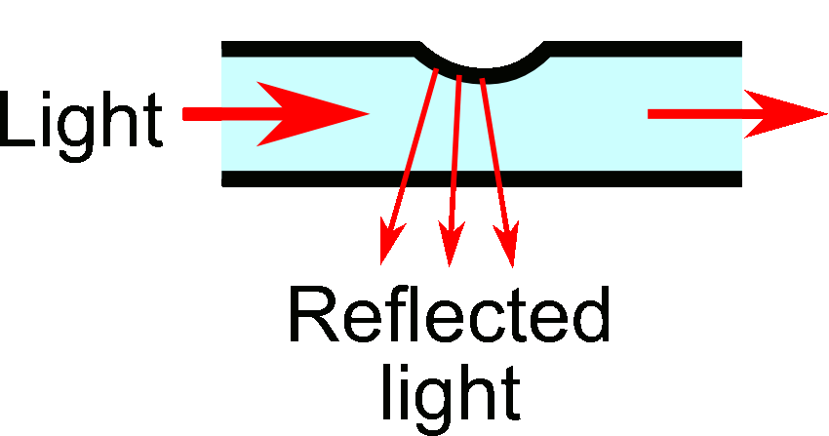
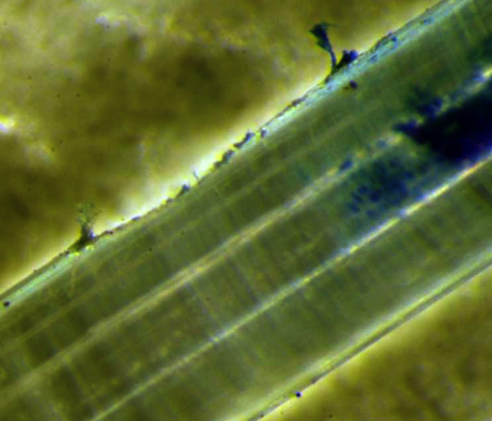
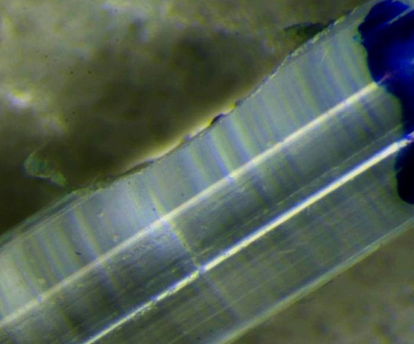
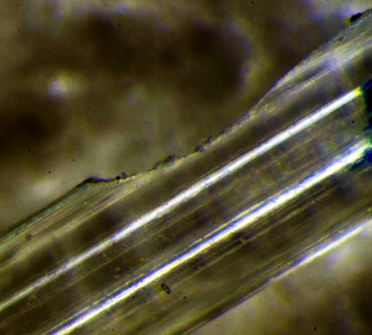
Distribution of light:
Notched Fiber
Iluminated by
Green laser
24 notches
Light is emitted from the notches
The notch is a special scratch to the fiber, which reflects the light to the opposite direction
The size of the notch varies from the beginning to the end of the fiber to maintain homogeneity of the light, which comes from notches
Emission from the fiber (side view)
First notch
Middle notch
End position notch

