Slide 1
SiD Workshop
Magnet DBD STATUS
SLAC
January 17, 2013
Wes Craddock

Slide 2
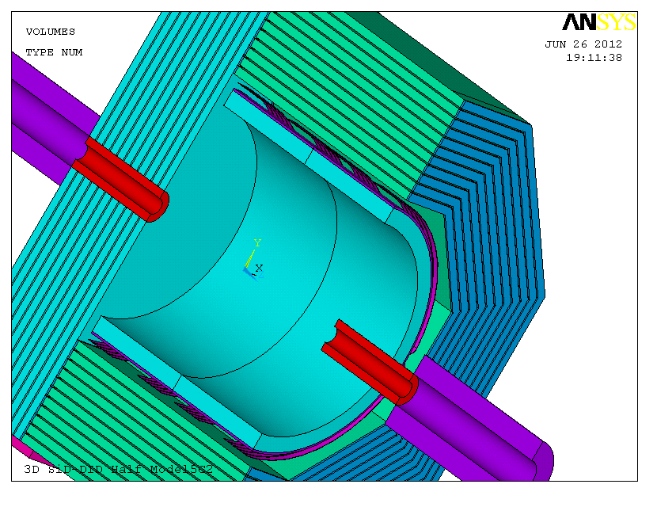
Cross Section Showing Volumes

Slide 3
RECENT CHANGES
A 3D MAGNETIC FIELD MODEL WAS COMPLETELY REVISED AND NOW HAS SUFFICIENT CONVERGENCE
3D ANALYSIS PICTURES AND RESULTS PRESENTED IN THE DBD ARE REASONABLE
PREVIOUS DBD RESULTS FOR PHYSICS ANALYSIS WOULD NOT BE ADEQUATE. NEW RESULTS WOULD BE ADEQUATE
THE NEW MODELING INCLUDE BARREL/DOOR SPACER PLATES BUT NOT THE CRYOSTAT AND CHIMNEY PENETRATIONS
AXIAL AND VERTICAL DECENTERING FORCES ARE NOW CALCULATED

Slide 4
3D ANSYS MAGNETIC
ANALYSIS DEVELOPMENT
ALL 3D ANALYSIS USE EDGE ELEMENT FORMULATION. THIS REDUCES THE VECTOR POTENTIAL DOF FROM 3 TO 1.
ANALYIS STARTED (DBD RESULTS) WITH 1 MILLION, MOSTLY HEXAHEDRA (Brick) ELEMENTS using a 8 GB memory PC.
REFINEMENT CONTINUED WITH A 64 GB memory PC UP TO A MODEL SIZE OF 4.5 MILLION HEXAHEDRA ELEMENTS
(12 million nodes) WITHOUT SUFFICIENT CONVERGENCE.
PROBLEM APPEARS TO BE CREATION OF PYRAMID (degenerate hexahedra) ELEMENTS in high field and gradient volumes that transition from hexahedra to tetrahedra.
THE 167 VOLUMES WERE REMESHED WITH PRIMARILY TETRAHEDRA ELEMENTS ( 6.4 M elements and 9 M nodes) WITH SATISFACTORY RESULTS. Solution time = 24 hours (still out of core).

Slide 5
3D ANSYS MAGNETIC
RESULTS cont.
3D MAGNETIC AXIAL SPRING CONSTANT = 1870 kN/cm
2D MAGNETIC AXIAL SPRING CONSTANT = 1830 kN/cm
3D MAGNETIC VERTICAL SPRING CONSTANT = 278 kN/cm
2D MAGNETIC VERTICAL SPRING CONSTANT = 380 kN/cm

Slide 6
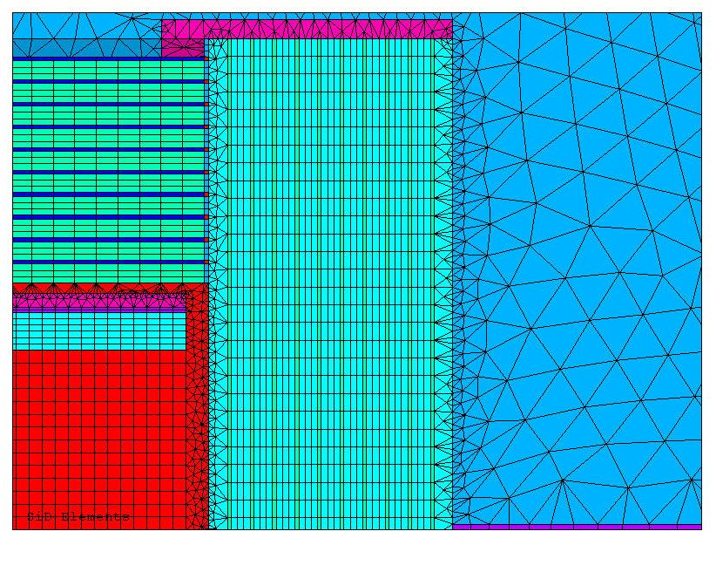
Previous 1 million hexahedra mesh model

Slide 7
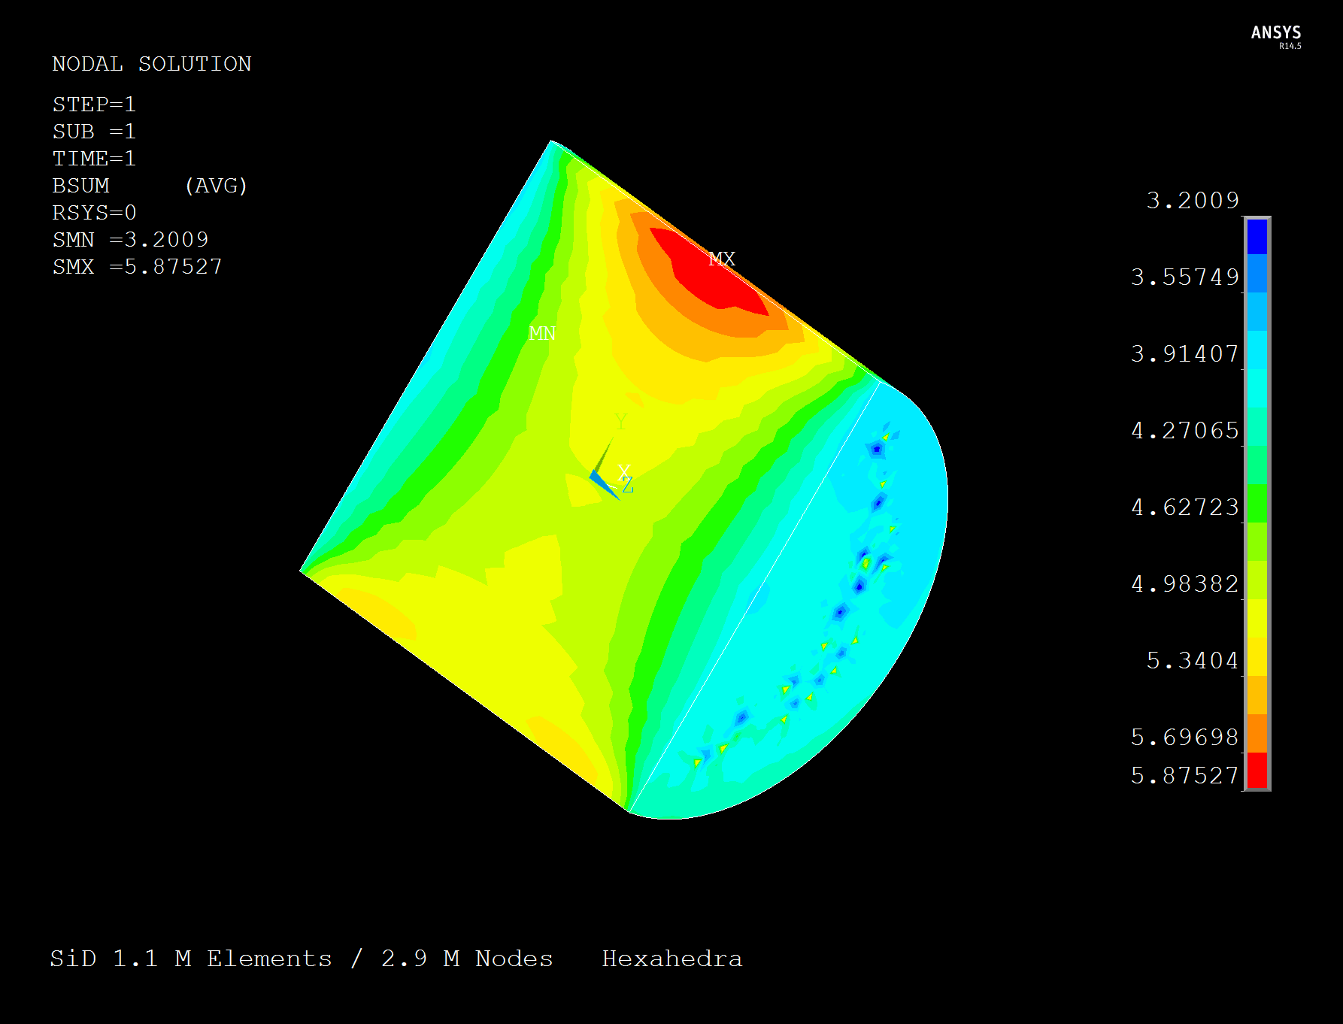

Slide 8
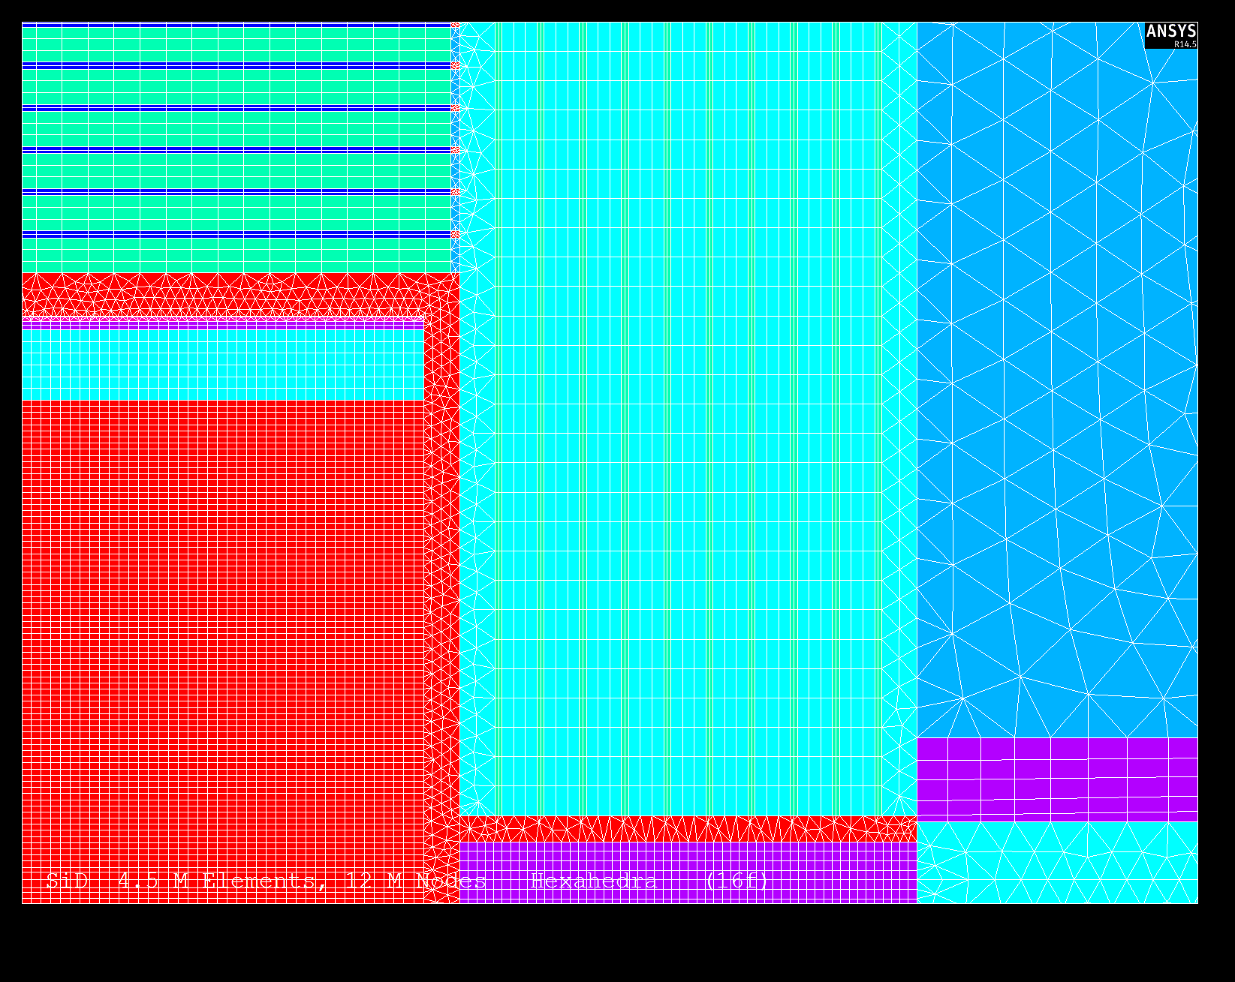
4.5 Million Elements & 12 Million Nodes (Hexahedra Mesh)

Slide 9
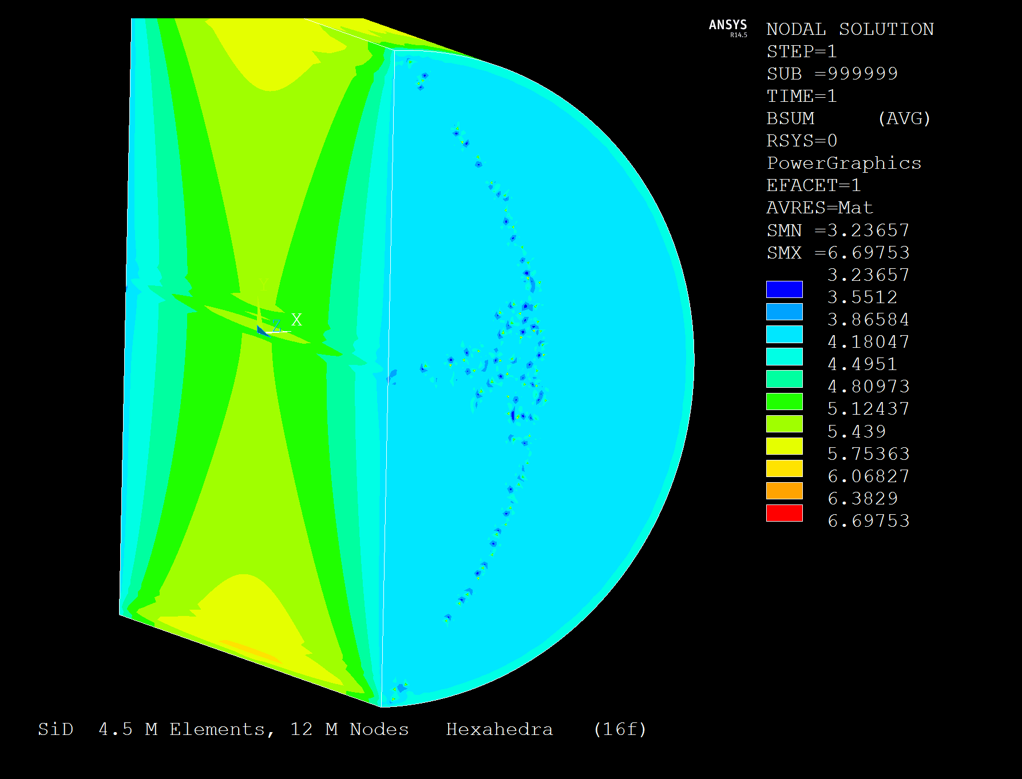

Slide 10
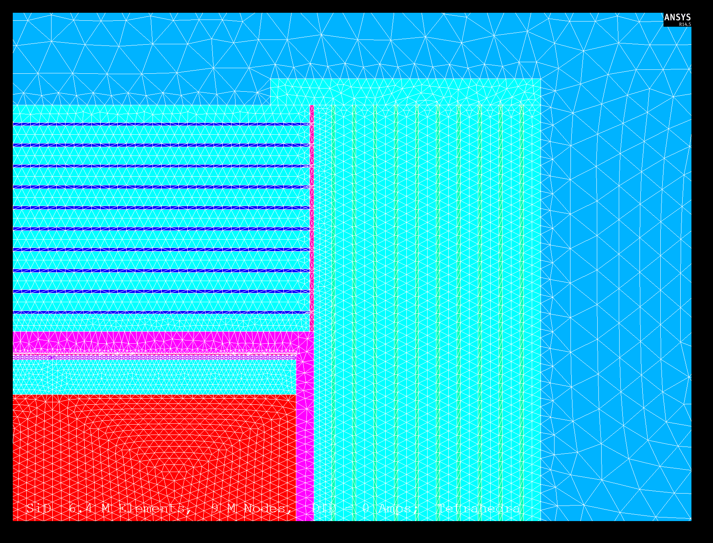
6.4 Million Elements & 9 Million Nodes (Tetrahedra Mesh)

Slide 11
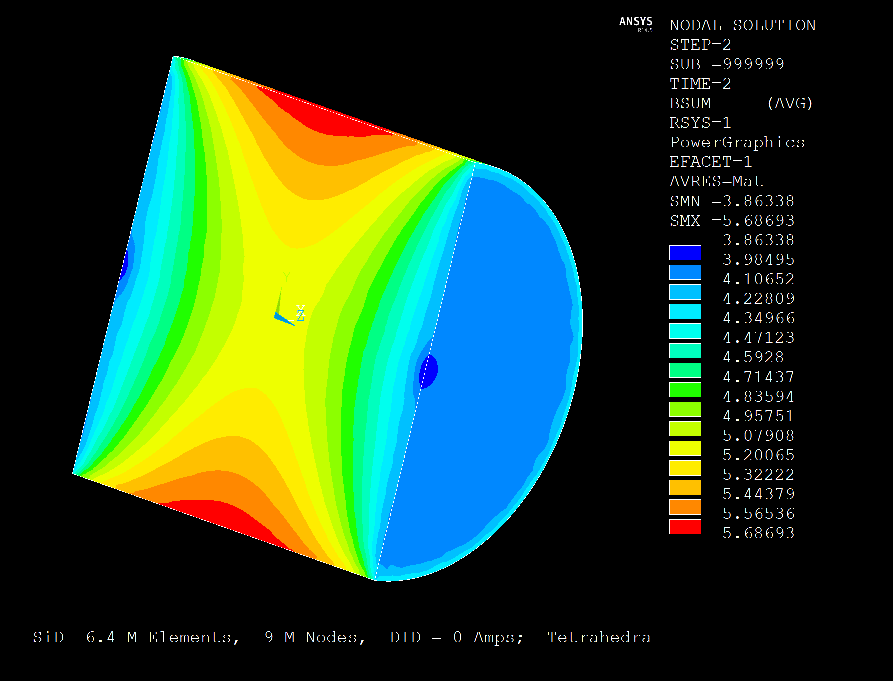

Slide 12
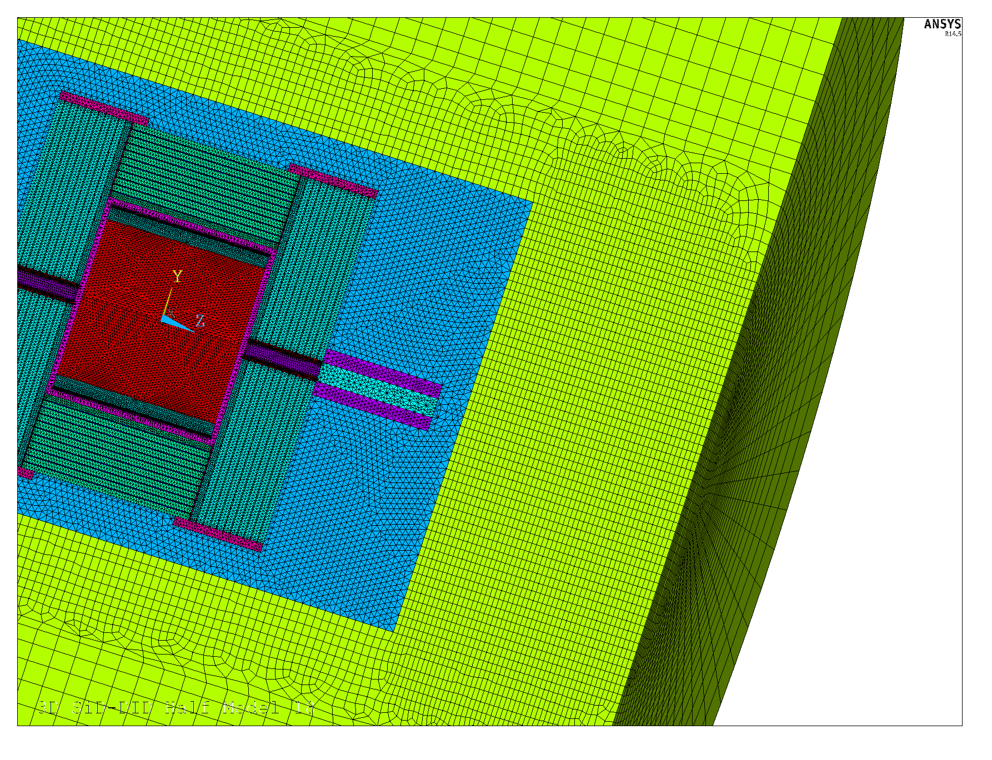
6.4 Million Elements & 9 Million Nodes (Tetrahedra Mesh)

Slide 13
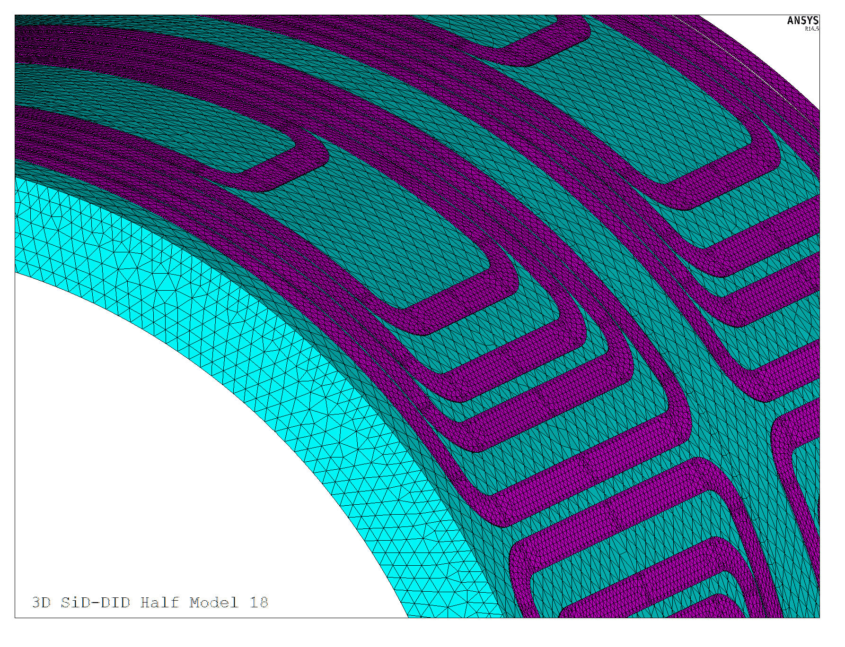

Slide 14
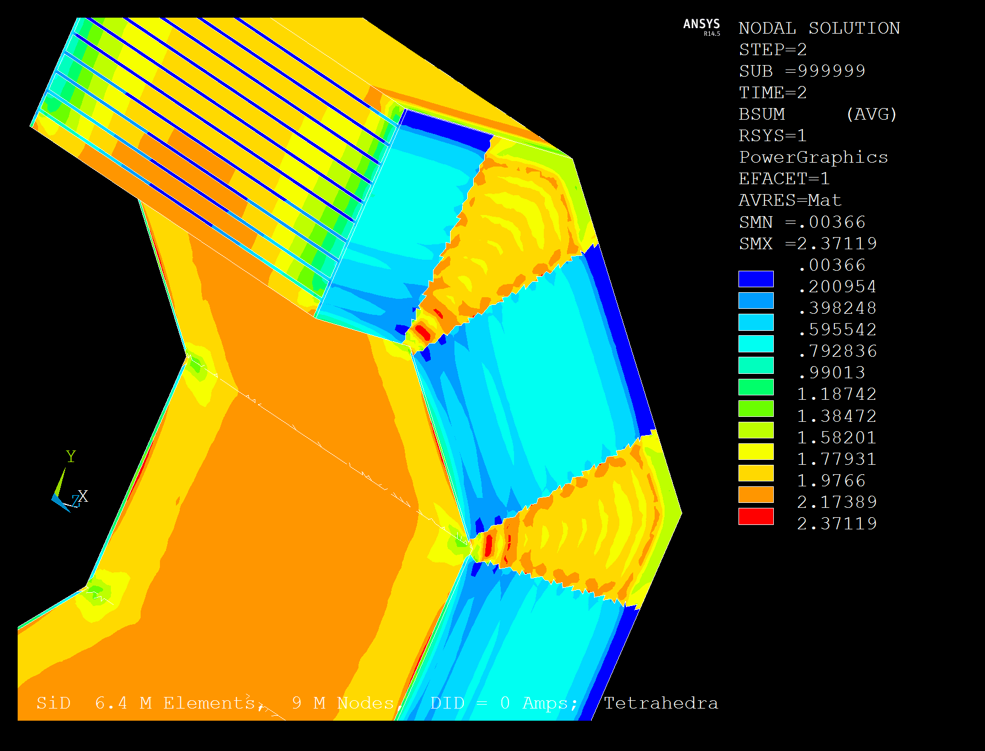
B Field Showing Barrel/Door Gap Plates

Slide 15
CONCLUSIONS
A PARAMETERIZED 3D MAGNETIC FIELD MODEL WAS CREATED THAT SHOULD BE SUFFICIENT FOR ENGINEERING DESIGN. This model could be easily adapted for any SiD/DID type of magnet.
WOULD HAVE BEEN NICE FOR DBD:
BH Curves for actual iron.
Additional iron plates for required fringe field reduction.
Refinement in the DID region for peak field on the DID conductor.
Chimney penetrations for localized fringe fields.
Input magnet force results into solenoid, DID and iron plate stress and deflection ANSYS analysis.
Magnetic energy calculation. Will be available with ANSYS 15 (towards end of 2013).
FUTURE ANALYSIS WAY BEYOND THE DBD:
A full 3D model for horizontal decentering forces.
Transient analysis to predict DID quenching of solenoid.

