Slide 1
Building the SiD collaboration
Proposal & suggestions
H.Weerts
Argonne National Laboratory

Slide 2
Building the SiD collaboration
Proposal & suggestions
To realize the SID detector at the ILC in Japan
H.Weerts
Argonne National Laboratory

Slide 3
SiD accomplishments
Unique concept
Inspired new R&D
Many talks and presentations
All within LC framework
Complete simulation & reconstruction framework (working !)
Benchmarking done
Wrote LOI and were “validated” as one of two
Successfully used as part CLIC TDR
Now are completing DBD
SiD has done a lot
Despite all obstacles and minimal support
So obviously we have the will
Now there is “the start of a light” at the end of the tunnel
ILC in Japan

Slide 4
ILC or Higgs factory will materialize in Japan
Approaches from Japan to US & EU will start ~spring 2013
US Snowmass 2013 exercise ranks LC (fine ILC) high as science priority
We want to see SiD as one of detectors at ILC in Japan
Assumptions:
If this all comes to pass…… institutions/groups/people will want to join
SiD needs a mechanism/rules in place that enable joining and keeping track of that.
There will be more visibility
Are we ready for that

Slide 5
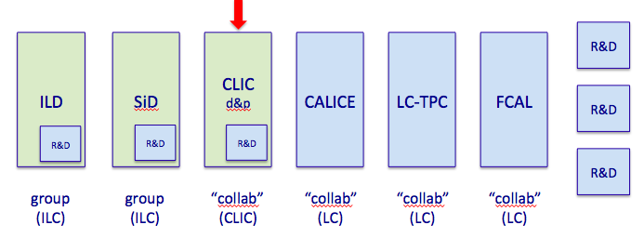
SiD is now more like a “group” or “club”
We have no real funding
We have good will
We will be in the same organization box with other “collaborations”
Observations:

Slide 6
What does this mean ?:
Form Collaboration
Have an executive committee ( at least for a while)
Two spokespeople
Institutional Board of Institutions ( this is body that approves things)
Written bylaws/rules for joining and day to day operation ( start simple and augment when needed: election of spokespeople, criteria for joining, publications, authorship, etc)
Have a WEB site stating what we do
Clear interface to LCO “Physics & Detector”
More………
SiD needs a mechanism/rules in place that enable joining and keeping track of that.

Slide 7
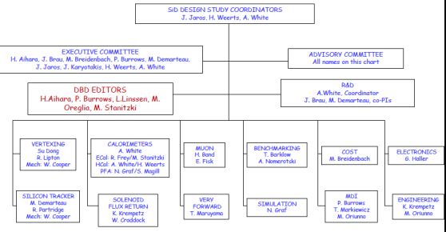
Some observations/questions:
( do not take this personal)
Who is now in SiD ?
Do we have a list of institutions ?
Where is it ?
WEB page
https://silicondetector.org/display/SiD/home
It is linked from DBD signature page
It is out of date
It is out of date; needs update
Org chart

Slide 8
Discussion, objections, suggestions, other directions ……
Should SiD have a “Host lab” ?
Where in the world i.e which lab?
Discuss options
Japan
CERN – already – heard preference
DESY-- obvious
Others
Connections ?
Others …

Slide 9
The END

Slide 10
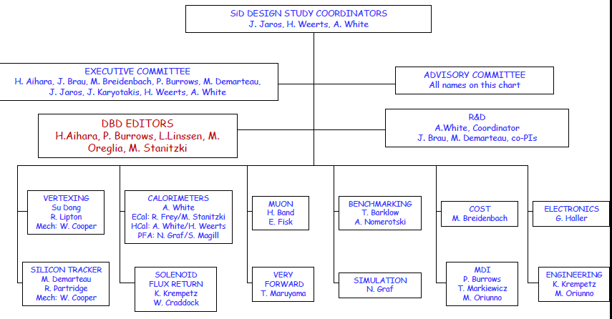
SiD Design Study Organization at KILC2012
Update this

Slide 11
SiD Design Study Organization at KILC2012
SiD DESIGN STUDY COORDINATORS
J. Jaros, H. Weerts, A. White
EXECUTIVE COMMITTEE
H. Aihara, J. Brau, M. Breidenbach, P. Burrows, M. Demarteau,
J. Jaros, J. Karyotakis, H. Weerts, A. White
ADVISORY COMMITTEE
All names on this chart
DBD EDITORS
H.Aihara, P. Burrows, L.Linssen, M. Oreglia, M. Stanitzki
R&D
A.White, Coordinator
J. Brau, M. Demarteau, co-PIs
VERTEXING
Su Dong
R. Lipton
Mech: W. Cooper
CALORIMETERS
A. White
ECal: R. Frey/M. Stanitzki
HCal: A. White/H. Weerts
PFA: N. Graf/S. Magill
MUON
H. Band
E. Fisk
BENCHMARKING
T. Barklow
A. Nomerotski
COST
M. Breidenbach
ELECTRONICS
G. Haller
SILICON TRACKER
M. Demarteau
R. Partridge
Mech: W. Cooper
SOLENOID
FLUX RETURN
K. Krempetz
W. Craddock
VERY
FORWARD
T. Maruyama
MDI
P. Burrows
T. Markiewicz
M. Oriunno
ENGINEERING
K. Krempetz
M. Oriunno
SIMULATION
N. Graf

