Slide 1
Overview of the 2013 Micromegas test beam run
P. Colas
D. Attié, P. Bhattacharya, P. Colas, M. Dixit, G. de Lentdecker, T. Maerschalk, N. Majumdar, S. Mukhopadhyay, M. Riallot, N. Shiell, W. Wang, R. Yonamine, J. Timmermans

Slide 2
Data taking preparation
Initial plans followed and even surpassed
January 28 : Arrival
January 29 : final HV and DAQ test and mounting of the modules. Cosmic-ray trigger setting up.
January 30 : mounting and testing of HV filtering. Noise reduction studies, HV check and setup. Start gas circulation.
January 31 : Alignment/centering of the TPC. Cosmic data taking. Tuning of the t0.
February 1,2 : drift velocity measurement at nominal fields. Rotation to beam position and accurate alignment in phi. Tests of the moving stage.
Feb 3: Z scans at 2 nominal fields (2 omega.tau conditions)
Feb 4: Phi scan, gain studies
Feb 5: data at 2 GeV, momentum resolution studies. Crack scans
Feb 6: Data with 1 module HV=0, data at B=0. Z scan.
Feb 7: Morning: Drift velocity vs E field. Afternoon: dismounting and packing
Feb 8: Travel back.

Slide 3
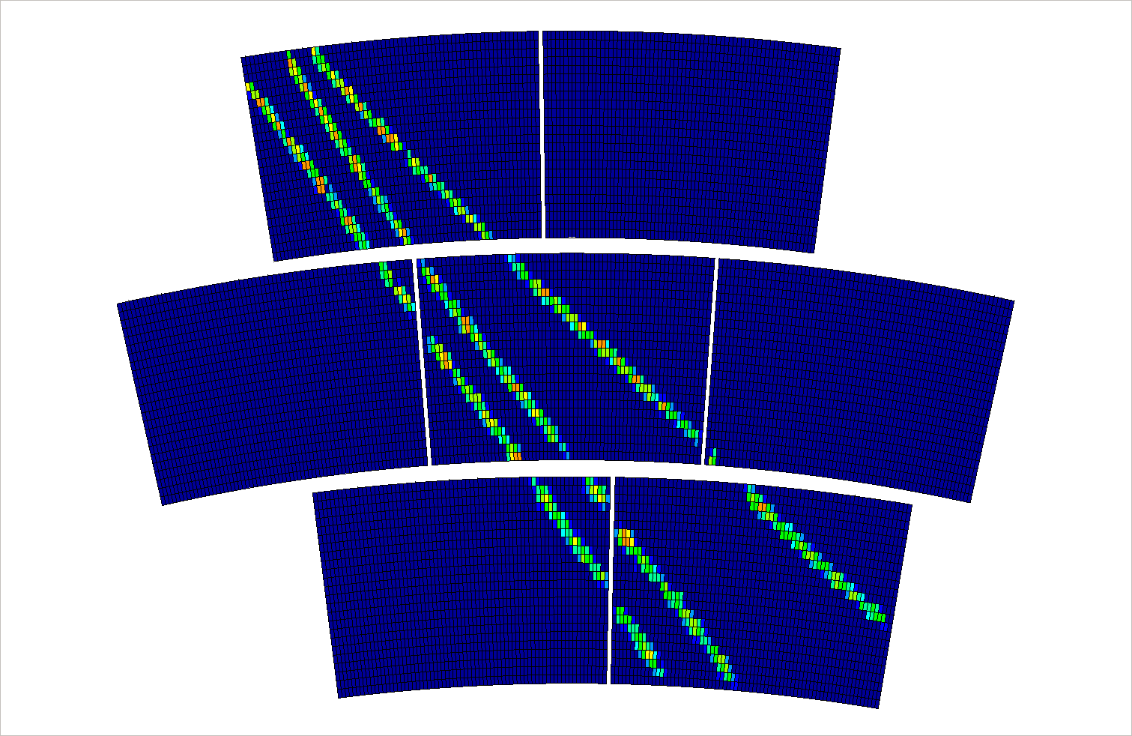
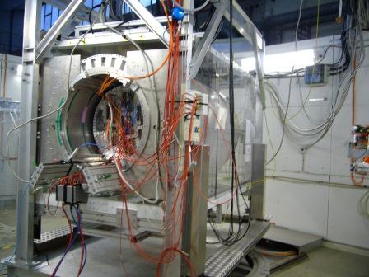
About 1 Million events taken so far.
12000 channels (all connected but 10 per module at the beginning. Unfortunately loosing connections)
Perfectly smooth DAQ (14 Hz) and Micromegas operation (6-7 nA total)
Z scans at B=0 and B=1T, drift fields of 140 and 230 V/cm
Phi scan 0°, 5°, 10°, 15°, 20°, 45° at z=5cm and 15cm, B=0 and 1T
Mesh HV scan from 330 V to 410 V (nominal 380 V).
Momentum scan 1,2,3,4,5 GeV, drift fields of 140 and 230 V/cm
Various beam positions for module alignment
All data at 100 ns shaping time so far
Theta 20°

Slide 4
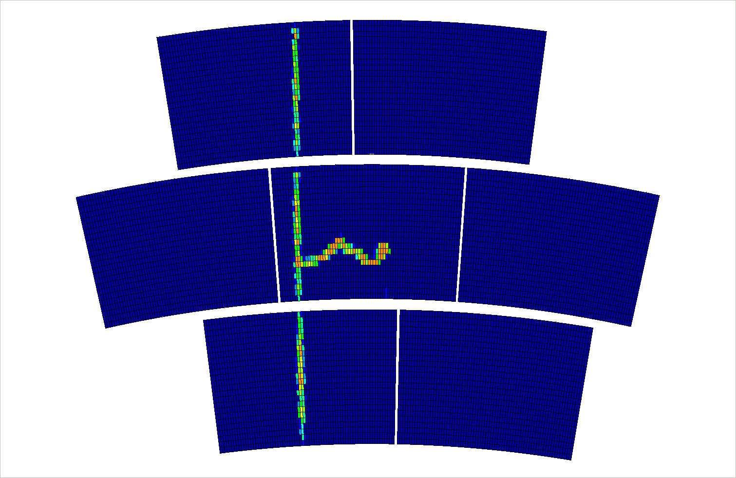

Slide 5
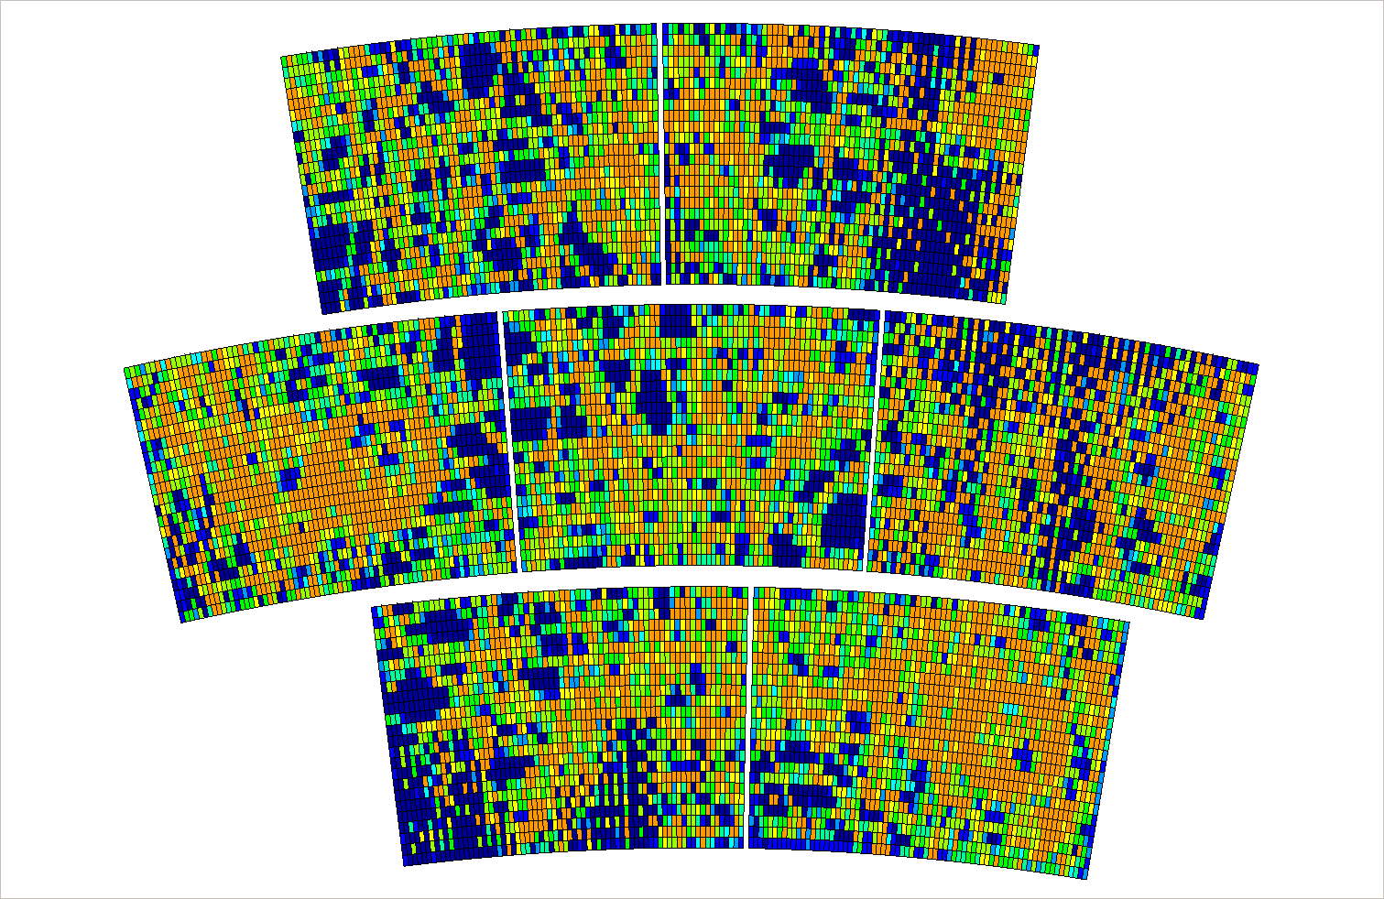

Slide 6
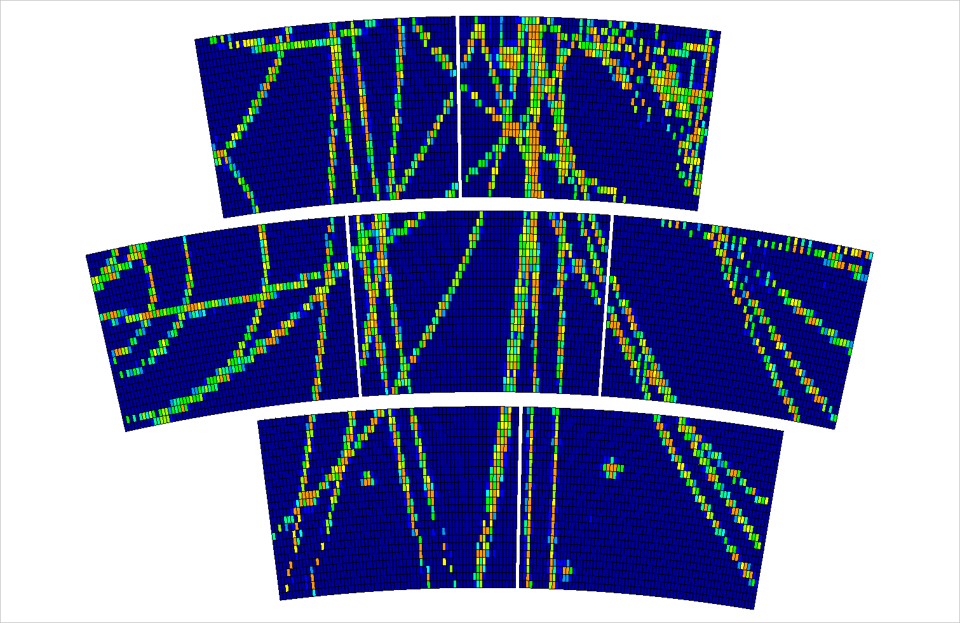

Slide 7
