Slide 1


Review of 30/01/13 Shift
Mikey Davis
31 January 2013
1/Number

Slide 2
Introduction
Try and build on the success of the previous trips
Aims were
Test to see the affects of the upstream kick
Retest the affects of upstream feedback
Test the feed forward cable – actually kick the beam
Try and make feed forward work
Two things to think about
What to do next shift (Friday)
What to bring home (just so we remember)
Mikey Davis
31 January 2013
2/Number

Slide 3
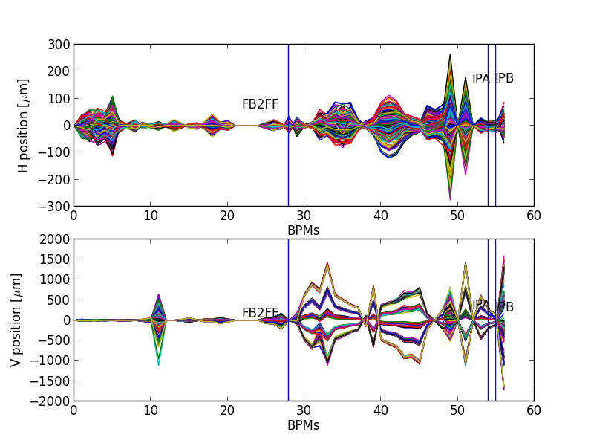
Affects of Upstream Kick
Courtesy of YoungIm
Mikey Davis
31 January 2013
3/Number

Slide 4
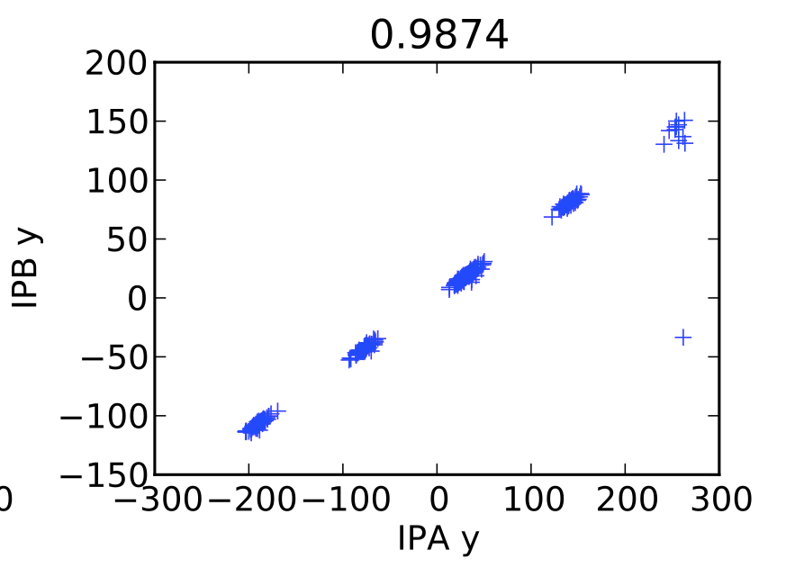
Affects of Upstream Kick
Courtesy of YoungIm
Mikey Davis
31 January 2013
4/Number

Slide 5
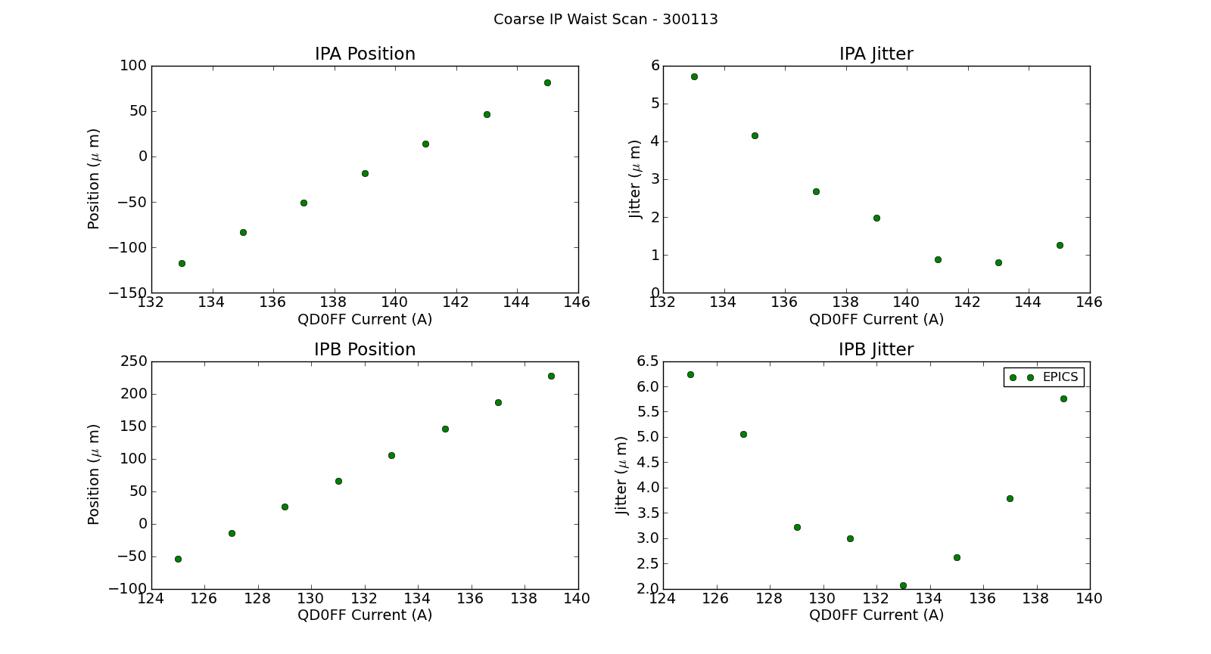
Coarse IP Waist Scan
Mikey Davis
31 January 2013
5/Number

Slide 6
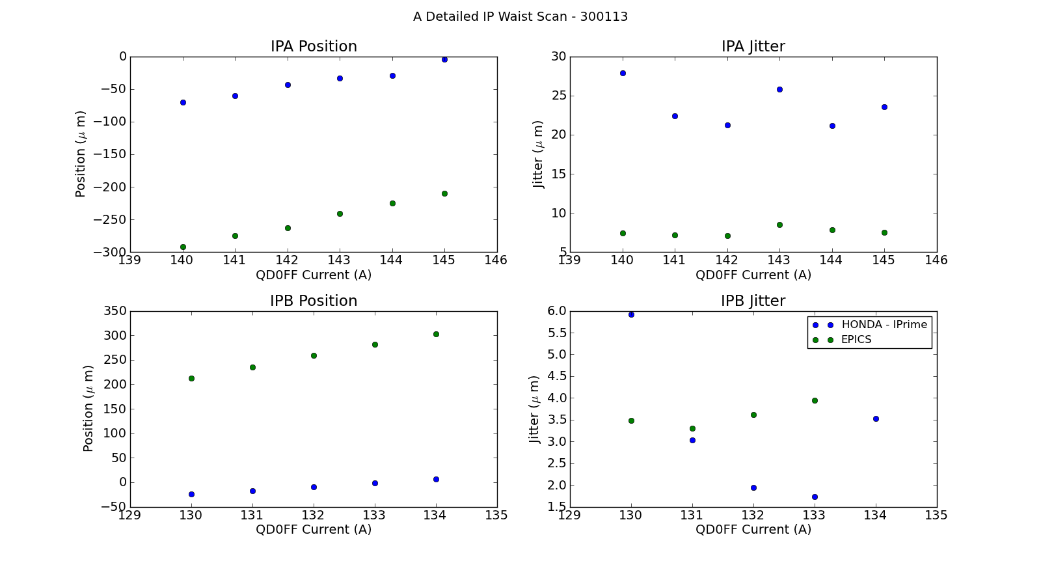
Fine IP Waist Scan
Mikey Davis
31 January 2013
6/Number

Slide 7
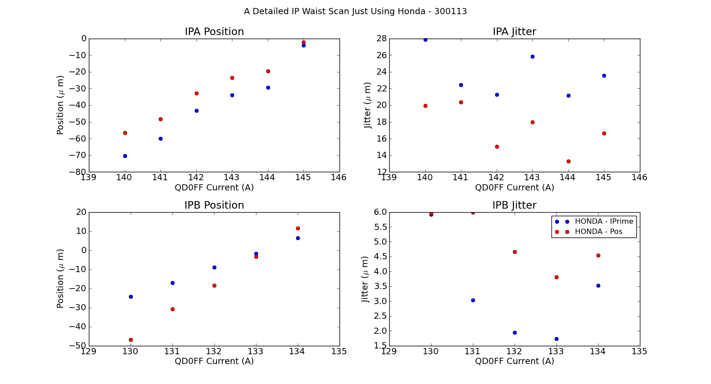
Fine IP Waist Scan
Mikey Davis
31 January 2013
7/Number

Slide 8
IP BPM Calibrations
From last weeks shifts it was apparent that:
It was difficult to correlate the BPMs in two bunch mode as you tended to saturate on of the bunches
There is something off about the upstream charge measurement during the calibrations
With this in mind
We did 4 calibrations this time
One for each bunch in each BPM
Waist centred at the BPM you were calibrating
Mikey Davis
31 January 2013
8/Number

Slide 9
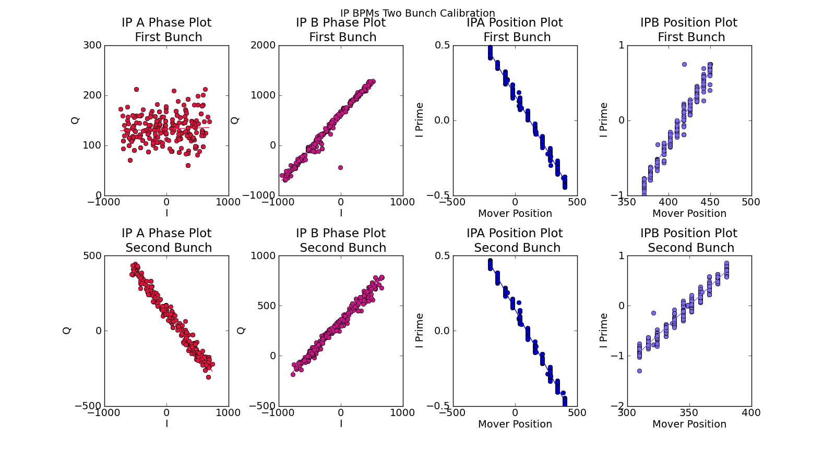
IP BPM Calibrations
Mikey Davis
31 January 2013
9/Number

Slide 10
IP BPM Calibrations
I was concerned about IPB second bunch having a higher jitter than the first bunch
This has been explained:
I found a bug in my code
The charge for bunch one and bunch two during calibration is different
This difference then follows through all analysis
Acts like a scaling factor
I will show examples of IPrime and Pos, I think we should use pos
Mikey Davis
31 January 2013
10/Number

Slide 11
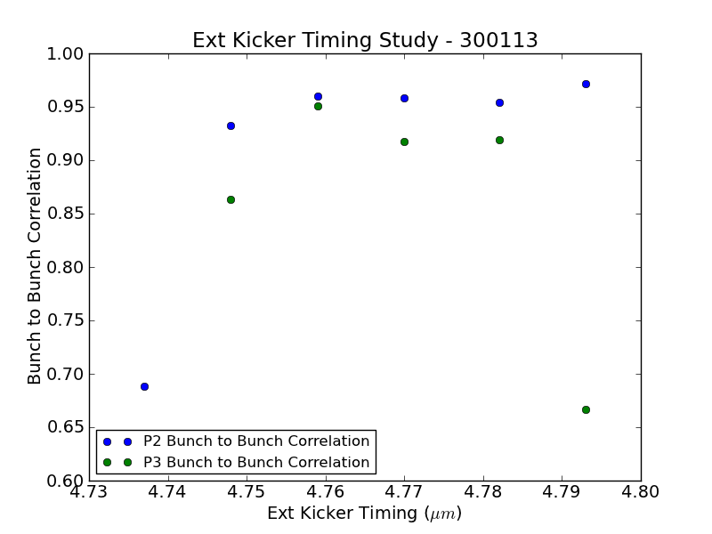
Ext Kicker Timing Study
Mikey Davis
31 January 2013
11/Number

Slide 12
Upstream Feedback
As I said we have some evidence that this was having a positive effect at the IP
Problem is it’s a small effect and therefore easy to miss
Bunch to Bunch correlation was again very bad
Around 90pc
Charge is low
Limits the resolution
0.7 – 1 μm in the runs I’ve looked at
Upstream the feedback isn’t having a great effect
Mikey Davis
31 January 2013
12/Number

Slide 13
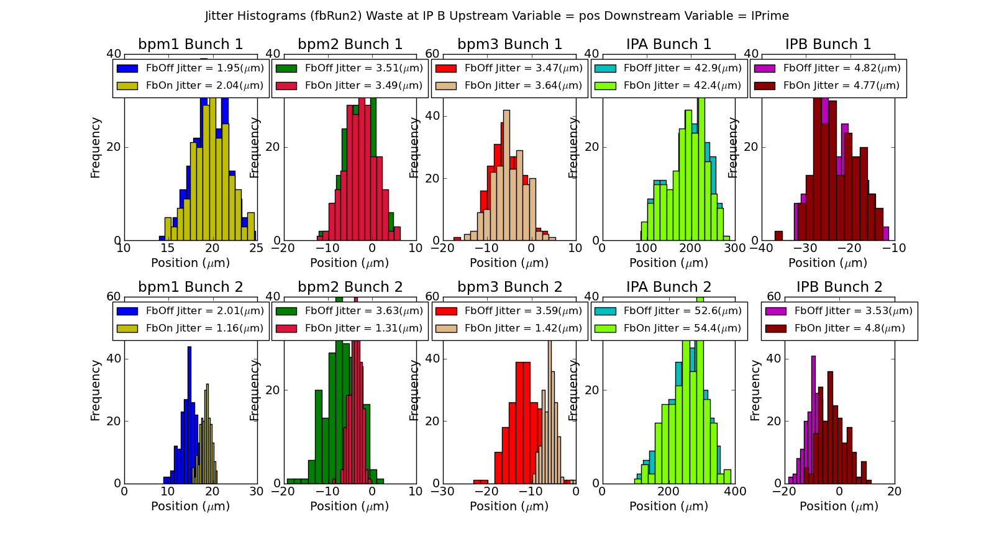
Upstream Feedback
Mikey Davis
31 January 2013
13/Number

Slide 14
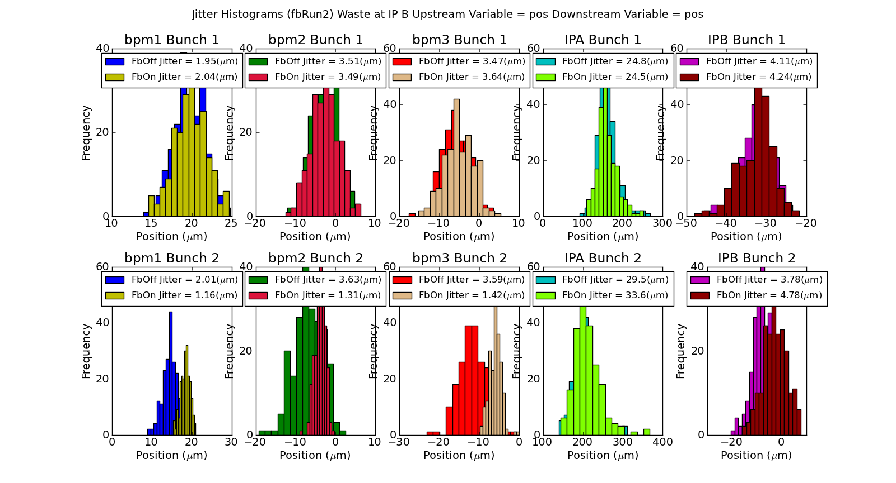
Upstream Feedback
Mikey Davis
31 January 2013
14/Number

Slide 15
Upstream Feedback
File Name | IPB_fBposFbOffS | IPB_fBposFbOnS | IPB_sBposFbOffS | IPB_sBposFbOnS
fbRun2_Board2_270113 | 4.110959673 | 4.240028861 | 3.775445054 | 4.78189598
fbRun3_Board2_270113 | 3.13761347 | 3.319464938 | 2.90949938 | 3.392662127
fbRun5_0.8Gain_Board2_270113 | 3.035764113 | 3.377131868 | 2.723924904 | 2.611554907
fbRun6_0.7Gain_Board2_270113 | 3.910302357 | 4.00606952 | 3.536395383 | 3.022695871
fbRun7_0.6Gain_Board2_270113 | 3.644620473 | 3.555804584 | 3.251811456 | 2.880490219
fbRun8_0.5Gain_Board2_270113 | 3.369260649 | 4.240547495 | 2.9461129 | 2.863566407
fbRun9_0.7Gain_Board2_270113 | 3.671081323 | 4.024180332 | 3.798058557 | 3.800200511
fbRun10_0.7Gain_Board2_270113 | 3.452492033 | 4.270821251 | 2.947891984 | 3.831728373
Mikey Davis
31 January 2013
15/Number

Slide 16
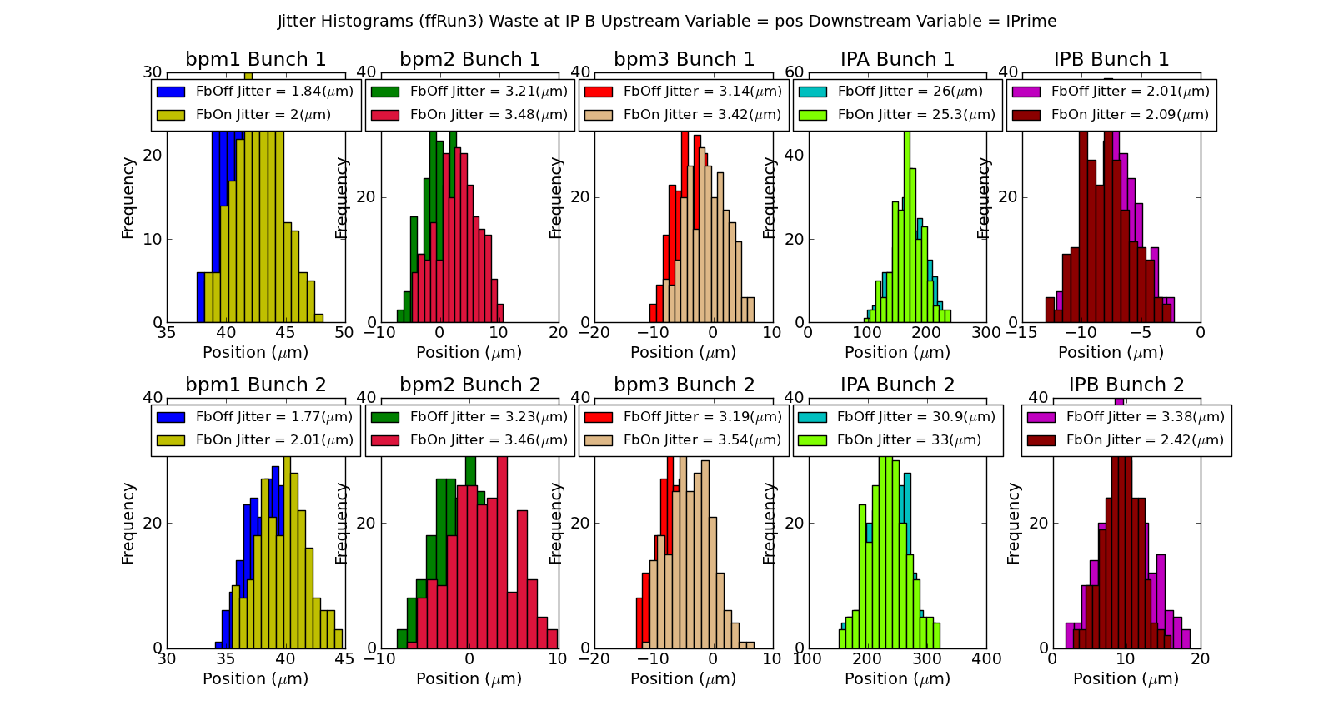
Feed Forward
Mikey Davis
31 January 2013
16/Number

Slide 17
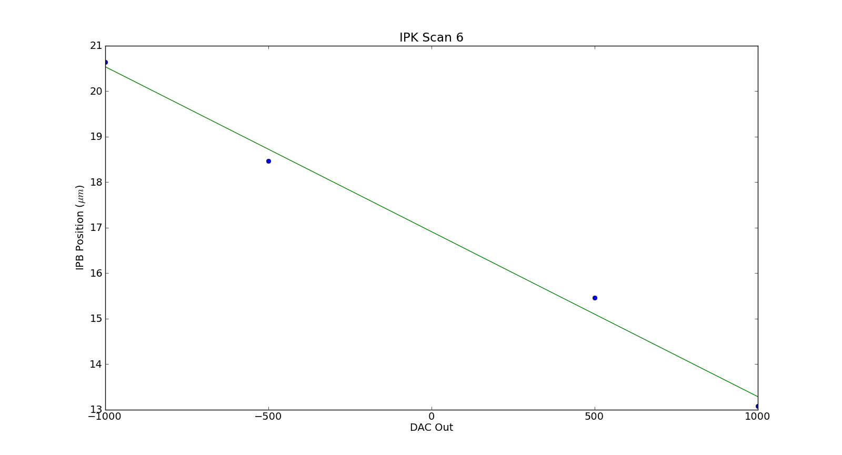
IPK Scan
Mikey Davis
31 January 2013
17/Number

Slide 18
Feed Forward
Mikey Davis
31 January 2013
18/Number

Slide 19
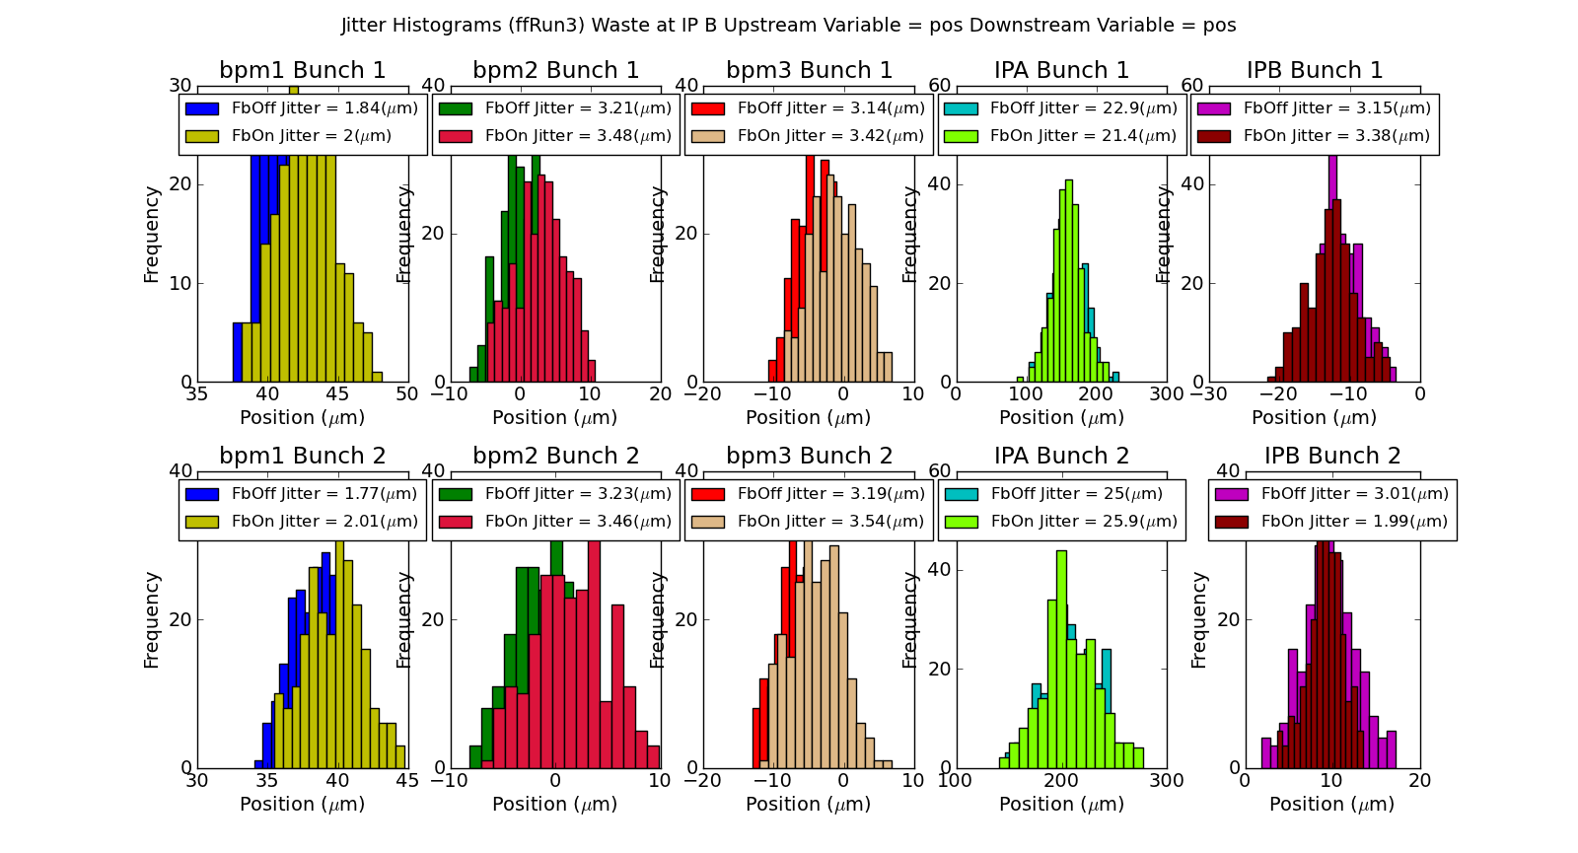
Feed Forward
Mikey Davis
31 January 2013
19/Number

Slide 20
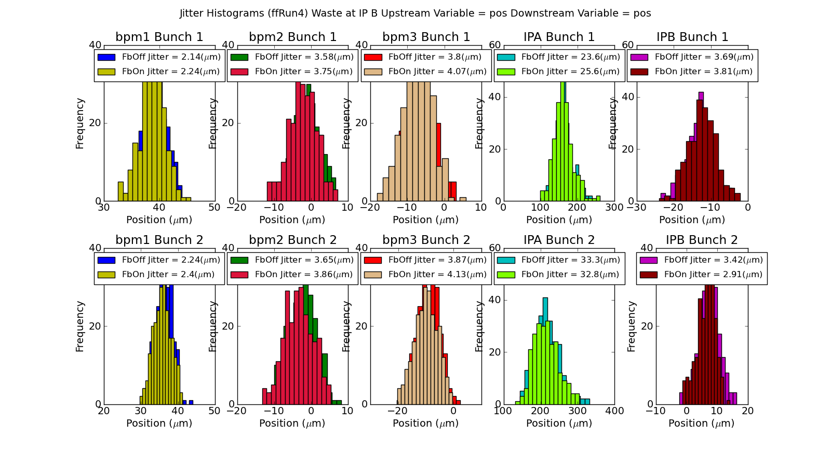
Feed Forward
Mikey Davis
31 January 2013
20/Number

