Slide 1


Large Prototype TPC using Micro-Pattern Gaseous Detectors
− David Attié −
On behalf of the LC-TPC collaboration
VCI13, February 12th, 2013
Notes:
I’m here to present a TPC review

Slide 2
Overview
Introduction: Physics case at International Linear Collider (ILC)
Large Prototype Time Projection Chamber for ILC
TPC Readout using Micro-Pattern Gaseous Detectors:
  GEM module with ALTRO electronics
  Integrated AFTER-based electronics and resistive Micromegas detector module
Latest results
  Time information
  Spatial resolution
Conclusion

Slide 3
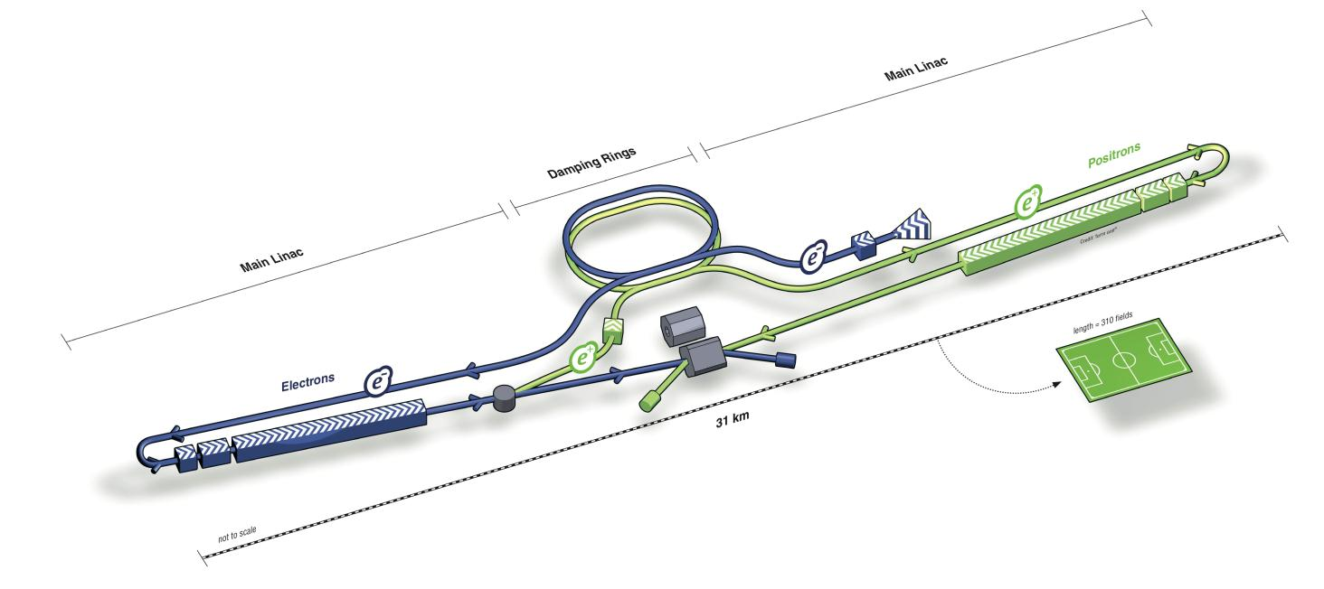
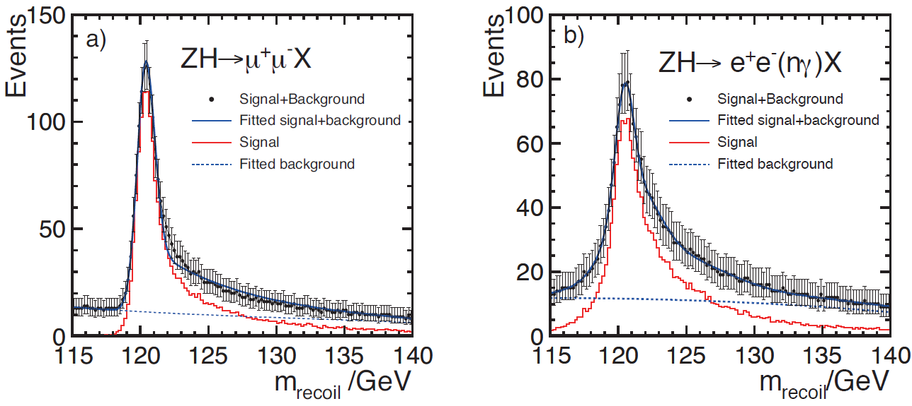
Introduction: Physics Case at ILC
Identify the particle of cosmic dark matter
Find the origin of the masses of elementary particles
  precision of Higgs coupling ∝ to each particle mass
  sensitivity of the ILC experiments to Higgs
  boson couplings in a model-independent analysis
Higgs recoil mass: e⁺e⁻ → ZH (Z→μ⁺μ⁻/e⁺e⁻) + X
Next collider: linear e+e– collider, length: ~ 31km
Tunable center of mass energy of 200-500 GeV
Two detectors with push-pull concept
Need to to fit into Particle Flow* concept:
[*] Particle flow: the aim to reconstruct every particle in the best suited sub detector

Slide 4
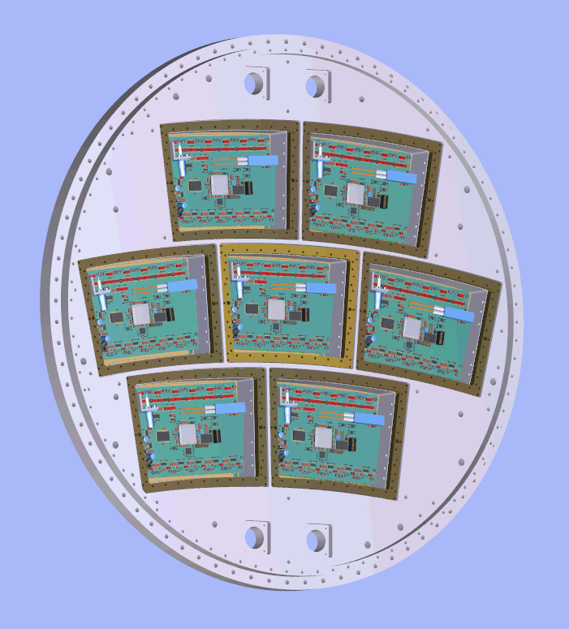
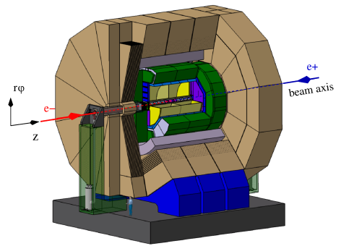
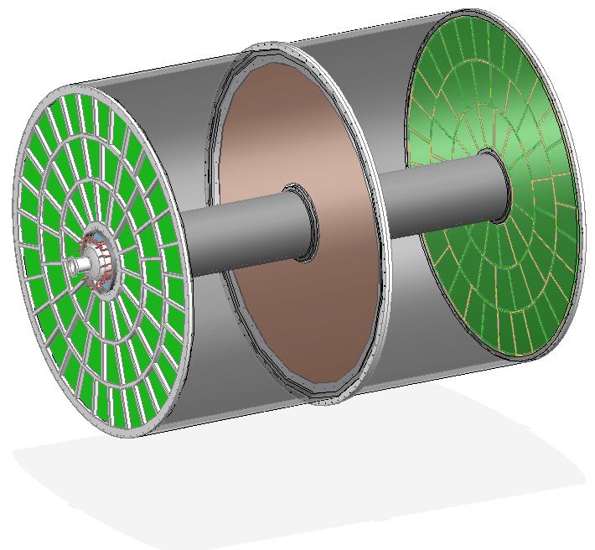
Time Projection Chamber for ILD
TPC is the central tracker for International Linear Detector
– Large number of 3D points → continuous tracking
– Good track separation and pattern recognition
• Low material budget inside the calorimeters important for PFA
– Barrel: ~5% X₀
– Endplates: ~25% X₀
• Two options for endplate readout:
    – GEM: 1.2x5.4 mm² pads using ALTRO electronics
    – Micromegas: 3x7 mm2²pads using AFTER electronics
• Alternative: pixel read out with pixel size ~55x55 μm²
TPC Requirements :
Momentum resolution:
δ(1/p_{T}) < 9×10⁻⁵ GeV-1
Spatial resolution at 3.5T:
σ(rφ) < 100 μm
σ(z) < 500 μm
Tracking eff. for p_{T}>1 GeV: 97%
dE/dx resolution ~5%
4.3m
3.6m
Cathode membrane
Endplate
MPGD
ILD
TPC
Large Prototype

Slide 5
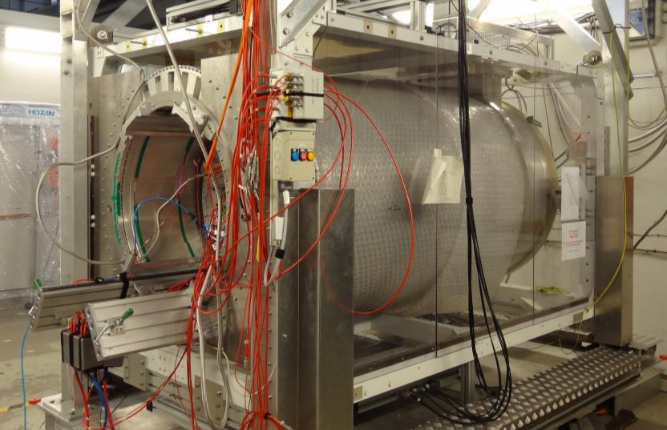



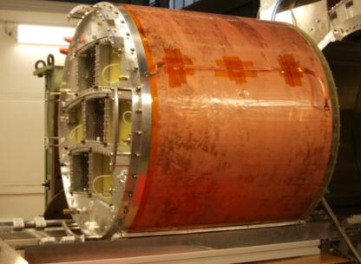
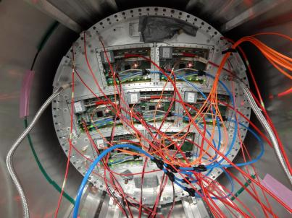
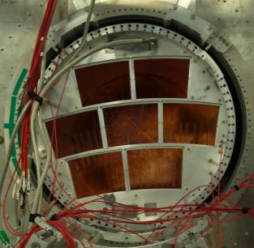
Large Prototype TPC for ILC
1T PCMagnet on lifting stage
Built by the collaboration LC-TPC
Financed by EUDET & AIDA
Located at DESY: 6 GeV e- beam
Sharing out :
- magnet: KEK, Japan
- field cage: DESY, Germany
- lifting stage: DESY, Germany
- cosmic trigger: Saclay, France
- beam trigger: Nikhef, Netherlands
- endplate: Cornell, USA
- Micromegas: Saclay, France, Carleton U., Canada
- GEM: Saga, Japan
Desy, Bonn, Germany
- TimePix pixel: F, G, NL
Large Prototype TPC
Enplate + 7 Micromegas modules

Slide 6
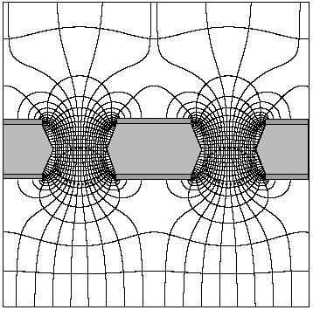
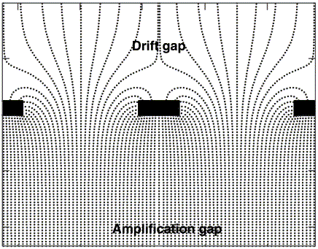
Micro-Pattern Gaseous Detectors: Micromegas & GEM
Technology choice for TPC readout: Micro Pattern Gaseous Detector
more robust than wires
no E×B effect
fast signal & high gain
low ion backdrift
better ageing properties
easier to manufacture
Micromegas
GEM
MICROMEsh GAseous Structure
(Y. Giomataris et al., 1996)
metallic micromesh (typical pitch 50μm)
sustained by 50μm pillars, multiplication between anode and mesh, high gain
Gas Electron Multiplier (F. Sauli, 1997)
2 copper foils separated by kapton
multiplication takes place in holes
2-3 layers needed
Gas Electron Multiplier (F. Sauli, 1997)
2 copper foils separated by kapton
multiplication takes place in holes
use of 2 or 3 stages
Avalanche
50-100 µm
40 kV/cm
~100 µm
80 kV/cm
~1000 µm
1 kV/cm

Slide 7
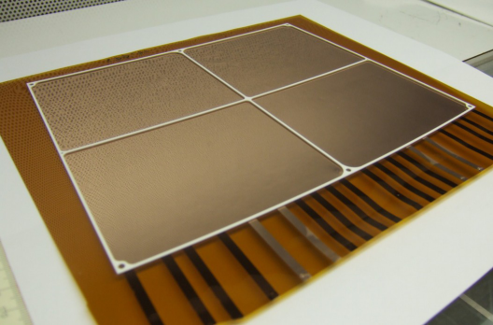
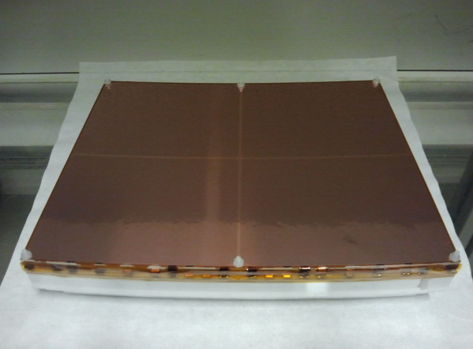
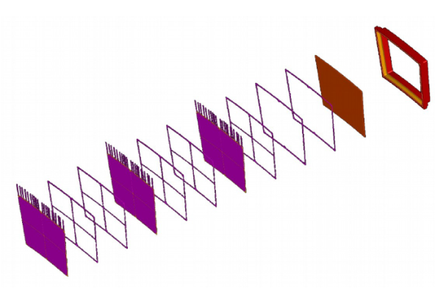
DESY GEM: Module Design
Triple GEM stack
Grid support structure
Top GEM electrode not segmented
Bottom segmented into 4 sectors
4829 channels (pad size: 1.26x5.85 mm²)
read out by ALTRO electronics
HV line for each GEM side
Protection resistors very close to GEM

Slide 8
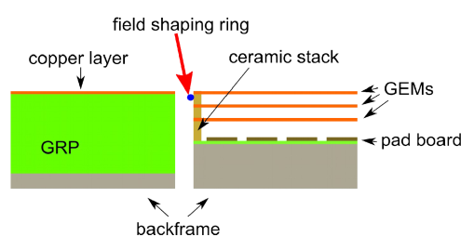
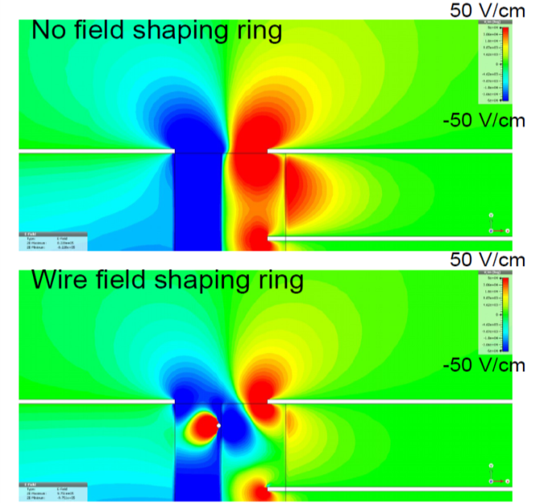
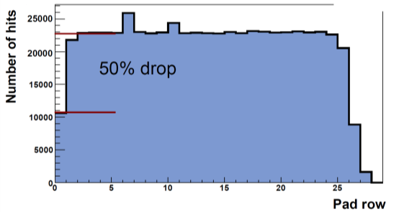
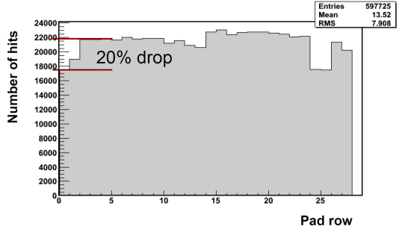
DESY GEM: Simulations of Field Distorsions
Simulation of electric field at module borders
Using a field shaping wire improves field
homogeneity
Better charge collection efficiency
Simulations
Measurements

Slide 9
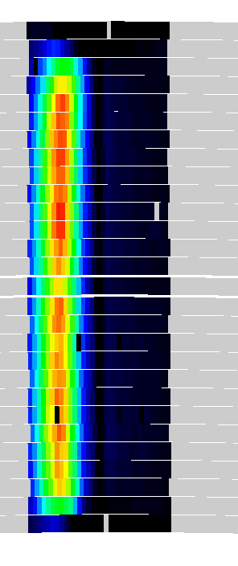
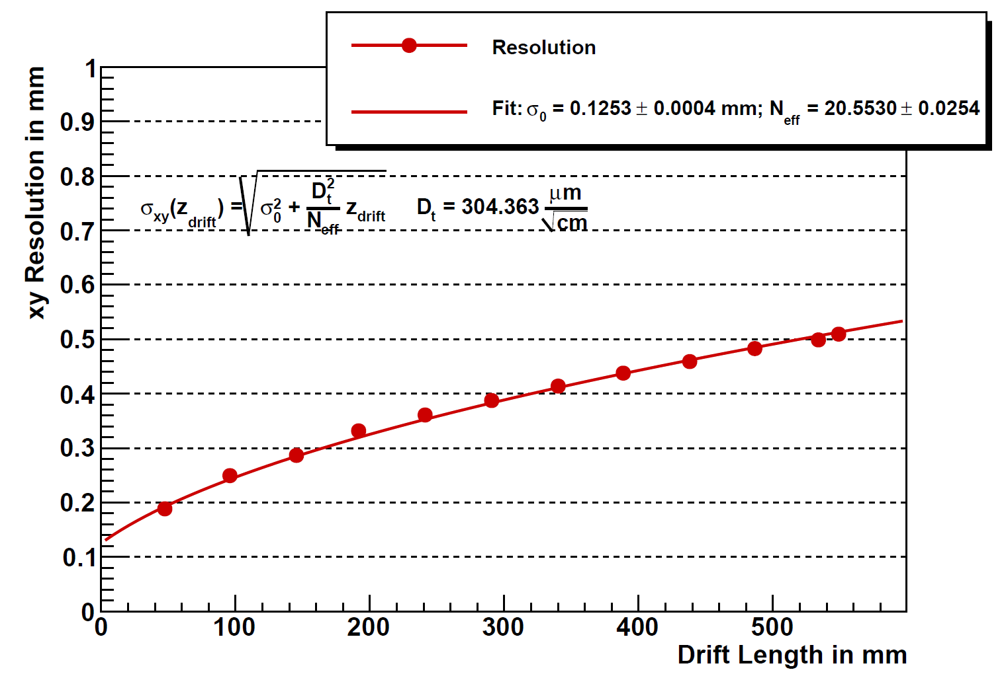
DESY GEM: Single Point Resolution
Without magnetic field using a single module
1 module data from 2011

Slide 10
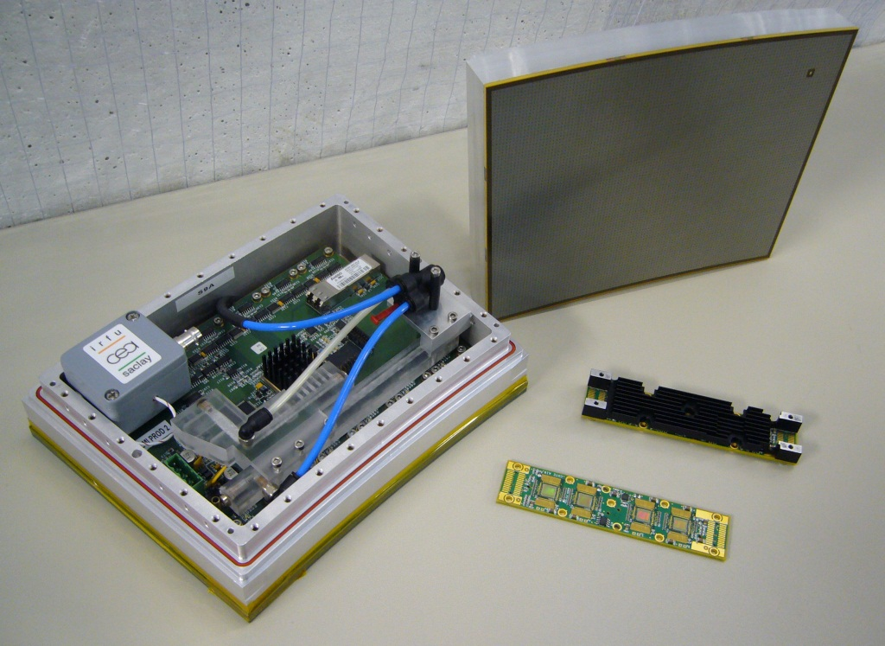
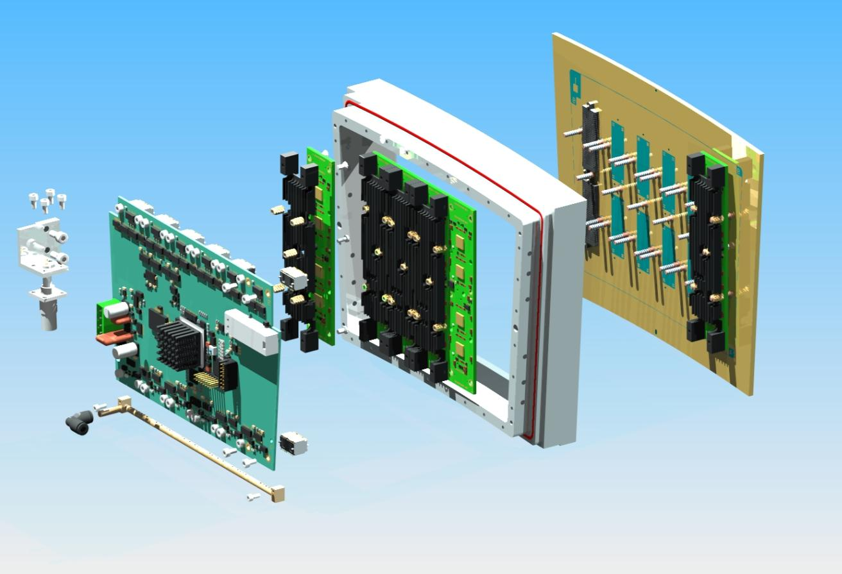
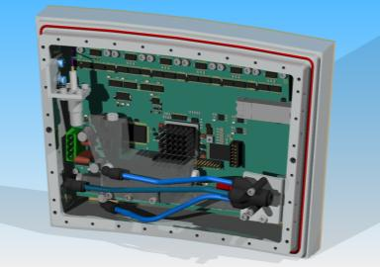
Resistive Micromegas: Module Design
Pads PCB
+
Micromegas
Front-End Card (FEC)
Front-End Mezzanine
FEM
Resistive Micromegas Detector
FEC
Cooling system
Fully integrated Module

Slide 11
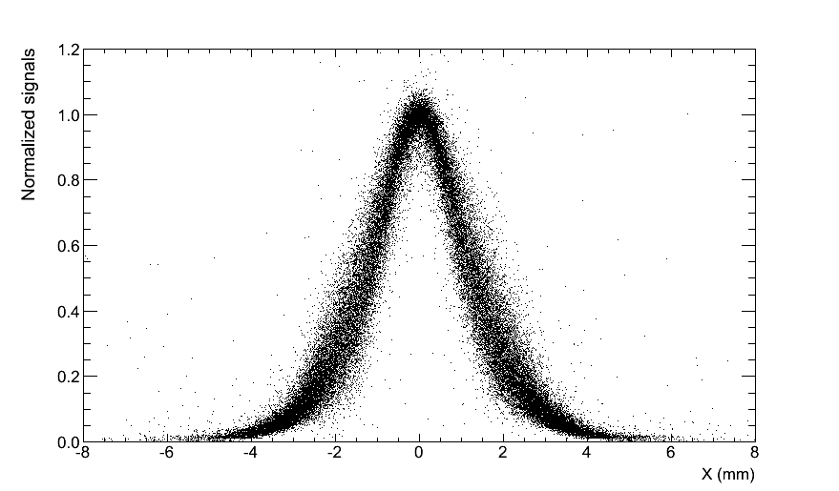
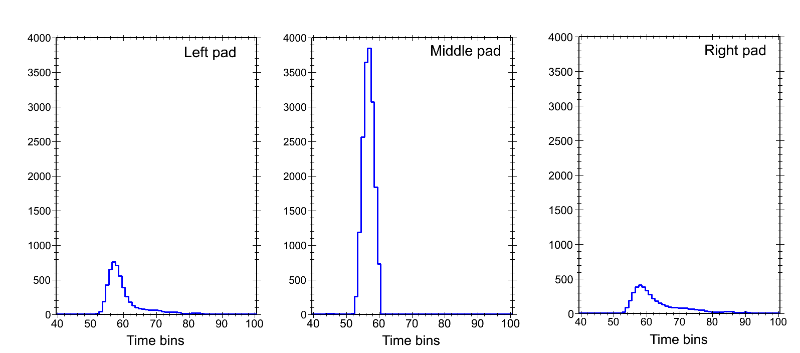

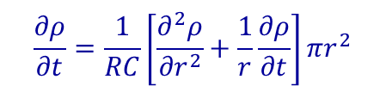
Resistive Micromegas: spread charge technology
Use material properties and geometry to spread charge over pads
Diffusion equation on the 2D continuous RC network:
$$\frac{∂ρ}{∂t}=\frac{1}{RC}\left[\frac{∂^{2}ρ}{{∂r}^{2}}+\frac{1}{r}\frac{∂ρ}{∂t}\right]πr^{2}$$
$$\underset{⇒}{}ρ(r,t)=\frac{RC}{2t}e^{\frac{−r^{2}RC}{4t}}$$
Micromegas mesh
M.S.Dixit et.al., NIM A518 (2004) 721
Resistive foil
Isolated layer
Pads
left
middle
right
Pads
Specific Pad Response Function (PRF) needed
PRF parameter determination by fitting data
PCB

Slide 12
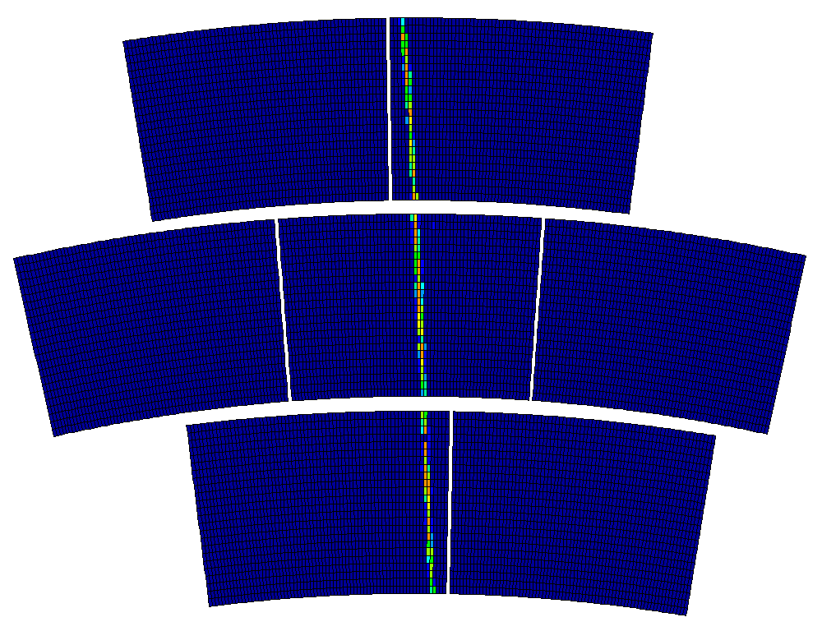

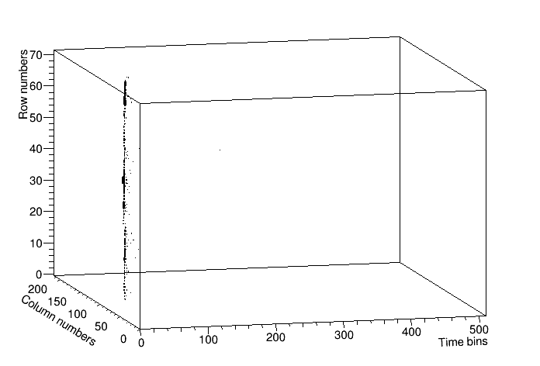
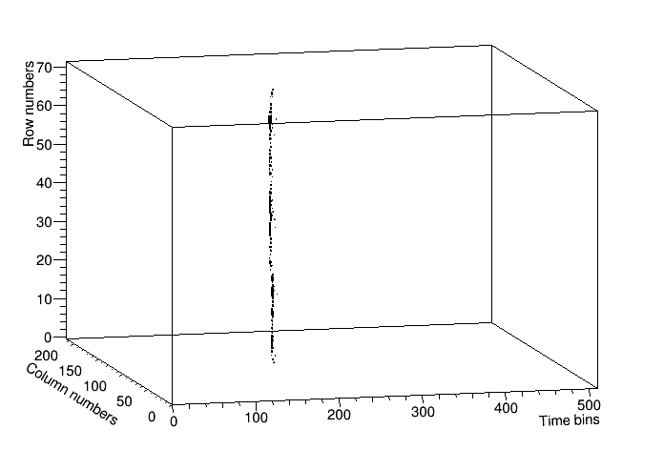
Resistive Micromegas: 7-Module Beam Tests
Z_{beam}=50 cm
Z_{beam}=2.5 cm
Gas: Argon/CF₄/Isobutane (95/3/2)
E_{drift} = 230 V/cm
B = 1 T
Micromegas gain (380V): ~5000
5 GeV electron beam

Slide 13
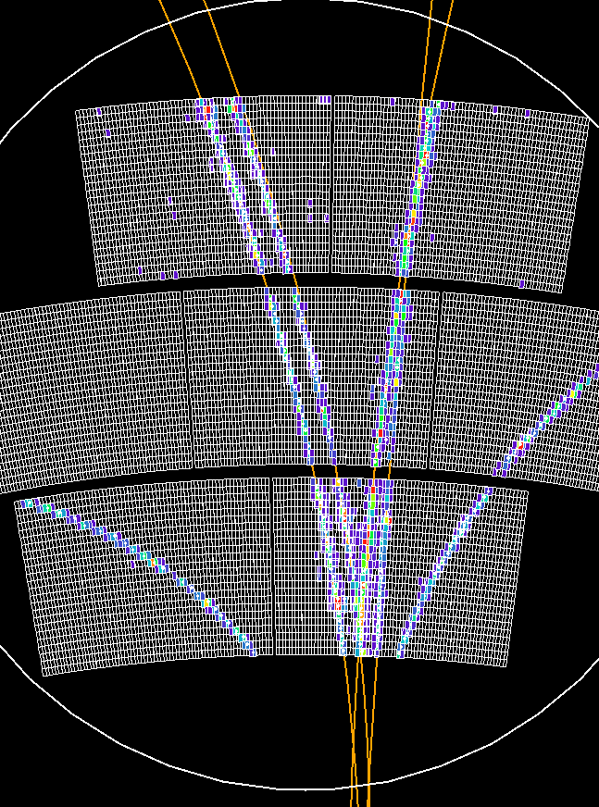
Resistive Micromegas: ILC Software analysis
Analysis done using ILCSoft framework:
  Find the pulses in the detector
  Obtain hit with PRF fit
  → (x,y,t)
  Tracks are reconstructed used a
  Kalman filter processor
  Resolution, moment, …
No telescope was used to determined
the position of the tracks

Slide 14
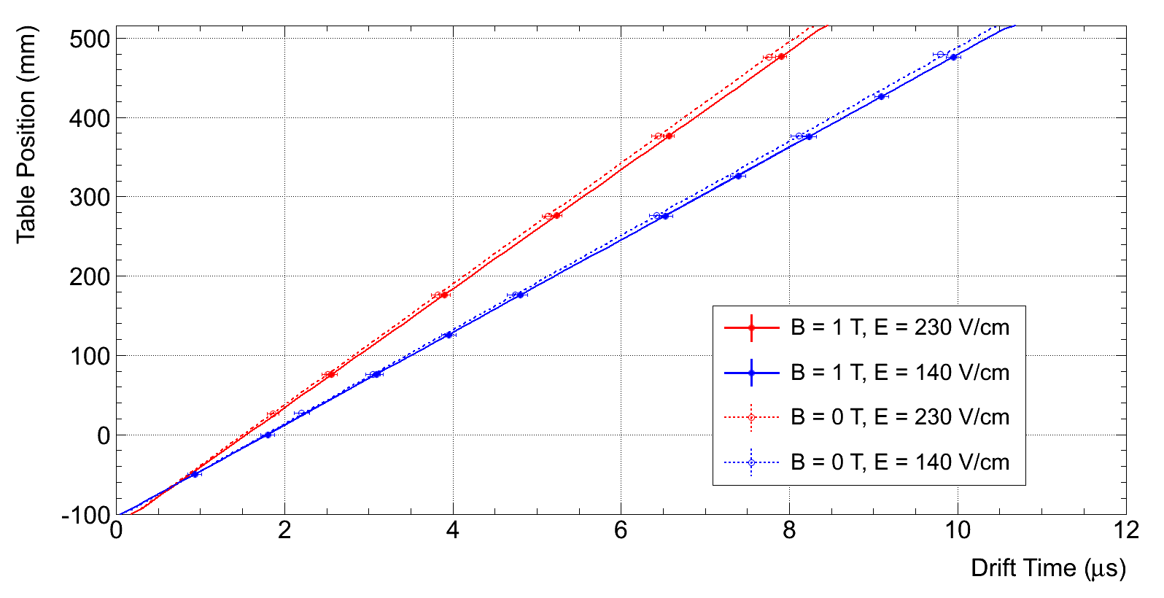
Resistive Micromegas: Time Zero and Drift Velocity
B_{field} (T) | E_{drift} (V/cm) | Drift Velocity (cm/μs)
 |  | Measured | Simulated
1 | 230 | 7.50±0.07 | 7,6
1 | 140 | 5.83±0.03 | 5,91
0 | 230 | 7.63±0.04 | 7,6
0 | 140 | 5.94±0.04 | 5,91

Slide 15
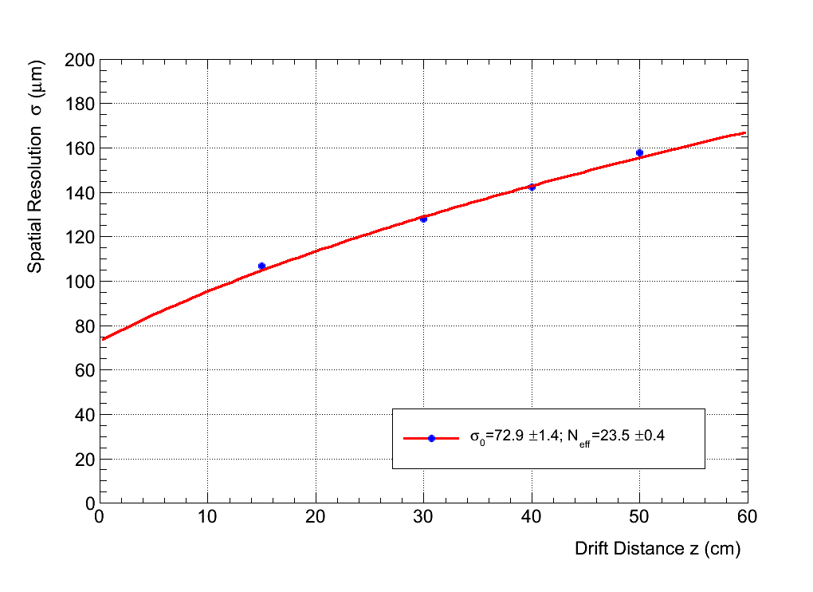

Resistive Micromegas: Space resolution studies
E_{drift} = 230 V/cm
B_{field}=1T
V_{mesh} = 380 V
Beam energy = 5 GeV
Preliminary
$$σ=\sqrt{{σ_{0}}_{}^{2}+\frac{{C_{d}^{}}^{2}.z}{N_{eff}}}$$

Slide 16
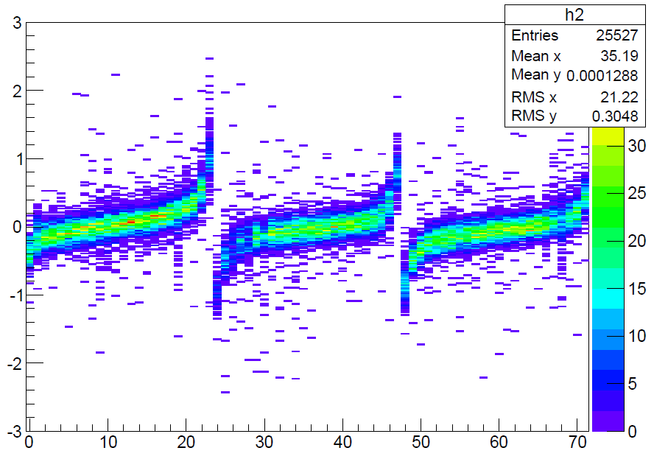
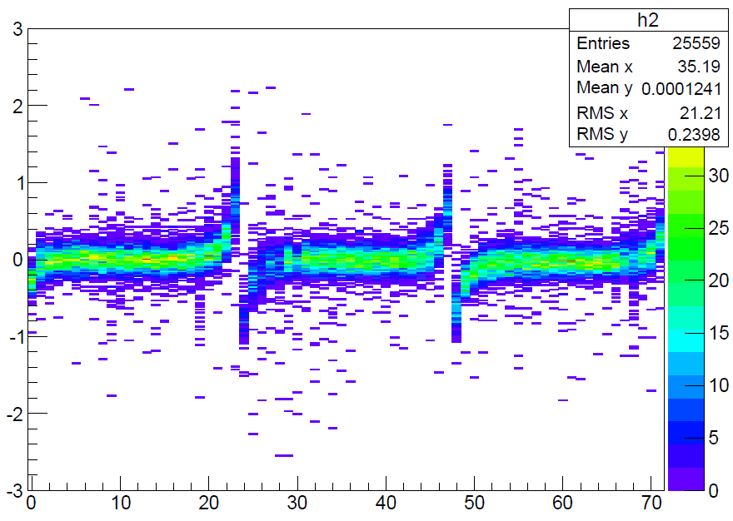
Resistive Micromegas: Field Distorsions
B_{field}=1T
Before alignment
After Alignement
Displacement (mm)
Displacement (mm)
Row Number
Row Number
Module # (rows #) | 1 (0-23) | 3 (24-47) | 5 (48-71)
Δφ (mrad) | 2.9 | 2.1 | 2.2
δx (μm) | 47 | -43 | -52

Slide 17
Summary
The LCTPC collaboration have been working since many years on a Large Prototype of a TPC
The performance of two MPGD technology reached the requirements of the ILD detector
The readout technology has to be chosen (GEM or Micromegas)
Ion back flow, electronics, mechanical integration, ... are under study
waiting for the approval of the ILC

Slide 18
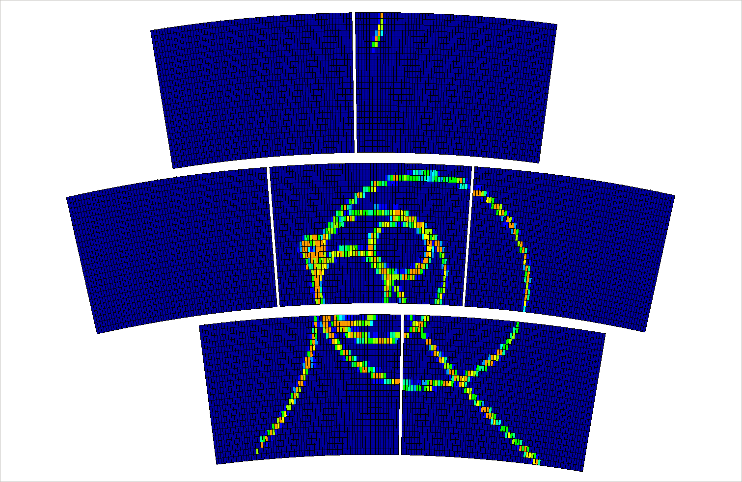
Thank you

Slide 19
Backup slides

Slide 20
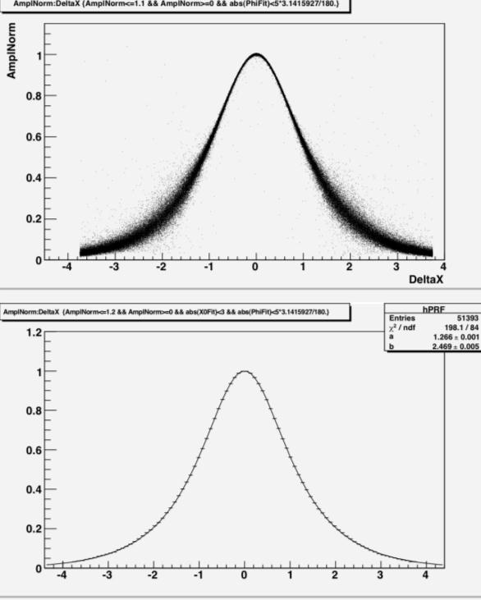
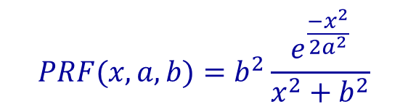
Pad Response Function PRF
PRF function:
$$PRF(x,a,b)=b^{2}\frac{e^{\frac{−x^{2}}{{2a}^{2}}}}{x^{2}+b^{2}}$$
Only two parameters
Easier to work with
Better fits to data

Slide 21

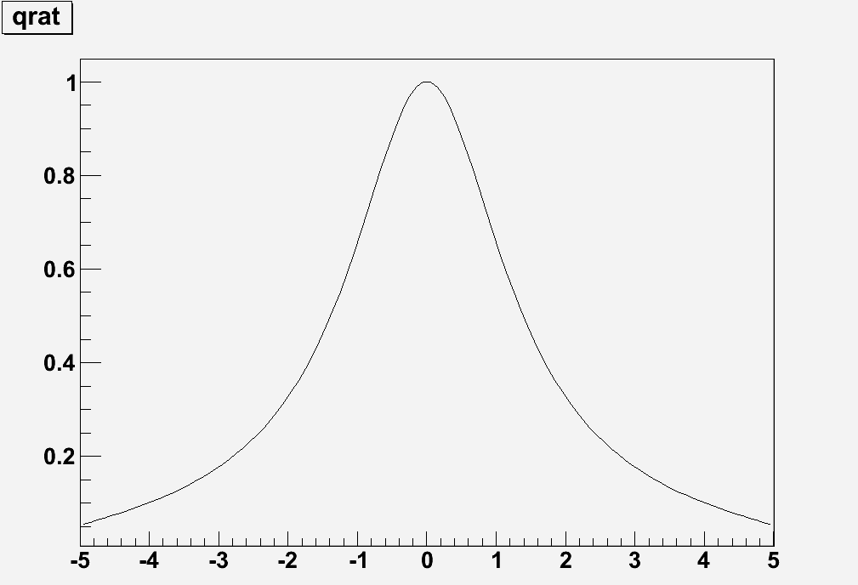
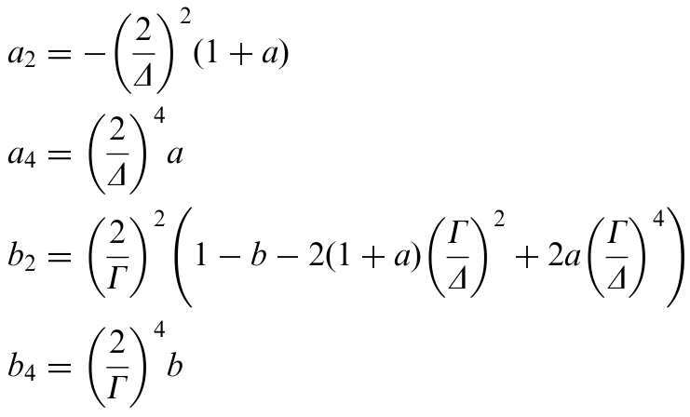
Old PRF – Ratio of two symmetric quartics

