Slide 1


Analysis of Feed Forward Runs
Mikey Davis
08 Febuary2013
1/8

Slide 2
Introduction
This presentation will focus on analysis of the FF
This effect is obviously limited, not sure by what
We don’t understand the gains
  This is obvious
  We have the right ballpark
Mikey Davis
08 Febuary2013
2/8

Slide 3
Gains – From Fb Runs
Fb Run No | Corr (%) | P2 Gain | P3 Gain
1 | 84 | - 167,500.00 | 68,103.00
2 | 80 | - 159,505.00 | 66,746.00
3 | 82 | - 119,214.00 | 30,868.00
4 | 71 | - 39,085.00 | - 21,202.00
5 | 74 | - 81,959.00 | 23,462.00
6 (Skew Quads Off) | 82 | - 137,983.00 | 67,595.00
Mikey Davis
08 Febuary2013
3/8

Slide 4
Observations
The DAC output is very sensitive to the upstream beam pos
Neven and I get the same calibration constants
  I have found the cause of my erroneous minus sign
  He used a slightly different method
    Good cross check
    Validates my k values
Mikey Davis
08 Febuary2013
4/8

Slide 5
All Run Analysis – Jitter (μm)
File Name 30 Jan Shift | IPA_fBposFbOffS | IPA_fBposFbOnS | IPA_sBposFbOffS | IPA_sBposFbOnS | IPB_fBposFbOffS | IPB_fBposFbOnS | IPB_sBposFbOffS | IPB_sBposFbOnS
ffRun1_Board2_270113 | 32.45 | 32.04 | 33.53 | 32.47 | 4.42 | 4.14 | 4.00 | 3.53
ffRun3_gain-1_Board2_270113 | 32.83 | 29.40 | 29.72 | 33.02 | 3.05 | 3.46 | 3.40 | 2.43
ffRun4_Board2_270113 | 34.35 | 35.30 | 39.46 | 38.16 | 3.90 | 4.08 | 3.66 | 3.41
ffRun5_Board2_270113 | 25.32 | 23.75 | 25.54 | 26.54 | 3.36 | 3.19 | 3.29 | 2.36
ffRun6_Board2_270113 | 26.32 | 24.42 | 26.26 | 25.93 | 3.49 | 3.35 | 3.27 | 5.22
ffRun7_Board2_270113 | 41.78 | 38.39 | 38.34 | 38.53 | 5.67 | 5.00 | 4.37 | 3.87
ffRun8_Board2_270113 | 27.40 | 30.16 | 28.38 | 28.27 | 3.80 | 3.97 | 3.78 | 3.19
ffRun9_Board2_270113 | 32.67 | 33.40 | 35.47 | 32.58 | 4.03 | 4.31 | 3.77 | 3.62
ffRun10_Board2_270113 | 30.56 | 33.83 | 29.06 | 32.77 | 3.93 | 4.04 | 4.08 | 3.31
File Name 02 Feb Shift
ffRun1_Board2_290113 | 7.00 | 6.72 | 7.14 | 6.99 | 3.14 | 3.30 | 3.10 | 2.62
ffRun2_Board2_290113 | 8.76 | 8.35 | 8.05 | 7.06 | 3.75 | 3.78 | 3.41 | 2.96
ffRun3_Board2_290113 | 7.11 | 8.01 | 7.01 | 6.91 | 3.49 | 3.97 | 3.24 | 2.94
ffRun5_Board2_290113 | 8.43 | 10.40 | 9.08 | 9.40 | 4.06 | 3.88 | 3.62 | 3.42
ffRun6_Board2_290113 | 10.63 | 10.05 | 8.31 | 9.20 | 3.91 | 4.38 | 3.81 | 3.60
ffRun7_Board2_290113 | 8.74 | 10.02 | 10.85 | 9.42 | 3.56 | 4.08 | 3.46 | 3.21
ffRun8_Board2_290113 | 9.73 | 10.47 | 10.16 | 8.85 | 4.68 | 3.82 | 3.03 | 4.87
Mikey Davis
08 Febuary2013
5/8

Slide 6
All Run Analysis - Improvements
File Name - 30 Jan Shift | P2 IPK Gain | P3 IPK Gain | Fb Improvement (%) | Sb Improvement (%)
ffRun1_Board2_270113 | - 48,000 | 30000 | -6.42 | -11.77
ffRun3_gain-1_Board2_270113 | - 48,000 | -30000 | 13.49 | -28.61
ffRun4_Board2_270113 | - 46,000 | -10000 | 4.69 | -6.85
ffRun5_Board2_270113 | - 48,000 | -30000 | -5.05 | -28.16
ffRun6_Board2_270113 | 48,000 | 30000 | -3.80 | 59.66
ffRun7_Board2_270113 | - 48,000 | -30000 | -11.88 | -11.56
ffRun8_Board2_270113 | - 70,000 | 0 | 4.60 | -15.43
ffRun9_Board2_270113 | - 50,000 | 0 | 7.06 | -3.91
ffRun10_Board2_270113 | - 90,000 | 0 | 2.83 | -18.84
02 Feb Shift
ffRun1_Board2_290113 | - 40,000 | 20,000 | 5.03 | -15.70
ffRun2_Board2_290113 | - 80,000 | 40,000 | 0.89 | -13.01
ffRun3_Board2_290113 | - 120,000 | 60,000 | 13.70 | -9.18
ffRun5_Board2_290113 | - 60,000 | 30,000 | -4.44 | -5.62
ffRun6_Board2_290113 | - 10,000 | 50,000 | 11.87 | -5.39
ffRun7_Board2_290113 | - 50,000 | 25,000 | 14.53 | -7.14
ffRun8_Board2_290113 | 50,000 | - 25,000 | -18.41 | 60.66
Mikey Davis
08 Febuary2013
6/8

Slide 7
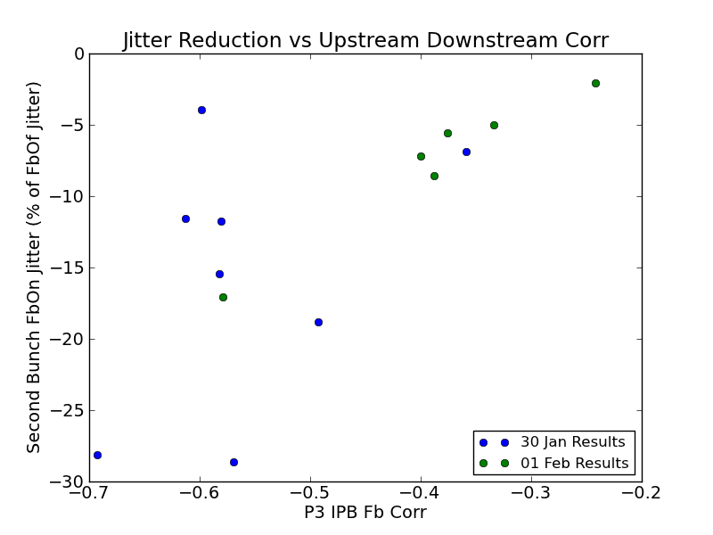
Jitter Reduction vs Correlation
Mikey Davis
08 Febuary2013
7/8

Slide 8
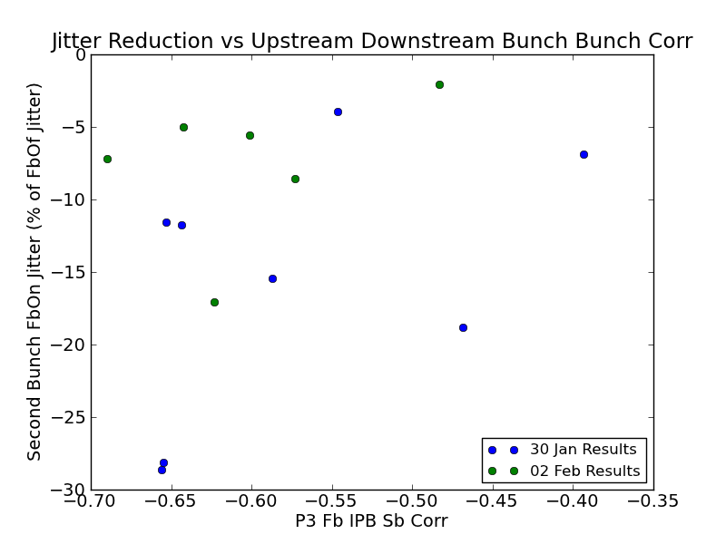
Jitter Reduction vs Correlation
Mikey Davis
08 Febuary2013
8/8

