Slide 1
Benchmarking Summary Table
Draft
Based on
ILD DBD : SVN source on February 13 morning (JST)
SiD nightly build: sid_dbd_2013-02-13_r871.pdf
Akiya Miyamoto
KEK

Slide 2


LOI 500 GeV: tau tau
ILD : Table 4.2.1
500 fb⁻¹, eL80/pR30
SiD :
250fb⁻¹ for eL80/pR30 & 250fb⁻¹ for eR80/pL30
0.002?
SiD LOI
p.123
For Summary table:
For eL80/eR80 = (250,250) fb-1, 0.0021/0.0024
→ 0.0023 as eL/eR average

Slide 3
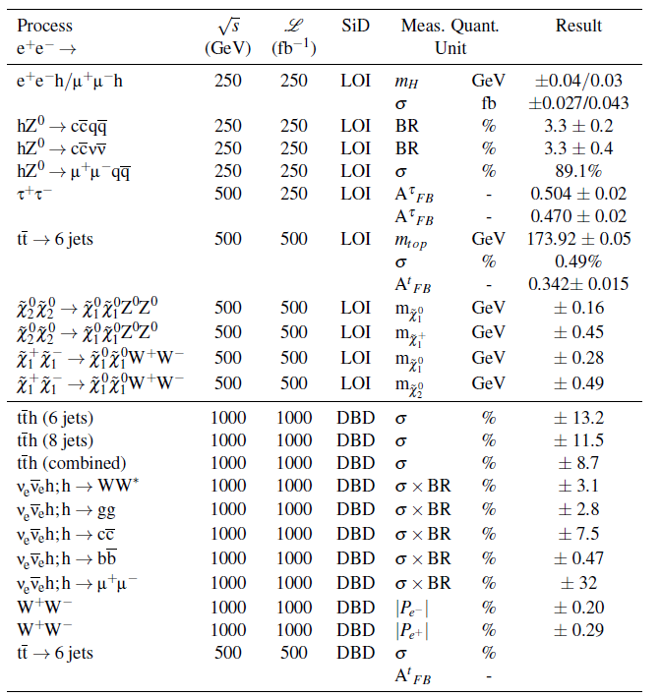
SiD
Summary

Slide 4
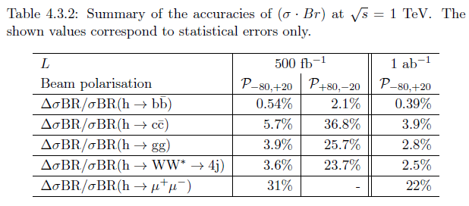
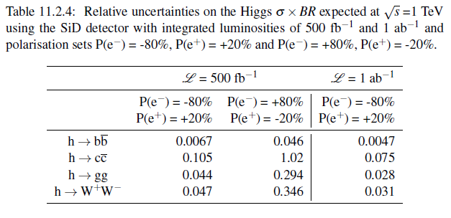
1 TeV vvh
ILD
Issues:
ILD: backgrounds
SiD: Number of events
SiD

Slide 5

1 TeV WW,
ILD
SiD
For Summary table
|Pe-| = 0.0016
|Pe+| = 0.0027

Slide 6
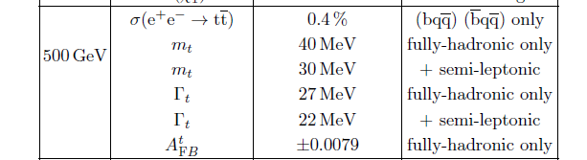


500 GeV tt
ILD LOI
ILD DBD
SiD LOI
SiD DBD
Not filled yet
For summary table
ΔA_{FB}=0.011
Δm_{t} = 40 MeV
Δσ/σ=0.5%

