Slide 1
2013.02.19: Hayano
Cavity status; recent KEK activities
There are four vertical tests since the last S0 meeting. However there is no new cavity test.
The green figure results are the new test.
STF CM-1 cavities are;
MHI-014 36.6MV/m for CM-1 ILC cryomodule (3-rd VT)
MHI-015 35.7MV/m for CM-1 ILC cryomodule (4-th VT)
MHI-016 33.8MV/m for CM-1 ILC cryomodule (2-nd VT)
MHI-017 38.4MV/m for CM-1 ILC cryomodule (1-st VT)
MHI-018 36.2MV/m for CM-1 ILC cryomodule (4-th VT)
MHI-019 37.0MV/m for CM-1 ILC cryomodule (2-nd VT)
MHI-020 35.1MV/m for CM-1 ILC cryomodule (3-rd VT)
MHI-021 38.9MV/m for CM-1 ILC cryomodule (1-st VT)
MHI-022 35.8MV/m for CM-1 ILC cryomodule (2-nd VT)
The next 4 cavities for CM-2a are under fabrication.
(2) New bender/KEK cavities/R&D cavities;
TOS-02(w/o HOM): 1-st : 31.2MV/m, 2-nd :32.7MV/m, 3-rd :36MV/m
HIT-02(with HOM): 1-st : 35.2MV/m, 2-nd :40.9MV/m, 3-rd : 32.7MV/m, 4-th : 32.3MV/m
5-th : 38.0MV/m
KEK-00(w/o HOM): 1-st : 26MV/m, 2-nd :29MV/m, 3-rd :24MV/m, 4-th : 22MV/m
KEK-01(with HOM): under fabrication
MHI-C(with HOM): 1-st : 36.1MV/m
They all were jacketed with HPV qualification and waiting for the CM-1 installation.

Slide 2
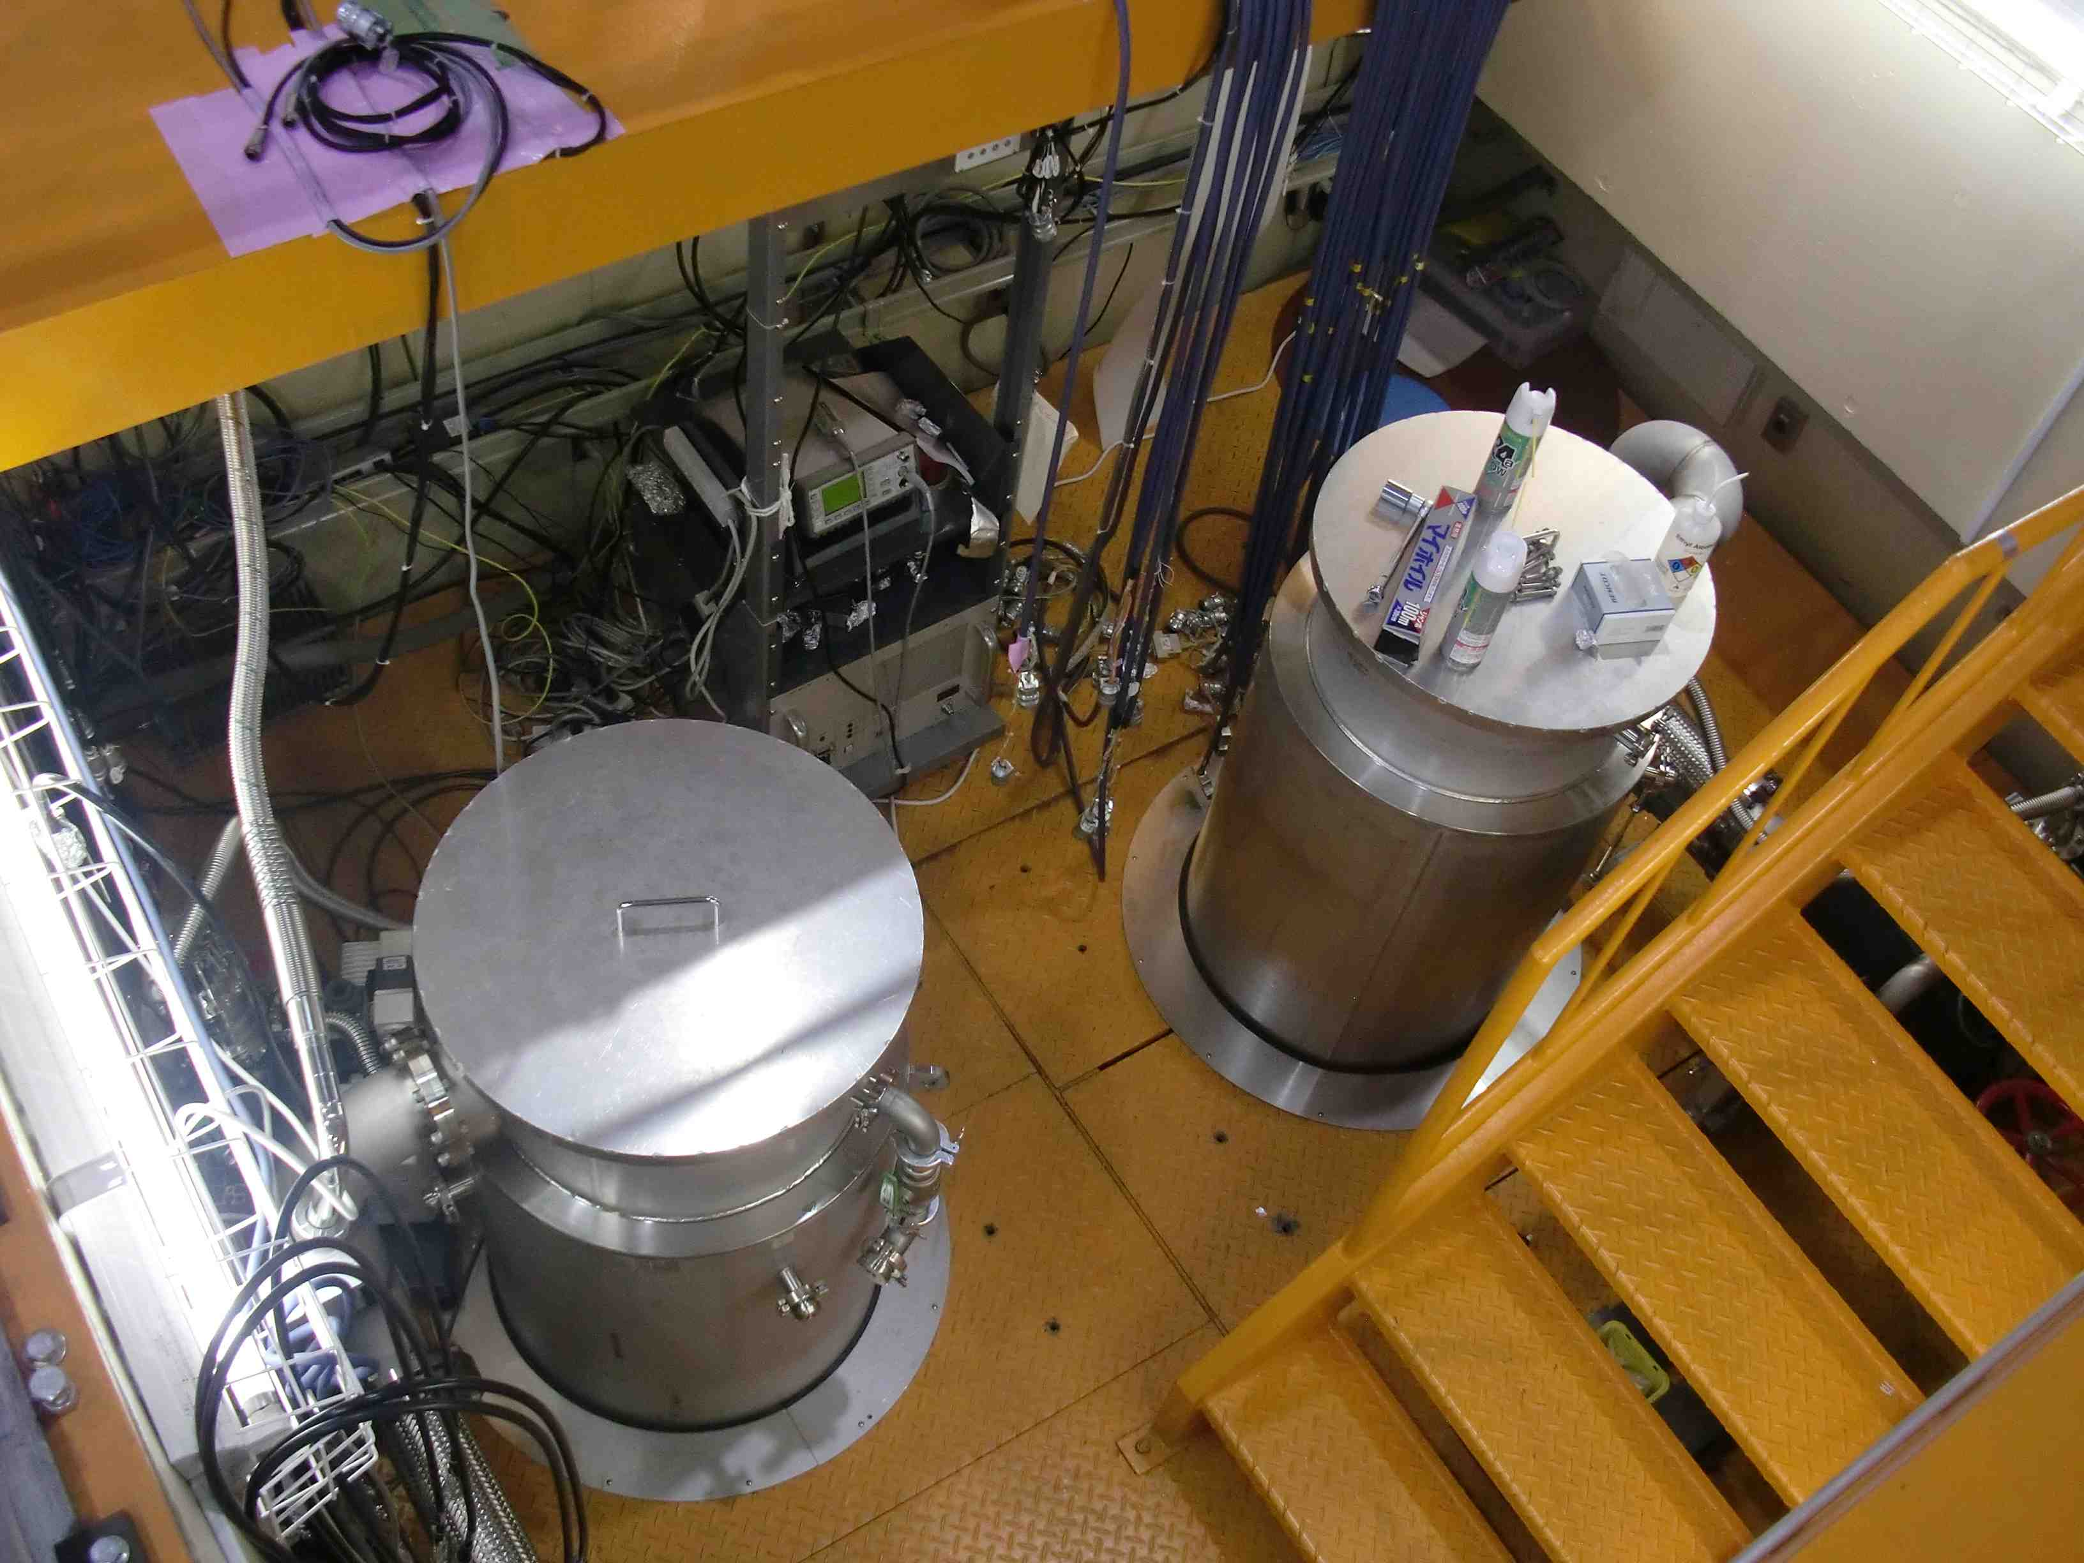
Cryostat of STF-Vertical Test Stand
No.2 Cryostat (New)
(Mag Shield is inside of
vacuum insulation part)
No.1 Cryostat
(Mag Shield is insdie of cryostat: in LHe)

Slide 3
New VT Cryostat (No.2 Cryostat)
commissioning
3-rd vertical test :
(mag shield in
cryostat vacuum layer)
Q slightly lower than No1 cryostat
2-nd vertical test in the No.1 cryostat:
as a reference
4-th vertical test :
(add mag shield
inside of cryostat)
no imrovement of Q ?!

Slide 4
Check ultra-sonic rinsing
is effective or not
with 2% FM-20 detergent
-> was effective, but not sufficient.
5-th vertical test : skip ultrasonic rinsing
radiation was factor 3 higher than before.
2-nd vertical test : as a reference
(radiation was not plotted,
but about one order lower than
5-th test)

Slide 5
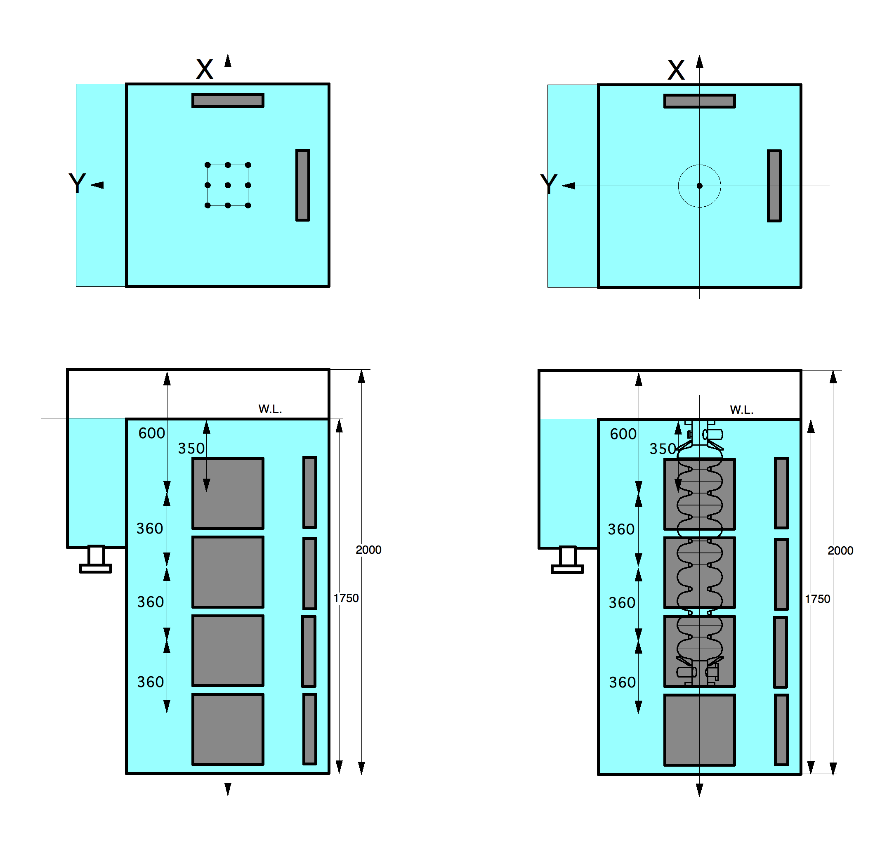
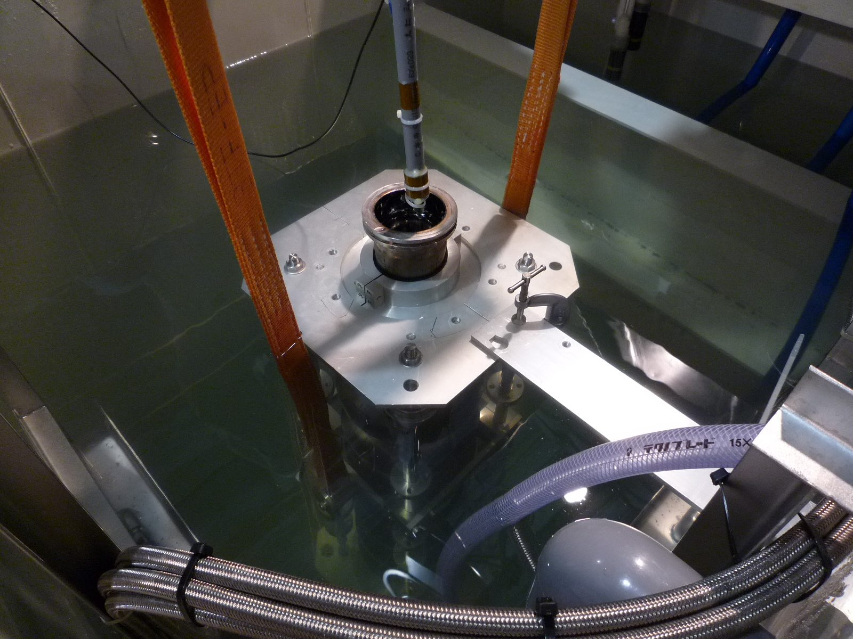
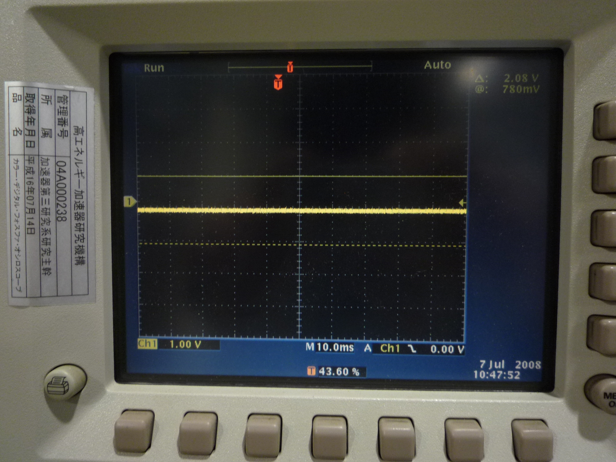
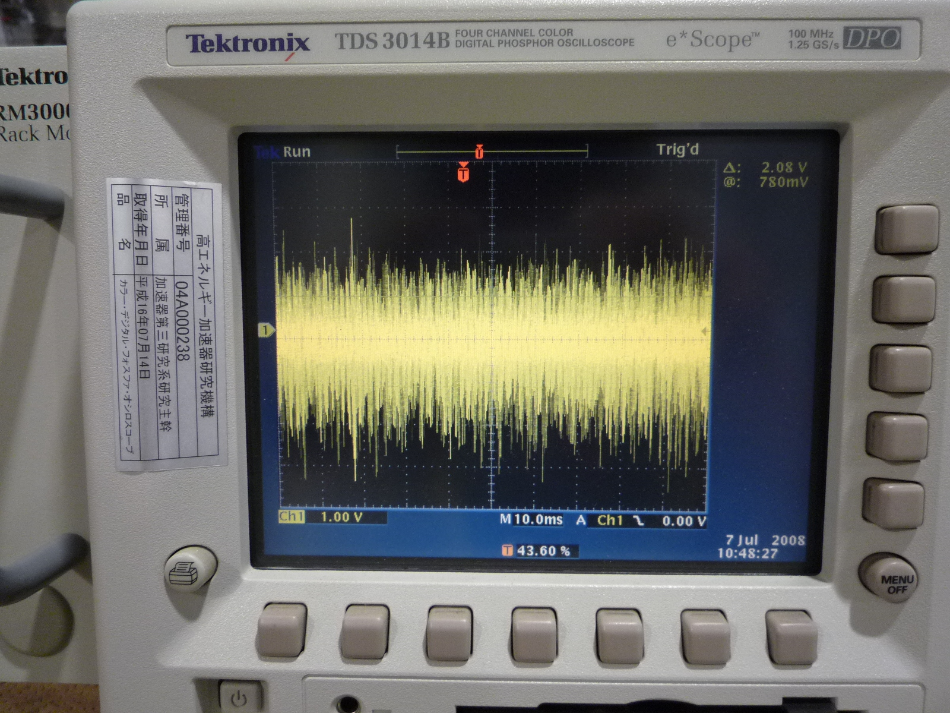
Measurement of Ultrasonic amplitude (July 2008)
piezo sensor
Ultra-sonic
set-up of Ultrasonic sensor
Ultrasonic OFF
Ultrasonic ON

Slide 6
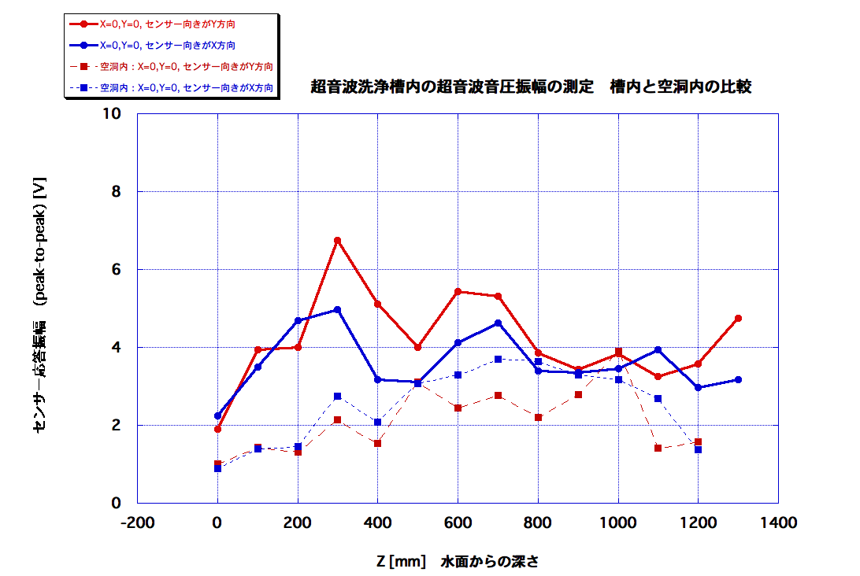
Comparison of ultrasonic intensity with/without cavity (July 2008)
amplitude of sensor output [V]
no cavity: Y-direction
no cavity: X-direction
inside of cavity: Y-direction
inside of cavity: X-direction
depth from water surface
Intensity was about similer or half for inside of the cavity

Slide 7
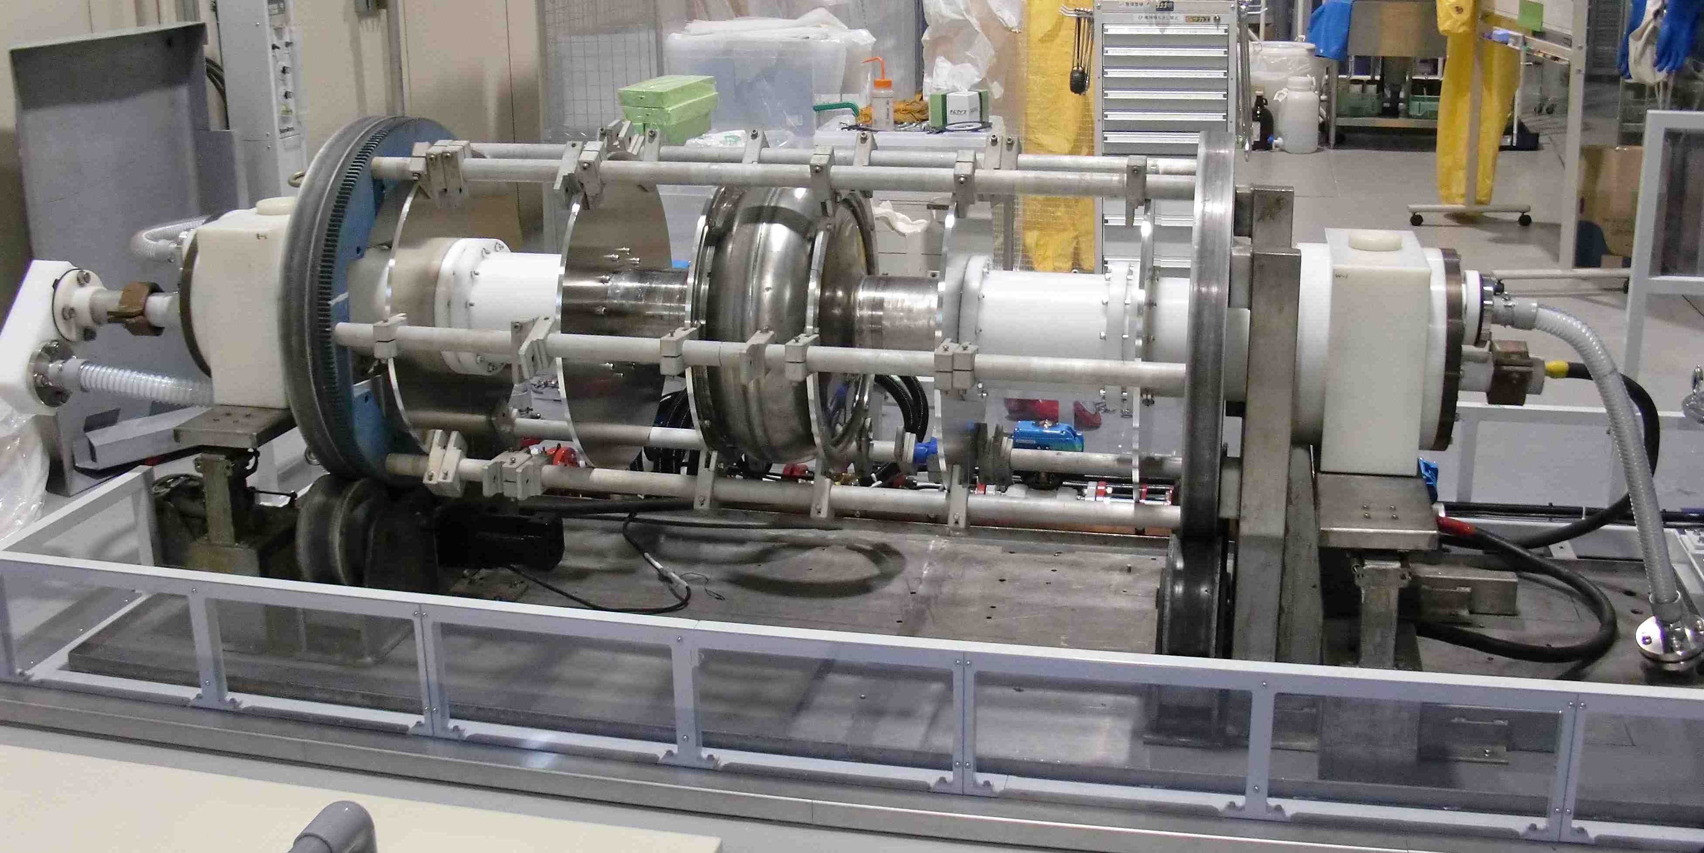
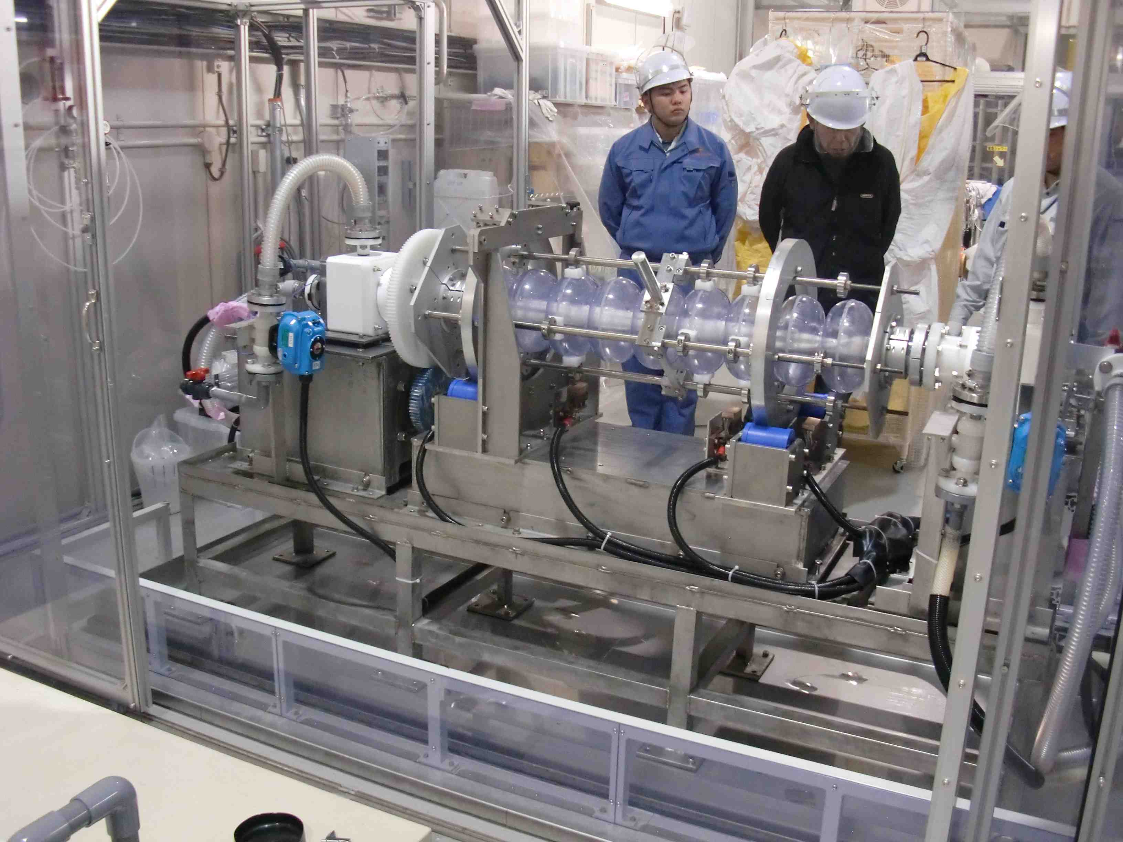
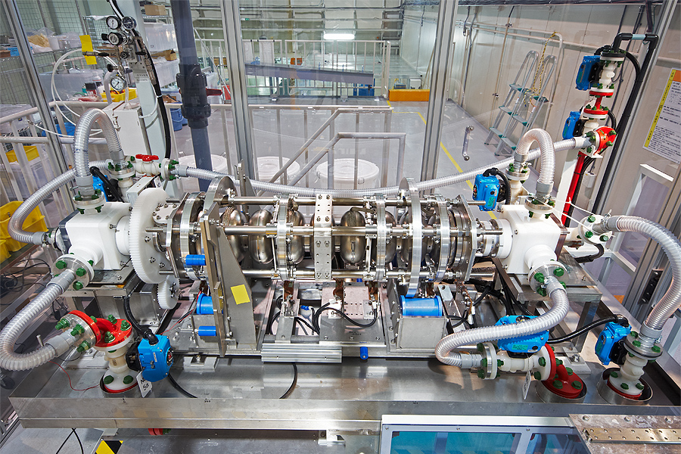
STF EP Facility
No.2 EP stand is now utilized for ILC cavities
No.2 EP Bed
for 500MHz cavity
flow test using water
No.1 EP Bed
No.2 EP Bed
modified to fit ILC cavity

Slide 8
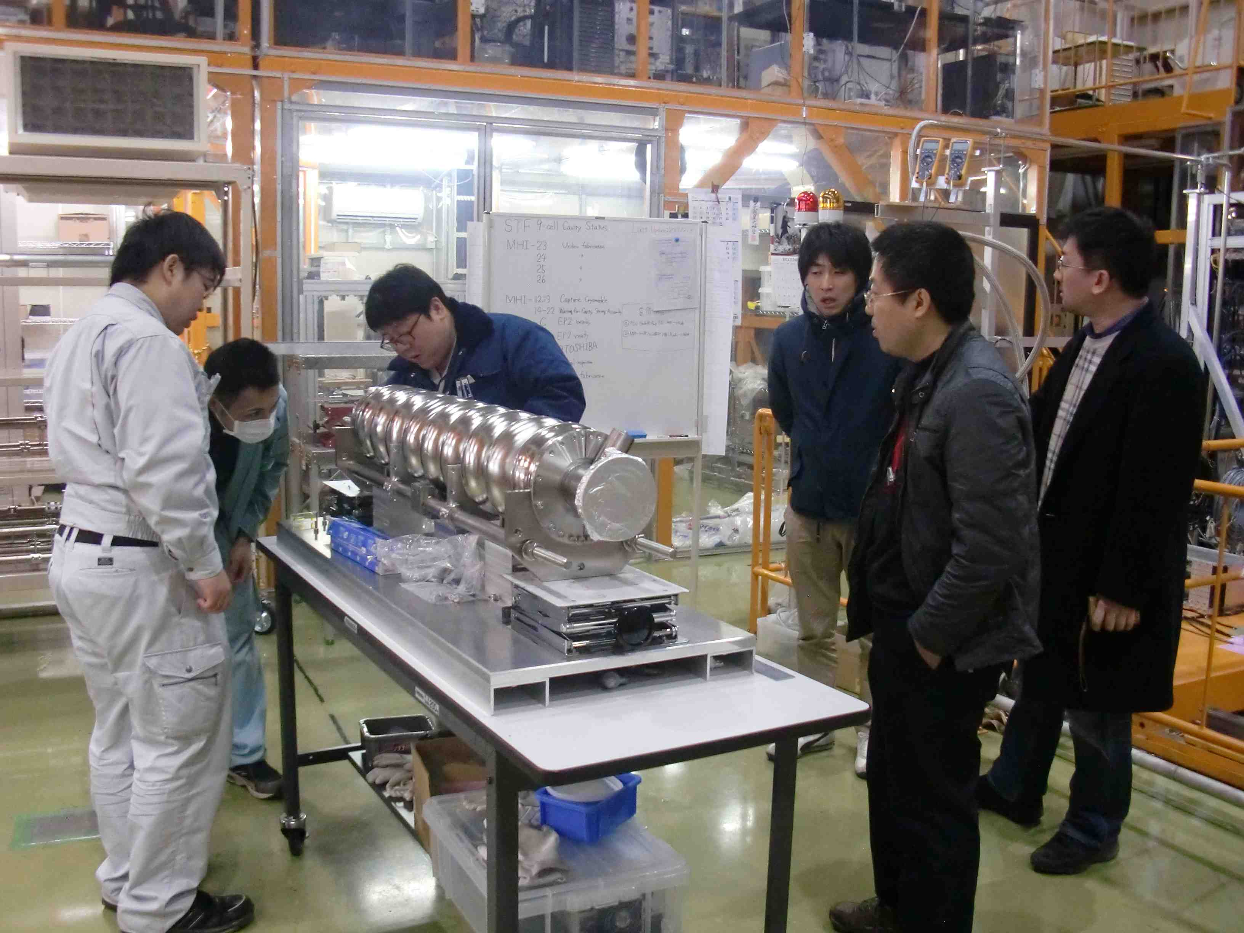
Collaboration with Beijing University
EP process & vertical test for PKU04 (large grain cavity) on a way
vertical test is scheduled on the next week(Feb. 28).

Slide 9
End of Slide

