Slide 1
GDE ML-SCRF: FuzeBox Meeting
Feb., 13, 2013
Reports from PMs
  ILC-GDE SCRF schedule
  Reports from the External Cost Review and actions/responses required
Reports from TA Group Leaders
  Cavity, Cavity Integration, Cryomodule, Cryogenics, HLRF, ML
    R. Geng, H. Hayano, P. Pierini, T. Peterson, S. Fukuda/C. Nantista, C. Adolphsen
Special Discusssions
  Further works for TDR to be finalized
  Remark and Acknowledgments

Slide 2
SCRF: FY2013 Plan
M. | SCRF WebEx | GDE / International
12 | 19 (today) | 13-14: ILC-PAC (KEK) 15: LC Symposium (Tokyo)
1 | (16) | 9, 16, 23, 30 (11, 18, 25, 2/1) External cost-review preparation mtgs. for SCRF
2 | 13 SCRF FuzeBox mtg) | 6-7 External Cost Review (London) 21-22: ICFA/ILCSC (Vancouver) : Transition from GDE to the next organization, Linear Collider Board/Directorate (LCB/LCD)
5 |  | 13~17: IPAC (Shanghai) 27-31: ECFA-LC 2013 (DESY)
6 |  | ILC Event (KEK, CERN, Fnal) at 5:00 pm 12 – 14? (US) TTC topical WS on CW SRF at Cornell (proposed)
9 |  | 22-27: SRF2013 (Paris)
11 |  | 11-15: LCWS-2013 (Tokyo)

Slide 3
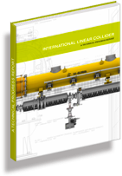
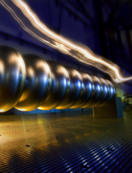

Completion of Technical Design Report to be printed by June, 2013
2007
2011
2013*
TDR Part I:
R&D
~250 pages
Deliverable 2
ILC Technical Progress Report
(“interim report”)
AD&I
TDR Part II:
Baseline
Reference
Report
~300 pages
Deliverables 1,3 and 4
Technical Design Report
Reference Design Report
* end of 2012 – formal publication early 2013

Slide 4
ILC TDR: External Cost Review
Windsor, UK, Feb. 6-7, 2013
Reviewers
S. Akutagawa
J. Bagger (observer)
R. Brinkmann
L. Evans (observer)
N. Holtkamp (Chair)
K. Dale
P. Lebrun
R. Rubinstein (PAC Secretary)
E. Tada
S. Uno
T. Watson
C. Zhang
T. Shidara (ECR Scientific Secretary)
Reports from GDE:
Introduction B. Barish
ILC design overview N. Walker
Cost methodology G. Dugan
SCRF system overview A. Yamamoto
HLRF:
  Modulator PDS C. Adolphsen
  Klystron, PD, MP S. Fukuda
SCRF
  Cavity (RI study) N. Walker
  Cryogenics T. Peterson
  CM assembly (BN study) V. Parma
  System test M. Ross
CFS
  Overview V. Kuchler
  Cost Basis- Asia A. Enomoto
  Cost Basis – Europe J. A. Osborne
  Cost Basis – Americas V. Kuchler
  Regional Cost comparison V. Kuchler
Damping Ring M Harrison
Coventional Acc. Sys. B. List
Installation F. Asiri
Cost summary/roll-up G. Dugan
Schedule M. Gastal
Further R&D for cost driver M. Ross
Project Impl. Plan B. Foster

Slide 5
ILC-TDR Cost Estimate:
SCRF Overview
Akira Yamamoto (KEK)
for
GDE Project Managers, Cost Engineers, and
SCRF Technical-Area Collaborators
To be presented at the ILC GDE External Cost Review,
Windsor, Feb. 6, 2013

Slide 6
Fraction of SCRF Cavity and CMs
ILC total:
100 %
in TDR-FT basis
Cavity and CM :
35 %
Cryogenics:
8 %
HLRF
10 %

Slide 7

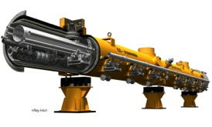
Cavity/Cryomodule Fabrication
Purchasing Material/Sub-component
Manufacturing Cavity
Processing Surface
Assembling LHe-Tank
Qualifying Cavity, 100 %
Cavity String Assembly
Cryomodule Assembly
Qualifying CMs, 33 + 5 %

Slide 8
Cost uncertainty methodology
 | Value basis | Premium
1 | COTS or equivalent | 5%
2 | Procurement | 8%
3 | Vendor quote | 10%
4 | Industrial Study, mass production | 20%
5 | Engineering estimate: conventional technology | 15%
6 | Engineering estimate: R&D needed | 30%
Examples:
Modulator (Engineering estimate, no R&D): basic 15%; quantity discount/2 = 33%/2 = 16%. Total cost premium = 31%
Cavity superconducting material (Procurement): basic 8%; quantity discount/2 = 16%/2 = 8%; special premium = 20% (Nb price fluctuations). Total cost premium = 36%.

Slide 9
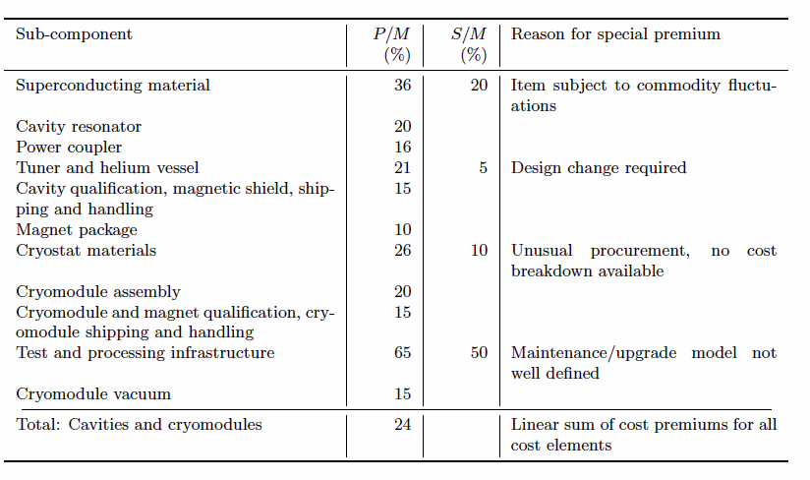
Cost Premiums for Cavity and CM
Market dynamically fluctuated
To be cost equivalent with
that of EXFEL production
Further survey/investigation
required
To learn more from EXFEL

Slide 10
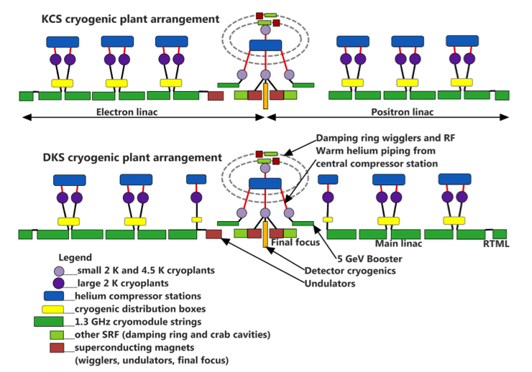
Cryogenics Configuration and Cost to be further reported by T, Peterson
from 20121030-EC-TDR2

Slide 11
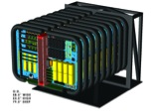
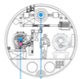
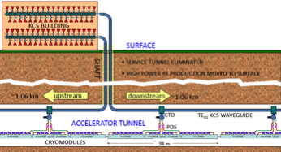
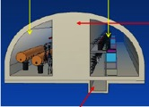
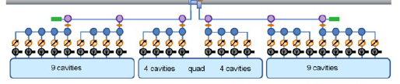
HLRF and Power Distribution
C. Adolphsen, S. Fukuda
Klystron Cluster Scheme (KCS)
  Marx Modulators
  Clusters of klystrons
  (2 × ~ 30 10-MW MBK) on surface
  RF power distribution via major waveguide (300 MW)
Distributed Klystron Scheme (DKS)
  Marx modulator
  10-MW MBK per 39 cavities
  Everything in tunnel

Slide 12
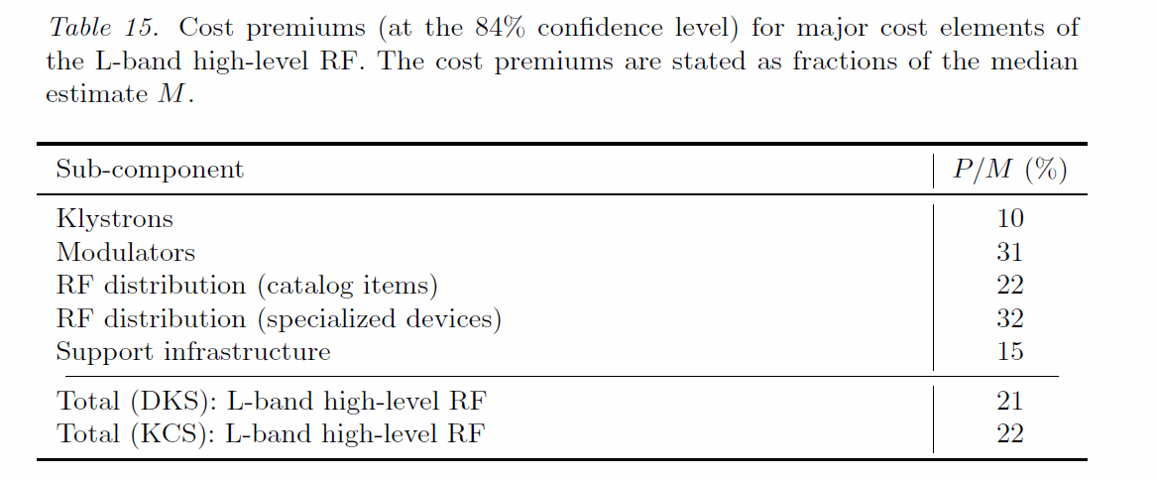
Summary of Cost Premiums for HLRF

Slide 13
Summary of SCRF Cost-estimate
 | Fraction [%] | Uncertainty [%]
ILC total | 100 % | 24 %
SCRF
Cav. & CM | 35 | 24
Cryogenics | 8 | 22
HLRF | 10 | 21/22

Slide 14
Summary
SCRF cavity and Cryomodule production cost estimates have been made in cooperation with industry, and realized with learning EXFEL experience.
The cost estimates are based on that:
  Industry should be accessible from any laboratories, and be responsible for fabrication based on “build-to-print” specification without without guarantee for the final/major performance such as field gradient.
    Industrial cost include both infrastructure and manufacturing costs.
  Laboratory is responsible for qualifying the performance.
    Laboratory cost include both test infra-structure and test operation.
Cryogenics and HLRF cost estimate has been with basis of vendor cost.
Most of SCRF costs have been re-evaluated by referring EXFEL procurement experience and by specific cooperative works with industry.
The cost estimate uncertainty evaluated to be in a range of 20 - 25 %.

Slide 15
ILC Cost Review Report
Digested for SCRF by AY
International/External Cost Review
Windsor, UK 7-8.02.13

Slide 16
What are the high priority steps in the near term before construction start
Develop a plan for the next (transitional) phase of engineering design leading to readiness to start construction.
  Develop key deliverables and prioritized activities and milestones needed for start of construction.
  Seek funding for these activities and support for sufficient manpower commensurate with a project of this magnitude.
  Create a resource loaded schedule that takes the comments into account and reevaluate the manpower distribution, M&S needs and space requirements.
Update the cost estimate and schedule with key missing items.
Develop a preliminary ILC Project Management Plan suitable for negotiation with potential collaborators.

Slide 17
The Elements in the cost estimate that need to be refined
The cost estimate of the cavities seems overly optimistic given other project experience.
Reassess the cost of cavity / cryomodule test assumption of doing it in the hub labs with no initial investment.
The cost of manpower should be explicitly included. A clear understanding of manpower needs in the central versus hub teams is needed.
Develop placeholders for the site specific cost
Plus a lot of details

Slide 18
The Linac: SRF linac, cryogenics, component qualification
Findings
  Cost estimates for the components of the superconducting accelerator modules are based on the actual procurements of the EXFEL project and application of a 95% learning curve to account for economy of scale. An exception is the estimate for cavity fabrication, which is based on an industrial study by RI, yielding fabrication cost per cavity more than a factor of two lower than present EXFEL cost.
  The cost estimate for module assembly is based on a detailed industrial study by BNG and is consistent with actual EXFEL cost.
  Cost estimates for cryogenic plants are based on costs of existing large scale cryogenic installations and scaling accounting for system size and escalation.
  Qualification of all cavities and one third of accelerator modules (+5% during initial production phase) as well as processing of all RF couplers is foreseen. The cost estimate assumes that test infrastructure will be available at different places worldwide and can be “rented”, so that only 25% (5% per year/5 years operation) of the cost to build the facilities is defined as the value for this cost item. Cost for power consumption and consumables is included. Personnel for operating the test facilities is included in the explicit labor estimate.

Slide 19
The Linac: SRF linac, cryogenics, component qualification
Comments
  Overall, cost estimates for linac components and module assembly are complete, realistic and on solid ground with the known costs of EXFEL. A moderate cost premium for these items is well justified, with the assumption of fully correlated cost risks (linear addition of cost premium) being very conservative. The estimate of explicit labor associated with this part of the project is reasonable.
  For cavity fabrication, there is an opportunity for a steeper learning curve by streamlining the production processes, but the value derived from the RI study seems to be significantly less conservative than the assumptions for other components. The proposed processes still will have to verified in practice and it is likely that in the project realization the contracts will be split among more than two manufacturers, reducing the economic gain from scale.
  The assumed facility costs for the component tests is too optimistic and the value quoted for electrical power costs for module tests is way too low in comparison with known operation costs for the EXFEL module tests.

Slide 20
The Linac: SRF linac, cryogenics, component qualification
Recommendations
  Define an updated value for the cavity fabrication which is in between what is obtained from EXFEL costs using a 95% learning curve and the value from the RI study (i.e. add 15 – 20% to the value presented in the TDR).
  Increase the cost value for the test facilities, a reasonable approach may be to assume half of the total cost of building a new facility.
  Re-assess the cost for power consumption of module tests.
Risks
  Maintaining the high gradient of cavities during the module assembly process is a challenge. Up to now, maintaining gradients above 30MV/m for all 8 cavities in a module have never been achieved in a first module assembly. It is uncertain which reliability of module assembly in this respect can be achieved in a larger production series.

Slide 21
The Linac: High Power RF
Findings
  Total is 749,3 MILCU; ~30% Klystrons, ~30%Modulators;~40% RF distribution.
  ~80% of the cost come from vendor quotes and or catalogue items. XFEL cost are used as comparison
  The RF distribution system for the KCS has not been sufficiently tested.
  The labor rates in the cost estimate for the Modulators is too low.
  LLRF is included under integrated controls & LLRF which is 357 MILCU and 800FTE.
Comments
  The design are well advanced. Costs are well justified. The necessary labor rate adjustment has a minor impact on the over cost for the modulators
  Technical performance for all systems in the DKS has been verified
  A remaining performance risk in the RF distribution for KCS could turn into the need for a second tunnel for FT sited. There is no other backup solution for the “big pipe”.
  The cost estimate for integrated controls is aggressive.
Recommendation
  Fix the labor rate in the modulator estimate
  In case the FT site is further pursued, verify the power distribution performance asap because of the major financial impact to the host.

Slide 22
Transition to the Next
Next Organization

Slide 23
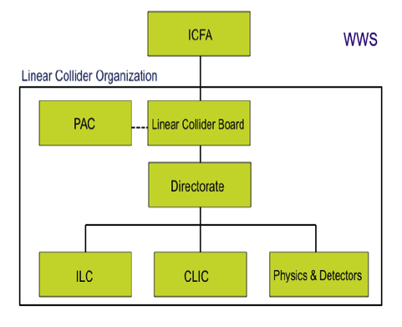
Transition to the Next ILC Organization
Linear Collider Collaboration (LCC)
Nex
Present
LCB: Chair:
- S. Komamiya
ILCSC
LCD: Director:
- L. Evans
Deputy:
- H. Murayama
CERN
CLIC
ILC-GDE
accelerator
iLC R/D
Phys/
Detetors
Director: M. Harrison
Role: Actions for the ILC Realization
・Detailed engineering design
・Further R&D for cost effective construction
Notes:
23

Slide 24
Acknowledgements
Many thanks for everybody
  who has been involved in the global cooperation for the ILC GDE SCRF and MT design and R&D works during ILC Technical Design Phase since 2007.
We wish our further process
  to be successful to realize the ILC in our near future, under supervision by the new ILC organization, LCC, LCB, and LCD.

