Slide 1
AWG1 (Injector) Summary
Steffen Döbert, Wei Gai, Masao Kuriki

Slide 2


Working Group Summary
3 presentations for electron source
13 presentations for positron source
1 presentation for polarization in physics
Posipol 2014 (ILC-CLIC e+ study group) meeting will be held in Morioka.

Slide 3
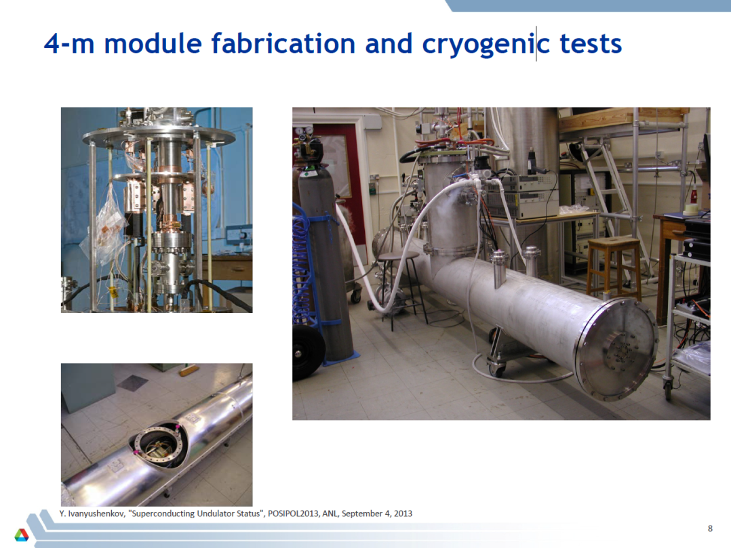
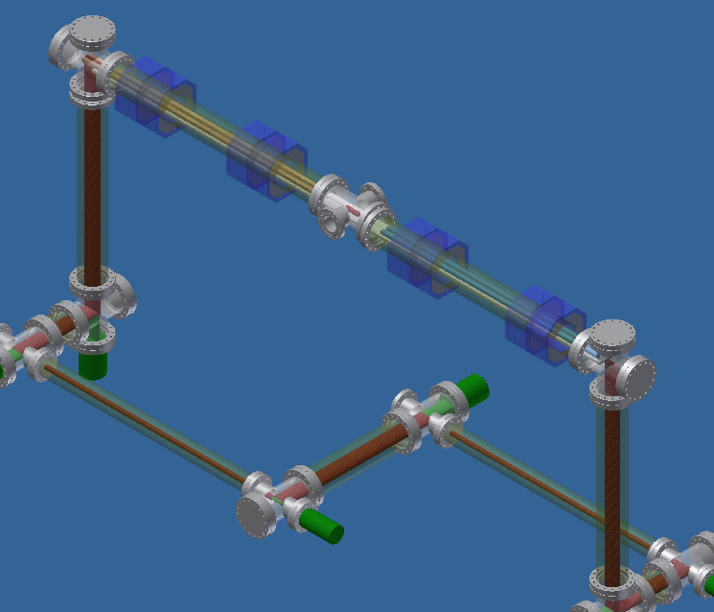
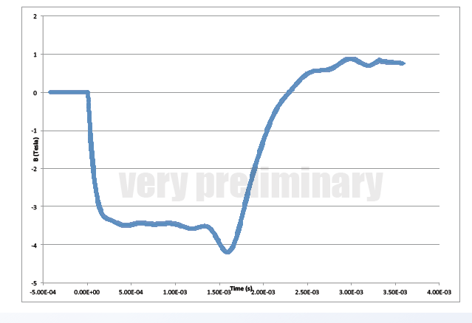
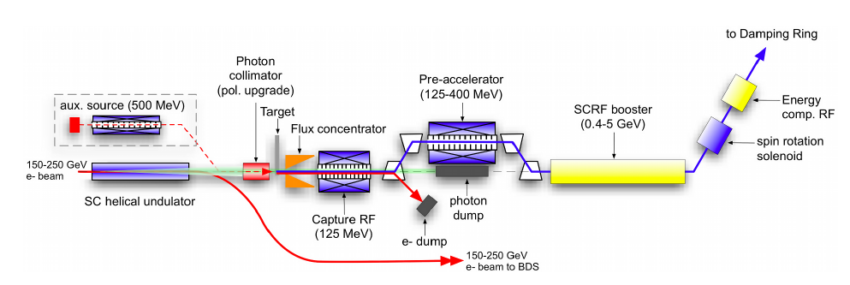
Undulator e+ source (baseline) W. Gai
Flux concentrator R&D J. Gronberg
Flux concentrator
1ms pulse!
Bullet target

Slide 4
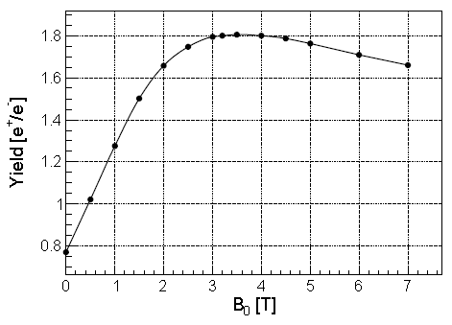
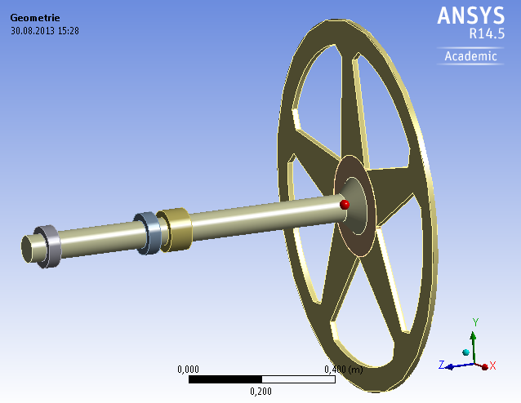

Undulator Source at ILC1 (120GeV) A. Ushakov
Heat load, stress and reaction force studies of target F. Staufenbiel
Less yield at ILC1 can be recovered by
  147 - > 231m undulator
  Optimze capture parameters.
No 10 Hz operation is needed.
Beam
fatigue limit
reaction
$$CMS$$
Reaction force

Slide 5
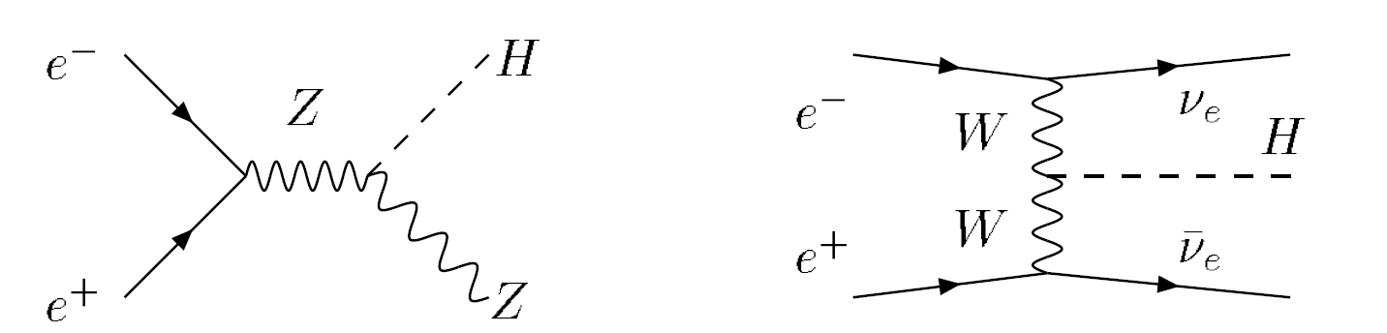
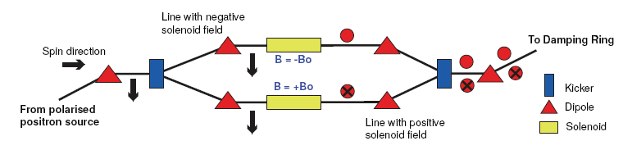
Polarized positrons at low energies S. Riemann
e⁺_{R} e⁻_{L}
e⁺_{L} e⁻_{R}
e⁺_{L} e⁻_{L}
e⁺_{R} e⁻_{R}
→ ZH
ZH
ZH
ZH
f_{i}
Best flexibility with polarized e+ and polarized e- beam
e⁺_{i}
?
i,j = L,R
e⁻_{j}
f_{j}

Slide 6
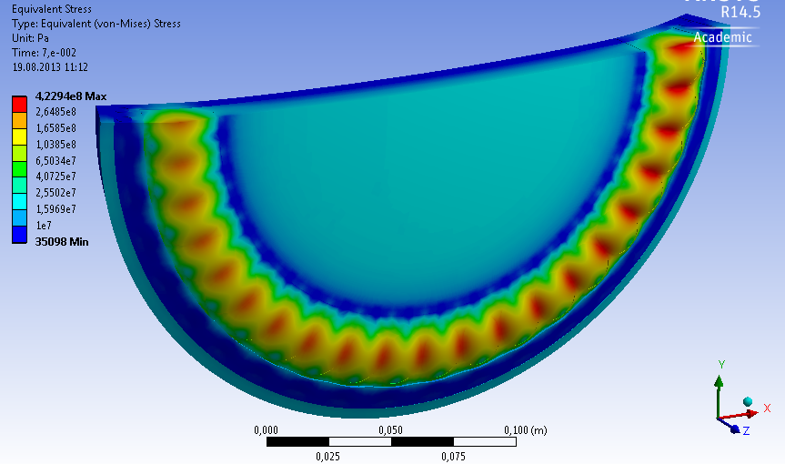
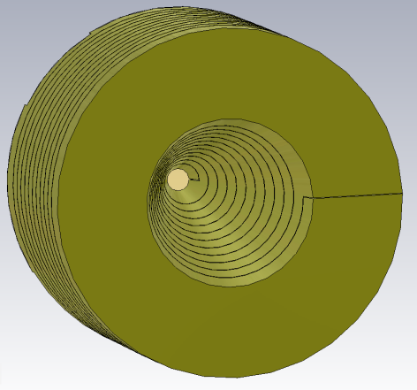
300Hz Conventional e+ Source: T. Omori
Flux Concentrator for Super-KEKB T. Kamitani
e+ creation
go to main linac
1ms pulse, 5Hz
20 triplets, 300Hz in 60ms
Drive Linac
6 GeV NC
Booster Linac
5 GeV NC
DR
5m/s W Target
T_{b_to_b} = 6.15 n sec
Super-B
AMD
2640 bunches
60 mini-trains
Applicable to ILC
Notes:
6

Slide 7
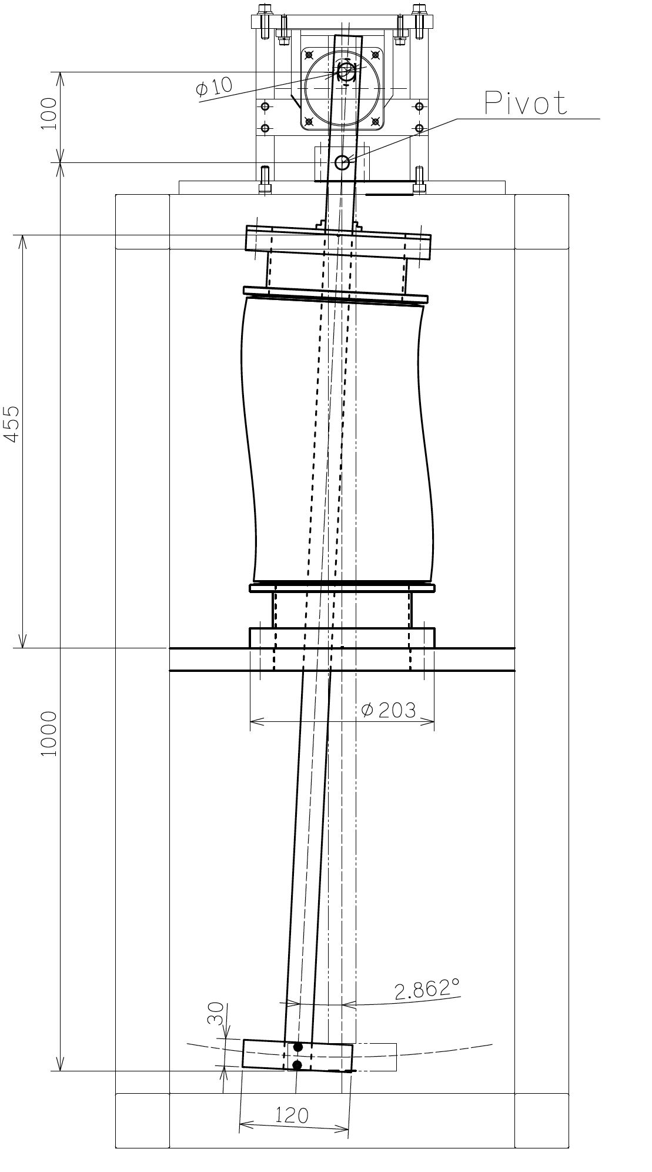
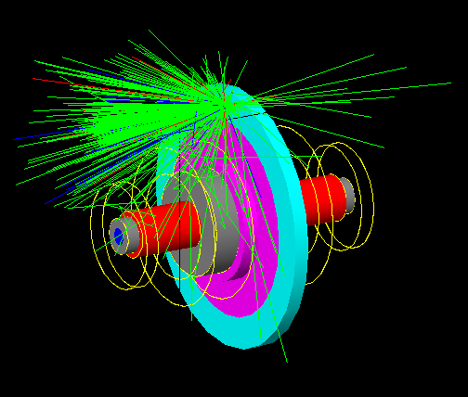
Target R&D T. Omori
Rad. Dose at Fluid seal T. Takahashi
Prototype will be delivered soon.
air
bellows seal
ferromagnetic
fluid seal
vacuum
air
vacuum
  280MGy/year at peak
  120MGy/year average
  Irradiation test will be
  made at JAEA Takasaki.
First step prototype fabricated

Slide 8
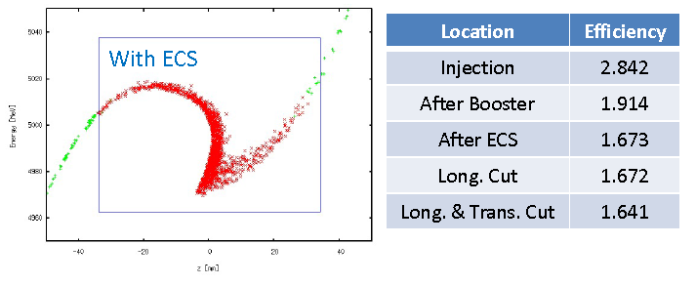
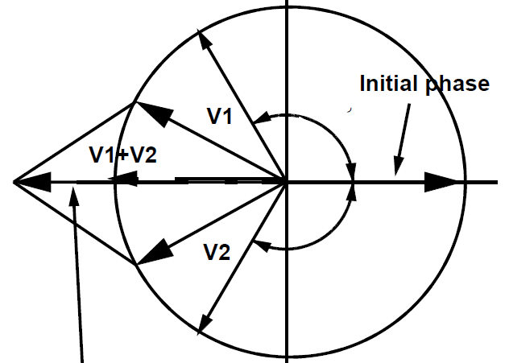
E+ Capture Optimization T. Okugi
Beam loading comp. for 300Hz e+ gen. J. Urakawa
40MV/m Acc.
2.0T Solenoid
Reproduce a similar result with more conventional parameters is desirable.
e+/e- > 1.5
80MW Klystrons
Low Level RF
Phase Shifter
and Amp.

Slide 9
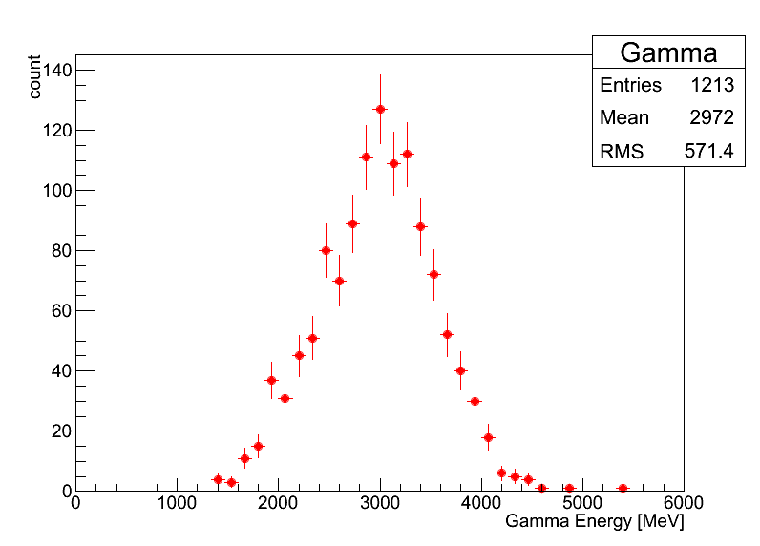
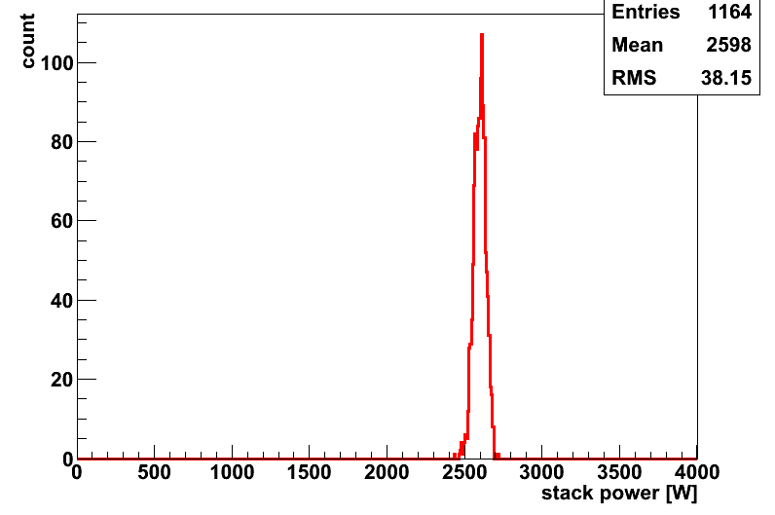
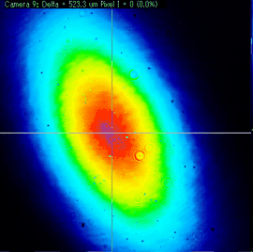
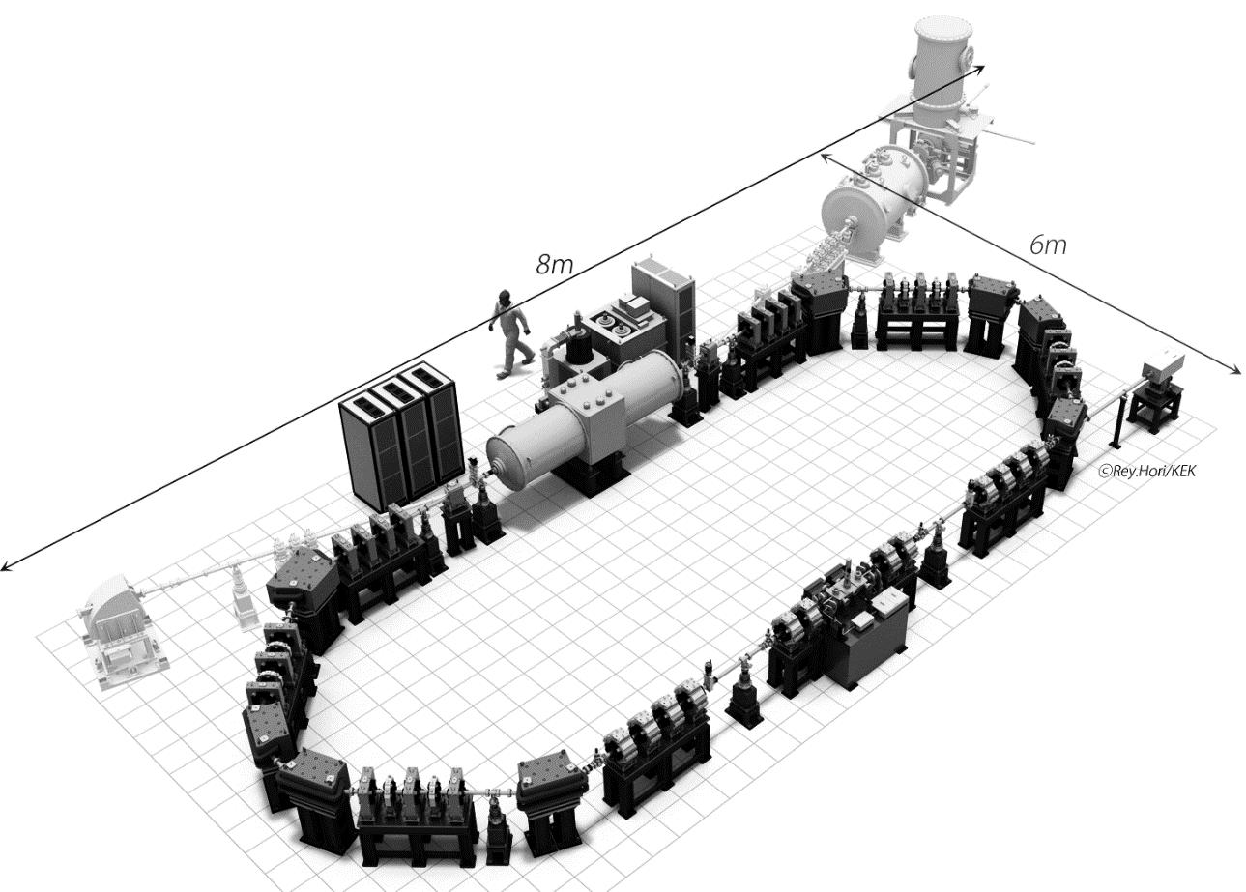
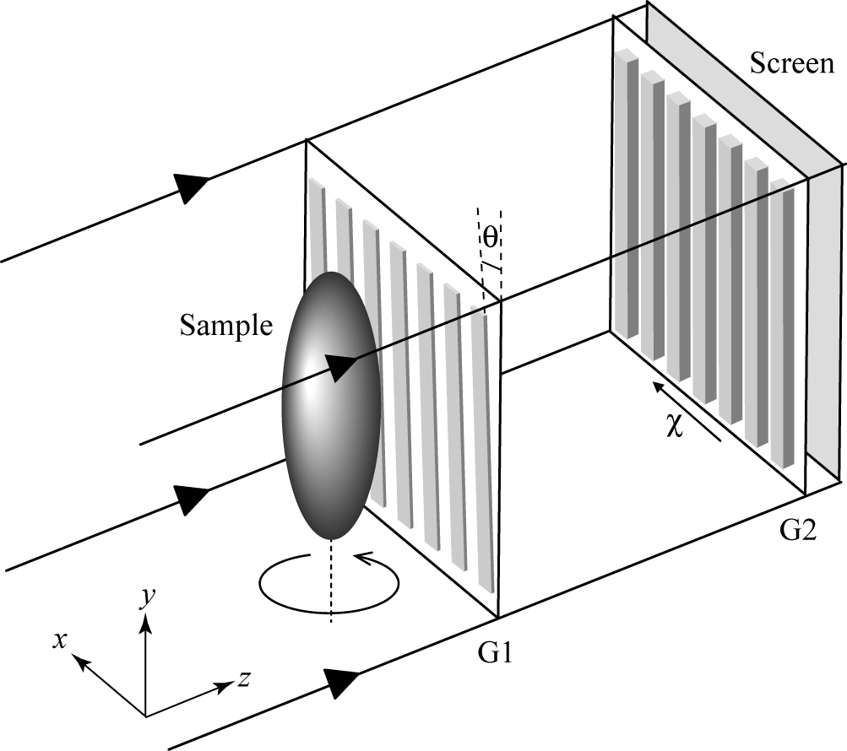
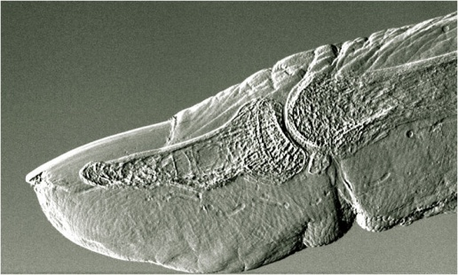
Laser Compton Exp. At ATF T. Takahashi
New Quantum Beam project J. Urakawa
ATF ~2.6×10⁸/sec
Achieved ΔL<<8pm
Stored Power [w]

Slide 10
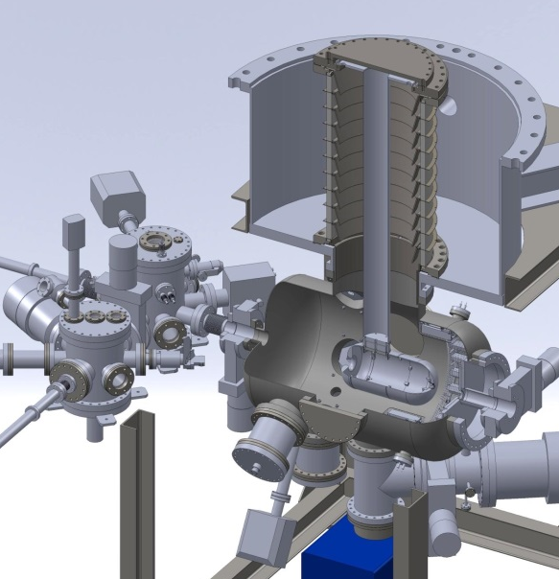
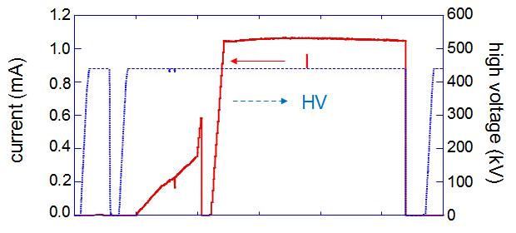
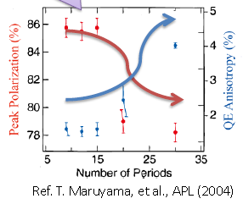
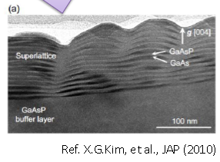
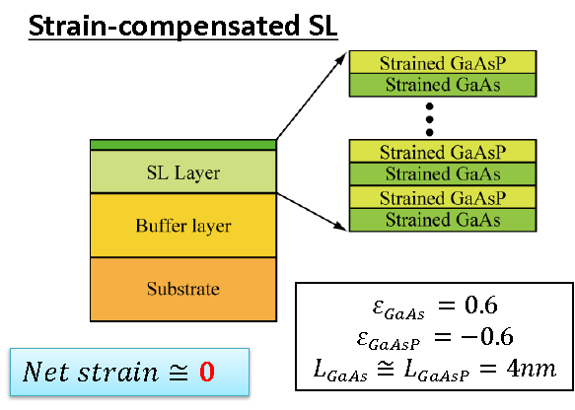
500kV DC gun for ILC M. Kuriki
Strain Compensated Super-lattice GaAs cathode N. Yamamoto
Demonstration
500kV, 10mA
Cathode emission current should be improved.
By controlling zero
net strain, high QE and High polarization is possible!

Slide 11
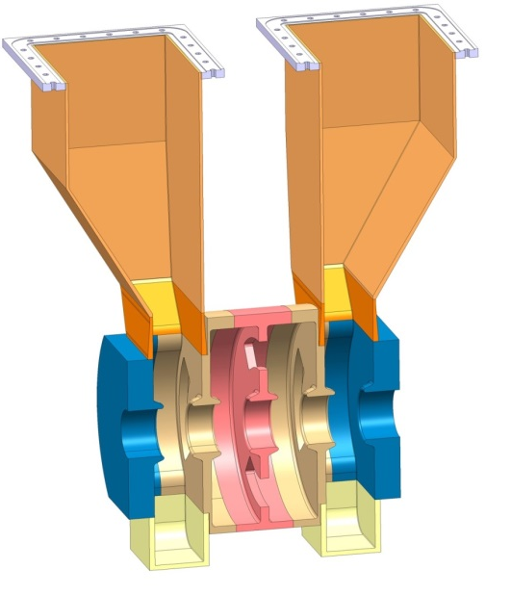
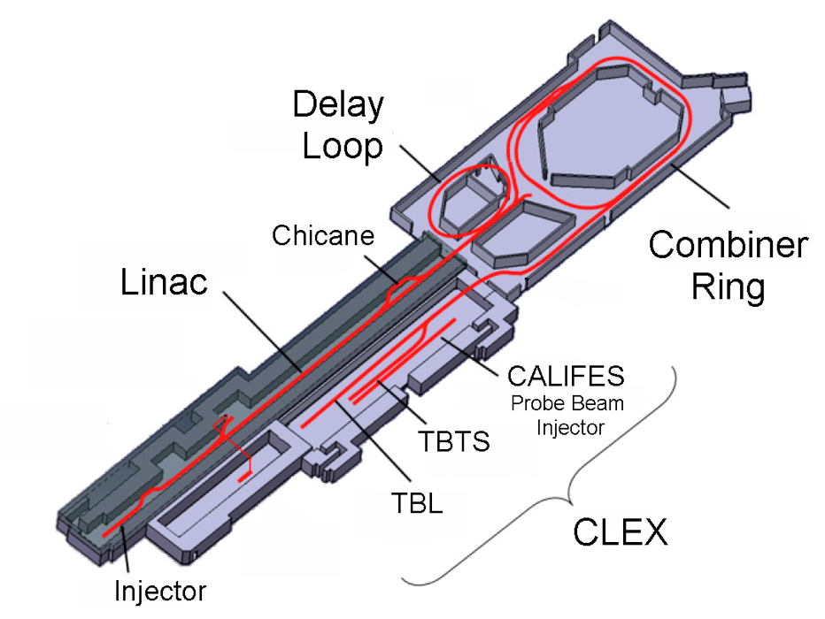
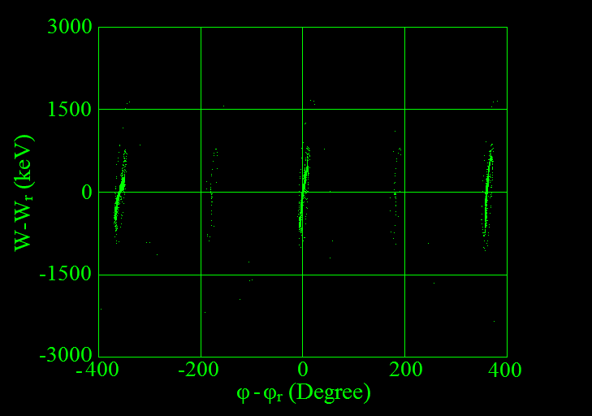
Drive Beam injector developments S. Döbert
Drive Beam Accelerator
efficient acceleration in fully loaded linac
Delay Loop × 2
gap creation, pulse compression & frequency multiplication
RF Transverse Deflectors
Combiner Ring × 3
pulse compression &
frequency multiplication
Combiner Ring × 4
pulse compression &
frequency multiplication
CLIC RF POWER SOURCE LAYOUT
Drive Beam Decelerator Section (2 × 24 in total)
Power Extraction

Slide 12
Discussion
Electron source
  The gun system development is desirable.
Undulator :
  Technical demonstration of e+ production target with an enough level is mandate.
  Mechanical engineering design of the undulator should be made.
300Hz e- driven:
  Target prototype will be made soon.
  Irradiation test of magnetic fluid seal will be made.
  Super-B AMD is applicable for ILC.
  An integrated simulation for e+ capture is urgent.

Slide 13

Strategy
Undulator is our baseline. At least, the critical devices should be well established prior to the ground breaking.
An integrated design of 300Hz conventional scheme should be completed urgently.
These two schemes have to be compatible from the CFS point of view. The foot prints should be same.
At some point, we will asses these schemes from the project point of view.
After that, we will concentrate on a single scheme.

Slide 14

No positron , No collision!
  We expect a good management to realize the collision.

