Slide 1



Toward Higher Gradient and Q₀
Rong-Li Geng

Slide 2
Outline
Why higher gradient and Q0 R&D
Challenges faced
Current activities
Outlook

Slide 3
Why higher gradient and Q0 R&D
Enable ILC 1 TeV energy upgrade
Enable higher luminosity within cryogenic limit
Enable reliable and repeatable cavity fabrication
Preserve cavity gradient and Q0
➔ Performance
➔ Cost
➔ Operation performance

Slide 4
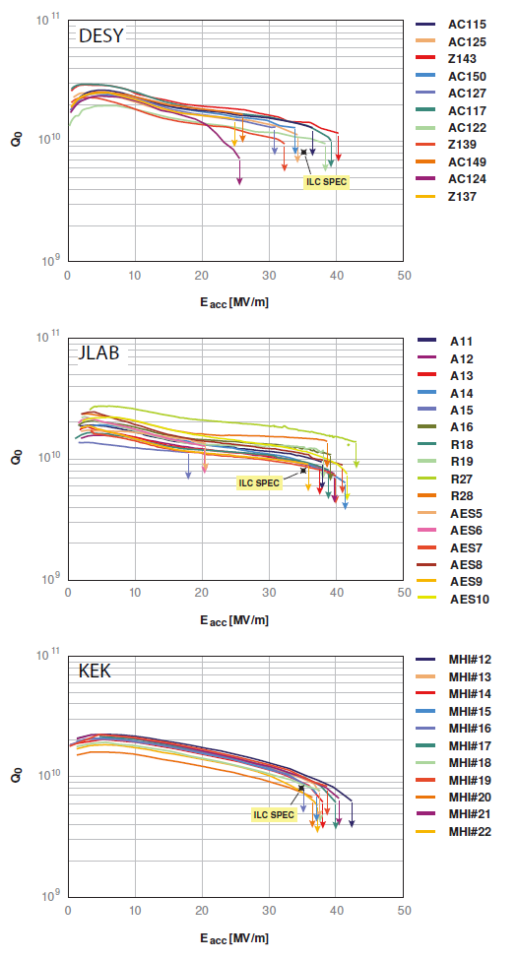
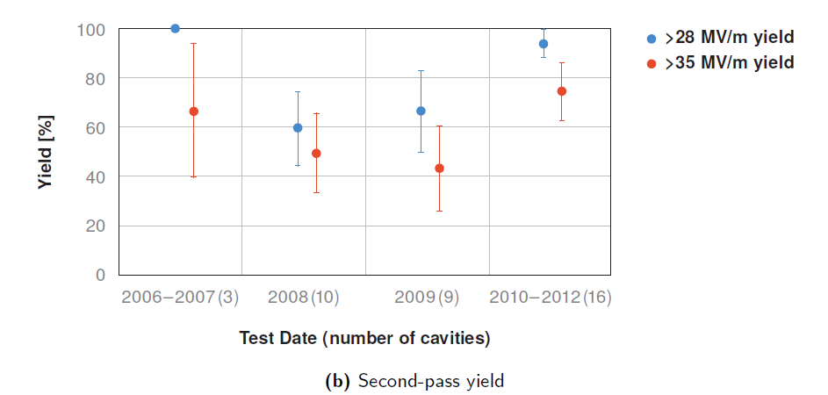
ILC Cavity Gradient R&D under GDE
Reliable cavity processing – clearly demonstrated
Second-pass processing – clearly defined
ILC S0 Program (2006-2012):
Average Gradient: 37 MV/m
The International Linear Collider Technical Design Report,
ISBN 978-3-935702-77-5 (2013).

Slide 5
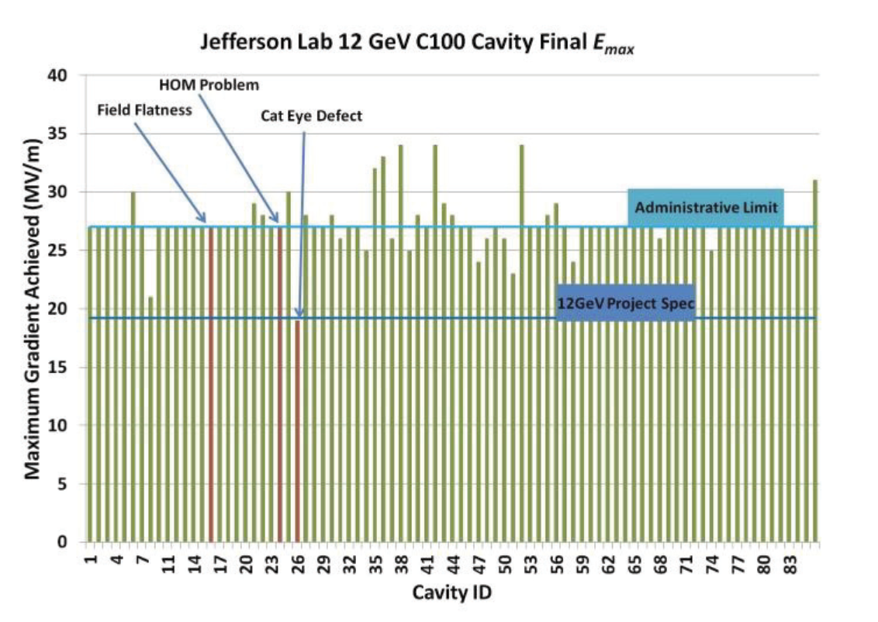
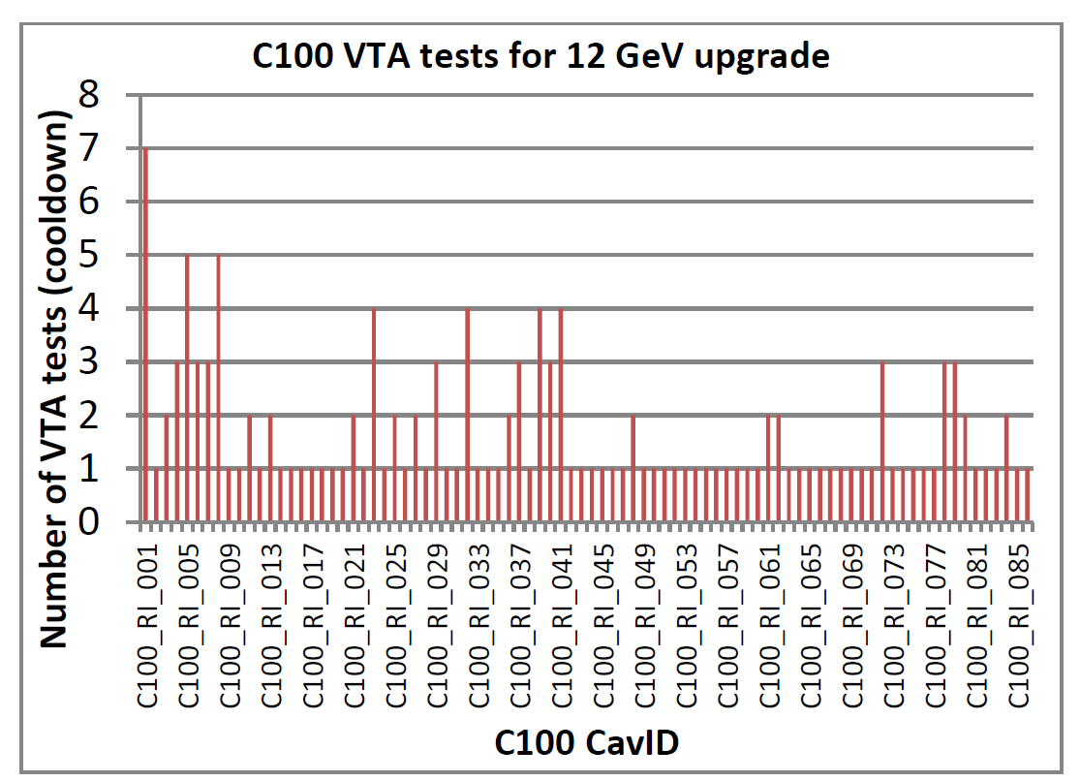
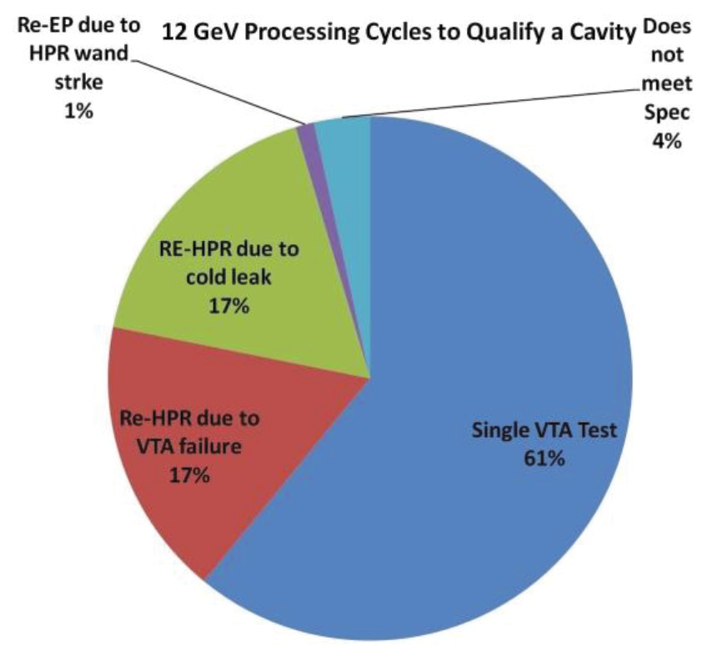
ILC-style Processing Applied to Project
JLab 86 7-cell Low-loss shape 1.5GHz cavities
Bulk BCP + “ILC style” final cavity processing: EP + bake
80 cavities installed in 10 cryomodules
All modules now in CEBAF tunnel
Operation with beam Jan 2014
Reliable EP
second-pass processing
Hogan et al., NA-PAC2013
Burrill et al., IPAC2012

Slide 6
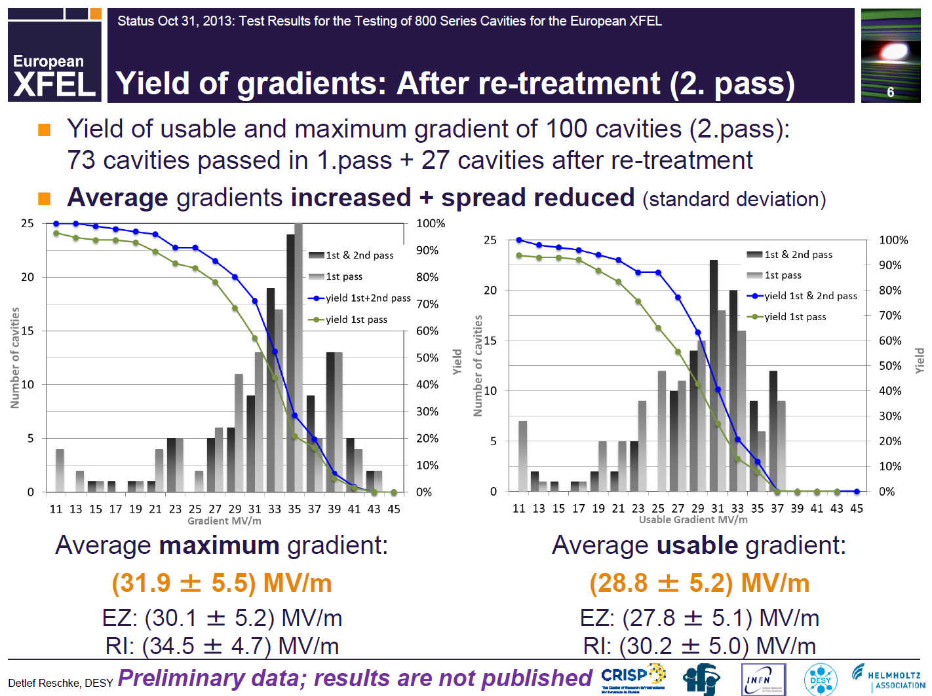
ILC-style Processing Applied to Project
Industrial fab. and proc., first 100+ cavities:
2nd-pass processing
Avg gradient 35 MV/m by one vendor already
Reschke, Presented at the 2nd LCC ILC Cavity Group Meeting, Nov. 6, 2013

Slide 7
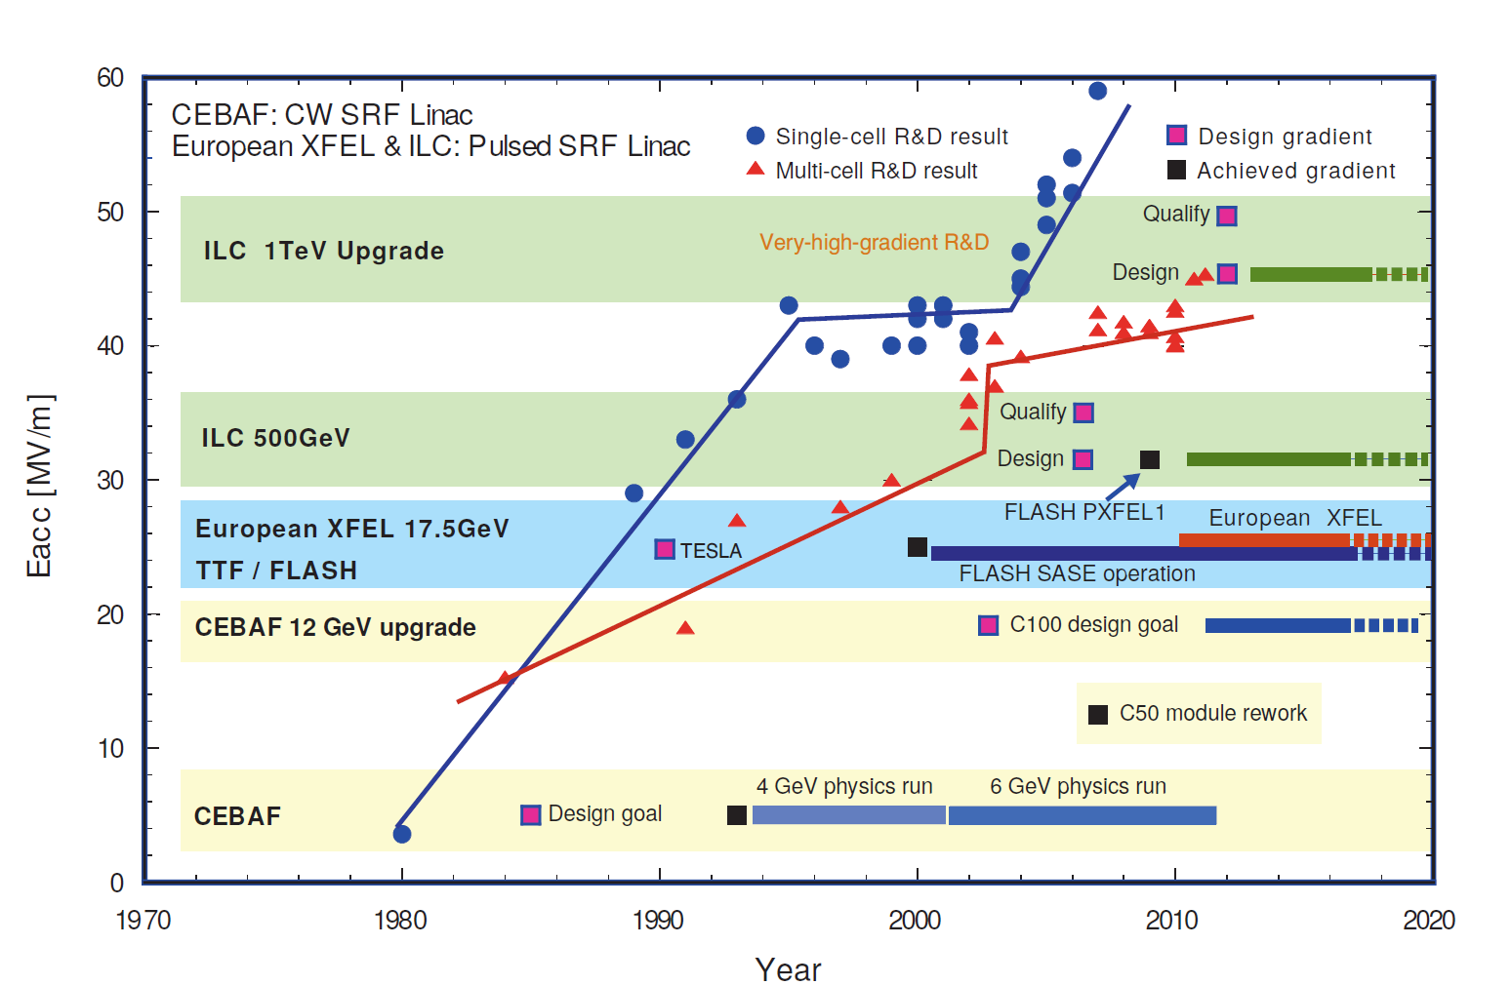
What is next?

Slide 8
Challenges faced
Field emission
Scatter in quench limit
Ultimate gradient limit
Q-drop
HOM coupler limit
Lorentz force detuning limit

Slide 9
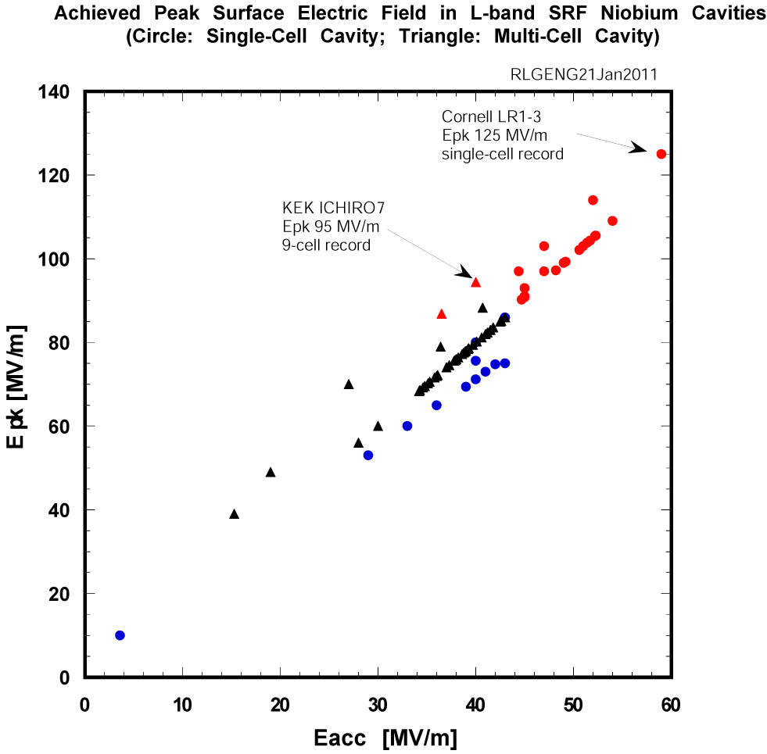

Field Emission Understanding and Control
Intensive R&D in past years resulted in reduced field emission
  Post-EP cleaning
  No longer a main limit for vertical test
But still not under complete control
  Causes additional cryo loss
  Risk increases rapidly with peak surface electric field due to exponential nature of the process
Critical issue for accelerator operation
  Dark current
  Radiation damage to electronics
  Beam line activation from neutron
For ILC operation Epk avg 63 MV/m and up to 76 MV/m
  For XFEL, Epk 47 MV/m
  For CEBAF upgrade, Epk 42 MV/m
ILC 1 TeV
ILC 500 GeV
XFEL
CEBAF 12 GeV
CEBAF 4 GeV

Slide 10
Field Emission R&D Goals
Near term goal: Reduce field emission reliably up to a surface electric field of 80 MV/m in 9-cell cavity so as to insure operation of cryomodules at average gradient of 31.5 MV/m with acceptable field emission induced cryogenic loss and field emission induced radiation dose
  (Cryogenic loss due to FE) / (Cryogenic loss due to dynamic + static heat) per cryomodule < 10%
  Dark current per cavity < 50 nA
Long term goal: Push the field emission onset gradient reliably beyond Epk = 50 MV/m in 9-cell cavities; Demonstrate Epk = 100-120 MV/m in 9-cell cavities
  Requires deeper fundamental understanding of FE phenomenon
  Requires advanced surface processing

Slide 11
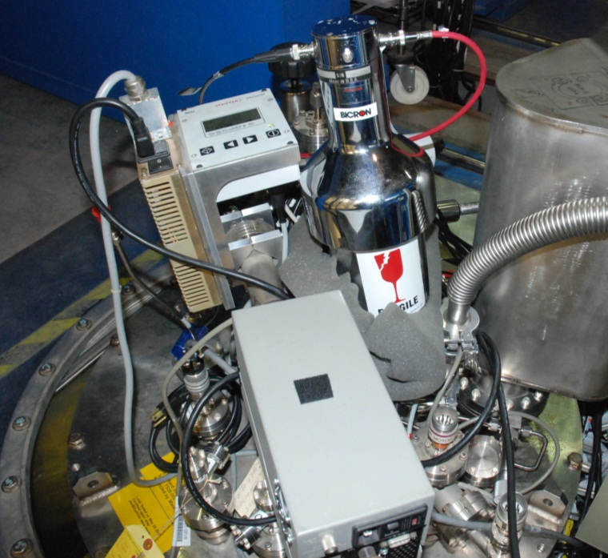
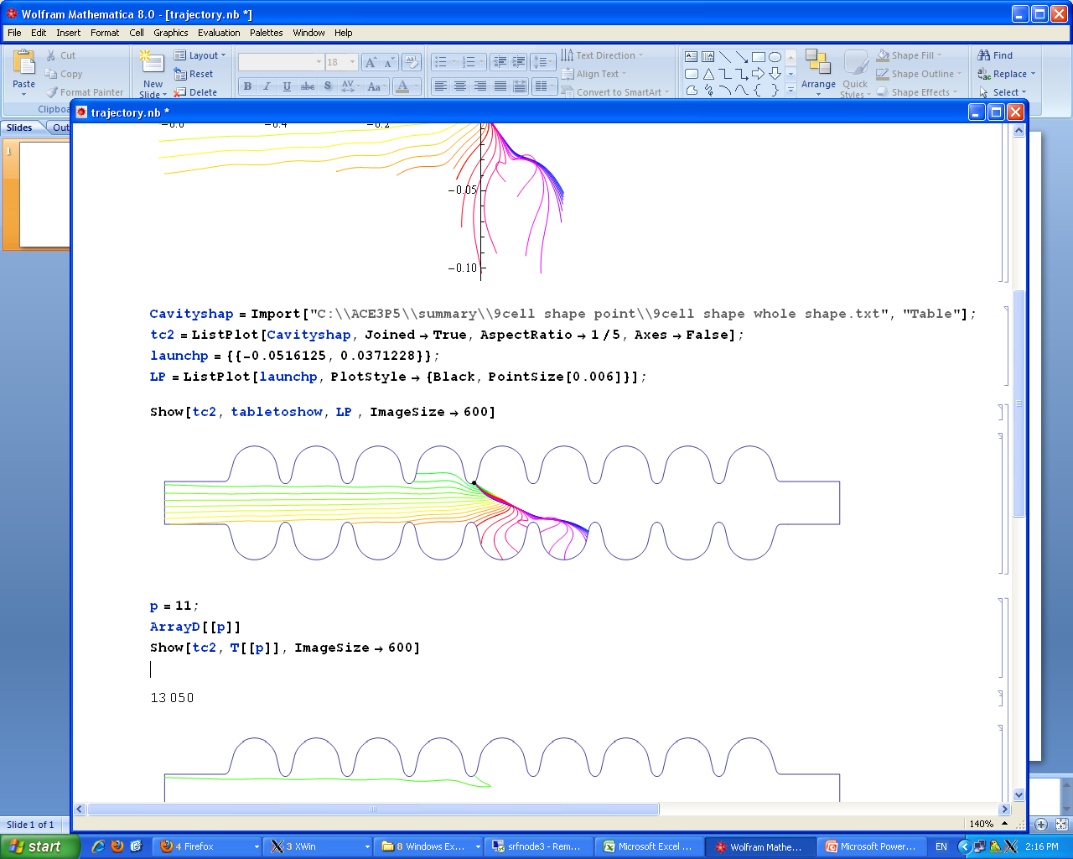
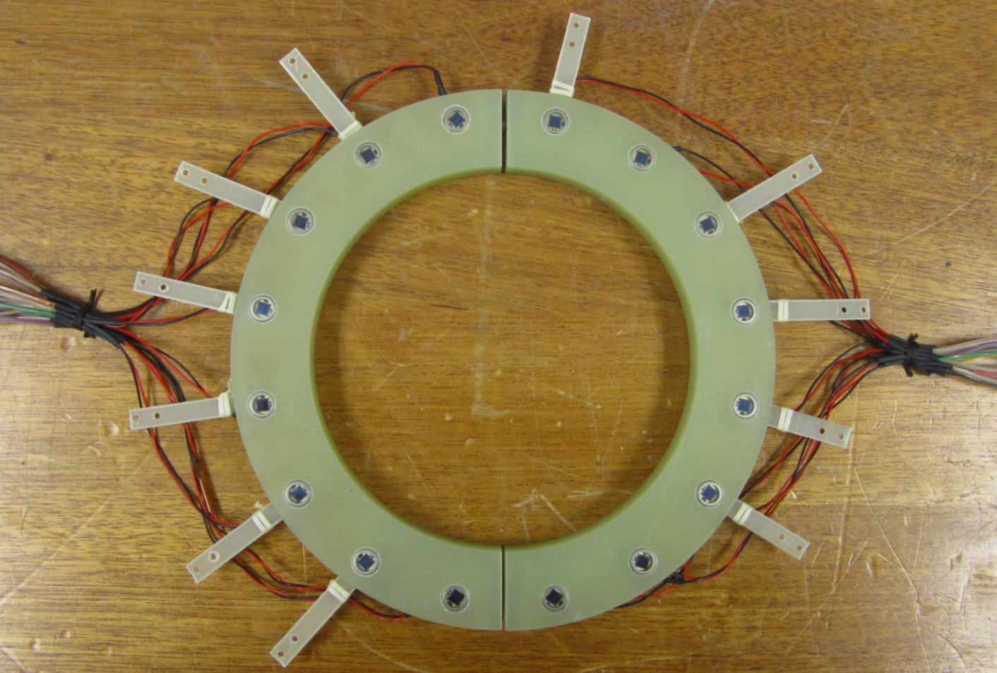
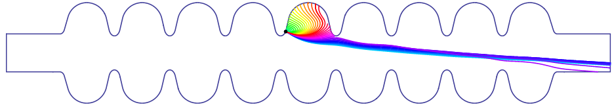
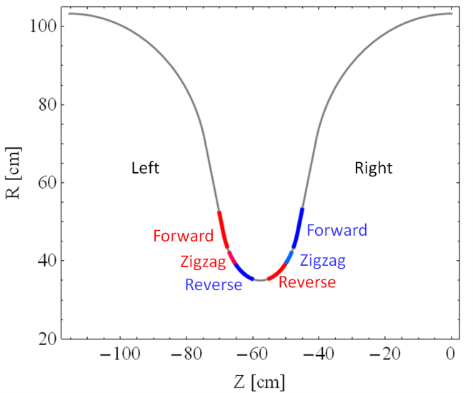
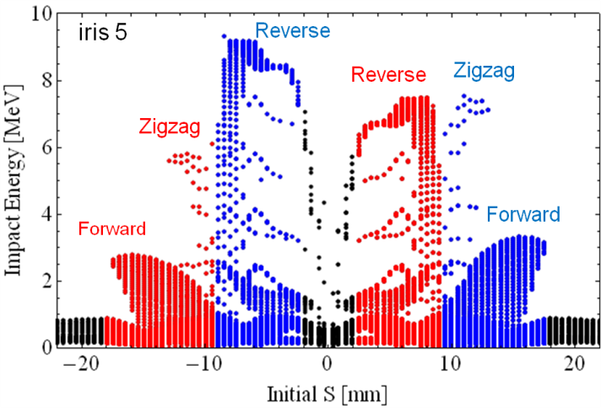
Locating Field Emitter in 9-cell Cavity
Emission in region
>>> “Reverse type”
Emission in region >>> “Zigzag type”
Emission in region >>> “Forward type”
IR5
Impact position VS impact energy distribution

Slide 12
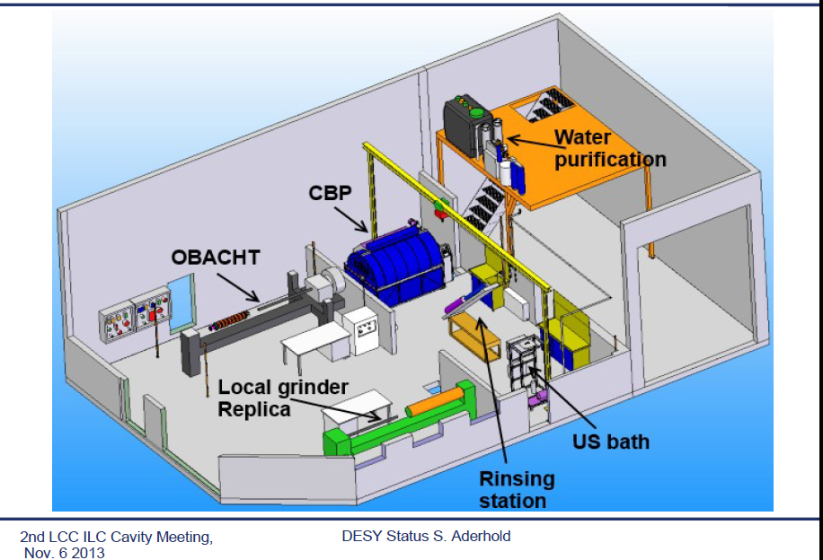
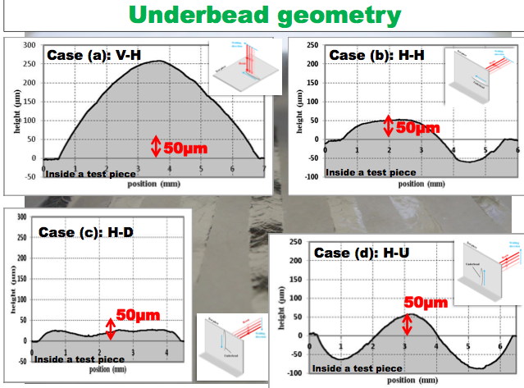
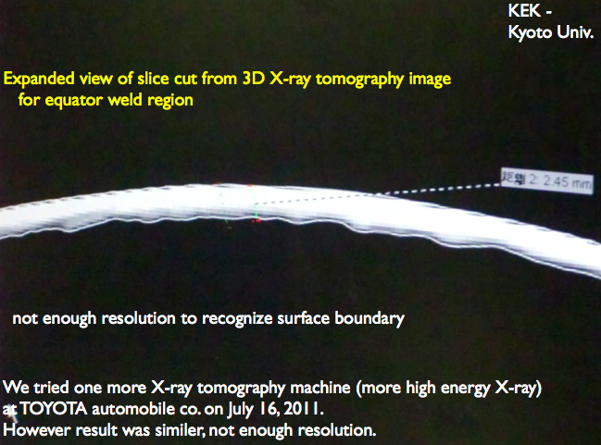
Understand and reduce gradient scatter
Natural defect studies
at DESY ILC HiGrade Lab
EBW parameter systematic optimization
at KEK
Kubo
➔
EBW x-ray imaging for studies of
Welding porosity at Kyoto University.
Welding porosity studies at JLab with controlled varied welding conditions.
Iwashita

Slide 13
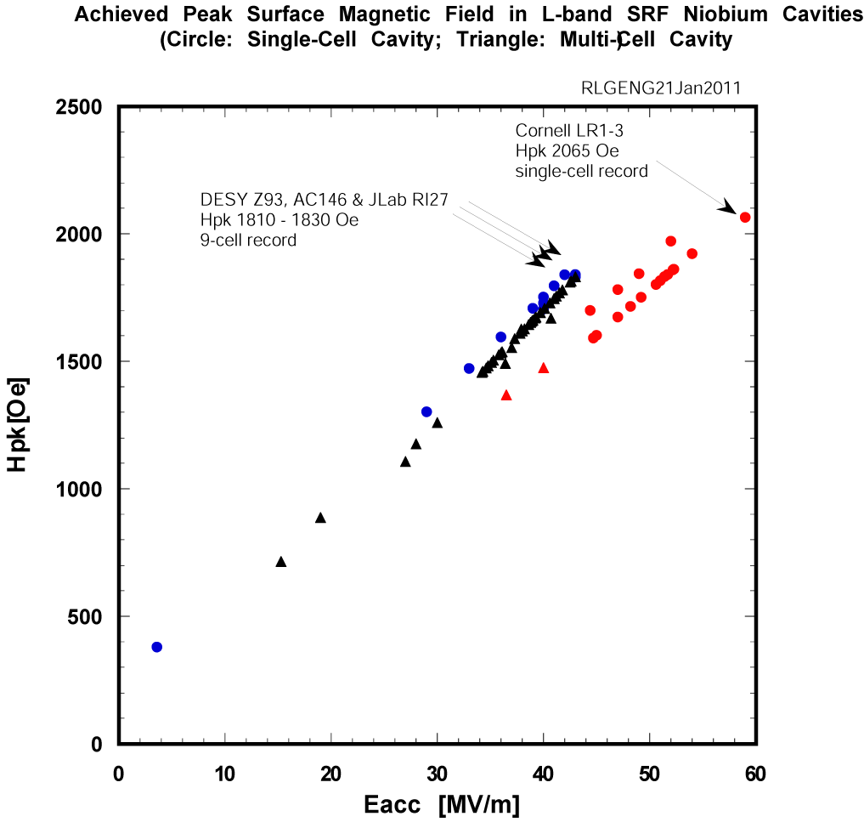
Ultimate Gradient (Nb)
DESY AC155, AC158
Hpk 1910-1950 Oe
New 9-cell record
Recent cavity results established that a peak surface magnetic field of 190-200 mT is possible and practical
45 MV/m in TTF shape means effectively > 50 MV/m in Re-entrant, low-loss or ICHIRO, and Low-Surface-Field shape cavities
In fact, this is already shown in many 1-cell cavities
ILC 1 TeV
ILC 500 GeV
XFEL
CEBAF 12 GeV
CEBAF 4 GeV

Slide 14
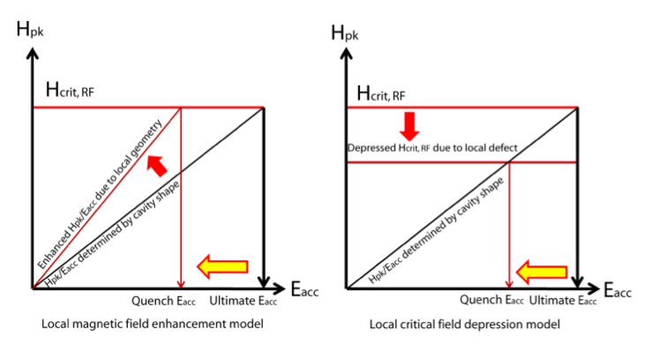
High Gradient via New Shapes
Ratio of Hpk/Eacc solely determined by shape
Lowering Hpk/Eacc for higher gradient up to critical RF magnetic field (material property)
Three cavity shapes under evaluation
  Low-loss (KEK, JLab, IHEP)
  Re-entrant (Cornell)
  Low-Surface-Field (JLab/SLAC)
Baseline shape
New shape

Slide 15
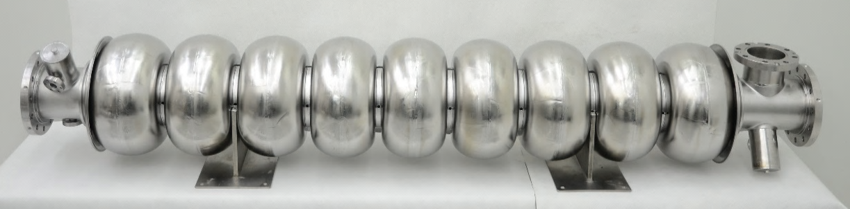
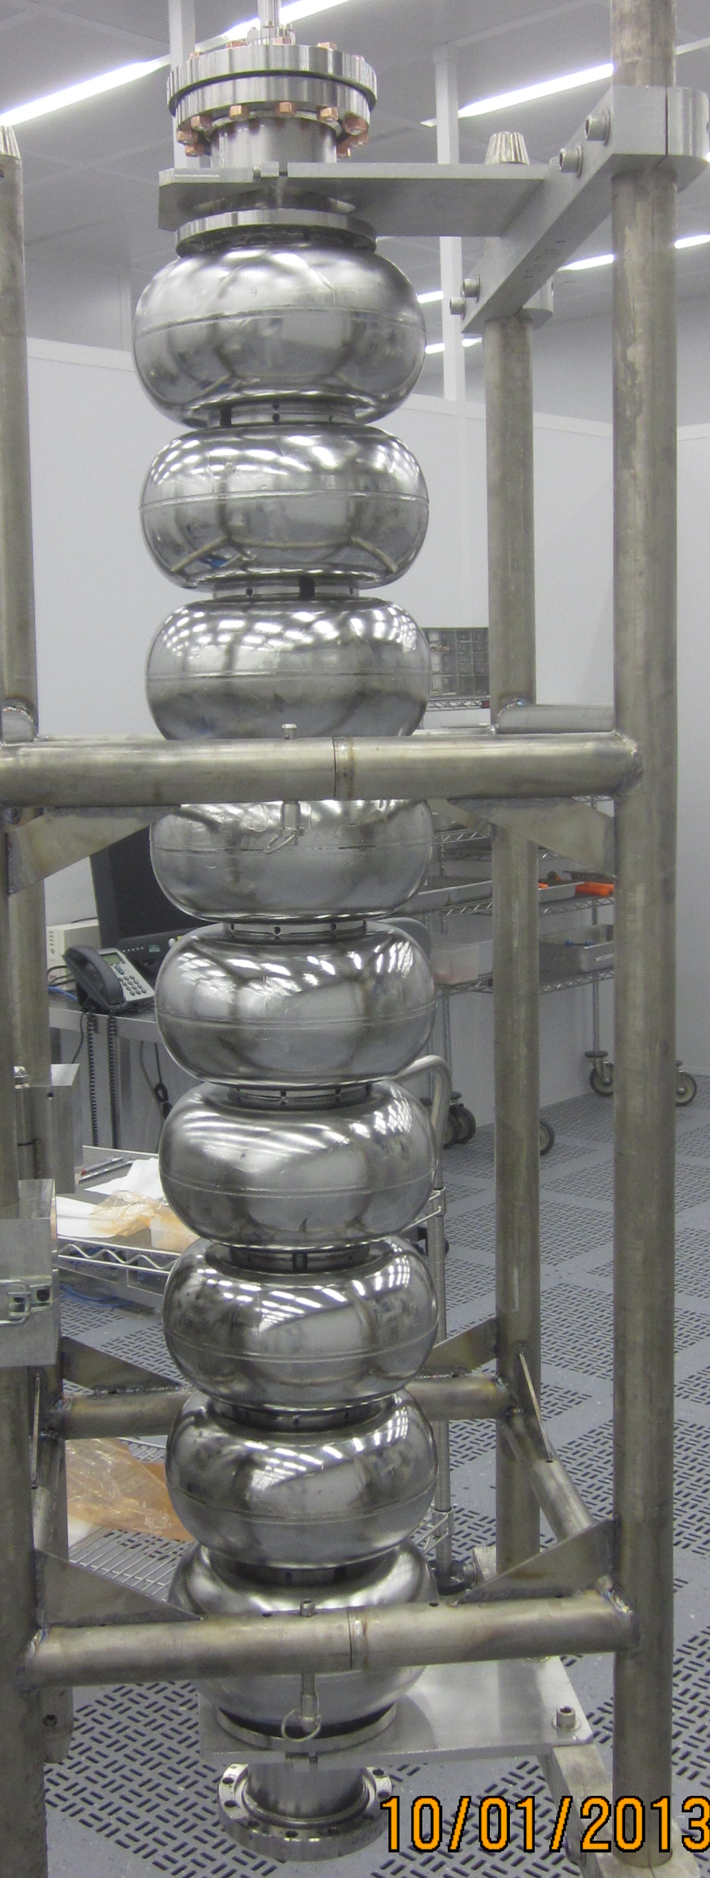
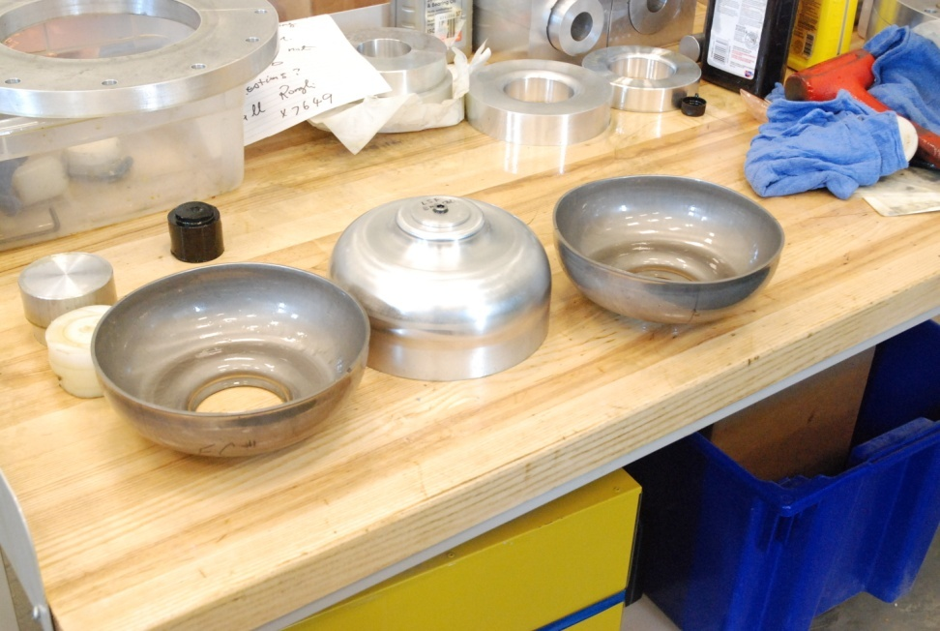
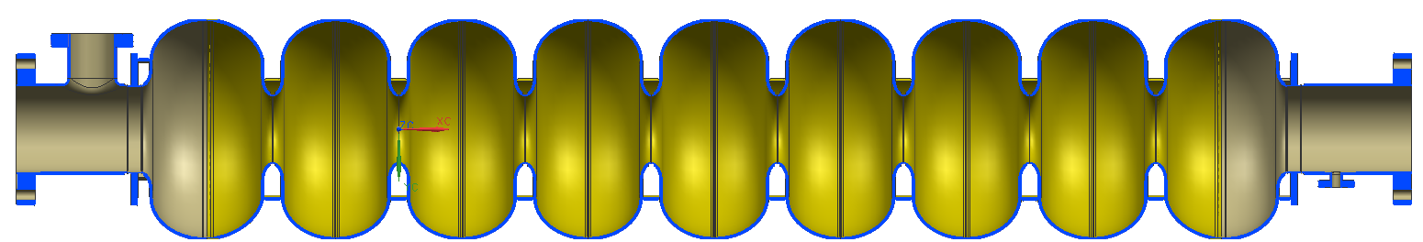
New Cavities of Improved Shapes
IHEP low-loss shape
LSF shape prototype at JLab
JLab Ichiro shape
2 each under testing

Slide 16
High Gradient via Materials
Ultimate gradient limit set by RF critical magnetic field
  Nb, 240 mT predicted by superheating theory
    Ultimate gradient 60 MV/m
    ~210 mT (~90% theoretical limit) achieved
      One 1-cell 1.3 GHz re-entrant cavity (R.L. Geng et al., PAC2007)
      One 2-cell 1.3 GHz cavity (K. Watanabe et al., KEK cERL, 2012)
    195 mT (~80% theoretical limit) achieved
      One 9-cell 1.3 GHz TTF-shape large grain cavity (D. Reschke et al., SRF2011)
  Nb3Sn, 400 mT predicted by superheating theory
    Ultimate gradient 100 MV/m
    Vapor diffusion
      Was investigated 20 years ago
      New efforts restarted at Cornell
        New test result of 1-cell cavity show new progress (next slides)

Slide 17
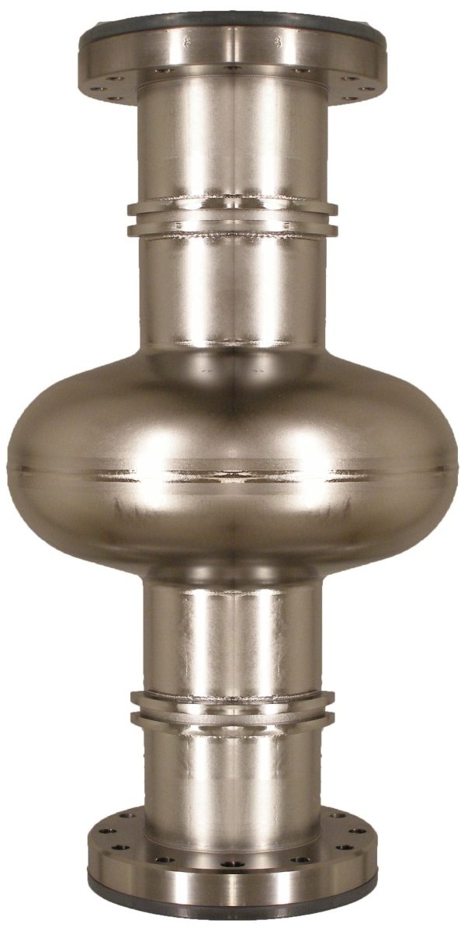
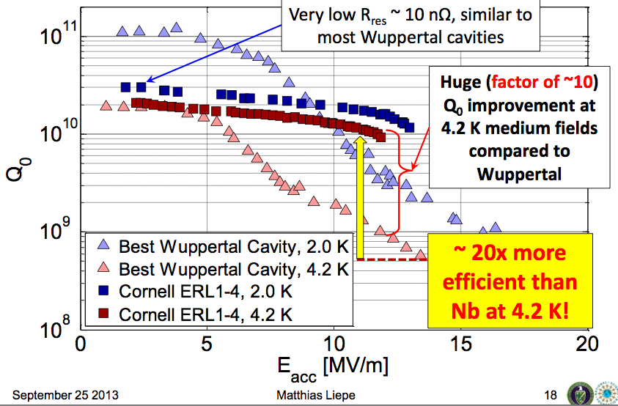
Posen

Slide 18
High Gradient via Multi-Layer
Theory by Gurevich, APL 88, 012511(2006)
Potential for magnetic limit 500-1000 mT
  Ultimate gradient up to 200 MV/m
Insulating layer nm thick
Thin film coated cavities
Higher-T_{c}SC: NbN, Nb₃Sn, etc
Coating techniques
  Several paths being explored at ANL (ALD), CERN (sputtering, HIPIMS), JLAB (ECR, CVD), LBNL (HIPIMS)
Requires RF evaluation of samples at low temperature
  Several apparatus being developed at CERN (Quadrupole resonator), Cornell (TE cavity), JLAB (SIC cavity)
Nb
Insulating
layers

Slide 19
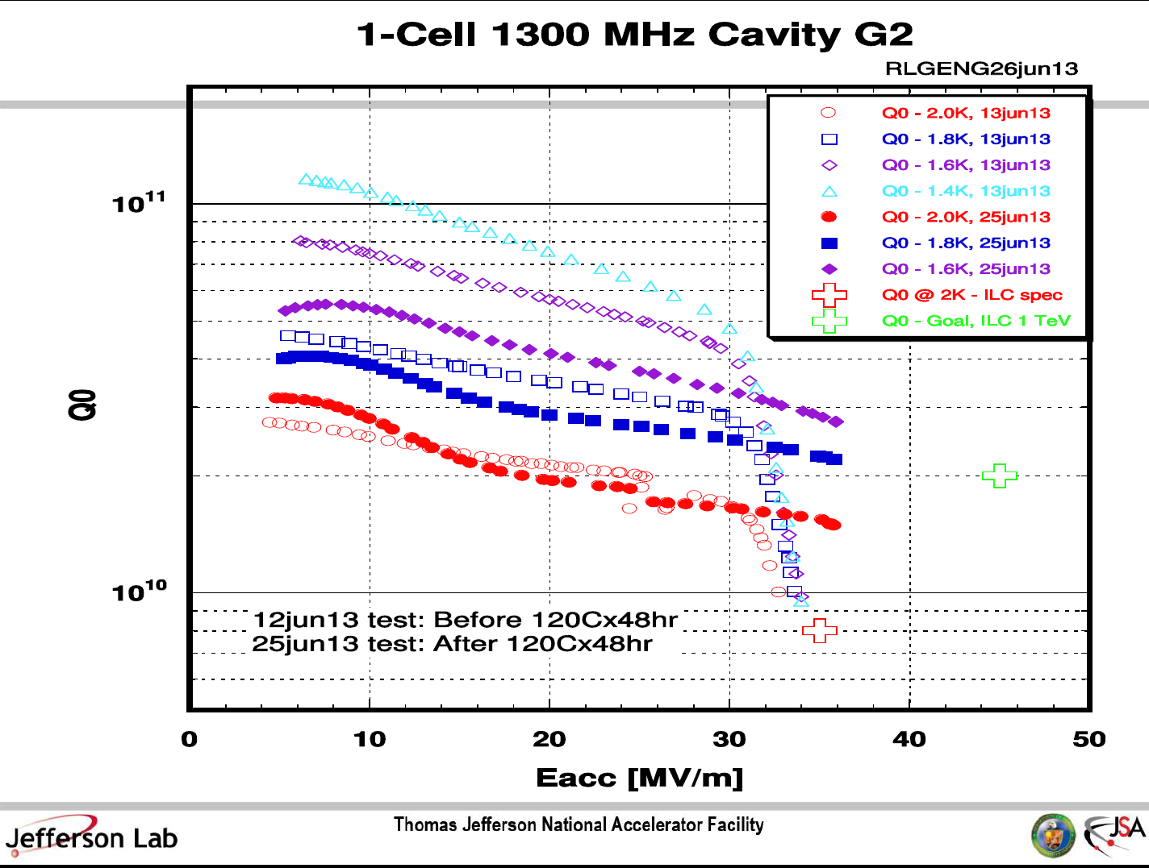
Q-drop
origin of Q-drop?
frozen flux effect
material studies

Slide 20
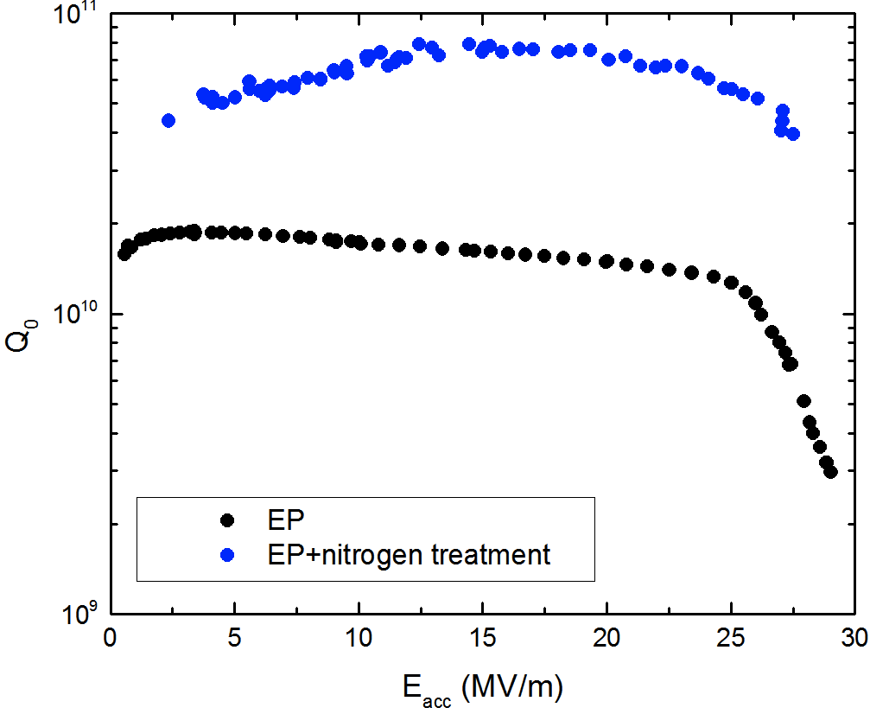
Anti-Q0slope due to Nitrogen Doping
Factor of 4 higher
~ 4e10 at 28 MV/m!
1.3 GHz, 2K
Grassellino

Slide 21
W. Singer for DESY data

Slide 22
W. Singer for DESY data

Slide 23
Outlook
Many compelling questions remain toward higher gradient and Q0.
ILC continues to drive SRF frontier R&D and generate benefits to other SRF projects.
Key infrastructures already in place at many lab due to GDE led effort – time to fully profit from these investments.
Close collaboration in is key. This was very true in GDE era and more critical in LCC era due to resource limit.

