Slide 1
Cu-plating R&D at CERN-DESY
L. Ferreira, 08.11.2013
1

Slide 2
Cu-plating R&D at CERN-DESY
Electroplating on Stainless Steel
Stainless Steels are self passivating Iron alloys and direct plating
gives poor or non adhesion of plated metals if care is not taken in
the choice of baths and preparation procedures.
In vacuum applications, 316LN is commonly used for the assembly
of parts. Typical composition:
Cr = 16-18.5%
Mn max. = 2%
Ni = 12-14%
P max. = 0.045%
Mo = 2-3%
S max. = 0.030%
C max. = 0.03%
N = 0.14-0.20%
Si max. = 1.0%
Fe = remainder
Primary element for formation of passive film
Promotes repassivation
Promotes repassivation
In combination with Cr stabilises passive layer, even in presence of Cl.
Within certain conditions N reacts with residual B (0.0005 to 0.003%) to form BN. CERN trials shows that BN forms when B≥9 ppm and for heat treatments in the range 700°C to 1150°C
2

Slide 3
Cu-plating R&D at CERN-DESY
Electroplating on Stainless Steel
The most common path to electroplate on stainless steel is to use
very low pH baths to remove the passive layer and plate an interface
layer between stainless steel and the functional metal to be plated.
The most used baths to apply this strike layer are:
Au III complex,
Ni Wood,
and Cu, HCl based bath.
Expensive, specially if a large volume is to be prepared
Relatively low efficiency (~60%, H2 evolving)
Possible re-oxidation after strike plating
Even in these very low pH conditions and in presence of Cl ions, the BN film remains untouched. Within CERN experience, only an anodic etching (electropolishing) is capable of removing this layer and allow electroplating.
3

Slide 4
Cu-plating R&D at CERN-DESY
Agreement subject:
Measurement of RRR on Stainless Steel copper plated samples
(CERN procedure);
b) Feasibility study for copper plating on stainless steel
X-FEL couplers components (within CERN present know-how and installations);
c) Support to X-FEL industrial partners (tbc);
4

Slide 5
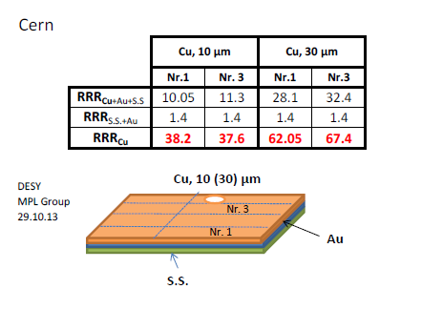
Cu-plating R&D at CERN-DESY
Present status:
Measurement of RRR on Stainless Steel copper plated samples
(CERN procedure);
RRR measurements made at DESY on CERN samples
5

Slide 6

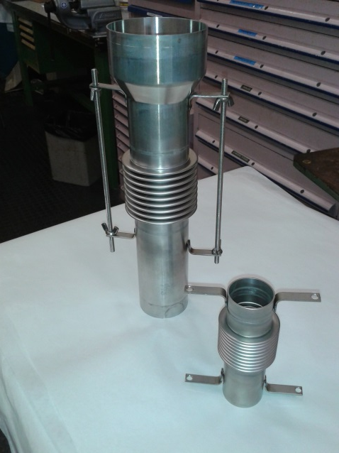
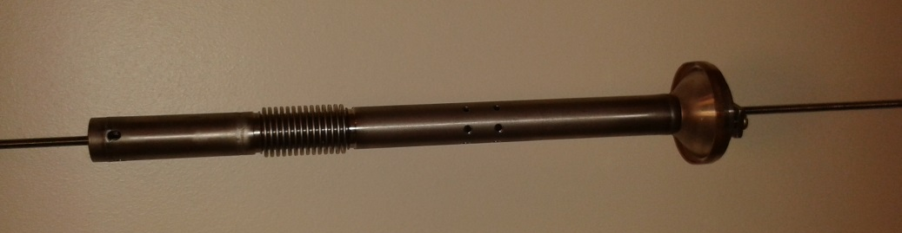
Cu-plating R&D at CERN-DESY
Present status:
Measurement of RRR on Stainless Steel copper plated samples
(CERN procedure);
b) Feasibility study for copper plating on stainless steel
X-FEL couplers components (within CERN present know-how and installations):
- Assembly of supports on mockup parts;
- First trial foreseen in Dec. 2013;
6

Slide 7
Cu-plating R&D at CERN-DESY
Present status:
Measurement of RRR on Stainless Steel copper plated samples
(CERN procedure);
b) Feasibility study for copper plating on stainless steel
X-FEL couplers components (within CERN present know-how and installations):
- Assembly of supports on mockup parts;
c) Support to X-FEL industrial partners;
- Check cleaning and plating procedures;
- Surface analysis on problematic flanges (peel-off);
7

