Slide 1
Status of R&D of
Optical Cvities at KEK-ATF
Tohru Takahashi
Hiroshima University
for
KEK, Hiroshima University
LAL (Orsay) in Collaboration withCELIA (Laser lab., Bordeaux) and LMA ( coatings Lab., Lyon)
Introduction
Status of the cavity R&D
Out Look
28 May 2013
ECFA2013 DESY

Slide 2
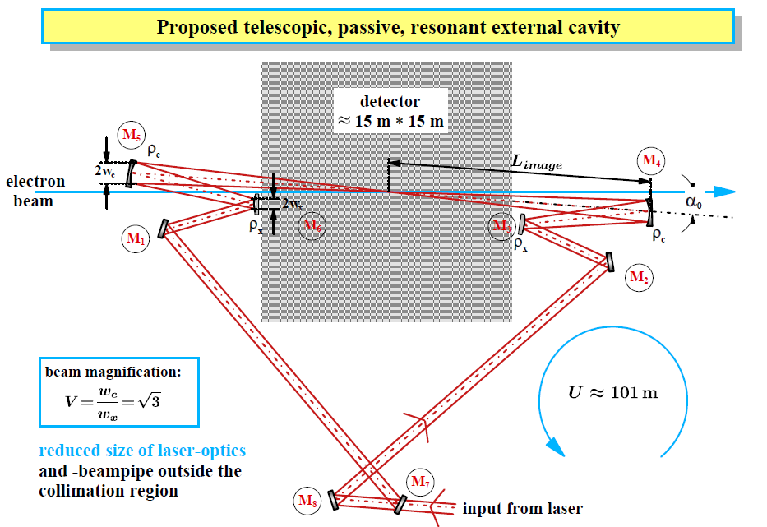
an idea
Klemiz, Monig

Slide 3
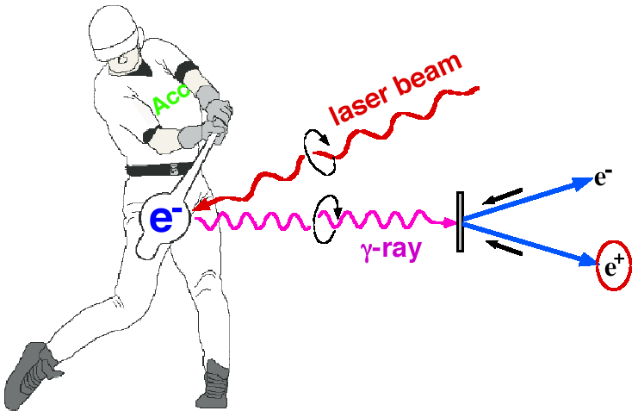
Compton at KEK ATF
Polarized e+ by laser Compton Scheme
Ee~1GeV for 10MeV gammas
controllability of polarization
Omori
Proof of principle
M.Fukuda et al., Phys. Rev. Letts. 91, 16480(2003)
T.Omori et al., Phys. Rev. Letts. 96, 114801(2006)
Toward the positron sources
ー> increase intensity of γ rays

Slide 4
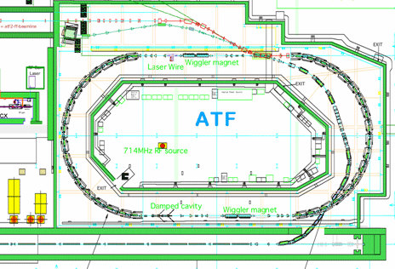
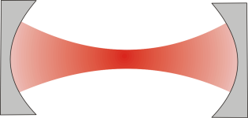
29th Mar 2013
Setup at the KEK-ATF
Laser cavity
γ
detector
ATF parameter
1.3GeV
1×10¹⁰ electron/bunch
Up to 10 bunch/train
2.16×10⁶ turn/s

Slide 5
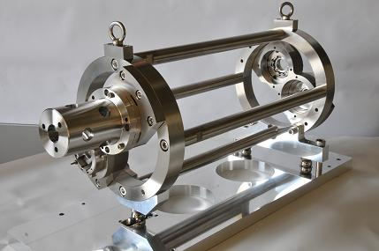
The Optical Cavity
Plane Mirror
Plane Mirror
Concave Mirror
IP
Concave Mirror
Main Parameters
Circumference:1.68m
Finesse:4040(Measured)
Power Enhansement:1230

Slide 6
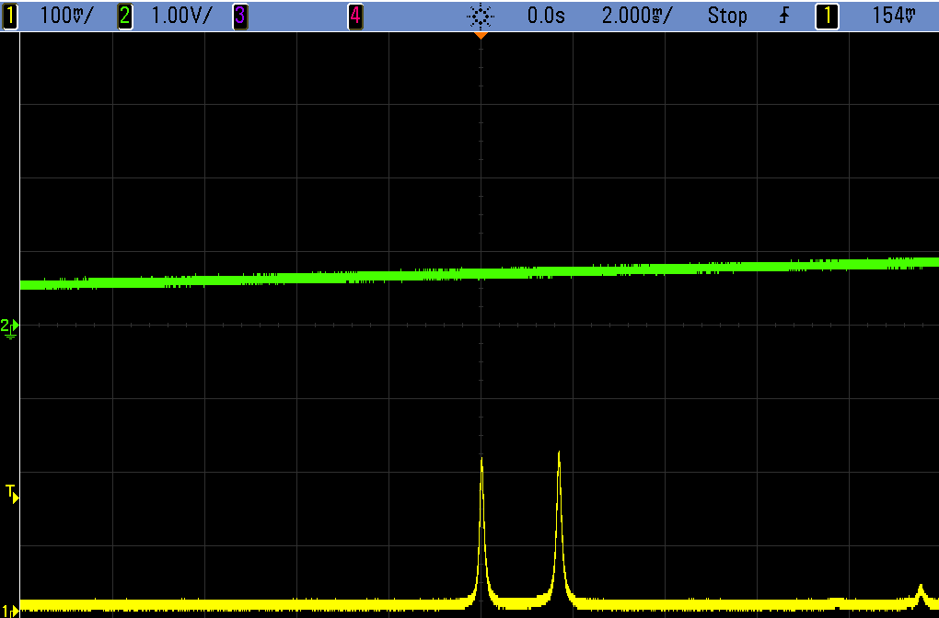
3Diensional 4Mirror Cavity
Resonates only for Circular polarization
Left/Right separately
left handed
right handed
Optical path

Slide 7
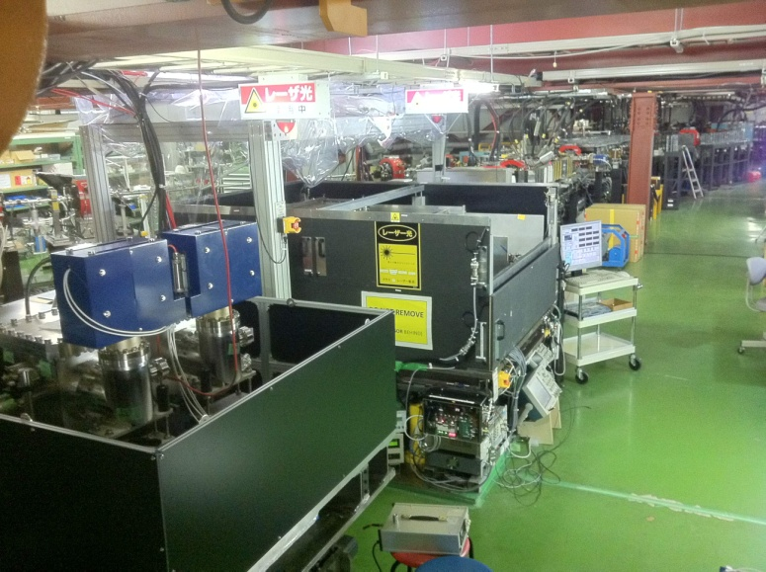
4 mirror cavities are at the ATF
KEK-Hiroshima
installed 2011
LAL-Orsay
installed summer 2010
relatively simple control system
employs new feed back scheme
sophisticated control
digital PDH feedback

Slide 8
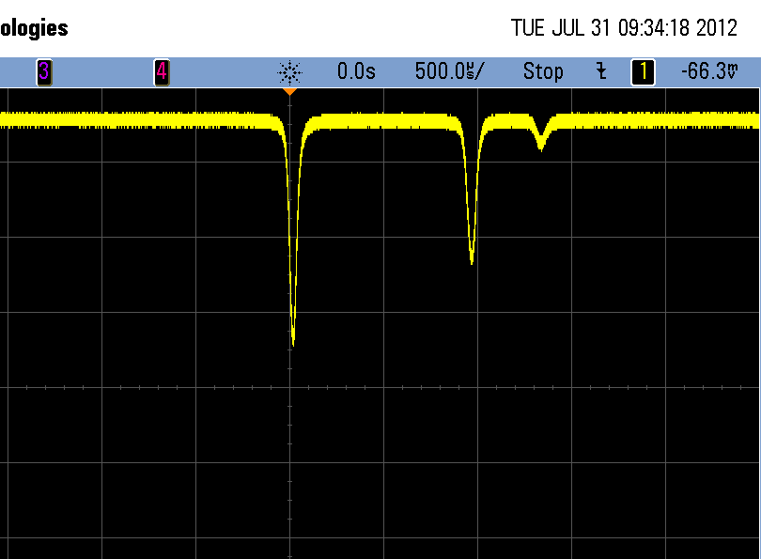
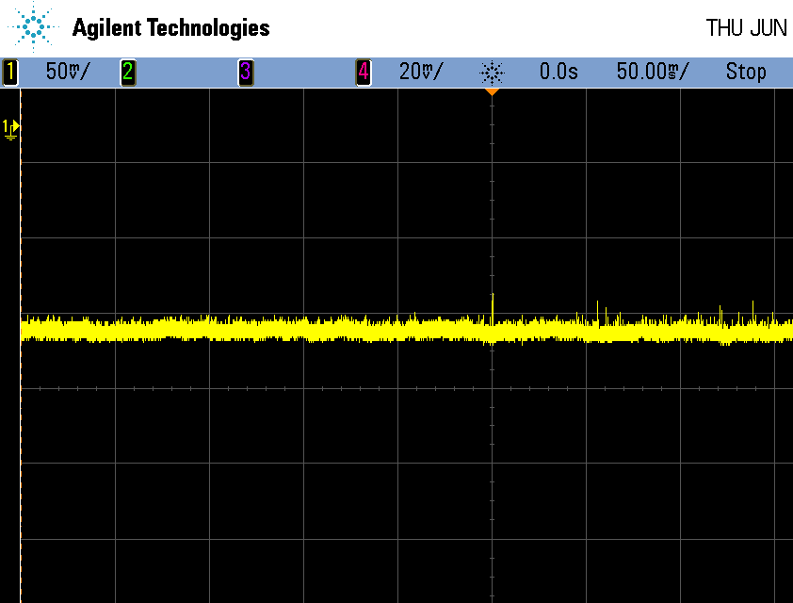
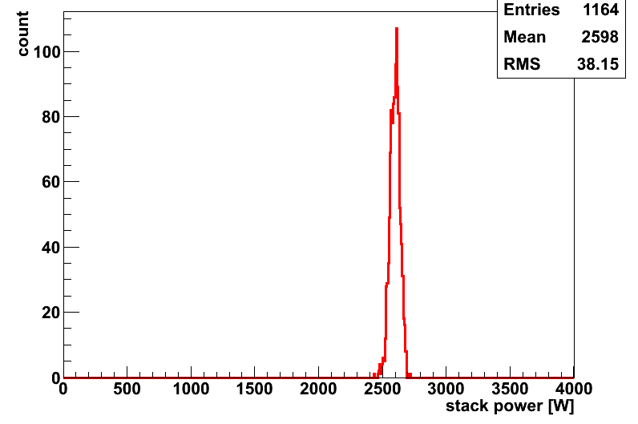
Stored Laser Power in the cavity
14th Sep 2012
Sotred power
Right pol
Left pol
Laser Power: 2.6kW
FWHM: 110pm
8pm
Stored Power [w]

Slide 9
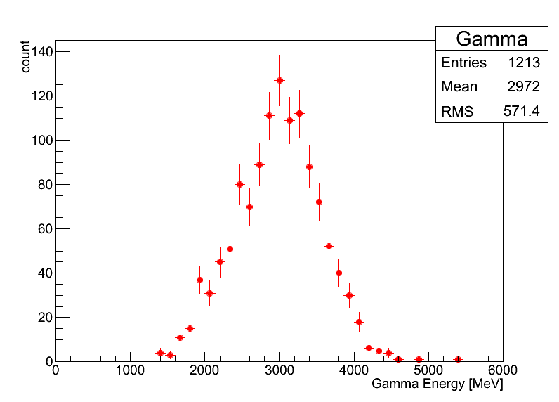
γ ray Generation
5bunches/train
laser
e-
γ
5.6ns
2970±20 MeV
⇒ ~120γs/trainのガンマ線に相当
ATF 2.16MHz
~2.6×10⁸/sec
Eγ[MeV]

Slide 10
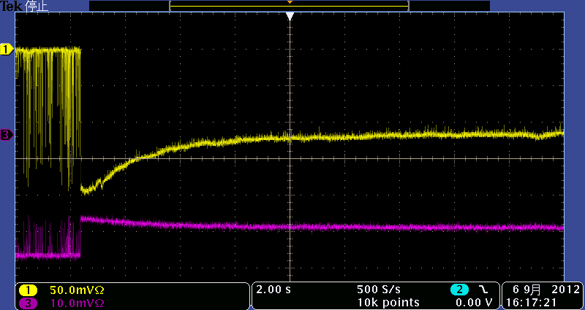
Issues
y
10um
Transmitted power
Reflected power
x
20s
27um
・Possible thermal effect
・Profile at the IP
(unexpected) losses on mirrors
→distortion
Design: circle

Slide 11
Beam Profile in the cavity
Profile at the focal point
depends on φ

Slide 12
Beam Profile in the cavity
We thought
we made it circle at the focal point,,,,,

Slide 13
Propagation of the laser light
Calculation
  transfer matrix
  Propagation of EM waves in the cavity
Systematic measurements
    φ＝87.5°, 90，92.5

Slide 14
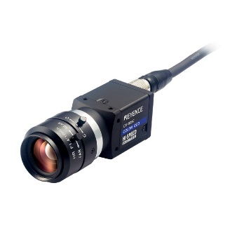
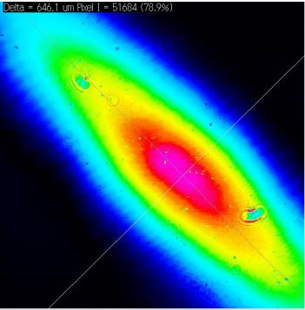
Measturemennsof the profiles
Major axis（μｍ) | 1 | 941.4 | 939.6 | 937.5
 | 2 | 938.7 | 941.6 | 939.5
Minor aixs（μｍ) | 1 | 775.5 | 775.5 | 775.7
 | 2 | 708.3 | 774.6 | 919.9
Angle Relative to 90 | 1 | +1.17° |  | -1.16°
 | 2 | +0.28° |  | +35.13°
Major axis |  | 944 | 937 | 939
Minor aixs |  | 532 | 546 | 507
Angle Relative to 90 |  | -0.9° |  | -9.1°
Calculation
still working on it
Measured

Slide 15
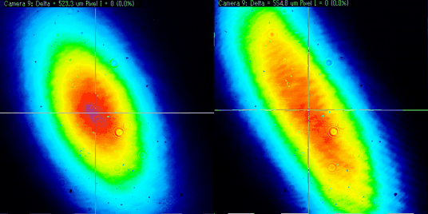
日本物理学会 2013年秋季大会
22nd Sep 2013
Deformation of Mirrors
透過光強度
20s
Low loss mirrors are
essential to increase
power

Slide 16
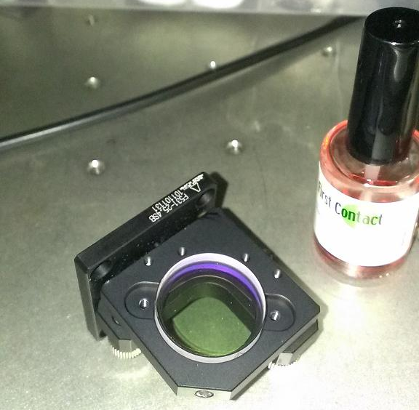
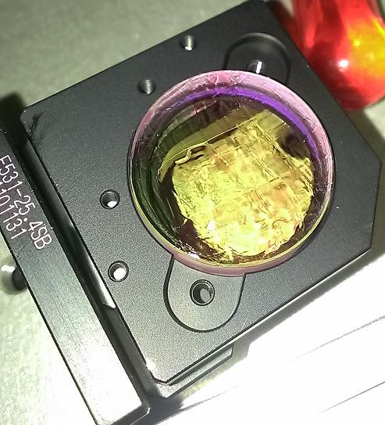
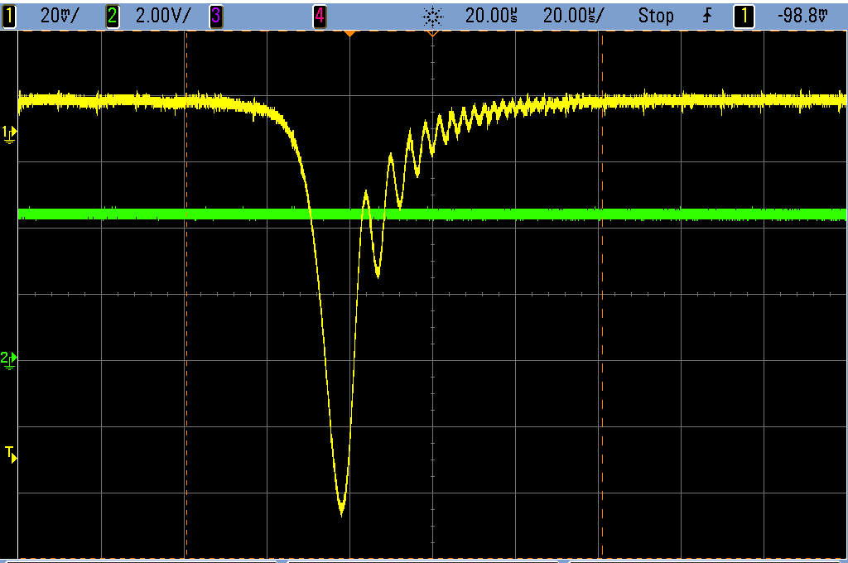
22nd Sep 2013
Cleaning the mirrors
透過光強度
共振器長
20um
Before
（Loss：50ppm）
After
（Loss：30ppm）

Slide 17
Summary
So far
  2.6kW stored w/ enhancement of 1230
  Highly stable ΔL～4pm
  vertical laser size at the IP 13μm
  120g/5bunches -> ~2.6×10⁸/sec
  Digital Feedback
Quantitative understanding
  Finesse
  Powers
  Profile

Slide 18
Future prospect
Try high reflectivity mirror
  w/ careful handling
  Trying 3000~5000 power enhancement this year -> more than 10,000 in next a few years
Low loss mirrors
  collaboration with NAO (gravitational wave guys)
  careful investigation of commercial mirrors
  develop mirrors (substrates) by ourselves?

