Slide 1
European Activities on ILC Machine
Brian Foster
(Uni Hamburg/DESY)

Slide 2
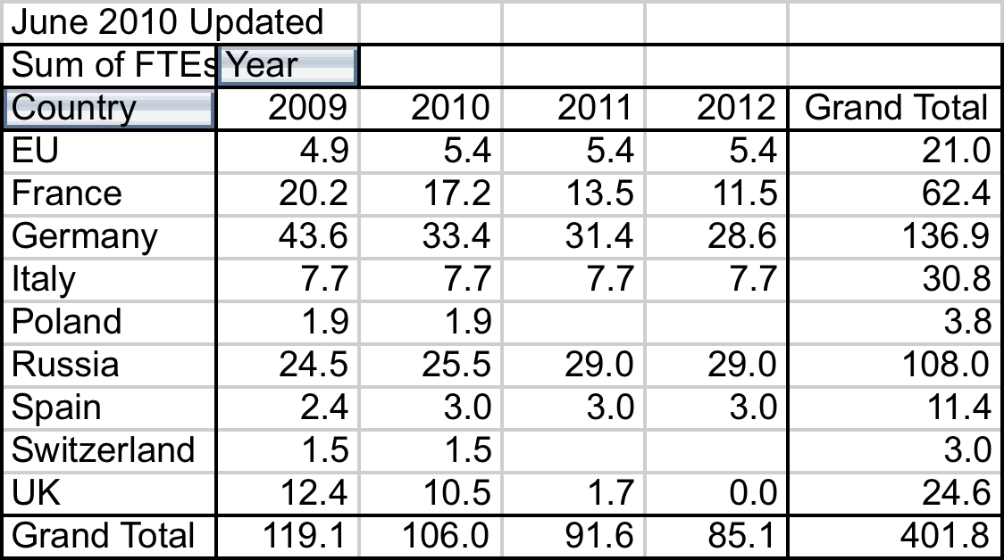
European FTEs to 2012

Slide 3
Europe – Country activities
France
Discussion with J. Martino (IN2P3) in January 2012. Expected
~ constant effort over next few years on SCRF-related topics,
e.g. HOM coupler etc. New meeting with JM, and leaders of CEA, planned this month in conjunction with IRFU LC meeting (see later). Substantial XFEL work, mostly at Saclay & Orsay, relevant for ILC. Production line for XFEL cryomodules now operating smoothly at Saclay.

Slide 4
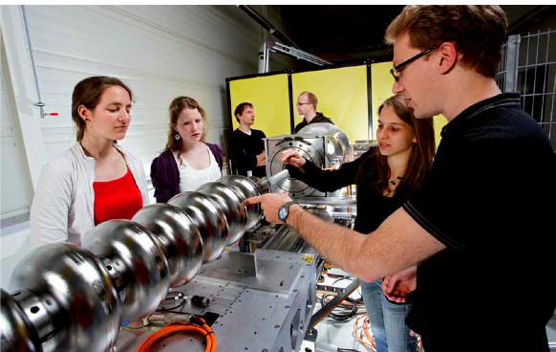
Europe – Country activities
Germany
Discussion with B. Vierkorn-Rudolph (BMBF) in August. Awaiting official contact from Japanese Govt. on ILC. Much relevant activity in Germany from XFEL. HiGrade funded by EU to learn from cavity production; examining cavities as they arrive from industry. OBACHT etc. detailed investigations of cavity surfaces.
Surface physics, tumbling machine, etc. financed from BF Humboldt Award. There is dedicated work on ILC machine – in 2013 >~ 10 FTEs & ~1M€ materials.

Slide 5
Europe – Country activities
Italy
Discussion with N. Perroni & U. Dosselli in June. ~All ILC dedicated activity stopped after “approval” of SuperB. After cancellation, INFN examining several ideas for future facilities. Several of them would use SCRF technology. INFN would like strong involvement in ILC once there is a clear signal from Japanese government.
Poland & Switzerland (=PSI)
No explicit ILC but small involvements in CLIC.
Russia (=Dubna & IHEP)
Efforts continue on ILC site investigations @ Dubna. Staff travel to DESY for involvement in XFEL SCRF.

Slide 6
Europe – Country activities
Spain
Continuing interest from CIEMAT in SC magnets for ILC. Work on beam dynamics associated with CLIC but also relevant for ILC at Valencia. Both activities at quite low level.
UK
Officially zero since STFC disengaged from LCs in 2007. However, in fact there is a quite large activity on CLIC funded through CERN at ~ 1MCHF/year that is also directly relevant to ILC. In the last 6 months, stimulated by positive news from JAPAN and the various Road Maps. LCUK has begun activity to put in Statement of Interest to STFC for ILC activities. STFC Road Map about to be revised. Meeting with J. Womersley last month – was assured that Road Map would be positive about renewed ILC involvement. However, no substantial funds available in short term. Longer term involvement depends on positive Japanese Govt. statement.

Slide 7
EU Commission activities
Long-standing contacts with Commission via ILC-HiGrade and previous projects and via ESFRI Roadmap (for “large” projects).
BF & E. Elsen visited Brussels on 13.9 to brief them on ILC status and enquire about possible H2020 funding. Very useful meeting.
BF attended annual CERN/EU meeting at CERN on 25.9. Attended by R-J Smits, DG of Directorate Research at EC.
ILC was explicit item on Agenda, given priority even though R-JS was 1 hour delayed. He and colleagues had been briefed after 13.9.
BF described current situation and R-JS responded at length. Discussion was animated. EC is clearly interested in ILC and wishes to follow closely. Agreement to set up “group of 4” – BF, SS + 2 from DGXII – to maintain close contact over ILC. In fact one person from DGXII nominated. Meeting suggested 5.12.13 - awaiting DGXII response.

Slide 8
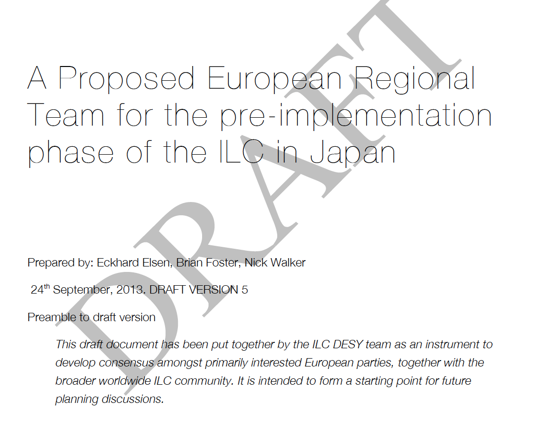
European activities
N. Walker et al. have drawn up draft indication of how Europe could get involved in site-specific work for next few years prior to project approval. BF & SS looking at mods & expansion.
Any European plan can only be in world-wide context. Under discussion at LCC Directorate meeting this week.

Slide 9



IRFU Linear Collider Days
The 2013 Irfu Linear Collider Days organized jointly with CNRS will take place in CEA Saclay on-site in Building 526 Amphitheater Joliot Curie on November 27-29.
This will be the second “Journées Collisionneur Linéaire”of the French community, following the first event organized in Lyon on May 13-14, 2013*
The goal of the meeting is to discuss and to review linear collider activities in France in the areas of physics/phenomenology, detector and accelerators technologies:
http://irfu.cea.fr/Meetings/jcl02
Program Layout (Wednesday, Nov. 27 – Friday, Nov. 29, 2013):
Wed., Nov. 27 14:00-18:00 - Physics/Phenomenology Activities in France
Thu., Nov. 28 09:00-12:30 - Accelerator Activities in France
14:00-18:00 - Detector Activities in France
Visit XFELCEA cryomodule production facility
Fri., Nov. 29 09:00 – 12:00 - ILC Country presentations from Europe, Asia and
North America (areas of cooperation with France)
(* https://indico.in2p3.fr/conferenceDisplay.py?confId=8347)

Slide 10
European ILC Meeting
Organised by the Linear Collider Collaboration
Friday, November 29, 2013
(Paris, 14:00 – 18:00):
Informal Discussion about the current status of EU projects,
future EU H2020 call and its implication for the ILC community
Organized in Conjunction with the 2nd
“Journées Collisionneur Linéaire”of the French community
November 27 – November 29, 2013 in CEA Saclay:
You are invited to join French Irfu Linear Collider Days, Fri., Nov. 29
Possibility to visit CEA XFEL Cryomodule Production Facility, Thu. Nov. 28

Slide 11
European ILC Meeting
Organised by the Linear Collider Collaboration
Friday, November 29, 2013
(Paris, 14:00 – 18:00):
Informal Discussion about the current status of EU projects,
future EU H2020 call and its implication for the ILC community
Outline programme
14:00 - 14:20 -- H2020 general description and opportunities for a possible ILC application.
14:25 - 14:45 -- Present situation of the Japanese initiative.
14:50 - 15:10 -- Plans of the machine community for a H2020 application.
15:15 - 15:35 -- What ILD needs in view of H2020.
15:40 - 16:00 -- What SiD needs in view of H2020.
- break –
16:30 – 16:45 -- CALICE view.
16:45 – 17:00 -- Silicon detector views (pixels+strip).
17:00 - 17:15 -- LCTPC views.
17:15 – 17:30 -- FCAL views.
17:30 - 18:00 -- Discussion to set the main goals of the EU application.

Slide 12
Summary and Prospects
There are signs that the monotonic decrease in ILC effort in Europe over the last few years is about to reverse. Many countries are restarting initiatives and getting ready to respond to a Japanese initiative.
The other side of the coin is that everything depends on such a Japanese initiative – without it these “green shoots of recovery” will wither away.
Without exception, the funding authorities I have talked to have said that they can give no serious consideration to substantial increase in ILC funding without a Japanese government statement that they wish to negotiate to site ILC in Japan – and that such an initiative must entail Japan putting forward the majority of the necessary funding up front.

Slide 13
Summary and Prospects
Assuming such a statement is forthcoming, it will be very tough to find a substantial European contribution. LHC upgrade will have priority and many countries are finding it hard to finance that. There is a contention with timing here, although it can be overcome.
There is a perception, particularly stated by R-J Smits, that in Europe “Physics has had its share” of available funding. This refers to ITER, which has given all large infrastructure projects a bad name. We will need to work round this perception.
Even so, there is a real sense of anticipation and excitement in Europe about ILC prospects. Given a prompt statement from Japan - & I emphasise time is critical – then I think there will be a positive response from Europe.

Slide 14
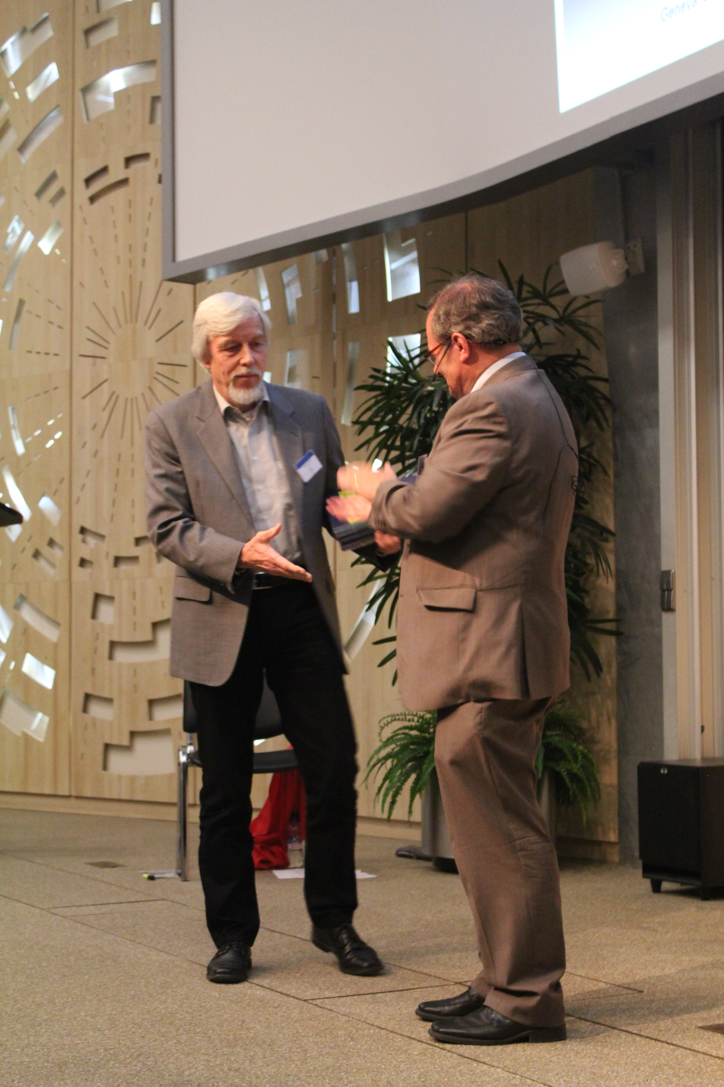
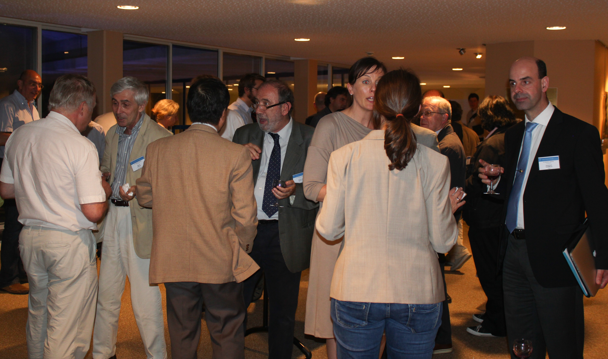
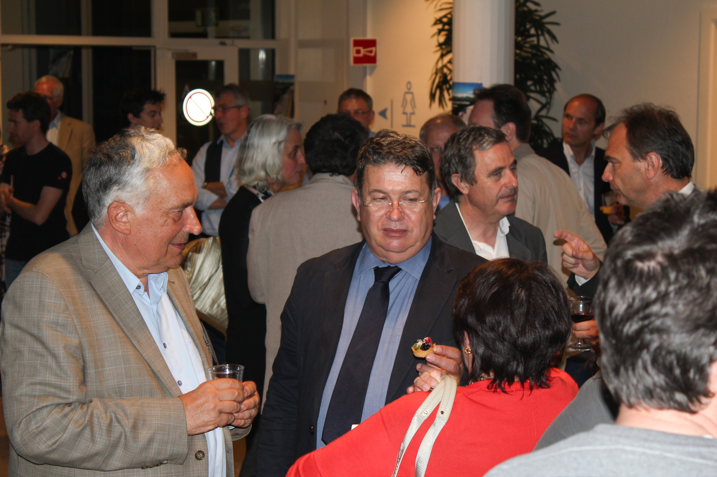
World-wide Event
On June 12th, ILC TDR was published in Worldwide Event.
End of major phase in ILC development – now what?

