Slide 1
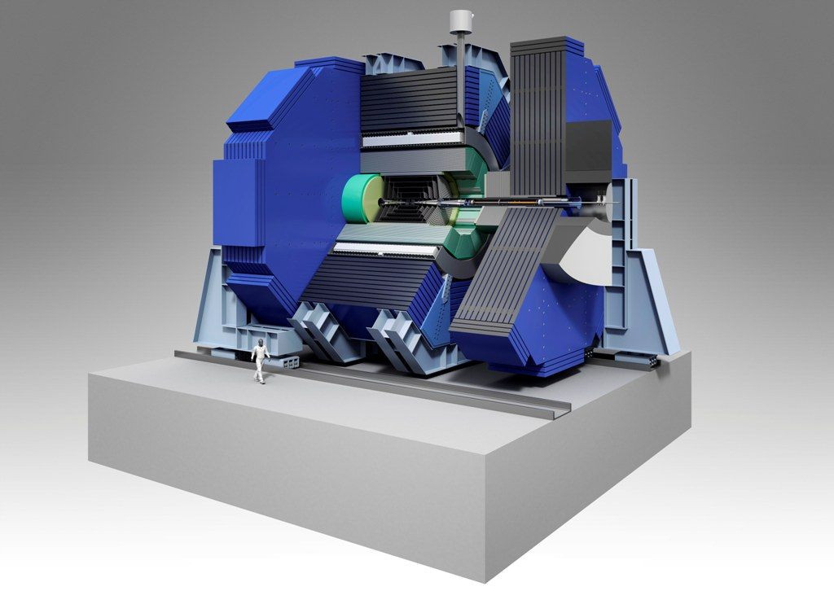
SID MDI & Engineering
Marco Oriunno (SLAC), Nov. 12, 2013
LCWS13, TOKYO

Slide 2
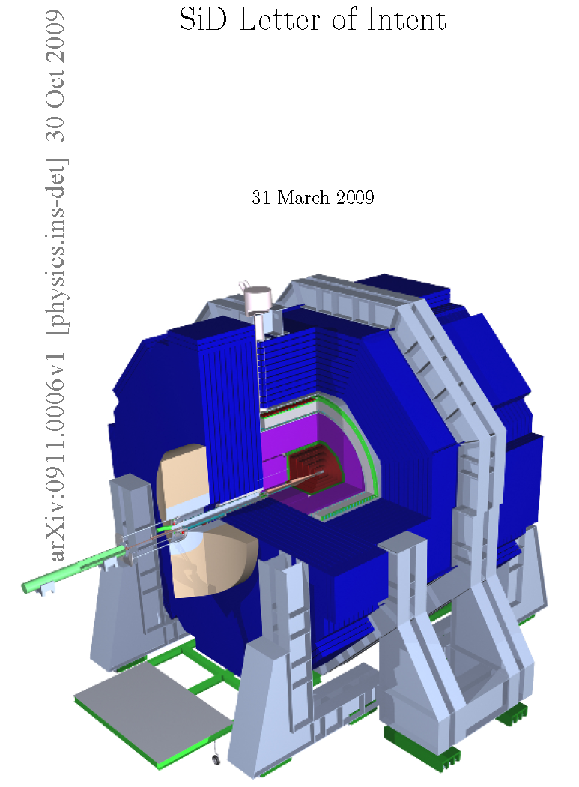
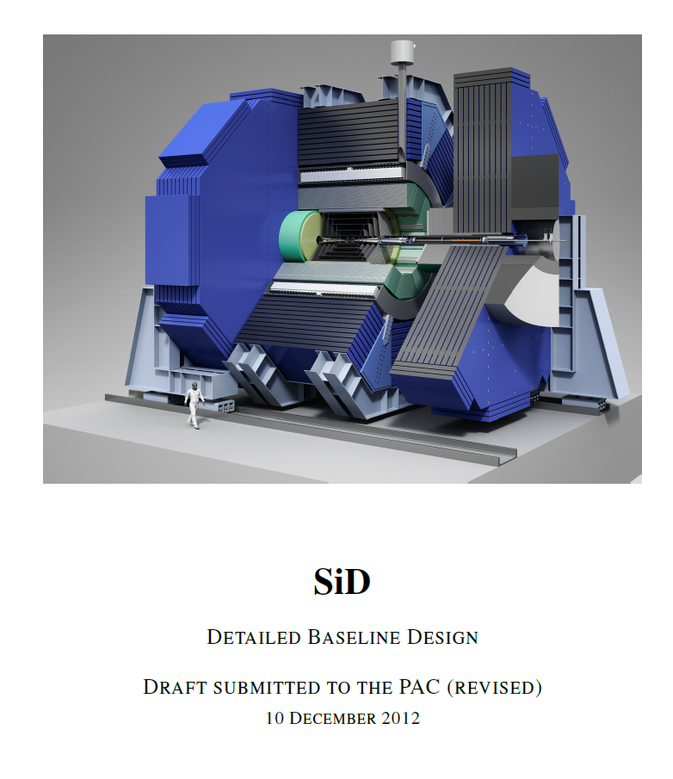
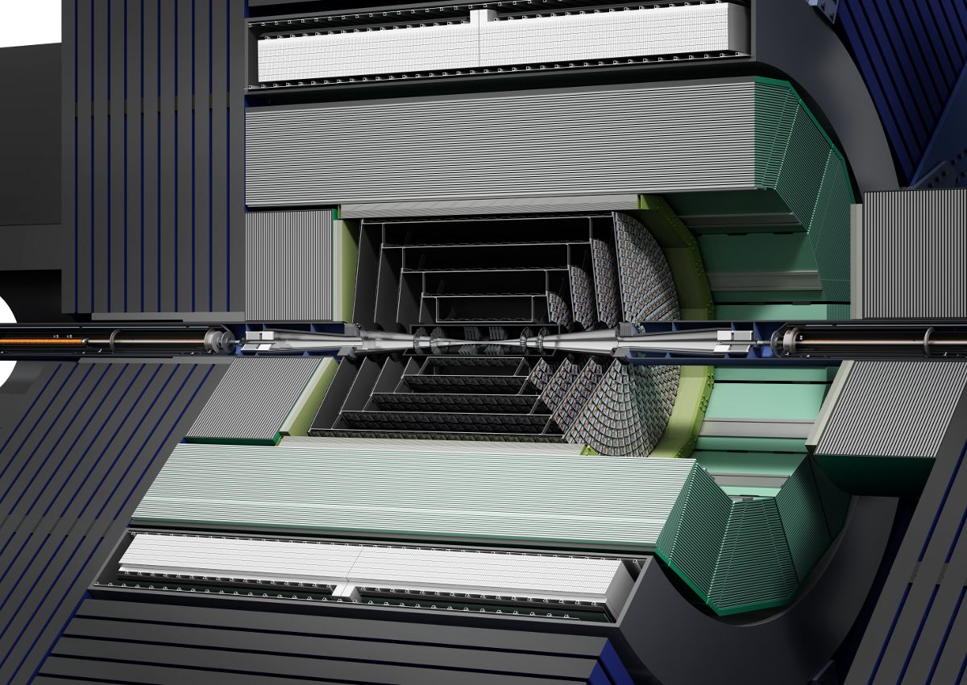
Slowly but Steadily
SID
Technical Design Report
...2018 ?
….…………

Slide 3
Detailed Baseline Document - MDI
7 Engineering, Integration and the Machine Detector Interface
7.1 Introduction
7.2 IR Hall Layout Requirements and SiD Assembly Concepts
7.2.1 Vertical Access (RDR style)
7.2.2 Horizontal Access (Japan style)
7.2.3 Detector Access for Repairs
7.3 Detector Exchange Via a Sliding Platform
7.3.1 Introduction
7.3.2 Platform
7.3.3 Vibration analysis and Luminosity Preservation
7.3.4 Push Pull Detector Exchange Process and Time Estimate
7.4 Beampipe and Forward Region Design
7.4.1 Introduction to the Near Beamline Design
7.4.2 Beampipe
7.4.3 LumiCal, BeamCal, Mask and QD0 Support and Alignment
7.4.4 QD0-QF1 interface
7.4.5 Vacuum System and Performance
7.4.6 Feedback and BPMs
7.4.7 Wakefield and Higher Order Mode Analysis
7.4.8 Frequency Scanning Interferometric (FSI) Alignment of QD0 and QF1
7.4.9 Routing of Detector Services
7.5 Impact on the Adjacent Detector While SiD is Operational
7.5.1 Radiation Calculations
7.5.2 Fringe Fields and Magnetics

Slide 4
Steps toward a real SiD
Some national body (ies) (Japan and collaborators?) commits to linear collider 2014
Optimize SiD + Value engineering : lower costs and preserve performance
Prepare serious TDR with technical prototypes and serious cost estimate. 3 years: 2017
Requires a fully reviewed TDR. Assume the review process, with minor iterations, takes 1 year. 2018
Ready for Construction…Adding time for collaboration formation…

Slide 5
From here to Commitment
A Technical Design Report should include:
  Clear baseline choices for all subsystems
  Final subsystem dimensions & clearances
  Reasonably complete mechanical designs including tooling
  Prototypes and Testbeam
  Serious cost estimate
We presently have < 0.5 Mechanical Engineers total in SiD. This would have to go to 2 FTE’s to begin to make mechanical progress.
In the intensive TDR stage, this should be ~10 FTE’s + similar number of designers.
The Electronic Engineering is in better shape.
System Engineering (Interfaces) needs serious effort, particularly cryogenics interfaces . Japanese codes (e.g. radiation, B fields, seismic, transport, etc) need to be studied. Need to encourage US-Japan collaboration proposal.

Slide 6
Critical Issues for Mechanical Engineering
Machine – Detector Interface
There is ~1.5 m radial difference between SiD and ILD. The SiD platform is 3.8 m thick. The platforms appear to add a year to the construction schedule. Revisit platforms??
SiD L* = 3.5 m; ILD L* = 4.5 m. BNL design dimensions for the SiD QD0 are needed.
Support and vibration issues need continued work.

Slide 7
Critical Issues for Mechanical Engineering
It is believed – within the engineering group – that while there are plenty of other difficult problems to work on, they do not have the impact or logjam effect of optimization.
There is an enhanced effort on MDI issues at SLAC. We will try to focus them on Critical Issue 2 – Support of the detector, quads, and vibrations and costs.

Slide 8
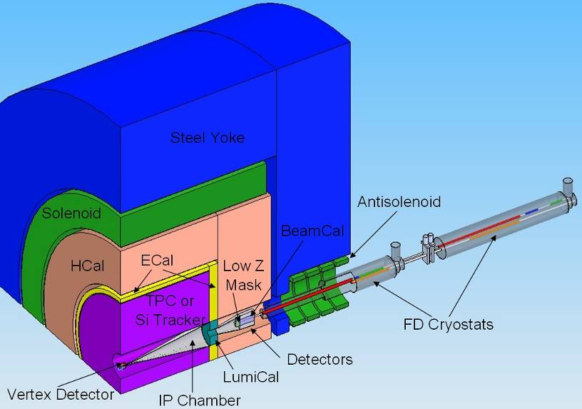
Interaction Region deliverable
“Provide reliable collisions of ultra small beams (~few nanometers), with acceptable level of background”

Slide 9
Vacuum Spec from Beam Gas Scattering
Scattering inside the detector is negligible up to 1’000 nT
250 GeV e-
OD2.4 cm x 7 m long gas (H₂/CO/CO₂)
only Moller scattering off atomic electrons is significant.
Luminosity backgrounds (pairs, γγ→hadrons) are much higher
Within the IP region there are 0.02 - 0.04 hits/bunch (3-6 hits TPC) at an average energy of about 100 GeV/hit originating QD0–200 m from the IP.
Therefore 1 nT from QD0–200 m is conservative.
On the FD protection collimator there are 0.20 charged hits/bunch (33 hits TPC) at an average energy of about 240 GeV/hit and 0.06 photon hits/bunch (9 hits TPC) at an average energy of about 50 GeV/hit originating 0–800 m from the IP.
Therefore 10 nT from 200–800 m.
Beyond 800 m from the IP the pressure could conceivably be at least an order of magnitude higher than 10 nT, pending look at BGB background in the Compton polarimeter and energy spectrometer.
Notes:
Cern note ref. in the TDR

Slide 10
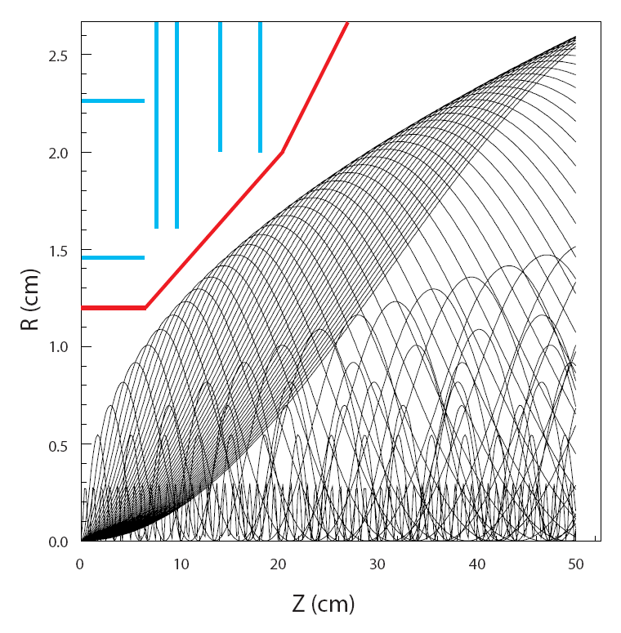
Pair edge and Beam pipe design
Vertex detector
~200 k pairs/BX are produced.
Pairs develop a sharp edge and the beam pipe must be placed outside the edge.
The pair edge is critically dependent on the IP beam parameters.
Beam pipe

Slide 11
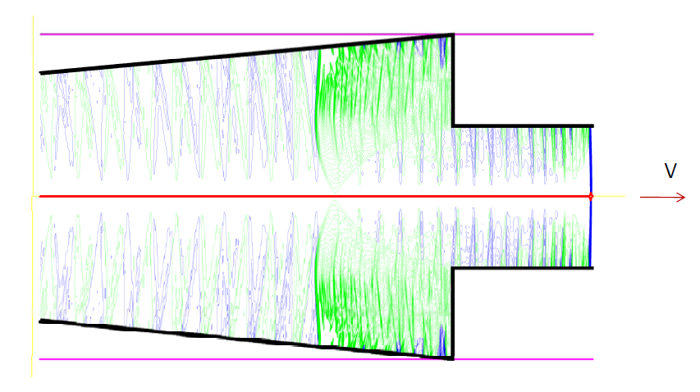
HOM heating at the IP and in QD0 (S.Novokhatski, SLAC)
Beam fields
Wake potentials and loss power
Trapped and propagating modes
Frequency spectrum
Resistive wake fields
Total power loss
The amount of beam energy loss in IR is very small.
Spectrum of the wake fields is limited to 300 GHz
Average power of the wake fields excited ~30 W nominal (6 kW pulsed)
In the QD0 region the additional losses are of 4W (averaged) .
BPMs and kickers must be added.
Example of Wakefields

Slide 12
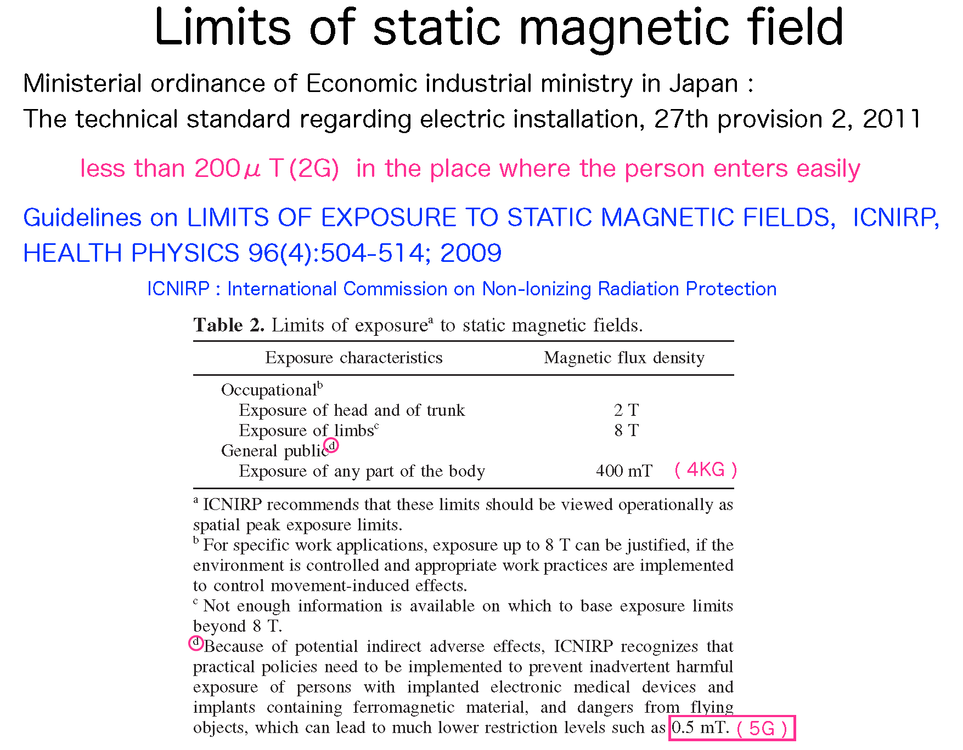
Magnetic Fields

Slide 13
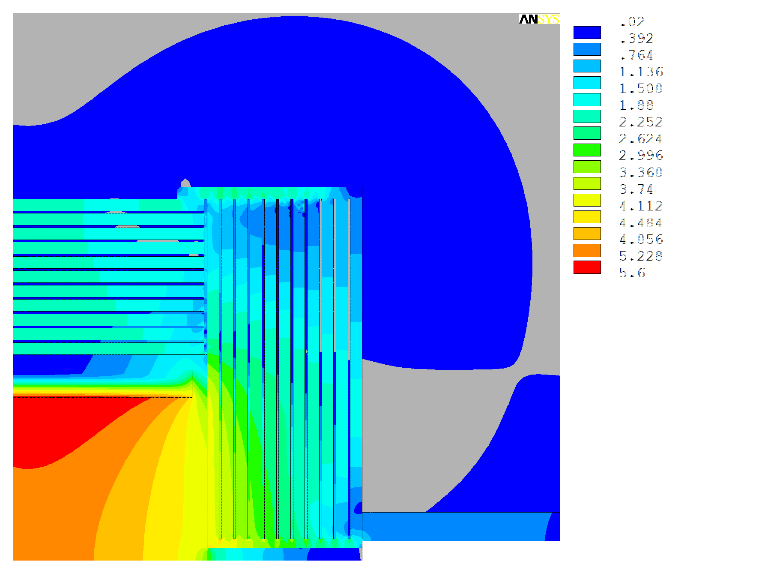
Fringe Field for a quadrant view of SiD
Cut off @ 200 Gauss

Slide 14
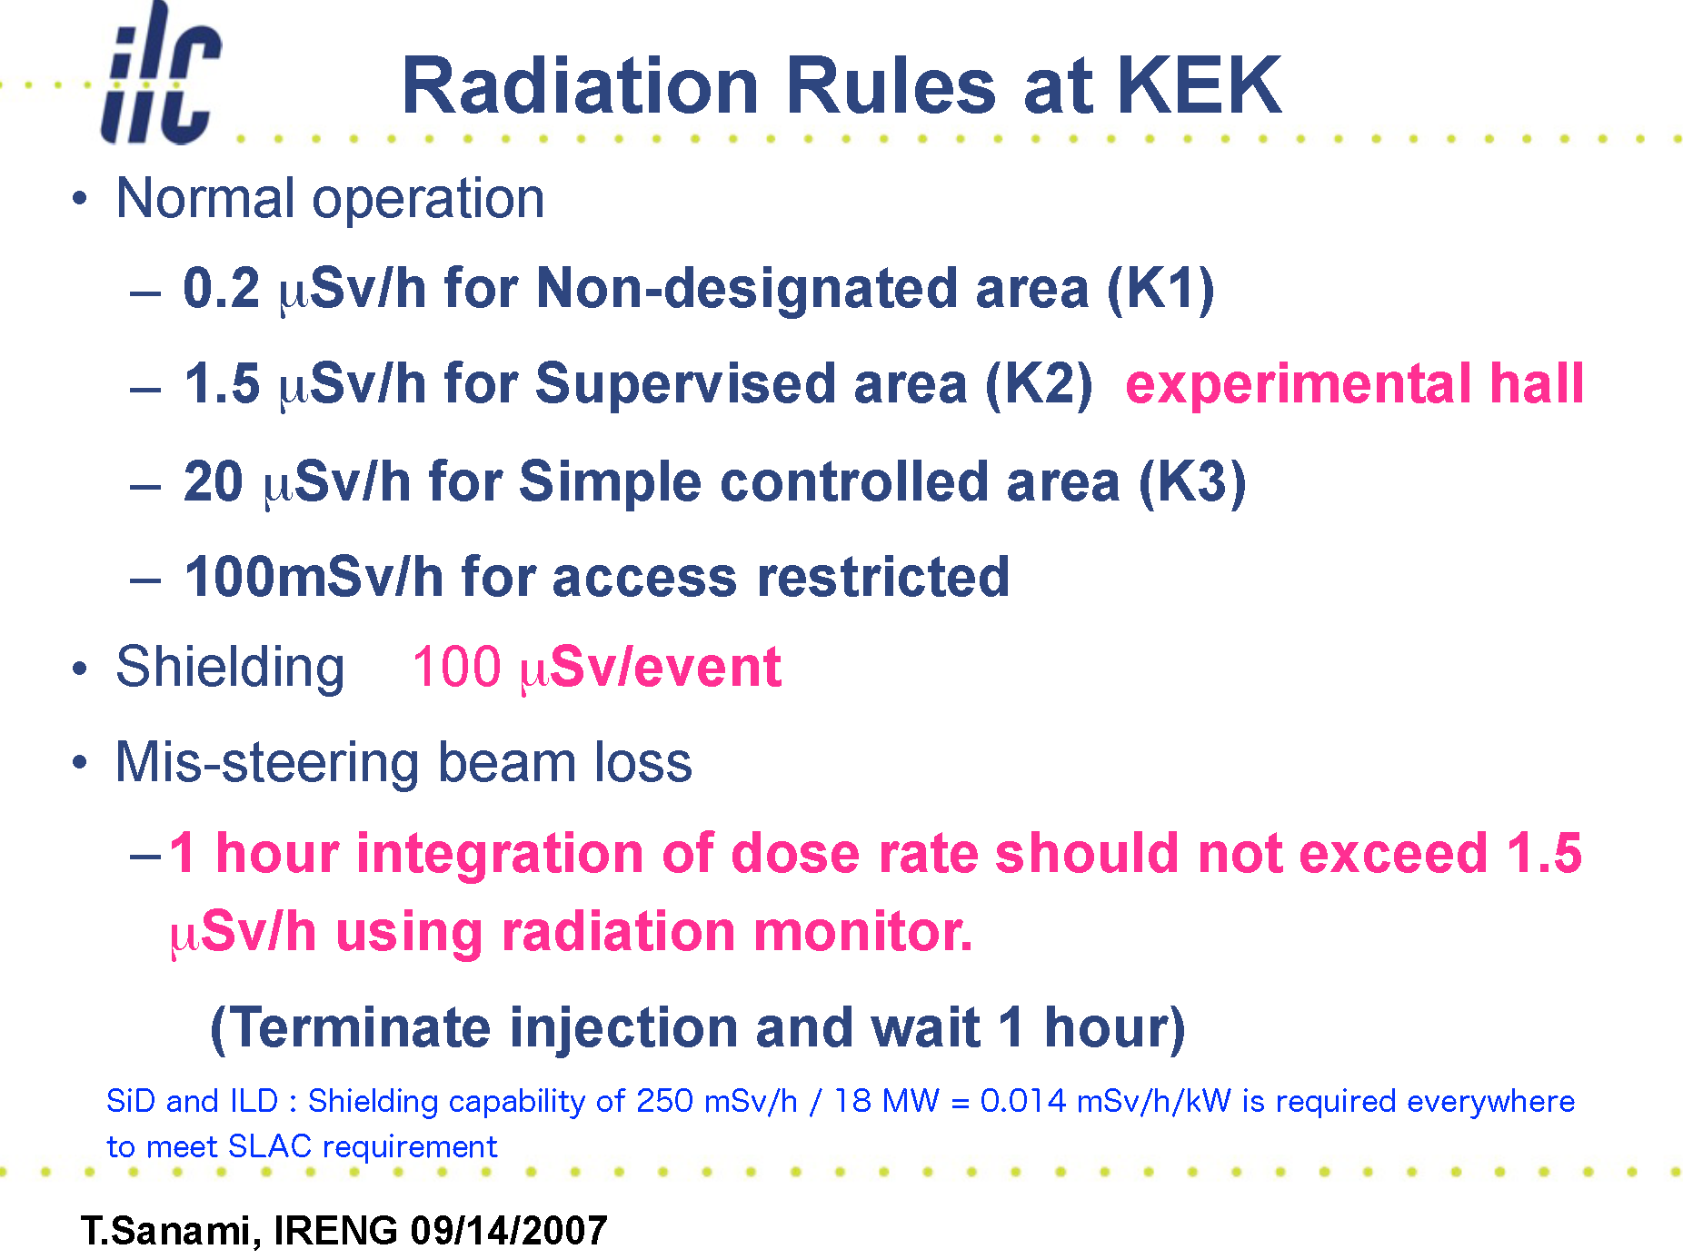
Radiation Rules - Japan

Slide 15
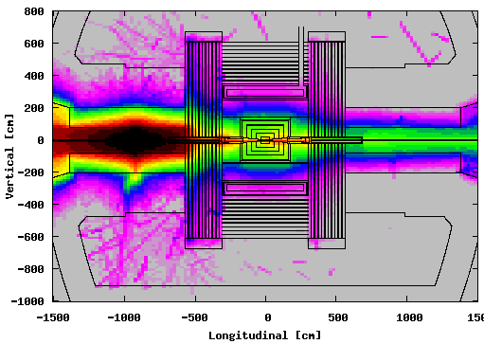
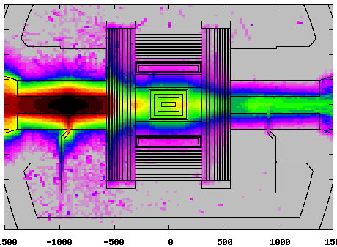
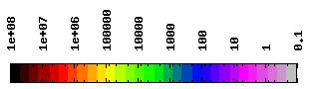
20 R.L. Cu target in IP-9 m. Large pacman.
M.Santana, SLAC
BEAM PLANE
PENETRATION PLANE
9 MW
9 MW
9 MW
9 MW
10 µSv/event
180 mSv/h
µSv/event
MSL - SLAC
15

Slide 16
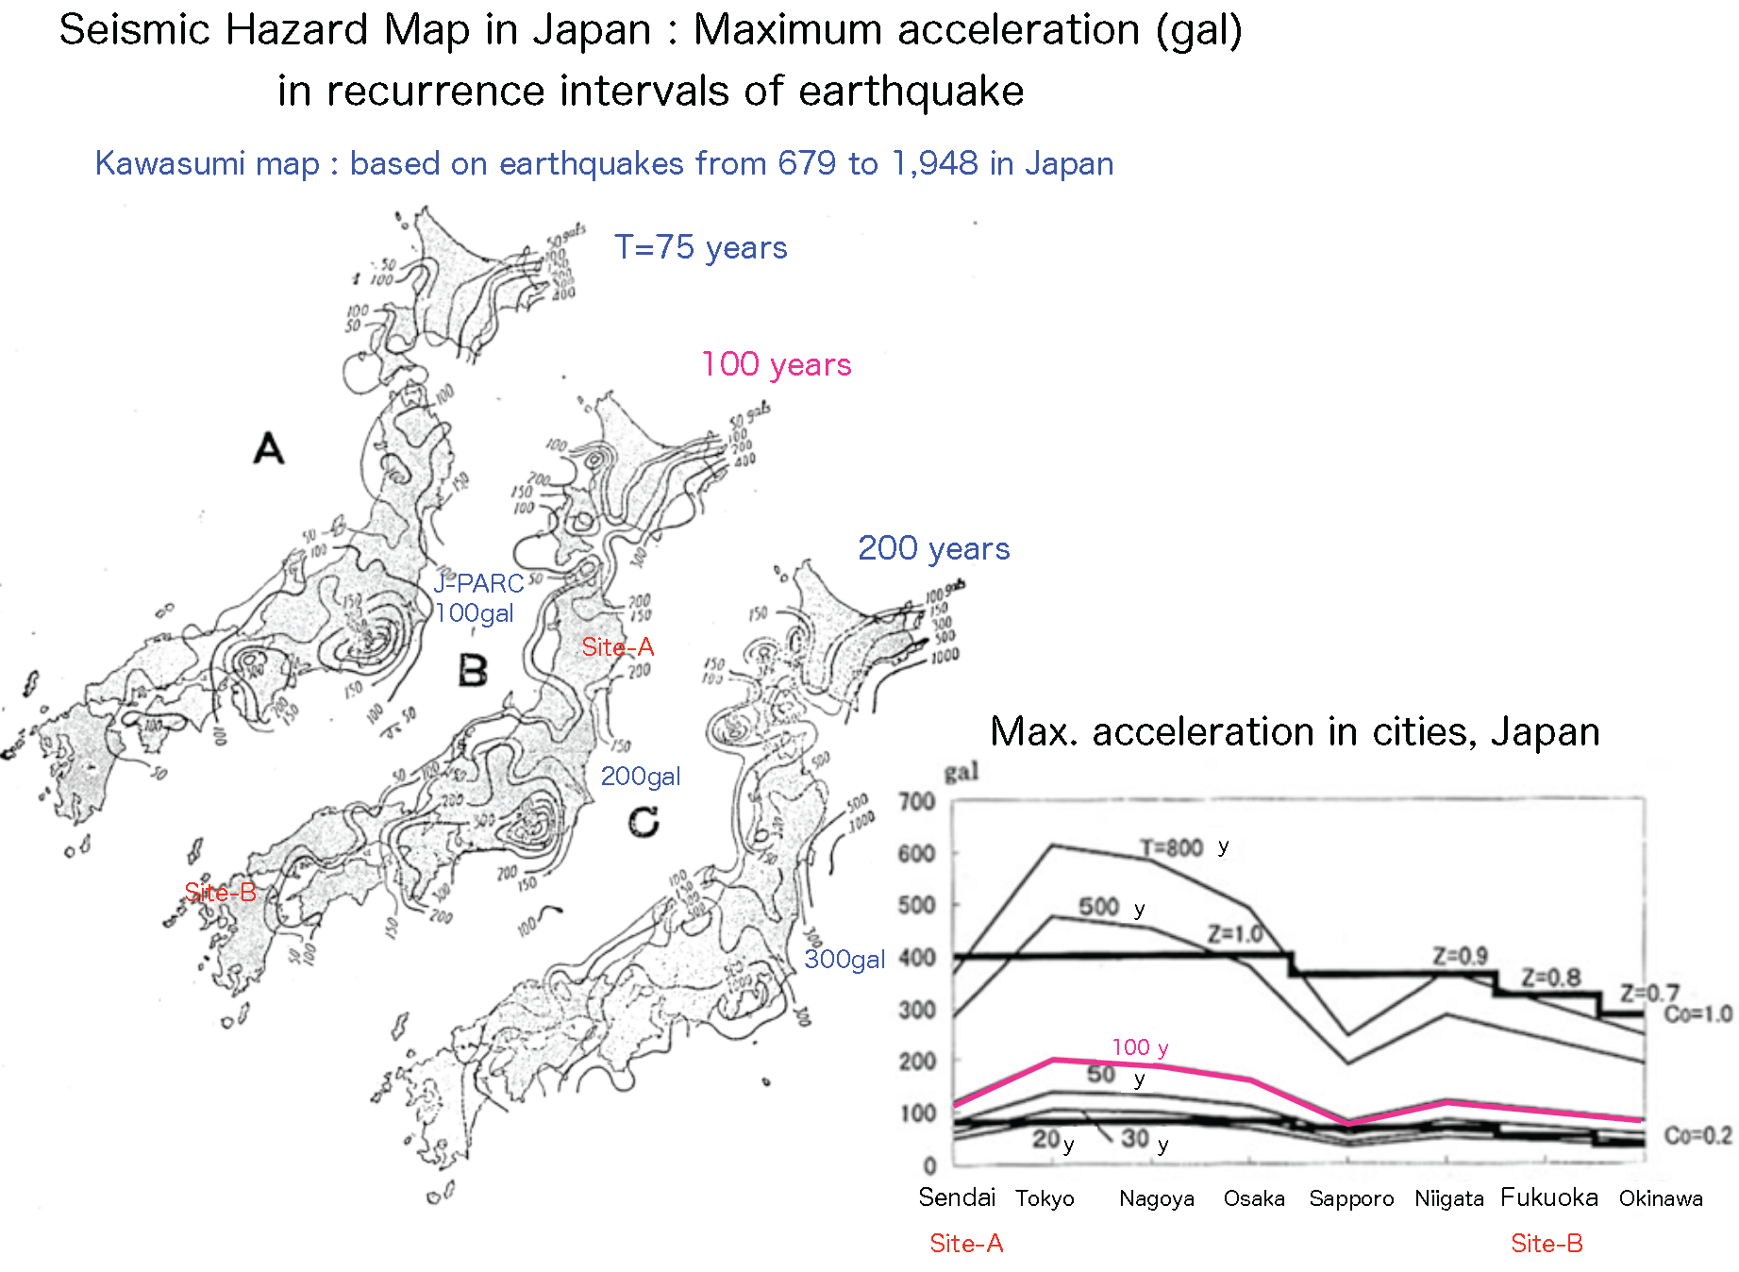
Seismic Map Japan
Kitakami Site :
Ultimate Limit State 1g
Service Limit state 0.15g

Slide 17
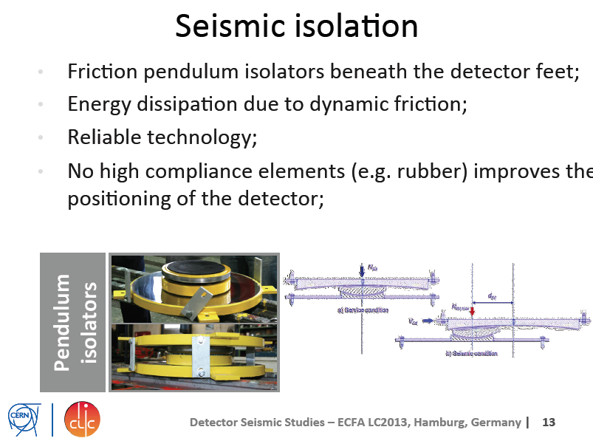
Detector
F.Duarte Ramos, CERN

Slide 18
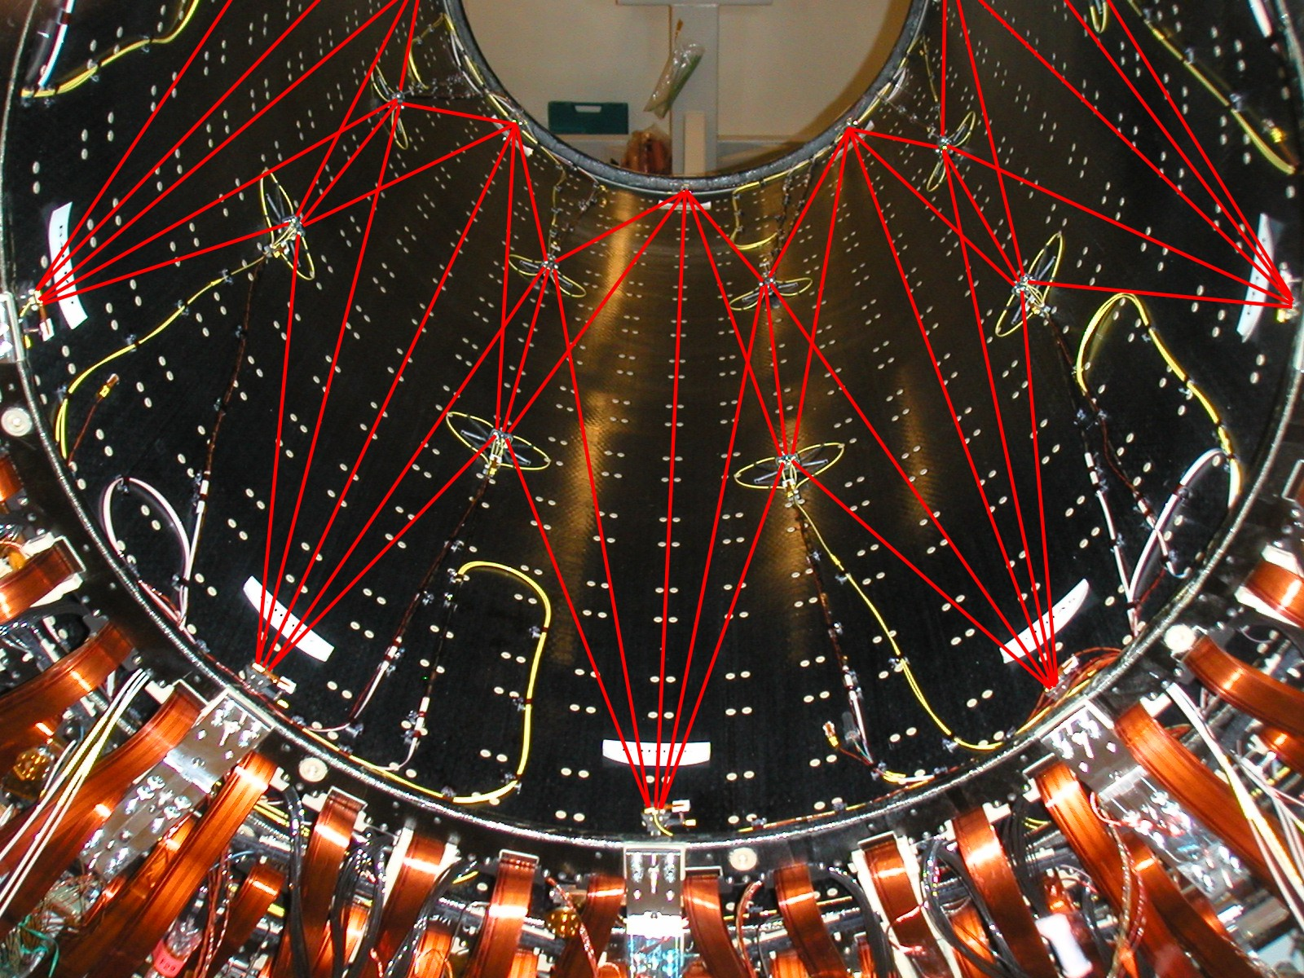
FSI alignment system, precision ~1um
##
ATLAS
FSI grid nodes attached to inner surface of SCT carbon-fibre cylinder

Slide 19
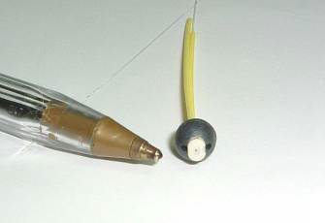
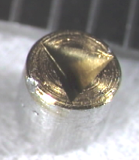
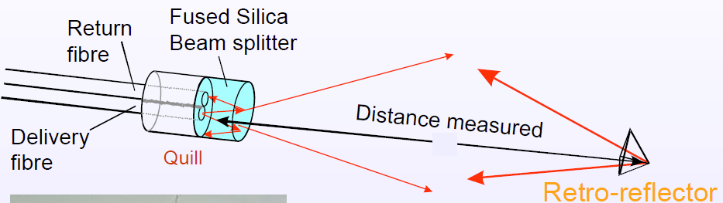
Detector Alignement – Frequency Scan Interferometry
Front-end components of
  minimal mass
  high radiation tolerance

Slide 20
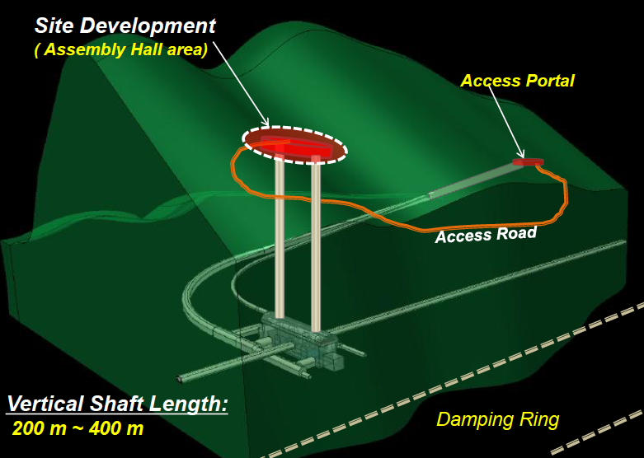
ILC Site

Slide 21
Lean Detectors ?
Toyota Factories pioneered Lean Assembly :
“preserving value with less work”
Fight The Seven Muda (futilities)
Transportation, Inventory, Motion, Waiting, Over-processing, Over-production, Defects.
Big Detectors for Big Science must be Lean :
Time vs labor (Costs)
Time vs Technology drive (Increasing Performances)
Low Maintenance (Costs)
High Upgradability (Costs and Scientific reach)
Shorter commissioning to get nominal performances
International Competition

Slide 22
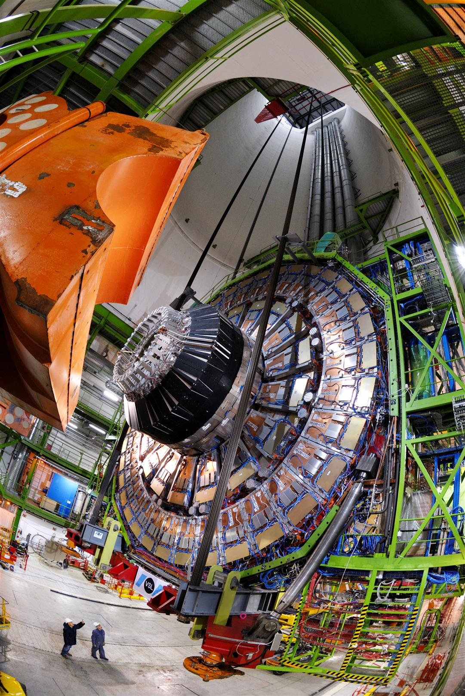
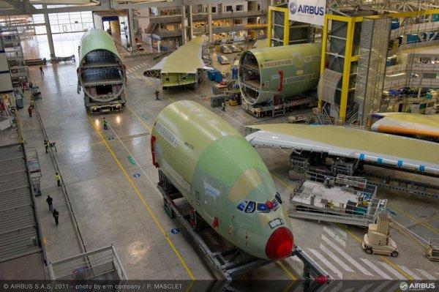
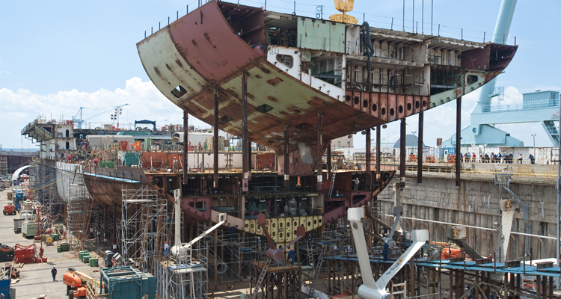
Lean assembly – Some Examples
Airbus
CMS Detector
Shipbuilding

Slide 23
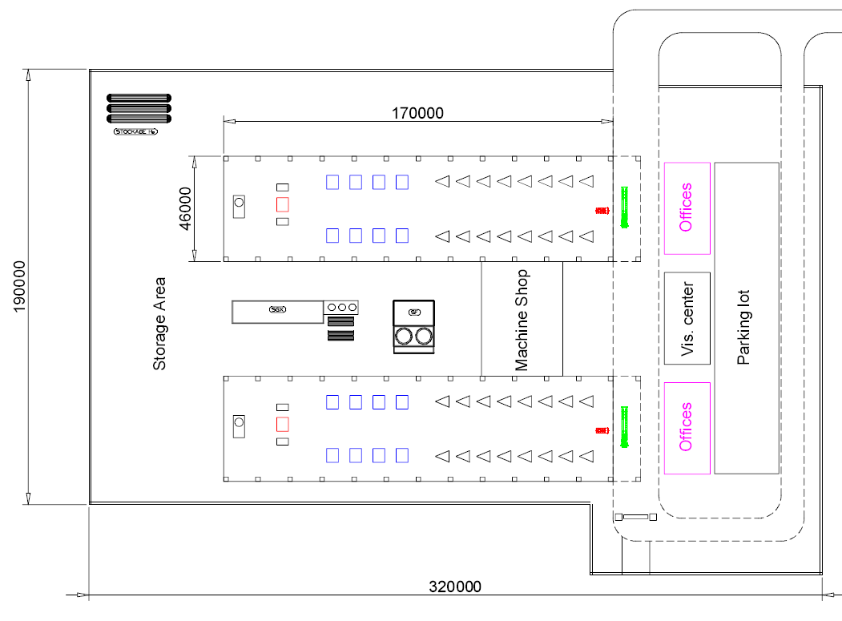
Kitakami Access Yard – Proposal
~ 60,000 m2
Tunnel

Slide 24
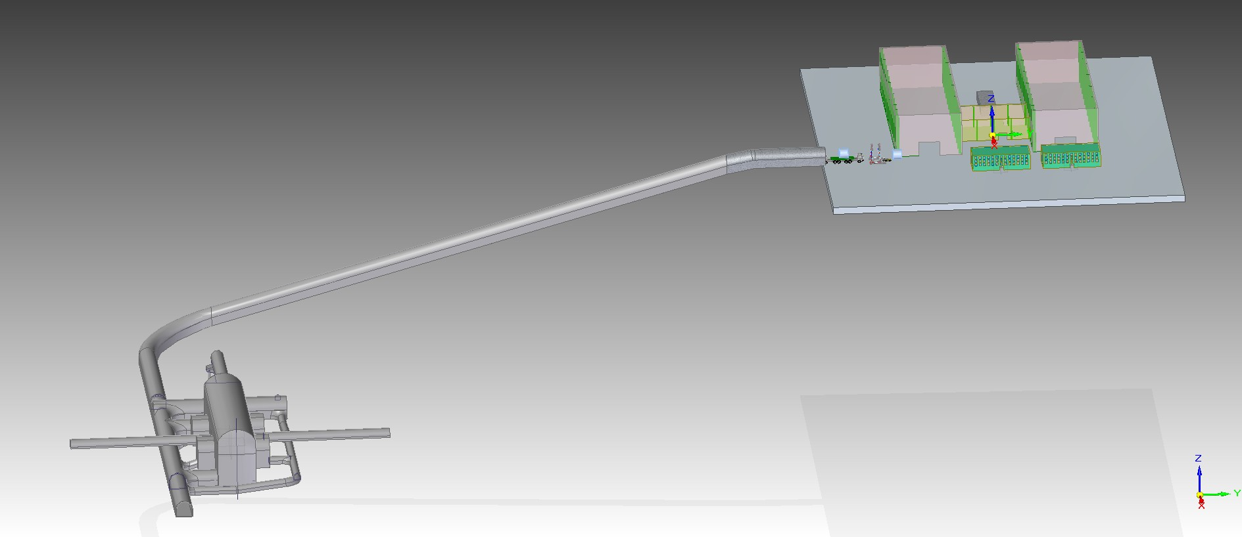
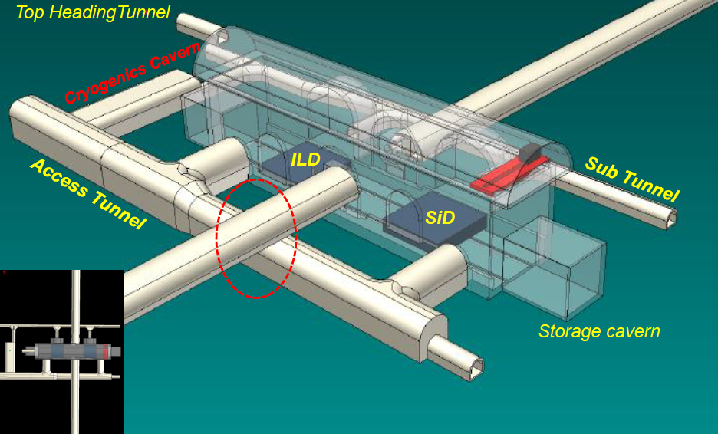
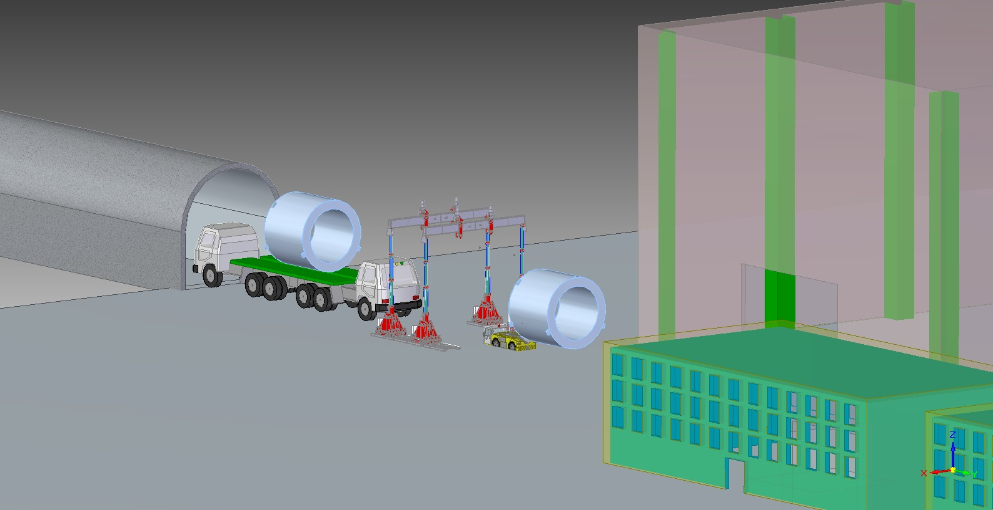
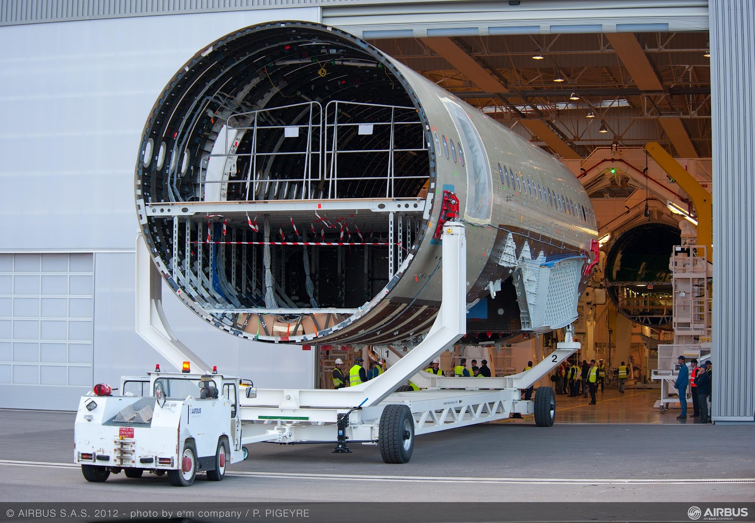
Kitakami Access Yard

Slide 25
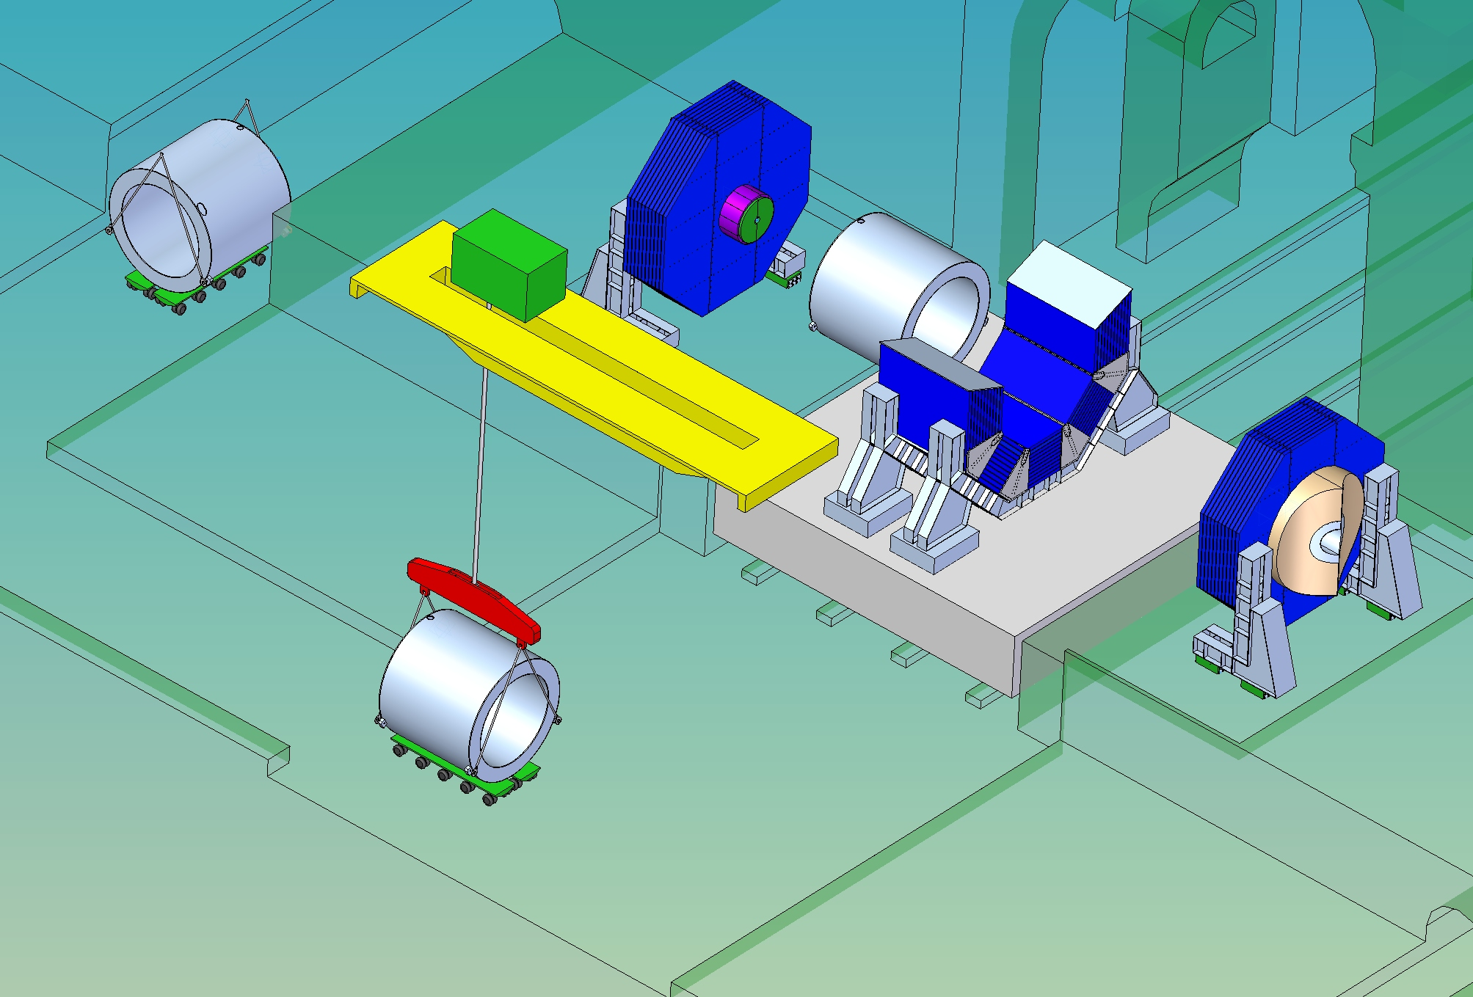
Magnet Installation – Japanese Site
215 tons Crane

Slide 26
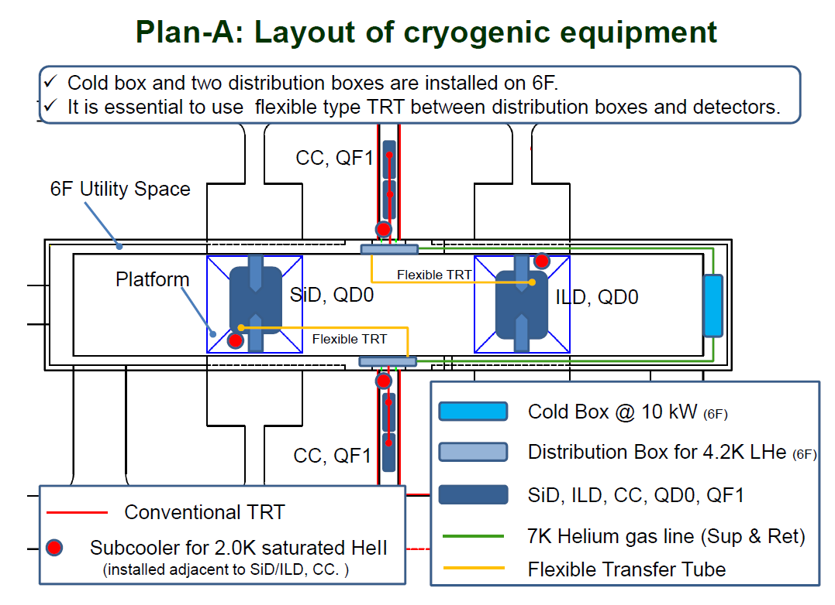
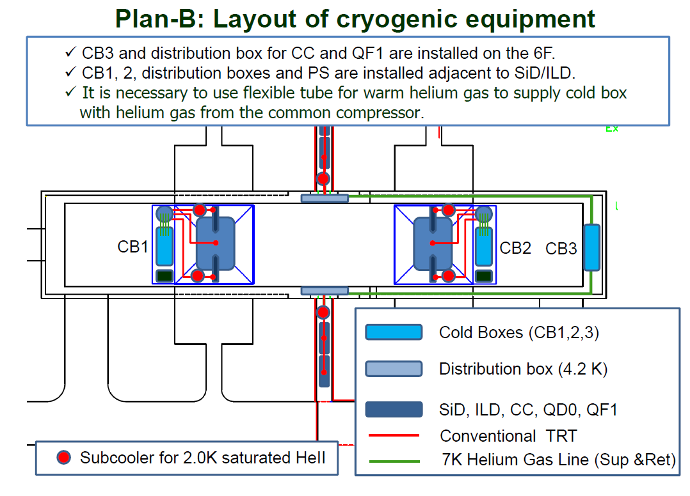
Cryogenic Layout : Two options
Plan A : Cold Boxes are stationary. Cold Transfer lines to each detector. Reliability for push-pull. Not off-the-shelf.
Plan B : Cold Boxes on the platform. Warm Transfer lines to each cold box. Vibrations, fringe field effects, space

Slide 27
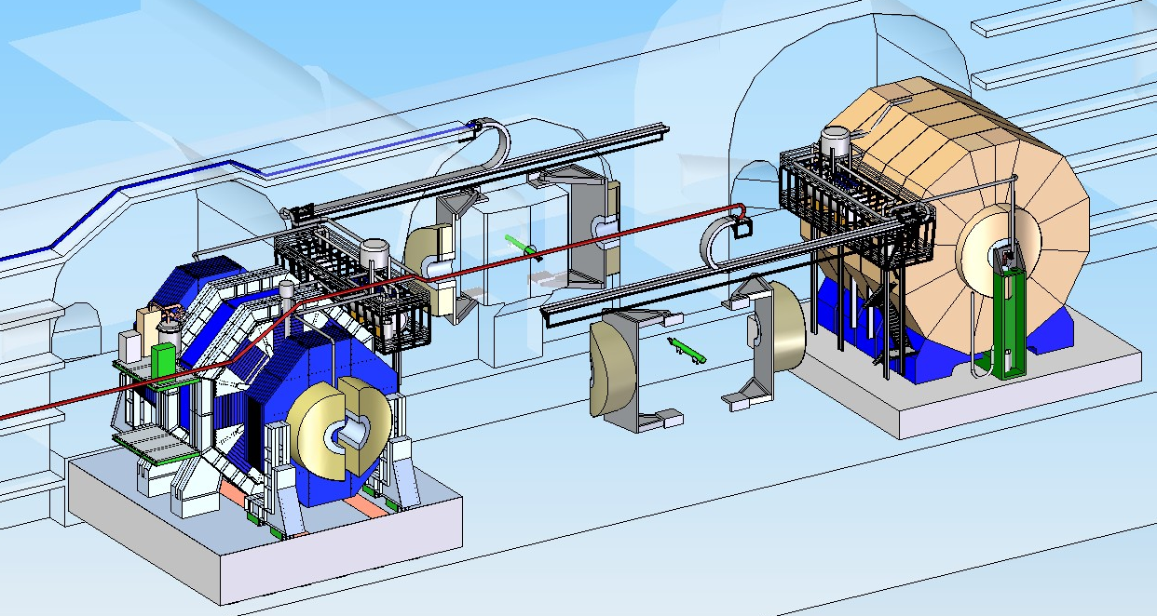
Push-Pull : Engineering Concept
Detector Hall, Japanese Mountain Site
e⁻
LHe refrigerator and LHe2 for the QD0’s above level on metallic structure.

Slide 28
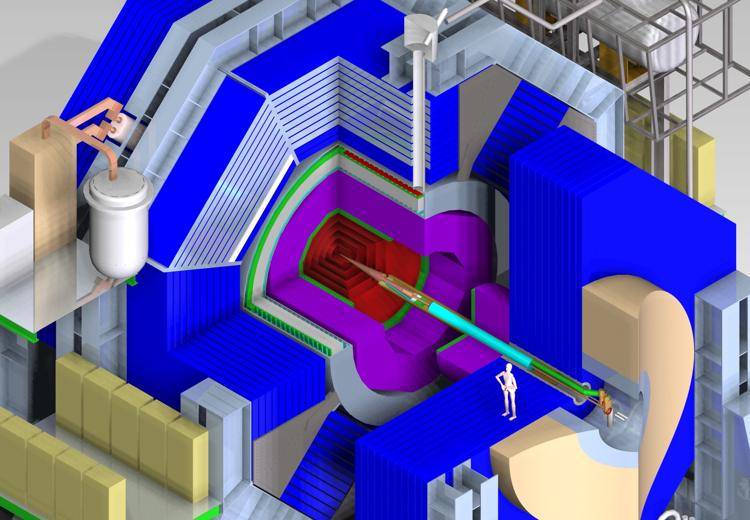

Slide 29
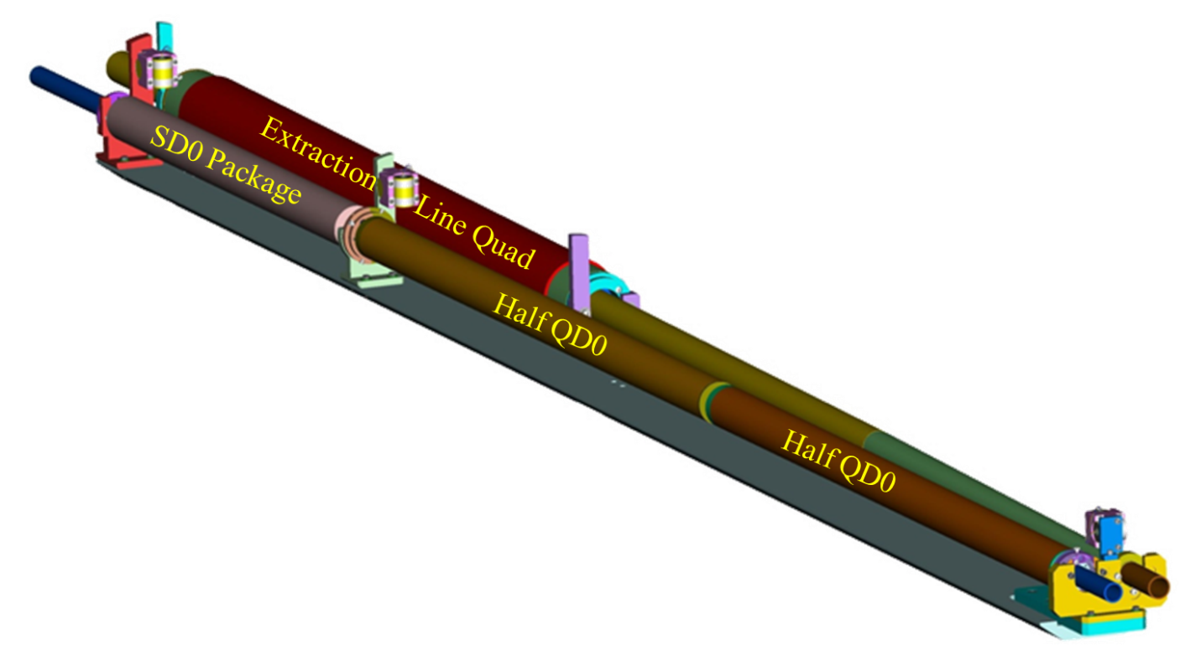
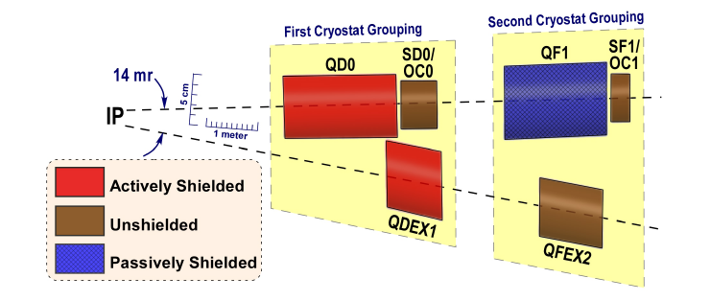
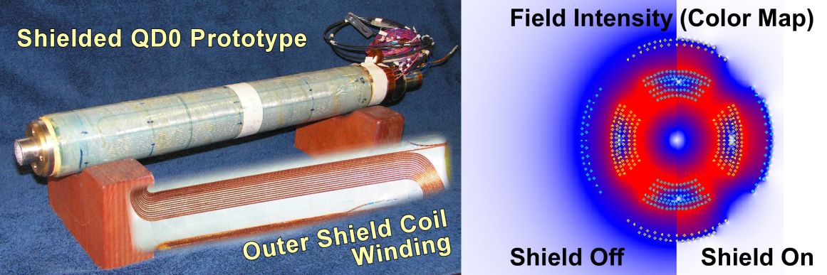
ILC QD0 : Cold Mass 2K Helium (BNL)
~3.5 m
Technology of the superconducting final focus magnets has been demonstrated
  by a series of short prototype multi-pole coils.
QD0 magnet split into two coils to allow higher flexibility at lower energies.
The quadrupoles closest to the IP are actually inside the detector solenoid.
Actively shielded coil to control magnetic cross talk
Additional large aperture anti-solenoid in the endcap region to avoid luminosity loss due to
beam optics effects.
Large aperture Detector Integrated Dipole (DID) used to reduce detector background at high beam energies or to minimize orbit deflections at low beam energies.

Slide 30
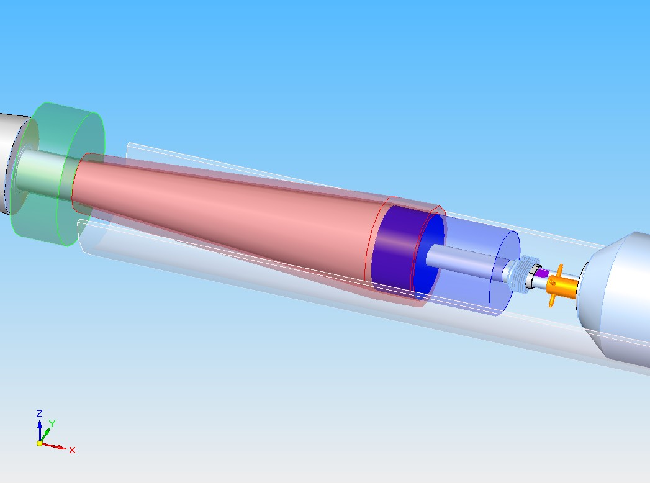
SID Forward Region
Lumical 220 kg
Mask 570 kg
Beamcal 136 kg
Bellow
BPM

Slide 31
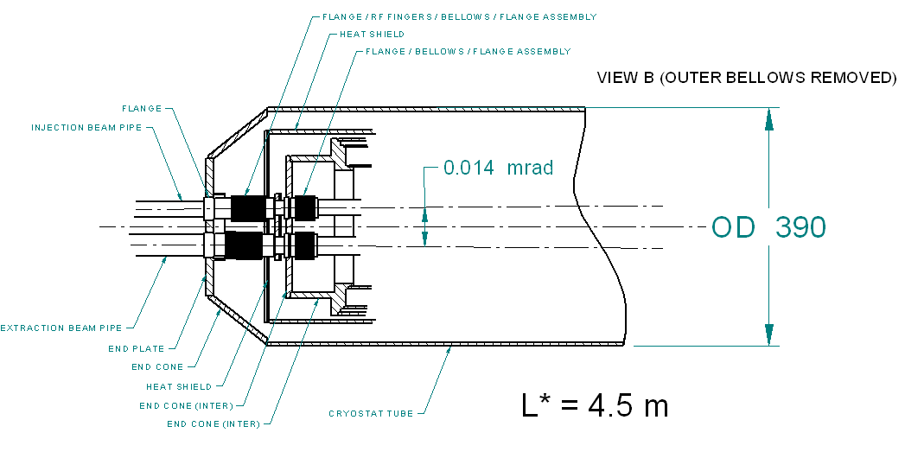
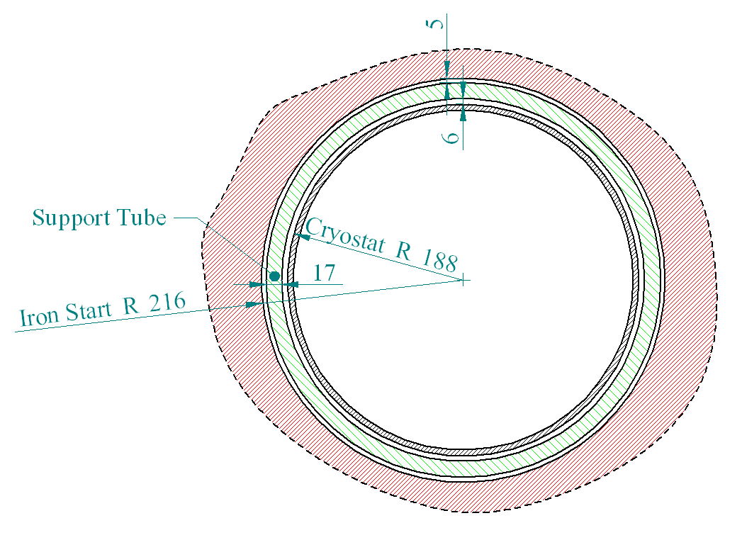
Space Requirements
Current QD0 Prototype is designed for L* 4.5 m
14 mm reduction of the QD0 cryostat gained moving the present QDO design at L*3.5 with the 14mrad crossing scheme
(1 m x 14 mrad = 14 mm)
L* 3.5 m cross section

Slide 32
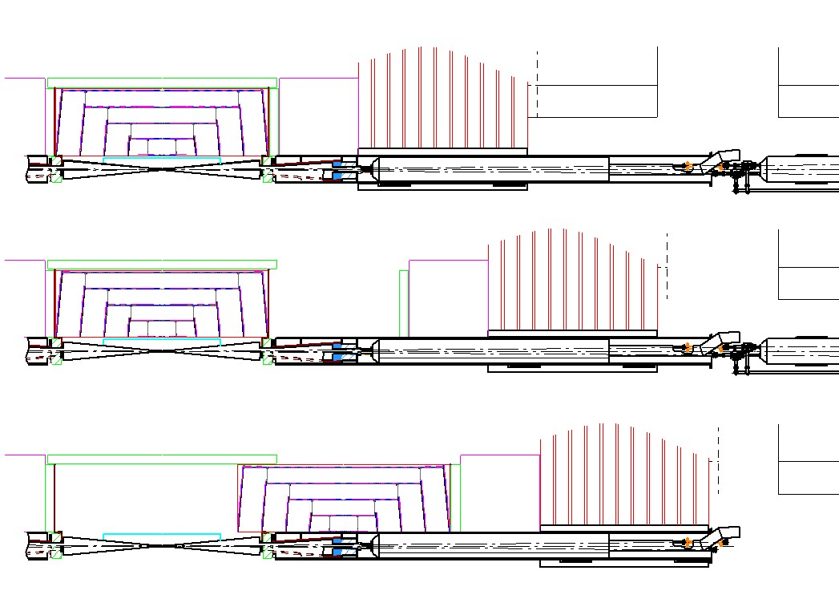
Forward Region Diameter – Tracker maintenance
Door Closed
Door 2 m Open
Door 3 m Open

Slide 33
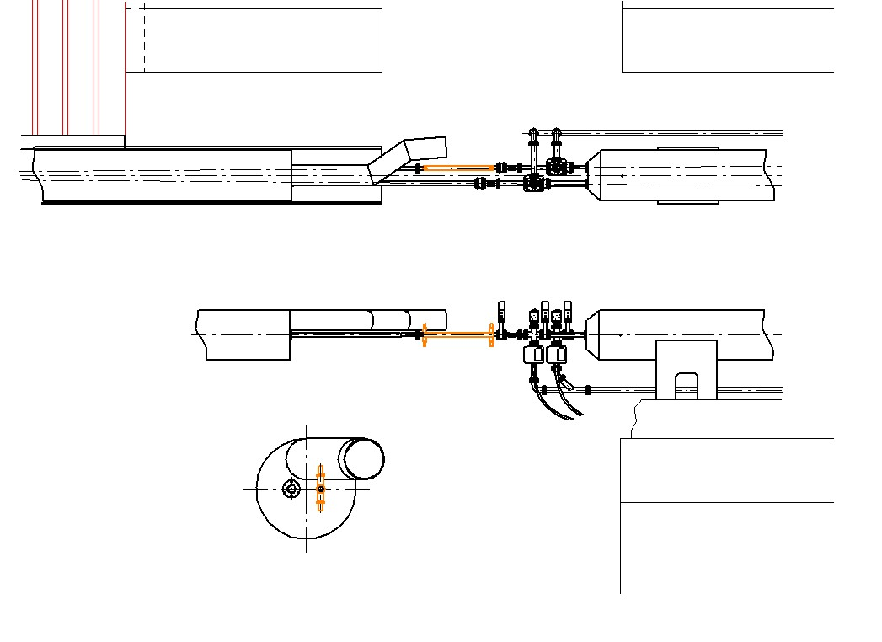
Interface QD0-QF1: Critical for Fast&Reliable Push-Pulls
Cryogenic Penetration
QD0
1 m
QF1
Vacuum Instrumentation
Kicker

Slide 34
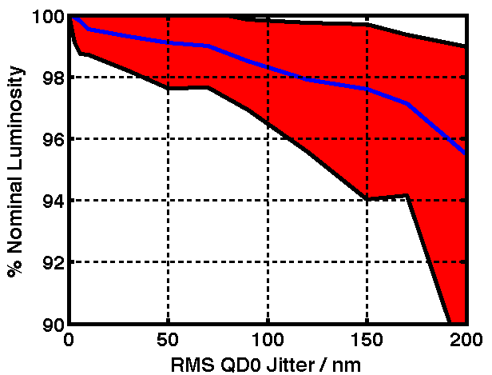
Luminosity Loss vs. QD0 Jitter
Data shown gives % nominal luminosity for different levels of uncorrelated QD0 jitter.
  100 pulses simulated per jitter cases with FFB
  Mean, 10% & 90% CL results shown for each jitter point from 100 pulse simulations
Tolerance to keep luminosity loss <1% is <50nm RMS QD0 jitter.

Slide 35
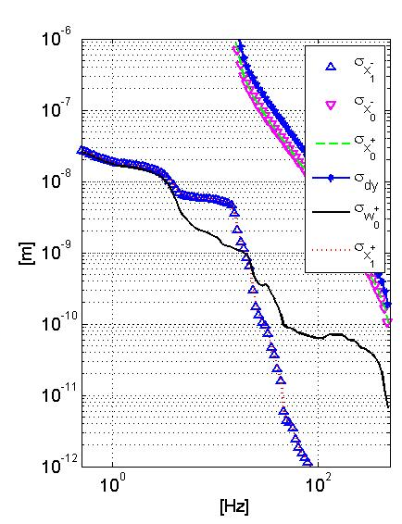
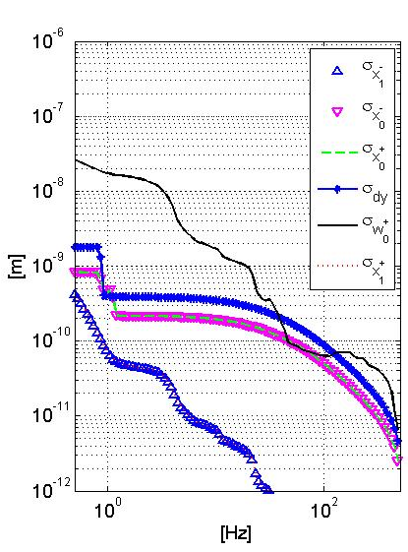
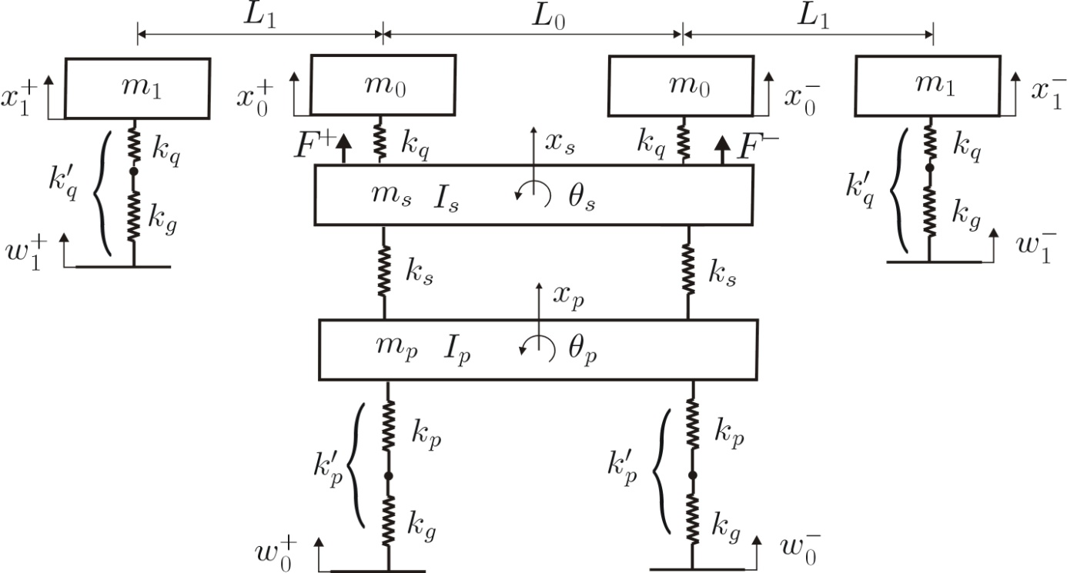
Vibration Study (C.Collette, D.Thsilumba,ULB)
QF1
QF1
QD0
SID
Platform
r.m.s.
Ground
Control OFF
Control ON
Ground Motions measured at the SLD detector hall
Conservative spectrum of the technical noise on the detector.
The model predicts that the maximum level of r.m.s. vibration seen by QDO is well below the capture range of the IP feedback system available in the ILC. With the addiction of an active stabilization system on QD0, it is also possible to achieve the stability requirements of CLIC.
Experimental measurements of the technical noise instrumenting CMS during LS1 with permanent vibration sensors

Slide 36
Summary
Many of the requirements of the MDI and the Detector Engineering are well established, but a vigorous Engineering effort needs to be deployed to spec them out.
Additional R&D is required on few cases.
The limiting factor at this stage is the Manpower (Engineers and Draftsmen) required to spec out the requirements in a consistent engineering design. It is not an SID specific problem.
The choice of a site (Kitakami) eliminates some options, although is not a game changer at this stage since the Engineering Design is still very conceptual.

Slide 37
EXTRA SLIDES

Slide 38
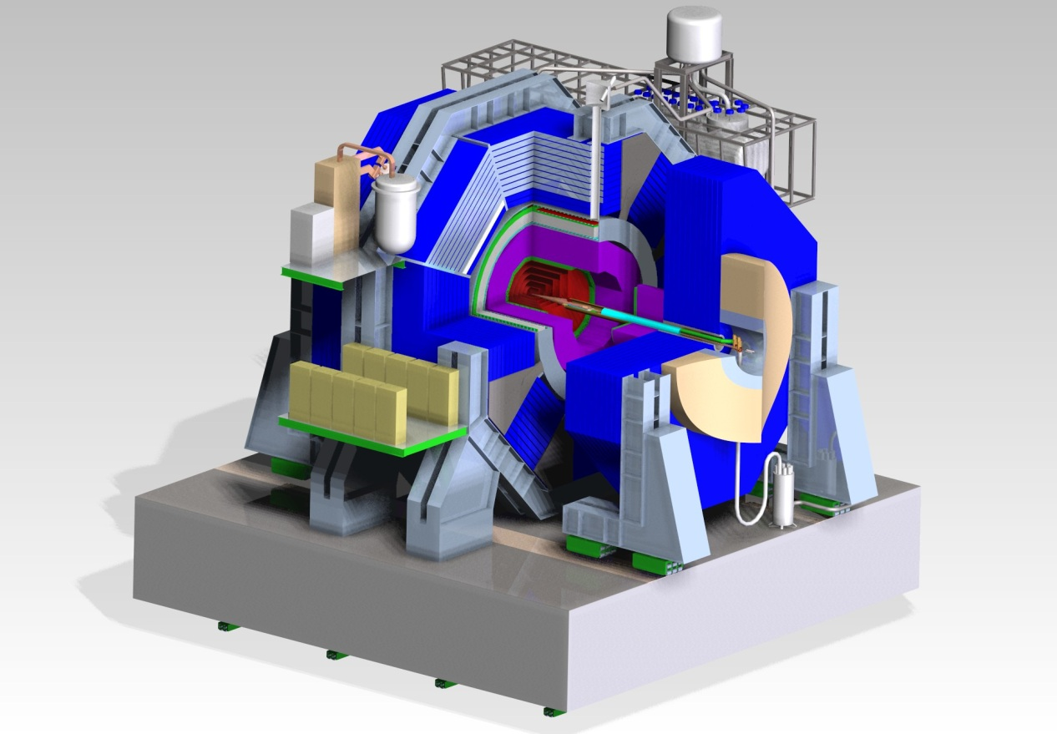
SID key design features
Compact design with 5 T Solenoid
Single Ring Barrel ~ 4’000 tons
Self Shielded: Stray Fields & Radiation
Short L* with QD0’s supported from the doors
Barrel Ecal | 60
Barrel Hcal | 450
Coil | 192
Barrel Iron | 3287
Total Barrel | 3990
Endcap Ecal | 10
Endcap Hcal | 38
Endcap Iron | 2100
Pacman | 100
Feet | 60
BDS | 5
Total Door (x1) | 2313
Total SiD | 8615

Slide 39
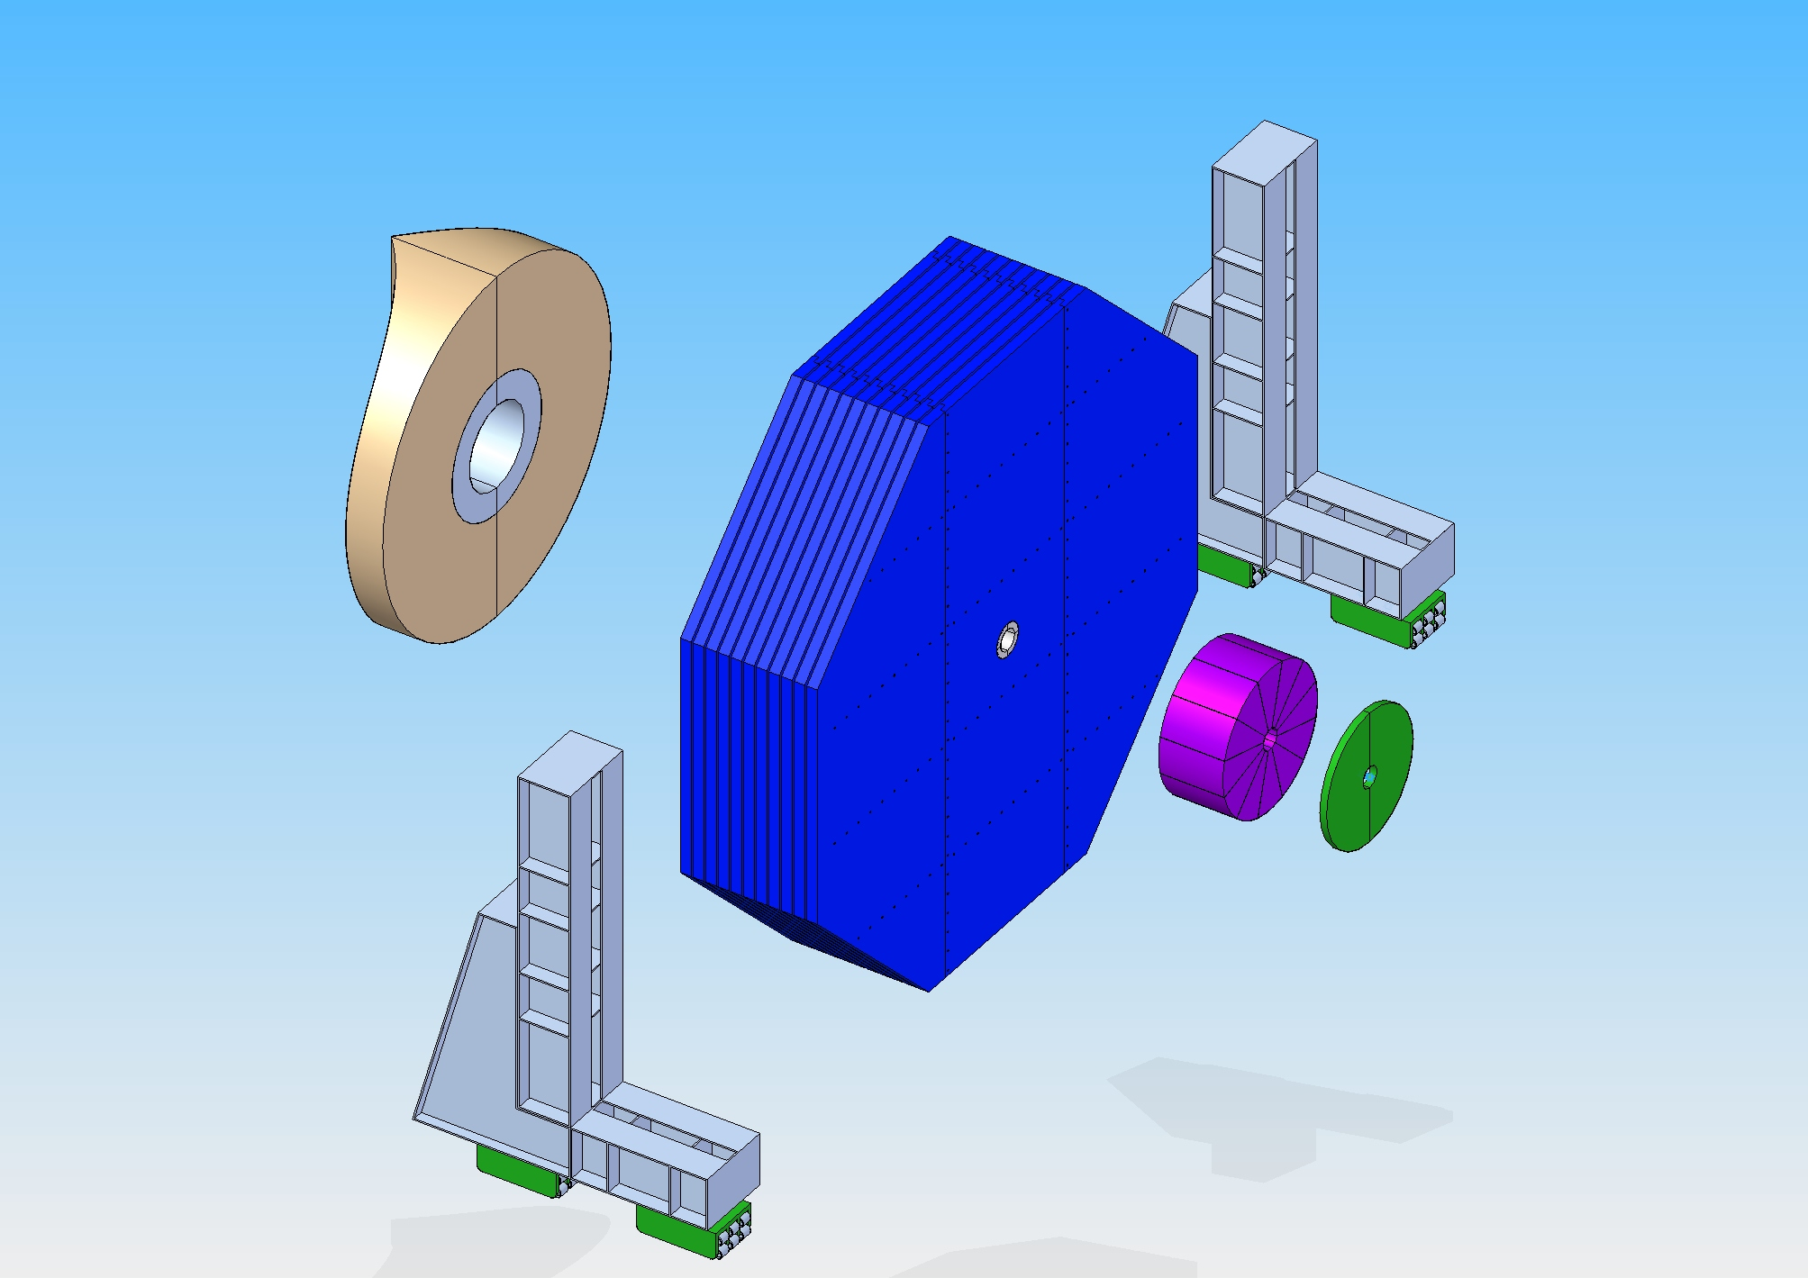
End Door
Pacman
on the door
11 x 200mm Iron plates
40mm gap
Total Mass ~ 2’300 Tons

Slide 40
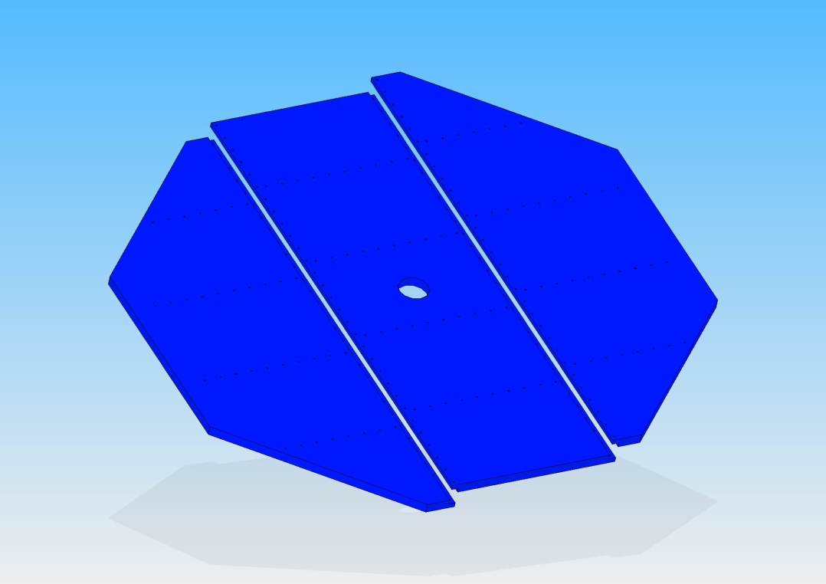
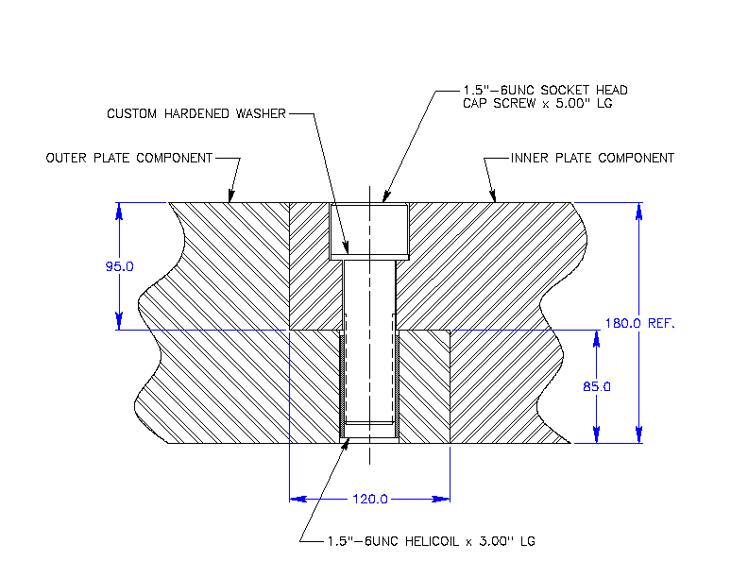
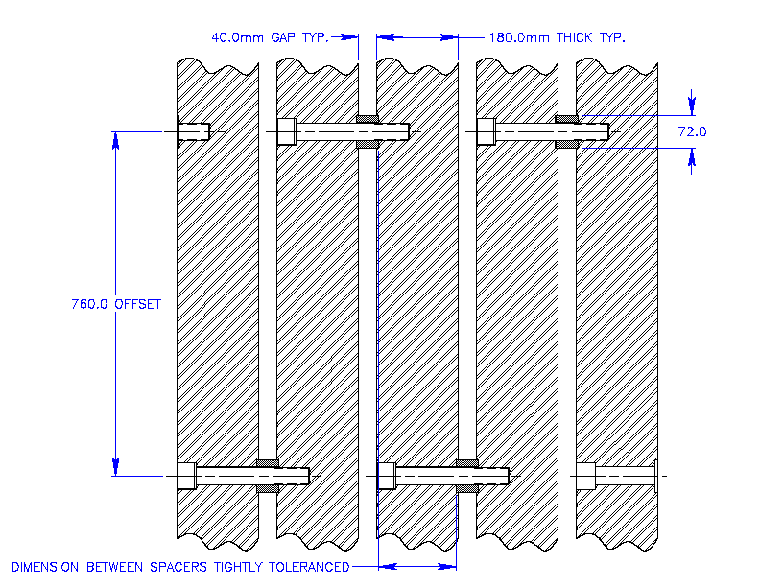
Intraplate connections
Spacer Offset
Pacman
on the door
Total Mass ~ 2’300 Tons
11 x 200mm Iron plates
40mm gap

Slide 41

Iron Barrel Yoke layout
Bolted assembly, 144 plates 200 mm thick, 40mm gap
Opportunity to make blank assembly at the factory before shipping
Preliminary Contacts with Kawasaki Heavy Industries
  Plate thickness tolerance for each: 0.1mm
  Plate flatness: 4mm (in a plate)
  Fabrication (assembling & welding) tolerance: 2mm
  Full trial assembly: capable (but need to study)
3990 tons
Max. Crane capacity 215 Tons

Slide 42

Site Delivery prior the start of the Detector Assembly
Two Cranes 215 tons,
Platforms
Minimum set of infrastructures (Power, Compr. Air, etc.)
Pacmen can wait until detectors are ready

Slide 43

Door Assembly on the platform
66 Tons
11 trips from Surface /Door
1 heavy lift / day

Slide 44

16 trips from Surface
1 heavy lift / day

Slide 45
Solenoid Installation
215 tons Crane

Slide 46




HCAL Barrel Assembly
Assembly beam
Assembly Spider
Insertion beam
Truck with HCAL Module
Insertion of HCAL
SLD, Liquid Argon Calorimeter
Assembly Beam

Slide 47



Beam Delivery System, ILC 500 GeV cm
IP Beam Parameter | σx (nm) | σy (nm) | Cross. Angle (mrad)
ILC 500 GeV_{cm} | 474 | 5.9 | 14
muon shield
ILC BDS, ± 2.2 km

Slide 48




Displacements (mm)
Door Closed, Max sag = 0.1 mm
Door Open 2 m, Max sag = 2.3 mm
Door Open 3 m
Door Open 2 m
Door Open 3 m, Max sag = 6 mm
Door Closed

Slide 49



QD0 Wedge Design Concept
ψ
X
θ
Y
Four Degree of Freedoms
Total Pad Travel as is = .475in
Height of pad and distance of displacement will be changed pending analysis on sagging of beam line.
Conceptual design only at this point
Limit Switches
Potentiometer

Slide 50



Integration of the Cryogenic plant on the platform
Main LHe refrigerator and LHe2 for the QD0’s above level on metallic structure.
Flexible line to the compressor
Valve Box
LHe2
IP
LHe2
LHe Box

Slide 51

Assembly on Site (surface)
Test with low current
Total Mass = 180 Tons
Ring 2
Ring 1
DID
Solenoid Cross section

Slide 52

Assembly Yard - CMS
34,000 m2
150 m
Control Room
Offices
140 m
25 m
Gas 1
Gas 2
He
223 m

Slide 53

SPS beam extraction - North area (CERN)
230 m
46 m

