Slide 1
ILC Accelerator
A 25-year effort towards an e⁺e⁻ collider
Nan Phinney
SLAC
ILC Worldwide Event, Fermilab, June 12, 2013
(Many slides courtesy of Marc Ross, Akira Yamamoto, Barry Barish)

Slide 2
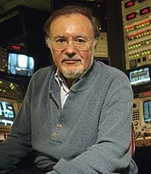
The Beginning – an idea
A Possible Apparatus for Electron-Clashing Experiments (*).
M. Tigner
Laboratory of Nuclear Studies. Cornell University - Ithaca, N.Y.
M. Tigner,
Nuovo Cimento 37 (1965) 1228
“While the storage ring concept for providing clashing-beam experiments (¹) is very elegant in concept it seems worth-while at the present juncture to investigate other methods which, while less elegant and superficially more complex may prove more tractable.”
Notes:
Basic linear collider experience through slac. Offset controls & instrumentation against high power. The present Lep3 wars.
International science-studies done for the pip. Alma and iter and CERN. The coming age of bigger science.
The explosion of accelerator technology. The promise of small beams.
The role of projects in the definition of new technology. Slac 2mile project. ILC.
The promise of SRF. ITRP history. Possible link with ncrf.
Industrialization.
Accelerators in the 1970's. where to go? Spear, pep, Petra and Lep.
The linear collider.
The story of the SLC.

Slide 3
Two Linacs, No Bends!
bang!
e⁺
e⁻
~15-20 km
For a E_{cm} = 1 TeV machine:
Effective gradient G = 500 GV / 15 km
= 34 MV/m real-estate gradient
Cost scaling: storage ring $_{tot} ∝ E²
linear collider $_{tot} ∝ E

Slide 4
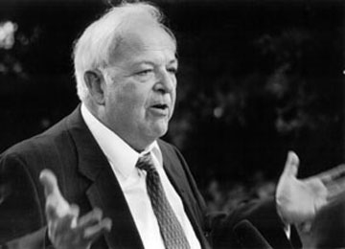
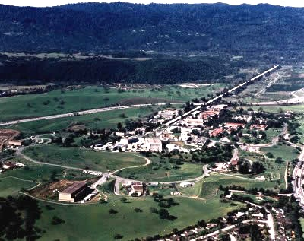
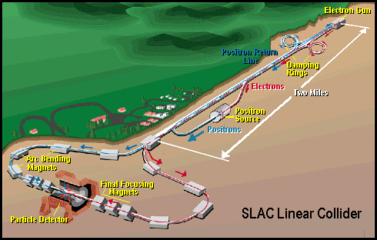
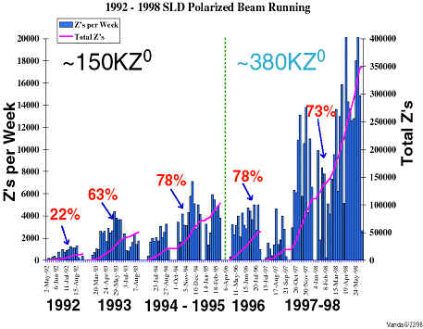
The real Beginning was at SLAC
SLAC Linear Collider (SLC)
1988-1998
A proof of principle
Burt Richter
Achieved σ^{x}×σ^{y} = 1/3 of design

Slide 5
Linear Collider Design Issues
L – Luminosity: Effectiveness of collider
N – particles in a bunch
n_{b} – bunches in a machine pulse
f_{rep} – pulses per second
σ_{x,y} – x (and y) beam sigma at IP
H_{D} – disruption of one beam caused by the fields of the other
Energy Reach
LC Parameters
E_{CM} – collision Center of Mass Energy
b__{fill} – the fraction of the machine length actually used for acceleration
L__{linac} – the length of the linac
G__{RF} – the average accelerating gradient
Luminosity

Slide 6
The Luminosity Issue
High current (n_{b} N)
High efficiency
(P_{RF} →P_{beam})
High Beam Power
Small IP vertical
beam size
Small emittance ε_{y}
strong focusing
(small β*_{y})

Slide 7
The Luminosity Issue
High current (n_{b} N)
High efficiency
(P_{RF} →P_{beam})
Superconducting RF Linac
Technology
(SCRF)
Small emittance ε_{y}
strong focusing
(small β*_{y})

Slide 8
the Big Jump from SLC to ILC:
In Beam Power (P_{beam}) X 100,
collision beam size (σ*_{y}) 1/100
and Luminosity (L) X 10⁴
SLC / ILC Comparison

Slide 9
1st LC Technology Review - 1994
Only one scheme (of 8) was superconducting
E_{cm}=500 GeV
 | TESLA | SBLC | JLC-S | JLC-C | JLC-X | NLC | VLEPP | CLIC
f [GHz] | 1.3 | 3.0 | 2.8 | 5.7 | 11.4 | 11.4 | 14.0 | 30.0
L×10³³ [cm⁻²s⁻¹] | 6 | 4 | 4 | 9 | 5 | 7 | 9 | 1-5
P_{beam} [MW] | 16.5 | 7.3 | 1.3 | 4.3 | 3.2 | 4.2 | 2.4 | ~1-4
P_{AC} [MW] | 164 | 139 | 118 | 209 | 114 | 103 | 57 | 100
γε_{y} [×10⁻⁸m] | 100 | 50 | 4.8 | 4.8 | 4.8 | 5 | 7.5 | 15
σ_{y}* [nm] | 64 | 28 | 3 | 3 | 3 | 3.2 | 4 | 7.4
ILC Accelerator
9
Nan Phinney, 6/12/13

Slide 10
2nd LC Technology Review - 2002
E_{cm}=500 GeV
 | TESLA | SBLC | JLC-S | JLC-C | JLC-X/NLC | VLEPP | CLIC
f [GHz] | 1.3 |  |  | 5.7 | 11.4 |  | 30.0
L×10³³ [cm⁻²s⁻¹] | 34 |  |  | 14 | 20 |  | 21
P_{beam} [MW] | 11.3 |  |  | 5.8 | 6.9 |  | 4.9
P_{AC} [MW] | 140 |  |  | 233 | 195 |  | 175
γε_{y} [×10⁻⁸m] | 3 |  |  | 4 | 4 |  | 1
σ_{y}* [nm] | 5 |  |  | 4 | 3 |  | 1.2
Not Represented
Not Ready
ILC Accelerator
10
Nan Phinney, 6/12/13

Slide 11
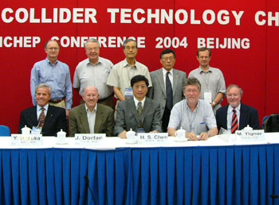
International Technology Review Panel
International Committee for Future Accelerators (ICFA) representing major particle physics laboratories worldwide convened a panel to choose the collider technology.
In Beijing 2004, ICFA accepted the ITRP recommendation.
Chose ILC accelerator technology (SCRF)
Determined ILC physics design parameters
Formed Global Design Effort and Mandate (TDR)
ILC Accelerator
11
Nan Phinney, 6/12/13

Slide 12
By late 2004: only ILC and CLIC
E_{cm}=500-1000 GeV
 | ILC | SBLC | JLC-S | JLC-C | JLC-X/NLC | VLEPP | CLIC
f [GHz] | 1.3 |  |  |  |  |  | 30.0
L×10³³ [cm⁻²s⁻¹] | ≥20 |  |  |  |  |  | 21
P_{beam} [MW] | 5-23 |  |  |  |  |  | 4.9
P_{AC} [MW] | 140-300 |  |  |  |  |  | 175
γε_{y} [×10⁻⁸m] | 3-8 |  |  |  |  |  | 1
σ_{y}* [nm] | 3-8 |  |  |  |  |  | 1.2
ILC Accelerator
12
Nan Phinney, 6/12/13

Slide 13
ILC and CLIC: 2013
E_{cm}=500-1000 GeV
 | ILC | SBLC | JLC-S | JLC-C | JLC-X/NLC | VLEPP | CLIC
f [GHz] | 1.3 |  |  |  |  |  | 11.4
L×10³³ [cm⁻²s⁻¹] | 18 |  |  |  |  |  | 23
P_{beam} [MW] | 5 |  |  |  |  |  | 4.9
P_{AC} [MW] | 160 |  |  |  |  |  | 257
γε_{y} [×10⁻⁸m] | 3 |  |  |  |  |  | 1
σ_{y}* [nm] | 6 |  |  |  |  |  | 1.2
Closer, but still Not Ready
This talk
ILC Accelerator
13
Nan Phinney, 6/12/13

Slide 14
25 year – long effort towards a very high performance e+ / e- collider
Year | 1987 | 1992 |  |  |  | 1998 |  |  |  | 2004 |  |  |  | 2006 |  |  | 2012
Phase | SLC @ SLAC |  |  |  |  |  | LC Design |  |  |  |  | Global Design Effort - ILC
500 GeV Linear Collider R & D | 8 schemes |  |  |  |  | 4 |  |  |  |  |  |  | 2
Comparative Reviews |  |  |  | Technology Review 1995 |  |  |  |  | Technology Review 2002 |  | International Technology Review Panel 2004 |  |  |  | ‘General issues’ ILC/CLIC
Beam Test Facilities - Linac (cost-driver) | (SLAC) |  |  |  | NLCTA, TTF / FLASH
 |  |  |  |  |  |  |  |  |  |  |  |  |  |  |  | NML, STF, CTF
Beam Test Facilities - Emittance |  |  | FFTB |  |  |  |  | ATF CesrTA ATF2
ILC Accelerator
14
Nan Phinney, 6/12/13

Slide 15
Requirements from Physics Experiments
Basic requirements：
  Luminosity : ∫Ldt = 500 fb⁻¹ in 4 years
  E_{cm} : 200 – 500 GeV and the ability to scan
  E stability and precision: < 0.1%
  Electron polarization: > 80%
Extension capability：
  Energy upgrade: 500 → 1,000 GeV
5GeV e-, e+ Damping Ring (3.2km)
E+ production
Bunch compression
Bunch compression
e- ML
E+ ML
IP
E- production
Notes:
15

Slide 16
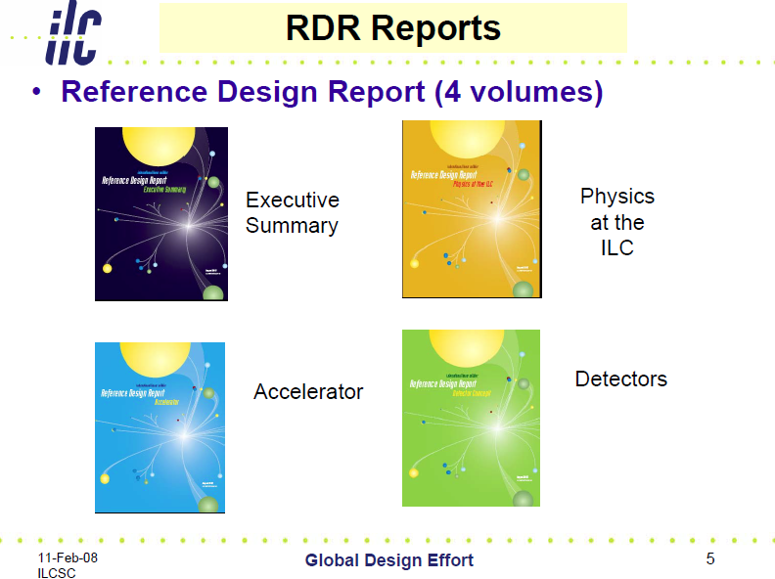
Reference Design - 2007
ILC Accelerator
16
Nan Phinney, 6/12/13

Slide 17
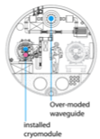
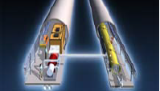
RDR (2007) to TDR (2012)
Cost Containment Effort
Single acc. Tunnel
Reducing # bunches
  w/ smaller damping rings
Allowing gradient spread
  31.5 MV/m +/- 20 %,
Site-dependent RF system:
  Clustered on surface (KCS),
  Distributed in tunnel (DKS)
RDR’07 →
(Reference Design Rep.)
TDR’12
(Technical Design Rep.)
5 m
Flat-land or Mountainous Tunnel Design

Slide 18
Major R&D Efforts in TD Phase
SCRF technology and beam acceleration：
  Cavity Gradient required：31.5 MV/m
    ILC SCRF cavity R&D
      Effort for ~ 7 x Gradient (KEK-TRISTAN, CERN-LEP)
      Gradient Progress ： < 37 MV/m> （Record：46 MV/m at DESY)
      System engineering： S1-Global program with global effort
  Industrialization of cavity production
Electron Cloud Mitigation (CESR-TA)
Nano-beam handling :
  ILC requires a beam size ~ 6 nm (vertical) and stability ~2nm:
    Progress in KEK-ATF2:
      achieved ~70 nm (at 1.3 GeV),
      corresponding to 10 nm (at 250 GeV, ILC)

Slide 19
Global Plan for SCRF R&D
Year | 07 | 2008 |  | 2009 |  | 2010 |  | 2011 | 2012
Phase | TDP-1 |  |  |  |  |  | TDP-2
Cavity Gradient in vert test to reach 35 MV/m | → Yield 50% |  |  |  |  |  | → Yield 90%
Cavity-string to reach 31.5 MV/m, with one-cryomodule |  | Global effort for string assembly and test (DESY, FNAL, INFN, KEK)
System Test with beam acceleration |  |  | FLASH (DESY) , NML/ASTA (FNAL) QB, STF2 (KEK)
Preparation for Industrialization |  |  |  |  | Production Technology R&D
Communication with industry: | 1st Visit Vendors (2009), Organize Workshop (2010) 2nd visit and communication, Organize 2nd workshop (2011) 3rd communication and study contracted with selected vendors (2011-2012)
ILC Accelerator
19
Nan Phinney, 6/12/13

Slide 20
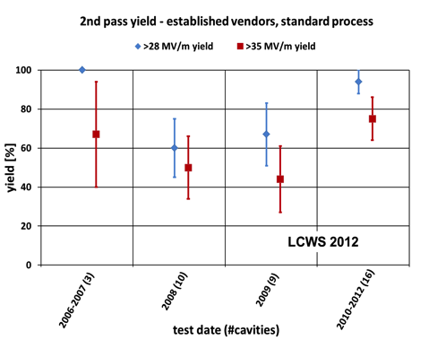
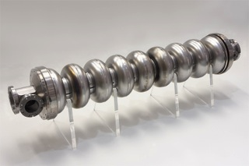
Progress in SCRF Cavity Gradient
Production yield:
94 % at > 28 MV/m,
Average gradient:
37.1 MV/m
reached in 2012
ILC Accelerator
Nan Phinney, 6/12/13

Slide 21
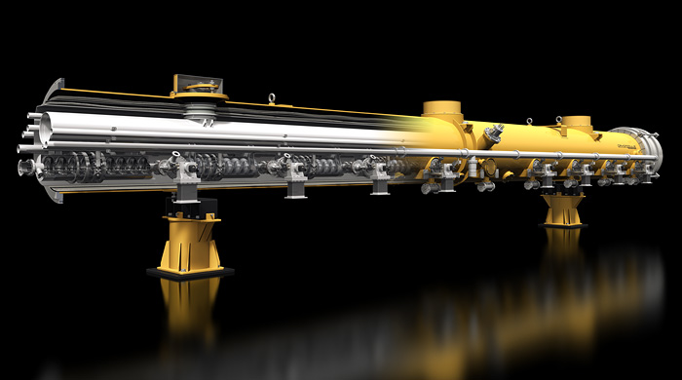
ILC Cryomodule
12.6 m long; 1 m diameter
  (Similar to LHC dipole)
  8 cavities w / SC quad magnet in middle

Slide 22
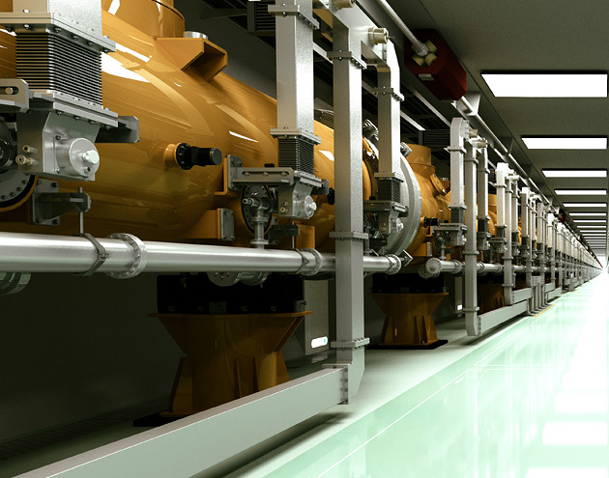
View along main linac:

Slide 23
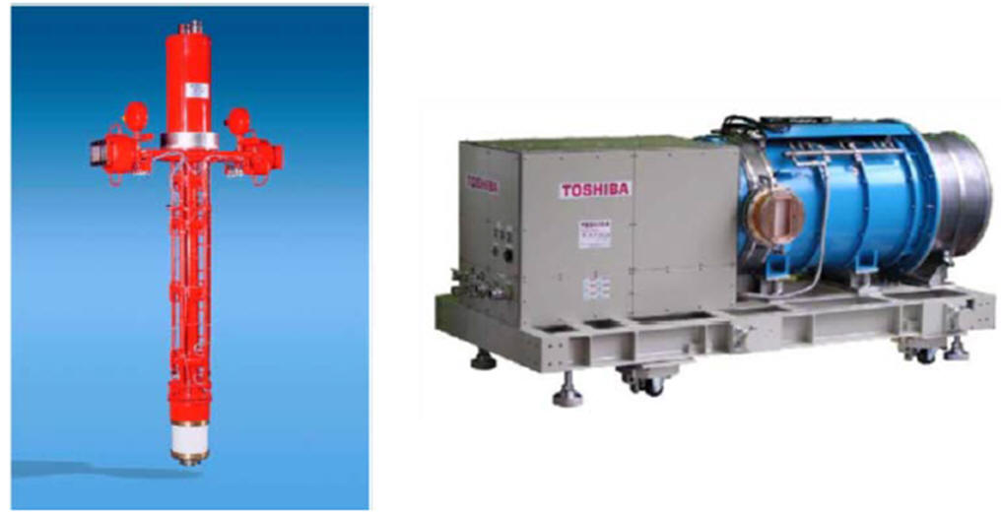
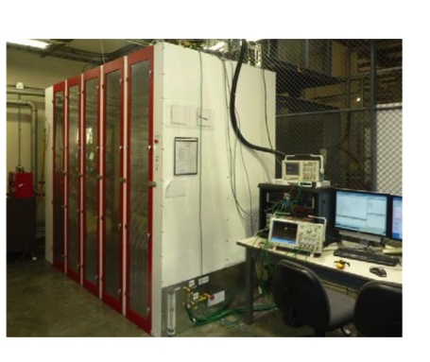
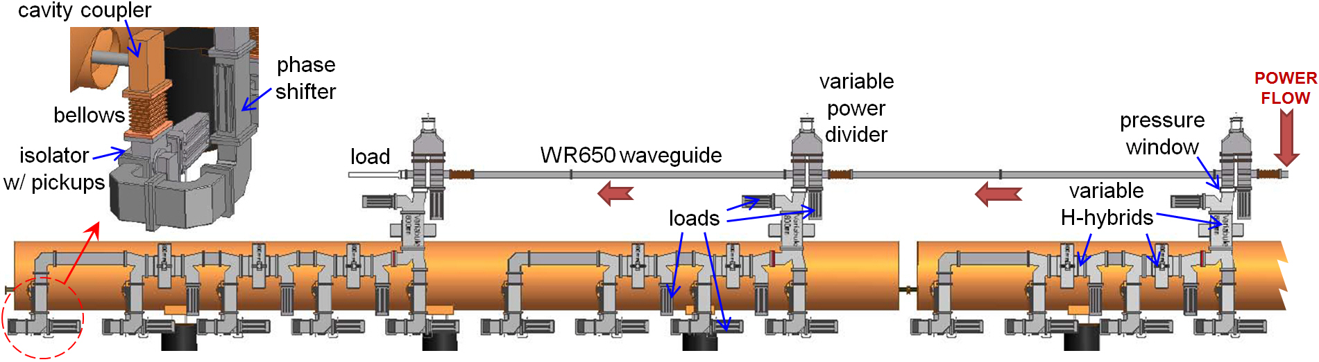
RF Power Source and Distribution
Marx modulator
10MW MB Klystron
Adjustable local power distribution system
ILC Accelerator
23
Nan Phinney, 6/12/13

Slide 24

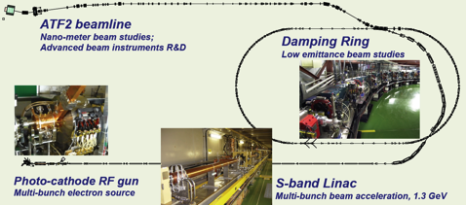
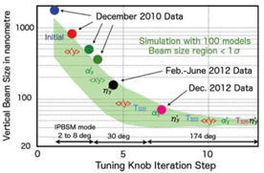
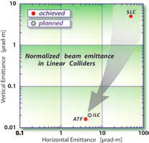
KEK-ATF：Progress
Ultra-small beam
Low emittance : KEK-ATF
  Achieved the ILC goal (2004).
Small vertical beam size : KEK ATF2
  Goal = 37 nm,
    160 nm (spring, 2012)
    ~70 nm (Dec. 2012) at low beam current
ILC Accelerator
24
Nan Phinney, 6/12/13

Slide 25
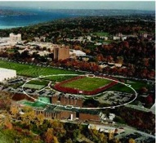
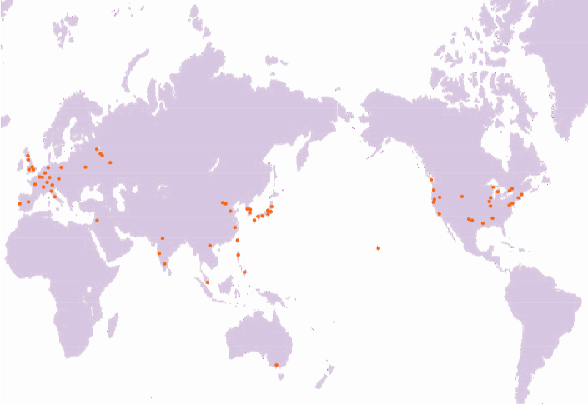
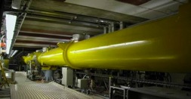
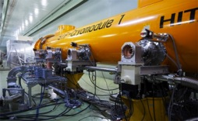
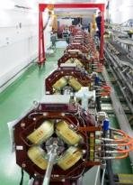
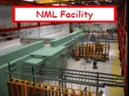
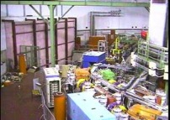
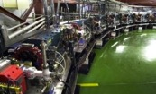
Global Cooperation for ILC Accelerator Beam Demonstration
TTF/FLASH (DESY) ~1 GeV
ILC-like beam ILC RF unit
(* lower gradient)
STF (KEK) operation/construction
ILC Cryomodule test： S1-Global
Quantum Beam experiment
CesrTA (Cornell)
electron cloud
low emittance
DESY
◉
◉
INFN Frascati
KEK, Japan
FNAL
◉
◉
Cornell
◉
ATF & ATF2 (KEK)
ultra-low emittance
Final Focus optics
KEKB electron-cloud
NML facility ILC RF unit test
Under construction
DA^{f}NE (INFN Frascati)
kicker development
electron cloud
ILC Accelerator
25
Nan Phinney, 6/12/13

Slide 26
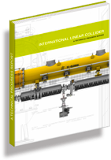
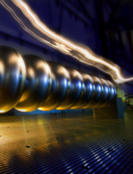
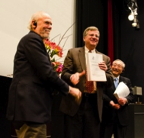
Technical Design Report Completed
2007
2011
2013*
TDR Part I:
R&D
~250 pages
Deliverable 2
ILC Technical Progress Report
(“interim report”)
AD&I
TDR Part II:
Baseline
Reference
Report
~300 pages
Deliverables 1,3 and 4
Technical Design Report
Reference Design Report
* end of 2012 – formal publication early 2013
ILC Accelerator
26
Nan Phinney, 6/12/13

Slide 27
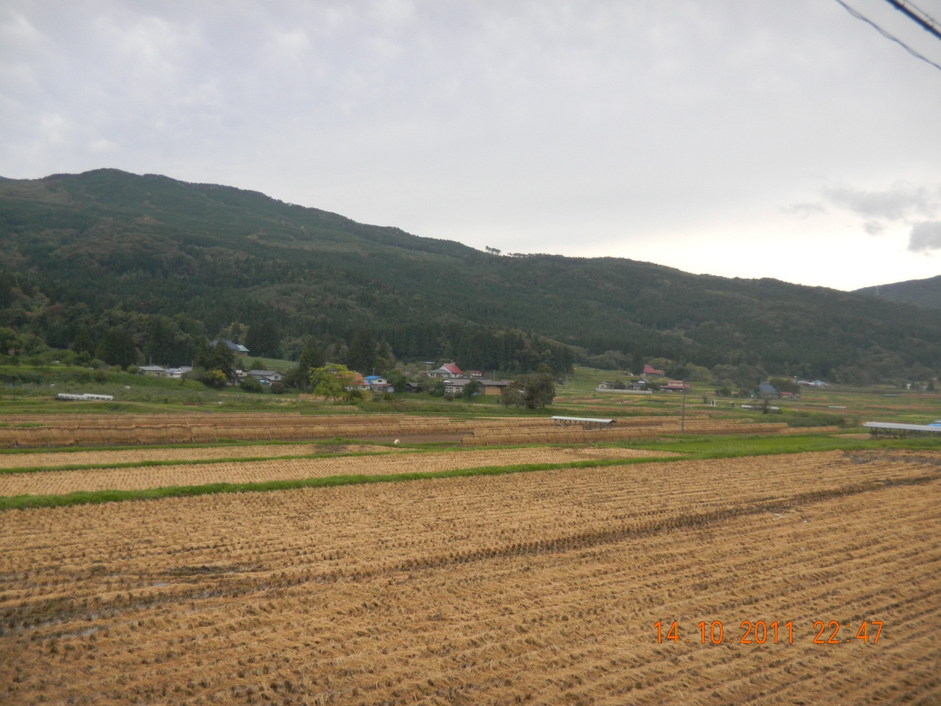
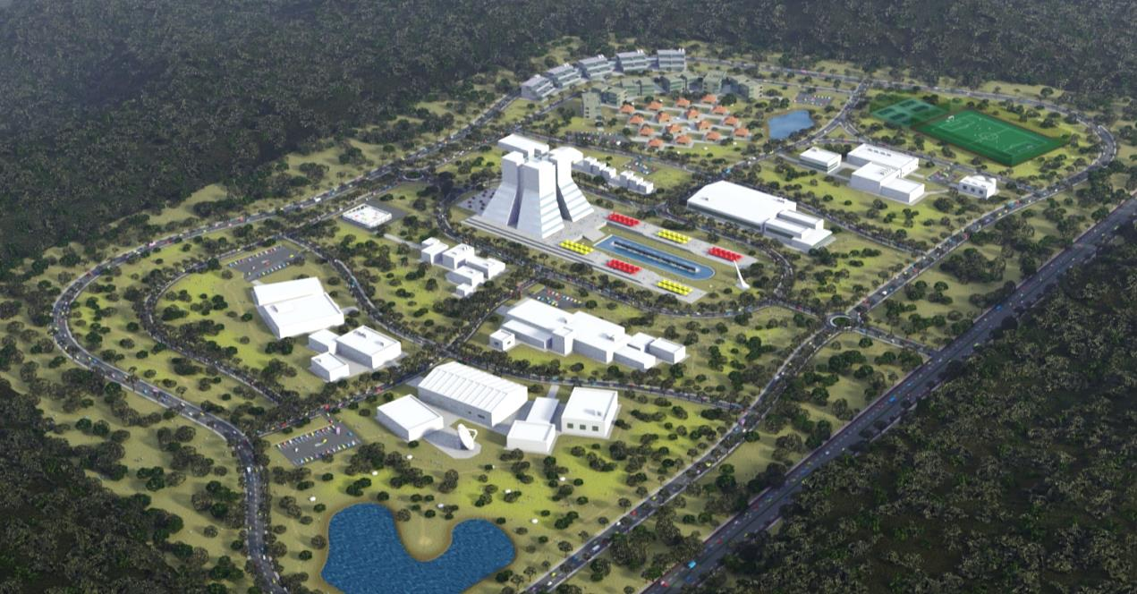


Japanese plans for a “Science City”

Slide 28
What’s next?
20 years from 1st idea to 1st prototype SLC
25 more years to a complete ILC design
2013
  TDR complete, Technical- and Cost-Reviews done
  Linear Collider Collaboration is being formed
  Japan plans to select a site this summer
2013-2016
  Prepare a proposal to the funding agencies
2016
The ILC is Good to Go
Quote from ILCSC chair Jonathan Bagger at LC2013 DESY

