Slide 1
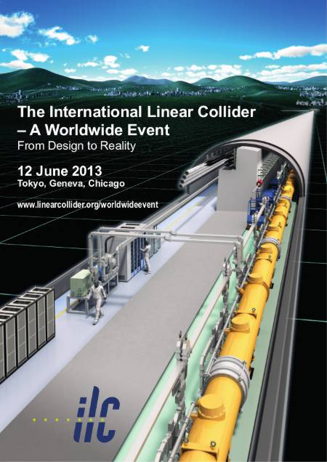

Detectors for a LC: from design to reality
LINEAR COLLIDER COLLABORATION
François Richard LAL/Orsay

Slide 2
Outline
What do we expect from LC detectors ?
Are the two proposed detectors (ILD & SiD) fit for this mission ?
What is the degree of realism achieved so far for the Detailed Baseline Design
How do these detectors differ from the existing ones ?
What is still needed ?

Slide 3
LC physics environment
Known (and speculated) physics channels dictate detector properties
A LC is a H/top/W factory with well defined initial state (mono-energetic e+ and e- with adjustable energy for scans) and excellent signal/background (e.g. top quarks as often produced as ordinary quarks in contrast to LHC)
Direct and very precise access to electroweak couplings using polarized beams
Far easier environment than at LHC but with much more ambitious goals in terms of accuracy (below %) and complexity (high efficiency for multi-jet events)

Slide 4
Physics at ECM=250 GeV
H(=BEH particle) inclusive reconstruction near threshold
Use Z->ee/µµ to isolate a very clean Higgs signal mass (HZZ coupling measurement)
-> high momentum resolution
H into bb/cc/ττ and WW*/gg + invisible decay in BSM (role of missing energy)
->Select c and b by measuring displaced vertices

Slide 5
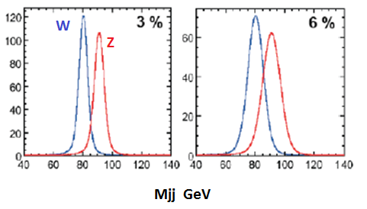
Physics at ECM≥500 GeV
Fusion with missing neutrinos requires reconstruction of H decays into jets
dEj/Ej~3% needed for a clean W/Z mass separation (worse by a factor 2 at LEP)

Slide 6
High jet multiplicity
ttH and ZHH have low cross sections and complex final states with up to 8 jets
Full angular acceptance needed keeping all tagging properties including for b/c/τ
Was not the case for LEP detectors (coping with 4 jets) with weaker performances in the forward region

Slide 7
An example: ttH (from SiD)

Slide 8

Bias free selection
Possible discoveries beyond LHC are not excluded
A bias free selection is therefore essential to cover any unforeseen physics scenario
The beam time structure (~ms bunch trains at 5Hz) allows to replace hardware triggering by software triggering in between trains
Detectors act as a camera where all the useful information (noise suppressed) is stored during the whole bunch train

Slide 9
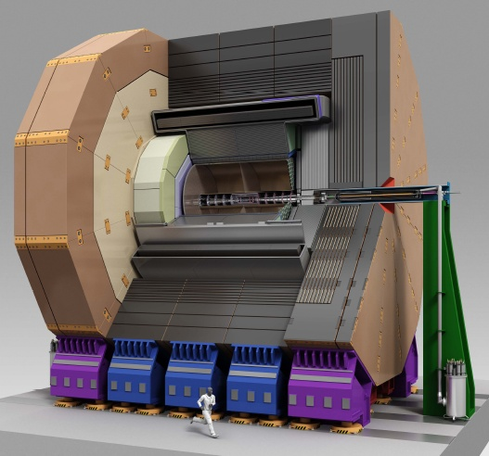
2 concepts: SiD & ILD

Slide 10
Common features
Full angular coverage including for flavor tagging
Large SC solenoidal magnetic field ‘a la CMS’ B>3 T ensuring excellent momentum resolution
Almost ‘transparent’ trackers with calorimeters included inside the coil minimizing material effects
Imaging calorimetry for PFA with a very large number of electronic channels(>10⁸)
Push-pull philosophy insuring scientific and technical safety

Slide 11
Differences
Different B field & tracker radius achieving similar energy/momentum resolution
100% Silicon tracker for SiD
ILD has a large volume gaseous tracker (TPC >>LEP) supplemented by silicon tracking
Various calorimeter technologies are considered, ILD leaving open its final choice
SiD 5T
ILD 3.5T
SiD 1.2m
ILD 1.8m

Slide 12
Particle Flow Algorithm (PFA)
Plays a major role in the optimization of the 2 detectors
What is the problem ?
Optimization of PFA shows that the main limitation is confusion not energy resolution
Compact (limited shower radial expansion) and granular calorimeters needed (0.5x0.5 cm² Si pads for ECAL), excellent tracking efficiency (>99%) and low material in front

Slide 13
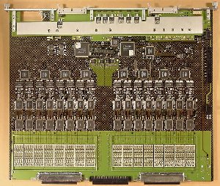
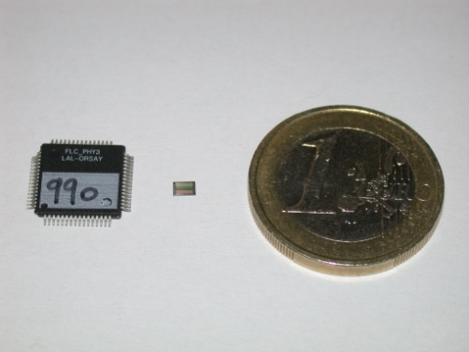

Imaging calorimetry
High granular calorimetry with >10⁸ channels becomes practical with low consumption µ-electronics inside the calorimeters
Power pulsing at 5 Hz
with ~1ms duration
ILC : 25µW/ch
Physics Proto. 18ch 10*10mm 5mW/ch
ATLAS LAr FEB 128ch 400*500mm 1 W/ch

Slide 14

Flavor tagging
Major breakthroughs with respect to existing detectors with many available new technologies
1st layer at R<2cm (5cm at LEP)
Detectors with very low material budget ~0.2% X0 per layer (~0.2mm Si) possible at ILC with low radiation
Easy cooling with power pulsing
Not only b/c separation is optimal but b charge determination becomes possible and very useful to measure t/b asymmetries

Slide 15
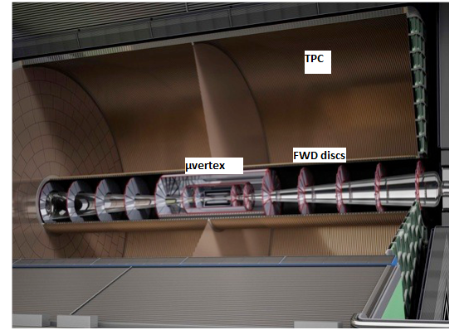
Full angular coverage ?
ILD

Slide 16
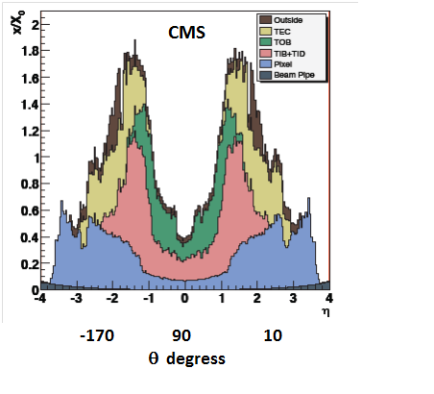
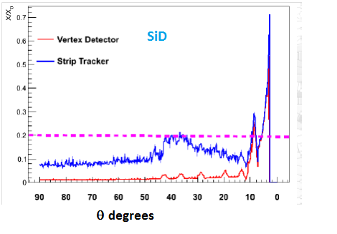
How do they compare to existing detectors ?
Material budget
Intrinsic reasons (radiation hardness) but we should remain very careful in maintaining this feature

Slide 17
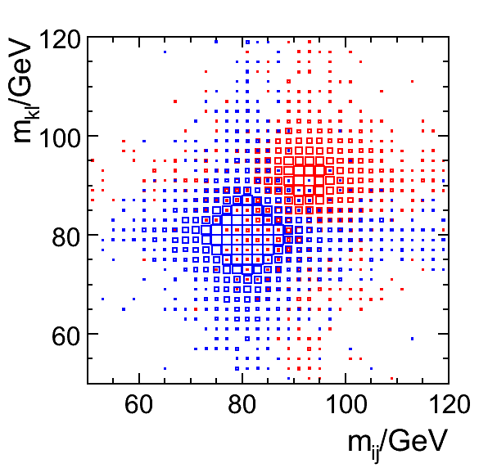
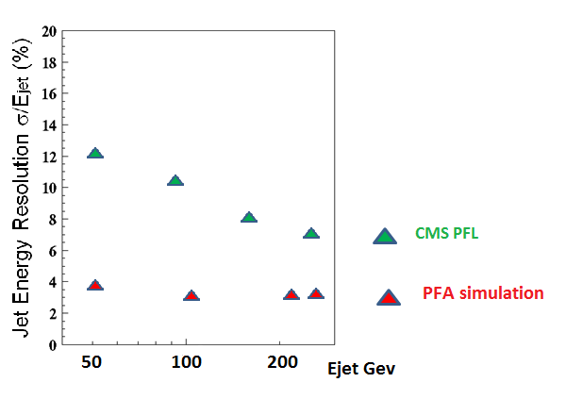
Particle Flow
ILD

Slide 18
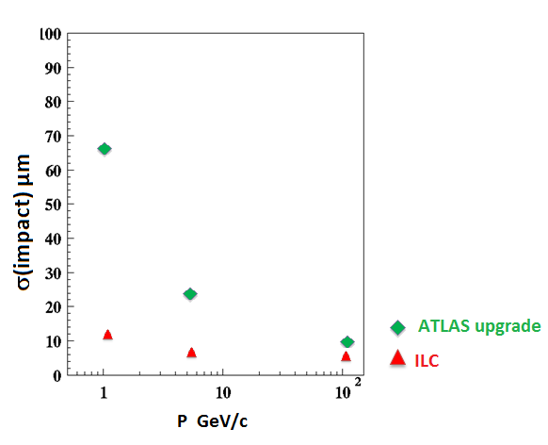
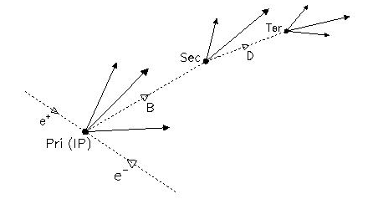
Microvertex accuracy

Slide 19



How realistic are these detectors ?
More than 10 years of coordinated R&D with large prototypes allow realistic evaluations of innovative technologies and insure moderate risks
This effort is internationally embedded in WW collaborations: CALICE, LCTPC, FCAL…with international peer reviewing
Present DBD documents organized around 2 detector concepts with close connection to R&D
Europe well structured through European contracts (AIDA etc…) and participation of CERN

Slide 20
R&D
Several alternate technologies are developed e.g. for calorimetry and µ-vertexing which allows a good safety margin in case of unexpected problems
As an example 3 cubic m HCAL prototypes (500000 RO channels) with Fe and W absorbers tested at CERN, FNAL, DESY…
An ECAL prototype with 10000 equipped Si channels has been associated to these prototypes
A large scale TPC prototype is currently operated at DESY
A wealth of applications has resulted from these efforts in various domains which extend well beyond HEP

Slide 21
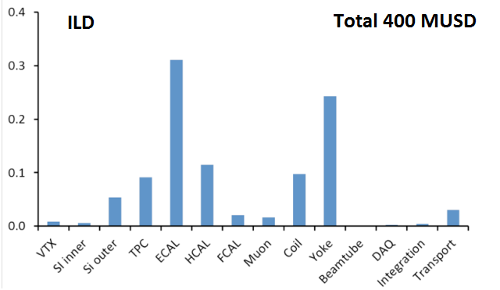
Costs
Cost drivers : coil+yoke and calorimetry

Slide 22
What remains to be done
‘Devil is in the details’: cabling, supports, cooling have been investigated but more is needed to fully assess the present set up
A lot has been done including installation and integration aspects but this is a ‘DBD’ not a TDR which would require knowledge of the site chosen for construction
More engineering efforts are therefore needed for a full TDR (ready for construction) level project
Work with industry for construction has to start

Slide 23
Summary
After a long and intense phase of R&D at the worldwide level two detector concepts are proposed for a LC operating up to 1 TeV center of mass
Realistic physics studies have shown that these detectors, with unprecedented reconstruction accuracies, optimally cover the physics needs
Engineering studies provide a solid proof of realism of these detectors close to a ‘ready for construction level’ (TDR) but full realism requires industrialization and understanding of the various assembly constraints within a well defined site
Resources should be provided to achieve these goals with a move toward two detector collaborations replacing the concept groups

Slide 24

Quoting a conclusion from Erice:
‘The initiative from the Japanese particle physics community to host the ILC in Japan is most welcome, and European groups are eager to participate’

Slide 25
BACK UPS

Slide 26
SiD cost

Slide 27
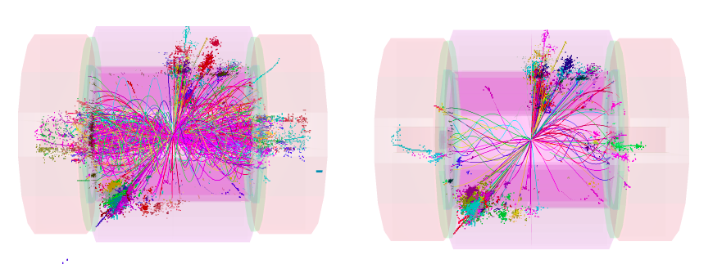
For CLIC
Same concepts studied allowing a very nice synergy with ILC
Extensions in size which can only be modest for B and the coil radius
Better stopping power by using W instead of inox for hadronic calorimetry (non trivial changes needed)
Special effort on time stamping with 0.5 ns separation between bunches (uses PFA)

Slide 28
Some spin-offs
Ref (M. Demateau at IEEE LC event):
https://indico.desy.de/conferenceDisplay.py?confId=6537
The LC effort has served various purposes:
Particle physics itself with various synergies with ALICE (ALTRO chip forb TPC & Calorimetry), T2K (TPC, SiPM), Belle-II at Super-KeKb (DEPFET), STAR at RHIC (µvertex) , CMS (SiPM for calorimetry)
Other research fields (PEBS ballon experiment with ASICS), X ray dectors for imaging in astronomy
Medical : proton (SiPM for calorimetry) and PET positron emission tomography (ECAL technology) , gamma camera (ASICS)
Vulcano tomography
SiPM ‘everywhere’ was started by this activity

Slide 29
Machine-Detector interface
In a LC the design of a detector is more tightly connected to machine constraints:
Focusing elements are embedded inside the detector and require tight alignments (nm beam spots)
Backgrounds aspects have to be studied in common
Detectors need to be moved and realigned easily with the push-pull constraints
~One week needed for replacement and realignment

Slide 30
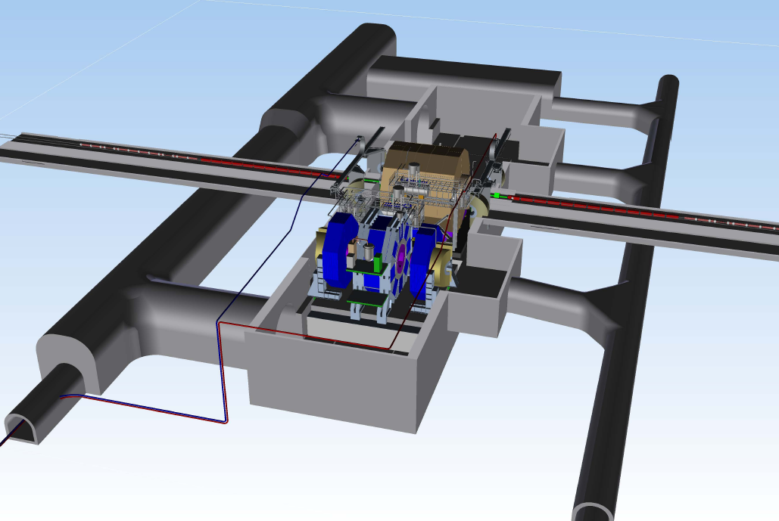
Japanese underground hall
Design, ILC-EDMS

Slide 32
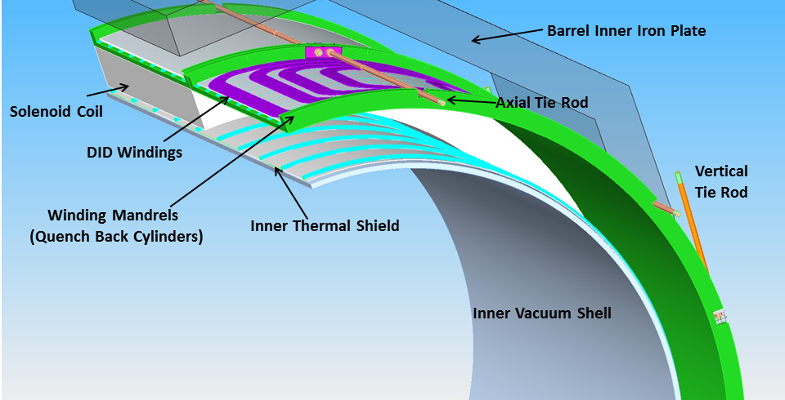
SID Solenoid, Wes Craddock (SLAC)
Simplified Magnet Section

Slide 33
Angular dependence

Slide 34
