Slide 1
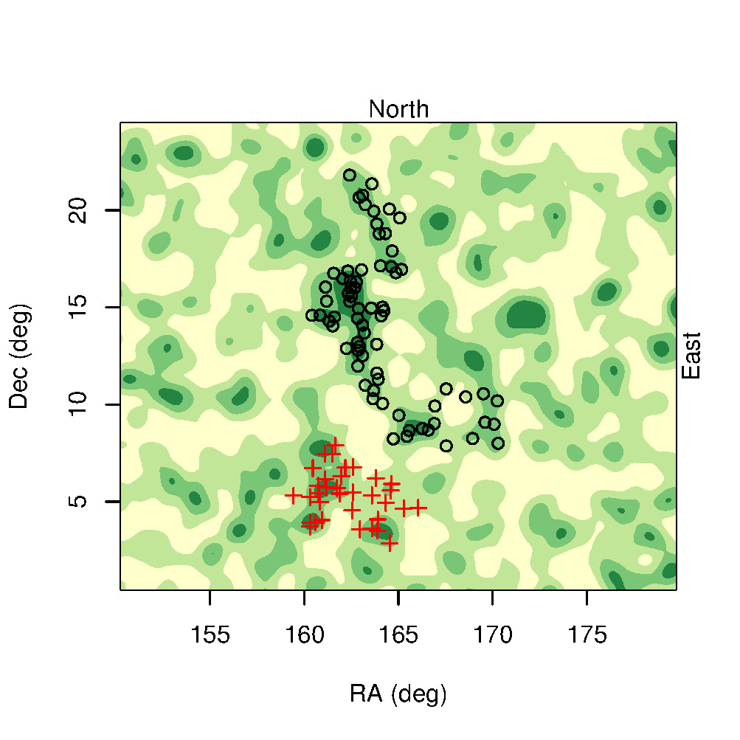
R. G. Clowes / UCLan
Notes:
5 tonnes !

Slide 2
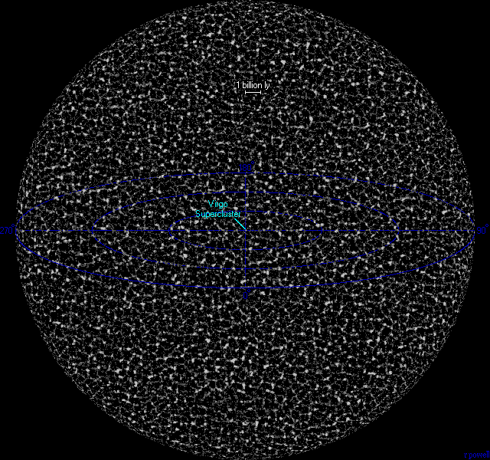

Slide 3
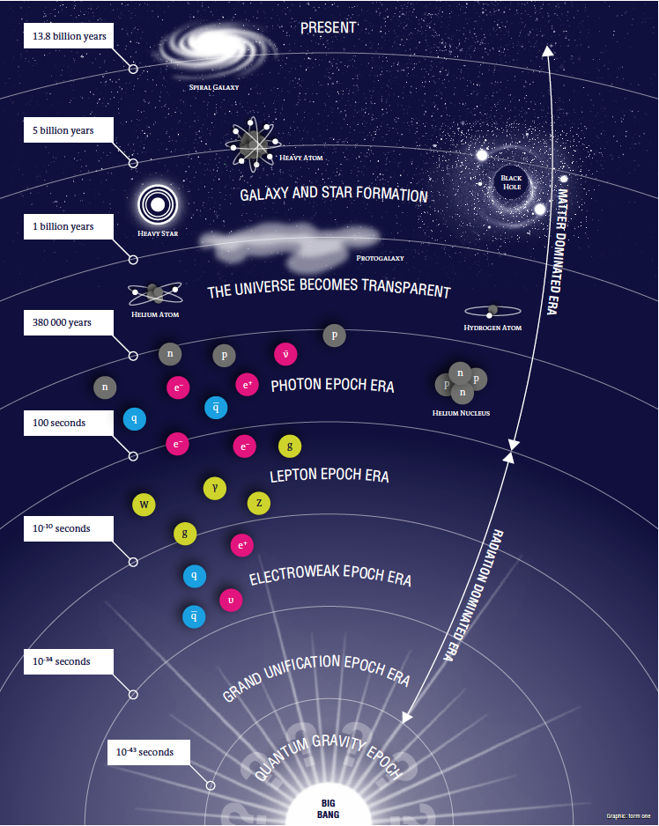

Slide 4
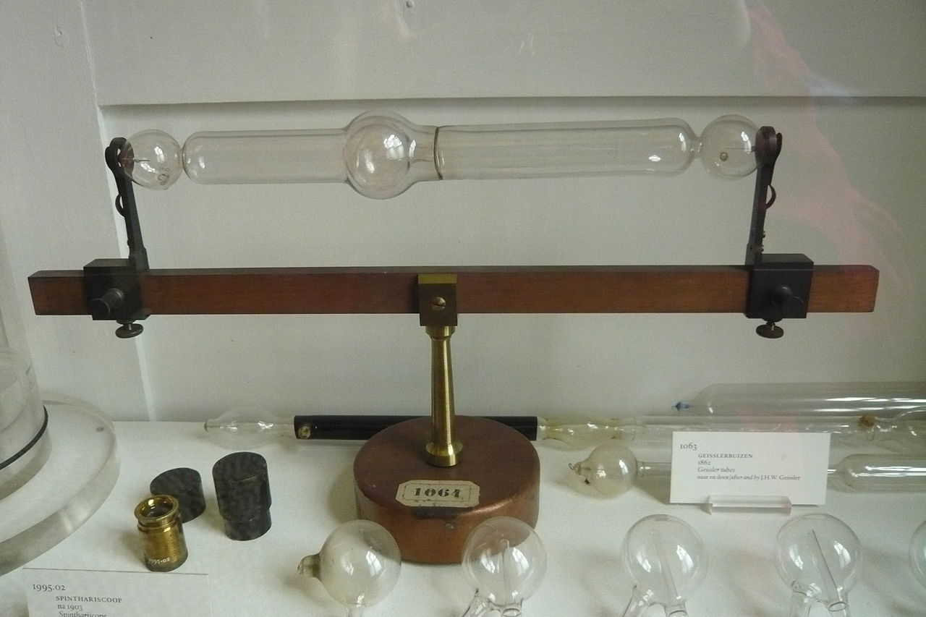
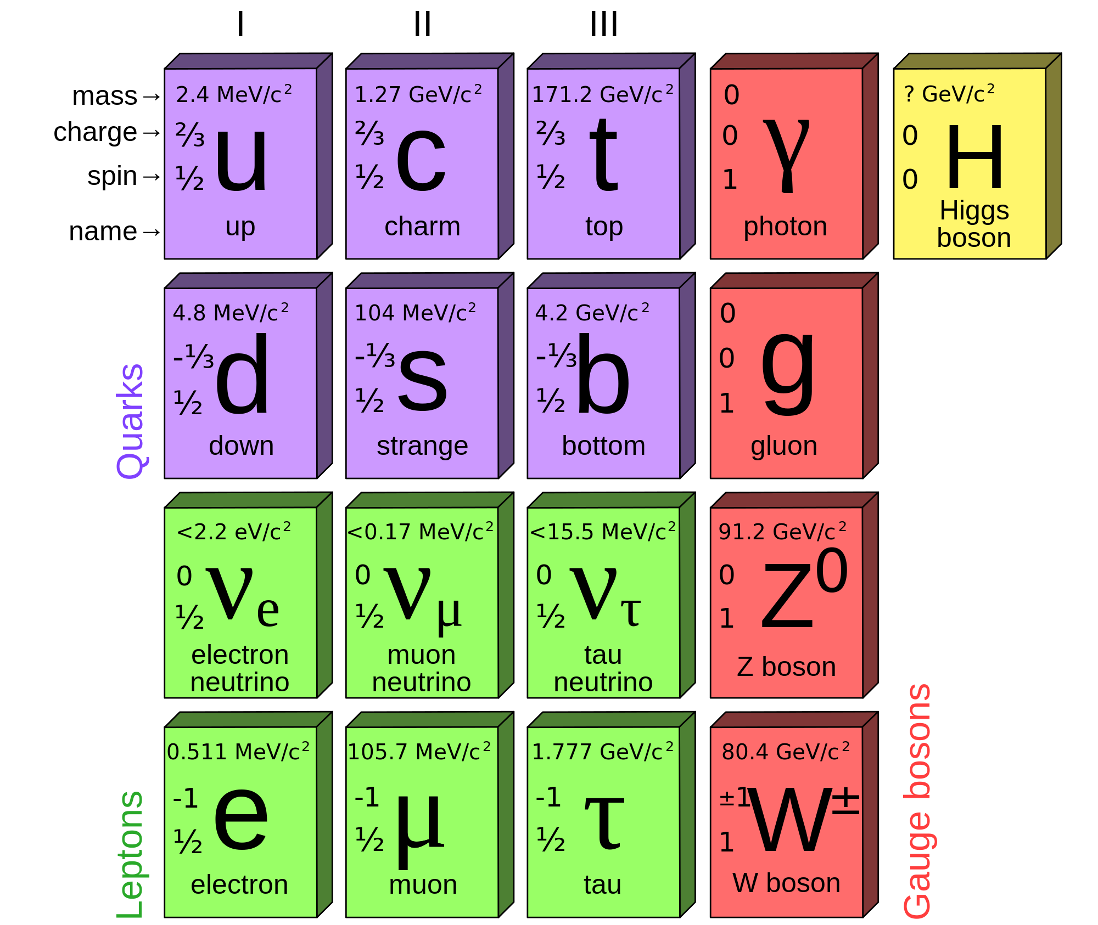

Slide 5
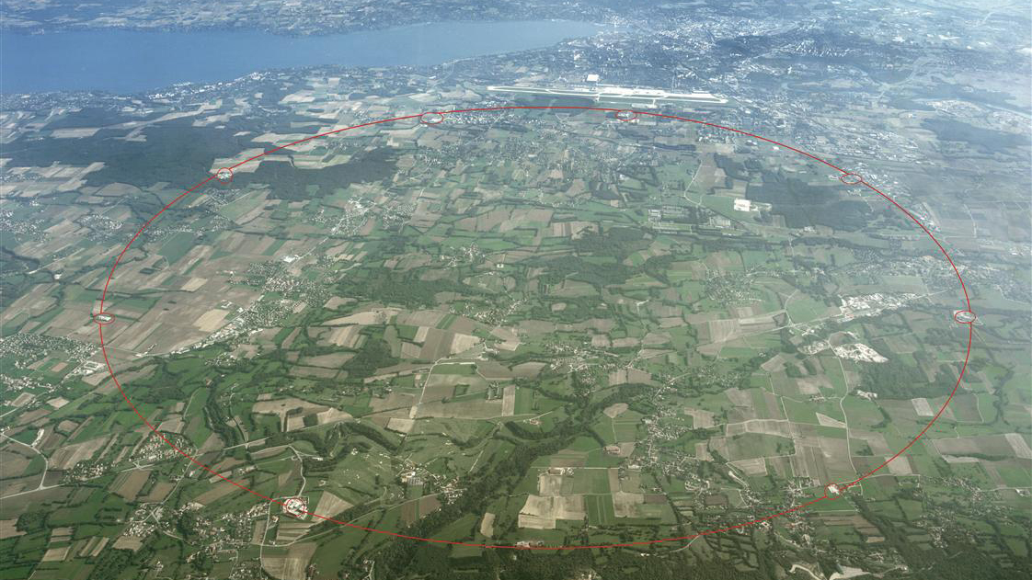



Slide 6



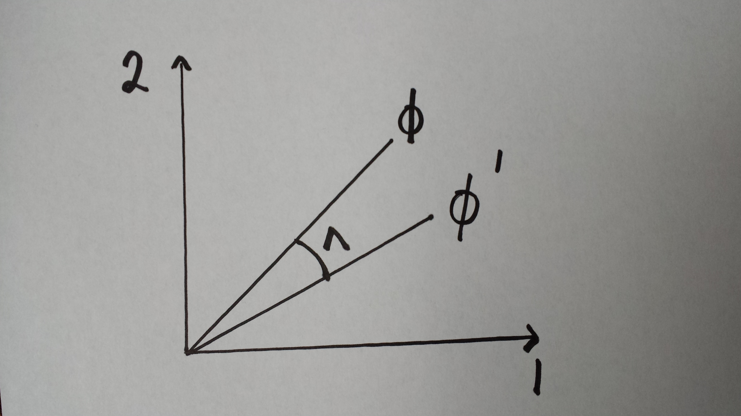




Slide 7


Slide 8
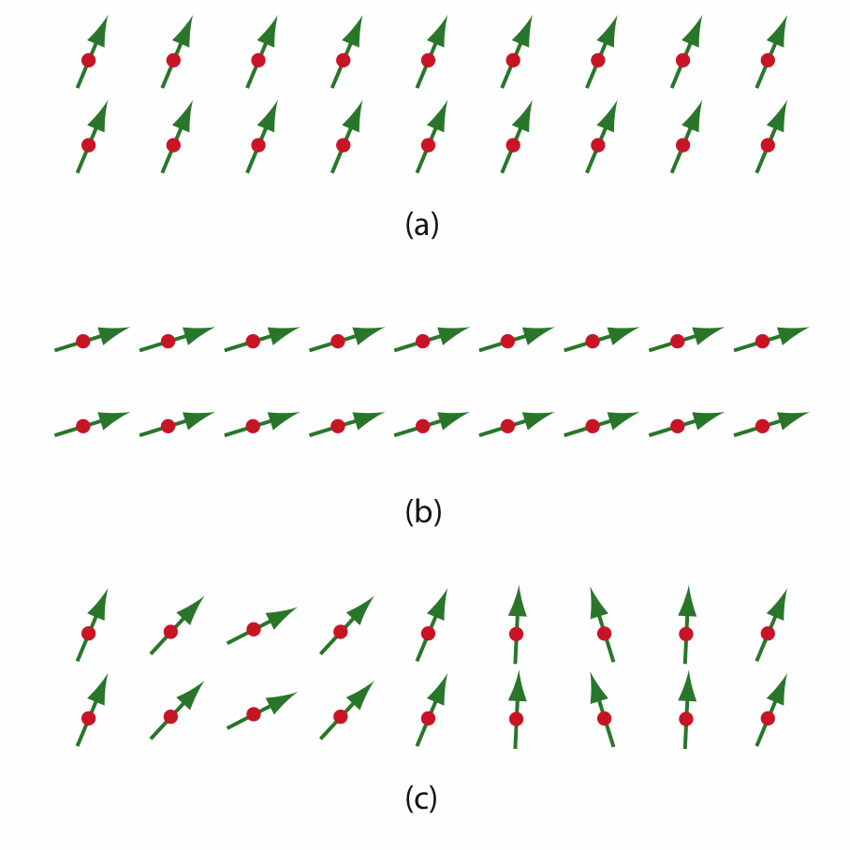
http://www.scholarpedia.org/article/Englert-Brout-Higgs-Guralnik-Hagen-Kibble_mechanism

Slide 9

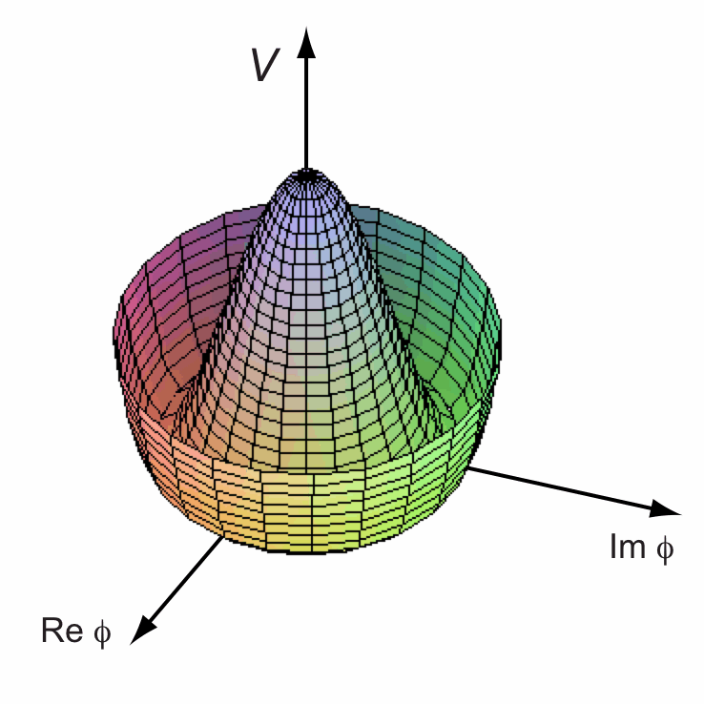
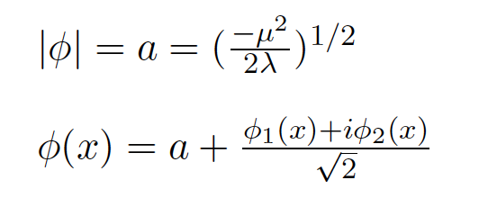


Slide 11
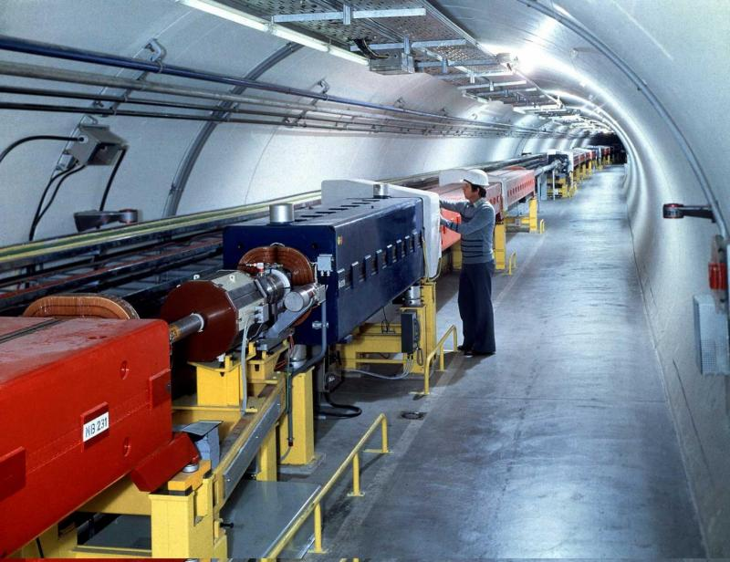



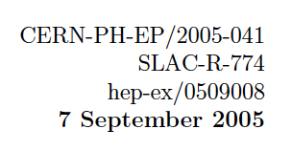



CDF arXiv:1203.0275v1 [hep-ex]
March 2012

Slide 12
Notes:
French physicist Louis de Broglie put forward the first official proposal for the creation of a European laboratory at the European Cultural Conference, which opened in Lausanne on 9 December 1949. A further push came at the fifth UNESCO General Conference, held in Florence in June 1950, where American physicist and Nobel laureate Isidor Rabi tabled a resolution authorizing UNESCO to "assist and encourage the formation of regional research laboratories in order to increase international scientific collaboration…"

Slide 13
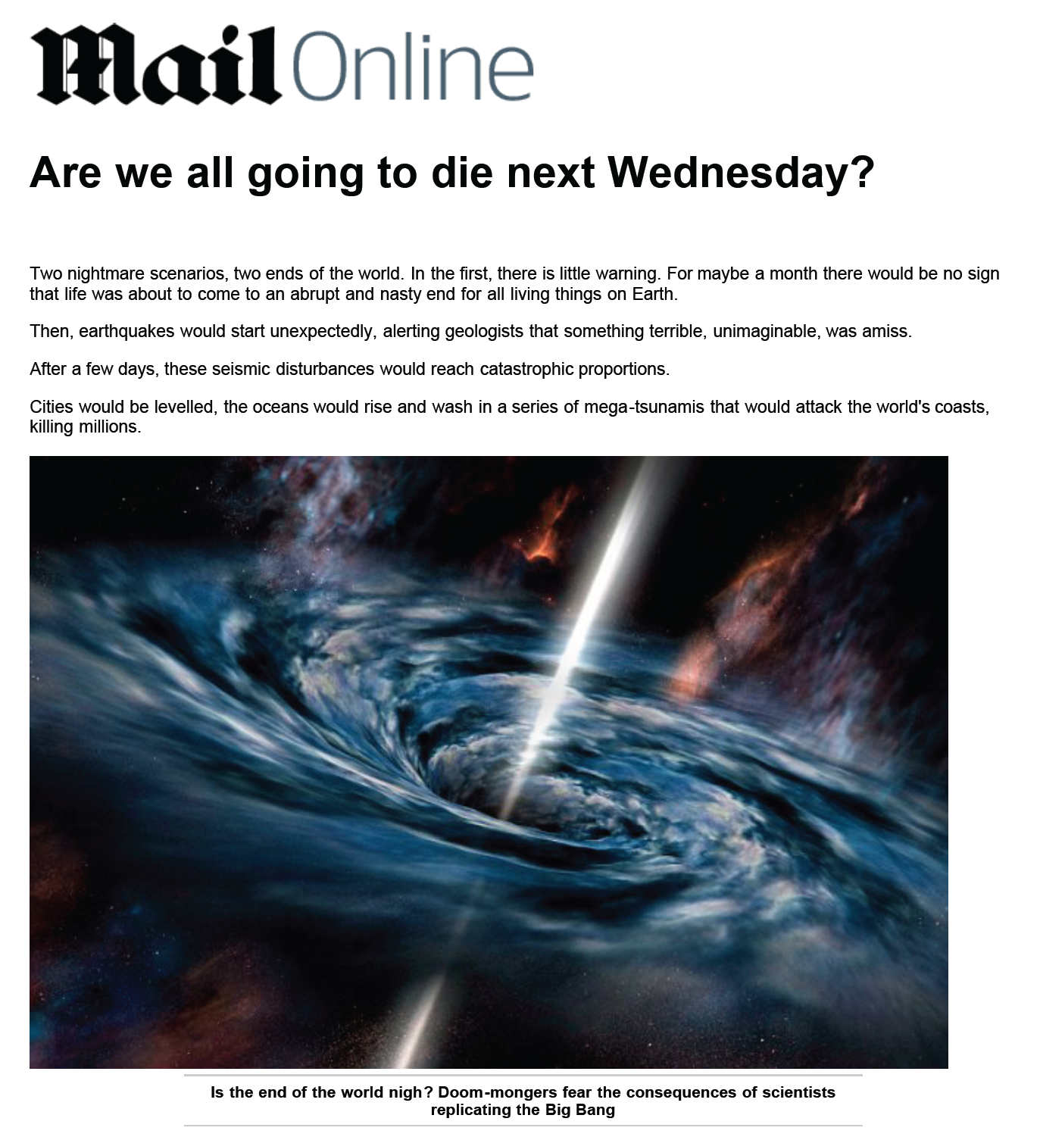

James Gilles pointed out that the planet hasn’t been destroyed yet
(MSNBC)

Slide 14
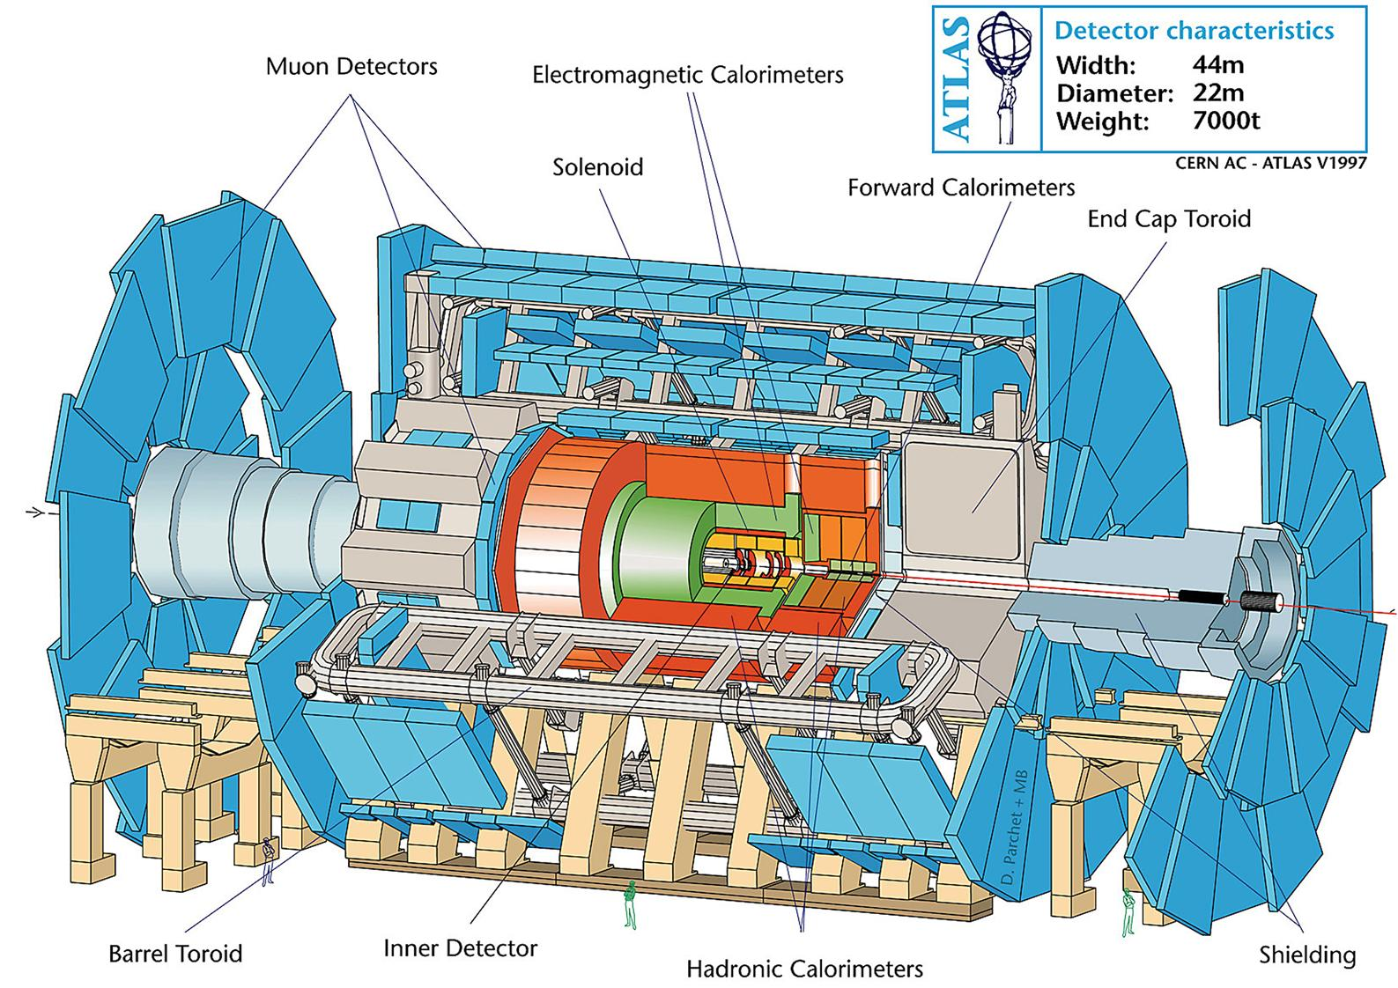

Slide 15

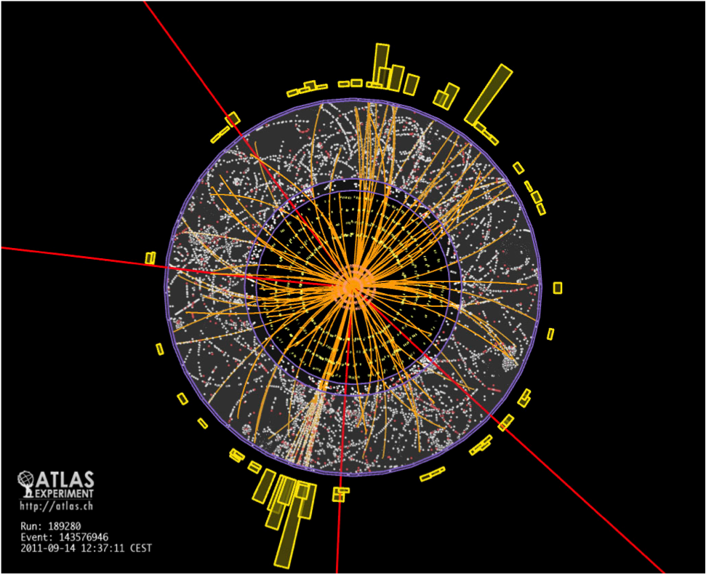

“It’s very nice to be right sometimes …” Peter Higgs
ATLAS-CONF-2013-014
Notes:
The marble index of a mind for ever Voyaging through strange seas of Thought, alone .wordsworth on newton

Slide 16
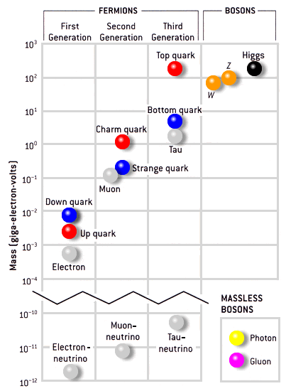
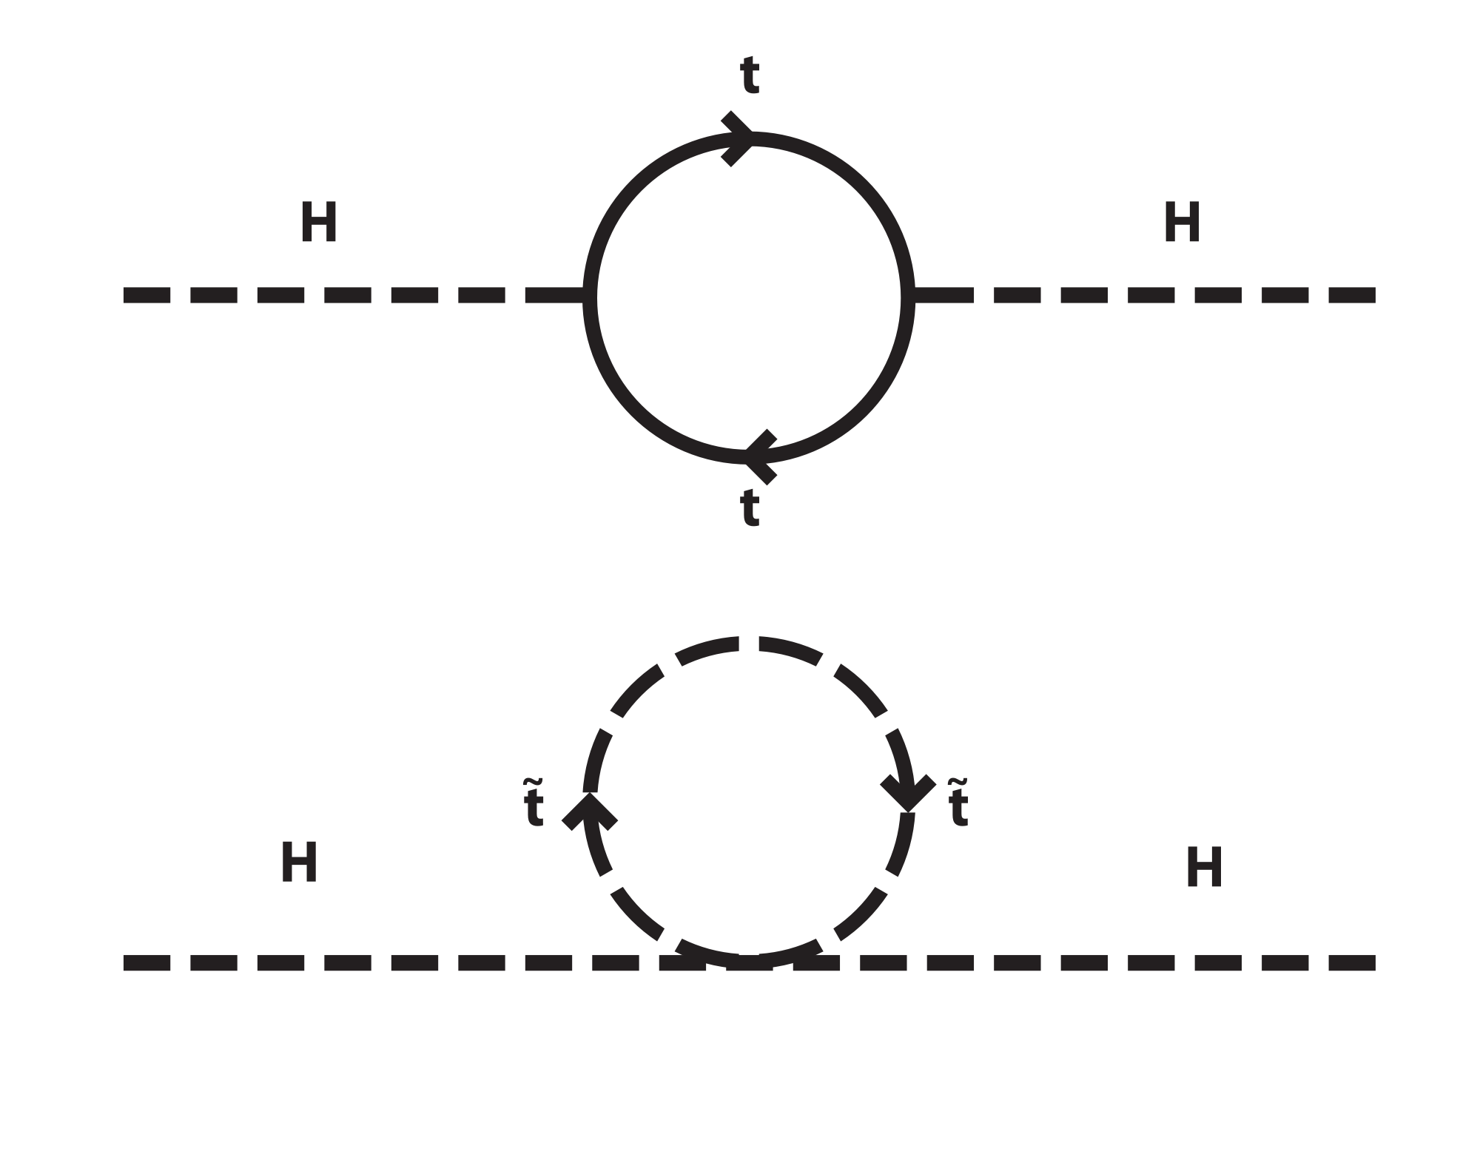


Slide 17
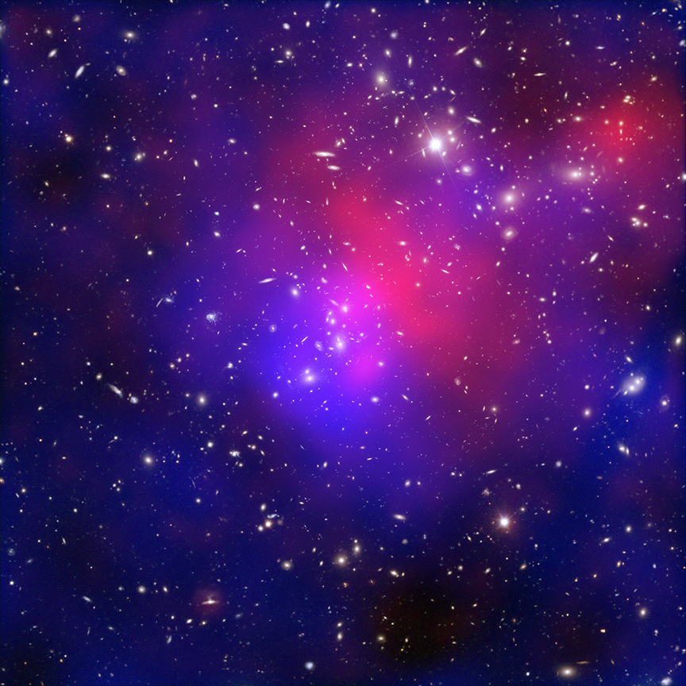

Slide 18
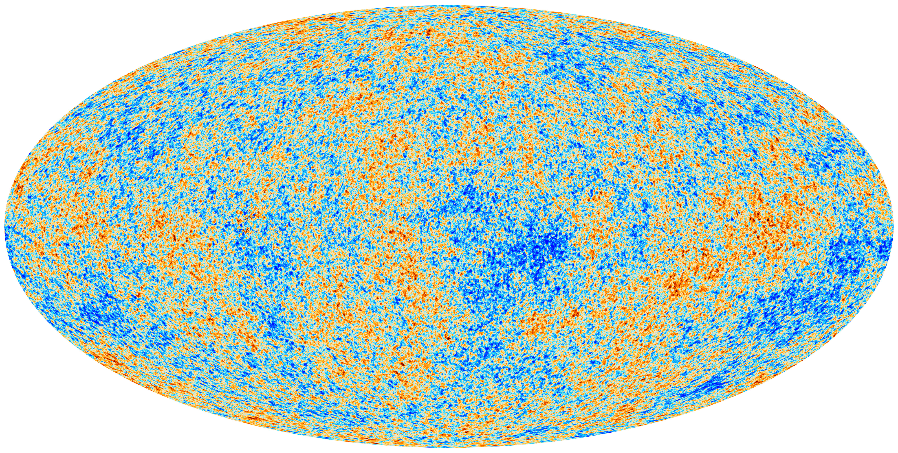

Slide 19
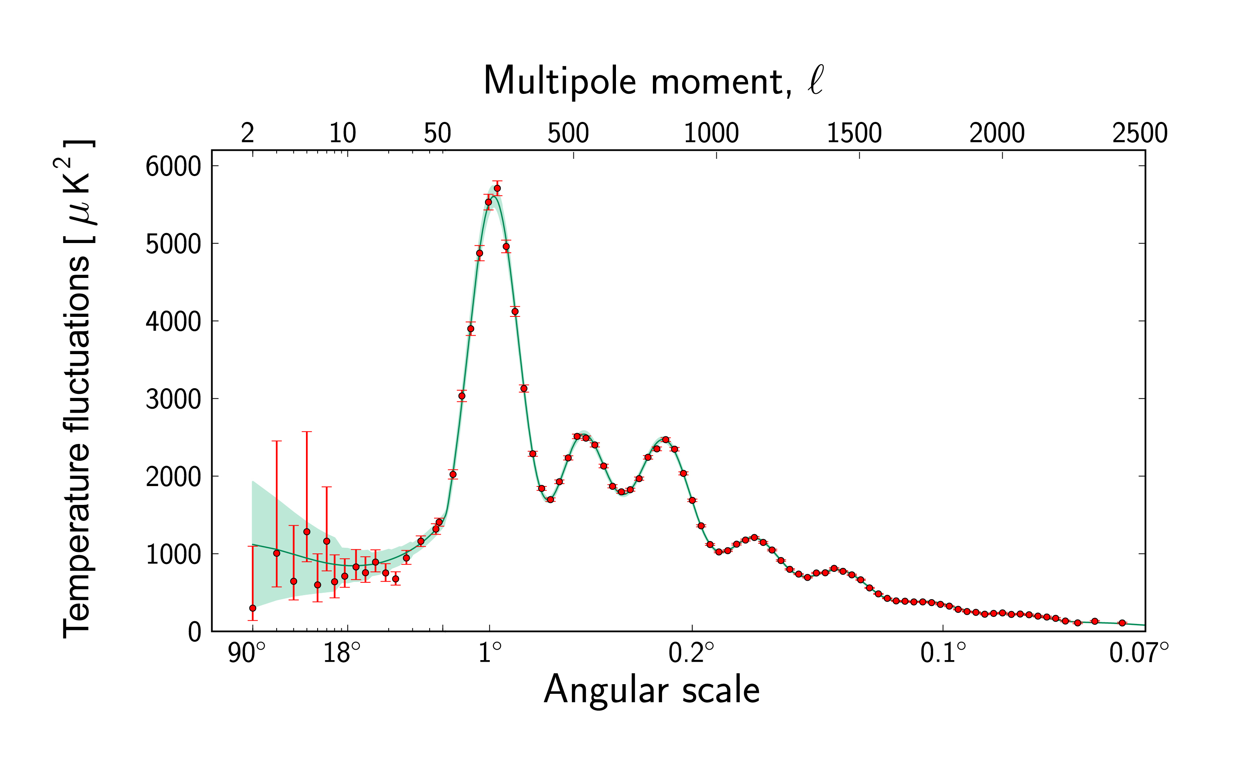

Slide 20
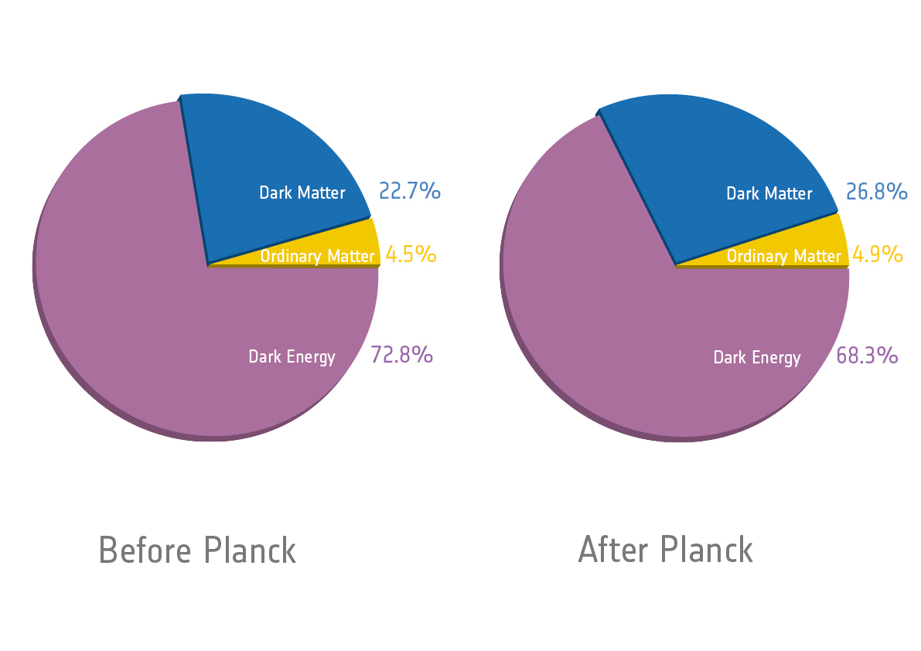
The Universe is 13.798 +/- 0.037 billion years old

Slide 21
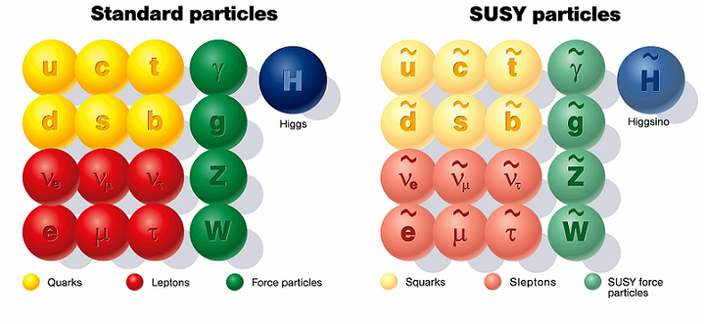

Slide 22
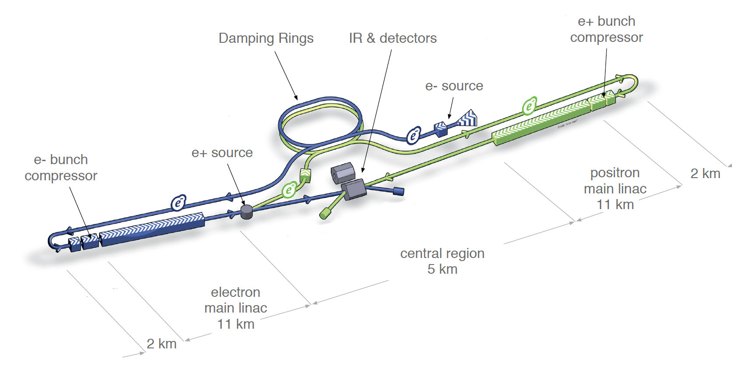

Slide 23
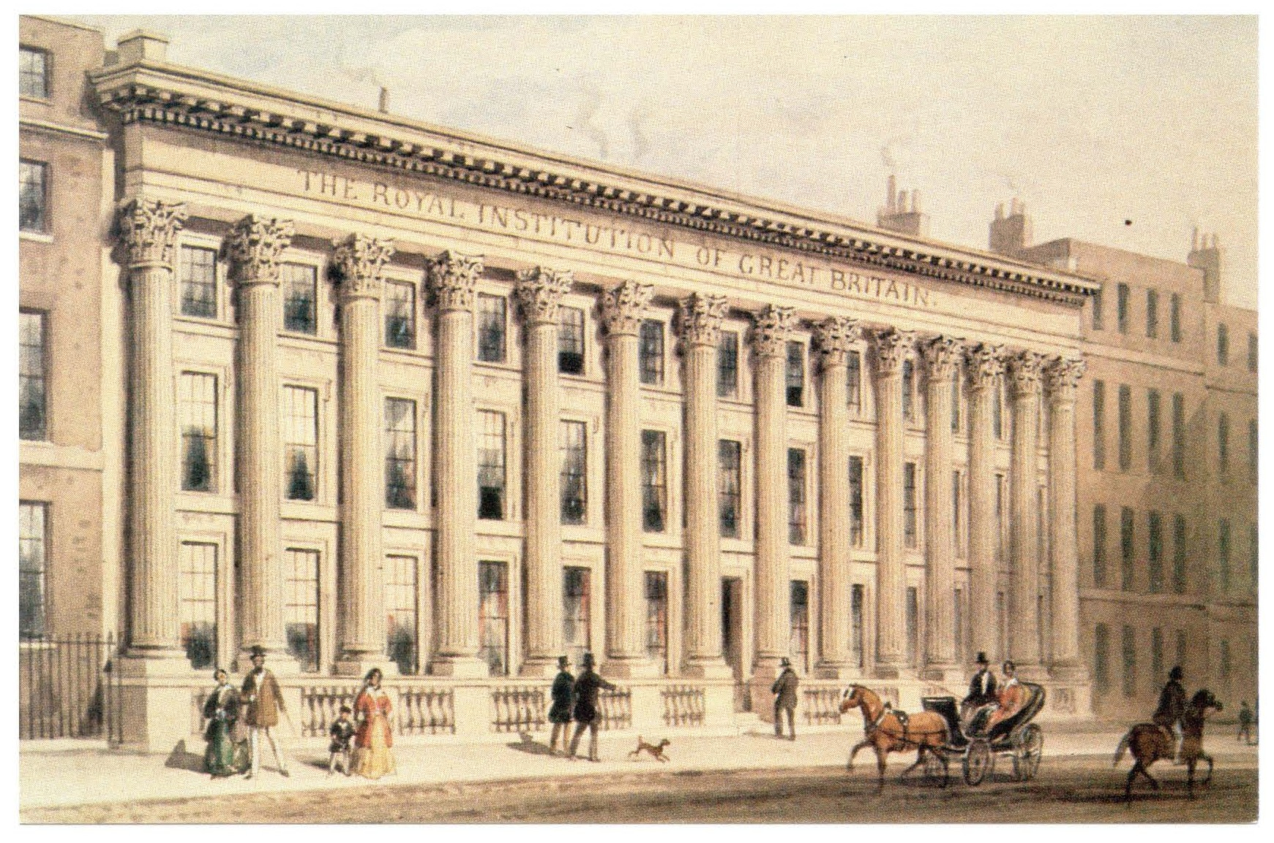

Slide 24
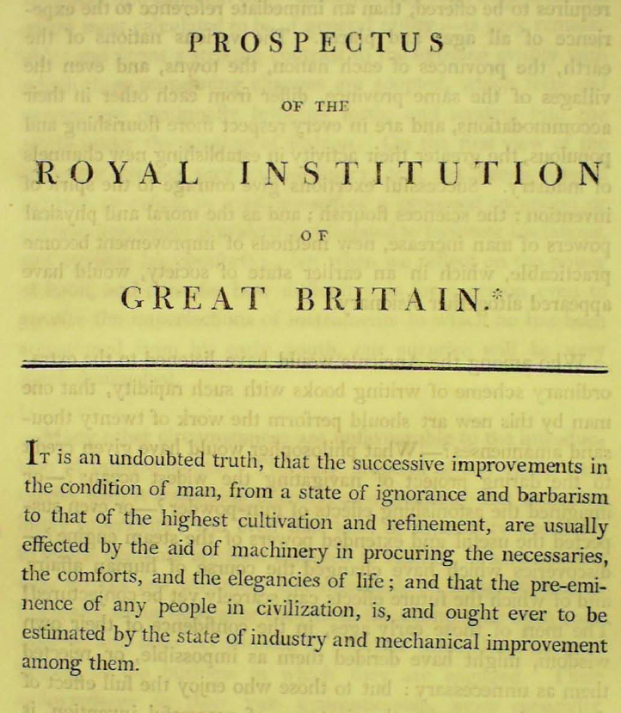

Slide 26
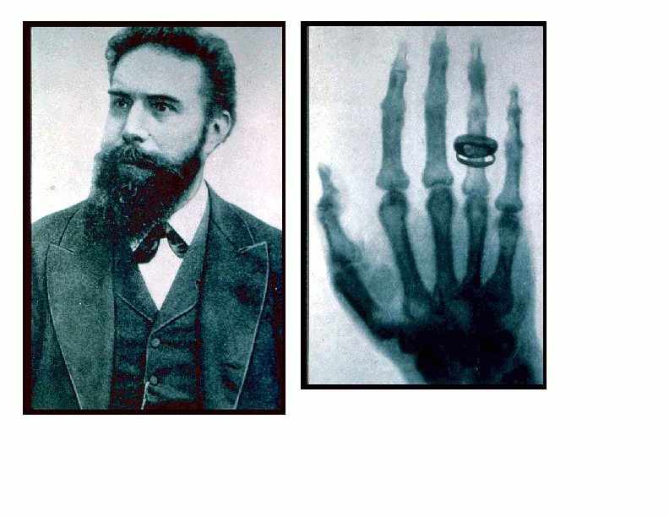

Slide 28
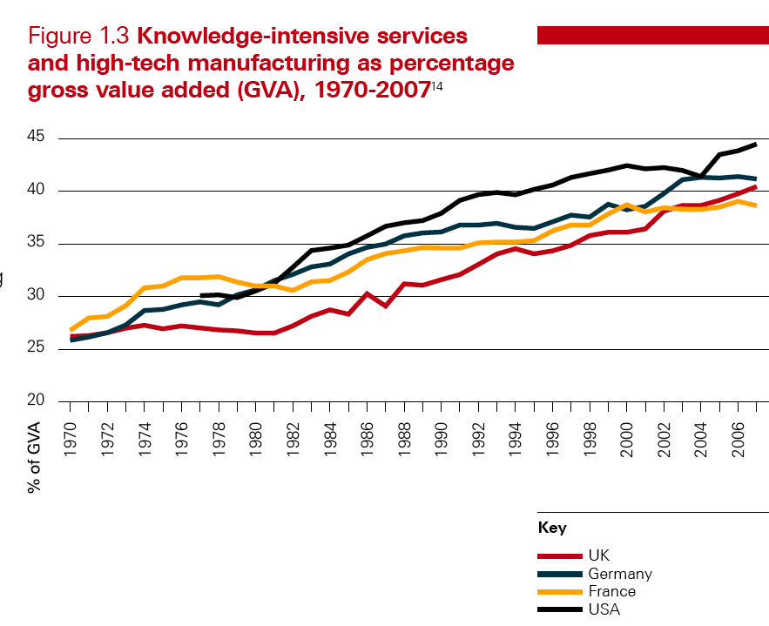

Slide 29
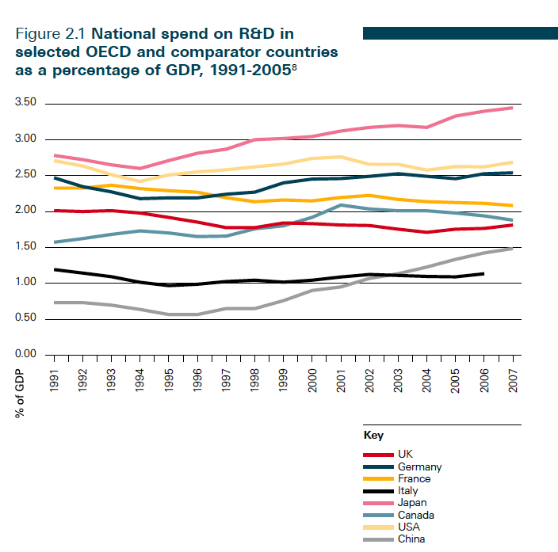

Slide 31
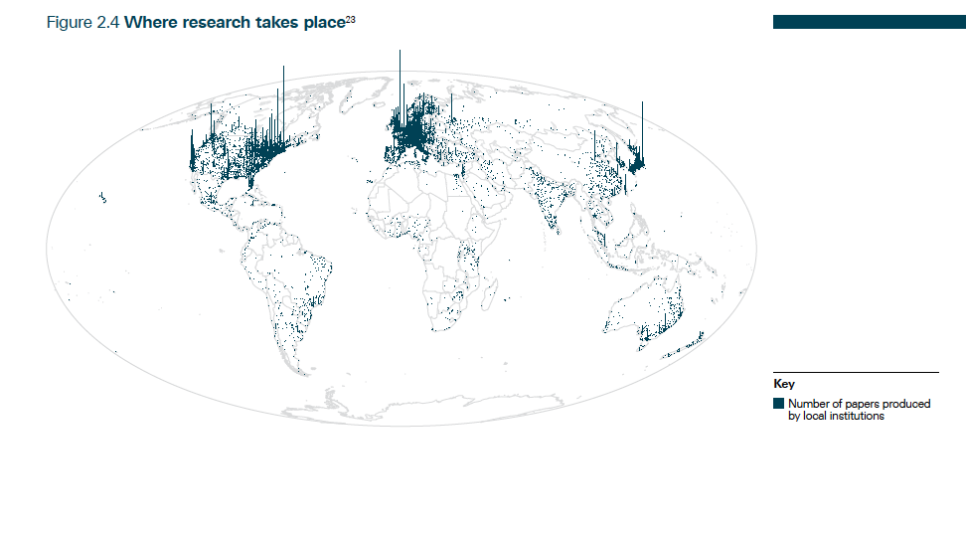

Slide 32
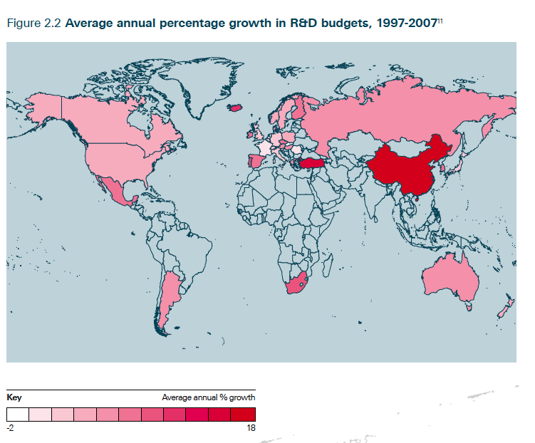

Slide 33
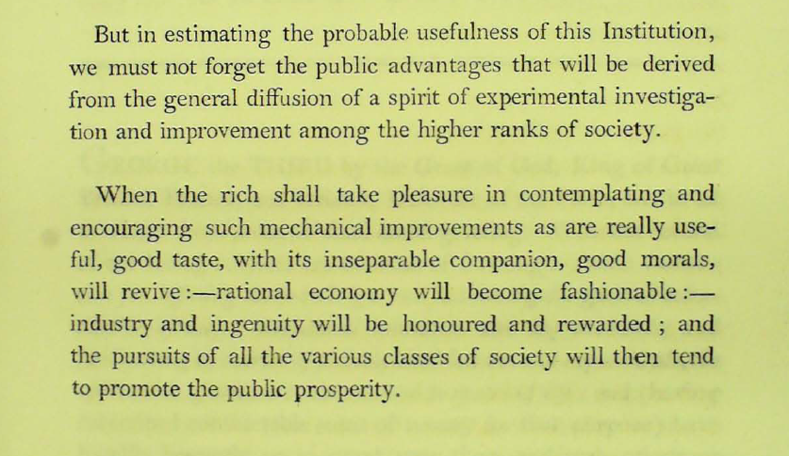

Slide 34
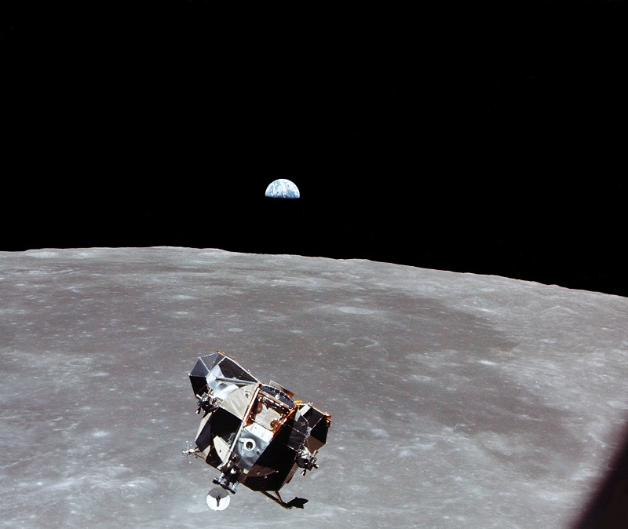

Slide 35
