Slide 1
Next workshop in the series of LC
  Last one: Arlington Oct ‘12
Similar format
  4.5 days
  3 days of parallel WG
Joint with Physics & Detector
  dominant part
Accelerator WGs
  this presentation
Under new management
  LCC
  Joint ILC – CLIC meeting

Slide 2
Accelerator WGs
Injectors
  e+ and e- sources, Damping Rings
BDS / MDI
  Optics, lattice design etc
  MDI (interaction region)
  MDI (instrumentation)
  ATF2 collaboration and TB meeting
Luminosity Performance
  LET beam dynamics (simulations)
  Start to end
  Static / dynamic tuning (feedback etc.)
  …
SCRF Technology
  Cavity and cryomodule
  HLRF
  Systems testing (FLASH, STF, NML etc.)
AD&I
  Overall integration (machine design)
  CFS, requirements, etc. (power, water)
  technical design documentation
  management & planning
Joint CLIC/ILC WGs
ILC specific
XFEL synergy
Mostly ILC specific
Focus on design for Japanese site

Slide 3
ECFA LC2013 Accelerator WGs
1 | Injectors (sources & DR) | Wei Gai (ANL) M. Kuriki (KEK) J. Papaphilippou (CERN)
2 | BDS/MDI | R. Tomas (CERN) G. White (SLAC) T. Tauchi (KEK) L. Gatignon (CERN) | subject to DoE appr.
3 | Luminosity Performance | A. Latina (CERN) N. Solyak (FNAL) K. Kubo (FNAL)
4 | SCRF Tech. | W.-D. Möller (DESY) H. Hayano (KEK) R. Geng (JLab) | almost green subject to DoE appr.
5 | AD&I (inc. CFS) | M. Ross (SLAC) A. Yamamoto (KEK) O. Napoloy (Saclay)

Slide 4
Workshop Goals (for ILC)
Planning for ILC R&D activities for next 3 years
  short term action items until next workshop
  longer term overall goals
Planning for Japanese site
  Understanding impact of moving to a specific and identified site
Project management framework
  TDR consolidation (documentation)
  Instruments to support next three years
    with a view to a transition to a ‘real project’
…
Tentative
for discussion

Slide 5
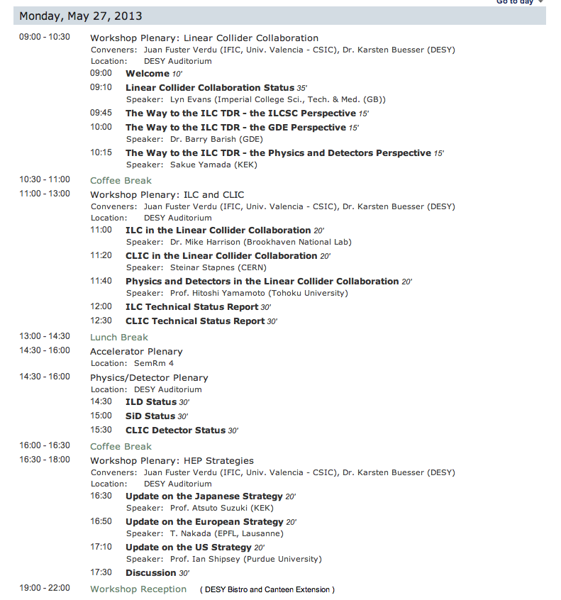
Monday (all day) joint plenaries
Propose to have separate machine plenary in parallel here (14:30-16:00)

Slide 6
Tentative Machine Plenaries
Monday 27.05 14:30-16:00
  CTF3 presentation (status, goals, future plans etc.)
    Corsini
  ILC integrated systems tests (overview)
    Me? (possibly Shin Michizono?)
  ATF/ATF2
    Terunuma
  AD&I and goals for the workshop
    M. Ross
ATF collaboration meeting Wednesday 29.05
  all day.
Satellite meetings
  As requested
  Discuss today requirements from this group (ILC-TB)

Slide 7
Please Register ASAP
http://lc2013.desy.de
DESY’s excellent hospitality awaits

