Slide 1
Feedforward runs
N. Blaskovic

Slide 2
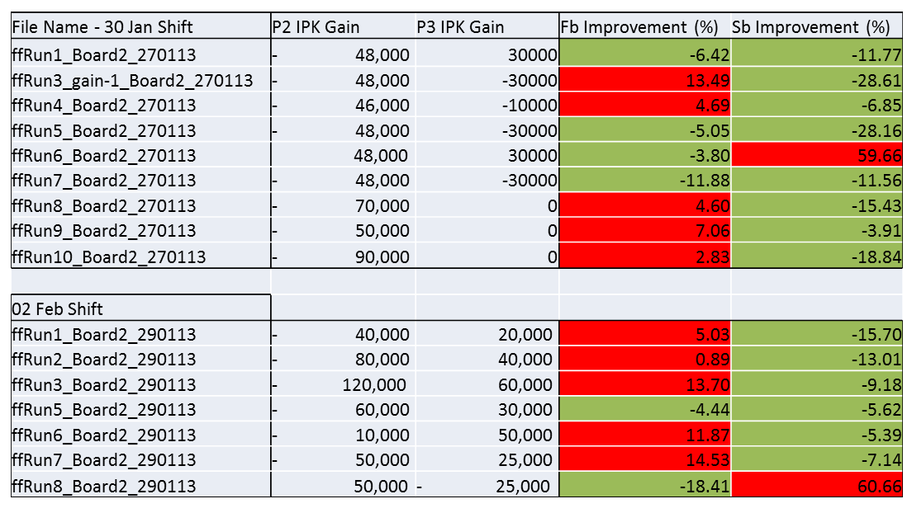
Introduction
Mikey showed on 8th Feb that most feed-forward runs show jitter reduction:
N. Blaskovic

Slide 3
Introduction
However, the extent of jitter reduction varies greatly between runs.
Today’s presentation concentrates on two issues that can limit feedforward correction:
Insufficient gain
DAC outputs beyond amplifier’s linear range
This study makes use of plots of kick to bunch 2 vs. position of bunch 1 at IPB (charge normalised), as shown on slide 4.
N. Blaskovic

Slide 4
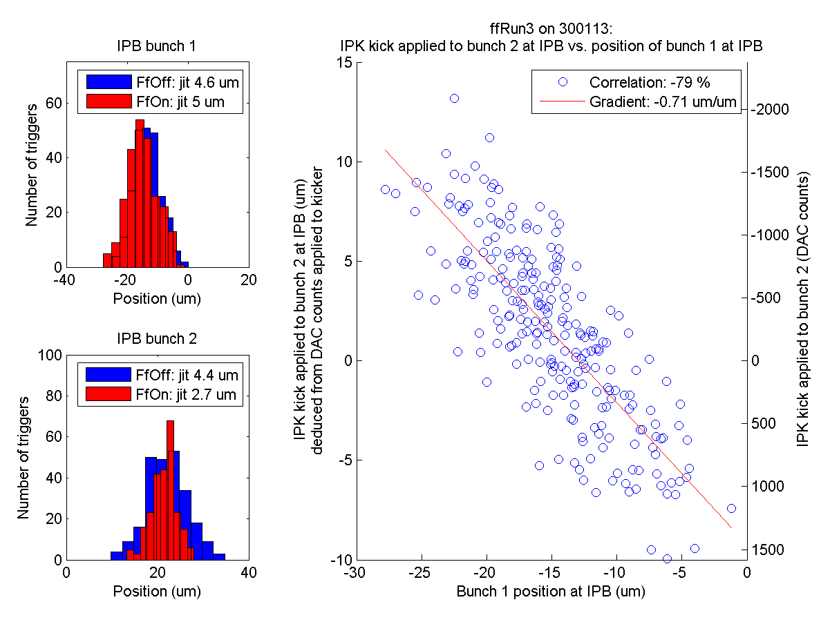
Example
Bunch 1 upstream-downstream position correlation
Ratio of calculated kick to kick that should have been applied
Whether DAC outputs are within the kicker amplifier’s linear range
Negative gradient: ‘correcting towards 0’
N. Blaskovic

Slide 5
Overview
Overview
30th Jan
ffRun1
ffRun3
This presentation will assess one feedforward run per slide as follows:
Assessment will be based on DAC output and gain level only, not on the level of correction achieved.
ffRun4
ffRun5
ffRun6
ffRun7
OK
ffRun8
ffRun9
Saturating kicker amplifier / insufficient gain
Wrong gain sign
1st Feb
ffRun1
ffRun2
ffRun3
ffRun5
ffRun6
ffRun7
ffRun8
N. Blaskovic

Slide 6
Criteria
Saturating kicker amplifier criterion:
Runs where most triggers have an IPK DAC output outside the range -1200 to 1200 counts
Insufficient gain criterion:
Runs where gradient of IPK kick to bunch 2 at IPB vs. bunch 1 position at IPB is 0 to -0.5
Wrong gain sign criterion:
Runs where gradient of IPK kick to bunch 2 at IPB vs. bunch 1 position at IPB is positive
N. Blaskovic

Slide 7
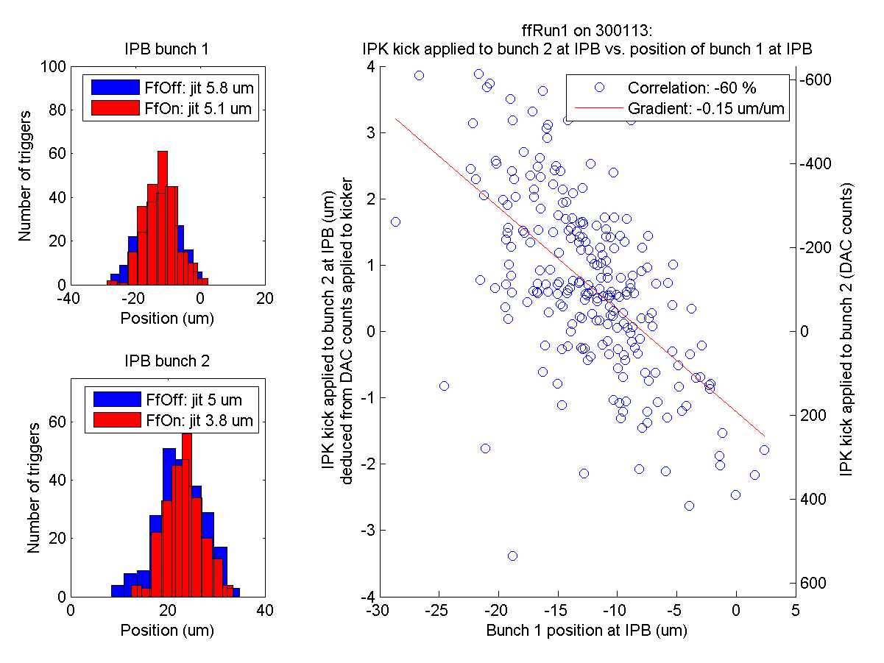
Overview
ffRun1
Gain P2-IPK: -48 000
Gain P3-IPK: +30 000
30th Jan
ffRun1
ffRun3
ffRun4
ffRun5
ffRun6
ffRun7
ffRun8
ffRun9
1st Feb
ffRun1
ffRun2
ffRun3
ffRun5
ffRun6
ffRun7
ffRun8
Insufficient gain!
N. Blaskovic

Slide 8
Overview
ffRun3
Gain P2-IPK: -48 000
Gain P3-IPK: -30 000
30th Jan
ffRun1
ffRun3
ffRun4
ffRun5
ffRun6
ffRun7
ffRun8
ffRun9
1st Feb
ffRun1
ffRun2
ffRun3
ffRun5
ffRun6
ffRun7
ffRun8
OK!
N. Blaskovic

Slide 9
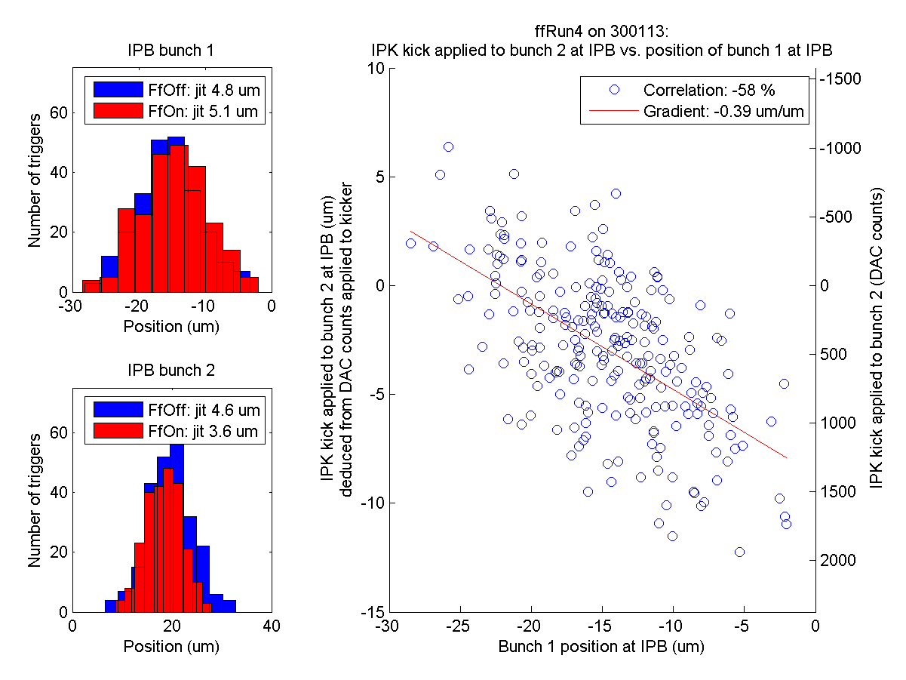
Overview
ffRun4
Gain P2-IPK: -46 000
Gain P3-IPK: -10 000
30th Jan
ffRun1
ffRun3
ffRun4
ffRun5
ffRun6
ffRun7
ffRun8
ffRun9
1st Feb
ffRun1
ffRun2
ffRun3
ffRun5
ffRun6
ffRun7
ffRun8
Insufficient gain!
N. Blaskovic

Slide 10
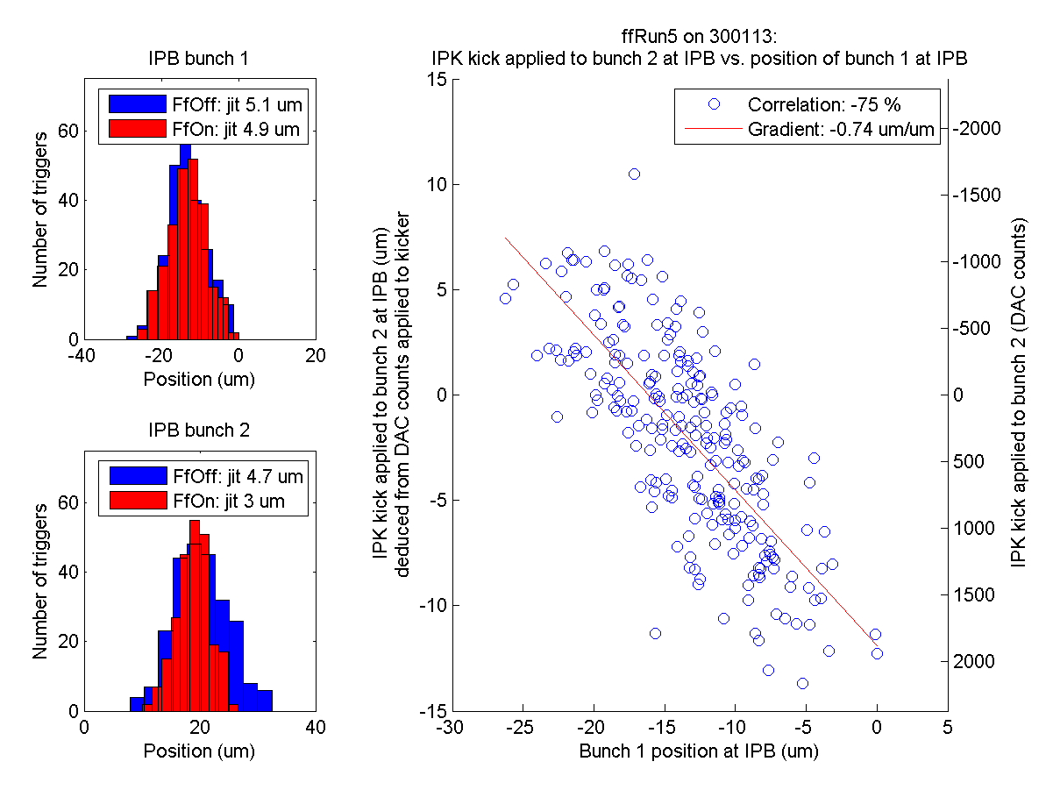
Overview
ffRun5
Gain P2-IPK: -48 000
Gain P3-IPK: -30 000
30th Jan
ffRun1
ffRun3
ffRun4
ffRun5
ffRun6
ffRun7
ffRun8
ffRun9
1st Feb
ffRun1
ffRun2
ffRun3
ffRun5
ffRun6
ffRun7
ffRun8
OK!
N. Blaskovic

Slide 11
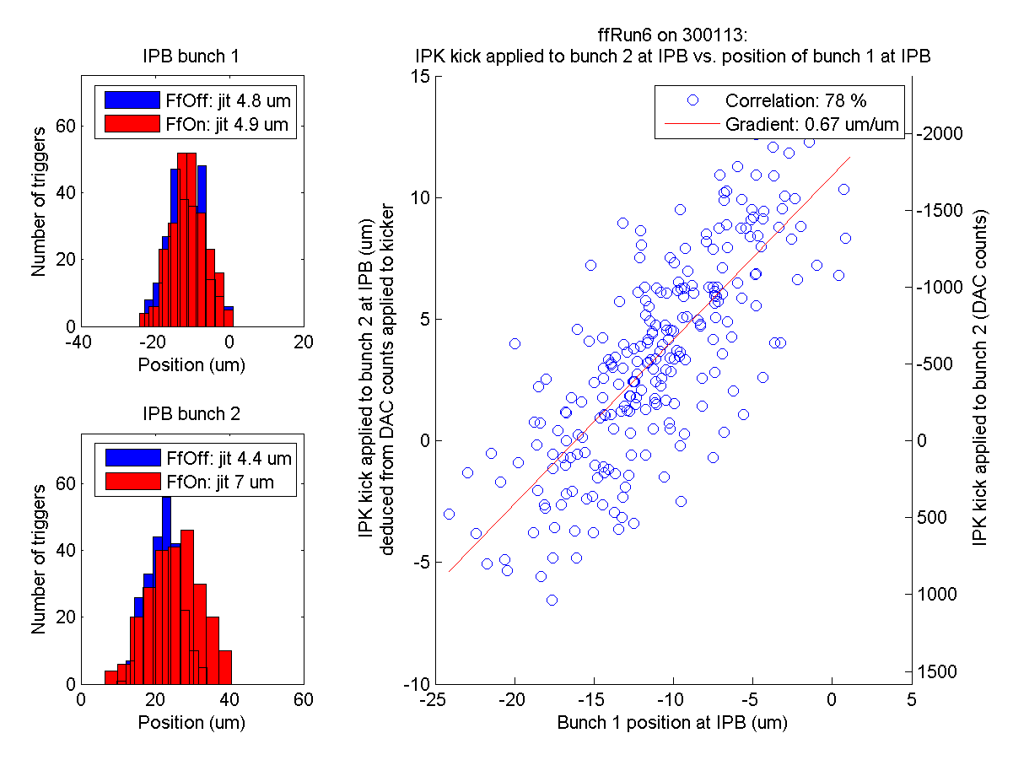
Overview
ffRun6
Gain P2-IPK: +48 000
Gain P3-IPK: +30 000
30th Jan
ffRun1
ffRun3
ffRun4
ffRun5
ffRun6
ffRun7
ffRun8
ffRun9
1st Feb
ffRun1
ffRun2
ffRun3
ffRun5
ffRun6
ffRun7
ffRun8
Wrong gain sign!
N. Blaskovic

Slide 12
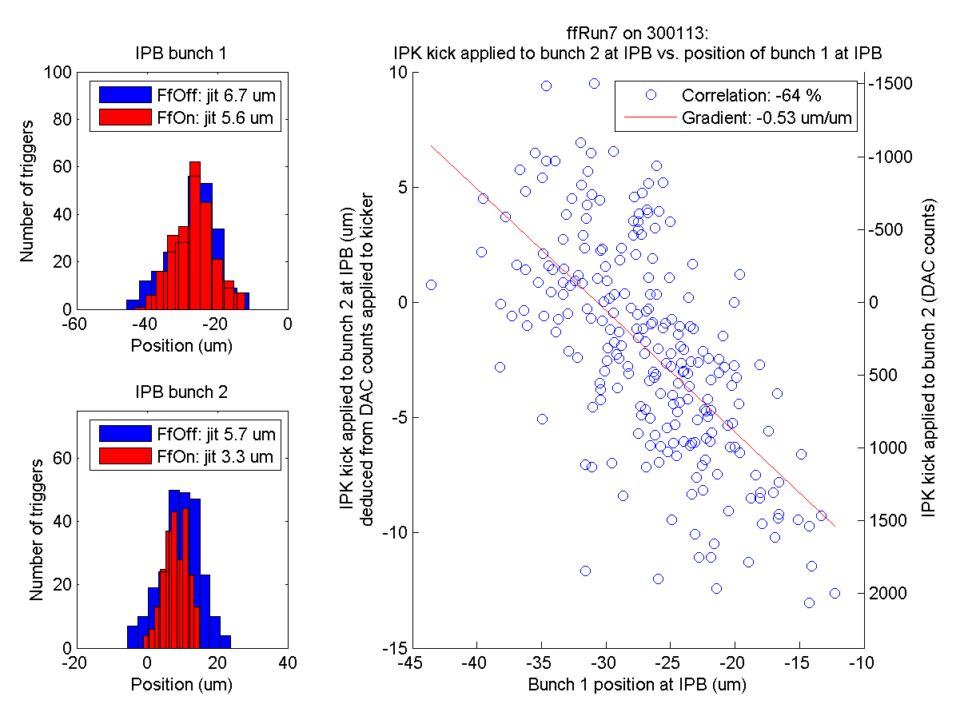
Overview
ffRun7
Gain P2-IPK: -48 000
Gain P3-IPK: -30 000
30th Jan
ffRun1
ffRun3
ffRun4
ffRun5
ffRun6
ffRun7
ffRun8
ffRun9
1st Feb
ffRun1
ffRun2
ffRun3
ffRun5
ffRun6
ffRun7
ffRun8
OK!
N. Blaskovic

Slide 13
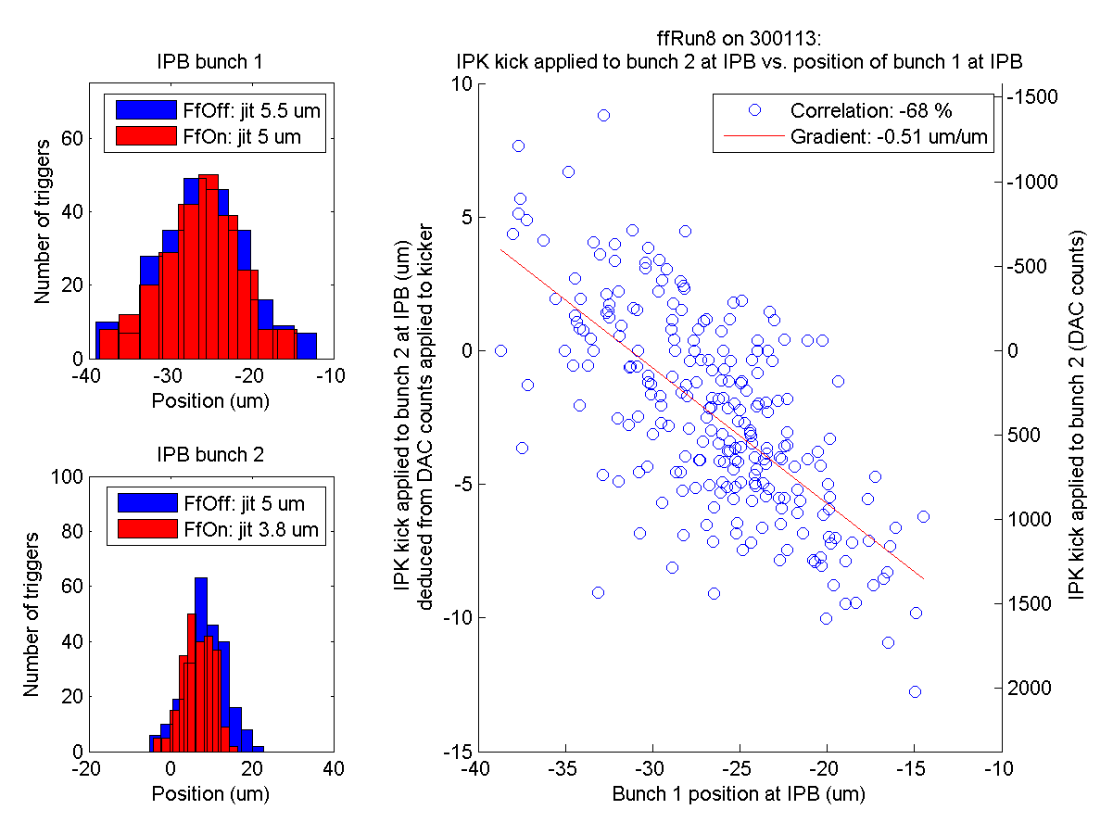
Overview
ffRun8
Gain P2-IPK: -70 000
Gain P3-IPK: 0
30th Jan
ffRun1
ffRun3
ffRun4
ffRun5
ffRun6
ffRun7
ffRun8
ffRun9
1st Feb
ffRun1
ffRun2
ffRun3
ffRun5
ffRun6
ffRun7
ffRun8
OK!
N. Blaskovic

Slide 14
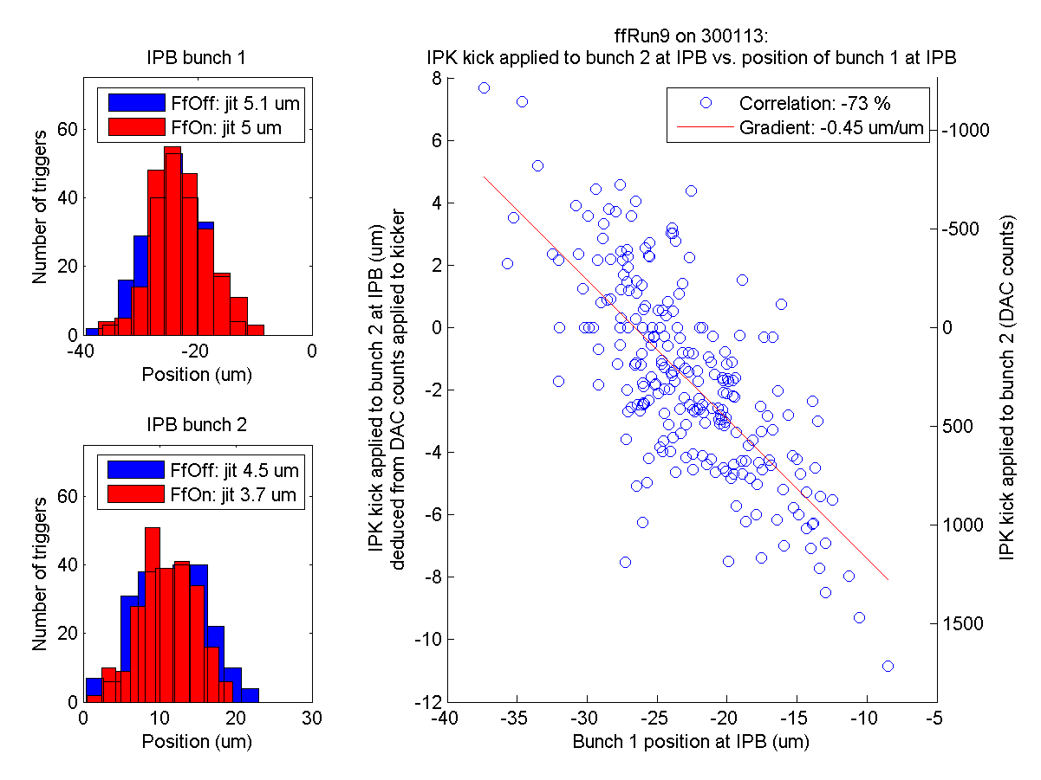
Overview
ffRun9
Gain P2-IPK: -50 000
Gain P3-IPK: 0
30th Jan
ffRun1
ffRun3
ffRun4
ffRun5
ffRun6
ffRun7
ffRun8
ffRun9
1st Feb
ffRun1
ffRun2
ffRun3
ffRun5
ffRun6
ffRun7
ffRun8
Insufficient gain!
N. Blaskovic

Slide 15
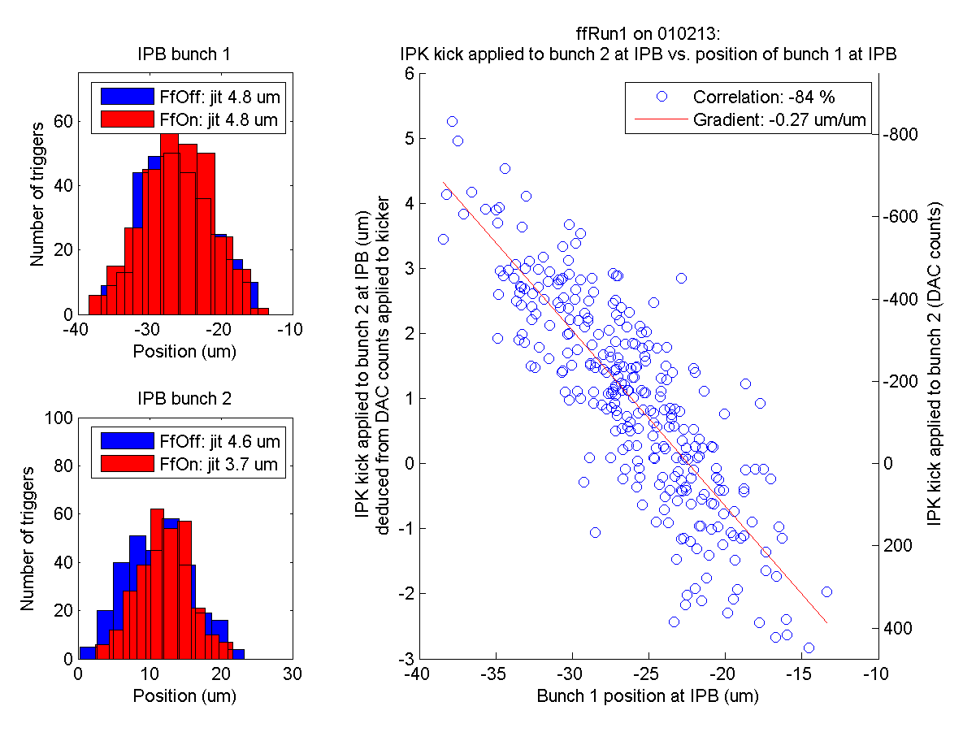
Overview
ffRun1
Gain P2-IPK: -45 000?
Gain P3-IPK: +20 000?
30th Jan
ffRun1
ffRun3
ffRun4
ffRun5
ffRun6
ffRun7
ffRun8
ffRun9
1st Feb
ffRun1
ffRun2
ffRun3
ffRun5
ffRun6
ffRun7
ffRun8
Insufficient gain!
N. Blaskovic

Slide 16
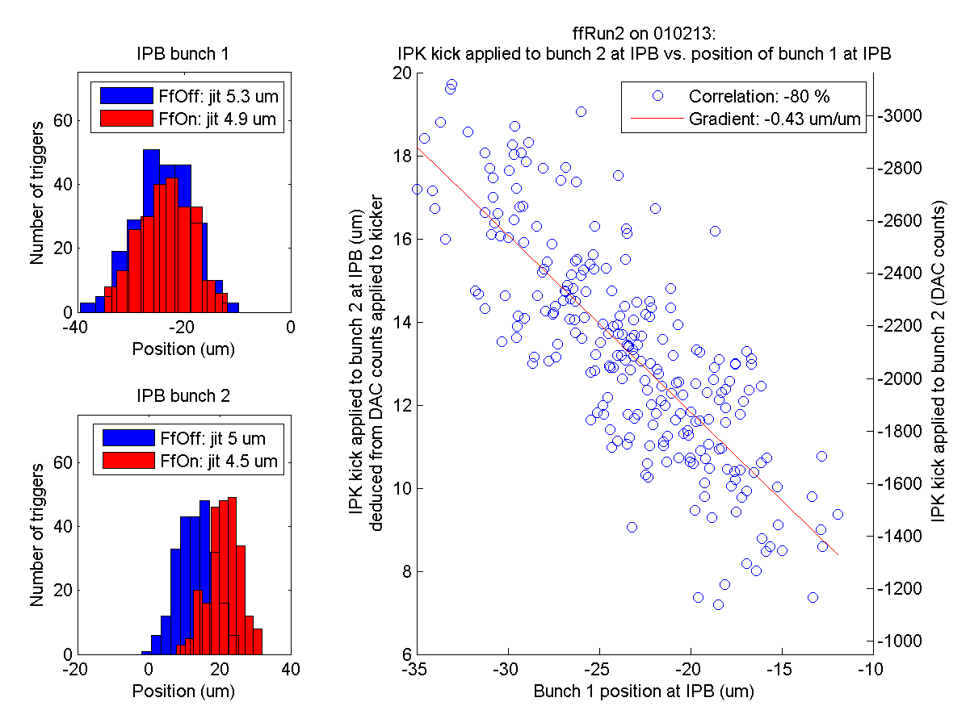
Overview
ffRun2
Gain P2-IPK: -80 000
Gain P3-IPK: +40 000
30th Jan
ffRun1
ffRun3
ffRun4
ffRun5
ffRun6
ffRun7
ffRun8
ffRun9
1st Feb
ffRun1
ffRun2
ffRun3
ffRun5
ffRun6
ffRun7
ffRun8
Saturating kicker amplifier & insufficient gain!
N. Blaskovic

Slide 17
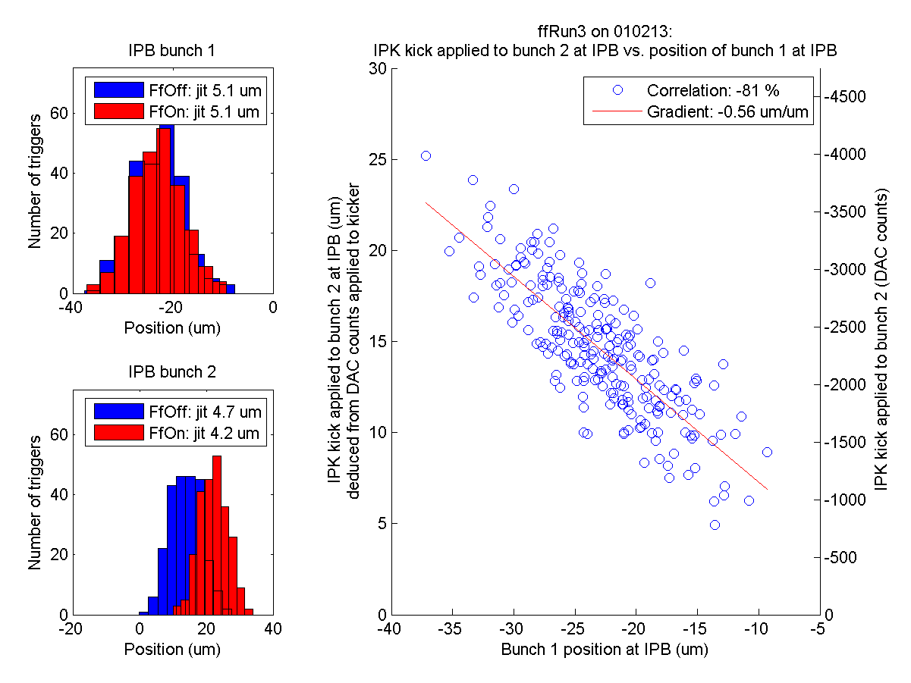
Overview
ffRun3
Gain P2-IPK: -120 000
Gain P3-IPK: +60 000
30th Jan
ffRun1
ffRun3
ffRun4
ffRun5
ffRun6
ffRun7
ffRun8
ffRun9
1st Feb
ffRun1
ffRun2
ffRun3
ffRun5
ffRun6
ffRun7
ffRun8
Saturating kicker amplifier!
N. Blaskovic

Slide 18
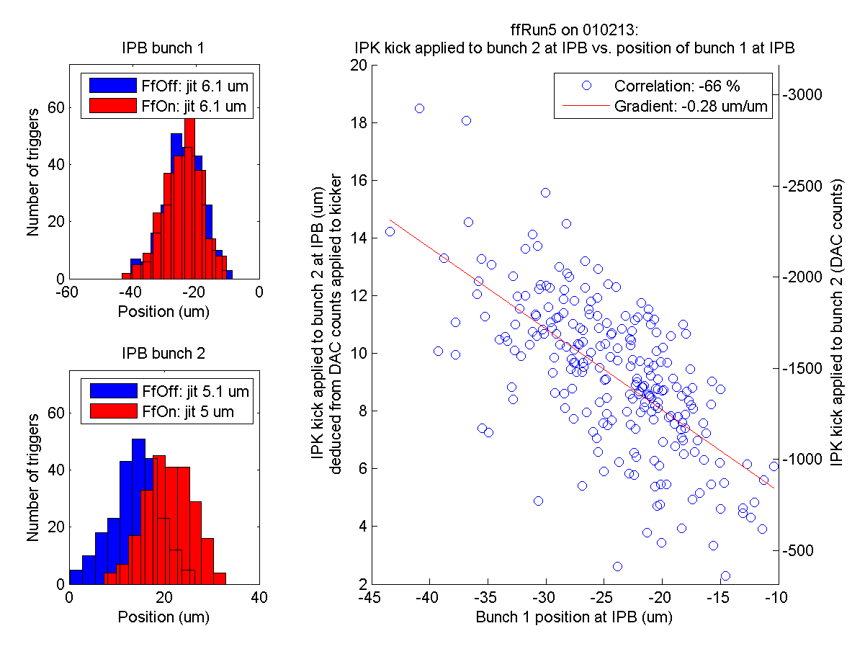
Overview
ffRun5
Gain P2-IPK: -80 000
Gain P3-IPK: +40 000
30th Jan
ffRun1
ffRun3
ffRun4
ffRun5
ffRun6
ffRun7
ffRun8
ffRun9
1st Feb
ffRun1
ffRun2
ffRun3
ffRun5
ffRun6
ffRun7
ffRun8
Saturating kicker amplifier & insufficient gain!
N. Blaskovic

Slide 19
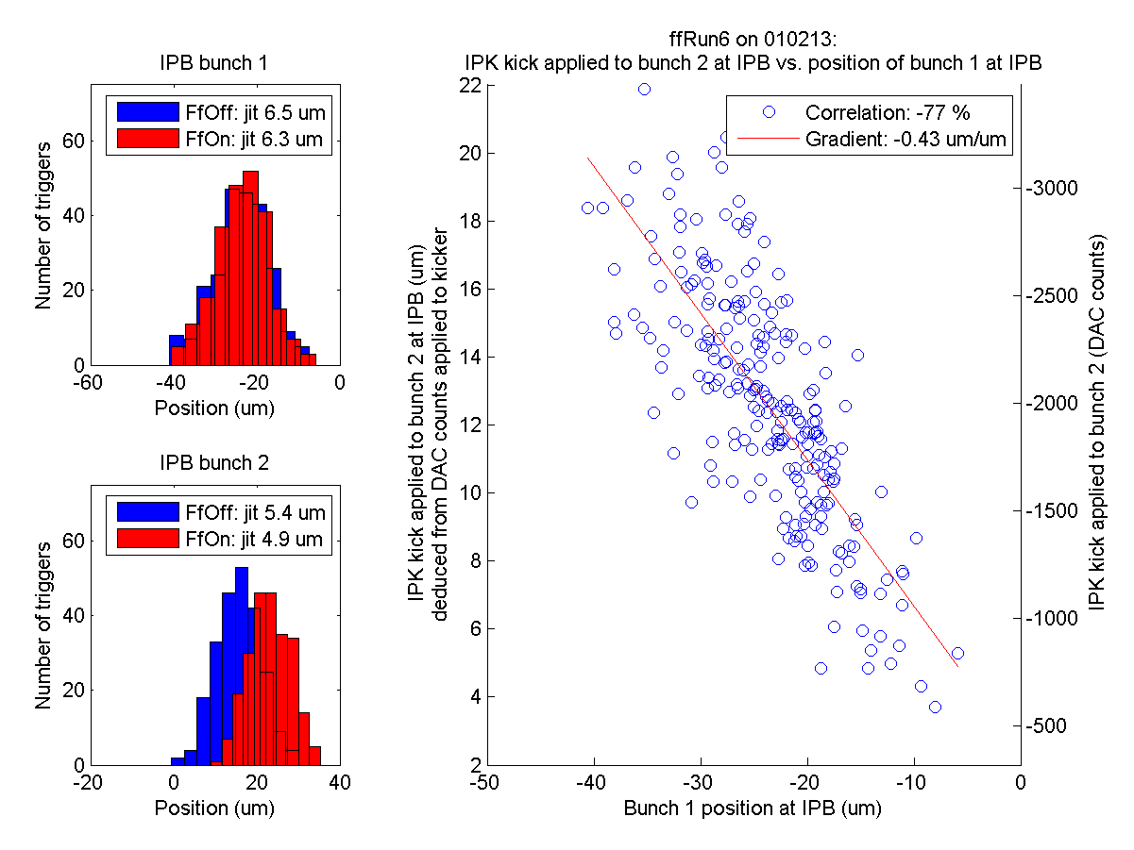
Overview
ffRun6
Gain P2-IPK: -100 000
Gain P3-IPK: +50 000
30th Jan
ffRun1
ffRun3
ffRun4
ffRun5
ffRun6
ffRun7
ffRun8
ffRun9
1st Feb
ffRun1
ffRun2
ffRun3
ffRun5
ffRun6
ffRun7
ffRun8
Saturating kicker amplifier & insufficient gain!
N. Blaskovic

Slide 20
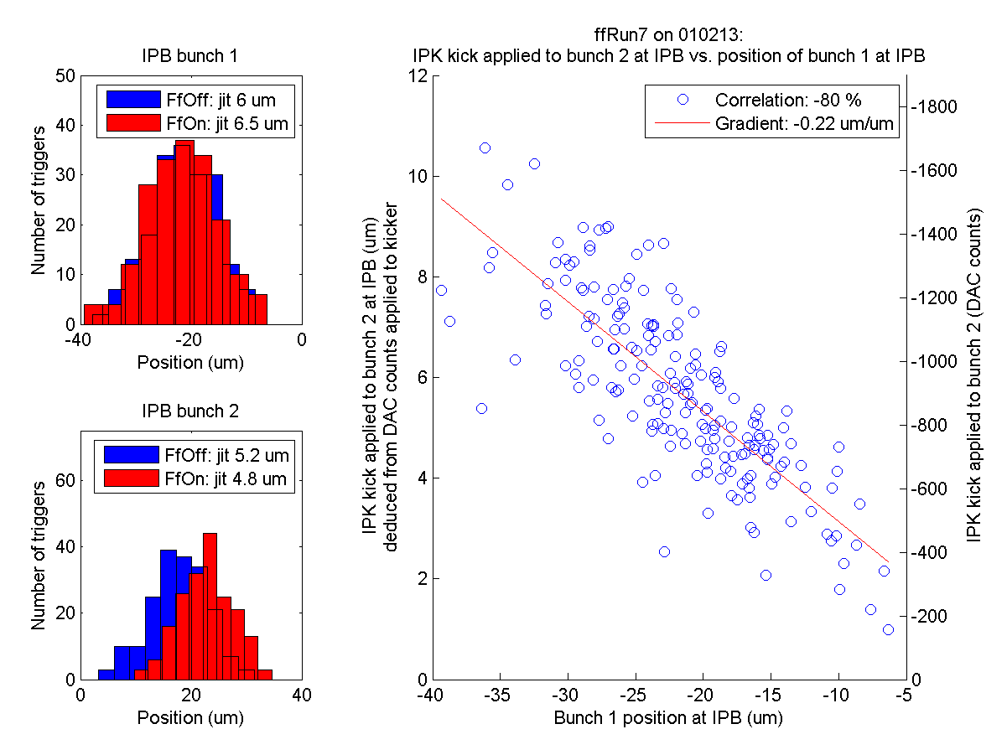
Overview
ffRun7
Gain P2-IPK: -50 000
Gain P3-IPK: +25 000
30th Jan
ffRun1
ffRun3
ffRun4
ffRun5
ffRun6
ffRun7
ffRun8
ffRun9
1st Feb
ffRun1
ffRun2
ffRun3
ffRun5
ffRun6
ffRun7
ffRun8
Insufficient gain!
N. Blaskovic

Slide 21
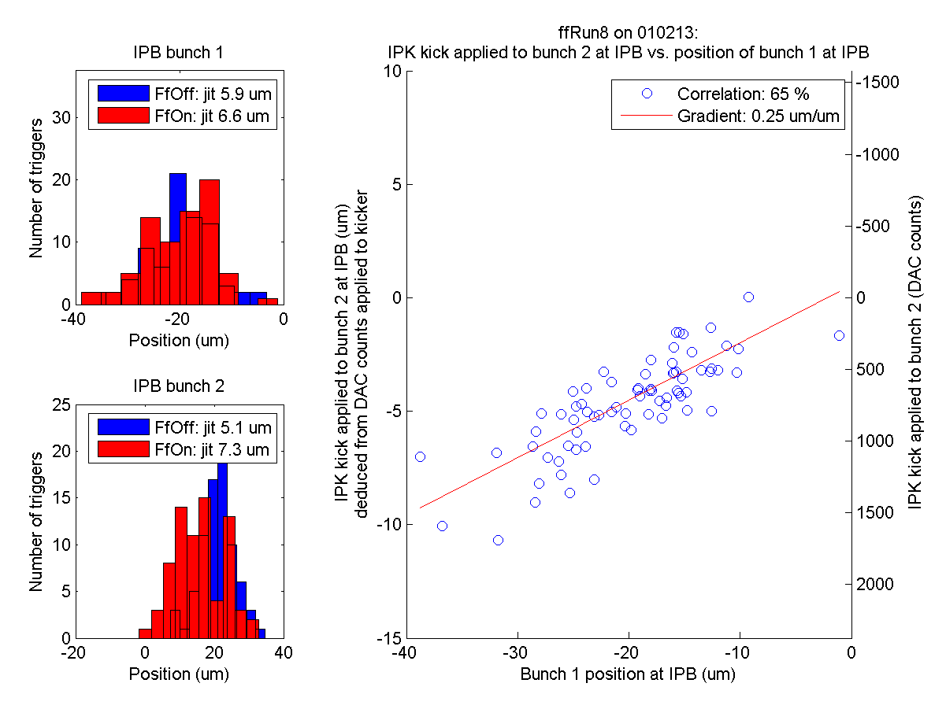
Overview
ffRun8
Gain P2-IPK: +50 000
Gain P3-IPK: -25 000
30th Jan
ffRun1
ffRun3
ffRun4
ffRun5
ffRun6
ffRun7
ffRun8
ffRun9
1st Feb
ffRun1
ffRun2
ffRun3
ffRun5
ffRun6
ffRun7
ffRun8
Wrong gain sign!
N. Blaskovic

Slide 22
Summary
On next slide, summary of how insufficient gain and/or saturating kicker amplifier is related to extent of feedback correction.
As done by Mikey, ‘Improvement’ is given by:
‘’${′Improvement}^{′}=\frac{{Jitter}_{FfOn}^{B2}−{Jitter}_{FfOff}^{B2}}{{Jitter}_{FfOff}^{B2}}$ where B2 is bunch 2
N. Blaskovic

Slide 23
30th Jan
‘Improvement’
30th Jan
‘Improvement’
ffRun1
-12 %
ffRun1
-24 %
ffRun3
-29 %
ffRun3
-39 %
ffRun4
-7 %
ffRun4
-22 %
ffRun5
-28 %
ffRun5
-39 %
ffRun6
60 %
ffRun6
59 %
ffRun7
-12 %
ffRun7
-42 %
ffRun8
-15 %
ffRun8
-24 %
ffRun9
-4 %
ffRun9
-17 %
Mikey’s results from 8th Feb
Today’s results
1st Feb
‘Improvement’
1st Feb
‘Improvement’
ffRun1
-16 %
ffRun1
-20 %
ffRun2
-13 %
ffRun2
-10 %
ffRun3
-9 %
ffRun3
-11 %
ffRun5
-6 %
ffRun5
-2 %
ffRun6
-5 %
ffRun6
-9 %
ffRun7
-7 %
ffRun7
-8 %
ffRun8
61 %
ffRun8
43 %
Feedforward reduces jitter
Gain OK & DAC out OK
Feedforward increases jitter
Low gain / saturating amplifier
Wrong gain sign
N. Blaskovic

Slide 24
Conclusions
Some of the underperforming feedforward runs seem to be limited by:
Insufficient kicks due to diluted gains or incorrect sign of one of the gains
Operating beyond the kicker amplifier’s linear range
Ensure that average DAC out is centred at zero counts on shift.
N. Blaskovic

Slide 25
Appendix
Summary of the four feedforward runs deemed to have OK gain and OK DAC out

Slide 26
Summary of OK! runs
30th Jan
30th Jan
30th Jan
30th Jan
ffRun3
ffRun5
ffRun7
ffRun8
N. Blaskovic

Slide 27
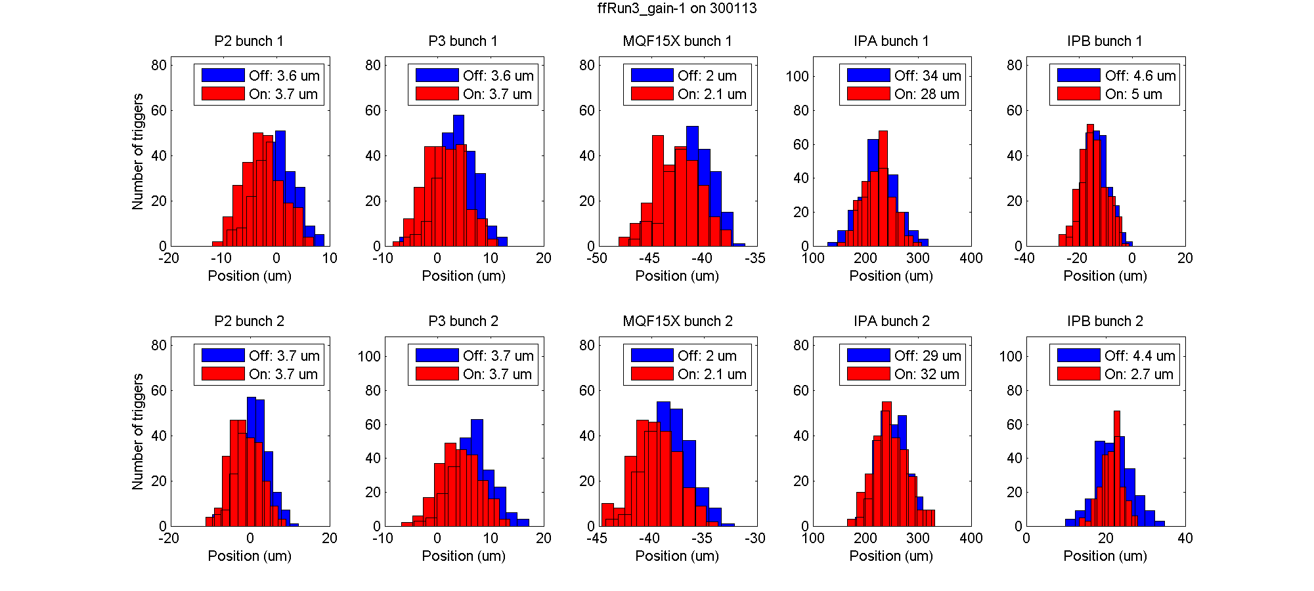
N. Blaskovic

Slide 28
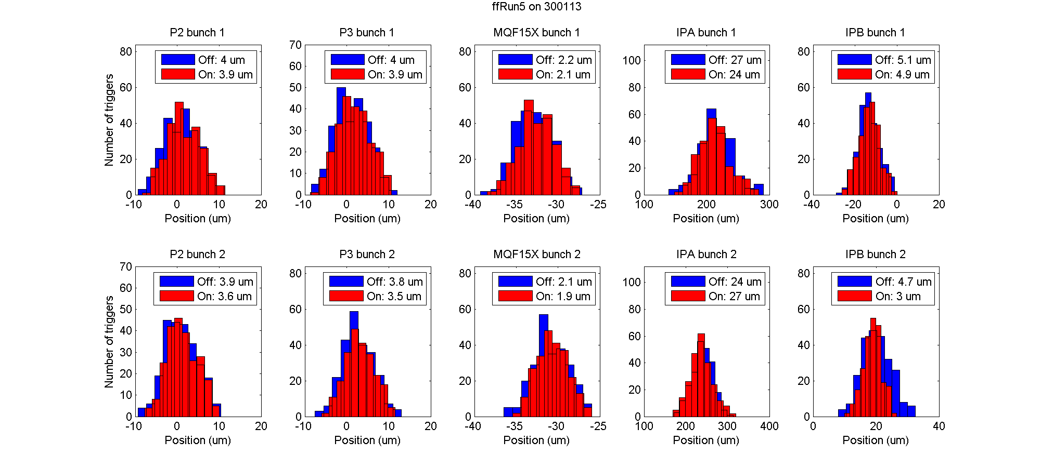
N. Blaskovic

Slide 29
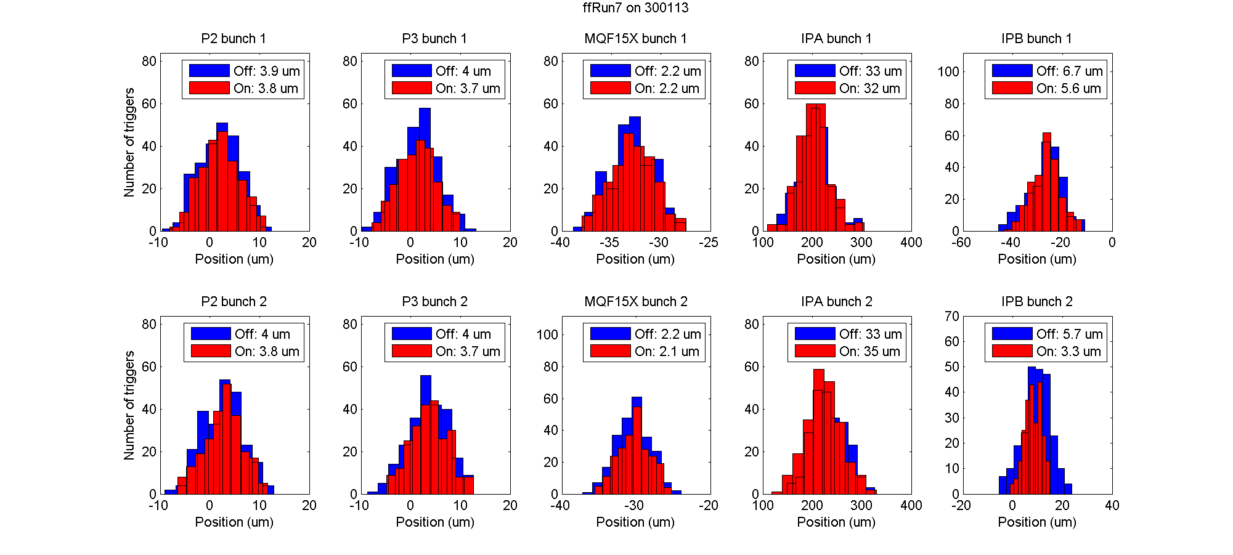
N. Blaskovic

Slide 30
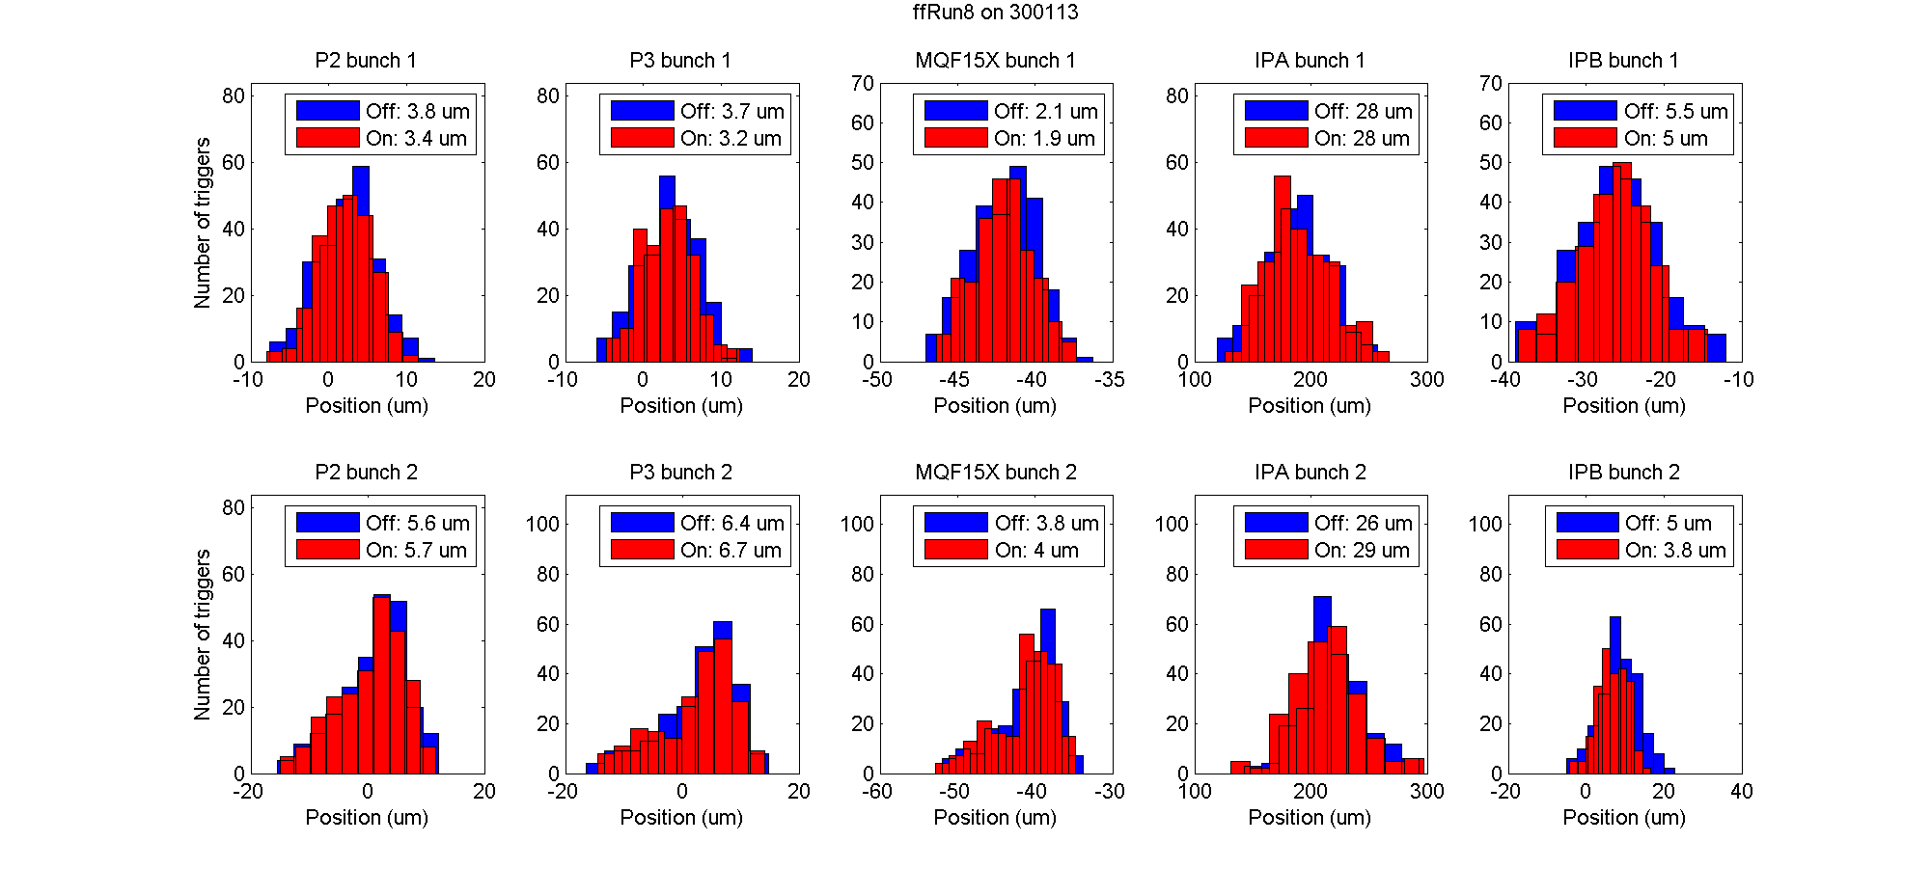
N. Blaskovic

Slide 31
Appendix
Analysis concerns

Slide 32
Possible analysis improvements
Reconsider double 3σ flier removal on position.
Calculate the jitter from a Gaussian fit, as opposed to just finding the std of the data.
Try Young-Im’s calibration, using reference cavity for charge normalisation.
N. Blaskovic

Slide 33
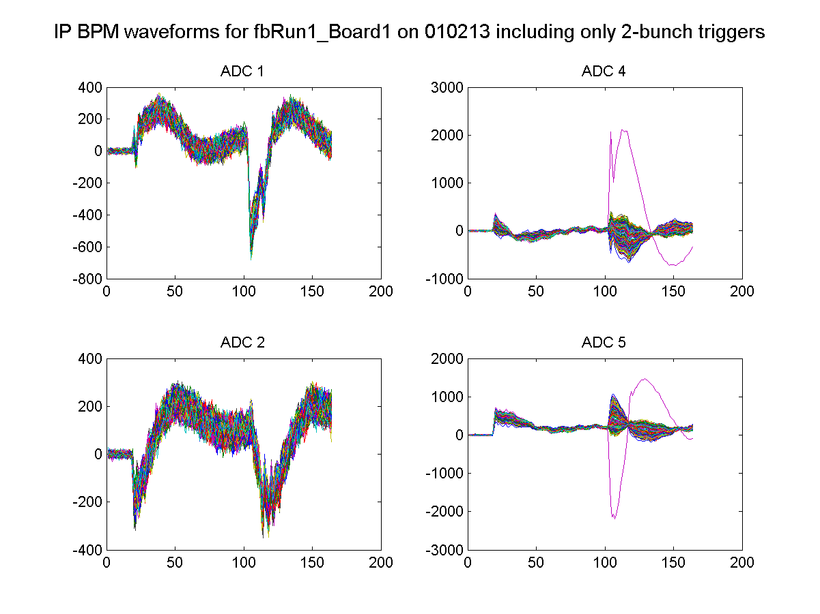
Apparent extraneous orbit
Trigger 267 from fbRun1 on 010213 has normal charge upstream and at IP and yet has a strange response at IPB:
trigger 267
trigger 267
N. Blaskovic

