Slide 1
Future Plans for the ATF
Nobuhiro Terunuma
3/12/2013 ILC-TB meeting

Slide 2
LC related R&Ds at present
R&Ds in DR
  Low emittance study
    achieve 2 pm vertical emittance (4-5 pm achieved in 2003)
    not enough time at present because of the ATF2 priority
  γ-ray generation by optical cavity
    positron source, γ-γ,
    KEK/Hiroshima, LAL
R&Ds in ATF2 beamline
  Goal-1: small beam, 37 nm
  Goal-2: 2 nm stabilization

Slide 3
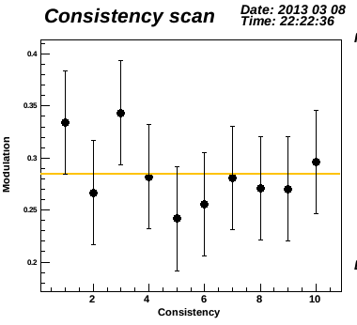
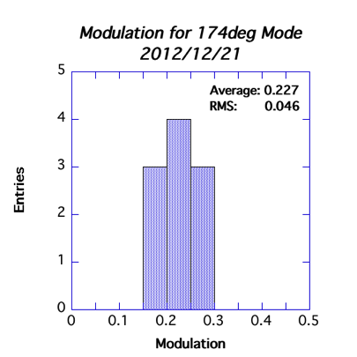
ATF2 status; goal-1, small beam
Improvement of the hardware in 2012 was successfully done.
  beam size monitor, Quadrupole etc.,…
Modulation of the Compton signal, correspond to the 70 nm beam size, was obtained in December 2012.
Good reproducibility
Study with a beam below 100 nm makes better understandings about …
  beamline errors; short coil, magnet miss-alignment
  beam size monitor errors
    Errors make the modulation smaller (correspond to larger beam size) than the real
      alignment of laser against a beam (fringe tilt), laser spatial coherency, polarization etc.,…
  Wake field effect
73 +- 5 nm

Slide 4
ATF2 status; goal-2, stabilization
Proto-type study at ATF2-IP
  Intra-train feedback system (FONT) has been installed at the ATF2-IP as a initial study of the nm-level orbit stabilization.
  It uses a proto-type IP-BPM and readout electronics.
  Studies are in progress using 2 or 3 bunches/pulse from DR.
Preparation of new IP setup
  Three cavity BPMs, low-Q for multi-bunch beam, and their readout electronics are fabricated and under testing (KEK/KNU). A beam test at ATF linac had been done.
  New vacuum chamber with the piezo movers for BPMs are under testing at LAL.
Unified system will be set in this summer

Slide 5
for Goal-2: New IP chamber and BPM movers at LAL

Slide 6
near future schedule
GDE/KEK ATF2 Technical Review
  April 3-4 (KEK)
Dedicated beam runs for ATF2 goal-1
  Two weeks, May 13-24
  37 nm beam size R&D
  keep the beamline settings for ATF2 program
IP upgrade for the ATF2 goal-2
  2 nm stabilization R&D
  install three IPBPMs with piezo movers into IP in this summer
  Intra-train position feedback (FONT) using IPBPM signal
  Re-alignment of the IP beam size monitor
Grand motion feedback study
  15 GM sensors (CERN, LAPP…) will be installed in the ATF2 beamline in this summer

Slide 7
Background: ATF/ATF2 in 2012-2013
JFY
2012
2013
4
7
10
1
4
7
10
1
Decrease the beam size
Continuous studies for establishment and for goal-2
Goal-1
(37nm)
Goal-2
(2nm stabilization)
Development of components at EXT and IP
IP installation
Electronics development (FONT, IPBPM readout)
Emittance 1pm
10pm→1pm study in DR
Cavity Compton
4-mirror Cavity R&D; KEK, Hiroshima, LAL

Slide 8
Long term plans
Past discussions proposed for the KEK roadmap 2014-2018
  Present R&D will be reconsidered at the end of JFY 2013
  Widening the research program not only ILC but also other fields.
  Obtain grants for new researches
  researches under the global collaboration
Final draft of the new KEK roadmap
  http://kds.kek.jp/conferenceDisplay.py?confId=11728
  2.3 Development of Particle Accelerators and Related Technologies at KEK
    KEK will establish the latest component technologies, as discussed above, for use in future accelerators within and outside of Japan. The ATF and Superconducting RF Test Facility (STF) are important vehicles for performing these tasks in the context of both the technology and international collaboration.

Slide 9
Target of the ATF future plan
Researches with low emittance and small beam
  Advanced Accelerator technology
  Multilateral cooperation
  Education of young researchers
ILC related R&D（50%）
  Achievement of the remaining ATF goal
  Establishment of technology
Other R&D（50％）

Slide 10
ATF Future Plan
ATF長期計画(案)
GDE
Next KEK Roadmap
CY
2011
2012
2013
2014
2015
2016
2017
2018
ILC
others
Delay by fire and earthquake
Nano beam orbit control
Develop.(2nmBPM, Fast FB)
Nano beam orbit control (FONT extension)
Beam study
2nm stab. R&D
2nm steady op.
37nm
Steady op.
Challenging R&D of the Very high chromaticity optics
Ultra small beam ~ 20 nm
Small beam
Beam study
Gamma-gamma collider R&D
Develop. / beam study
4-mirror optical cavity (LAL/KEK)
Gamma-gamma laser system R&D
Application
High Field Physics
General R&D
Ex) for KEKB; CSR, RF gun,
Instrument develop.,
Low emittance,…
Test beamline for detector?

Slide 11
ATF Future Plan
ATF長期計画(案)
GDE
Next KEK Roadmap
CY
2011
2012
2013
2014
2015
2016
2017
2018
Not yet approved,
but the next roadmap will state the importance of ATF.
ILC
others
Delay by fire and earthquake
Nano beam orbit control
Develop.(2nmBPM, Fast FB)
Nano beam orbit control (FONT extension)
Beam study
2nm stab. R&D
2nm steady op.
37nm
Steady op.
Challenging R&D of the Very high chromaticity optics
Ultra small beam ~ 20 nm
Small beam
Beam study
Gamma-gamma collider R&D
Develop. / beam study
4-mirror optical cavity (LAL/KEK)
Gamma-gamma laser system R&D
Application
High Field Physics
General R&D
Ex) for KEKB; CSR, RF gun,
Instrument develop.,
Low emittance,…
Test beamline for detector?

Slide 12
Budget?
We may face with a heavy reduction of budget in coming years.
  Down to 60% of the past years?
A minimum budget to keep the annual operation is offered by KEK-LC office.
  will be spent for the maintenance labor
  22 beam weeks in FY2013 (as usual)
  Installations for ATF2 goal-2 can be done in this summer. A half of them are in-kind contribution.
additional budget?
  keep trying to apply grants for new researches
  New budget for ILC?

Slide 13
backups

Slide 14
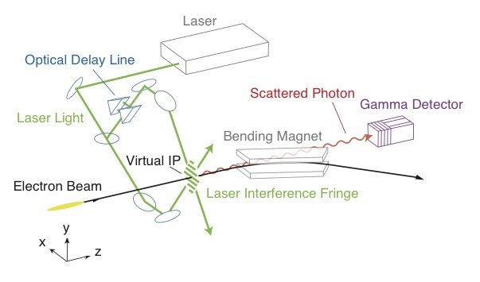
Nanometer Beam Size Monitor
Univ. Tokyo / KEK
    Laser wavelength
    (1064 → 532 nm)
 | 174° | 30° | 8° | 2°
Fringe pitch | 266 nm | 1.03μm | 3.81μm | 15.2μm
Minimum | 25 nm | 100 nm | 360 nm | -
Maximum | 100 nm | 360 nm | - | 6 μm

Slide 15
Proposal：nm small beam
Explore the small beam after the 37 nm at ATF2
Collaborated R&D for CLIC
Demonstration of the final focus with the Very high chromaticity optics and establish the beam tuning method → 20 nm beam
Critical Developments
Beam Size Monitor (Highly stable Laser Interference Fringe Monitor at ATF2); Modulation 0.8 (37nm) → 0.9 (20nm)
Beam Stabilization (IP-BPM + FONT)
Renew the Final Doublet Quadrupole (QF1) at ATF2; CERN proposed In-kind Contribution

Slide 16
Proposal from CERN
12 January 2012, KEK,14th ATF TB/SGC Meeting

Slide 17
Grand Motion Sensors prepared by LAPP
Proposal from CERN
12 January 2012, KEK,14th ATF TB/SGC Meeting

Slide 18
Proposal from CERN
12 January 2012, KEK,14th ATF TB/SGC Meeting

Slide 19
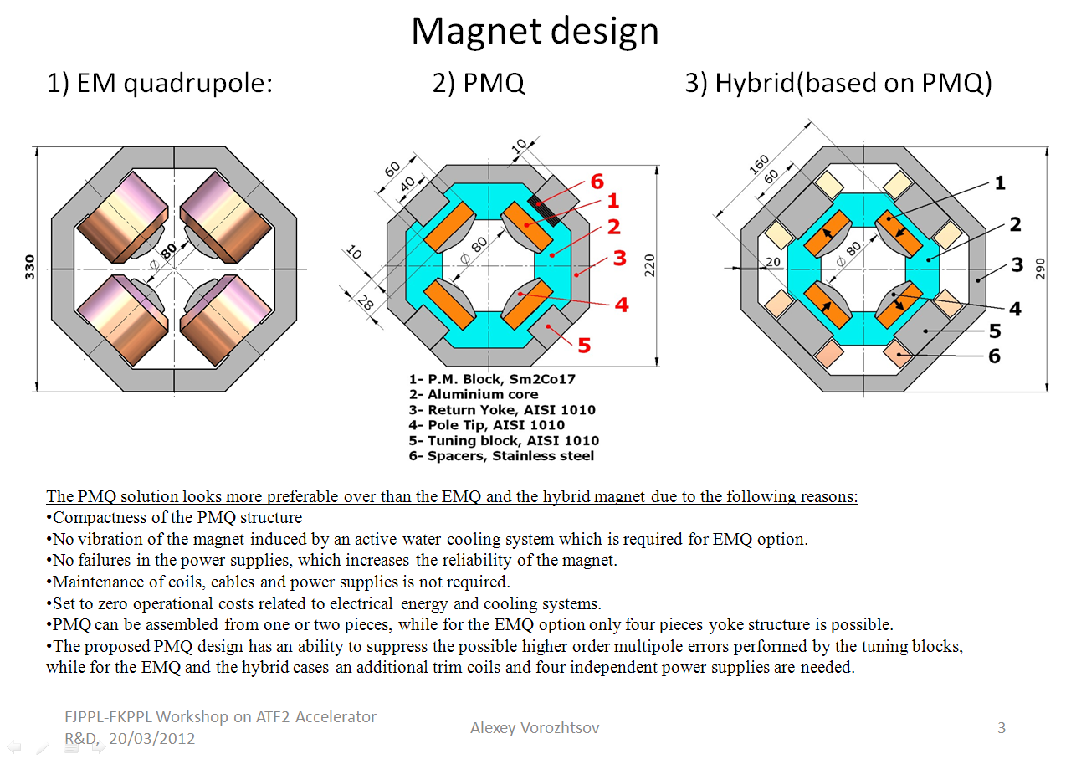
…from FJPPL-FKPPL WS on ATDF2 in March 2012:
14th ATF2 Project Meeting 26-27 June 2012: A. Bartalesi, M. Modena, A. Vorozhtsov on “New Final Doublets”

Slide 20
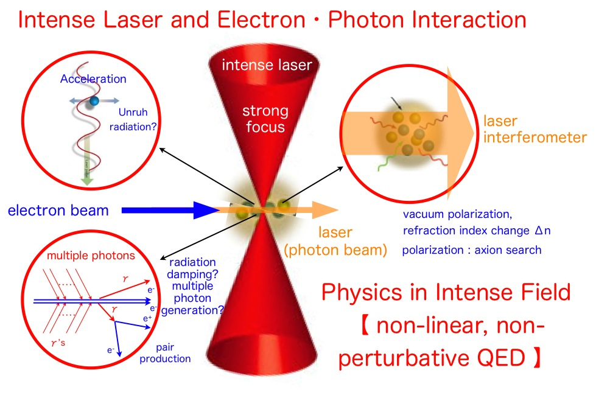
Proposal：High Field Physics
Apply the Grant for Scientific Researches
ATF2 small beam
Development
200 TW laser
Detector

