Slide 1
US ‘Snowmass’ Study –
CSS 2013
M. Ross
‘bottoms-up’ process managed by APS-DPF
CSS 2013 Update given to HEPAP yesterday
J. Rosner
http://science.energy.gov/~/media/hep/hepap/pdf/march-2013/Full_PresentationCFworkshopRosner.pdf

Slide 2
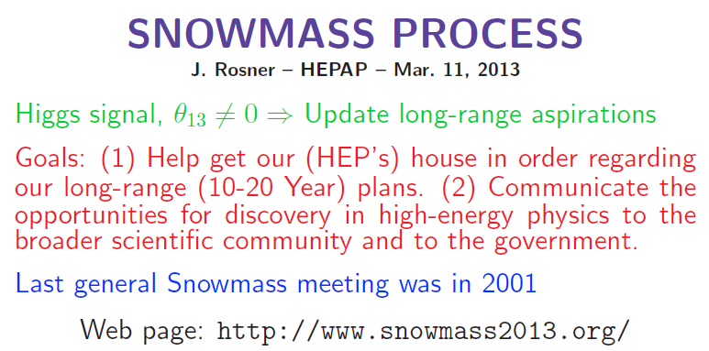
Relevant Groups:
  Energy Frontier
  Frontier Capabilities ←
Relevant Working Groups within ‘Capabilities’:
  WG2: Energy Frontier Lepton and Gamma Colliders
  WG6: Accelerator Technology Test-beds and Test Beams (NS)

Slide 3
  2: Energy Frontier Lepton and Gamma Colliders
Conveners:
  Markus Klute (MIT) / Marco Battaglia (UCSC), Kaoru Yokoya, Mark Palmer.
  Workshop: April 10, 11 at MIT
  https://indico.cern.ch/conferenceTimeTable.py?confId=233944#20130410.detailed
WG2 Charge:

Slide 4
WG2 Questions to address (1):
What the required parameters and key characteristics of lepton / gamma colliders in the Higg's factory range? with physics capabilities far beyond the LHC? at what cost? What are the possible configurations of a lepton / gamma collider Higgs factory that would use existing accelerator infrastructures? How might such a facility be upgraded in energy and / or luminosity? How does a Higgs factory scale cost-wise to a TeV scale linear collider? Can the luminosity of the collider scale with E^2?
What are parameters of ~ TeV scale lepton / gamma colliders? Which technical approaches are naturally linked and how can they be used in conjunction with each other? How does performance scale with energy? What are the most important luminosity limitations? What is the cost scaling with cm energy?

Slide 5
  WG2 Questions to address (2):
Can muons colliders have a role as a Higgs factory on a 10 to 15 year horizon? What are the limitations due to site-boundary radiation control and collider background for a TeV-scale muon collider?
For colliders from the Higgs to TeV scale, what is the characteristic power consumption and how does it scale with energy and luminosity? What is the characteristic footprint?
What are the critical technical challenges for lepton / gamma / muon colliders as a function of collider energy? What R&D must be done to address them and what are key demonstrations and milestones? What is the timescale and what are the pacing factors? What infrastructure is required?
What accelerator R&D is required to realized the physics opportunities in these areas? What are the anticipated cost drivers in the research program?
Are there special opportunities that could be provided by the beam characteristics of wakefield accelerators? On what time scale? What is R&D path? Is there a US leadership scenario? (This will be handled in detail in group 6.

Slide 6
WG2 Questions to address (3):
Are there technology applications beyond energy frontier science that motivate development?
General call for reports, opinions, white papers was issued 02.20. (posted to today’s TB indico)
Deadline 04.01. 2 to 3 pages summarizing R & D and plans (all Capabilities WG’s)
(WG2 conveners will produce a 30 page summary of the April MIT workshop.)
There will be a writers workshop in late June to combine input from all 6 Capabilities WG into a 30 top-level summary to be submitted at ‘Snowmass’
Schedule and Process:

Slide 7
LCC ILC-TB Issues (suggested)
Cost information has been requested and will be discussed
  What should we show and how?
WG6 (Accelerator Technology Test-beds and Test Beams) met 2 weeks ago
  See Rubin and Geng
  https://indico.fnal.gov/conferenceDisplay.py?confId=6326
What documentation should we submit to WG2 and WG6?
  schedule needed; B. Foster has agreed to help

Slide 8
Interaction with Energy Frontier
M. Peskin and C. Brock are the conveners of the Energy Frontier group
They have enlisted key international contributors who will attend pre-meetings:
  04.03-04.06 BNL and 06.30-07.03 UW Seattle
the Groups are quite strongly separated ←
(Minneapolis meeting is intended for cross-communication)
ILC – accelerator side international attendance may be helpful
  07.29 to 08.06

