Slide 1
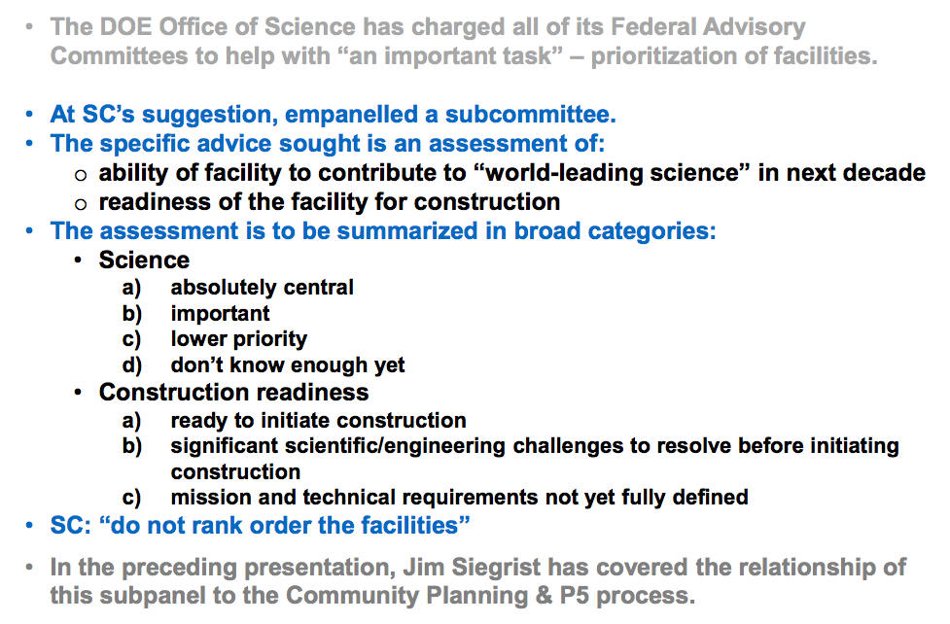
Facility Panel Goals

Slide 2
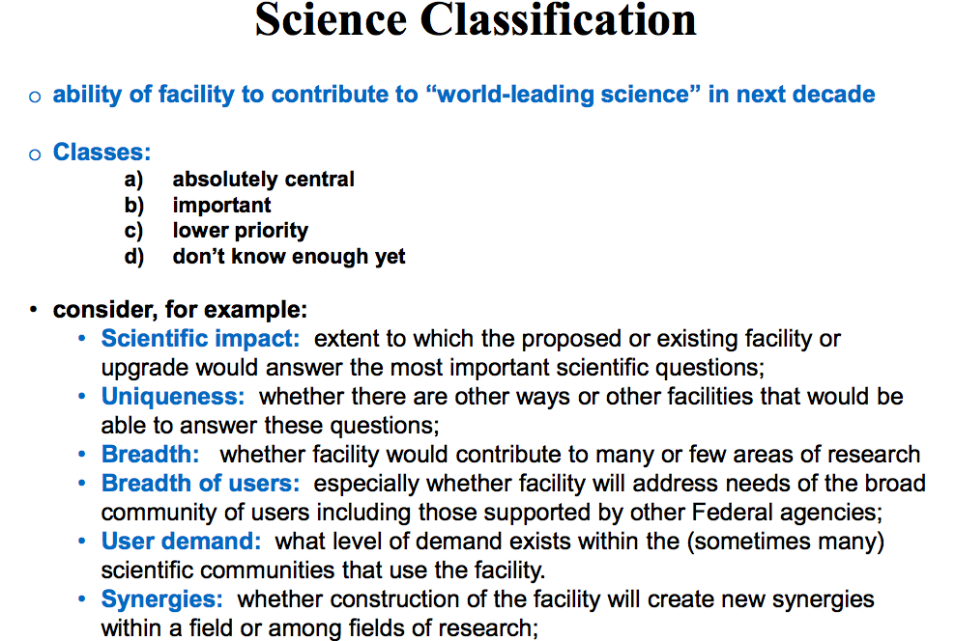
Facilities Panel Classification scheme

Slide 3
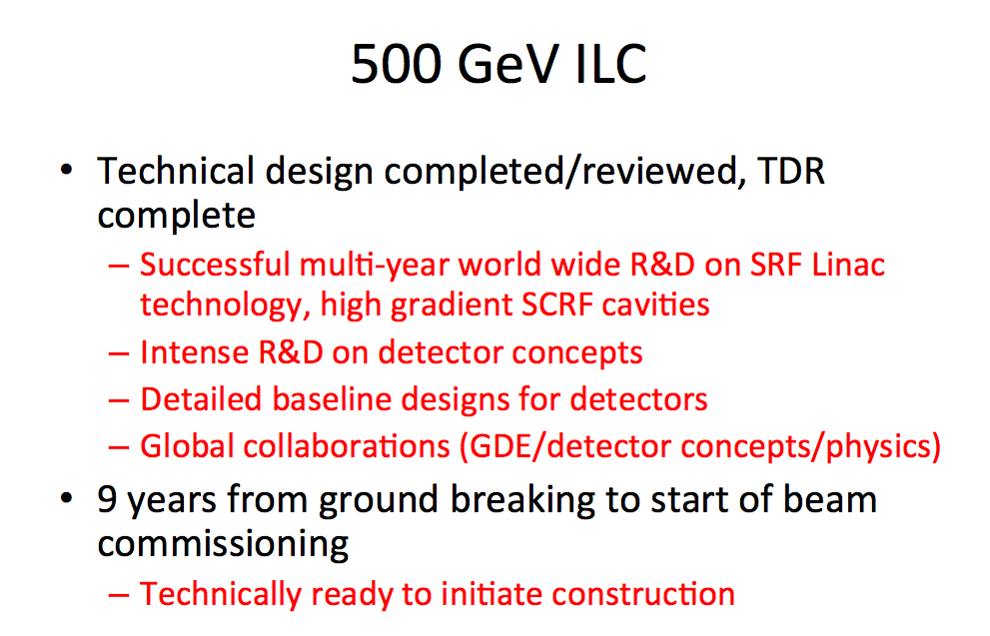
Energy Frontier findings

Slide 4
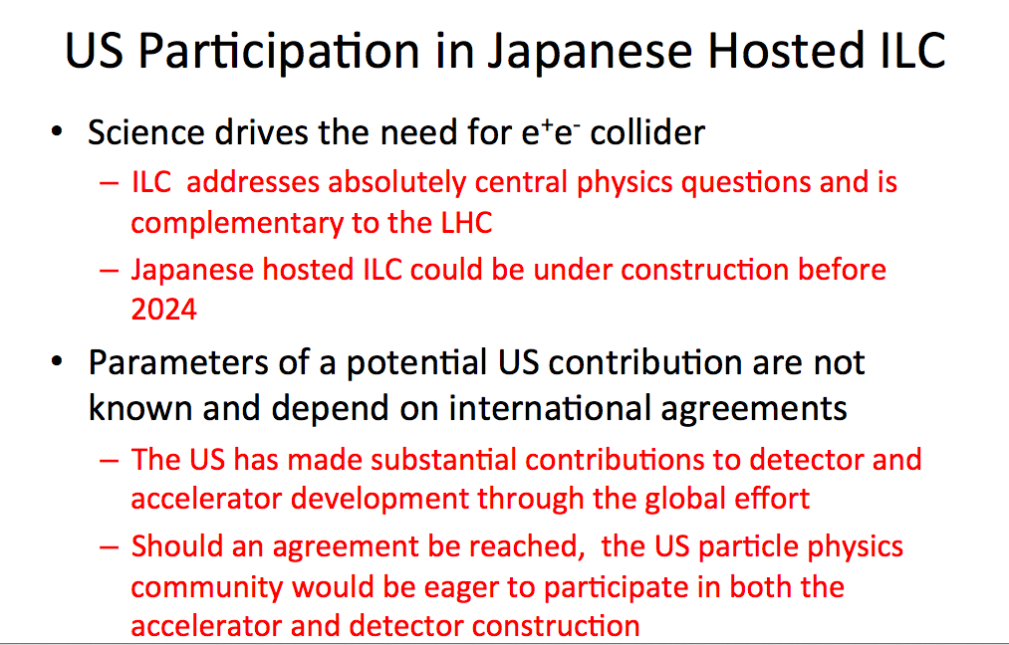
Energy Frontier findings

