Slide 1
ILC Overview
Designed and optimized for 500 GeV E_{cm}; upgradeable to 1 TeV
L₅₀₀ ~ 1.8e34 with 162 MW wall plug
  L₁₀₀₀ ~ 5e34 with 300 MW wall plug
R & D program completed: Detailed Design
  Technology Demonstrated (SCRF)
  8%-scale Demonstration ‘E-XFEL’ (DESY) in 2015
  IR optics & tuning Demonstration ‘ATF-II’ (KEK)
Higgs Quo Vadis workshop talk:
https://indico.cern.ch/getFile.py/access?contribId=60&sessionId=5&resId=0&materialId=slides&confId=202554
Notes:
Lhec
Lep3
Cost saving
Lumi integration - Nans problem (Pau)
Question about CLIC.
China question -
Tunneling question cost
Question to Sachio about gamma gamma

Slide 2
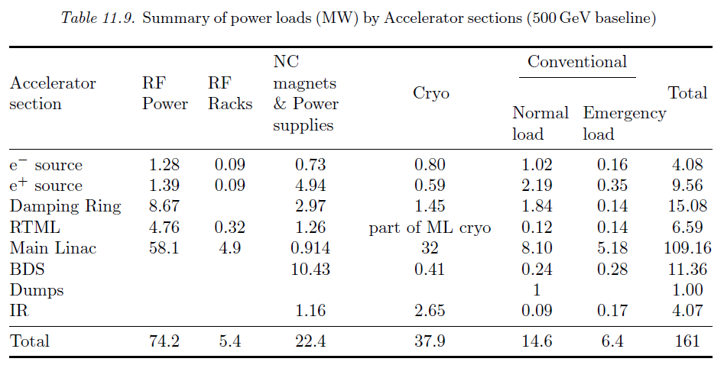
ILC AC Power loads:

Slide 3
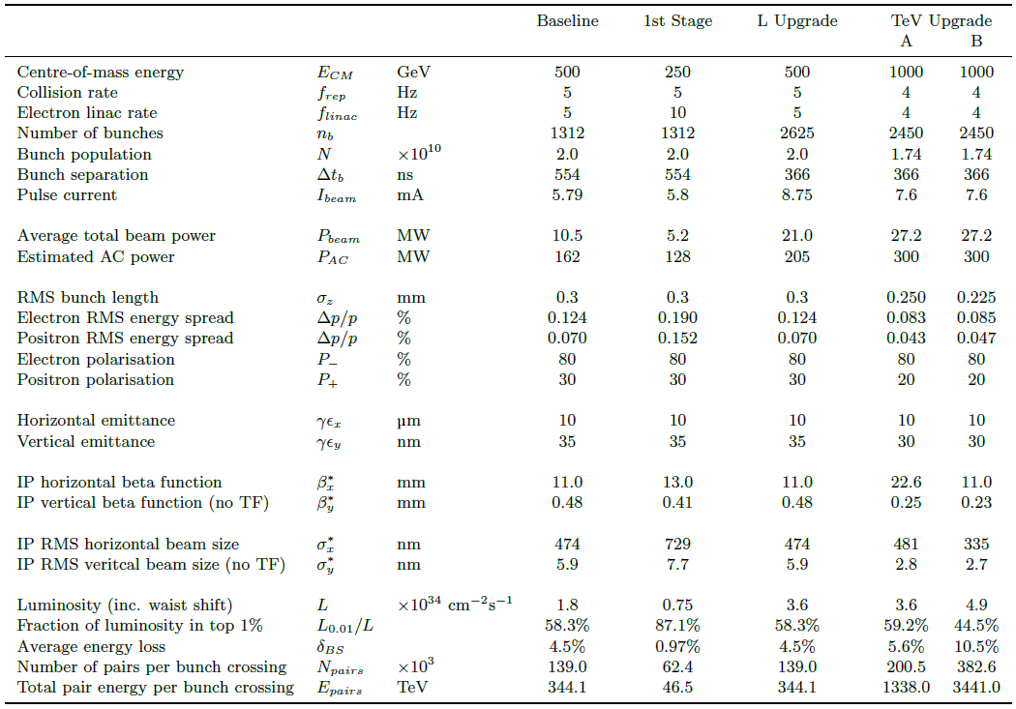
ILC Parameters
500 GeV Baseline
Initial ‘Higg’s Factory

Slide 4
ILC Luminosity Upgrade
Concept: increase n_{b} from 1312 → 2625
  Reduce linac bunch spacing 554 ns → 336 ns
  Increase pulse current 5.8 → 8.8 mA
  Increase number of klystrons by ~50%
Doubles beam power → ×2 L (3.6×10³⁴cm⁻²s⁻¹)
Damping ring:
  Electron ring doubles current (389mA → 778mA)
  Positron ring: possible 2nd (stacked) ring (e-cloud limit)
AC power: 161 MW → 204 MW (est.)
  AC power increased by ×1.5
  shorter fill time and longer beam pulse results in higher RF-beam efficiency (44% → 61%)

Slide 5
Staging and Upgrades:
Assume 30% improved efficiency; new ring may be required. Assume similar improvement in beam size
1500 GeV E_cm
1312 bunches
1500 GeV E_cm
2450 bunches
1000 GeV E_cm
1312 bunches
1000 GeV E_cm
2450 bunches
Design Baseline
500 GeV E_cm
1312 bunches
500 GeV E_cm
2620 bunches
E_cm
250 GeV E_cm
1312 bunches
250 GeV E_cm
2620 bunches
250 GeV E_cm
5240 bunches
Beam intensity

Slide 6
Assumptions:
Power consumption, Beam power are top-level constraints
Footprint secondary constraint
Technology lower level constraint
  R & D expected over 20 – 30yr lifetime: everything else can change!
Dumps sized for 14 MW each
300 MW power limit; roughly →
  Baseline (MW): 50 + 100 MW/500 GeV Ecm (155 GeV)
  RDR I_beam: 50 + 200 MW/500GeV
  (Nominal 1TeV: 50 + 125 MW/500 GeV Ecm; 2450 bunches)
  e.g. 1.5 TeV 50 + 3 * 125 = 425 MW
improve efficiency 30% to 50%? also gradient?
  e1.5 TeV Ecm → 50 + 3 * 100 = 350 MW (2450 bunches)

Slide 7
ILC at low/high Ecm
Low E_{cm} operation of upgraded ILC:
  L₂₅₀ ~ 3e34; Wall plug 200 MW
  Higgs Factory Option
High E_{cm} ~ 1.5 TeV
  L₁₅₀₀ ~ 6e34; Wall plug 340 MW
Assumes 2x improved efficiency; 2450 bunches
ILC - nominal
ILC - upgraded
80 km ring; per IP

Slide 8
Collider ‘Wall Plug’ AC Power use:
ILC and 80 km ring: | ILC -H | ILC-nom | Ring - H | Ring - t
E_cm (GeV) | 250 | 500 | 240 | 350
SRF Power to Beam (MW) | 5.2 | 10.5 | 100 | 100
Eff. RF Length (m) | 7,837 | 15,674 | 600 | 1200
RF klystron peak efficiency (%) | 65 | 65 | 65 | 65
klystron operating margin, HVPS, Klystron Aux and klystron water cooling (% inefficiency) | 30 + 20 Additional inefficiency due cavity fill-time |  | 20* | 20
Overall system RF efficiency (%) | 10 | 14 | 45 | 45
Cryo (MW) | 16 | 32 | 20 | 40
Normal Conducting (exc. Injector complex) (MW) | 6 | 10 | 120** | 120
Injector complex | 32 | 32 | 16*** | 16
Conventional (Air, lighting, ..) | 6 | 6**** | 18 | 18
Total (exc. detector) | 112 | 153 | 396 | 416
* 5% for operating margin, 2% for auxiliaries, 3% for HVPS and 10% for water cooling
** assume 1.5 kW / m tunnel inclusive (ILC avg. 3 kW / m)
*** from SSC / Fermilab injector (linac + LEB + MEB); assumes LHC not needed
**** 6 MW for 30 km beam tunnel complex; ~3x more for 80 ring
Assume two separate collider rings – similar to B Factories

Slide 9
Questions asked for ‘Snowmass’:
CSS2013 / P5 planning process:
“What the required parameters and key characteristics of lepton / gamma colliders in the Higg's factory range? with physics capabilities far beyond the LHC? at what cost? How does a Higgs factory scale cost-wise to a TeV scale linear collider?”
Comment: Cost comparisons with concepts can only be done parametrically.

Slide 10
ILC ‘value’ estimate:
‘Value’ is the direct cost of goods and services
Appropriate for in-kind projects
ILC: 7.8 B ILCU* + 23 million labor person-hours
21.02.2013
Component by component estimate
* 1 ILCU = USD 01.2012

Slide 11
Parametric ‘value’ costing for TeV–class machines (KILCU)*:
Civil Construction: 35 / m
Utilities: 5000 / MW
Superconducting RF 180 / m (inclusive)**
‘Conventional Acc.’ 35 / m
 |  | TLEP-t quantity | MILCU | ILC quantity | MILCU
Civil Construction | km | 80 | 3000 | 34 | 1200
Power and cooling | MW | 416 | 2000 | 162 | 800
SRF (incl. packing) | km | 1.2 / .7 | 250 | 22 | 4000
‘Conventional’ | km | 160* | 5500 *** | 12 | 800
Installation | km | 80 | 100 | 34 | 100
Total |  |  | 11000** |  | 7800
* Assume two collider rings
** cryogenics not included – reuse LHC assumed; 900 MILCU included for ILC
*** Conventional Acc. (Magnets, vacuum, etc) cost – scale reduced 2x for ring
Institutional Labor is part of the project cost and must also be analyzed.

Slide 12
250 GeV – Staged ILC
15.4 km
1.1 km
5.1 km
1.3 km
2.2 km
Main Linac
BDS
e+ src
IP
bunch comp.
125 GeV transport
central region
Half the linac
Full-length BDS tunnel & vacuum (TeV)
½ BDS magnets (instrumentation, CF etc)
1 RTML LTL
5km 125 GeV transport line
Extended tunnel/CFS already 500 GeV stage
See next talk

Slide 13
TeV upgrade: Construction Scenario
500GeV operations
start civil construction
BC
Main Linac
BDS
e+ src
IP
civil construction + installation
500GeV operations
BC
Main Linac
BDS
e+ src
IP
Installation/upgrade shutdown
BC
Main Linac
BDS
e+ src
IP
final installation/connection
removal/relocation of BC
Removal of turnaround etc.
Installation of addition magnets etc.
Commissioning / operation at 1TeV
BC
Main Linac
BDS
e+ src
IP
Notes:
An obvious possible approach to minimizing downtime for physics.
Assume something like a total of 5 year construction with perhaps 12-18 months with no physics??

Slide 14
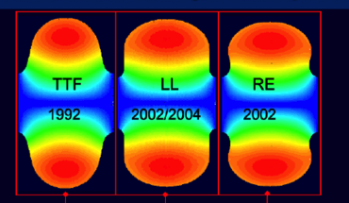
TeV Upgrade
<26 km ?
(site length <52 km ?)
1.1 km
<10.8 km ?
10.8 km
1.3 km
2.2 km
Main Linac
BDS
e+ src
IP
bunch comp.
Assume Higher Gradient
Main Linac
<G_{cavity}> = 31.5 MV/m
G_{eff} ≈ 22.7 MV/m
(fill fact. = 0.72)
central region
Snowmass 2005 baseline recommendation for TeV upgrade:
G_{cavity} = 36 MV/m ⇒ 9.6 km
(VT ≥ 40 MV/m)
Based on use of low-loss or re-entrant cavity shapes

Slide 15
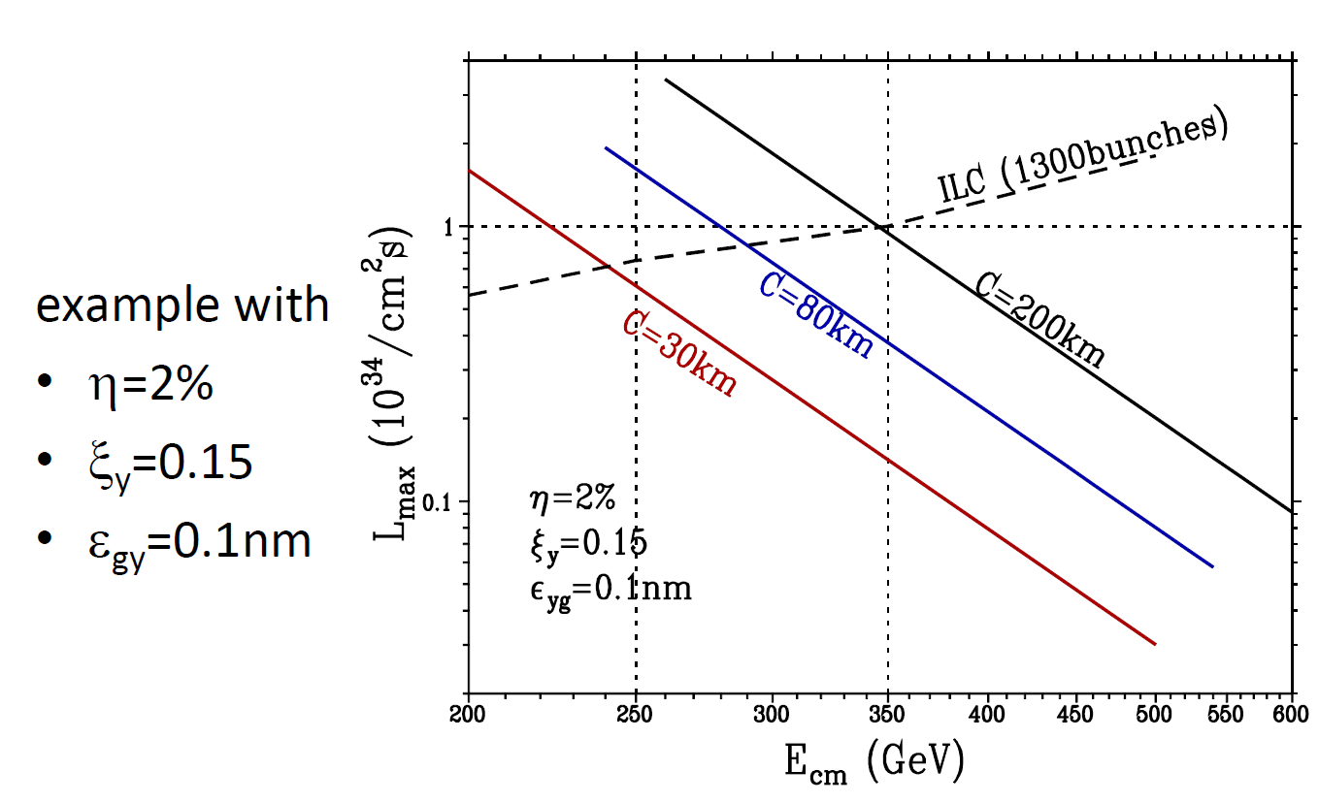
Model: ring luminosity vs C

