Slide 1


Analysis of March ATF Run
Mikey Davis
21 March 2013
1/22

Slide 2
Introduction
The data taking on the last trip focused on trying to understand the results from the BPMs
We found some interesting things, many I don’t understand
Highlights:
Explained approx 16dB of the mystery 20dB atten in IPB
Have managed to take runs with low jitters (0.2μm)
Lowlights:
Some confusing and slightly worrying results from EPICs
Further indications that we don’t understand the HOMOD system properly
Mikey Davis
21 March 2013
2/22

Slide 3
EPICs System
We spend a considerable period this trip looking at the EPICs system
In hindsight maybe too long but the results were so confusing we wanted to understand what was going on
We basically found that the jitter was proportional to the beam displacement from zero
As I understand Young Im has been unable to simulate this behaviour in the beam which I think suggests a measurement discrepancy
Import to note that the average position appears as expected
The waist was at IPB
Mikey Davis
21 March 2013
3/22

Slide 4
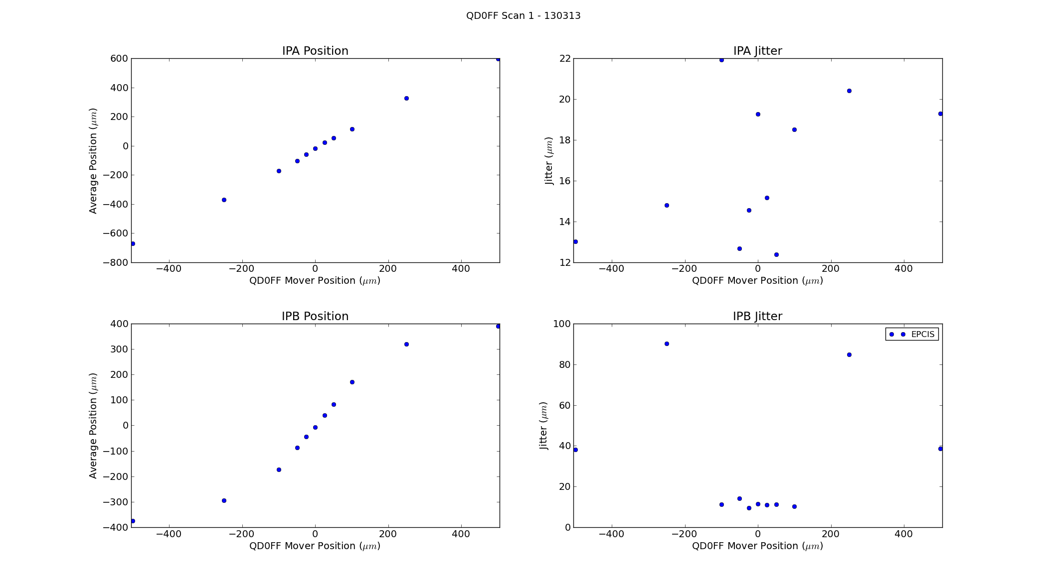
QD0FF Scan 1 - Coarse
Mikey Davis
21 March 2013
4/22

Slide 5
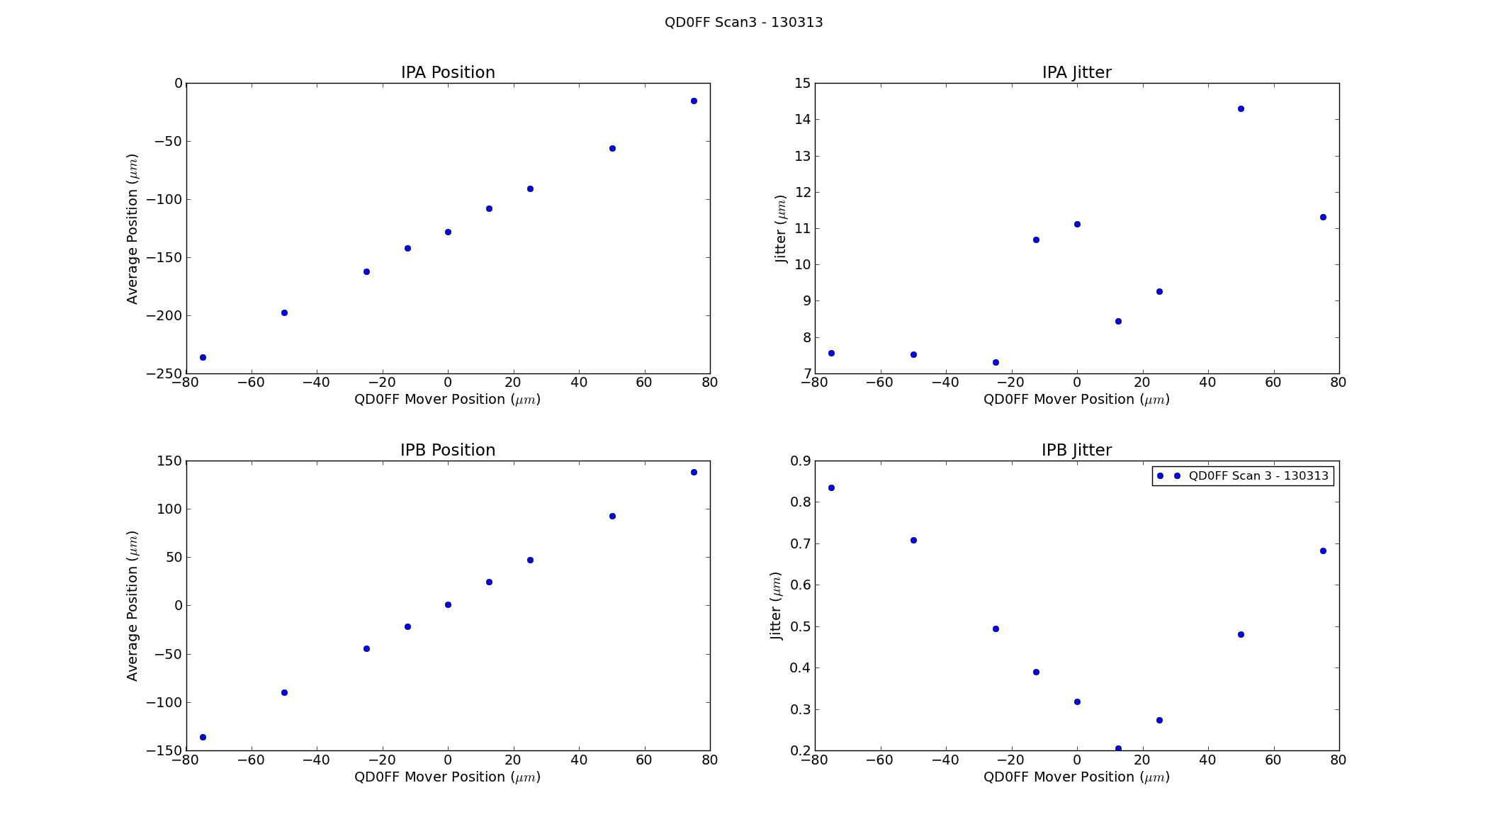
QD0FF Scan 3 - Coarse
Mikey Davis
21 March 2013
5/22

Slide 6
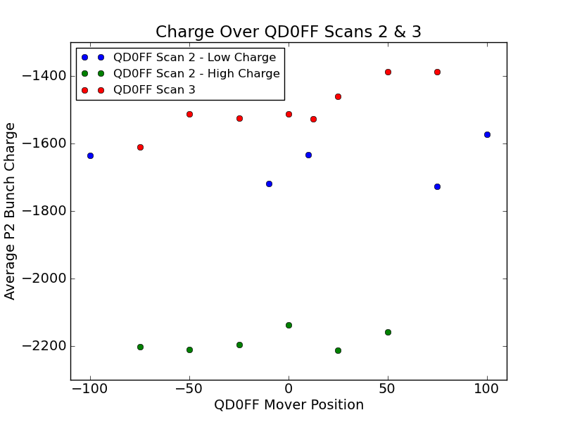
QD0FF Scan 2 -Charge
Mikey Davis
21 March 2013
6/22

Slide 7
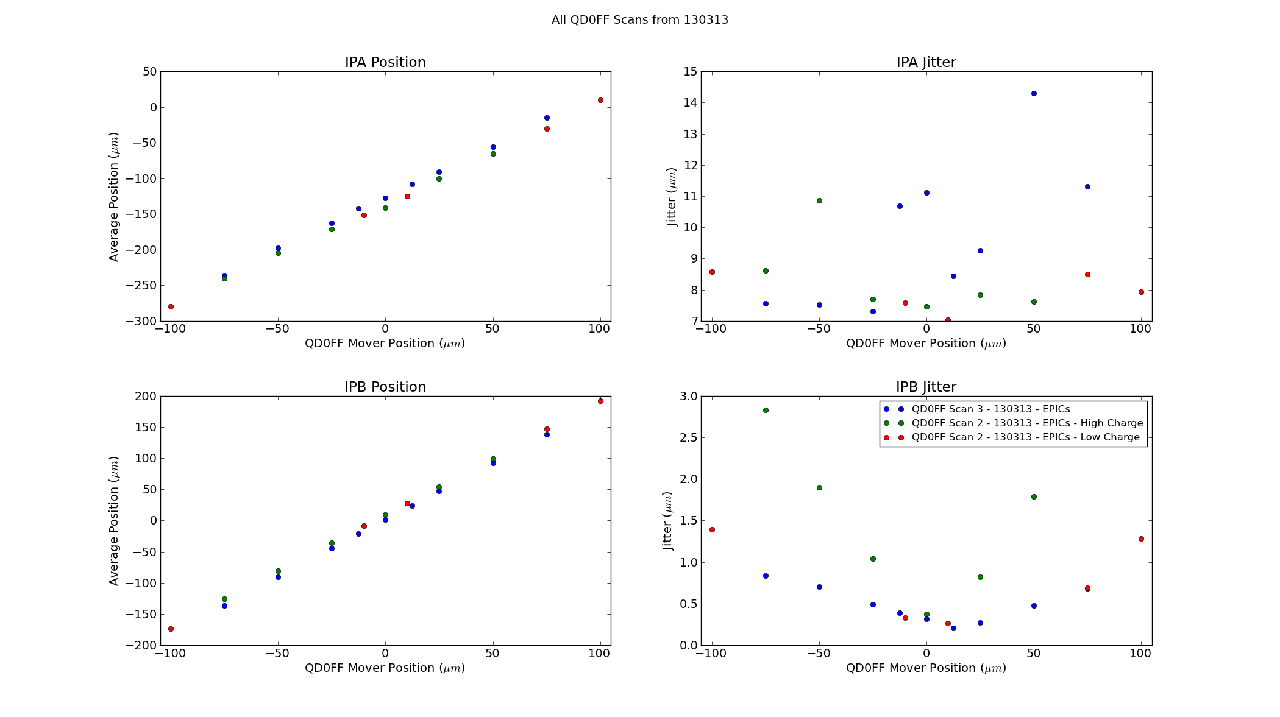
QD0FF Scans 2 & 3
Mikey Davis
21 March 2013
7/22

Slide 8
Honda System
We spent most of the third shift looking at the HONDA system and comparing it with EPICS
Tried swapping the IPA and IPB second stages
This is apparently 16dB of our mystery 20dB
The results from the HONDA system are very confusing
Charge was very low for most of shift (>500 counts with no attenuation)
I will focus on QD0FF Scan 4 and 5
Mikey Davis
21 March 2013
8/22

Slide 9
Honda Calibrations
We got two sets of calibrations at different attenuations with switched 1st and 2nd stages
This accounts for 16dB of out mystery 20dB
K @ 0dB | IPA | IPB
Before Swap | 5.19 | -46.09
After Swap | 22.23 | -13.07
K @ 10dB | IPA | IPB
Before Swap | 16.51 | -147.1
After Swap | 61.20 | -39.87
Mikey Davis
21 March 2013
9/22

Slide 10
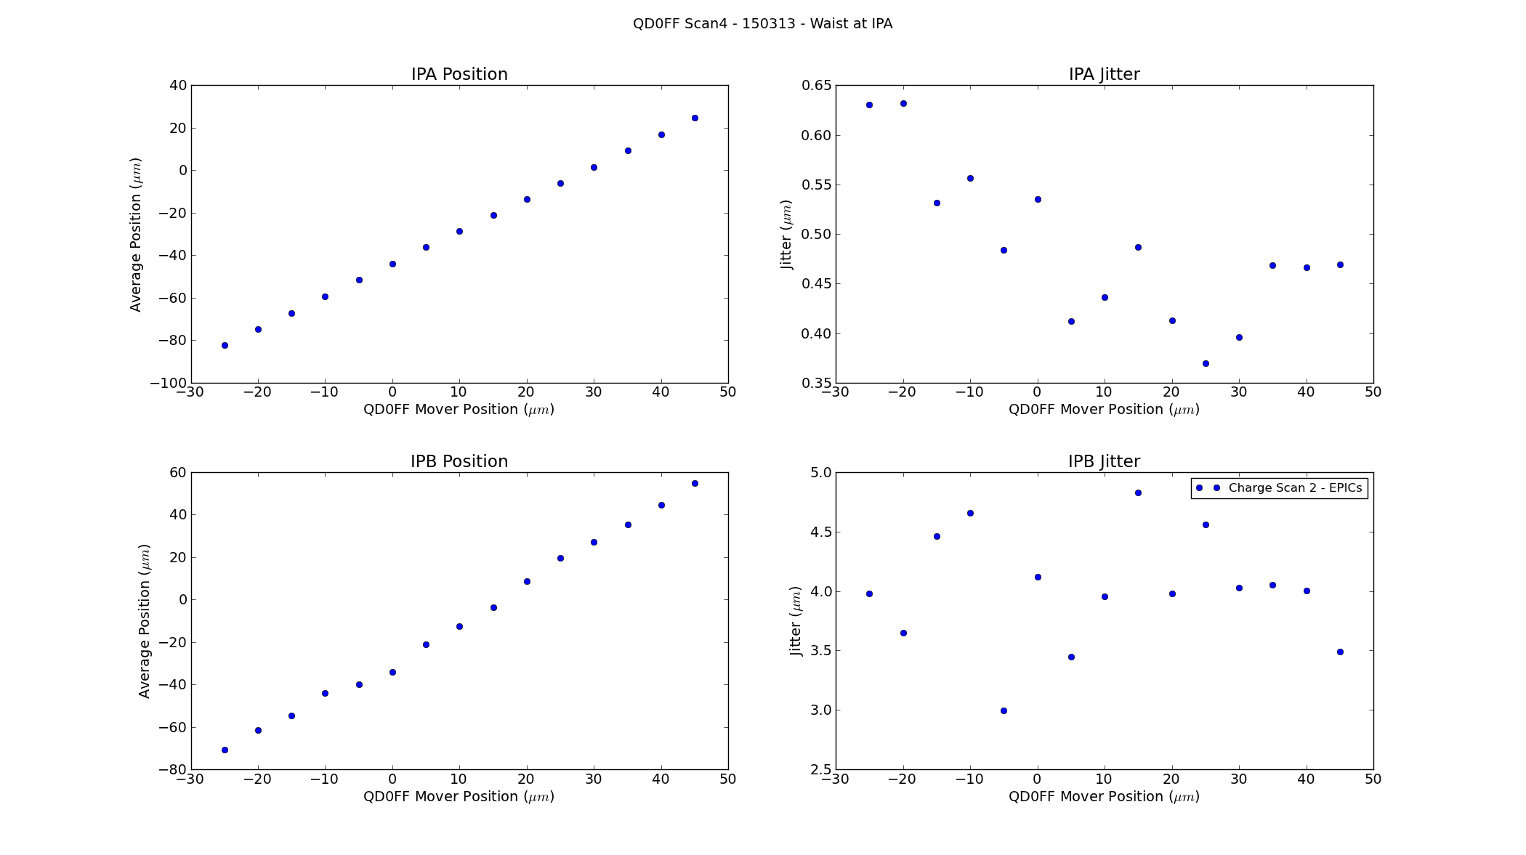
QD0FF4 – Waist @ IPA
Mikey Davis
21 March 2013
10/22

Slide 11
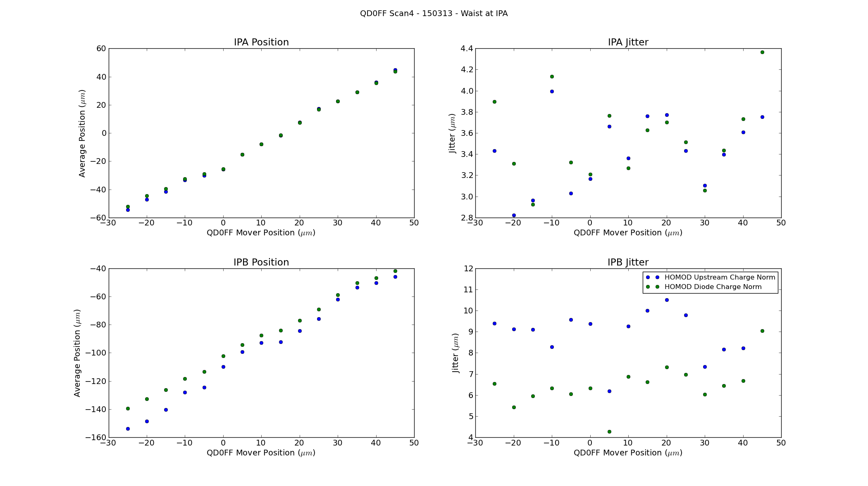
QD0FF4 – Waist @ IPA
Mikey Davis
21 March 2013
11/22

Slide 12
Honda System
After QD0FF Scan 4
We swapped the 2nd stages for IPA and IPB
The inputs were also swapped into the FONT V board
Ch1 -> IPB I
Ch2 -> IPB Q
Ch4 -> IPA I
Ch5 -> IPA Q
The charge was also tuned up from 500 to 1500 counts (with no attenuation)
Graph labels I think are correct
Mikey Davis
21 March 2013
12/22

Slide 13
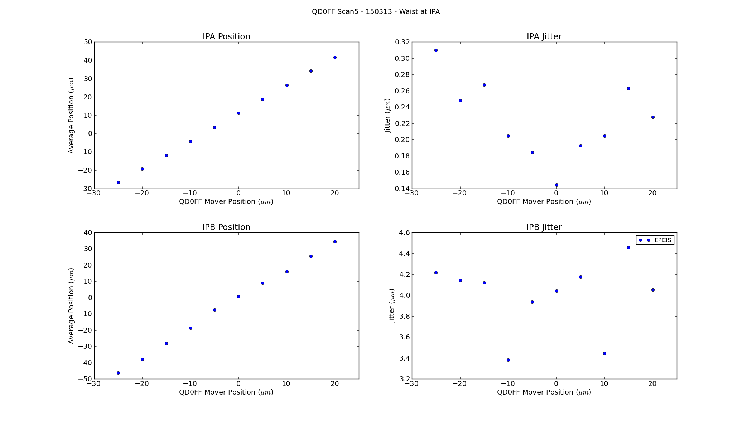
QD0FF5 – Waist @ IPA
Mikey Davis
21 March 2013
13/22

Slide 14
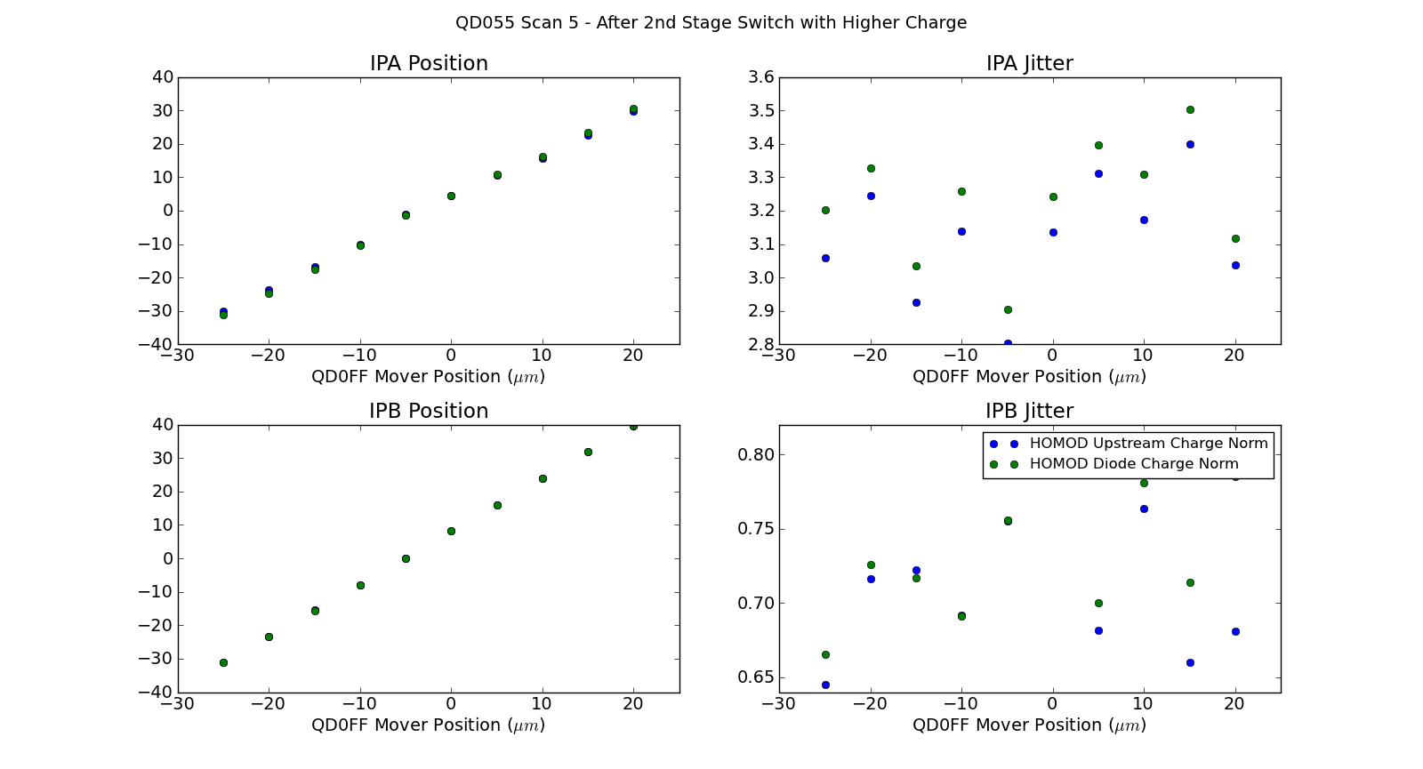
QD0FF5 – Waist @ IPA
Mikey Davis
21 March 2013
14/22

Slide 15
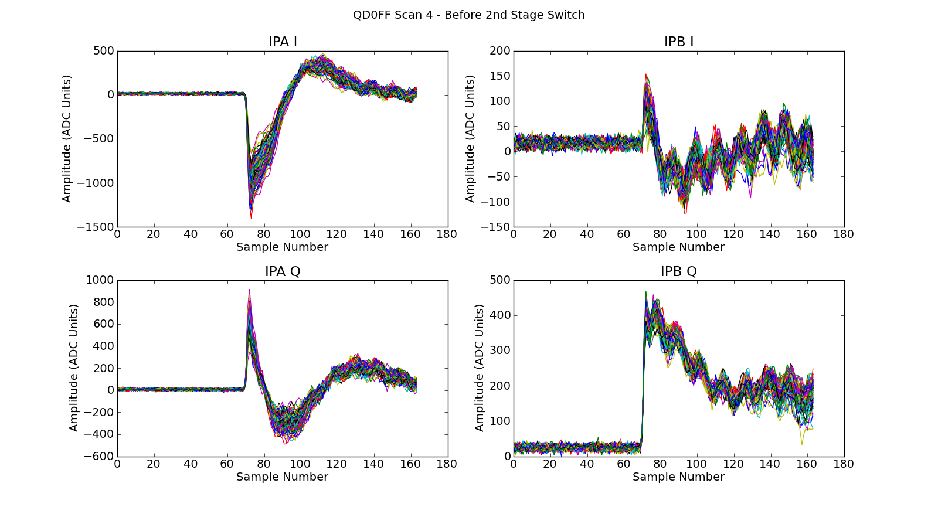
QD0FF4 – Raw Wave Forms
Mikey Davis
21 March 2013
15/22

Slide 16
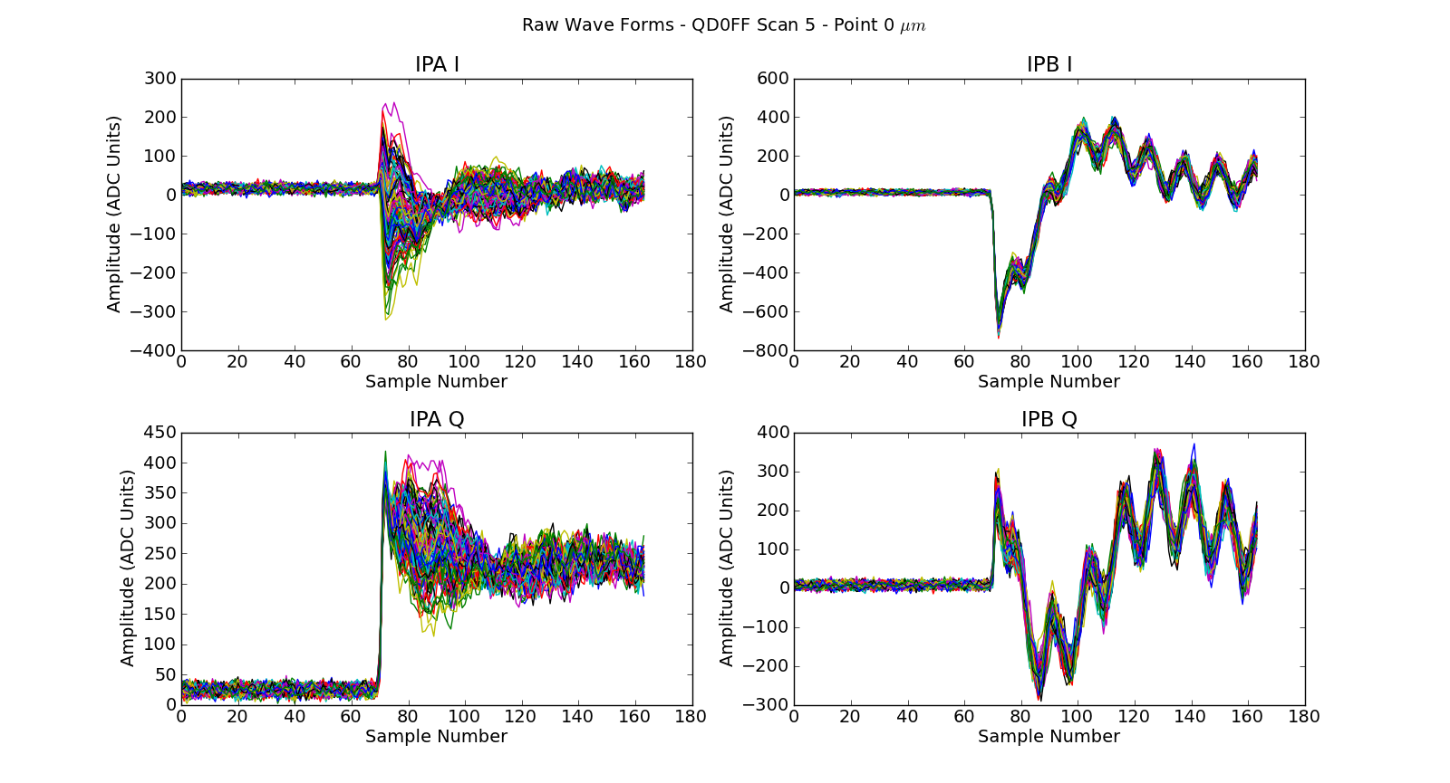
QD0FF5 – Raw Wave Forms
Mikey Davis
21 March 2013
16/22

Slide 17
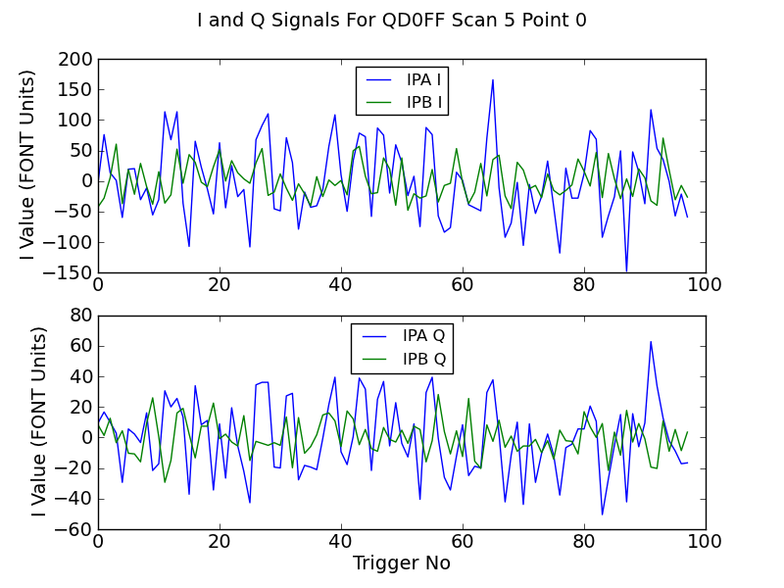
QD0FF5 – Raw Wave Forms
Mikey Davis
21 March 2013
17/22

Slide 18
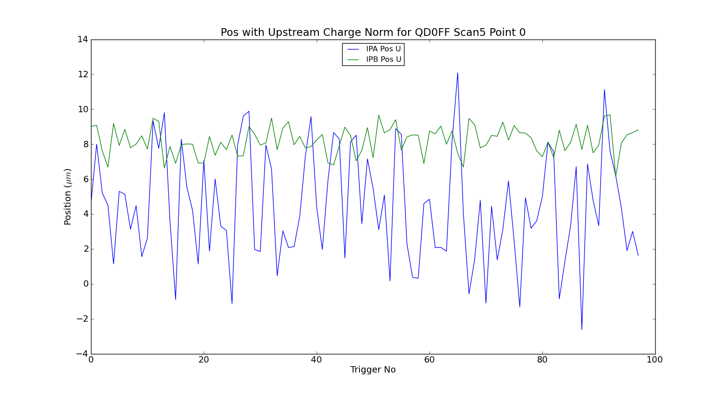
QD0FF5 – Raw Wave Forms
Mikey Davis
21 March 2013
18/22

Slide 19
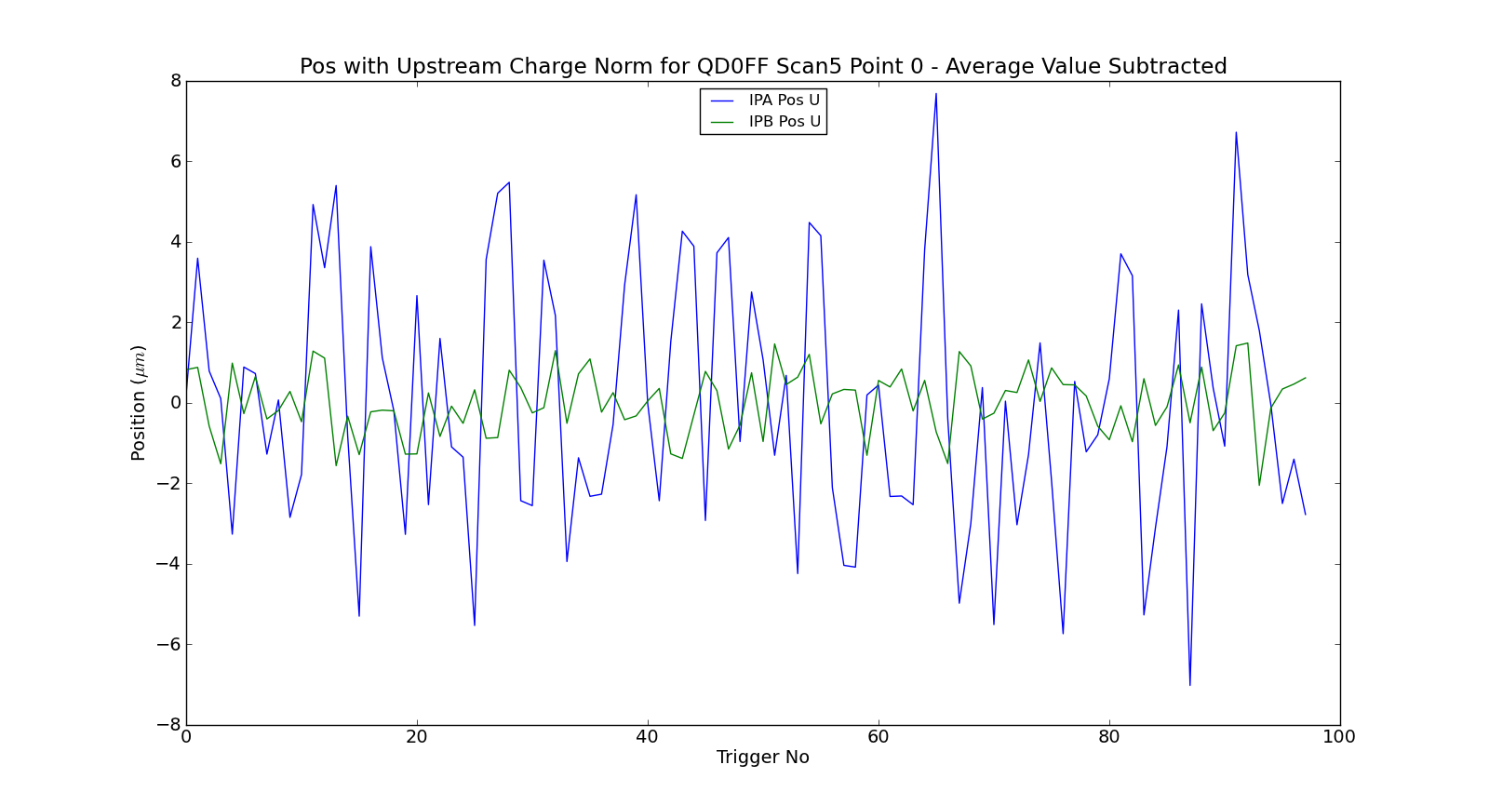
QD0FF5 – Raw Wave Forms
Mikey Davis
21 March 2013
19/22

Slide 20
Best Jitters - Roughly
QD0FF4 Jitter (μm) | IPA | IPB
EPICs | 0.35 | 3
Homod | 2.8 | 5
Charge Tripled, 2nd Stages Swapped
QD0FF5 Jitter (μm) | IPA | IPB
EPICs | 0.14 | 3.4
Homod | 2.8 | 0.5
Atten. Reduced to 0dB
jitRun8 Jitter (μm) | IPA | IPB
EPICs | 0.16 | 4.29
Homod | 3.73 | 0.24
Mikey Davis
21 March 2013
20/22

Slide 21
System Noise and Lo Tests
I was quite concerned with the results so I took some time and did some extra tests:
I measured the levels of the LOs at various points
I took runs with beam and LO from ref but no cavity input to second stage
I measured the noise using a constant LO with different power levels but no cavity input
I tried to measure the electronics with a constant LO and input but I got nothing out, wasn’t sure if this was expected
I took screenshots of the reference cavity LO at various points
Mikey Davis
21 March 2013
21/22

Slide 22
LO Levels
Point | Suggested Level (dB) | High Charge Level (dB) | Low Charge Level (dB)
Ref Cavity Input | -40 to -30 | I couldn’t measure this but we have 30dB of fixed attenuation on it in the tunnel
Limiter Input | -20 to -10 | -30 | -
Ch 2 Limiter Out (IPA Y) | +1 | -3.4 | -6.5
Ch 3 Limiter Out (IPB Y) | +1 | -3.4 | -6.5
Notes
They were tweaking the charge during this, low charge is around 500 counts, high charge around 2000
The limiter measurement was done using a 30dB amp
Mikey Davis
21 March 2013
22/22

